Slide 1
Proxy Update 3
Chase King - ck240617
Laura Klions
Nick Maude - nm346217
Jeff Parker - jp344916

Slide 2
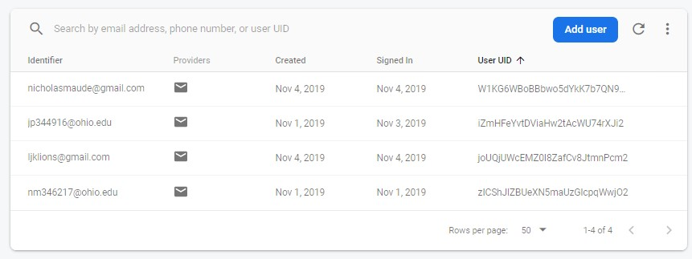
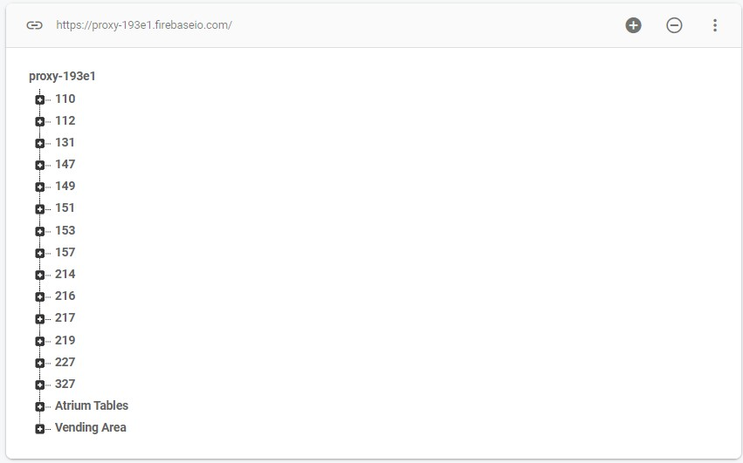
Updates
Connected app to firebase backend
Finished account registration and authentication
Setup firebase realtime database
Fixed errors causing App to crash

Slide 3
Roadblocks
Learning to use Android Studio
Inexperience with Java, still a big learning curve
Nearby API Only detects connections if all devices are running the api and are configured properly
Nearby API won't work for our purposes
Not all wireless adapters have “monitoring mode”,
we need to buy a wireless adapter that can listen to all traffic to detect the number of devices in an area.
Accurate Data Collection
Quantity of quality data

Slide 4
To-Do
Add support for other screen sizes and densities (currently supports Pixel 3)
Connect App to Real-Time Database
Clean up UI and overall design
Implement algorithm for data calculations
Add ability to change password
Add real-time data collection
Documentation in Doxygen
Potential Changes
Create webapp with same applications
Add support for more locations

Slide 5
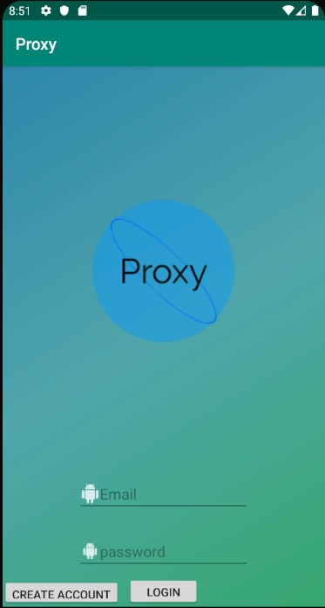
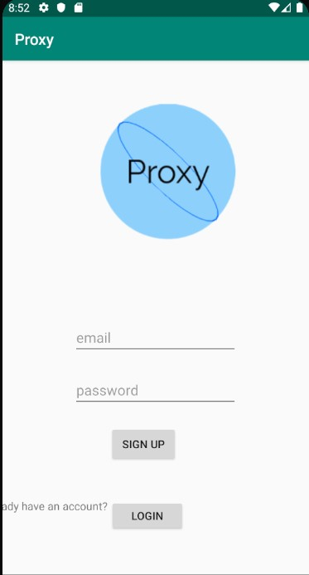
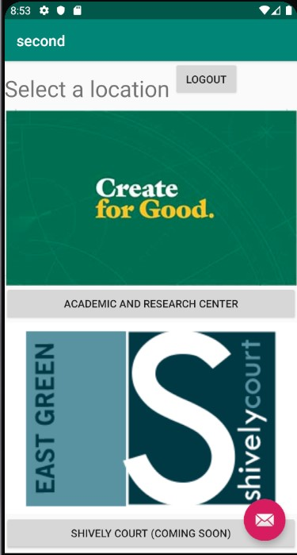
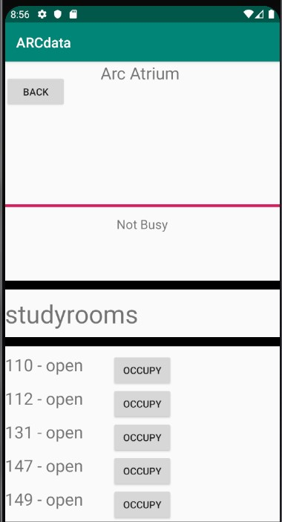
Login Page
Create Account
Select Location
Arc Data

Slide 6
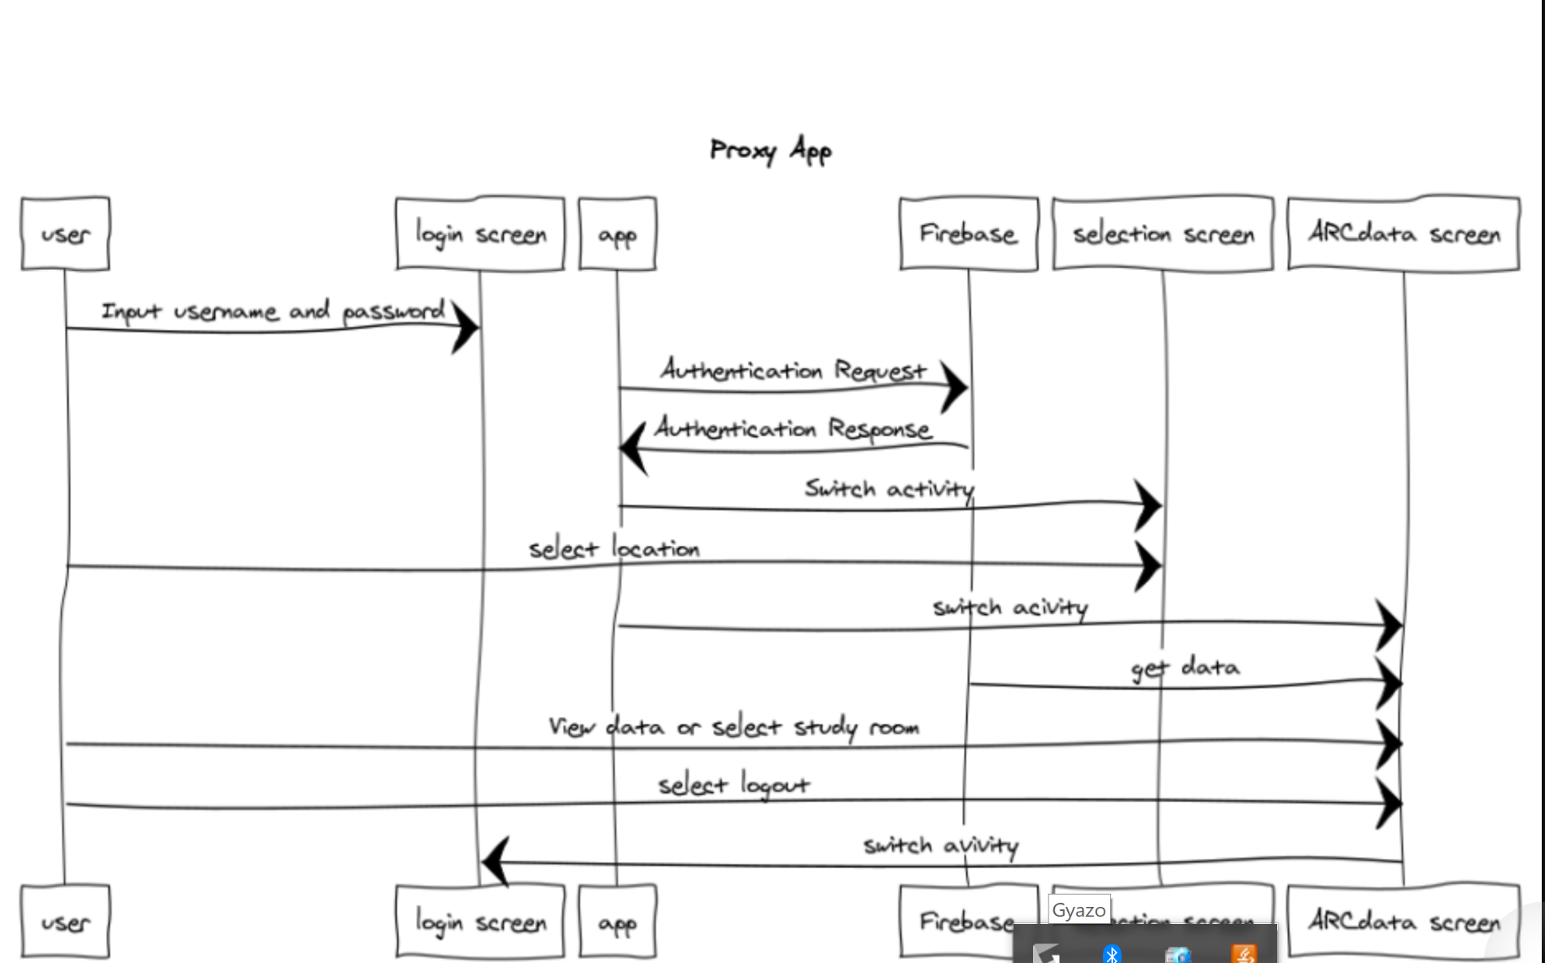

Slide 7
Individual Accomplishments
Nick - Connected app to firebase, built create account page, worked on input validation and login authentication.
Chase - Worked on our previously-collected data, added an app launcher icon, changed app display name
Laura- Worked on class to perform statistical analysis, and fitting app to multiple screen sizes and densities (in progress)
Jeff - Setup the firebase realtime database, tested methods to obtain user input to database

Slide 8
Next Sprint
Chase - Streamline UI, set up data calculations algorithm
Nick- Work on reading firebase data into the app, create python script to detect wireless devices in an area and connect it to the firebase real-time database
Laura- Finish statistics class and screen fittings, work on documentation in Doxygen
Jeff - Work on reading firebase data into the app, clean up UI and overall design, possibly work on web application for the android app.

Slide 9

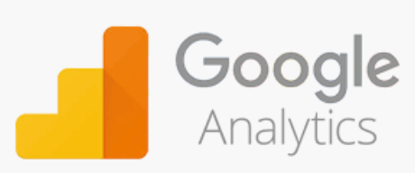




Tools Chain
Tools: Android Studio, Firebase, GitHub, Gradle, Doxygen, Google Analytics
Languages: Java, C++
https://www.websequencediagrams.com/

