Slide 1

Relationships Between Income, Education, & Incarceration Nick Moir & Matthew Gottfried

Slide 2
Data Selection
Considerations
In deciding what data to analyze, we considered many different socioeconomic factors.
Noticing how quickly Charlottesville changes once going off grounds inspired us to look at how education affected incarceration rates.
Additionally, we wanted to consider how income affected incarceration, as income and education level tend to have a positive correlation.
Expected Results
We expect there to be an inverse correlation between income/education and incarceration.
This is because we believe that higher-income individuals would not have to resort to crime to get by.
We gathered census, incarceration, and other data from the NIH.

Slide 3
ETL Pipeline: Creation & Implementation
Creation
To create our ETL pipeline, we used the base conversion methods.
After transforming your file, the pipeline produces a summary of the transformed data to ensure that there are no errors.
Implementation
We used our ETL pipeline to transform and combine the data we sourced from the NIH and other sources.
We converted the data from CSV to SQL.
We opted to use SQL because of our experience using Python libraries in conjunction with SQL.

Slide 4
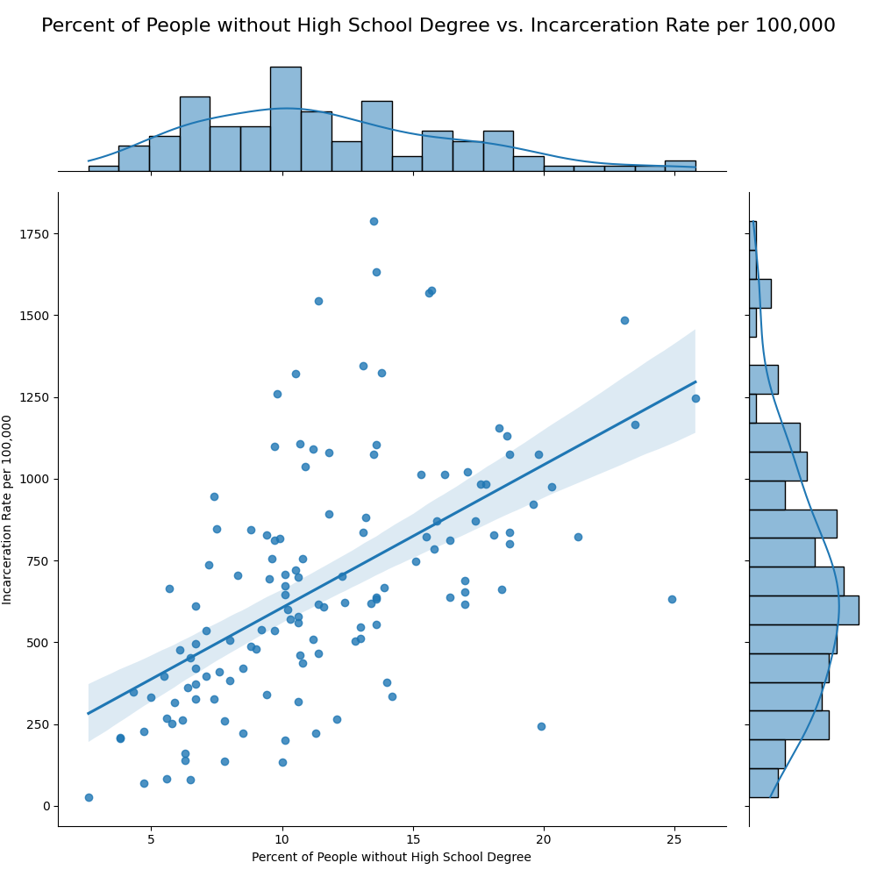
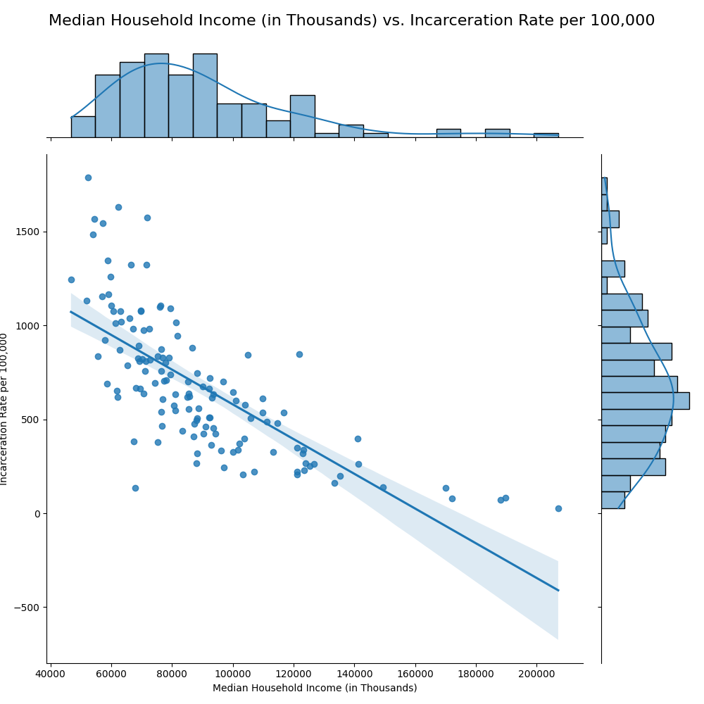
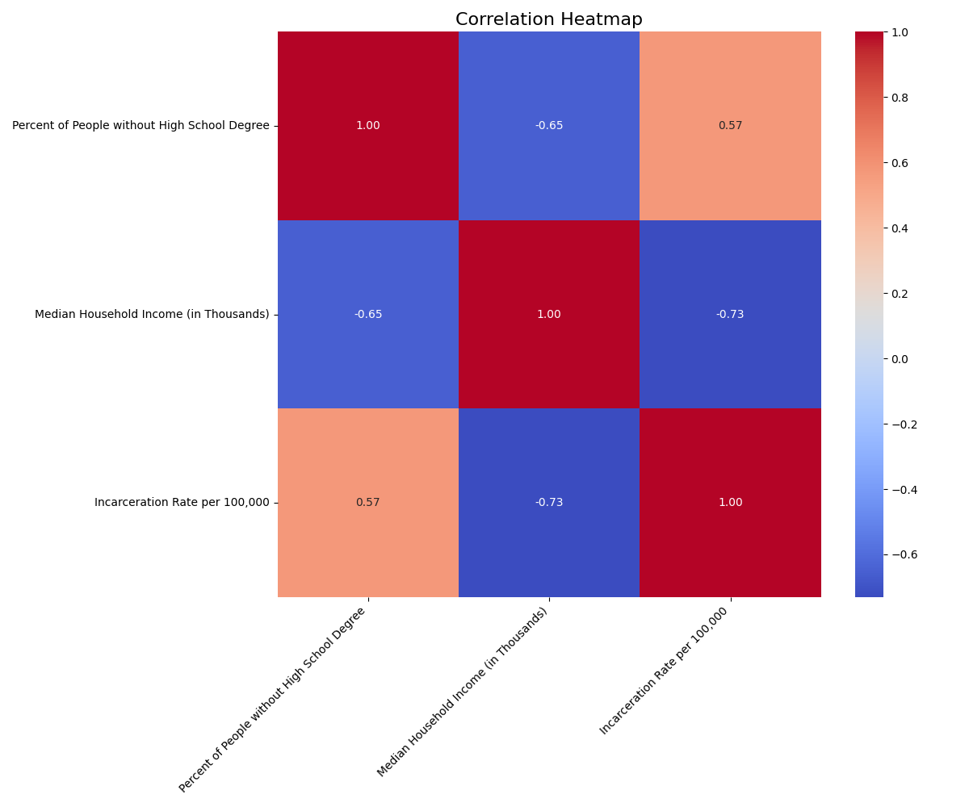
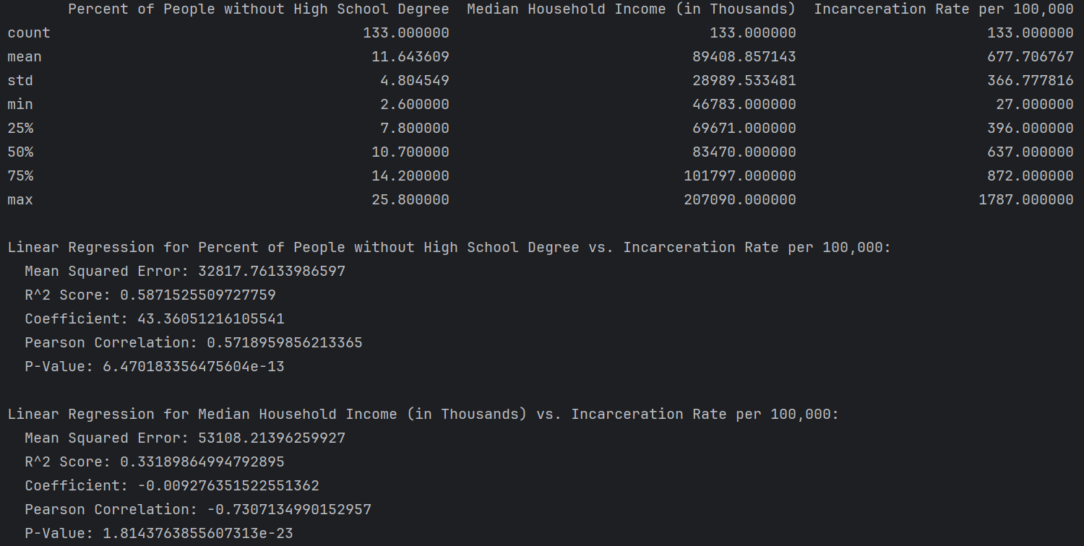
Data Analysis
Analysis
As we expected, people without high school diplomas are expected to be incarcerated.
Also, a higher household income results in lower incarceration percentages.

Slide 5

Thank you

