Slide 1

Relationships Between Income, Education, & Incarceration Nick Moir & Matthew Gottfried

Slide 2
Data Selection
Considerations
In deciding what data to analyze, we considered many different socioeconomic impact factors.
Noticing how most UVA Safety alerts were concentrated in low-income areas around Charlottesville inspired us to investigate how income levels affect the incarceration rate within the area.
Additionally, we wanted to consider how education levels affected incarceration, as income and education level tend to have a positive correlation.
Expected Results
We expect there to be an inverse correlation between income/education and incarceration.
This is because we believe that higher-income individuals would generally have less of a need to commit crimes, especially financial crimes.
We gathered census, incarceration, and other data from the NIH and Prison Policy Initiative.

Slide 3
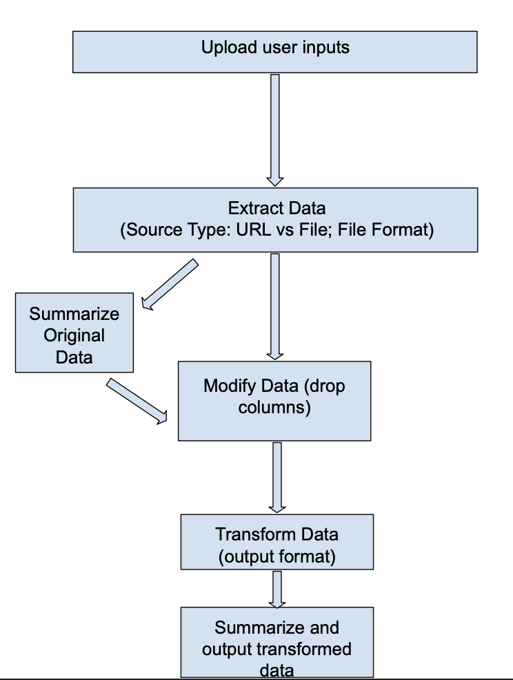
ETL Pipeline: Creation & Implementation
Creation
To create our ETL pipeline, we used the base conversion methods.
After transforming your file, the pipeline produces a summary of the transformed data to ensure that there are no errors or lost/corrupted data.
Implementation
We used our ETL pipeline to transform and combine the data we sourced from the NIH and other sources.
We converted the data from CSV to SQL.
We opted to use SQL because of our experience using Python libraries in conjunction with SQL.

Slide 4
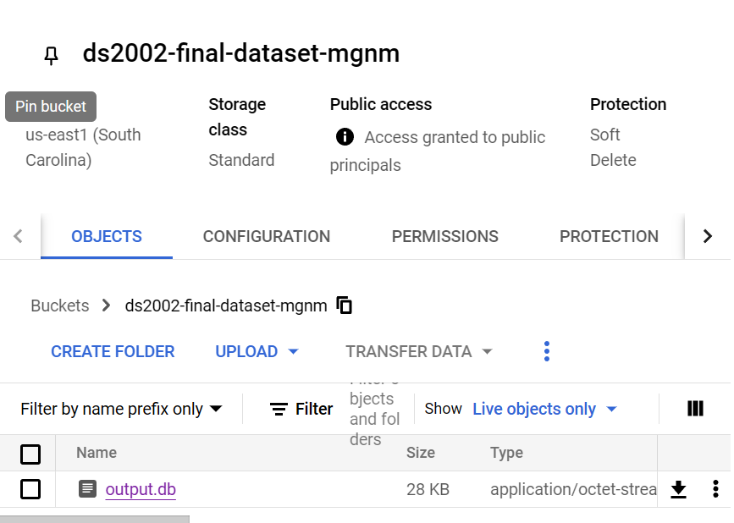
Google Cloud Storage
Creation
To store our database, we used Google Cloud to upload and store our database, with a public access link to allow people to query the data and retrieve the file with just a link. Both of us maintain administrative control over the bucket and database structure/content, while others only have viewing and download access.

Slide 5
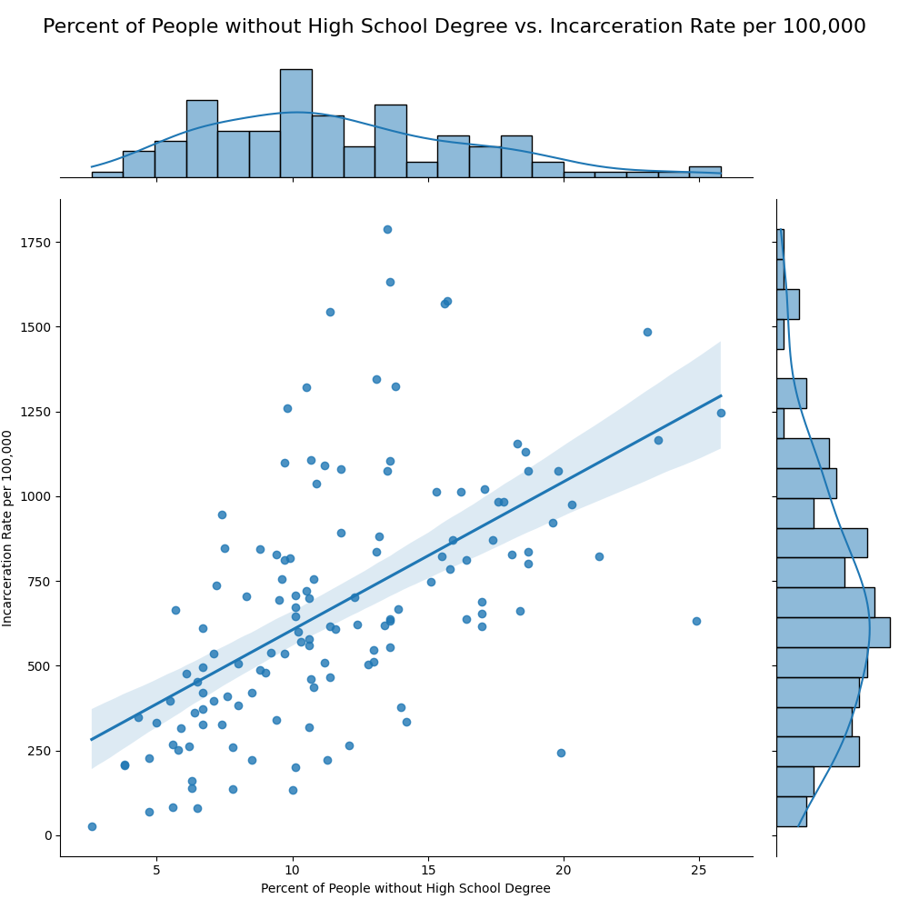
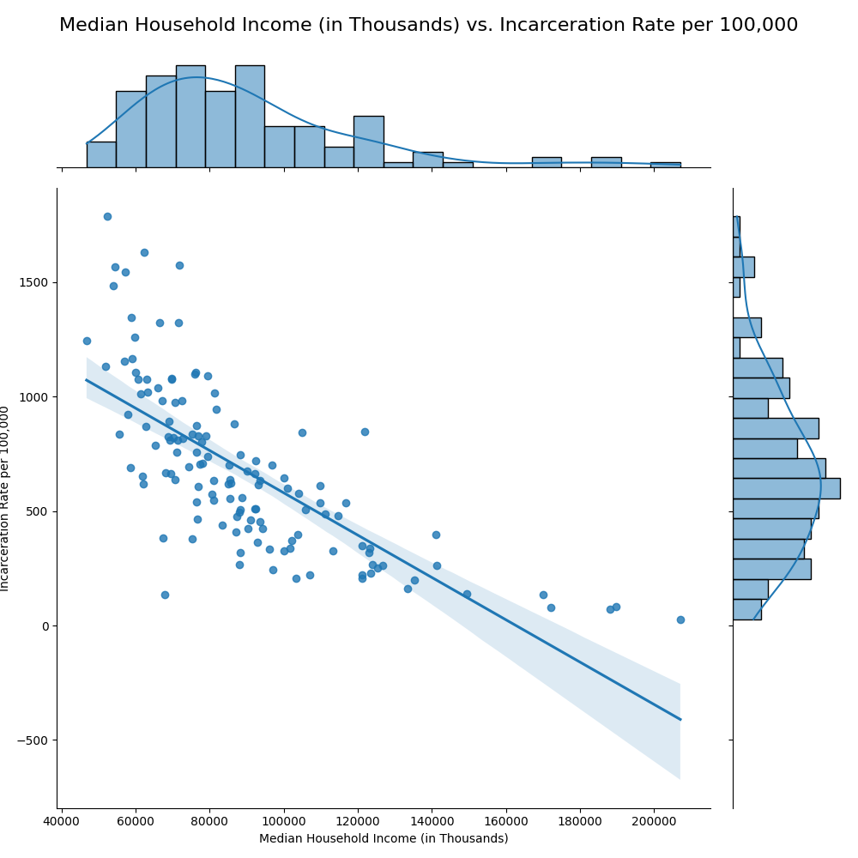
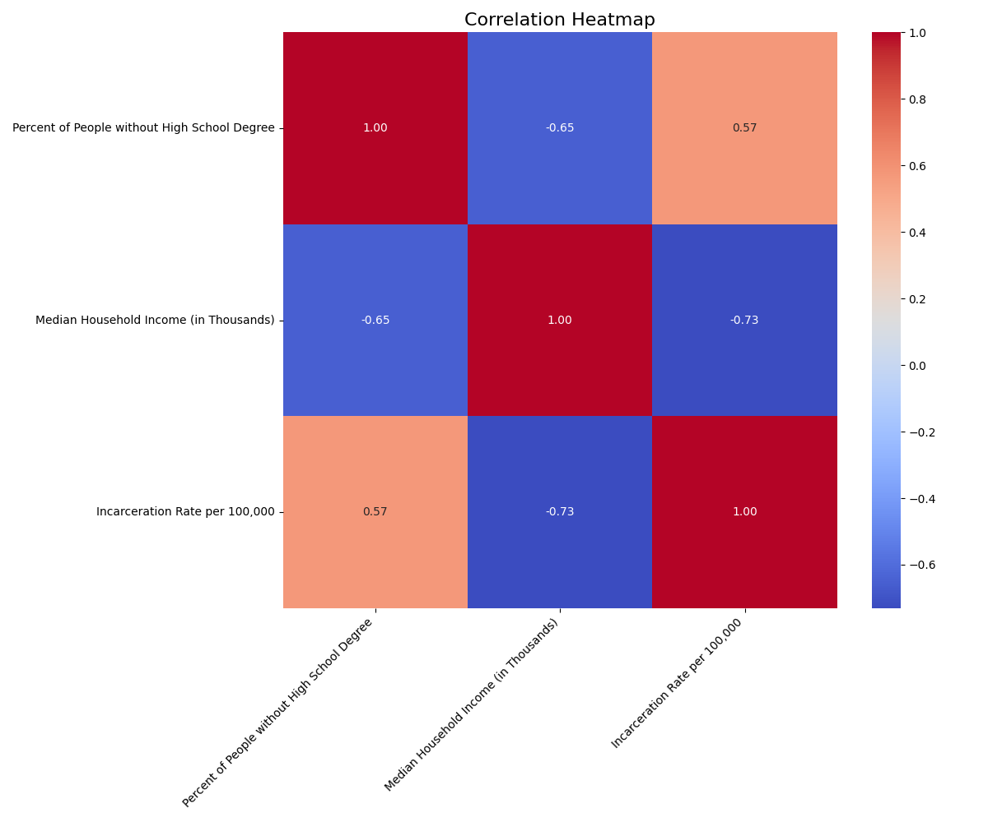
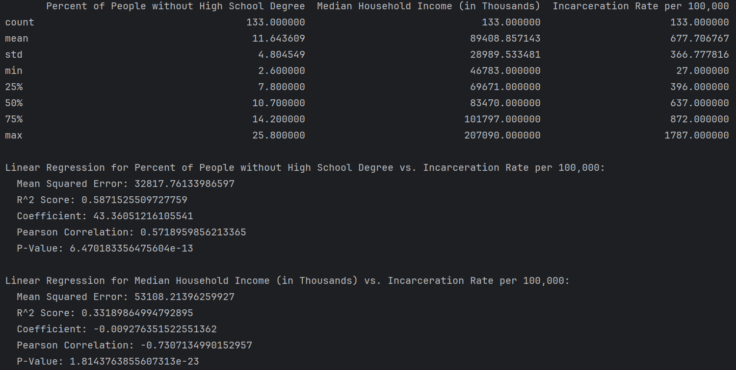
Data Analysis
We first performed a linear regression and plotted the correlation heatmap with the correlation values between each variable.
We then plotted all of the data points, the line of best fit we calculated, and the data distribution, onto a scatter plot to help visualize the correlation.
Our Python script also outputs a few regression quality metrics for our model. These included mean squared error, R^2 value, and P-value to determine variance from the predictions and significance of the data.

Slide 6
Conclusions and Looking Forward
Conclusions from the Data
As we expected, areas with a large population of people without high school diplomas are more likely to have a high incarceration rate.
Also, areas with a lower median household income tend to have higher incarceration rates.
These results are aligned with our initial predictions.
Looking Forward
If we were to continue with this project, we would want to look at other factors that may impact these results. Examples: violent crime rates in each county, public high school ranking in VA by county.
Another area of improvement for future exploration would be looking at datasets over longer periods to better identify trends over time.

Slide 7

Thank you

