Slide 1
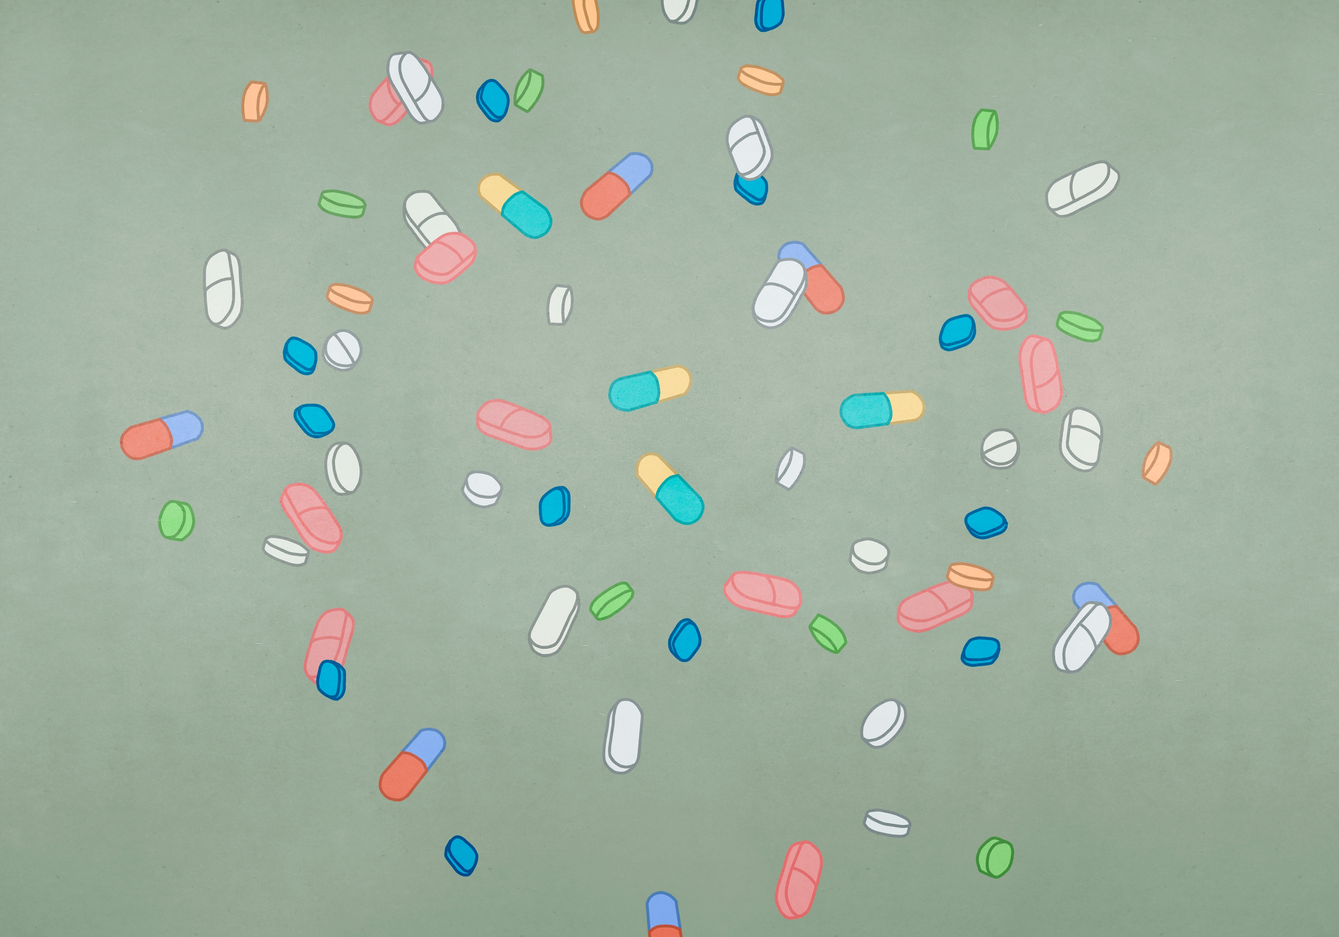
TechConnect
Hanna, Eetu, Nick, Chiem, Flo & Mo

Slide 2



Assignment
Technology in a Smart Society
We had to use image recognition, morobot and connection between them

Slide 3
Jetson Nano
Jetson Nano
Is a powerful single-board computer designed for AI and egde computing applications.
In this project we use it as image recognition.
Notes:
Info jetsonista

Slide 4
Node-RED
Node-RED
An open-source visual programming tool used to connect hardware devices, APIs and online services.
In this project we use it as image recognition.
Notes:
Info from node-red

Slide 5
Morobot
Morobot aims at scaling features from real robots used in research and industry into a package accessible for education. The robots of the morobot-platform are covered with easy to use hardware providing all basics needed for students and instructors to ensure high quality learning outcomes.
Morobot
Notes:
Info from morobot

Slide 6
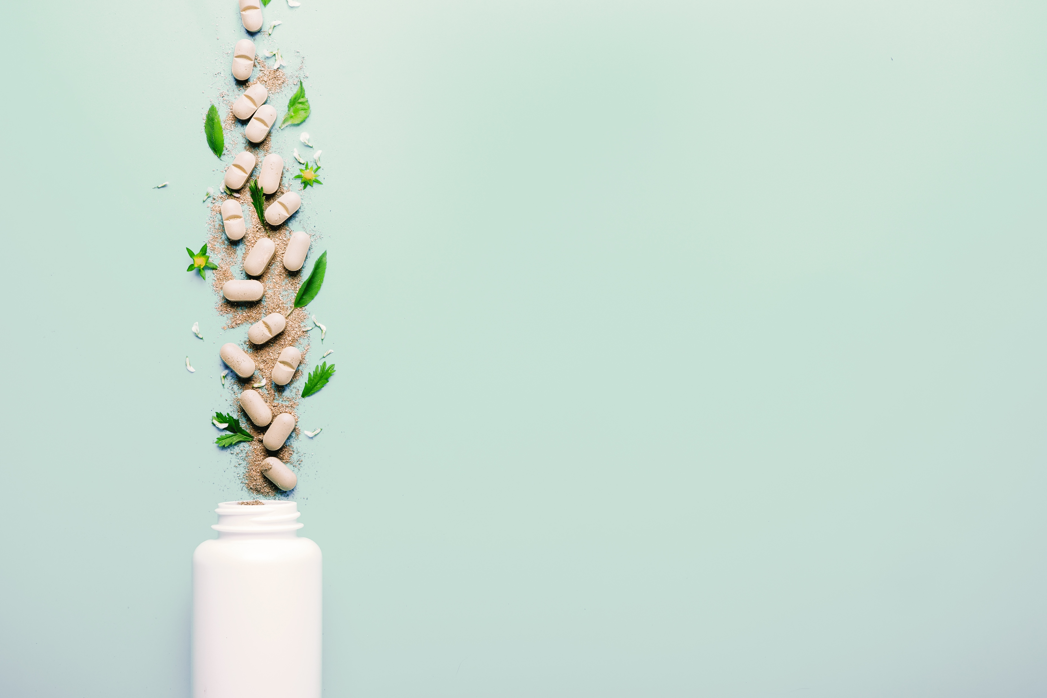




Our Mission
We wanted to make it easier for customers to take their medications by distributing them in weekly doses
With the AI, we were able to teach the equipment to read recipes
Based on the prescription, the robot would be able to collect the right medicines for the client
Collect data on what medications the client uses
Notes:
Mikä meidän idea oli? Mitä haluttiin tavoittaa?
What was the idea, what was wanted to be achieved?

Slide 7
What We do?
Opetimme AIn tunnistamaan kuvien perusteella reseptejä
Notes:
What we recived?
What features u can find in our project?
Add the images and number?

Slide 8
What in future?
Notes:
What we could made to the future?
Which would be shelfy considering the sequel?

Slide 9
Experience and learning

