Slide 1
Example 1
Node1
[R_{1x},R_{1y}]?
Bar1
[F₁]?
5
Node2
[F_{2x}=0,F_{2y}=-1]
Bar2
[F₂]?
5
1
Node3
[R_{3x},R_{3y}]?
10

Slide 2
Joint equilibrium
TBC

Slide 3
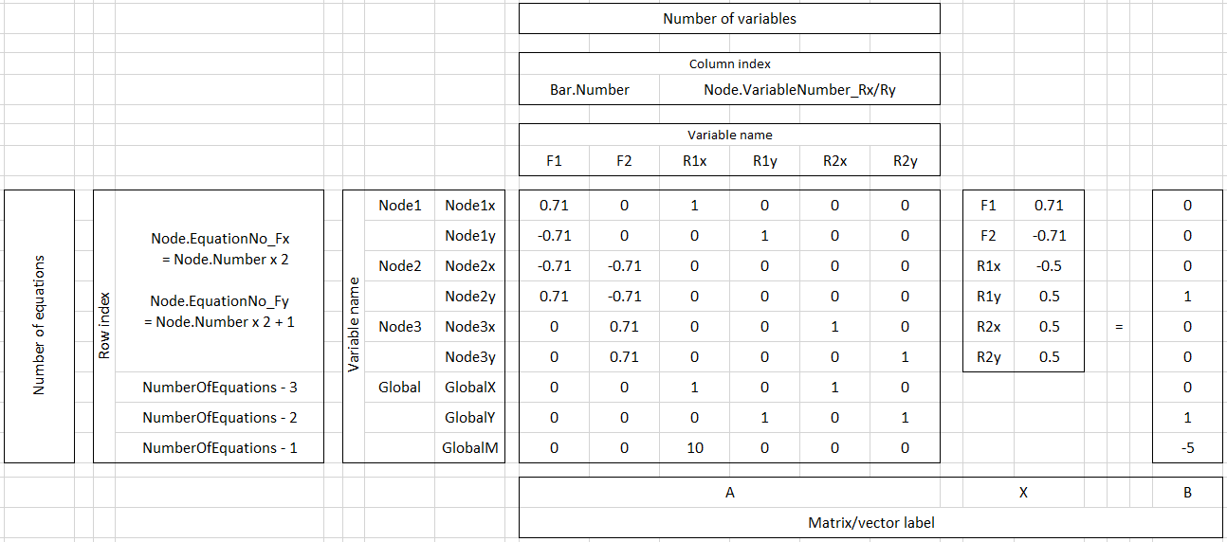
Force equilibrium equations

Slide 4
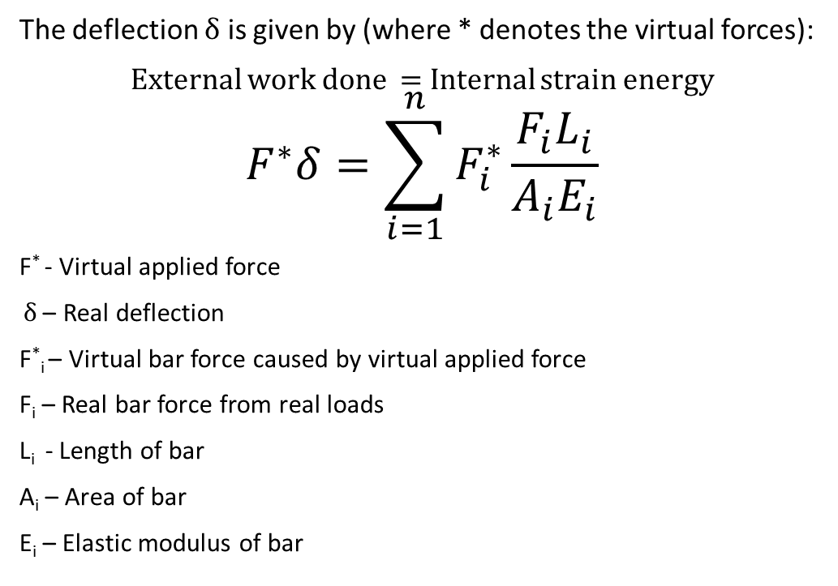
Virtual work methodolgy
The deflection $δ$ is given by (where * denotes the virtual forces):
External work done = Internal strain energy
$$F^{∗}δ=\sum_{i=1}^{n}{F_{i}^{∗}\frac{F_{i}L_{i}}{A_{i}E_{i}}}$$
F* - Virtual applied force
$δ$ – Real deflection
F*_{i} – Virtual bar force caused by virtual applied force
F_{i} – Real bar force from real loads
L_{i} - Length of bar
A_{i} – Area of bar
E_{i} – Elastic modulus of bar

