Slide 1




Node.js Native AddOns from zero to hero
ROME - APRIL 13/14 2018
Nicola Del Gobbo

Slide 2
Me

Slide 3

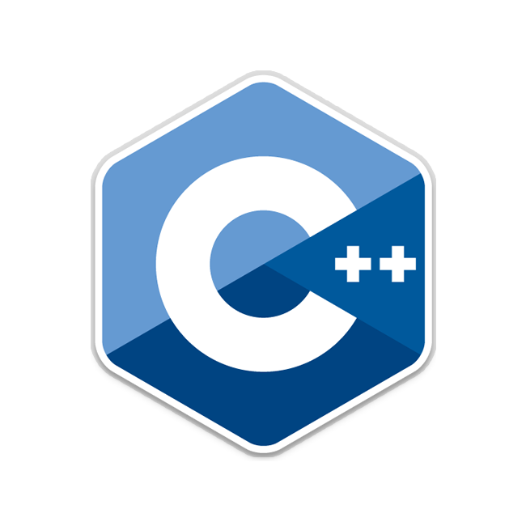

What is Node.js Native Add-on?
C / C++ code called from JavaScript
BRIDGE
Native environment
JavaScript environment

Slide 4
From Node.js documentation
Node.js Addons are dynamically-linked shared objects, written in C++, that can be loaded into Node.js using the require() function, and used just as if they were an ordinary Node.js module.
They are used primarily to provide an interface between JavaScript running in Node.js and C/C++ libraries.

Slide 5
How is it possible?
All the magic is behind the Node.js architecture

Slide 6
Why should you implement new Native Add-on?
Performance
In general C / C++ code performs better than JavaScript code, but it’s really true for CPU bounds operations
Image processing (in average 6 times faster)
Video processing
CRC cyclic redundancy check (in average 125 times faster)
Compression
Scientific calculus
Algorithms that execute CPU heavy tasks

Slide 7
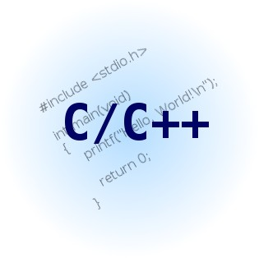
Why should you implement new Native Add-on?
Integrate legacy application
You have the source code of an old C / C++ application and want to expose something of its functionalities through the new Node.js application

Slide 8
Why should you implement new Native Add-on?
You don’t find what fits your specific needs on npm
Sometimes completely reimplementing the module in JavaScript is not the right solution
Think at libraries like:
ImageMagick
Ghostscript
FFmpeg
TensorFlow
You have to concentrate on business logic of your application and not on developing a single module

Slide 9
Why should you implement new Native Add-on?
Desktop application
You want to use the local underlying CPU or GPU resources to execute the most complex tasks
Better performance on the local side
Better performance on the server
Es. Electron or NW.js

Slide 10
Why should you implement new Native Add-on?
Desktop application
You want to use the local underlying CPU or GPU resources to execute the most complex tasks
Better performance on the local side
Better performance on the server
Es. Electron or NW.js

Slide 11
Why should you implement new Native Add-on?
Better error handling
Even if you will use an old C / C++ library you will get an error code that explains the error that just happened.
In new C / C++ library you have the exception
You don’t have to parse some string to identify if there was an error and what kind of it

