Slide 1
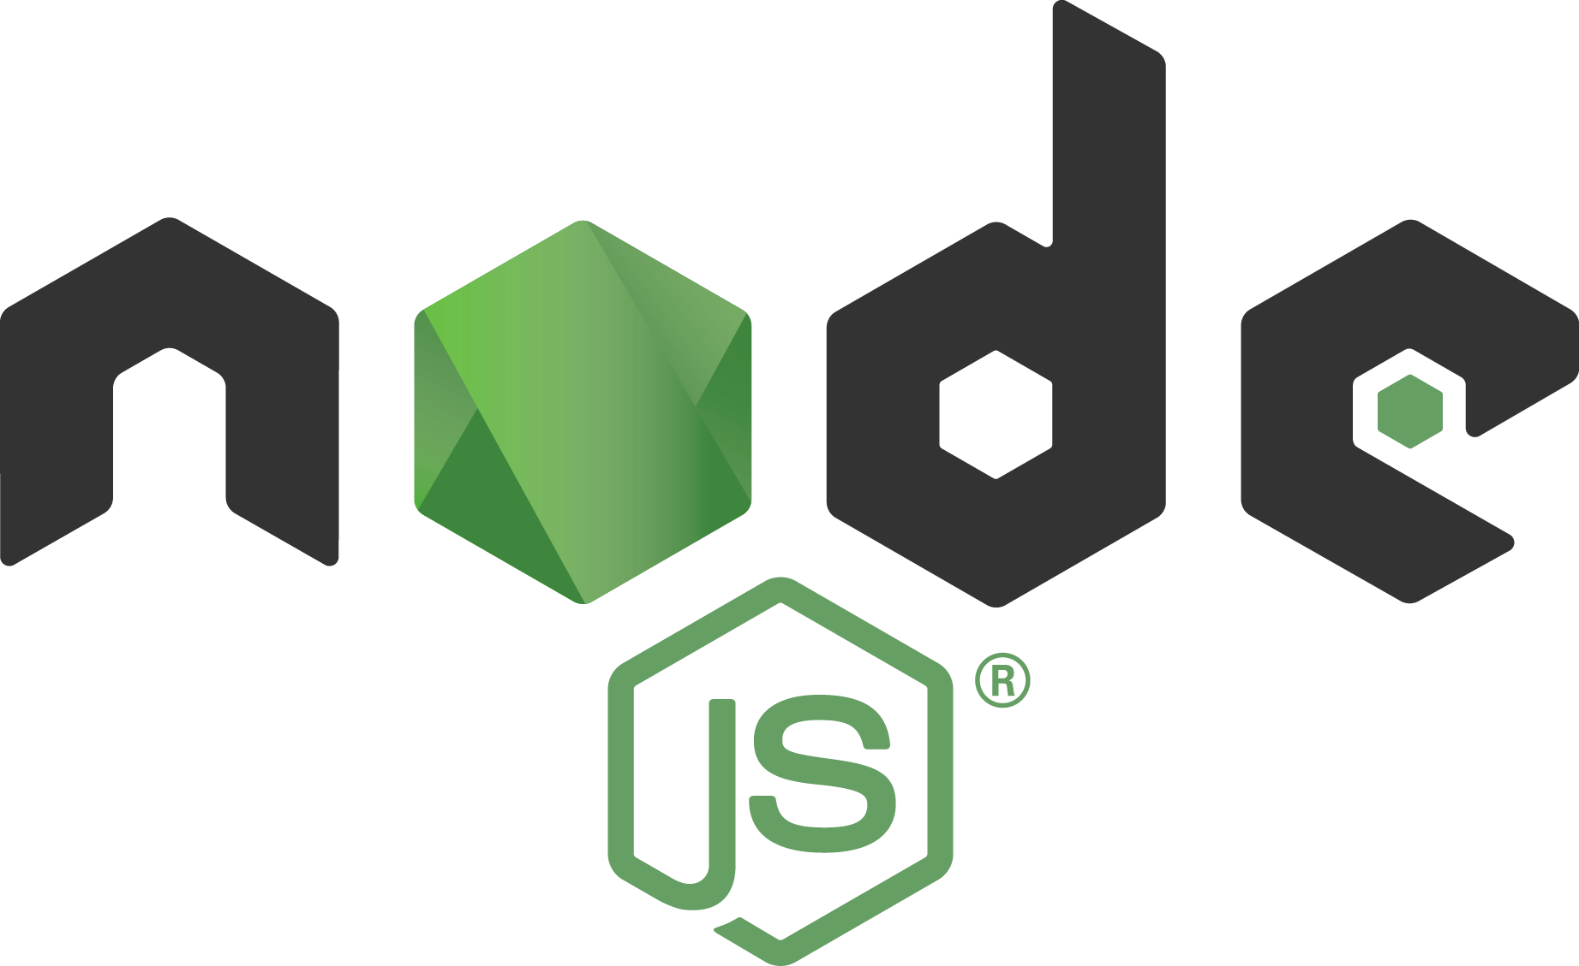
Node.js from zero to hero
Nicola Del Gobbo

Slide 2



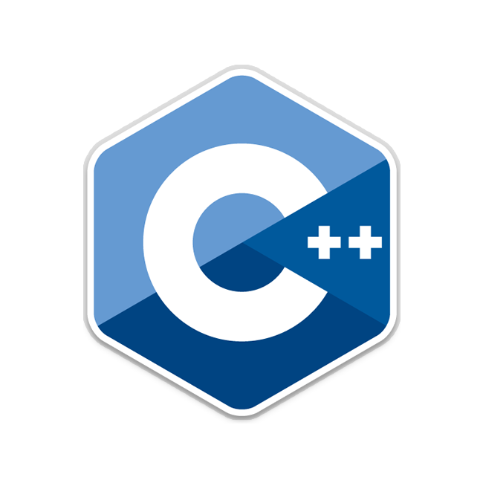


Who am I?
Developer
Full stack developer highly focused on performance
N-API Team
My research field
How to implement a native addon for Node.js with programming languages different from C or C++

Slide 3




Agenda
Introduction to Node.js
How to create distributed services
Native Addons

Slide 4









Who use Node.js?
Notes:
Update the numbers

Slide 5

What can I do with Node.js?
Everything
Great thank to Node.js Community and Working Groups
Packages
963,619
Downloads - Last Week
10,822,198,617
Downloads - Last Month
48,577,378,041
Notes:
Update the numbers

Slide 6









What can I do with Node.js?
CLI APPLICATION
DISRTRUBUTED SYSTEM
REAL TIME SYSTEM
DESKTOP APPLICATION

Slide 7
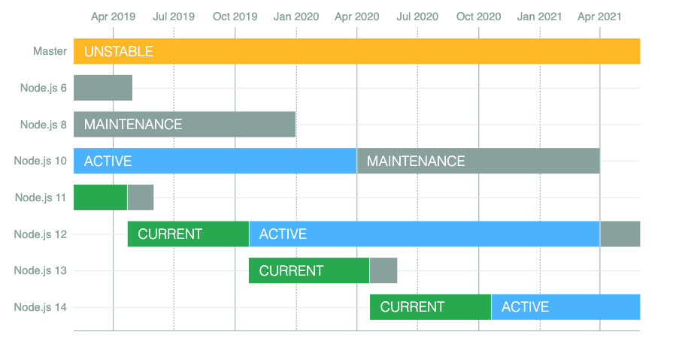
Release

Slide 8
What is Node.js?
Node.js is a JavaScript runtime built on Chrome's V8 JavaScript engine
~100k LOC of JS and C++
A JavaScript engine
Asynchronous I/O
Node is a glue

Slide 9
Node.js architecture

Slide 10
CONCURRENCY MODEL?
Single threaded
by default
Worker Threads from Node.js v10.5.0
Asynchronous I/O
Execution never stop
Don’t block the event loop

Slide 11
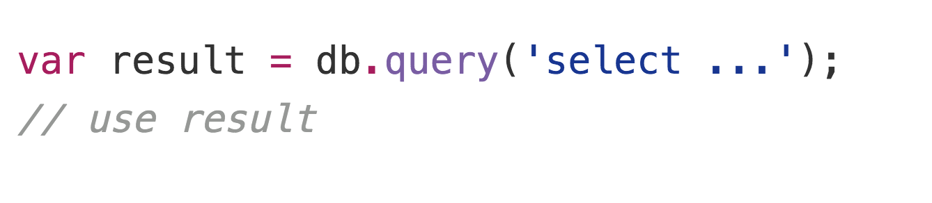
Synchronous model?
Blocking the whole process or you need to have multiple execution stacks

Slide 12
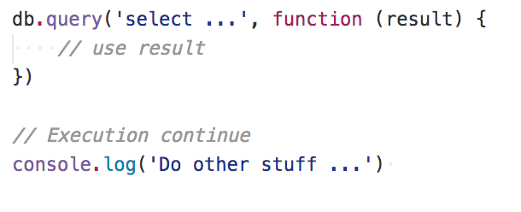
Asynchronous model?
The main process is never blocked. No strategy is required to handle competing requests

Slide 13
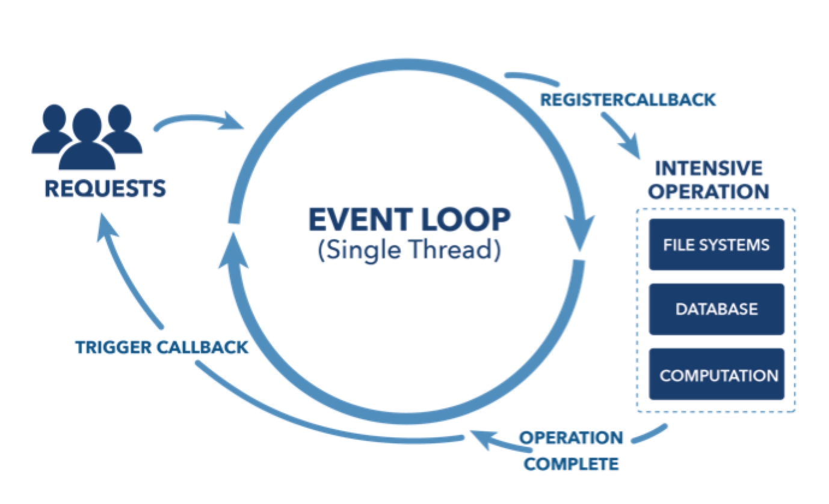
The event loop

Slide 14
Asynchronous in low level

Slide 16
JavaScript
“The world's most misunderstood programming language“
Douglas Crockford
“Please use JavaScript like JavaScript“

Slide 17
JavaScript
In JavaScript, functions are first-class objects, because they can have properties and methods just like any other object
Procedural - OOP - Functional

Slide 18
The long hard route out of callback hell
From callbacks to promises and async/await, trying to understand the event loop

Slide 19
MODULARITY
CommonJS Module
ES6 Module from v8.5.0
“Se non hai provato Node.js non sai cos’è la modularità e il riuso”
Matteo Collina

Slide 20
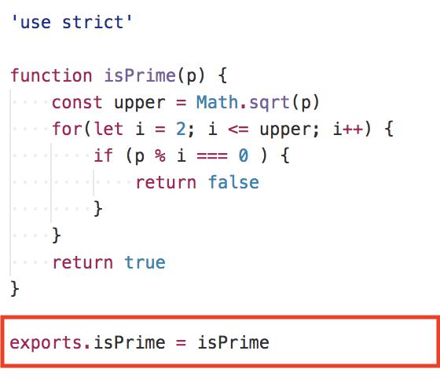
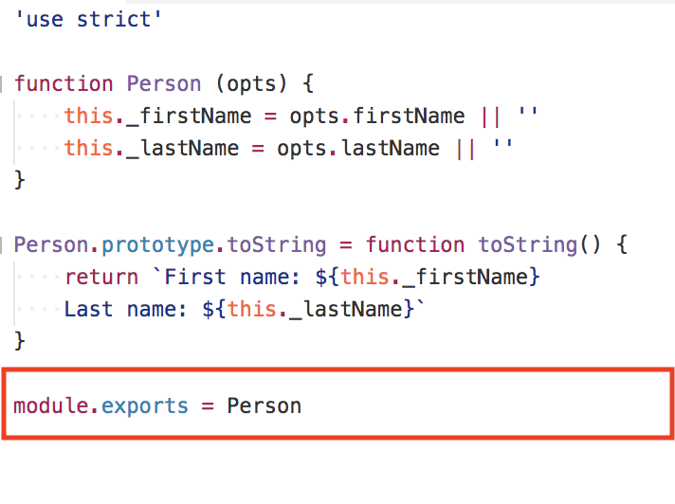
MODULARITY

Slide 21
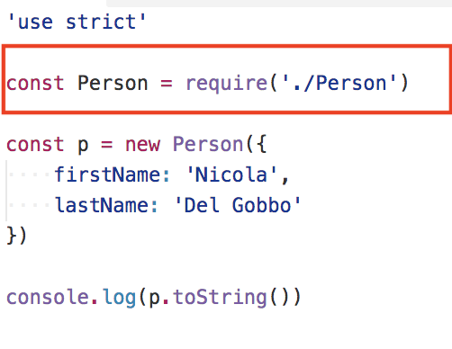
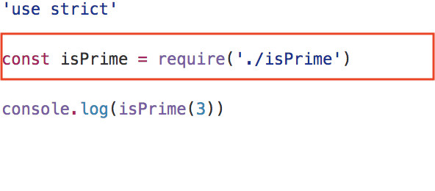
MODULARITY

Slide 22
EVENT EMITTER
EventEmitter is a very important class in Node.js. It provides a channel for events to be dispatched and listeners notified. Many objects you will encounter in Node.js inherit from EventEmitter

Slide 23
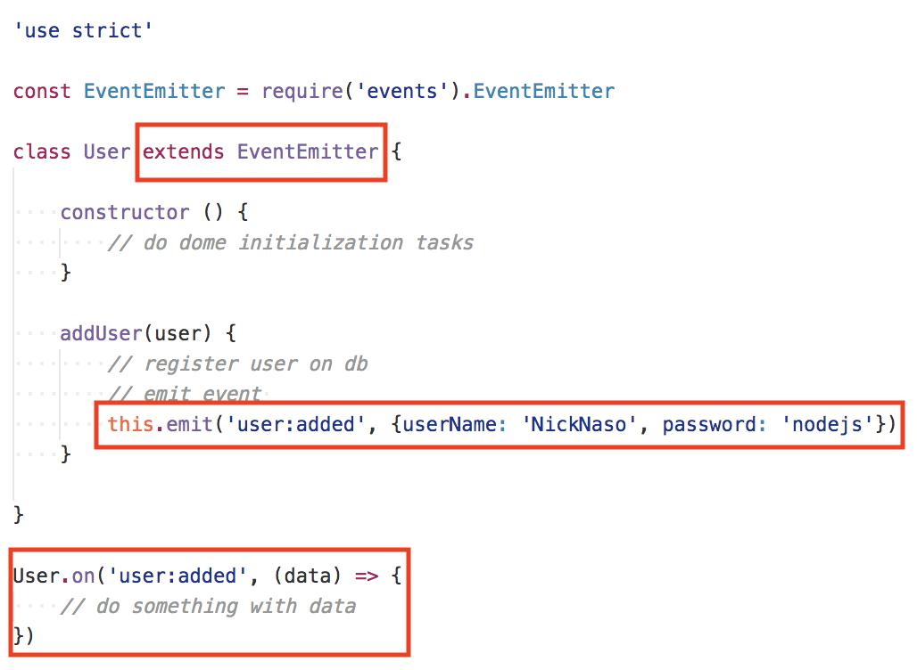
EVENT EMITTER

Slide 24

WEB APPLICATION
Response
NODEJS HTTP SERVER
REQUEST
HANDLER
CLIENT
Request
Browser
Mobile App
http://your-web-application

Slide 25
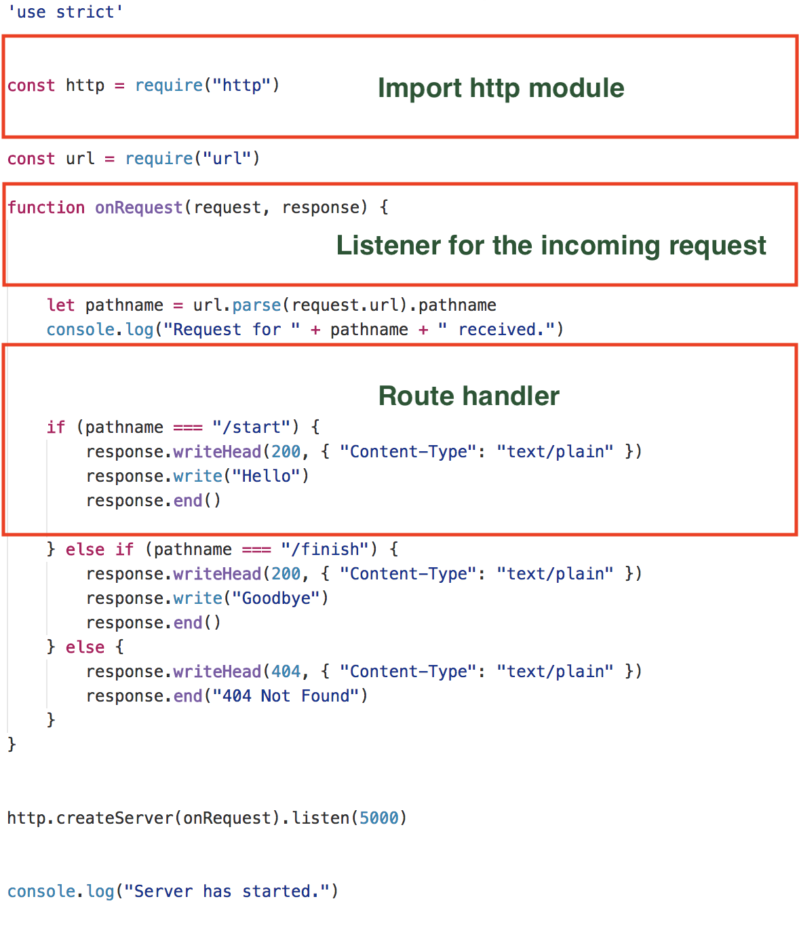
~40k req/s
Hard to maintain

Slide 26
FRAMEWORKS

Slide 27
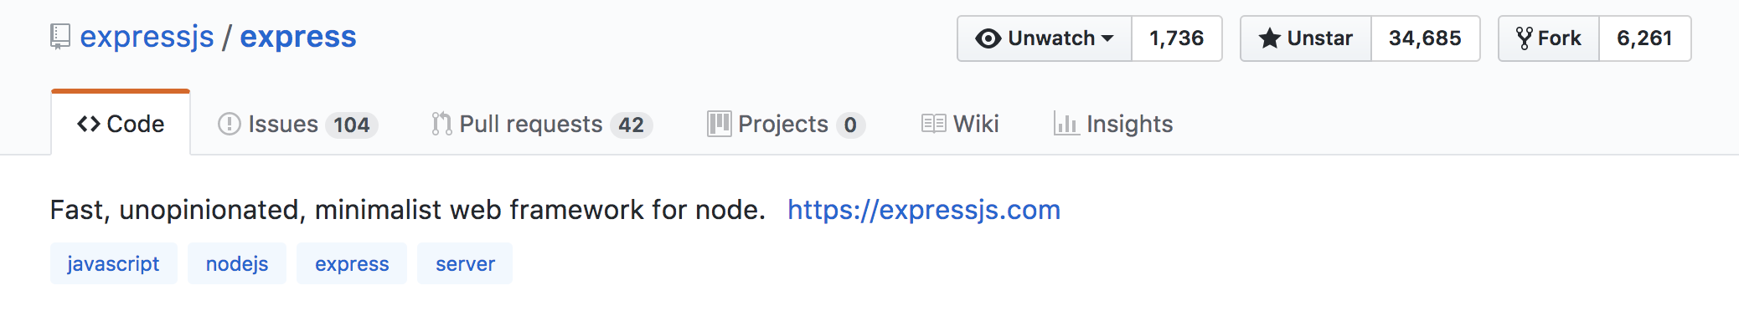

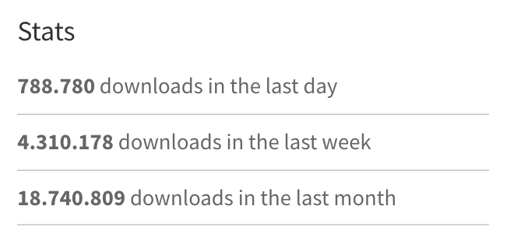
EXPRESS

Slide 28
EXPRESS
Minimalist
Unopinionated
Fast (about 21k req/sec)
Simple (do one thing well philosophy from Unix world)
Wrapper of http core module

Slide 29
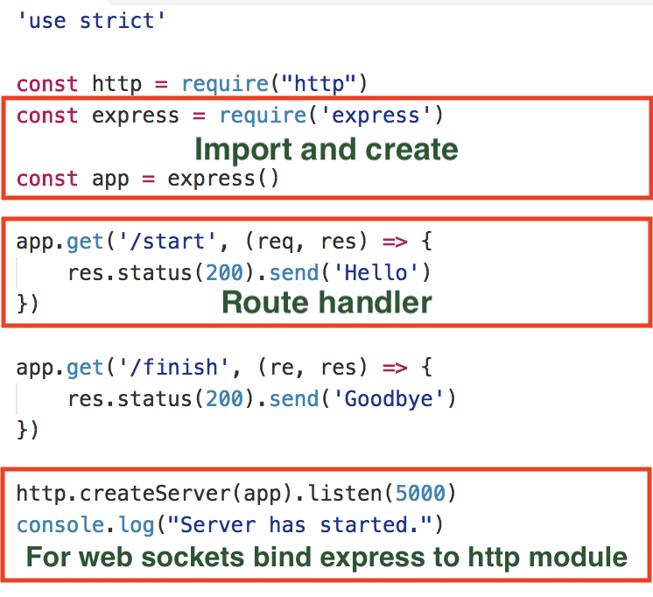

Slide 30
EXPRESS MILESTONES
Middleware
Error handler
Router
Views / template engine

Slide 31
MIDDLEWARES
It’s always a question to manipulate the Request and Response object

Slide 32
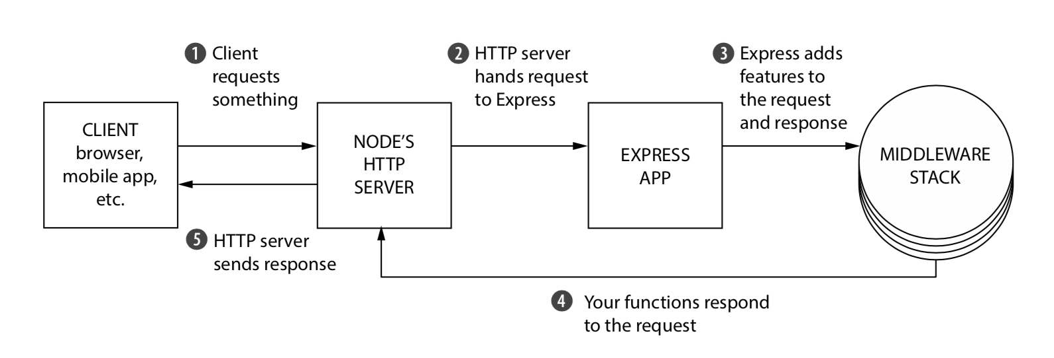
MIDDLEWARES

Slide 33
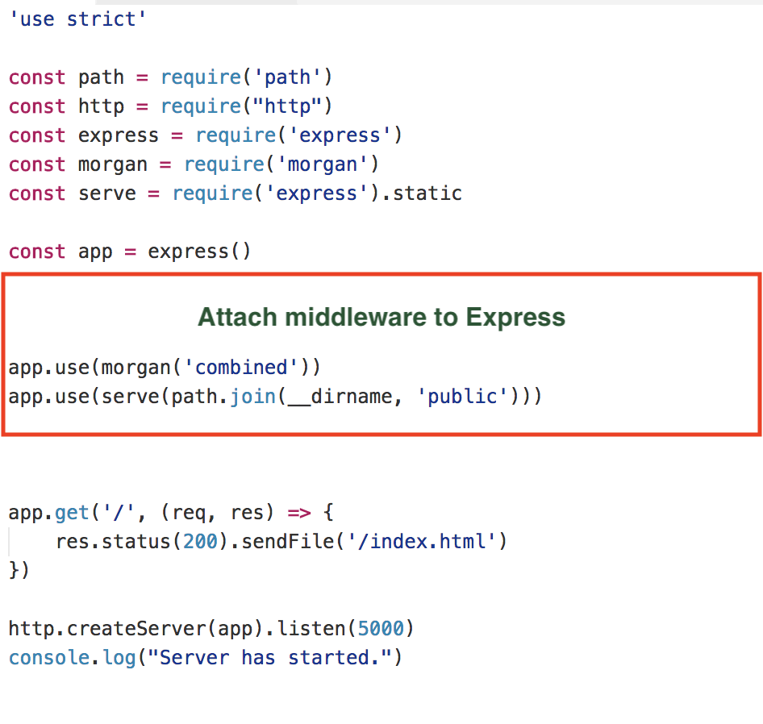
MIDDLEWARES

Slide 34
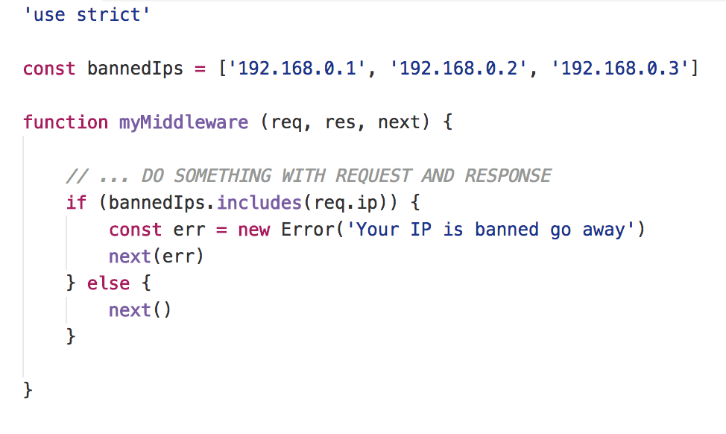
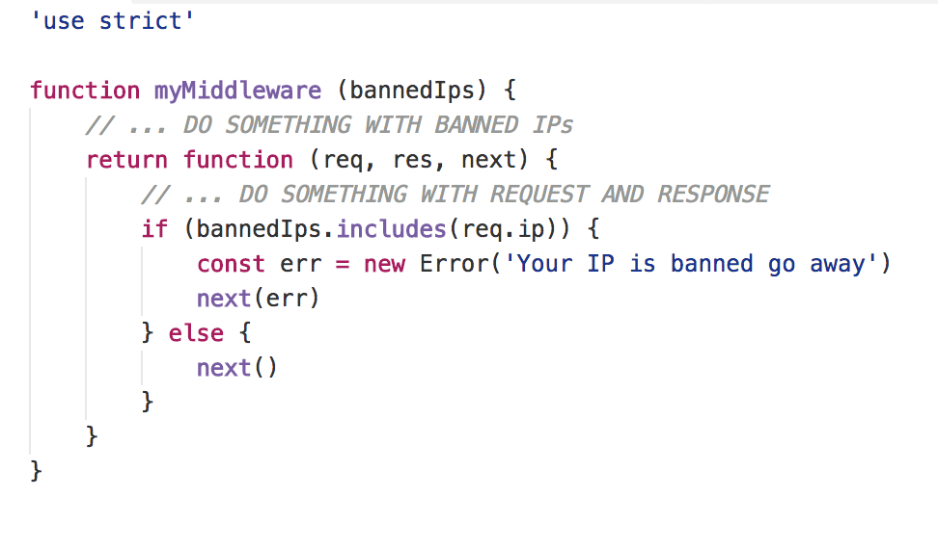
MIDDLEWARES

Slide 35
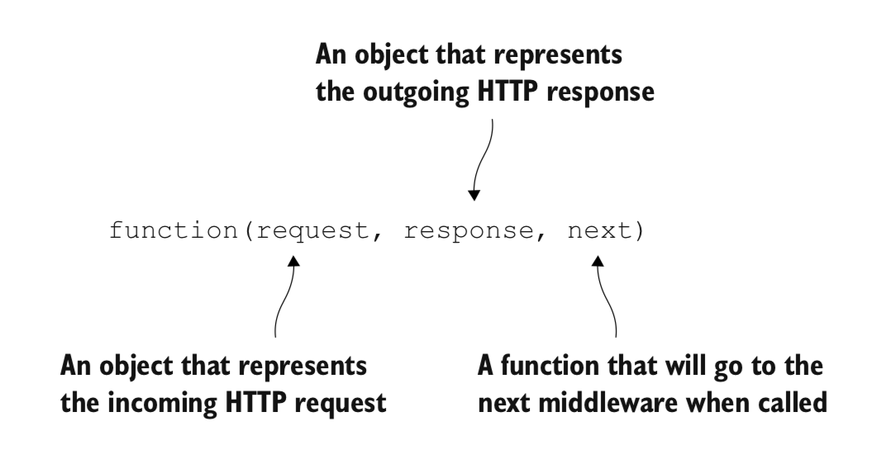
MIDDLEWARES
http://expressjs.com/en/resources/middleware.html

Slide 36
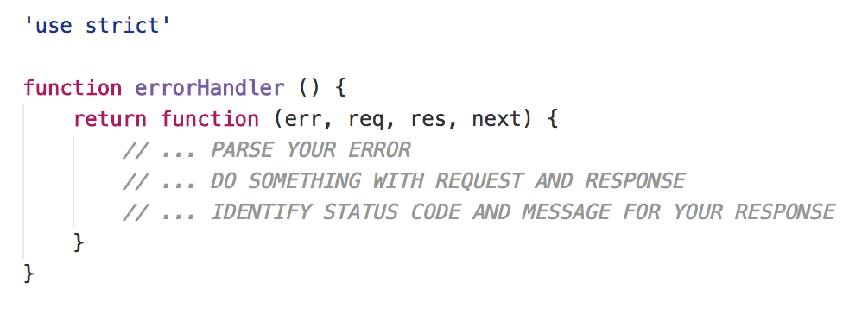
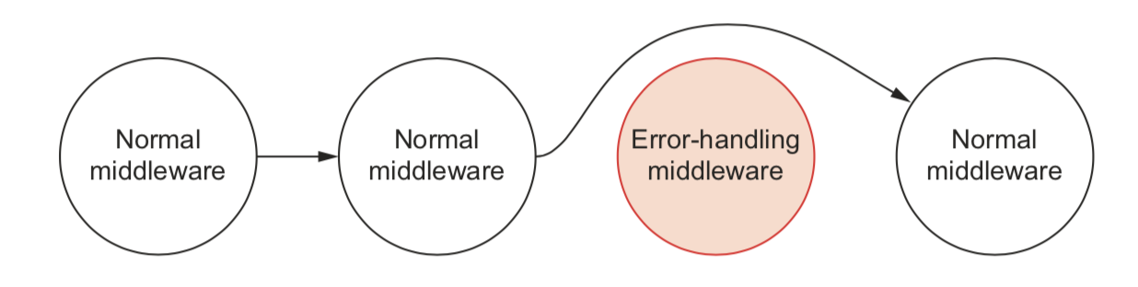
ERROR HANDLER

Slide 37
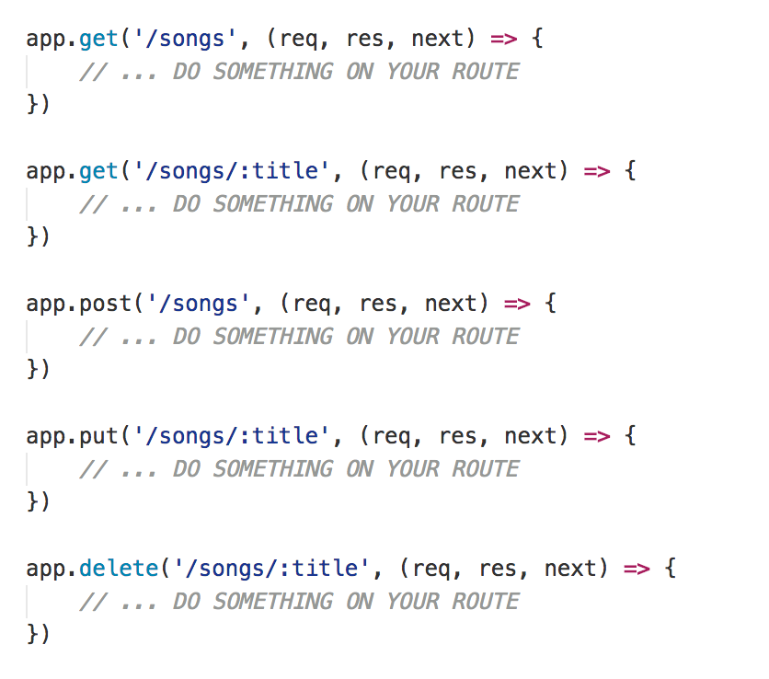
ROUTING
Routing refers to determining how an application responds to a client request to a particular endpoint, which is a URI (or path) and a specific HTTP request method

Slide 38
VALIDATE YOUR INPUT
Ajv
The fastest JSON Schema validator for Node.js and browser
npm install ajv
https://github.com/epoberezkin/ajv

Slide 39
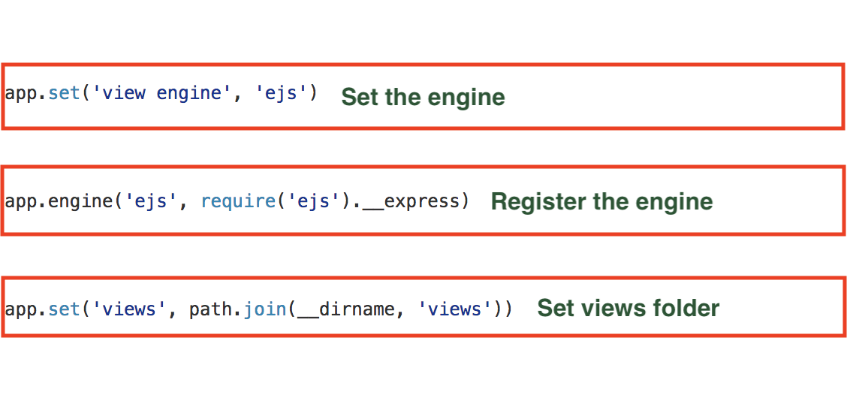
VIEWS / TEMPLATE ENGINE
Pug - Mustache - Dust - Nunjuks - EJS

Slide 40
SECURITY
Helmet helps you secure your Express apps by setting various HTTP headers
npm install helmet
https://github.com/helmetjs/helmet

Slide 41
LOGGER
Log everything that happens in your application
Pay attention there is a cost for logging
npm install winston
https://github.com/winstonjs/winston

Slide 42
DOMANDE?

Slide 43
GRAZIE
https://github.com/NickNaso/nodejs-tsw-2017

