Slide 1







Express from zero to hero
Nicola Del Gobbo, Developer, Packly S.R.L.

Slide 2



Me
Developer
Contribute to
N-API WG
EVANGELISM

Slide 3



WEB APPLICATION
Response
NODEJS HTTP SERVER
REQUEST
HANDLER
CLIENT
Request
Browser
Mobile App
http://your-web-application
Nicola Del Gobbo
@NickNaso

Slide 4
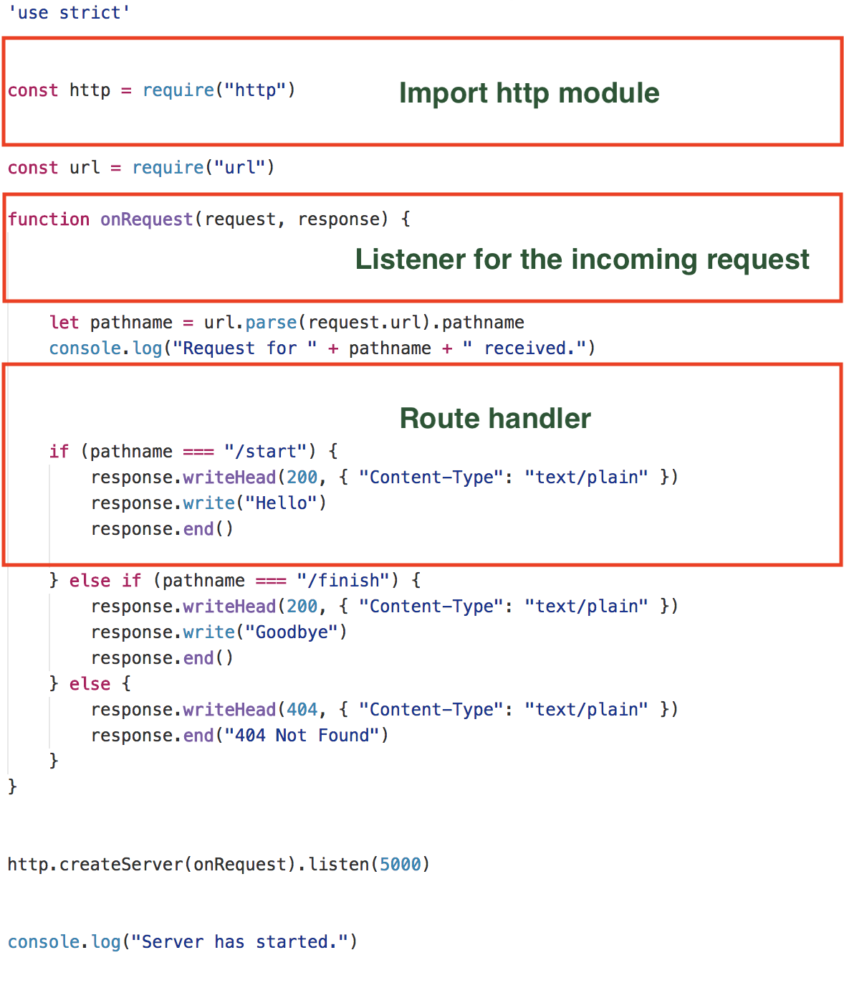
About 40k req/s
Hard to maintain
Nicola Del Gobbo
@NickNaso

Slide 5


FRAMEWORKS
Nicola Del Gobbo
@NickNaso

Slide 6
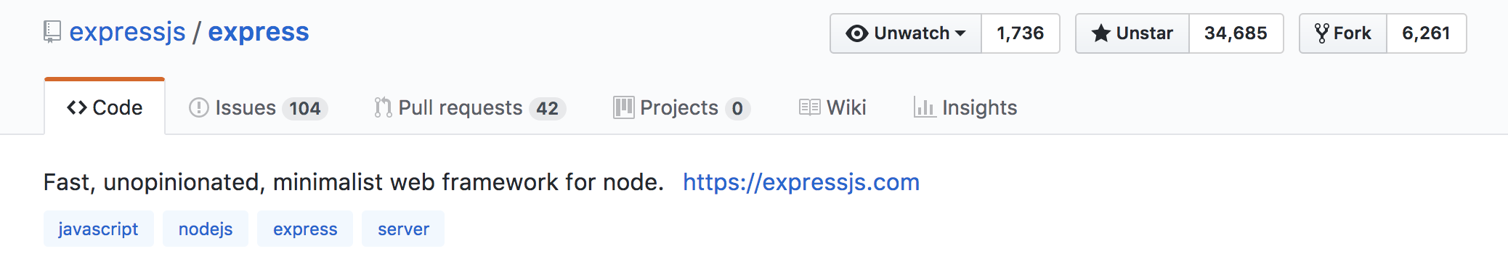

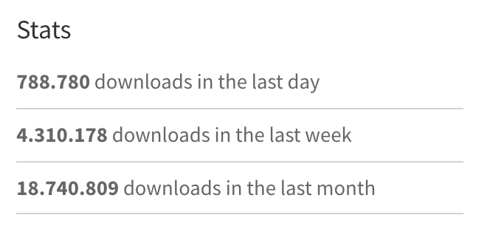
EXPRESS
Nicola Del Gobbo
@NickNaso

Slide 7
EXPRESS
Minimalist
Unopinioneted
Fast (about 21k req/sec)
Simple (do one thing well philosophy from Unix world)
Wrapper of http core module
Nicola Del Gobbo
@NickNaso

Slide 8
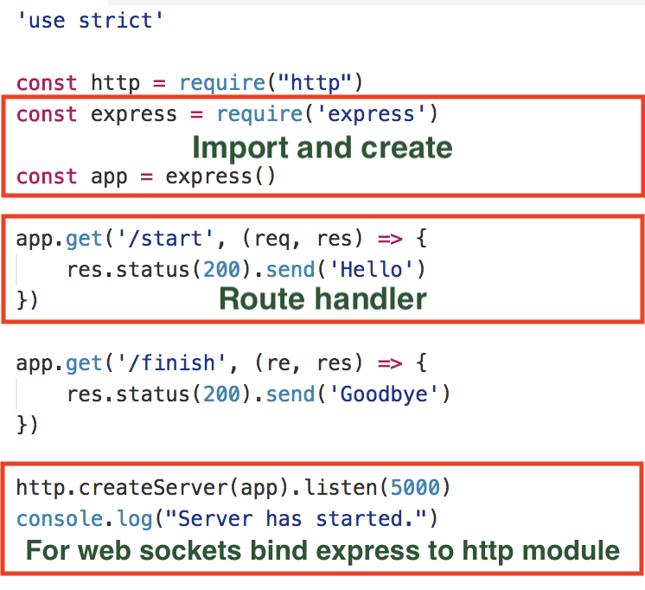
Nicola Del Gobbo
@NickNaso

Slide 9
EXPRESS
Middleware
Error handler
Router
Views / template engine
Nicola Del Gobbo
@NickNaso

Slide 10
MIDDLEWARES
It’s always a question to manipulate the Request and Response object
Nicola Del Gobbo
@NickNaso

Slide 11
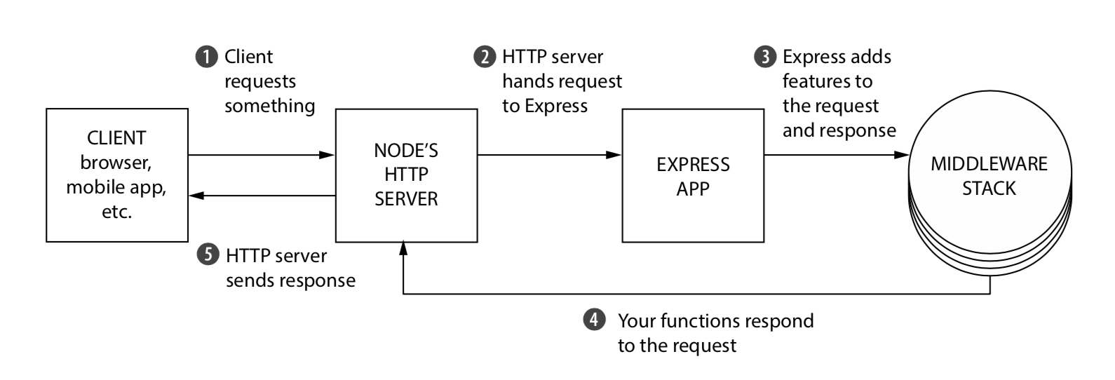
MIDDLEWARES
Nicola Del Gobbo
@NickNaso

Slide 12
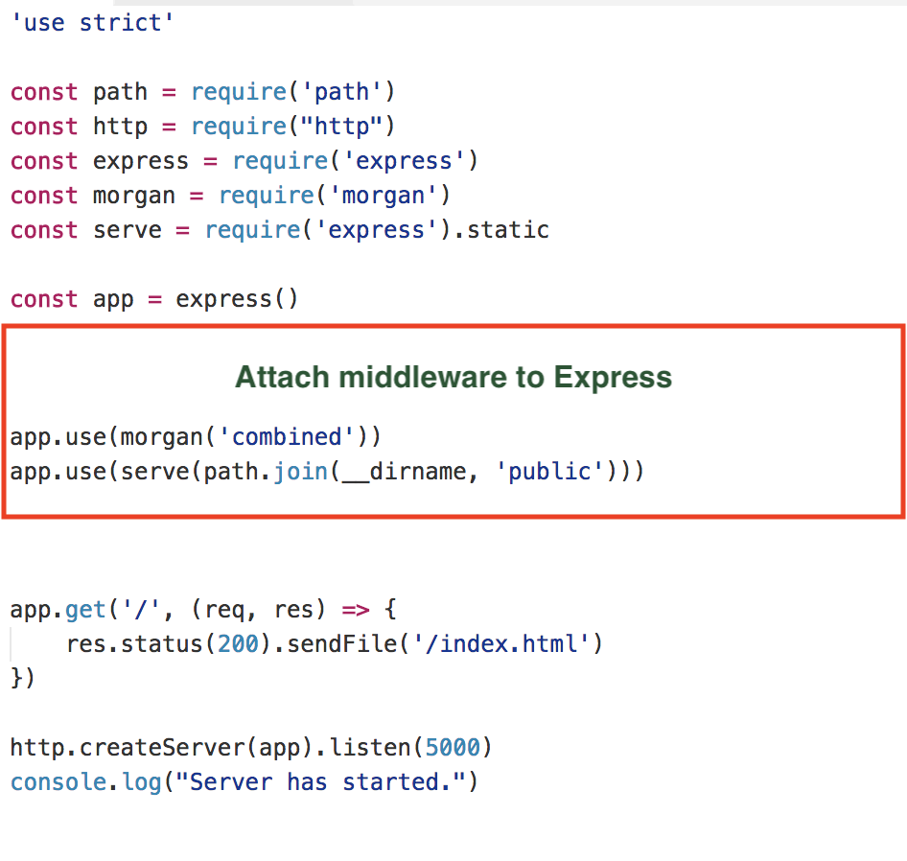
MIDDLEWARES
Nicola Del Gobbo
@NickNaso

Slide 13
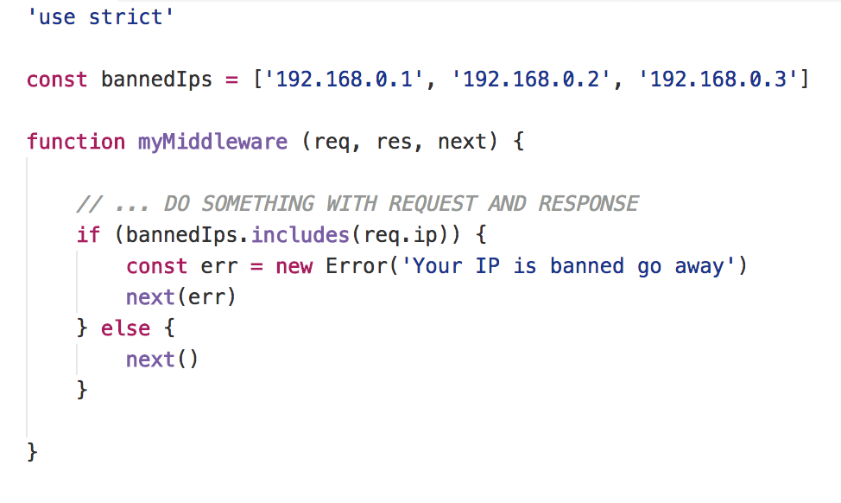
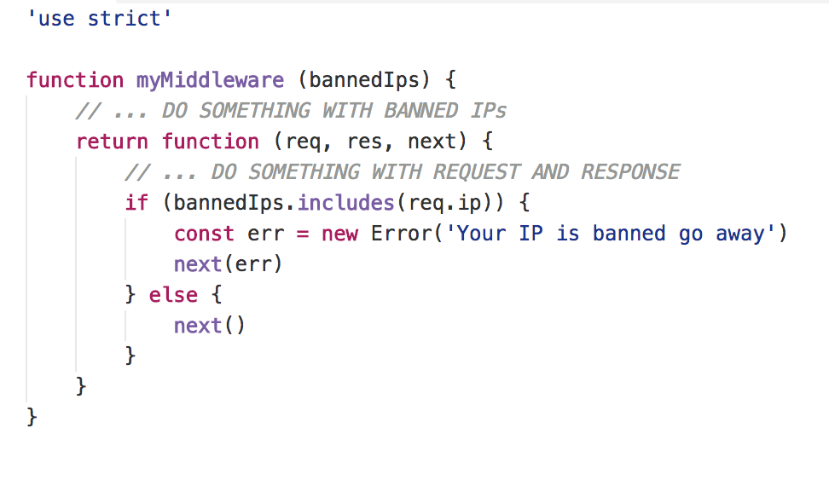
MIDDLEWARES
Nicola Del Gobbo
@NickNaso

Slide 14
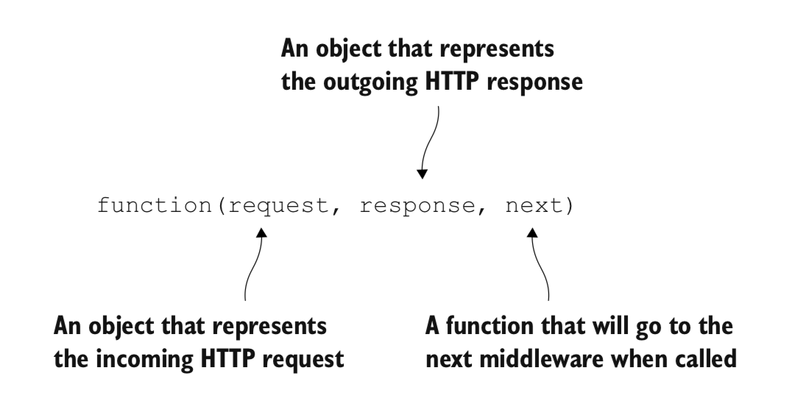
MIDDLEWARES
http://expressjs.com/en/resources/middleware.html
Nicola Del Gobbo
@NickNaso

Slide 15
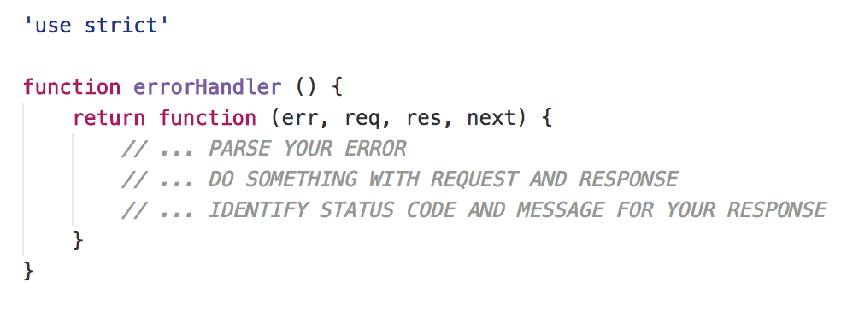
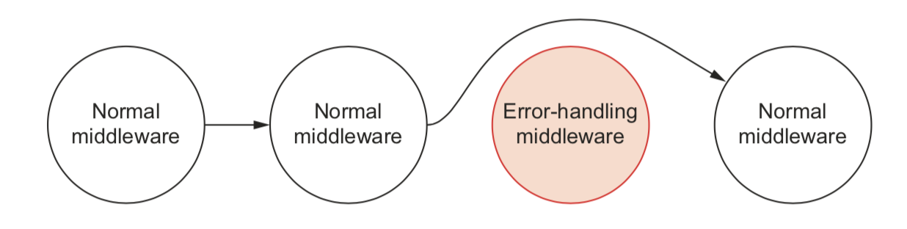
ERROR HANDLER
Nicola Del Gobbo
@NickNaso

Slide 16
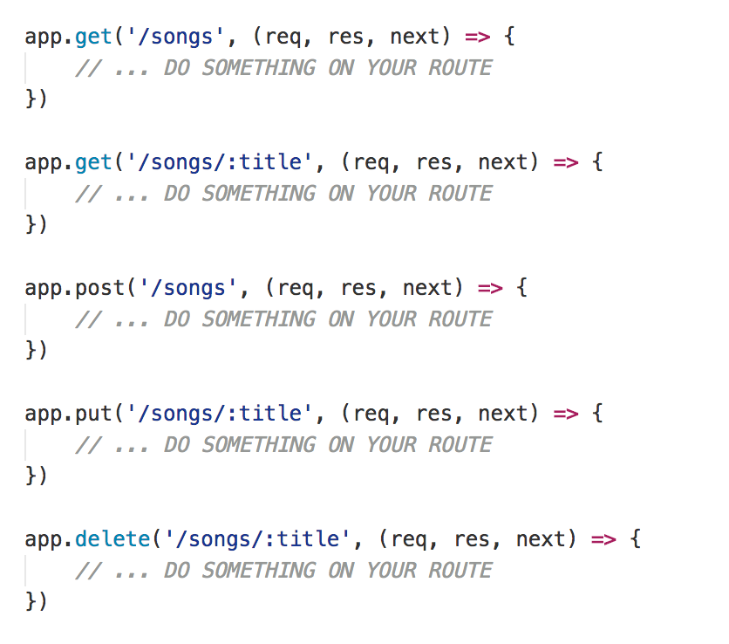
ROUTING
Routing refers to determining how an application responds to a client request to a particular endpoint, which is a URI (or path) and a specific HTTP request method
Nicola Del Gobbo
@NickNaso

Slide 17
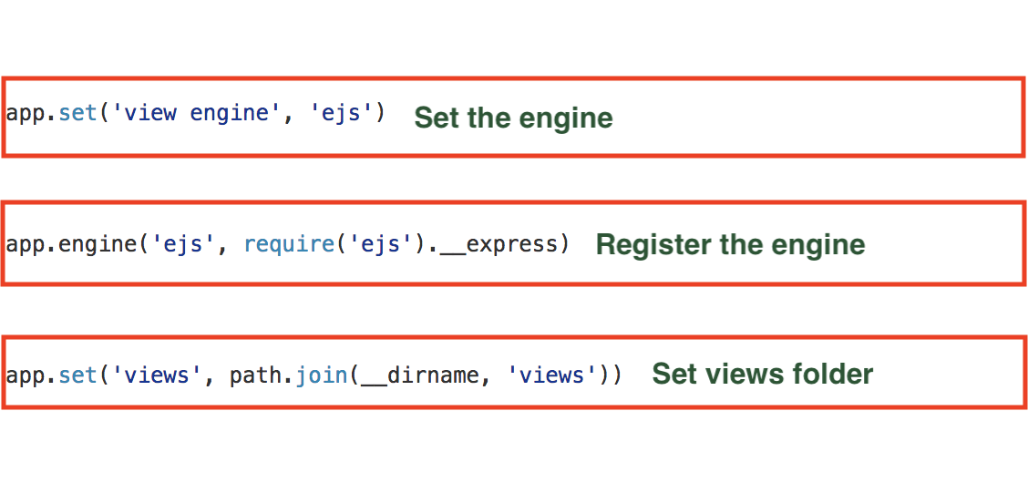
VIEWS / TEMPLATE ENGINE
Pug - Mustache - Dust - Nunjuks - EJS
Nicola Del Gobbo
@NickNaso

Slide 18
SECURITY
Helmet helps you secure your Express apps by setting various HTTP headers
npm install helmet
https://github.com/helmetjs/helmet
Nicola Del Gobbo
@NickNaso

Slide 19
VALIDATE YOUR INPUT
Ajv
The fastest JSON Schema validator for Node.js and browser
npm install ajv
https://github.com/epoberezkin/ajv
Nicola Del Gobbo
@NickNaso

Slide 20
EXAMPLES
Nicola Del Gobbo
@NickNaso

Slide 21
DOMANDE?
Nicola Del Gobbo
@NickNaso

Slide 22



GRAZIE
https://github.com/NickNaso/expressjs-from-zero-to-hero
Nicola Del Gobbo
@NickNaso

