Slide 1
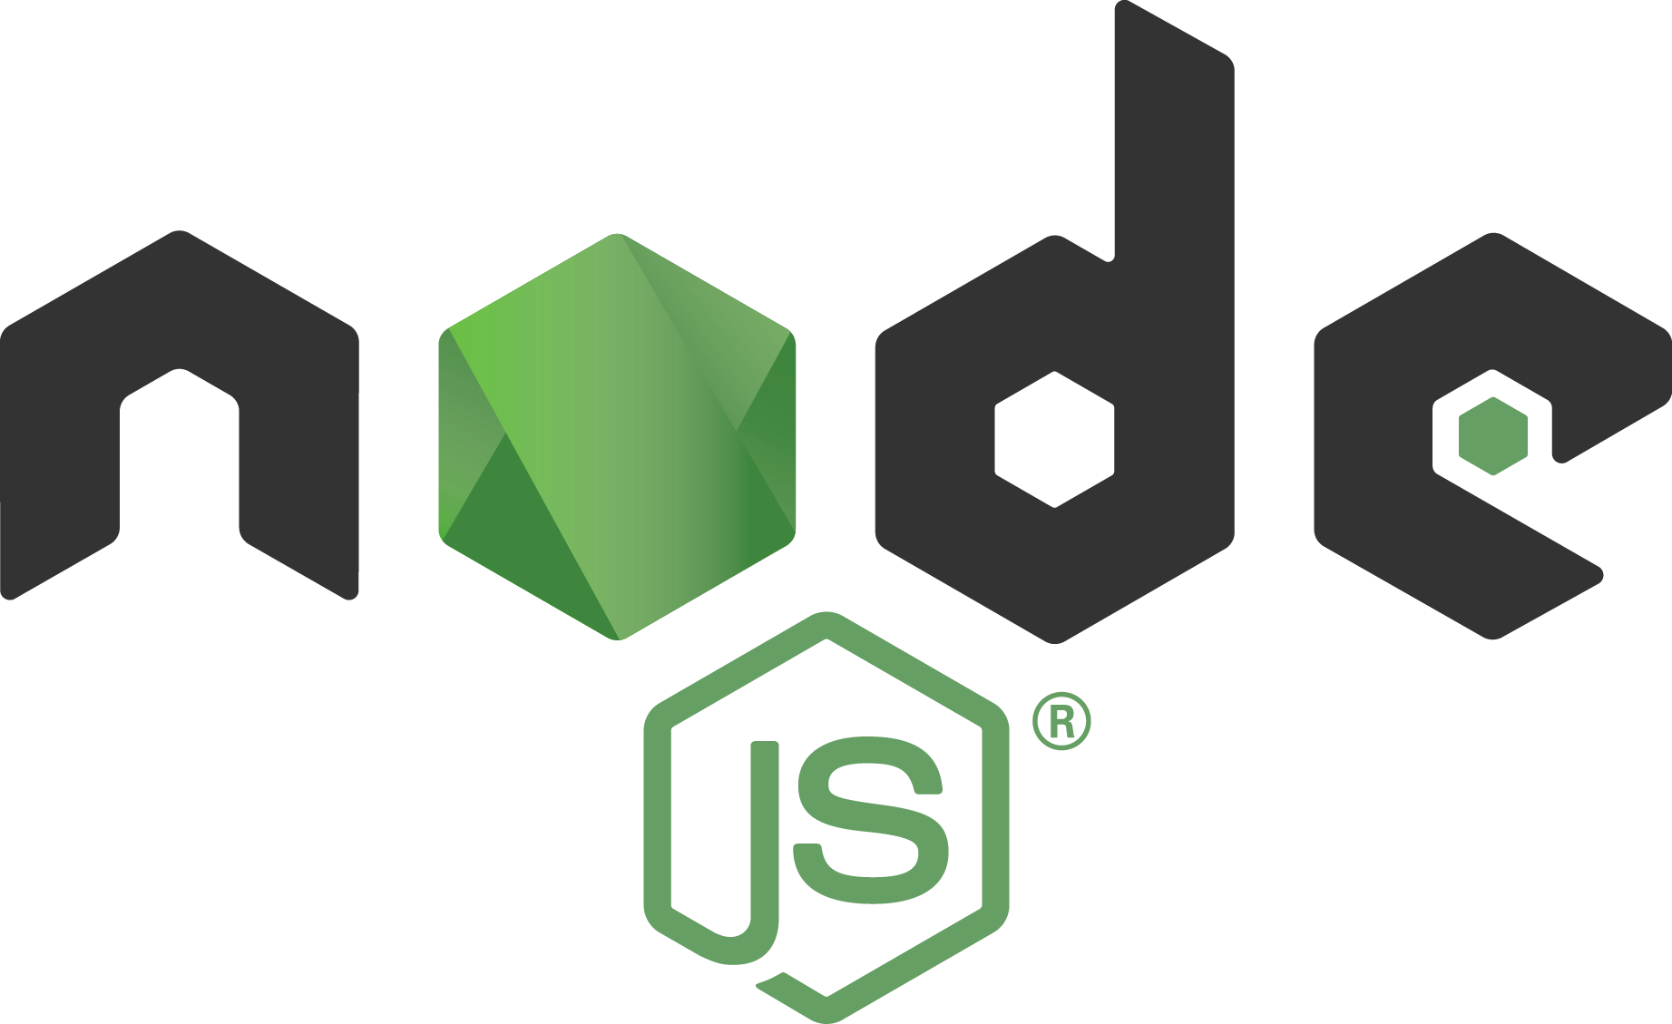
Node.js from zero to hero
Nicola Del Gobbo – Mauro Doganieri

Slide 2



WHAT IS Node.js?
Node.js is a JavaScript runtime built on Chrome's V8 JavaScript engine
Node.js uses an event-driven, non-blocking I/O model that makes it lightweight and efficient
Node.js' package ecosystem, npm, is the largest ecosystem of open source libraries in the world
~100k LOC of JS and C++
A JavaScript Runtime
Asynchronous I/O based on event loops
Node glue
Ecosystem of packages

Slide 3



WHAT CAN I DO WITH Node.js?
EVERYTHING
Great thank you to Node.js Community and Working Groups

Slide 4









WHAT CAN I DO WITH Node.js?
CLI APPLICATION
DISRTRUBUTED SYSTEM
REAL TIME SYSTEM
DESKTOP APPLICATION

Slide 5
ARCHITECTURE

Slide 6
CONCURRENCY MODEL?
ASINCHRONOUS I/O
SINGLE THREADED

Slide 7
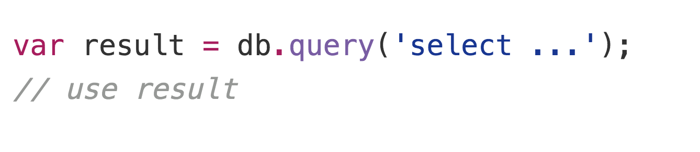
SINCHRONOUS MODEL?
Blocking the whole process or you need to have multiple execution stacks

Slide 8
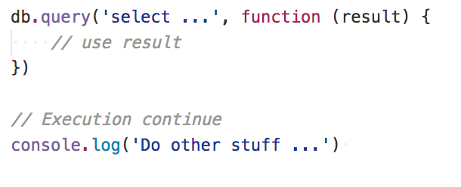
ASINCHRONOUS MODEL?
The main process is never blocked. No strategy is required to handle competing requests

Slide 9
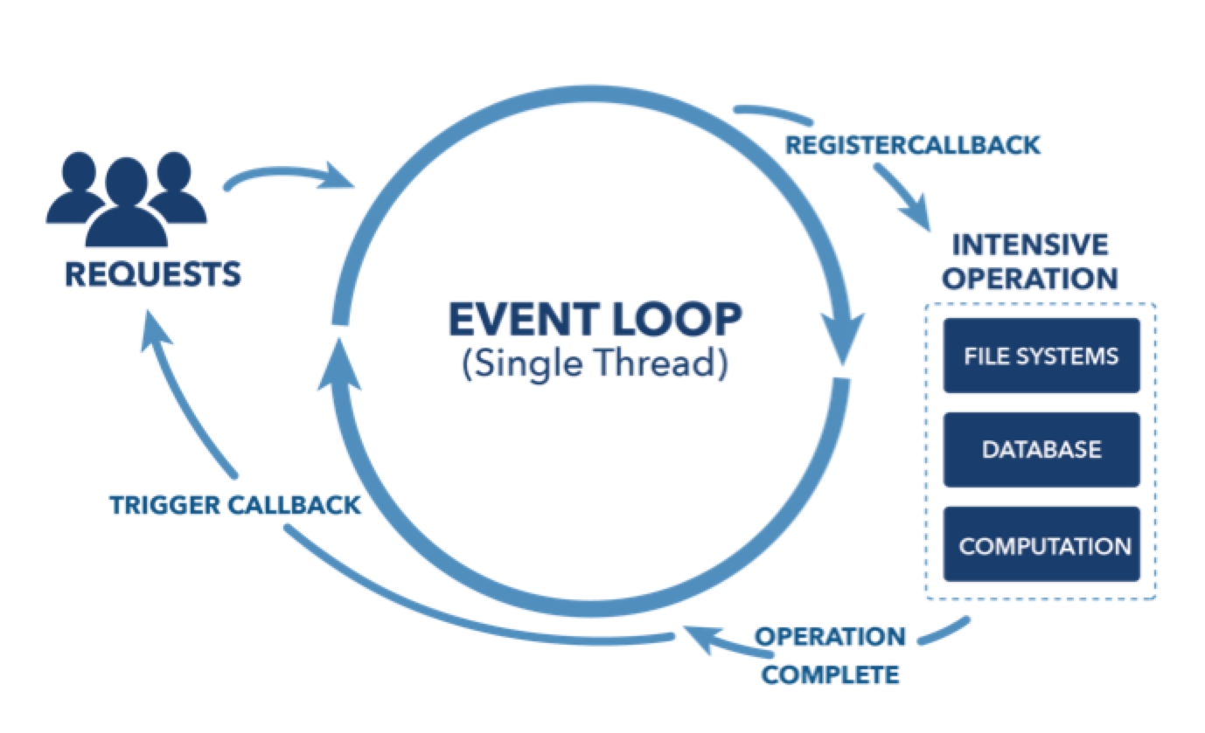
EVENT LOOP

Slide 10
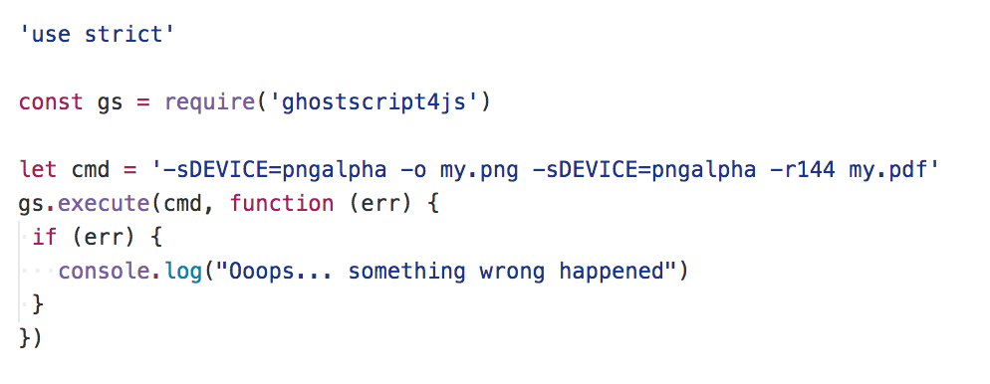
ASINCHRONOUS IN LOW LEVEL

Slide 11
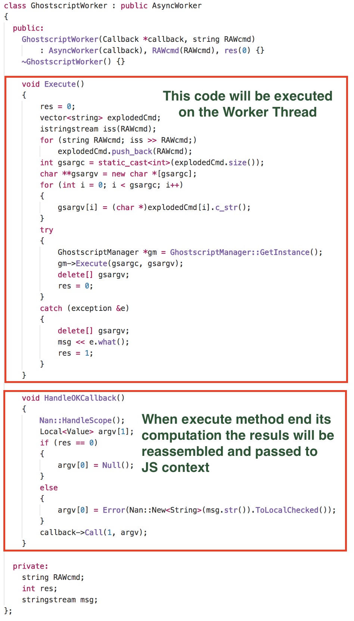
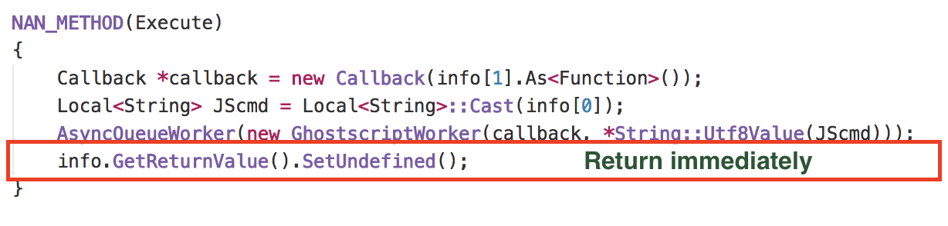

Slide 12
ASINCHRONOUS IN LOW LEVEL

Slide 13
JAVASCRIPT
“The world's most misunderstood programming language“
Douglas Crockford

Slide 14
STRICT MODE
ECMAScript 5's strict mode is a way to opt in to a restricted variant of JavaScript.
Strict mode isn't just a subset: it intentionally has different semantics from normal code.

Slide 15

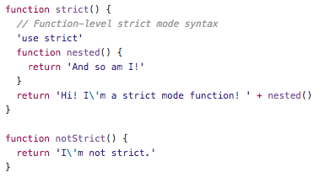
STRICT MODE - HOW TO
Scripts
Functions

Slide 16
SCOPE
Where your variables are actually created depends on
how you declare them, using var, let or const
if you are in strict mode or not
if you are explicitly declaring them or not

Slide 17
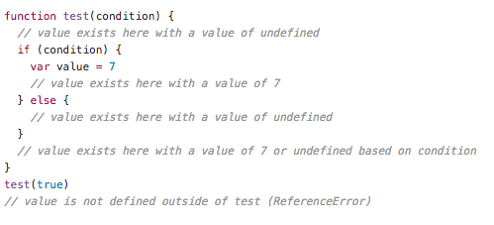
SCOPE var DECLARATION AND HOISTING
Declared variables are constrained in the execution context in which they are declared
Declared variables are created before any code is executed

Slide 18
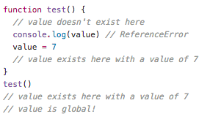
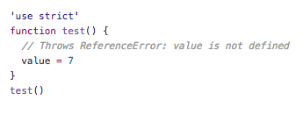
SCOPE UNDECLARATION VARIABLES
Undeclared variables are always global
Undeclared variables do not exist until the code assigning to them is executed

Slide 19
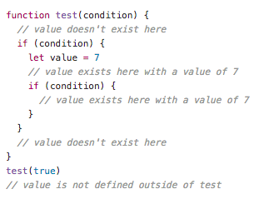
SCOPE - DECLARATION USING let
Variables declared by let have as their scope the block in which they are defined, as well as in any contained sub-blocks

Slide 20

SCOPE - NO REDECLARATION USING let
Redeclaring the same variable within the same function or block scope raises a SyntaxError

Slide 21
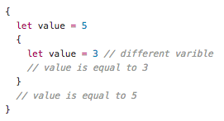
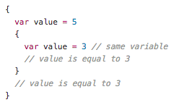
SCOPE - REDECLARATION USING var vs let

Slide 22
FUNCTIONS
In JavaScript, functions are first-class objects, because they can have properties and methods just like any other object

Slide 23
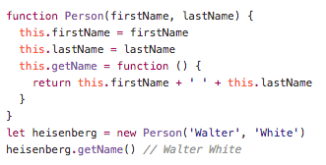
FUNCTIONS - HOW TO REPRESENT AN OBJECT

Slide 24
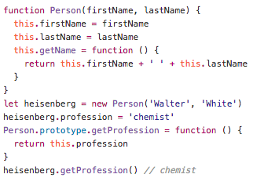
FUNCTIONS - HOW TO REPRESENT AN OBJECT

Slide 25
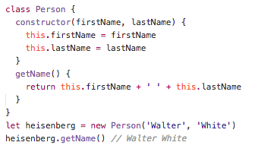
FUNCTIONS - THE class KEYWORD

Slide 26
FUNCTIONS - ARROW FUNCTIONS
An arrow function expression has a shorter syntax than a function expression and does not have its own this, arguments, super...
These function expressions are best suited for non-method functions, and they cannot be used as constructors

Slide 27
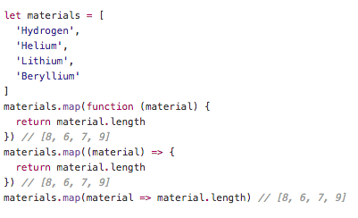
FUNCTIONS - ARROW FUNCTIONS

Slide 28
FUNCTIONS - CLOSURES
A closure is the combination of a function and the lexical environment within which that function was declared

Slide 29
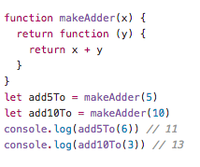
FUNCTIONS - CLOSURES

Slide 30
THE LONG HARD ROAD OUT OF CALLBACK HELL
From callbacks to promises and async/await, trying to understand the event loop

Slide 31
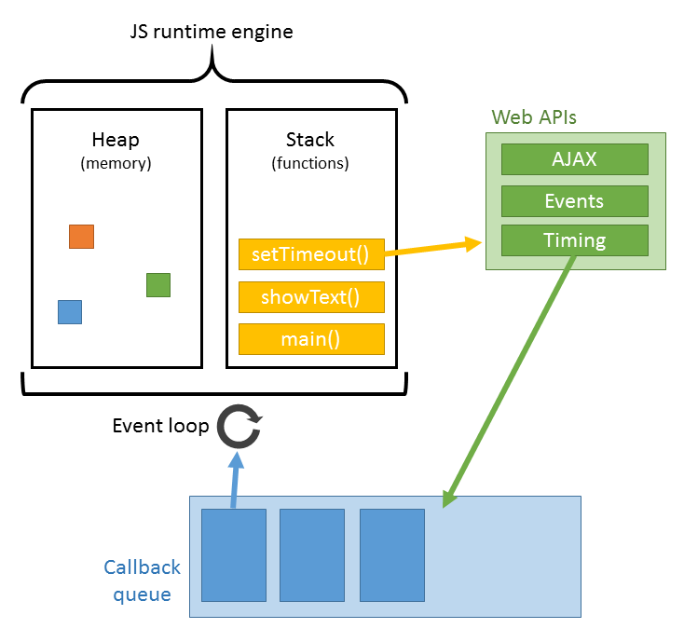
THE EVENT LOOP

Slide 32
MODULARITY
CommonJS Module
ES6 Module from v8.5.0
“Se non hai provato Node.js non sai cos’è la modularità e il riuso”
Matteo Collina

Slide 33
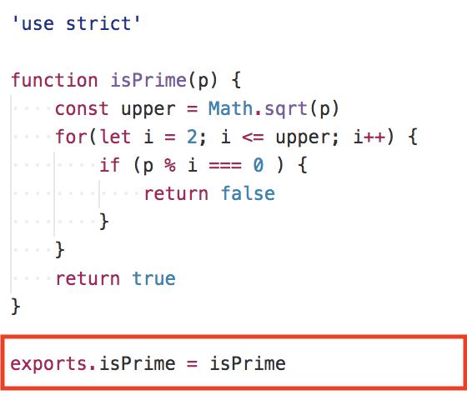
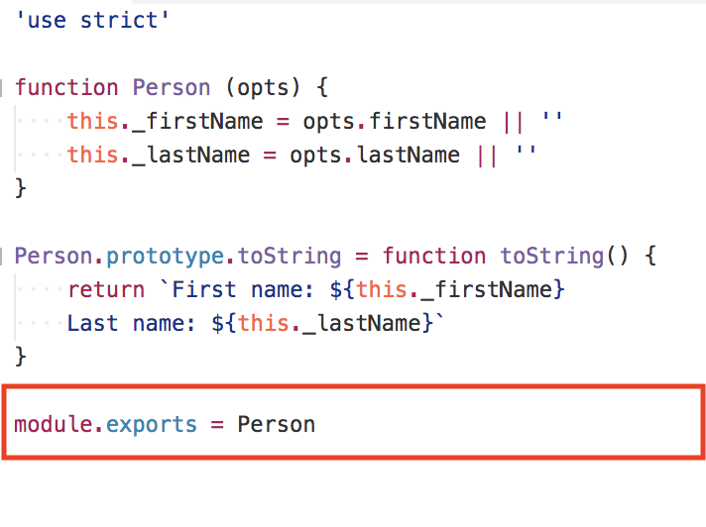
MODULARITY

Slide 34
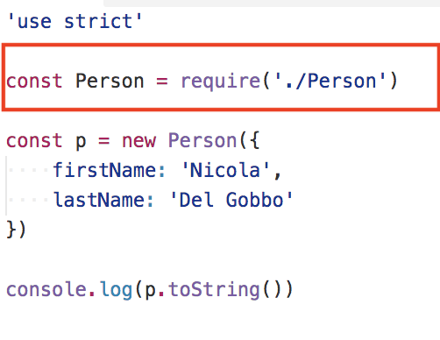
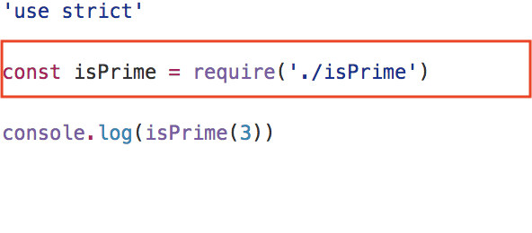
MODULARITY

Slide 35
EVENT EMITTER
EventEmitter is a very important class in Node.js. It provides a channel for events to be dispatched and listeners notified. Many objects you will encounter in Node.js inherit from EventEmitter

Slide 36
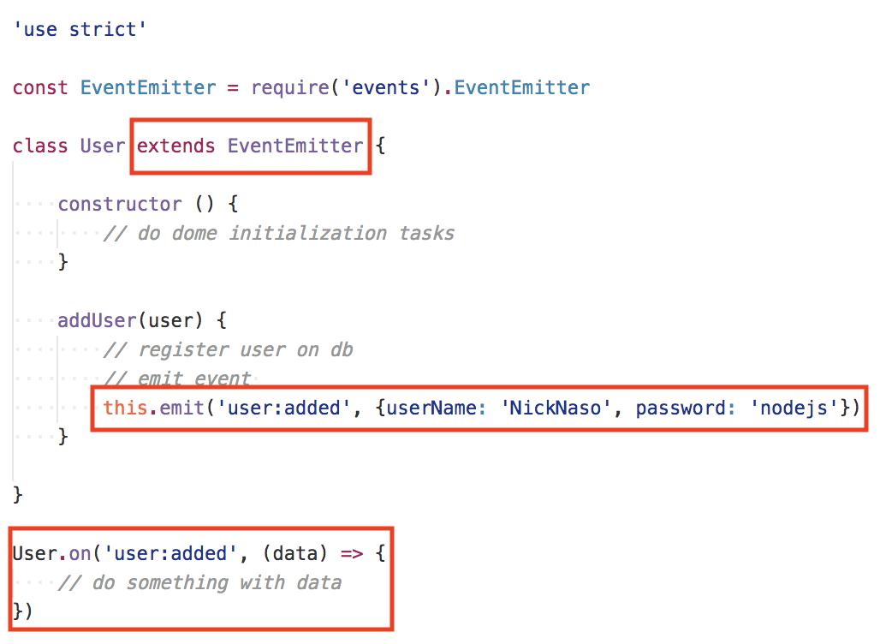
EVENT EMITTER

Slide 37

WEB APPLICATION
Response
NODEJS HTTP SERVER
REQUEST
HANDLER
CLIENT
Request
Browser
Mobile App
http://your-web-application

Slide 38
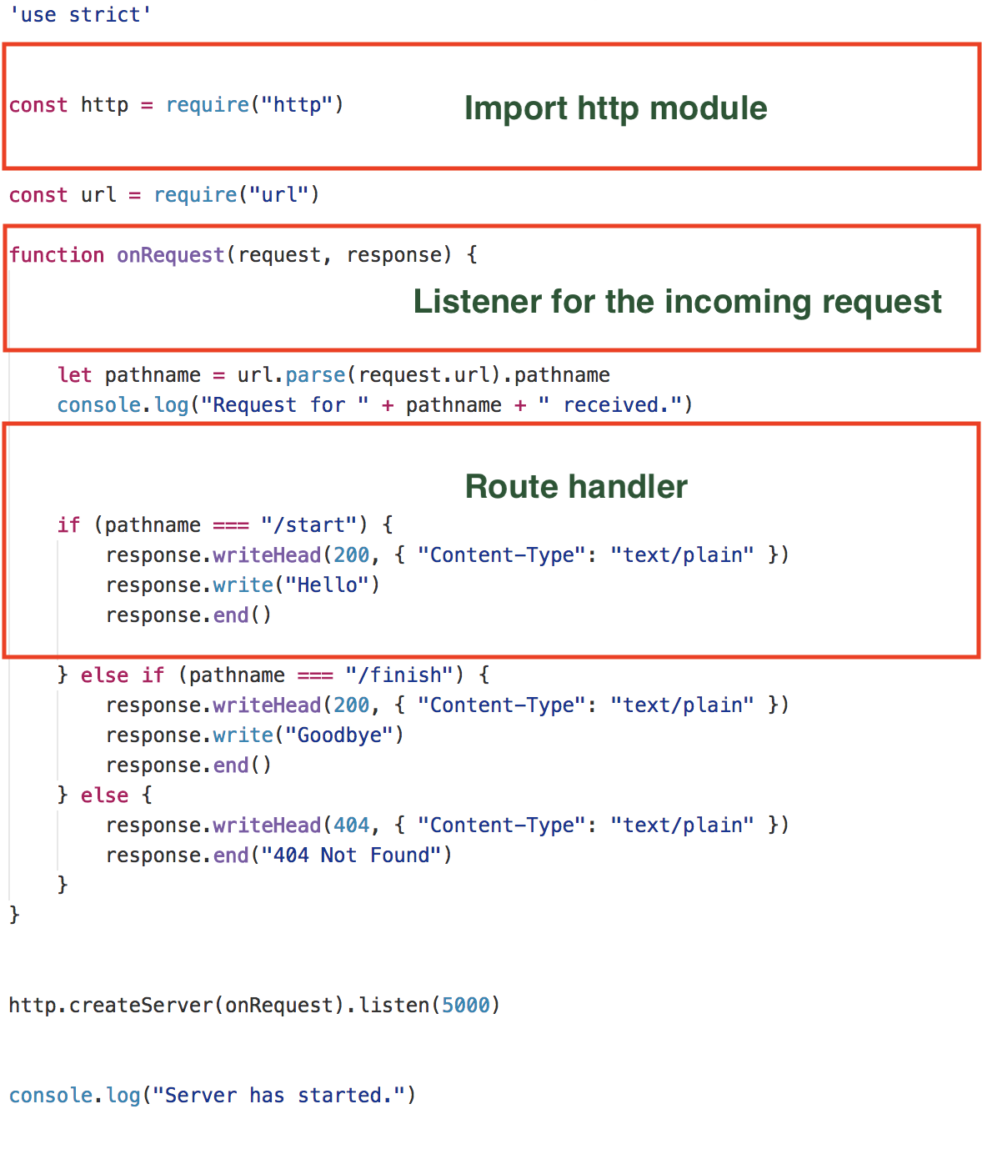
~40k req/s
Hard to maintain

Slide 39
FRAMEWORKS

Slide 40
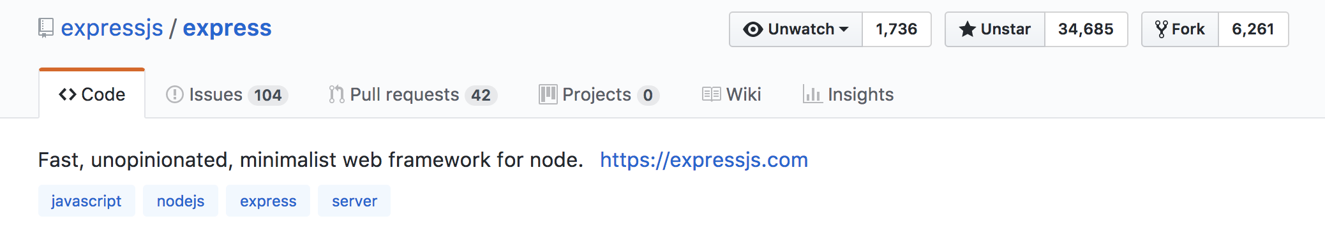

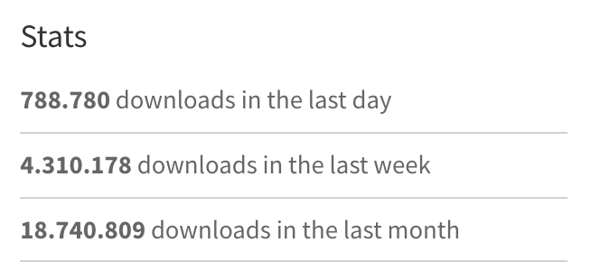
EXPRESS

Slide 41
EXPRESS
Minimalist
Unopinionated
Fast (about 21k req/sec)
Simple (do one thing well philosophy from Unix world)
Wrapper of http core module

Slide 42
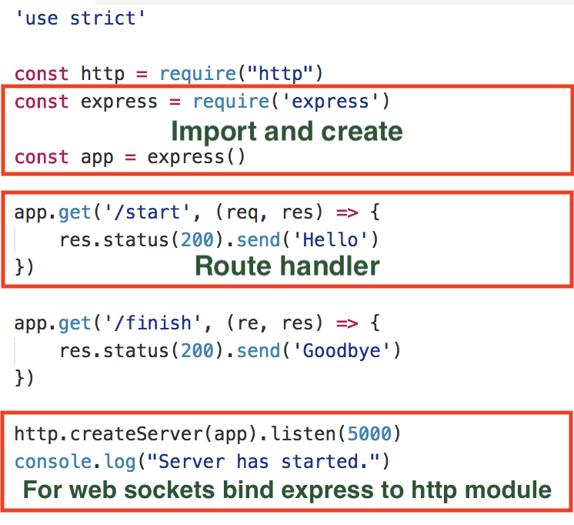

Slide 43
EXPRESS MILESTONES
Middleware
Error handler
Router
Views / template engine

Slide 44
MIDDLEWARES
It’s always a question to manipulate the Request and Response object

Slide 45
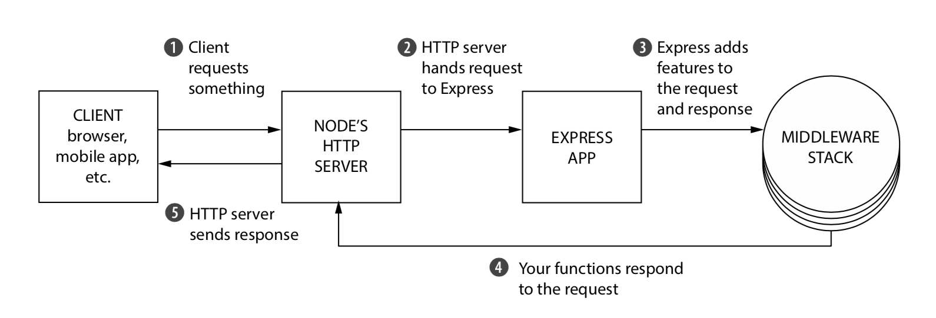
MIDDLEWARES

Slide 46
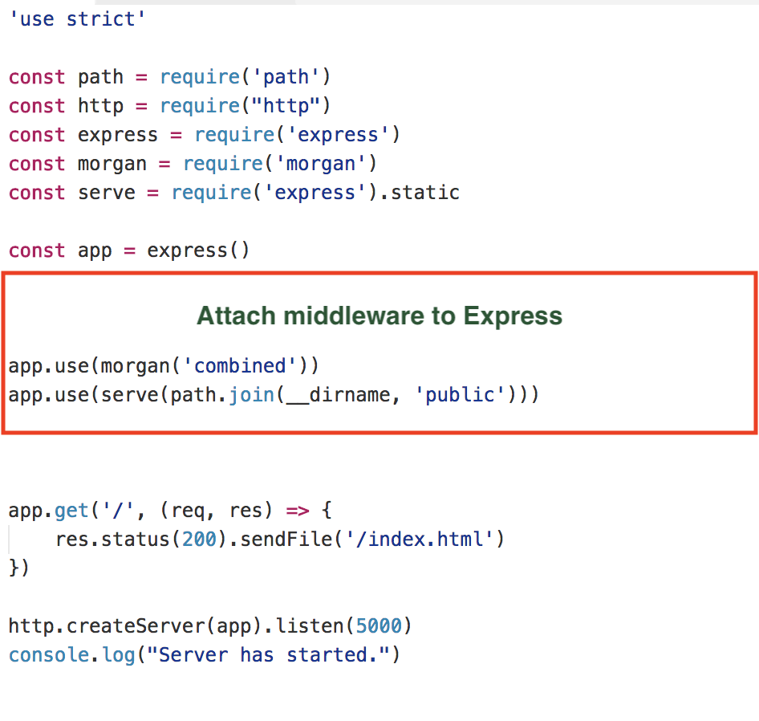
MIDDLEWARES

Slide 47
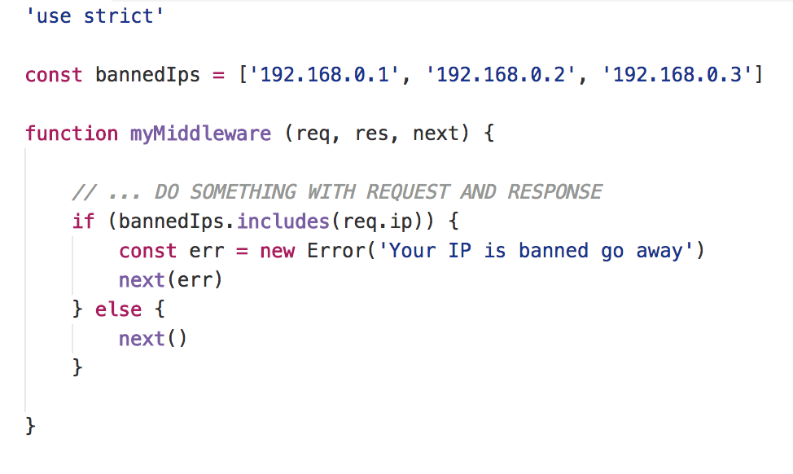
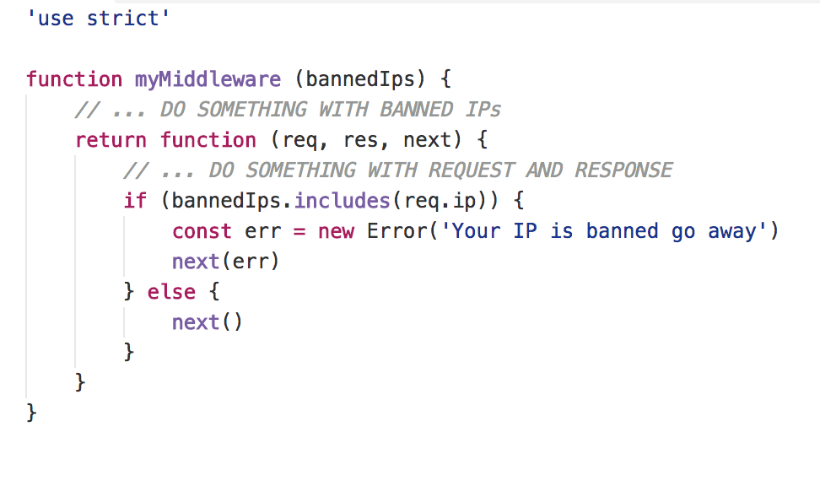
MIDDLEWARES

Slide 48
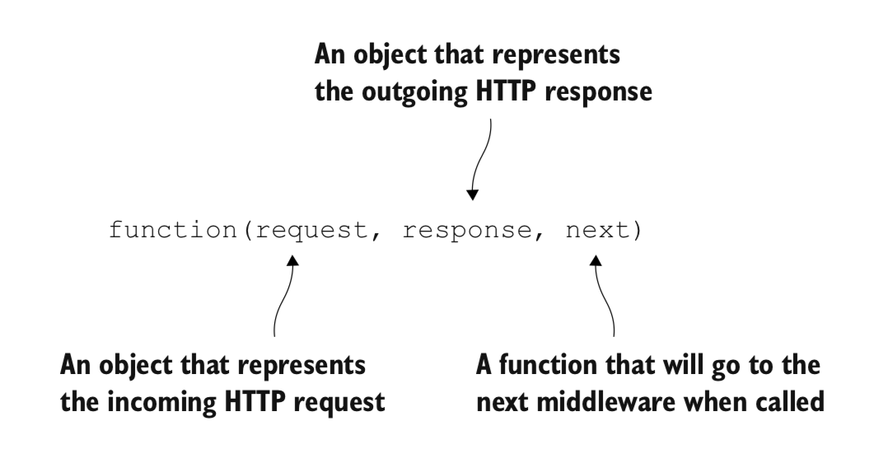
MIDDLEWARES
http://expressjs.com/en/resources/middleware.html

Slide 49
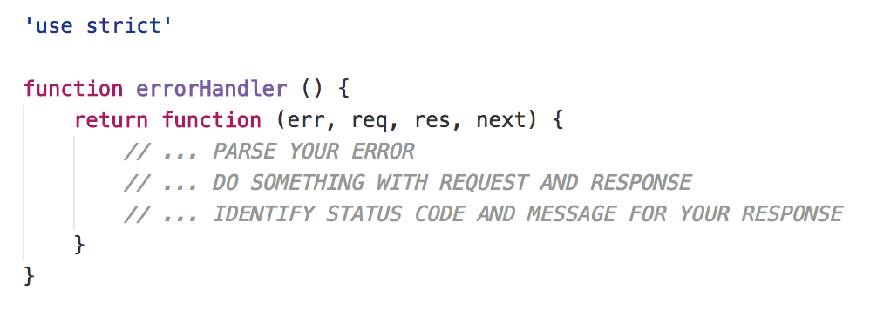
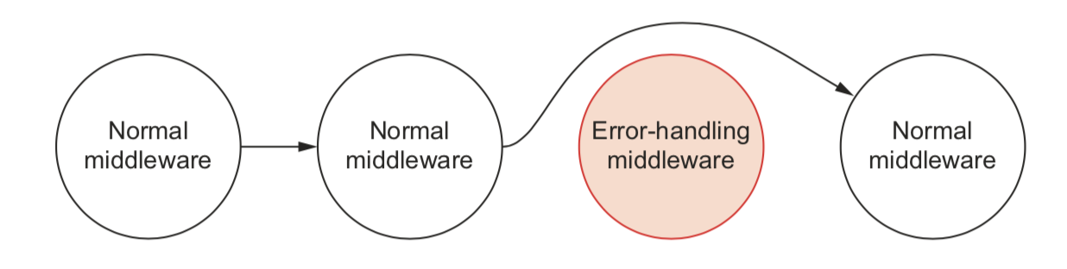
ERROR HANDLER

Slide 50
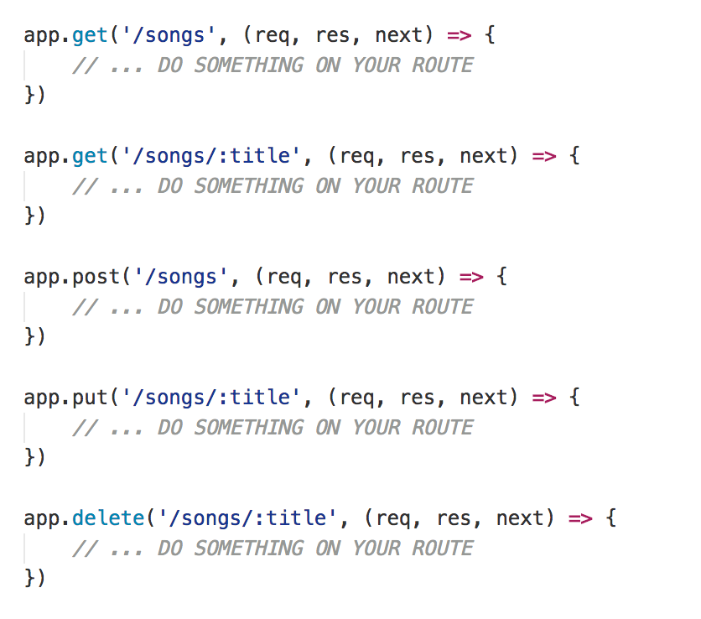
ROUTING
Routing refers to determining how an application responds to a client request to a particular endpoint, which is a URI (or path) and a specific HTTP request method

Slide 51
VALIDATE YOUR INPUT
Ajv
The fastest JSON Schema validator for Node.js and browser
npm install ajv
https://github.com/epoberezkin/ajv

Slide 52
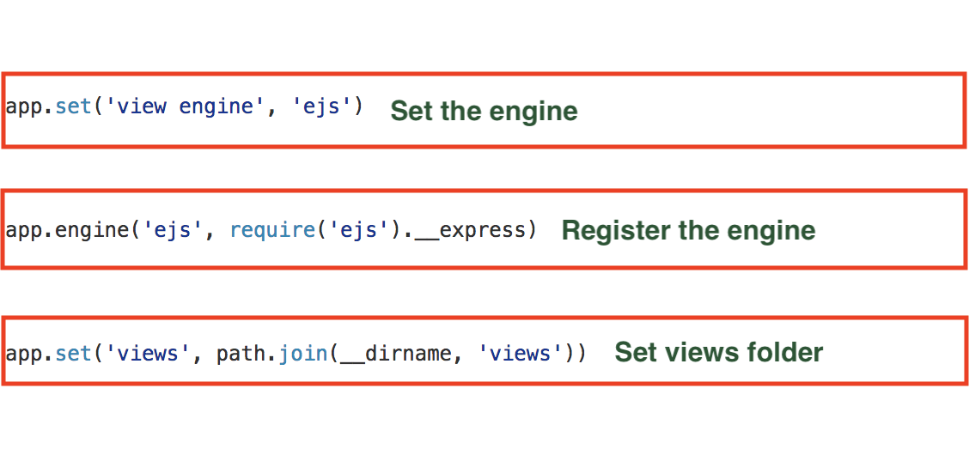
VIEWS / TEMPLATE ENGINE
Pug - Mustache - Dust - Nunjuks - EJS

Slide 53
SECURITY
Helmet helps you secure your Express apps by setting various HTTP headers
npm install helmet
https://github.com/helmetjs/helmet

Slide 54
LOGGER
Log everything that happens in your application
Pay attention there is a cost for logging
npm install winston
https://github.com/winstonjs/winston

Slide 55
DOMANDE?

Slide 56
GRAZIE
https://github.com/NickNaso/nodejs-tsw-2017

