Slide 1
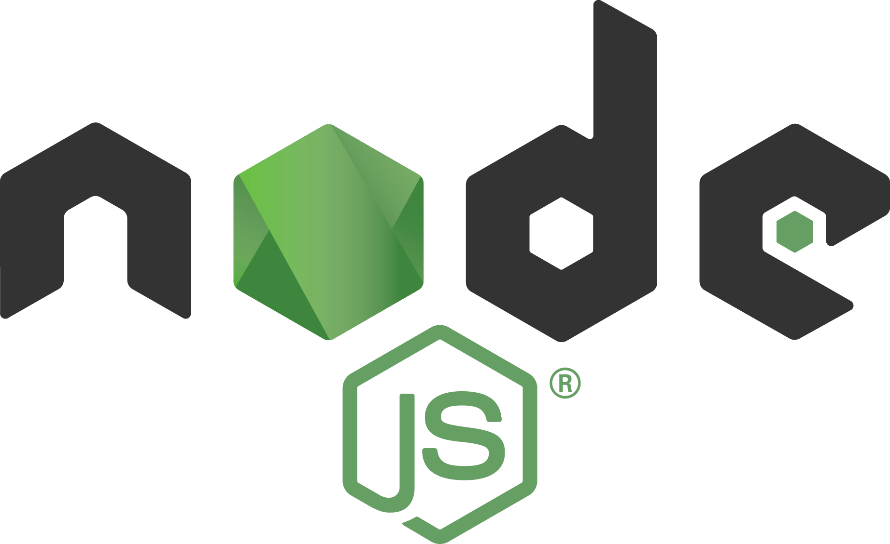
Node.js from zero to hero
Nicola Del Gobbo – Mauro Doganieri

Slide 2



WHAT IS Node.js?
Node.js is a JavaScript runtime built on Chrome's V8 JavaScript engine
Node.js uses an event-driven, non-blocking I/O model that makes it lightweight and efficient
Node.js' package ecosystem, npm, is the largest ecosystem of open source libraries in the world
~100k LOC of JS and C++
A JavaScript Runtime
Asynchronous I/O based on event loops
Node glue
Ecosystem of packages

Slide 3



WHAT CAN I DO WITH Node.js?
EVERYTHING
Great thank you to Node.js Community and Working Groups

Slide 4









WHAT CAN I DO WITH Node.js?
CLI APPLICATION
DISRTRUBUTED SYSTEM
REAL TIME SYSTEM
DESKTOP APPLICATION

Slide 5
ARCHITECTURE

Slide 6
CONCURRENCY MODEL?
ASINCHRONOUS I/O
SINGLE THREADED

Slide 7
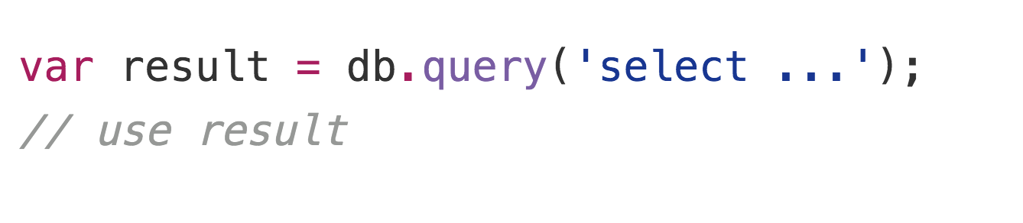
SINCHRONOUS MODEL?
Blocking the whole process or you need to have multiple execution stacks

Slide 8
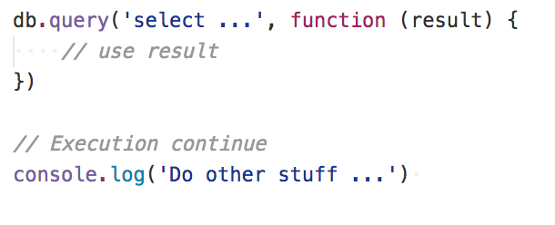
ASINCHRONOUS MODEL?
The main process is never blocked. No strategy is required to handle competing requests

Slide 9
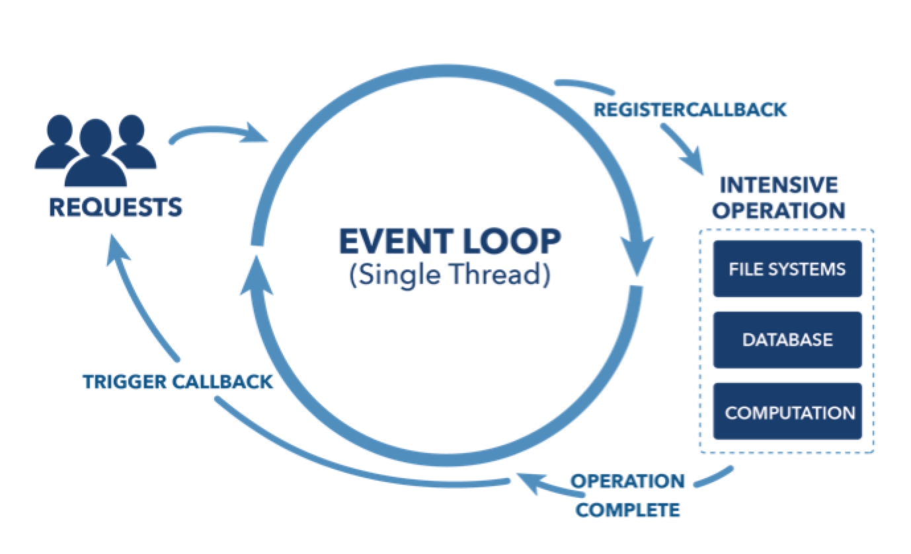
EVENT LOOP

Slide 10
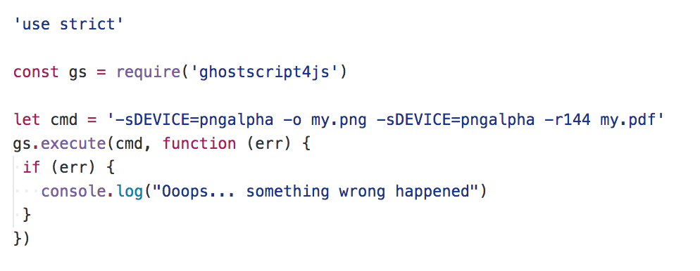
ASINCHRONOUS IN LOW LEVEL

Slide 11
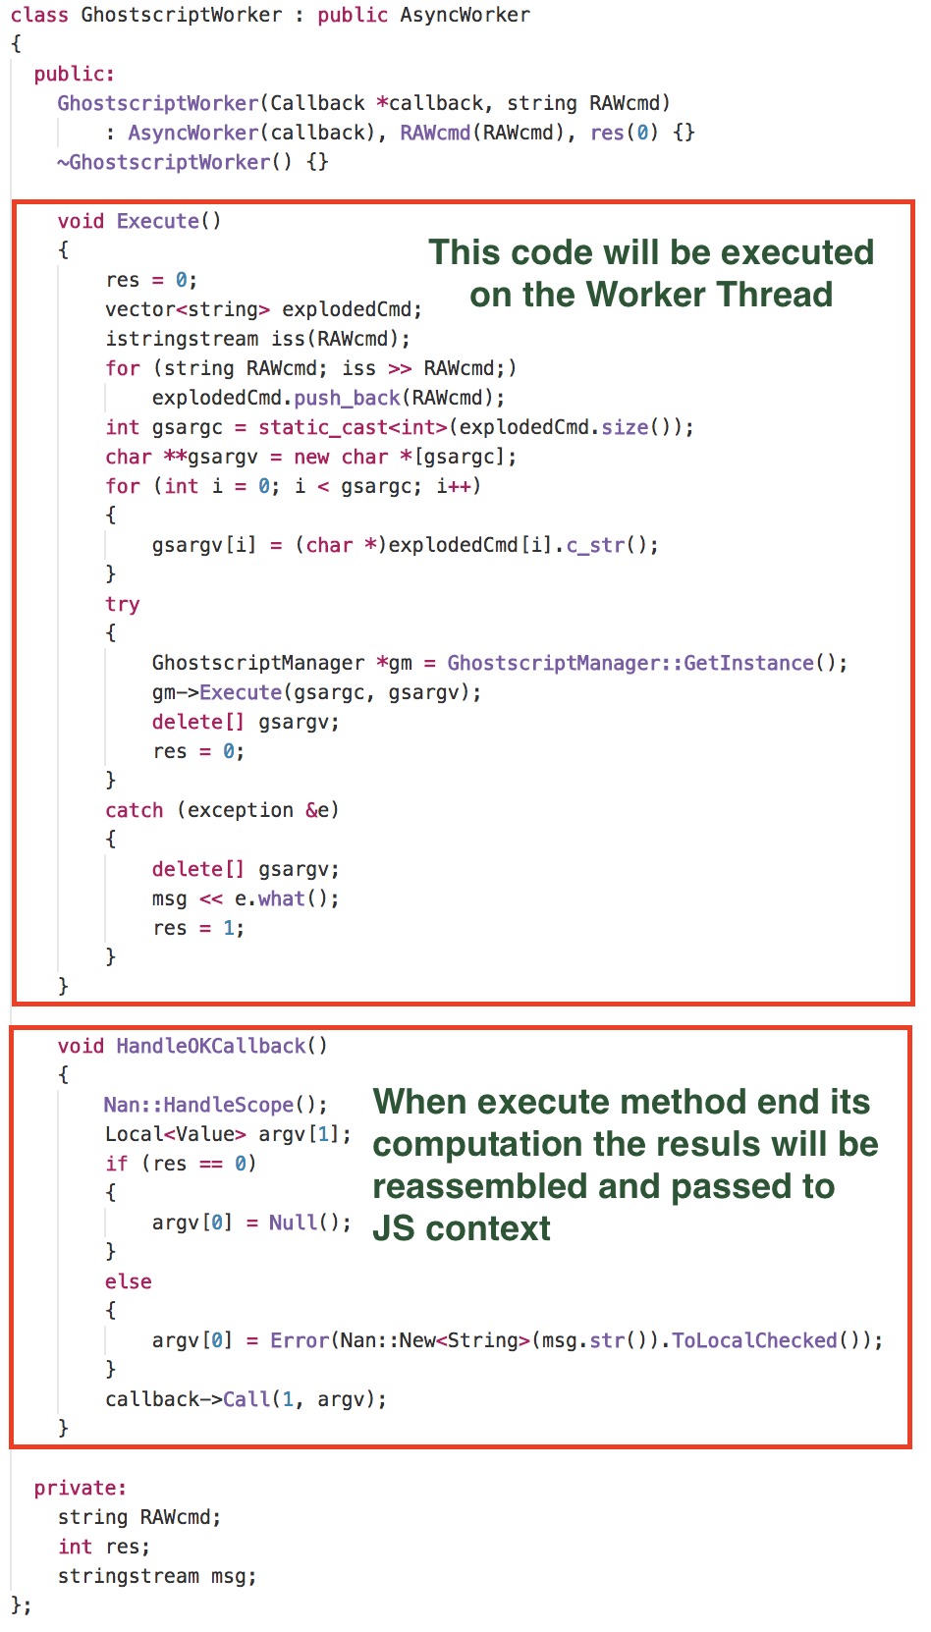
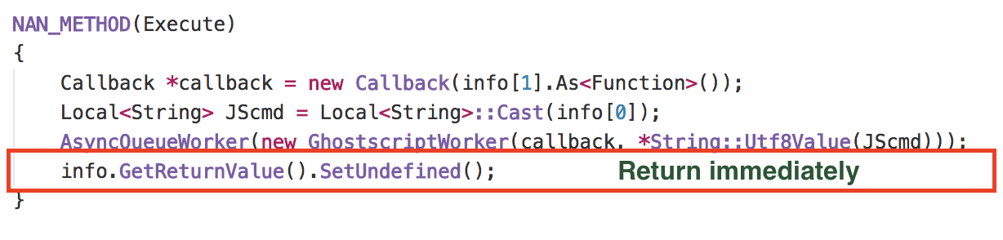

Slide 12
MODULARITY
CommonJS Module
ES6 Module from v8.5.0
“Se non hai provato Node.js non sai cos’è la modularità e il riuso”
Matteo Collina

Slide 13
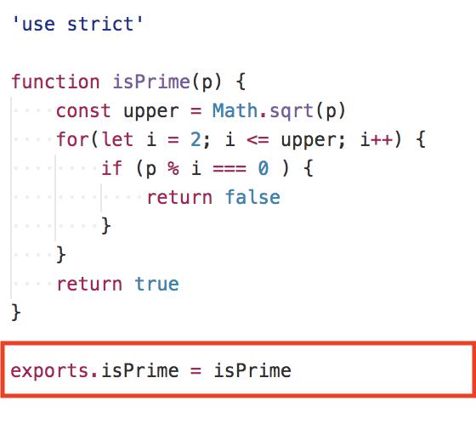
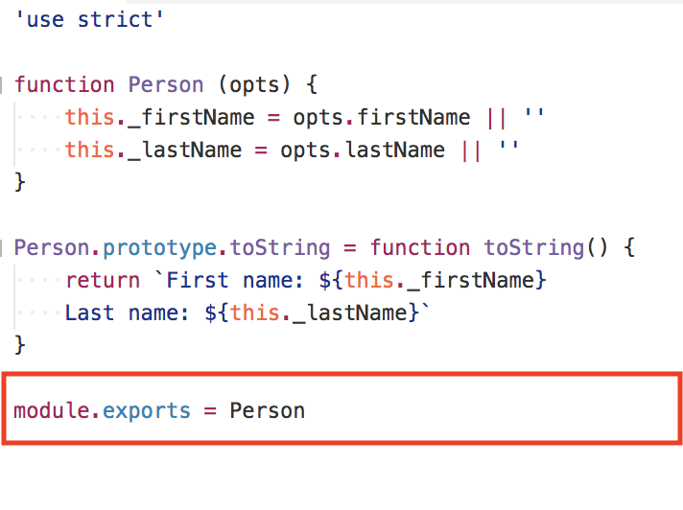
MODULARITY

Slide 14
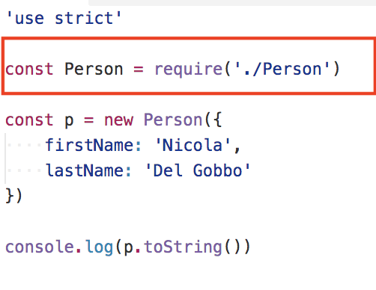
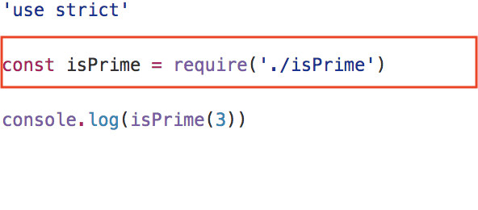
MODULARITY

Slide 15
EVENT EMITTER
EventEmitter is a very important class in Node.js. It provides a channel for events to be dispatched and listeners notified. Many objects you will encounter in Node.js inherit from EventEmitter

Slide 16
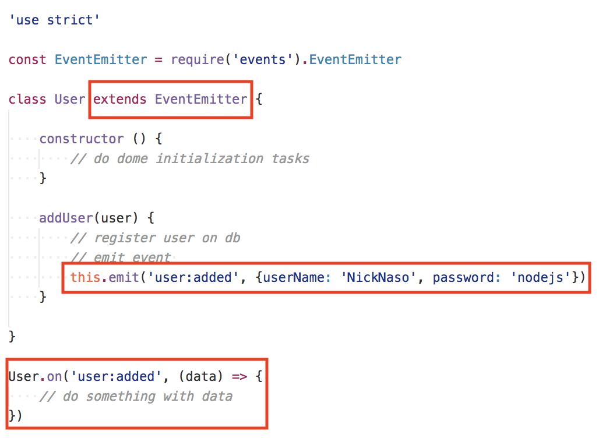
EVENT EMITTER

Slide 17

WEB APPLICATION
Response
NODEJS HTTP SERVER
REQUEST
HANDLER
CLIENT
Request
Browser
Mobile App
http://your-web-application

Slide 18
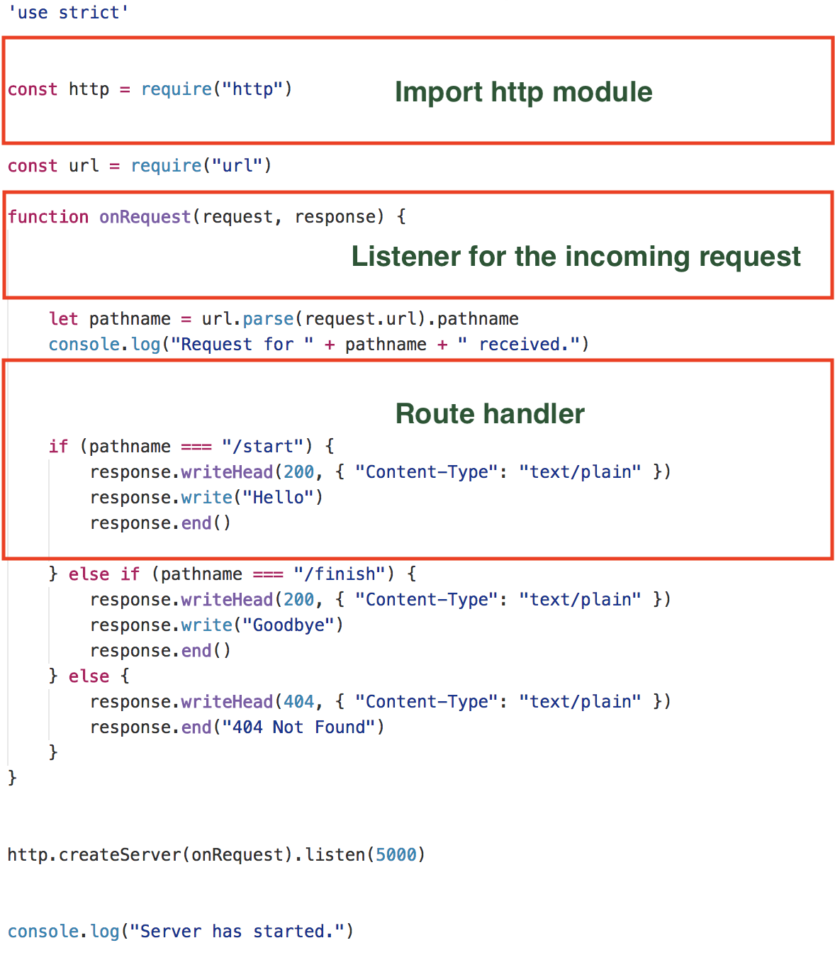
~40k req/s
Hard to maintain

Slide 19
FRAMEWORKS

Slide 20
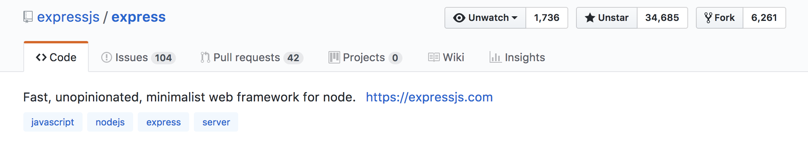

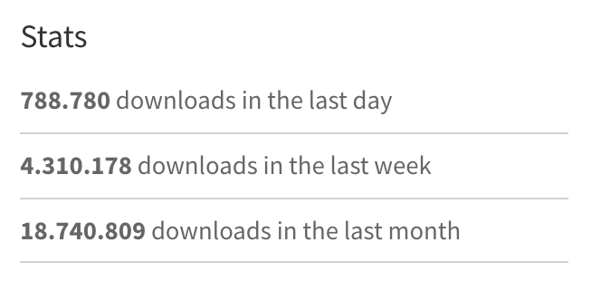
EXPRESS

Slide 21
EXPRESS
Minimalist
Unopinionated
Fast (about 21k req/sec)
Simple (do one thing well philosophy from Unix world)
Wrapper of http core module

Slide 22
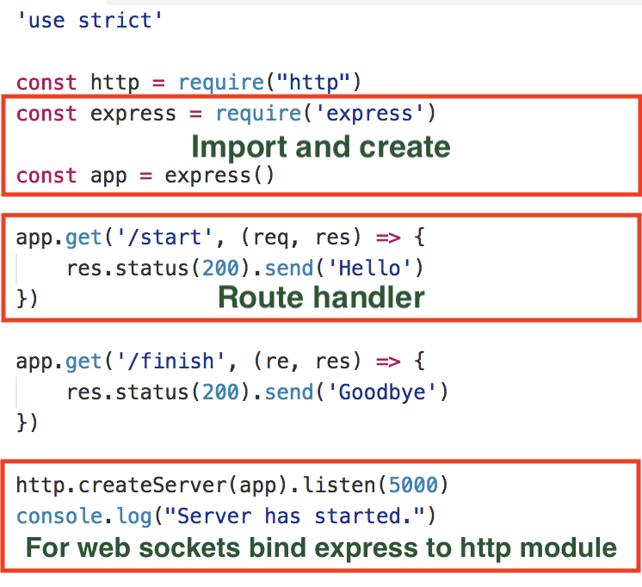

Slide 23
EXPRESS MILESTONES
Middleware
Error handler
Router
Views / template engine

Slide 24
MIDDLEWARES
It’s always a question to manipulate the Request and Response object

Slide 25
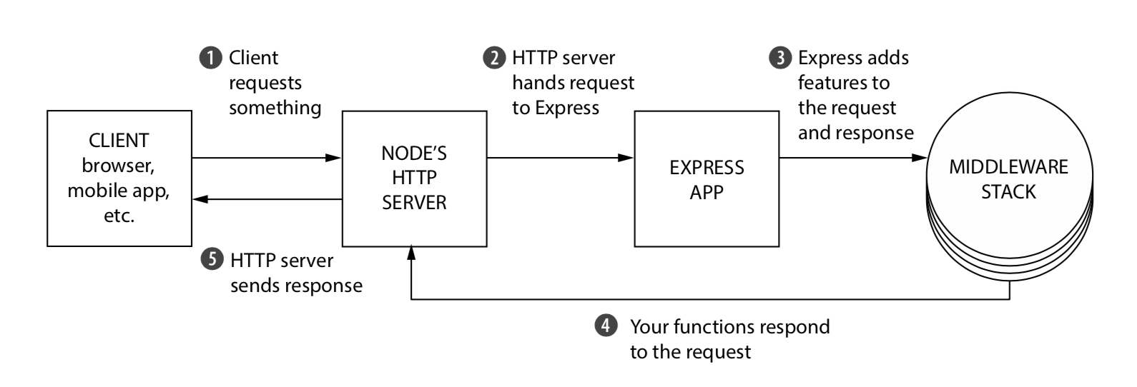
MIDDLEWARES

Slide 26
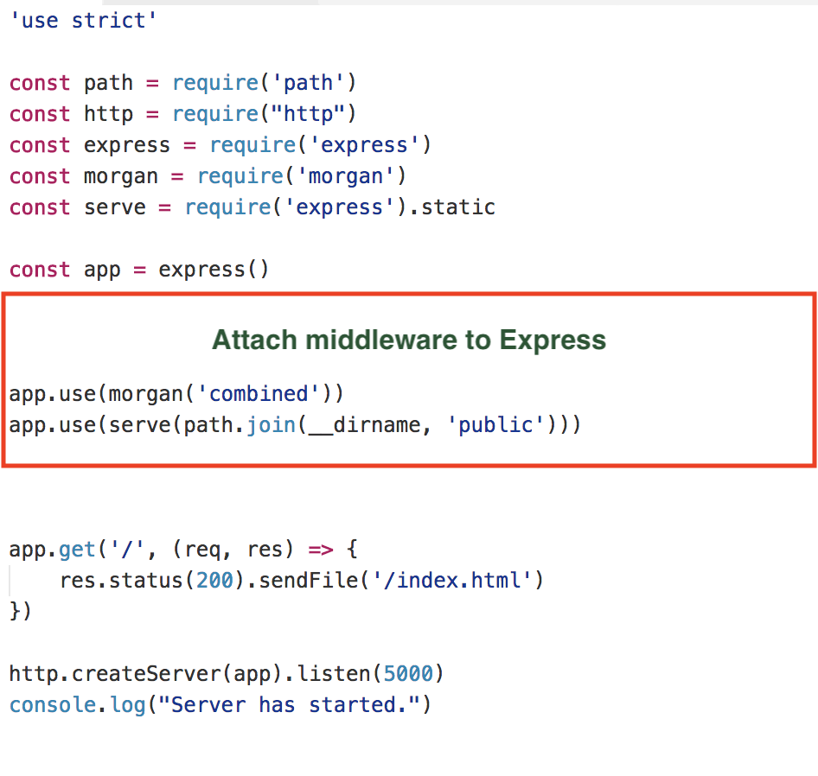
MIDDLEWARES

Slide 27
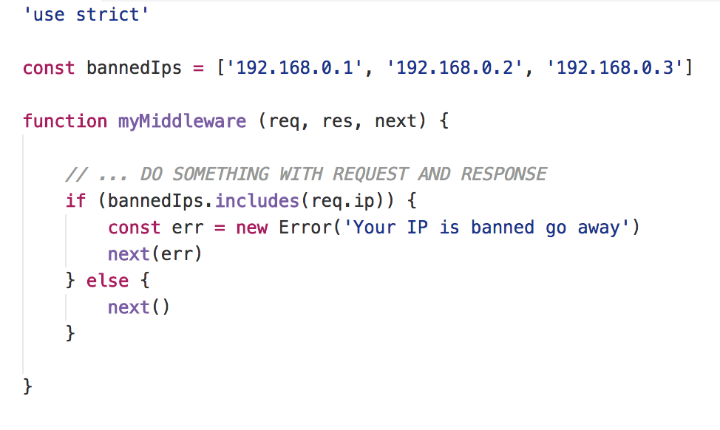
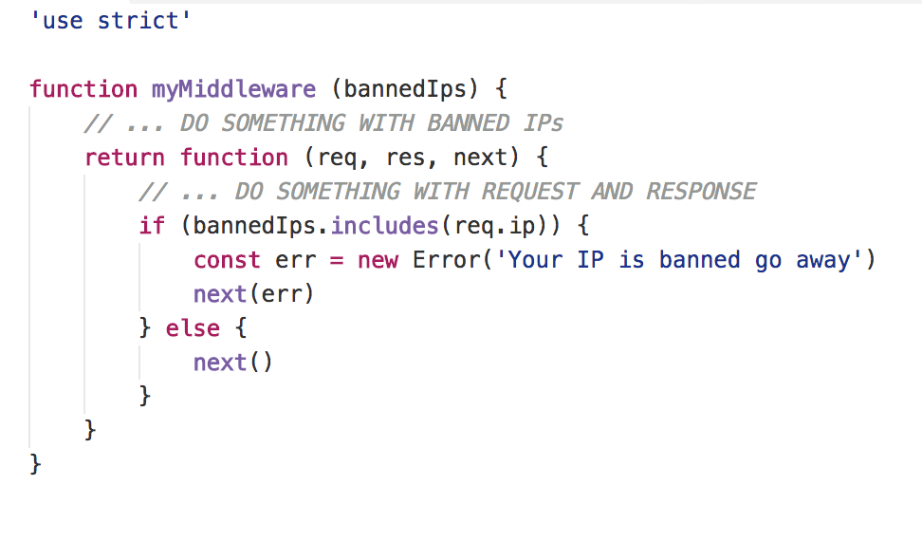
MIDDLEWARES

Slide 28
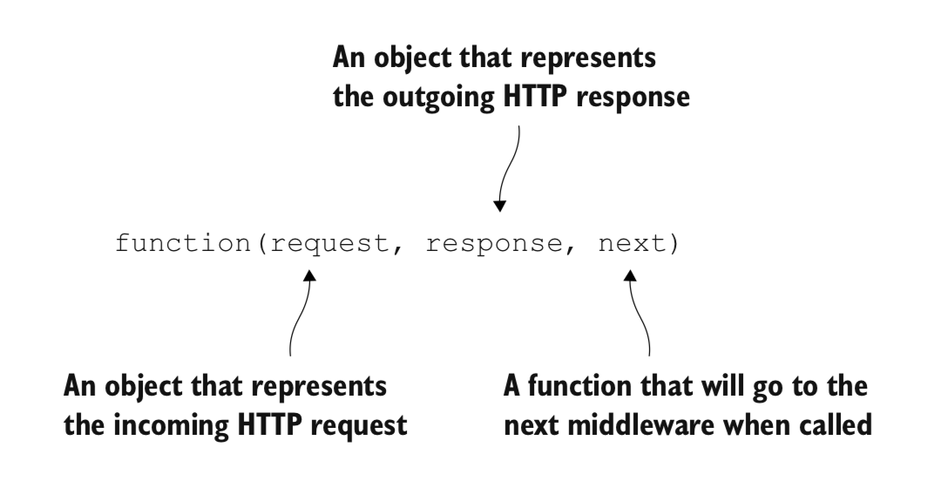
MIDDLEWARES
http://expressjs.com/en/resources/middleware.html

Slide 29
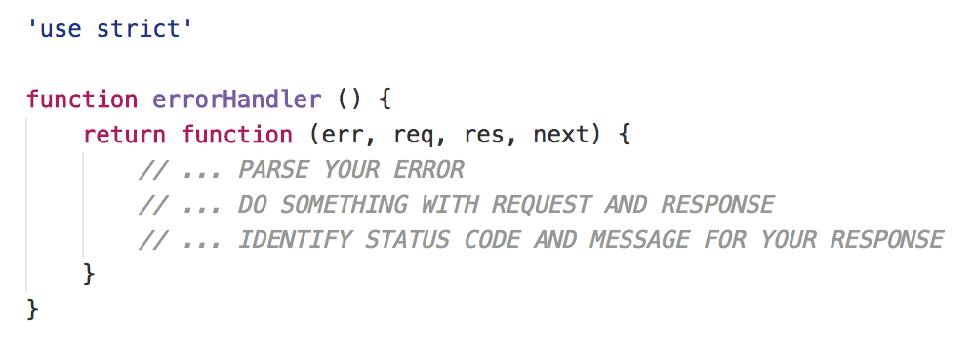
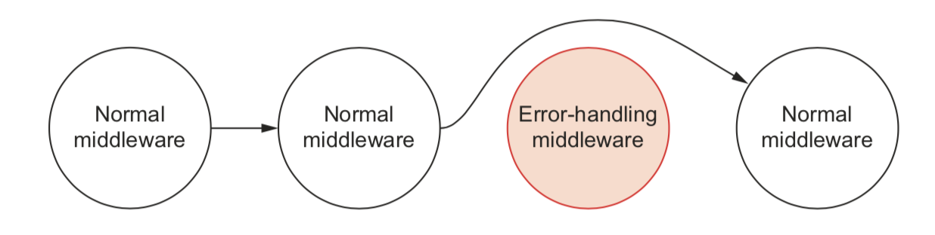
ERROR HANDLER

Slide 30
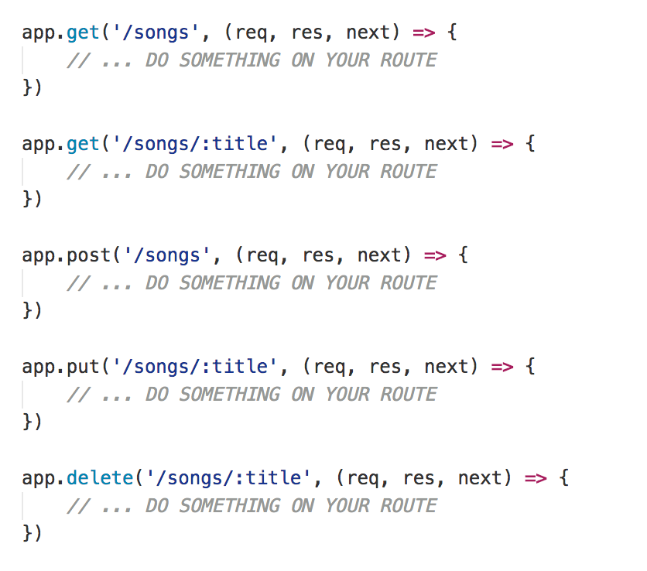
ROUTING
Routing refers to determining how an application responds to a client request to a particular endpoint, which is a URI (or path) and a specific HTTP request method

Slide 31
VALIDATE YOUR INPUT
Ajv
The fastest JSON Schema validator for Node.js and browser
npm install ajv
https://github.com/epoberezkin/ajv

Slide 32
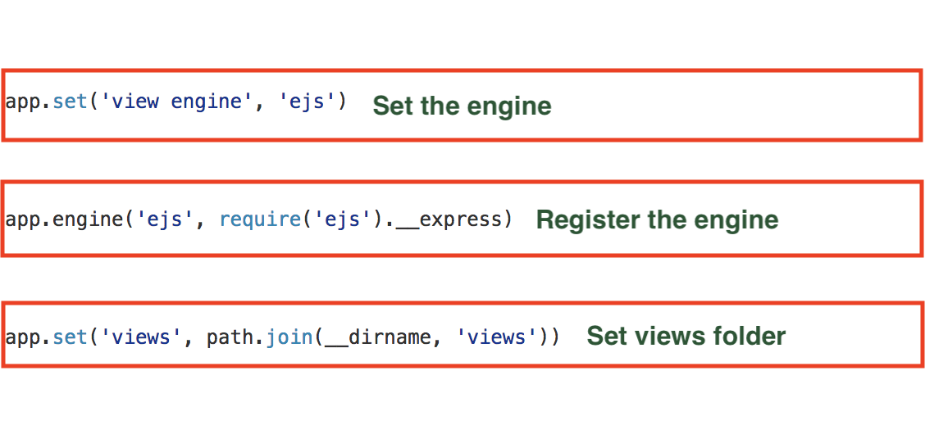
VIEWS / TEMPLATE ENGINE
Pug - Mustache - Dust - Nunjuks - EJS

Slide 33
SECURITY
Helmet helps you secure your Express apps by setting various HTTP headers
npm install helmet
https://github.com/helmetjs/helmet

Slide 34
LOGGER
Log everything that happens in your application
Pay attention there is a cost for logging
npm install winston
https://github.com/winstonjs/winston

Slide 35
DOMANDE?

Slide 36
GRAZIE
https://github.com/NickNaso/nodejs-tsw-2017

