Slide 1
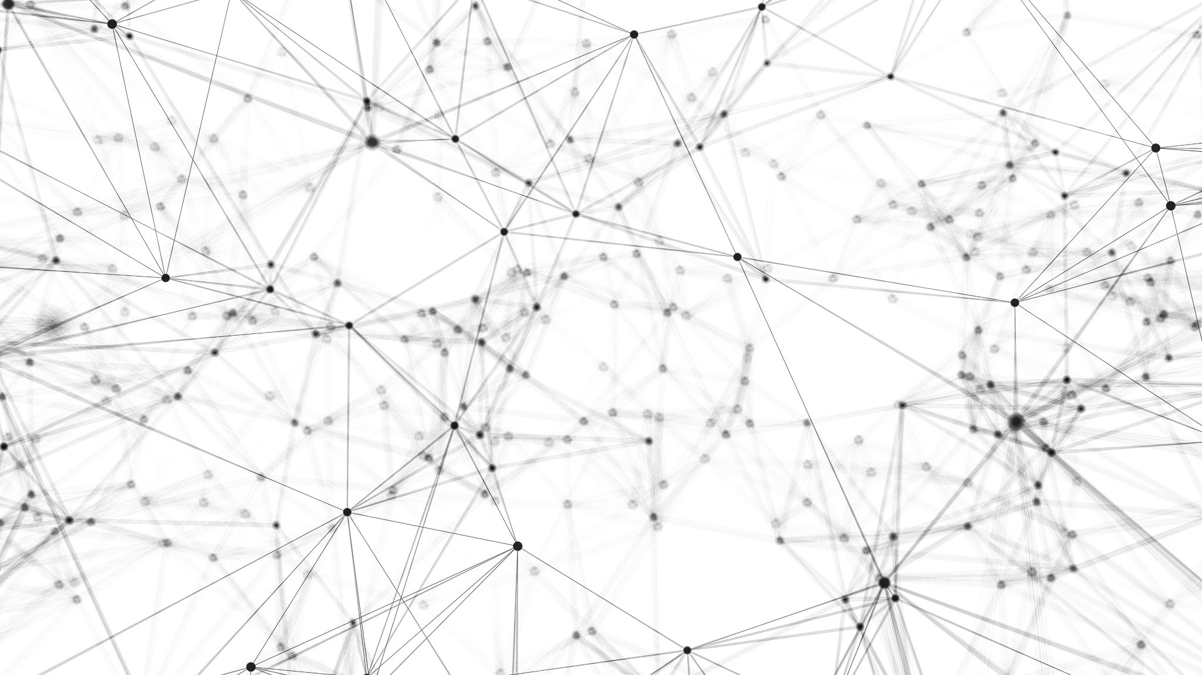
AI-based smart assistant using Natural Language Processing and deep learning
Supervisor:
Col Siddharth Malik, SM
Group Members
Md. Rezwan -A- Rownok (201714035)
Samiha Raisa Zaman (201714052)
Shahriar Rahman Khan (201714055)
Sharmila Rahman Prithula (201714057)

Slide 2
Broad area of research
A chatbot is a computer program which is used to interact with humans and fulfill their needs. Chatbot gives the response for the user query and are capable of executing some of the tasks.
In the world of machine learning and AI, there are many different kinds of chatbots. Some chatbots are virtual assistants; others are just there to talk to; some are customer support agents.
The main aim of creating AI chatbots is to help customers make better-informed decisions. Intelligent planning with the help of heuristics and ANN (Artificial Neural Network) aids an AI chatbot that learns to progress from one user request to another to come up with an intelligent response before completing the task.

Slide 3
Introduction
Chat bots and virtual assistants are the future of marketing and customer support.
A growing number of businesses are using chat bots in lots of exciting ways - in fact, according to Facebook, there are now over 300,000 active bots on Messenger.
There are some tech companies that don’t have any call centers. For example: Uber, Google, Facebook, Twitter.
But in Bangladesh, well recognized companies like Daraz, Evally , Robi Axiata, Pure-It etc. provide customer care using human agent and a large chunk of company’s revenue goes to this customer-care sector.
Also in most of the university websites, there are no proper chatbot that will provide all the necessary information for the queries asked the students and others visitors.
Current customer-care systems do not provide 24/7 services.

Slide 4
Literature Review
A chatbot can be developed in many ways and the bot developed using Deep Learning requires Neural Networks in order to learn the input sequence. Among them ANN, RNN, LSTM etc. are mostly used.
An artificial neural network (ANN): It is the piece of a computing system designed to simulate the way the human brain analyzes and processes information.
Recurrent Neural Network (RNN): It is an extension of general feed forward network, in which the network not only consider the current input, but also takes the previous output to generate a response. Moreover RNN's have memory which can be used to remember the input sequence.
Long Short-Term Memory (LSTM): The main drawback with RNN is, they cannot remember the input for a long sequence. This problem can be solved by LSTM's which is an extension of RNN and can remember long sequences of data.

Slide 5
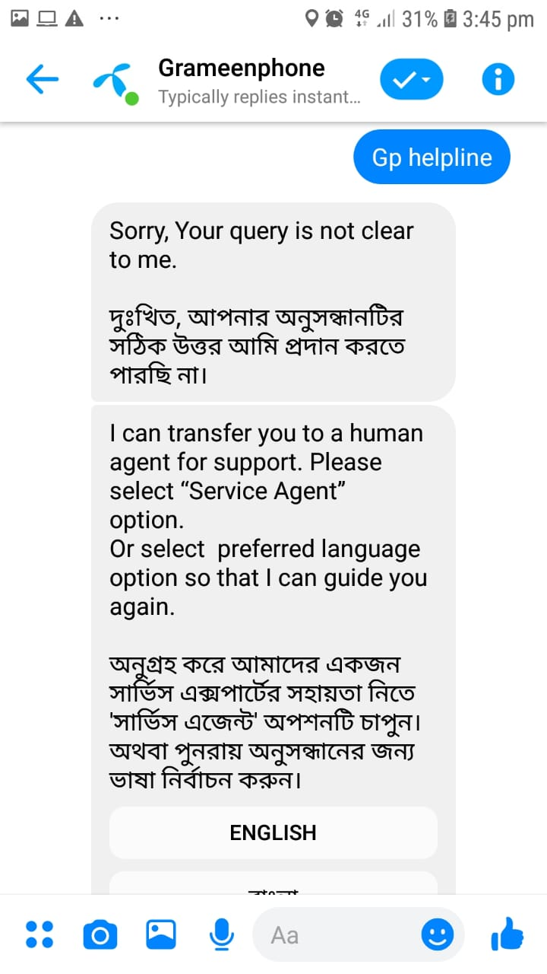
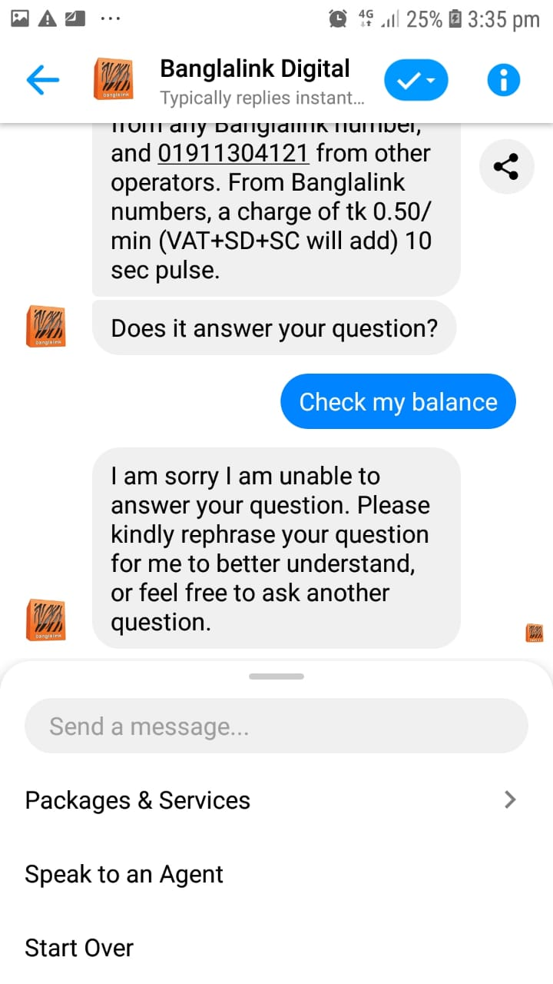
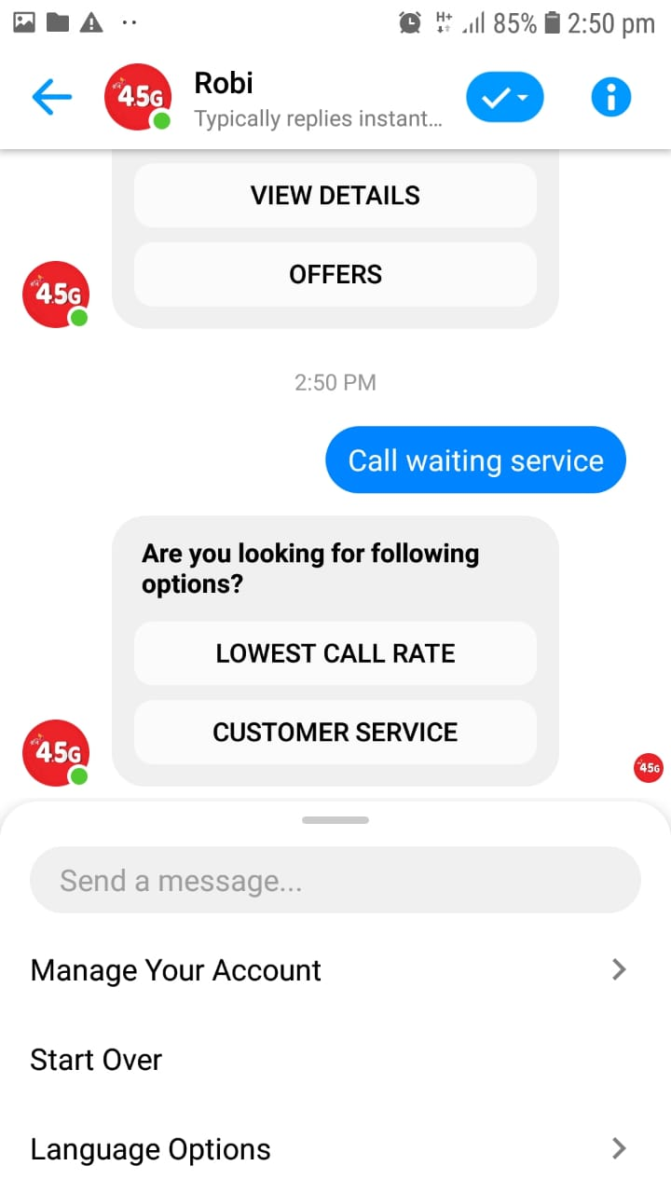
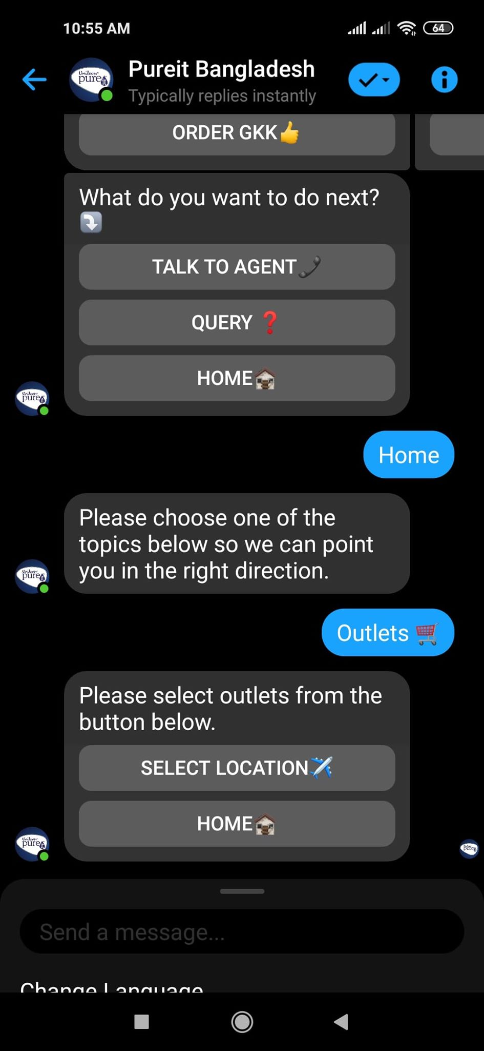
Literature Review
Chatbot of some famous companies of Bangladesh:
GP
Banglalink
Robi
Pure IT

Slide 6
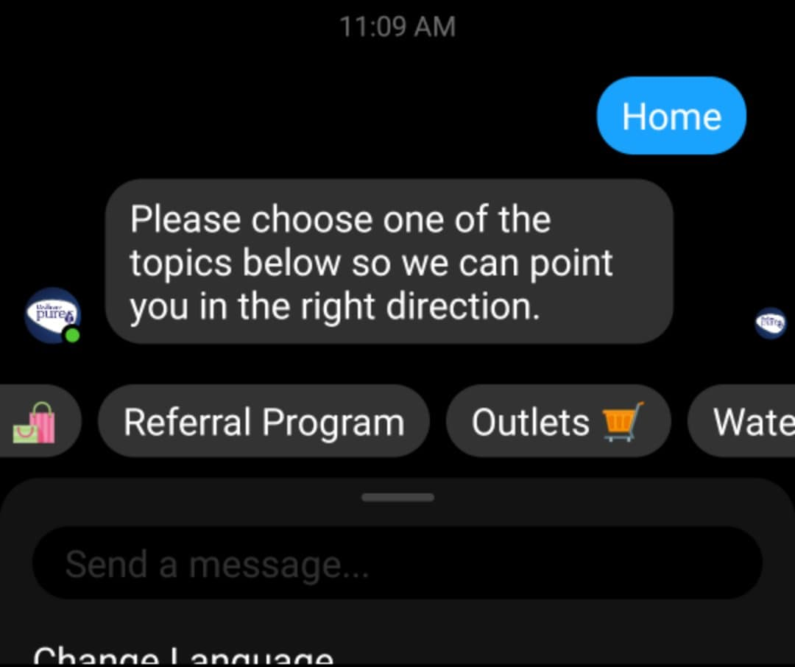
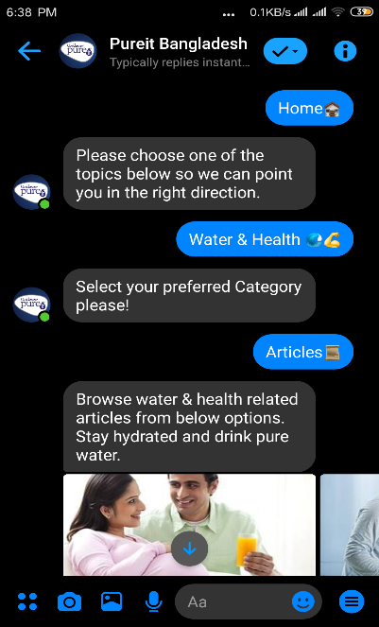
Literature Review
Chatbot of Pureit:

Slide 7
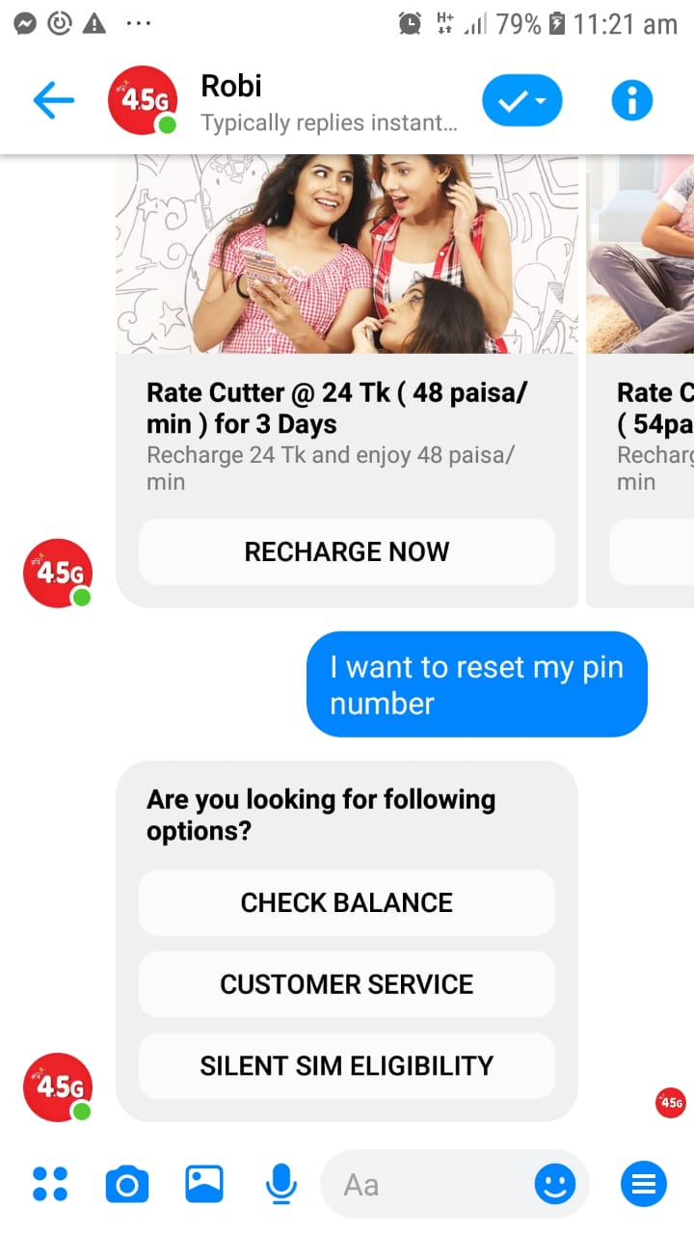
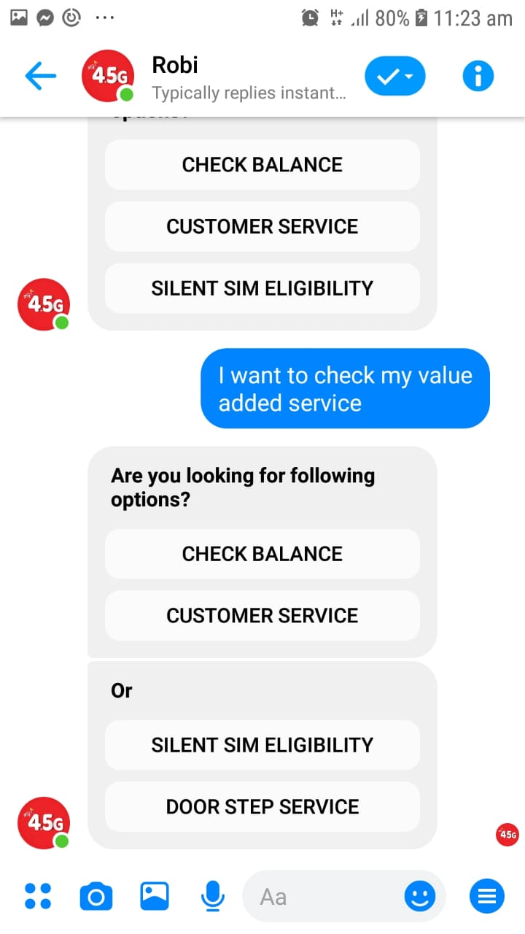
Literature Review
Chatbot of Robi:

Slide 8
Literature Review
Findings:
The chatbots are totally scripted.
There is no freedom to ask any type of question.
These chatbots cannot understand Natural language.
That is why most of the big companies depends on the human based call-center.
These chatbots doesn't have both audio and textual based query system.

Slide 9
Objective of the Thesis/Project
After the findings of the existing chatbots we have decided to build a AI-based smart chatbot for the MIST website which will have the following objectives.
An AI based digital solution of the old analog customer care systems.
Saving time and cost for conducting customer care services.
Providing services by 24/7
Both textual and audio based queries.
Works in both Bangla and English Language simultaneously.
Can understand the queries asked in natural language.
Easily customizable and integration for any organization.

Slide 10
Methodology
An AI-based chatbot is developed for MIST-website that will be used to answer frequently asked questions. This project has been done in 5 major steps.
Dataset creation and pre-processing the dataset for feeding it into the neural network.
Creating the Neural Network Model.
Predicting responses in real-time.
Both textual and Audio input in both Bangla and English language and give response respectively.
Sending unsuccessful queries to Realtime database for further development.

Slide 11
Dataset
The dataset is created in a JSON file, and a little portion of the dataset is shown below:
{
“Tag“ : "Department",
“Patterns": ["How many departments does MIST have?", "what is the total number of department in MIST?"],
“Responses": ["MIST has a total of 13 departments."]
}
{
“Tag": "Department Bangla",
“Patterns": ["এমআইএসটির কতটি বিভাগ রয়েছে?", "এমআইএসটিতে মোট বিভাগের সংখ্যা কত?"],
“Responses": ["এমআইএসটি-তে মোট ১৩ টি বিভাগ রয়েছে।"]
}

Slide 12
Data Preprocessing
For each pattern, word tokenizer is used to split the words from the sentences.
Then word-stemmer is used to reduce the vocabulary by replacing the word with its root form.
Neural networks model requires numerical input. Therefore, ‘Bag of Words’ is used to represent the sentences with numbers.
Each position in the list represents a word from the vocabulary-list. If the position in the list is a 1, then that means the word exists in our sentence; if it is a 0, then the word is not present.
The output is also formatted to make sense to the neural network. Each position in the output-list represents one distinct label/tag; a 1 in any of those positions shows which label/tag is represented.

Slide 13
Data Preprocessing
For example:
[How many departments does MIST have?]
Step 1: Tokenize
['How', 'many', 'departments', 'does', 'MIST', 'have', '?’]
Step-2: Root-form
['how', 'many', 'depart', 'doe', 'mist', 'hav']
Step-3: Conversion into numerical form
array([0, 0, 0, 0, 0, 0, 0, 0, 1, 0, 0, 0, 0, 0, 0, 0, 0, 0, 0, 0, 0, 0, 0, 0, 0, 0, 0, 1, 0, 1, 0, 0, 0, 0, 0, 0, 0, 0, 0, 0, 1, 0, 0, 0, 0, 0, 0, 0, 0, 0, 0, 0, 0, 0, 0, 0, 0, 0, 0, 1, 0, 0, 1……..]
The size of each question of the pattern section is the size of word-vocabulary list.

Slide 14
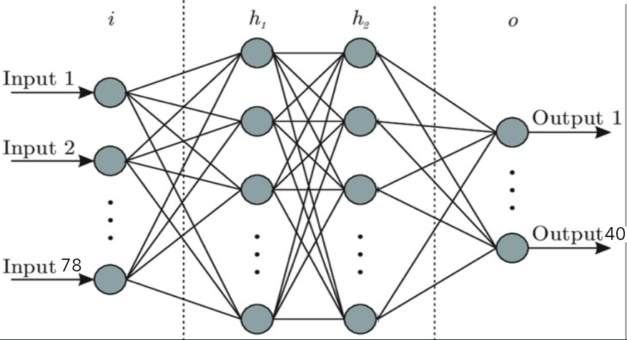
Neural Network Model
The architecture and the model summary are shown below:

Slide 15
Training & Saving the Model
The size of the input layer is 78 because there are 78 different question-patterns in the dataset. Two ‘dense’ hidden layers are used in the model with 8 neurons each. The output layer has 40 neurons with ‘SoftMax’ activation function.
SoftMax activation function will give probability
For fitting the data in the model, 1000 epochs are used. In each epoch, the batch-size is 8.
After training, the model is saved. Therefore, there is no need to fit the model in the next run. The datasets and the model simply can be loaded. It will save time.

Slide 16
User Input
Steps | Process
Input | Audio
 | Textual
Language | Bangla
 | English
Data Preprocessing | Tokenization
 | Stemming
 | Numerical Conversion
Prediction | Get a prediction from the model
 | Find the most probable class
 | Pick a response from that class

Slide 17
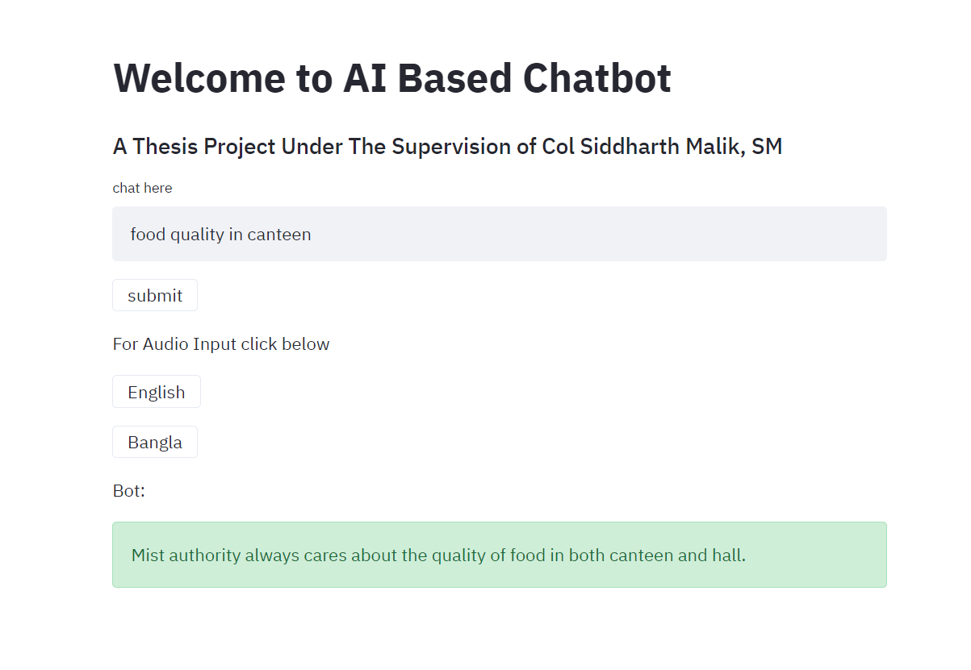
Graphical User Interface

Slide 18
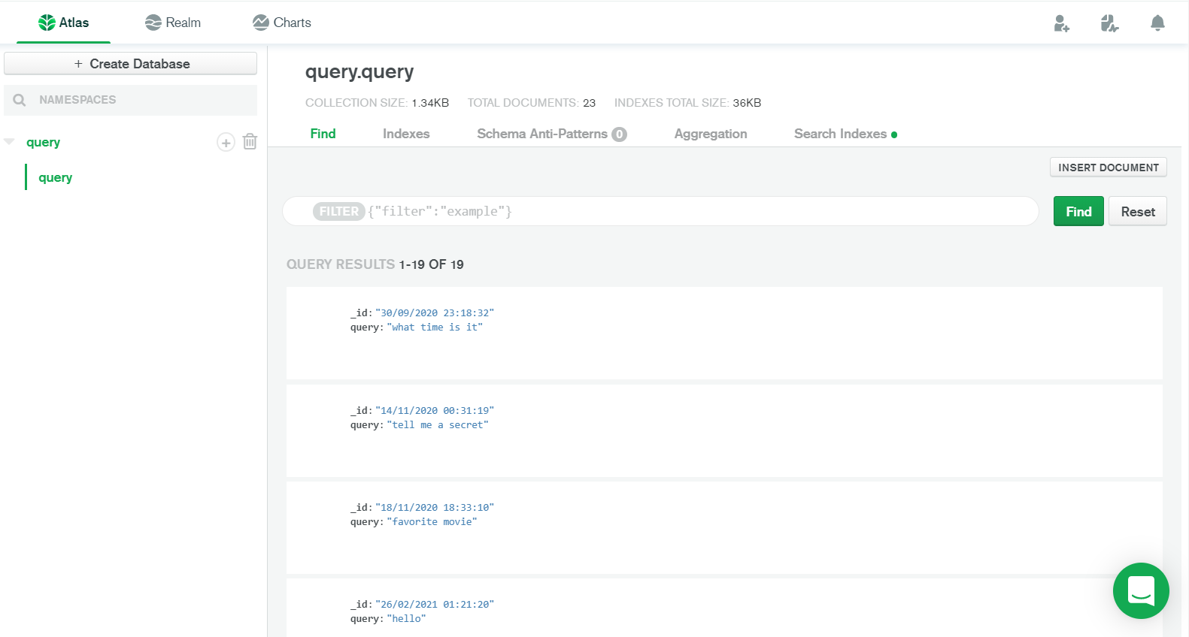
Backend Database

Slide 19
Results
The accuracy of the model is approximately 90%
The threshold of matching the input sentences with the patterns is set to minimum 50%.
If any query matches less than 50% with the patterns, Then that query is sent to the backend database.
If new data comes, the model needs to be trained again.

Slide 20
Conclusion & Discussion
This system can be implemented for MIST website provided that the dataset is extended.
Unsuccessful inputs are stored in database for future enrichment of dataset.
Bengali words are not taken to its appropriate root form.

Slide 21
Thank you

