Slide 1
Education Investigation: LA and NJ
Nick Ouellet and Garrett Gilliom
CMPS 3160: Intro to Data Science

Slide 2
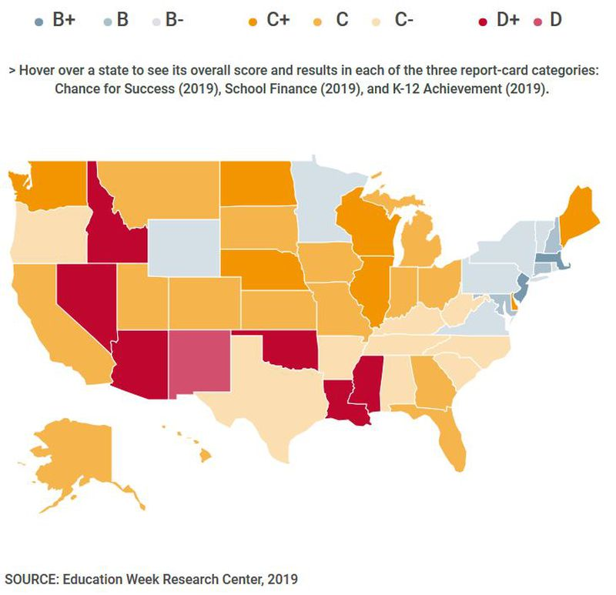
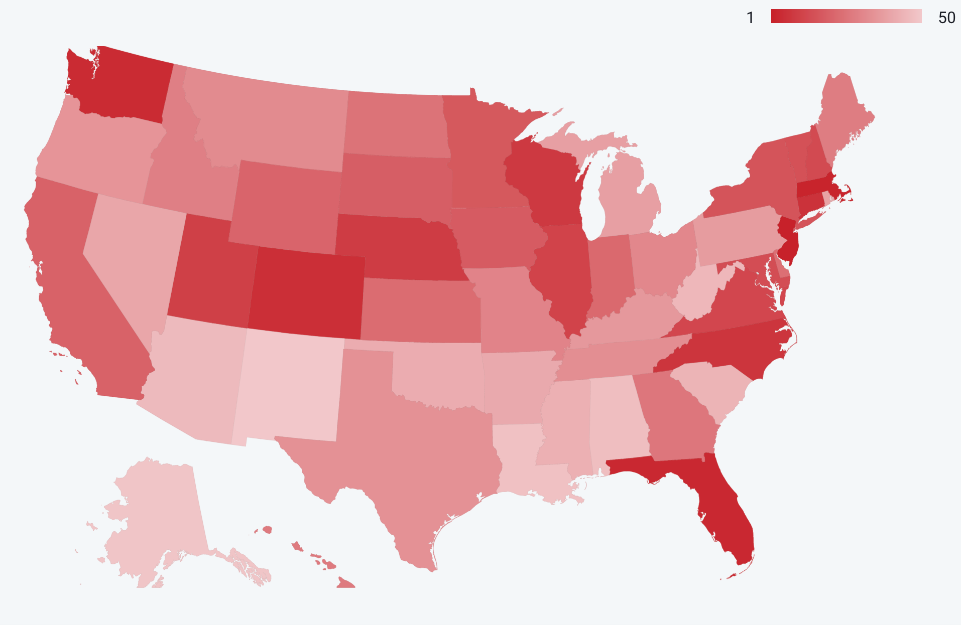
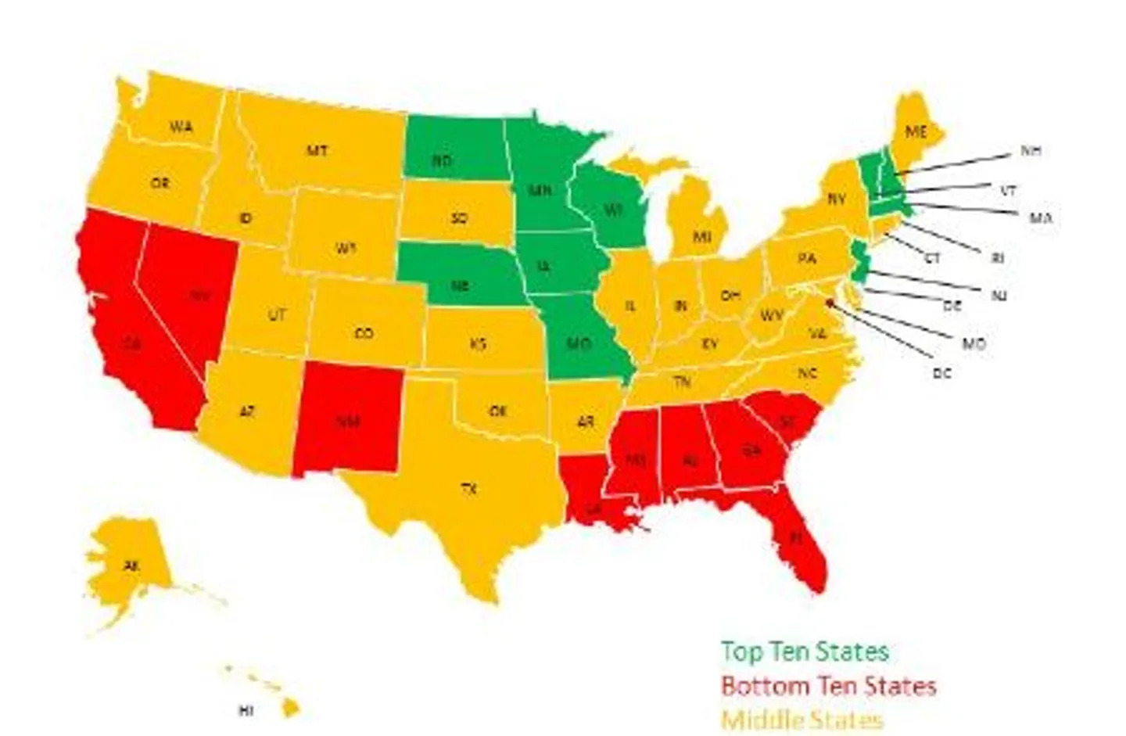
Why Education and School Districts? Why LA and NJ?
K-12 Education
Questions to Consider:
Louisiana Public School Districts
Bottom Few
Are relationships present between school district performance and quantifiable variables?
What major differences exist between these two states?
Where might these discrepancies come from?
New Jersey Public School Districts
Top Few
Notes:
https://www.courant.com/news/connecticut/hc-news-connecticut-schools-ranked-3-nation-20190927-kwdnsdrw7fgkzijqpzbpdrxrqq-story.html
https://www.good.is/articles/educational-performance-where-does-your-state-rank
https://www.usnews.com/news/best-states

Slide 3



Data Collection, Processing, and ETL
Louisiana
New Jersey
Finances, enrollment data
Finances, enrollment data, AND school performance
Finances
Enrollment
Performance
Monetary Difference
Revenue
Expenditures
Revenue/Pupil
Student population
Student:Teacher
ACT Score (avg)
4-year graduation rate
Academic performance data
Notes:
Talk ab data origins/sources, ease of collection
Mention availability/organization of data in NJ compared to LA
https://nces.ed.gov/pubs2014/2014098.pdf
https://www.louisianabelieves.com/
https://www.state.nj.us/education/bilingual/policy/ESSAGuidance.pdf

Slide 4
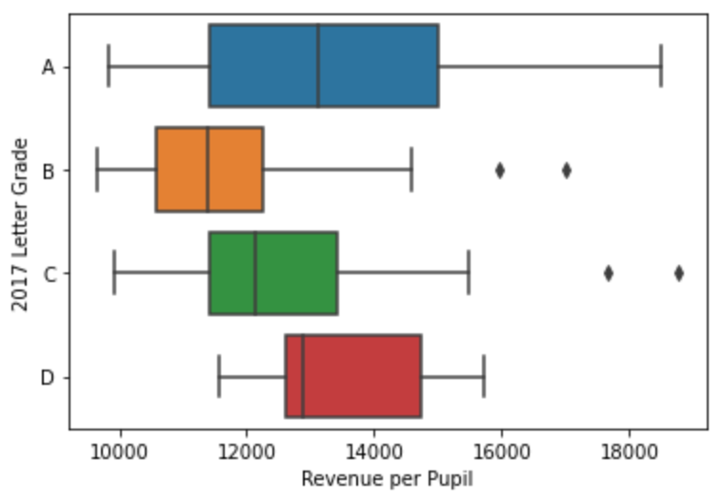
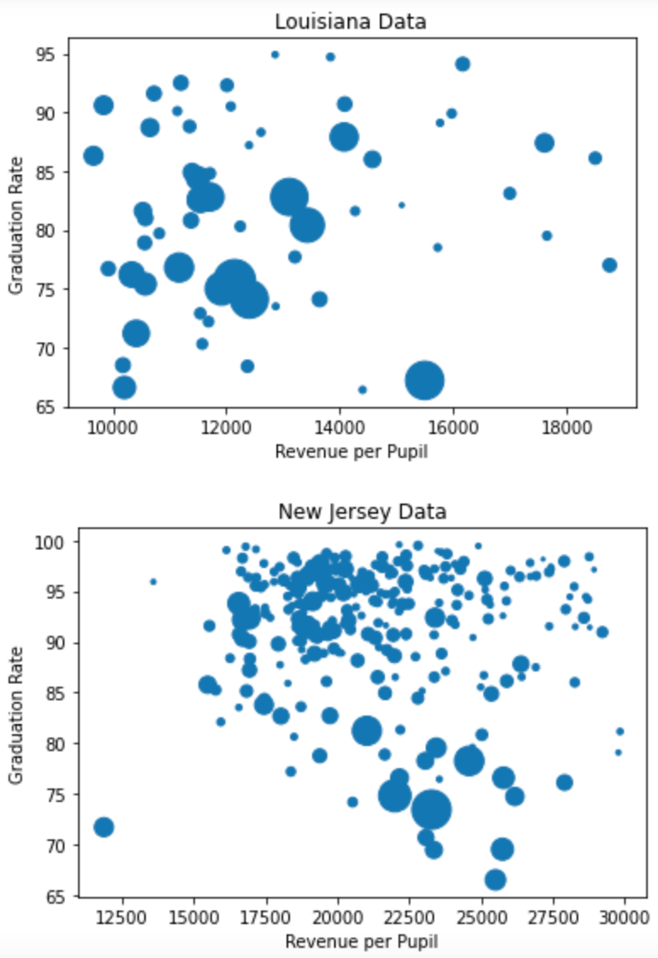
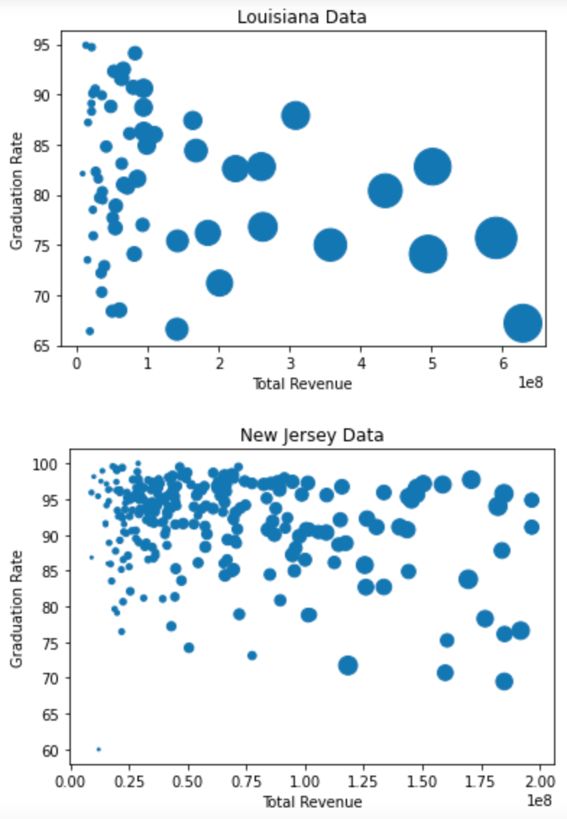
EDA Highlights – Full of Surprises
(Dot size == student population size)
Louisiana School District Performance
New Jersey total revenue: 28829669158.0
New Jersey school district count: 582
New Jersey average total revenue: $88,434,567.97
Louisiana total revenue: 7387585000.0
Louisiana school district count: 62
Louisiana average total revenue: $119,154,596.77

Slide 5
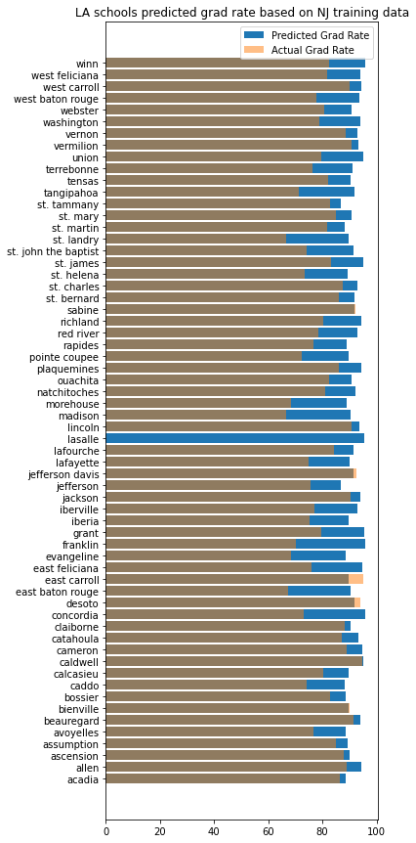
Hypothesis and Evidence
Revenue
Teacher to Student Ratio
Enrollment Number
Appropriations
Etc …
Graduation rates
ACT Scores
???

Slide 6
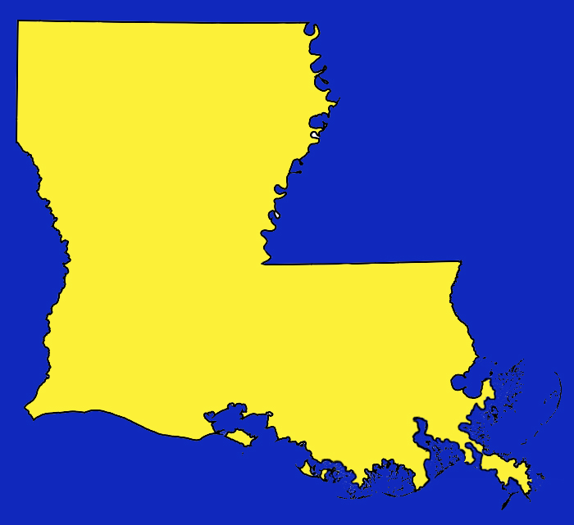




Takeaways
Louisiana Public School Districts
New Jersey Public School Districts
Total Average Revenue
$119,154,596
$88,434,567
Average Graduation Rate
81%
91%
Notes:
Consider: % of LA who’s white is ~63%; NJ is ~ 72%
We estimate that there are likely other factors that we have not measured thus far that are contributing to the discrepancies between the states’ school districts, perhaps cultural or political
Maybe mention what more could be done on all fronts? Look into more states, consider more variables, try to account for inherit demographic/cultural differences across the states

