Slide 1
Phonetic to Morphemic Text Conversion of a Very Low Resource Language using the ByT5-small Transformer Model
Nicholas Overacker¹ Michal Ptaszynski¹ Karol Nowakowski² Kenyu Yamamaru³
RIVF’24 @ Duy Tan University, Da Nang, Viet Nam
¹ Kitami Institute of Technology
² Tohoku University of Community Service and Science
³ The Foundation for Ainu Culture

Slide 2
The Ainu Language
Ainu (aynu itak) is the is the indigenous language family of northern Japan
Unrelated to any other living language, including Japanese
Today, Ainu is a critically endangered language
The Japanese Empire (19-20th century) enforced strict assimilation laws
Few or no remaining native speakers
Fluent second-language speakers are rare
The few existing Ainu texts are split between different scripts
Writings exist in the Latin alphabet, Japanese katakana, and Cyrillic
Very few resources in any script for NLP applications

Slide 3
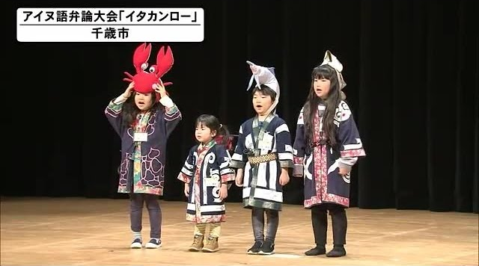
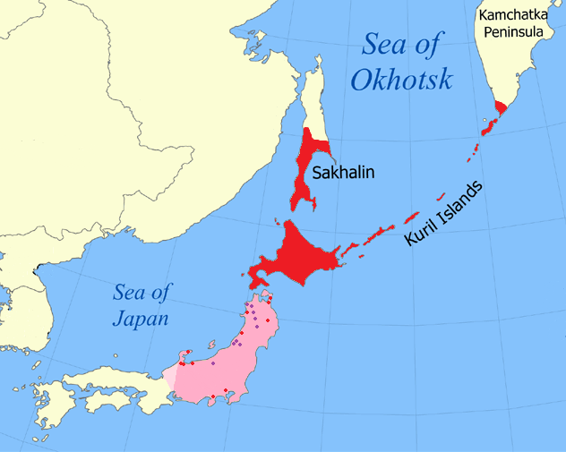
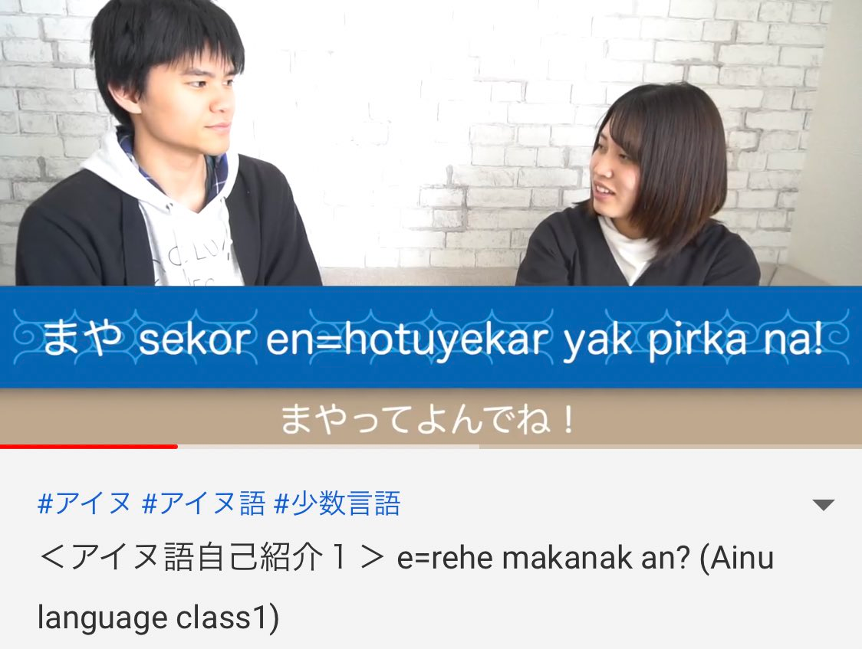
The Motivation
“Itak=an ro” Ainu Speech Contest
Chitose City, Hokkaido, Japan
A language lesson by Ainu influencer Sekine Maya.
https://www.youtube.com/watch?v=X1l4duE9s14
† Ask about this footnote during Q&A!

Slide 4
The Problem
We want to expand the Latin script corpus by converting katakana texts
This conversion is non-trivial
Procedural, rules-based conversion from Latin script to katakana is easy but lossy
Rules-based conversion from katakana to Latin script is much more difficult
Katakana script | Latin script | English definition
ヤイライケ | yayirayke | to thank
ヤイライケ | yayrayke | to commit suicide
カ | k=a | I sit
カ | ka | string

Slide 5
Previous Work
Cjyet Yo explored procedural Ainu transliteration in May¹
Results affirm that transliteration from katakana is particularly difficult
The Hokkaido University linguistics club Huling released a tool in November²
Seems to have similar performance and limitations to Yo’s tool
No other tools are known to exist
Evaluation of katakana-latin transliteration using Yo’s ainconv package
characTER | CER | chrF
0.0814 | 0.0822 | 76.60
¹ C. Yo, “Pushing the boundaries of rule-based processing for ainu texts,” Tech. Rep. 9, Osaka University Graduate School of Humanities, May 2024. ² https://hulinguistics.github.io/conv/ain

Slide 6
Our Approach
Base model: ByT5-small (Google)
Every byte is a token
No out-of-vocabulary words - useful for unseen language tasks
Selected because Ainu has a very high morpheme density
Often 2 phonemes and/or morphemes per katakana character, 1 per Latin letter.
One token per byte puts token density on par with morpheme/phoneme density
Training data: parallel Latin/katakana corpus of Saru Ainu dialect
Originally compiled by Karol Nowakowski from sources available on the web
Noisy; one side often contains annotations and notes that aren’t on the other
Not strictly monolingual; includes significant quantities of Japanese text
61725 paired strings after data preparation
Mean length: 19 katakana characters, 28 Latin characters

Slide 7
Data Preparation (1/2)
Normalize Latinized punctuation and remove accent marks
“orano cis =an a an a kor、” → “orano cis =an a an a kor,”
“sorekus_ a= wenpakasnu pa kus ne kus.” → “sorekus a= wenpakasnu pa kus ne kus.”
“hácir” → “hacir”
Remove all entries that do not have both Latin and katakana transcriptions
Remove identical entries
Avoid biasing the model towards specific inputs, and keep validation/test data out of training
Remove most near-identical entries
Same katakana input, different Latin output
Removed only obviously wrong outputs (extraneous characters such as “@” in the output)
22 near-identical pairs remained after this step

Slide 8
Data Preparation (2/2)
Replace all instances of the consonant cluster ‘np’ with ‘mp’
“sorekus a= wenpakasnu pa kus ne kus.” → “sorekus a= wempakasnu pa kus ne kus.”
This is to match the orthography of Dr. Hiroshi Nakagawa’s New Express Ainu-go textbook
Remove spacing between personal affix markers and affixed words
“sorekus a= wenpakasnu pa kus ne kus.” → “sorekus a=wempakasnu pa kus ne kus.”
Randomly split data into training (80%), validation (10%), and test sets (10%)
Shuffle the training and validation data with a fixed seed value

Slide 9
Model, Tokenizer, and Trainer
Model: ByT5-small
a “pre-trained byte-level Transformer [model] based on the T5 architecture”
Head: T5ForConditionalGeneration¹
Tokenizer: AutoTokenizer¹
No tokenizer is actually required for ByT5 models, but they help pad batched inputs
Fine-tuned using Seq2SeqTrainer¹
Arguments set with Seq2SeqTrainingArguments¹
¹ From the HuggingFace Transformers library.

Slide 10
Training Parameters
learning_rate | 4 × 10⁻⁶ to 56 × 10⁻⁶
weight_decay | 0.01 for initial sweep
lr_scheduler_type | ‘linear’ for initial sweep
evaluator_strategy | ‘epoch’
save_strategy | ‘epoch’
per_device_train_batch_size | 4
per_device_eval_batch_size | 4
save_total_limit | 1
load_best_model_at_end | true
num_train_epochs | 10
predict_with_generate | true
generation_max_length | 516*
All other parameters | default

Slide 11
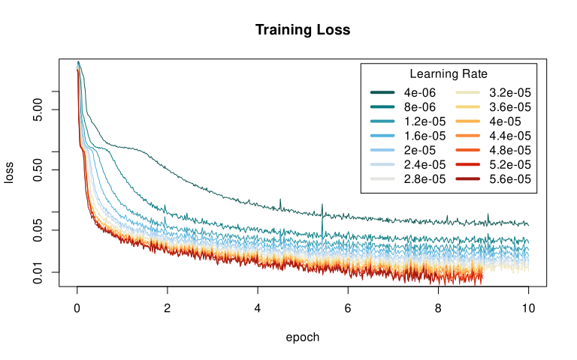
Fine-Tuning: Learning Rate Sweep

Slide 12
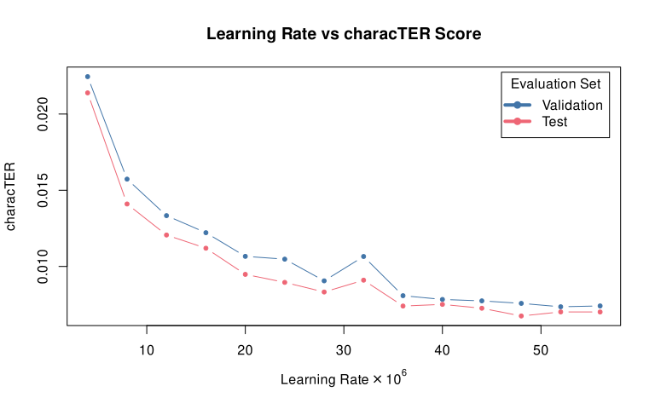
Fine-Tuning: Learning Rate Sweep

Slide 13
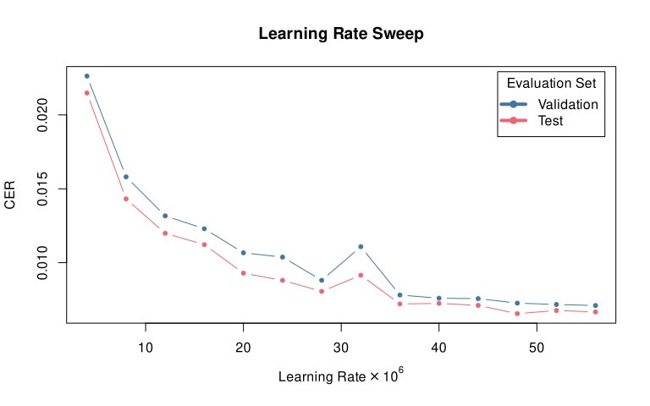
Fine-Tuning: Learning Rate Sweep

Slide 14
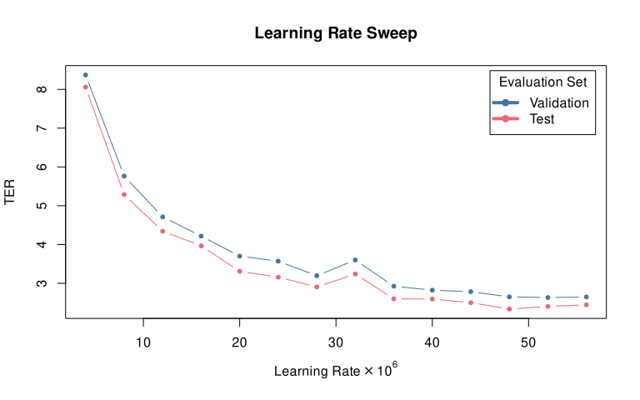
Fine-Tuning: Learning Rate Sweep

Slide 15
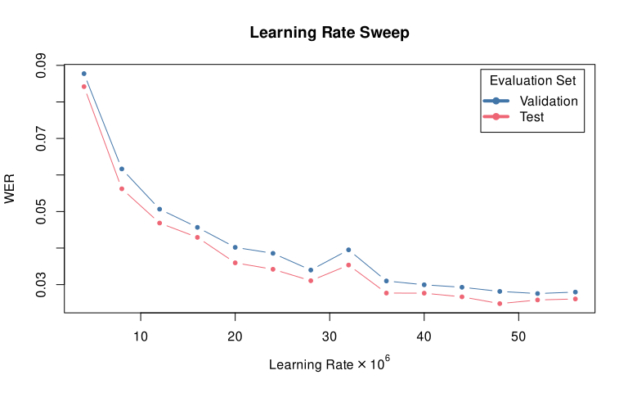
Fine-Tuning: Learning Rate Sweep

Slide 16
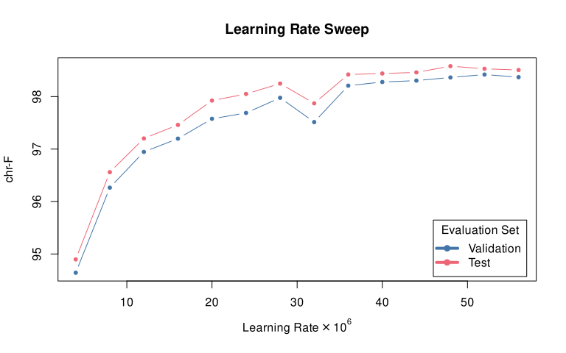
Fine-Tuning: Learning Rate Sweep

Slide 17
Fine-Tuning: Weight Decay Sweep
We fixed the learning rate at 48 × 10⁻⁶
We then swept through weight decays ranging from 10⁻⁵ to 10⁻¹
10⁻² was the best performing value, and 10⁻¹ was only slightly worse
Performed additional tests with adjacent learning rates to ensure local optimum

Slide 18
Fine-Tuning: Scheduler Type Sweep
We fixed the learning rate at 48 × 10⁻⁶ and weight decay at 10⁻²
We then swept through every scheduler type in the Transformers library
Choice of scheduler was not as significant as weight decay and learning rate
We continued to test different combinations of learning rate, weight decay, and scheduler where we found potentially interesting results
e.g., if the loss curve did not saturate in 10 epochs

Slide 19
Results
Compare to the rules-based approach explored by Cjyet Yo¹:
Our top 3 results:
characTER | CER | chrF
0.006673 | 0.006326 | 98.59
0.006686 | 0.006298 | 98.63
0.006751 | 0.006552 | 98.58
characTER | CER | chrF
0.0814 | 0.0822 | 76.60
¹ C. Yo, “Pushing the boundaries of rule-based processing for ainu texts,” Tech. Rep. 9, Osaka University Graduate School of Humanities, May 2024.

Slide 20
Next Steps: Improve the Corpus & Model
In about 10% of cases (5887 / 61725), model output differed from the target
We are evaluating this subset what kinds of issues cause incorrect output
In addition, we are improving the corpus by fixing incorrect transliterations
After completing this process, we will attempt to train improved models
We will use the final models to expand the Latin script Ainu corpus
The expanded corpus will be used to develop useful tools for Ainu speakers

Slide 21
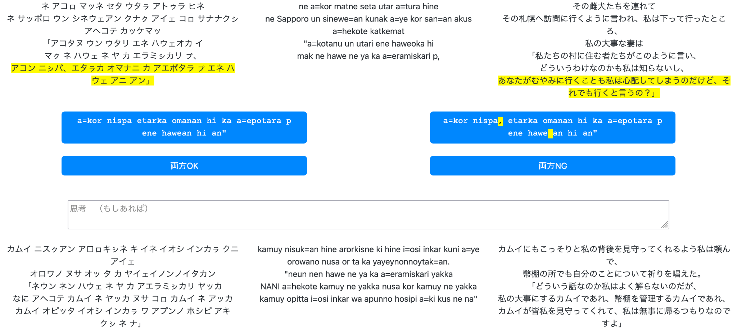
Next Steps: Improve the Corpus & Model

Slide 22
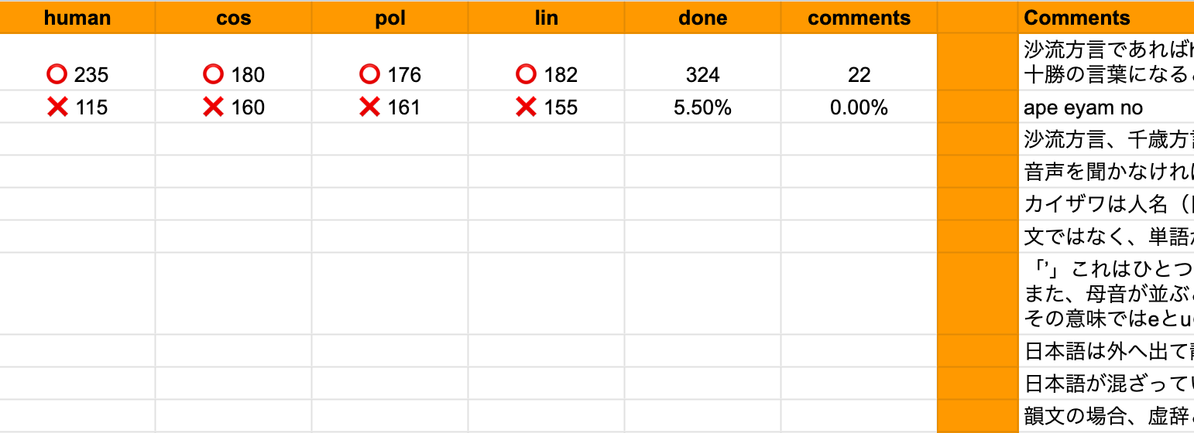
Next Steps: Improve the Corpus & Model

Slide 23
Conclusions and Discussion
ByT5 is highly effective for phonetic-to-morphemic transliteration
Even the worst models we produced outperform prior work using a rules-based approach
Our models are near parity with human transcriptions
But there is still room for improvement
Other low-resource language communities may benefit from our approach
For example, many indigenous Taiwanese languages have texts transcribed in IPA
Automated transliteration is a first step towards making more useful tools for the Ainu language community

Slide 24
Statement of Solidarity
This slide is the personal stance of the presenter, Nicholas Overacker
I stand with the Ainu Neno An Ainu Association and their struggles:
To rectify the theft of Ainu remains in the name of research
To secure data sovereignty for the Ainu and Ryukyuan peoples

Slide 25
Iyayraykere! (Thank you!)
Nicholas Overacker (Kitami Institute of Technology)
KIT Email: m3235380013@std.kitami-it.ac.jp
OSU Email: nick.overacker@okstate.edu
With help from:
Dr. Michal Ptaszynski (Kitami Institute of Technology)
Dr. Karol Nowakowski (Tohoku University of Community Service and Science)
Kenyu Yamamaru (The Foundation for Ainu Culture)

Slide 26
References
[1] UNESCO, ed., Atlas of the world’s languages in danger. Memory of Peoples Series, UNESCO, 3 ed., Feb. 2010. [2] The Foundation for Ainu Culture, “ア イ ヌ 語 入 門 講座 (Beginner Ainu Courses).” Available at https://www.ff-ainu.or.jp/web/session/files/r06_02shiraoi.pdf. [3] STV Radio, “アイヌ語ラジオ講座 (Ainu Language Radio Course).” Available at https://www.stv.jp/radio/ainugo/index.html. [4] The Foundation for Ainu Culture, “アイヌ語弁論大会～イタカンロー～(ainu language speech contest itak=an ro ).” Available at https://www.ff-ainu.or.jp/web/learn/language/itakanro/. [5] L. Xue, A. Barua, N. Constant, R. Al-Rfou, S. Narang, M. Kale, A. Roberts, and C. Raffel, “ByT5: Towards a token-free future with pre-trained byte-to-byte models,” Transactions of the Association for Computational Linguistics, vol. 10, pp. 291–306, 2022. [6] C. Yo, “Pushing the boundaries of rule-based processing for ainu texts,” Tech. Rep. 9, Osaka University Graduate School of Humanities, May 2024. [7] S. Tamura, ア イ ヌ 語 沙 流 方 言 辞 典 (Dictionary of the Saru Dialect of the Ainu Language). 株式会社草風館 (Soufuukan K.K.), 1996. [8] National Institute for Japanese Language and Linguistics (NINJAL), “A topical dictionary of conversational ainu.” Available at https://ainu.ninjal.ac.jp/topic/, 2015. [Software]. [9] K. Nowakowski, M. Ptaszynski, and F. Masui, “A proposal for a unified corpus of the ainu language,” Tech. Rep. 2, Kitami Institute of Technology, Kitami Institute of Technology, Kitami Institute of Technology, sep 2018. [10] H. Nakagawa, ニューエクスプレスアイヌ語 (New Express Ainu Language). 株式会社白水社 (Hakusuisha Publishing Co., Ltd.), Nov. 2013. [11] National Institute for Japanese Language and Linguistics (NINJAL), “A glossed audio corpus of ainu folklore.” Available at https://ainu.ninjal.ac.jp/folklore/, 2016-2024. [Software]. [12] T. Wolf, L. Debut, V. Sanh, J. Chaumond, C. Delangue, A. Moi, P. Cistac, T. Rault, R. Louf, M. Funtowicz, J. Davison, S. Shleifer, P. von Platen, C. Ma, Y. Jernite, J. Plu, C. Xu, T. L. Scao, S. Gugger, M. Drame, Q. Lhoest, and A. M. Rush, “Transformers: State-of-the-art natural language processing,” in Proceedings of the 2020 Conference on Empirical Methods in Natural Language Processing: System Demonstrations, (Online), pp. 38–45, Association for Computational Linguistics, Oct. 2020. [13] Google, “byt5-small.” Available at https://huggingface.co/google/byt5-small, 2015. [14] W. Wang, J.-T. Peter, H. Rosendahl, and H. Ney, “CharacTer: Translation edit rate on character level,” in Proceedings of the First Conference on Machine Translation: Volume 2, Shared Task Papers, (Berlin, Germany), pp. 505–510, Association for Computational Linguistics, Aug. 2016. [15] A. Morris, V. Maier, and P. Green, “From wer and ril to mer and wil: improved evaluation measures for connected speech recognition.,” 01 2004. [16] M. Popović, “chrF: character n-gram F-score for automatic MT evaluation,” in Proceedings of the Tenth Workshop on Statistical Machine Translation, (Lisbon, Portugal), pp. 392–395, Association for Computational Linguistics, Sept. 2015.

Slide 27
