Slide 1
MSDS Case Study 2
Employment Data Analysis
Nicholas Sager

Slide 2

Agenda
Employment Data Exploration
Attrition
Salary
Modelling
Attrition
Salary
Key Predictors

Slide 3
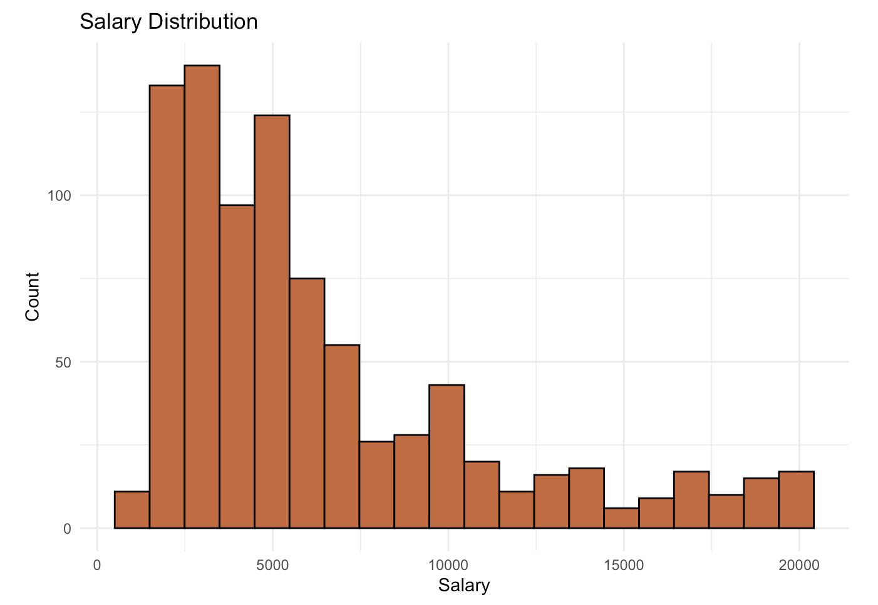
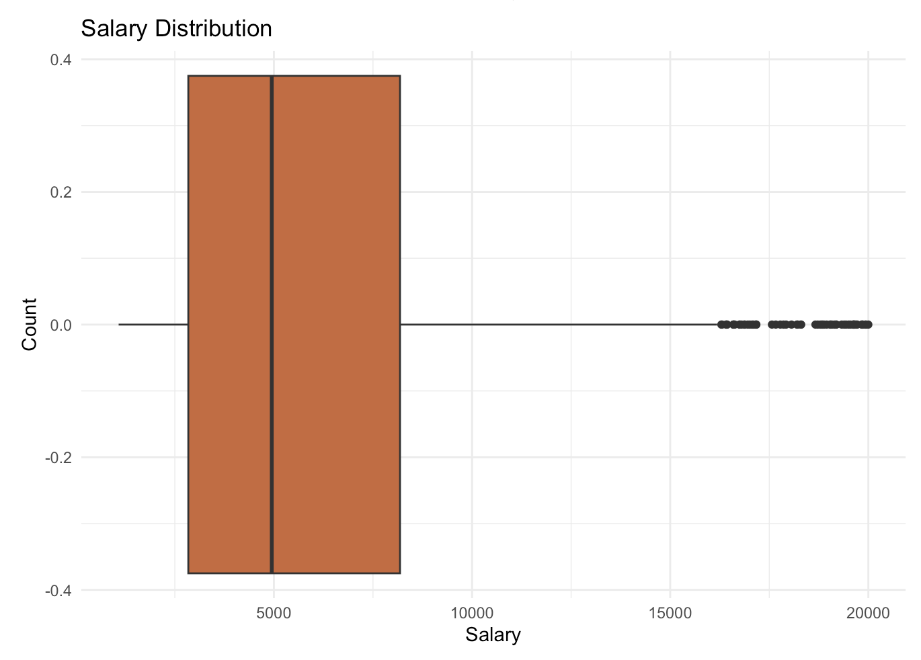
Employment Data Exploration
Salary
Right Skewed
Mean: $6390
Median: $4946

Slide 4
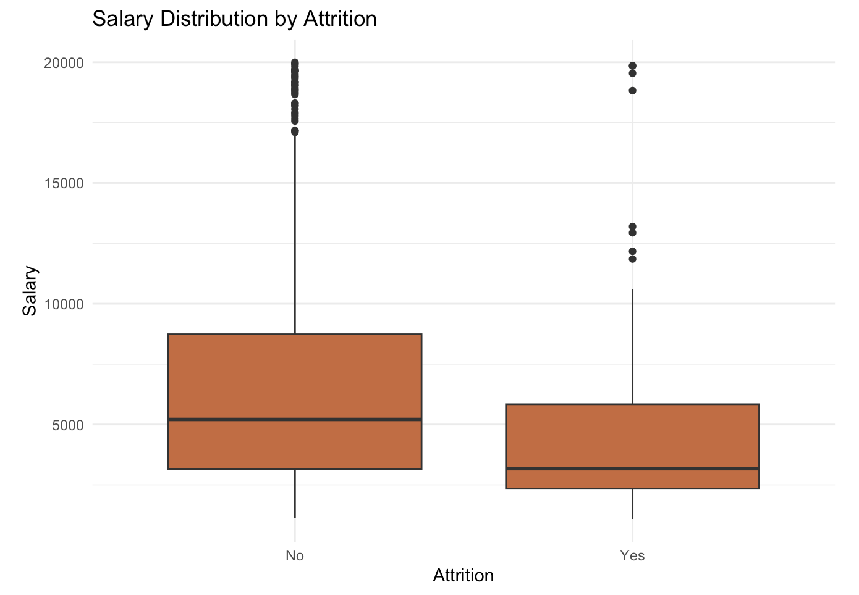
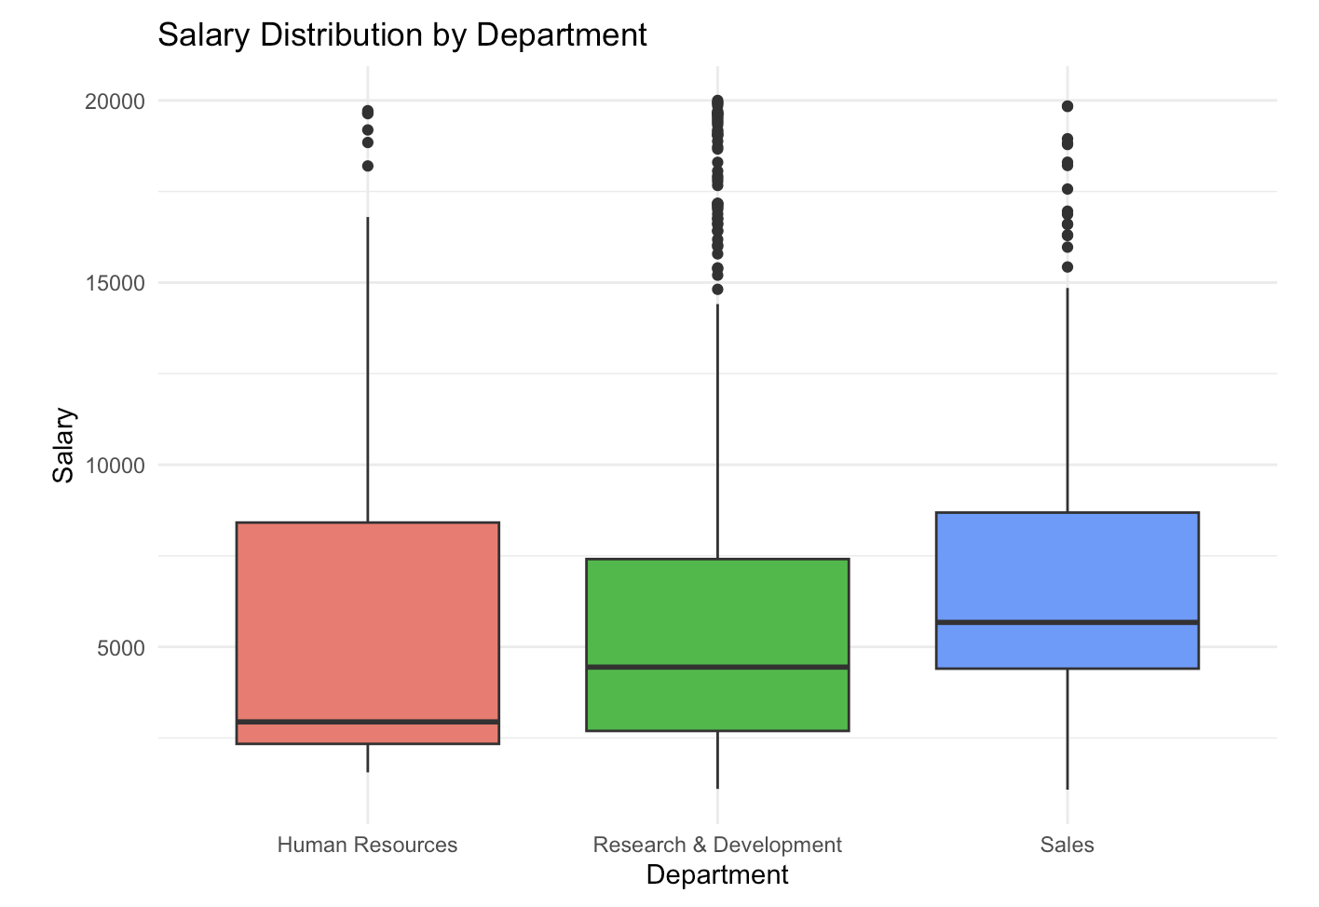
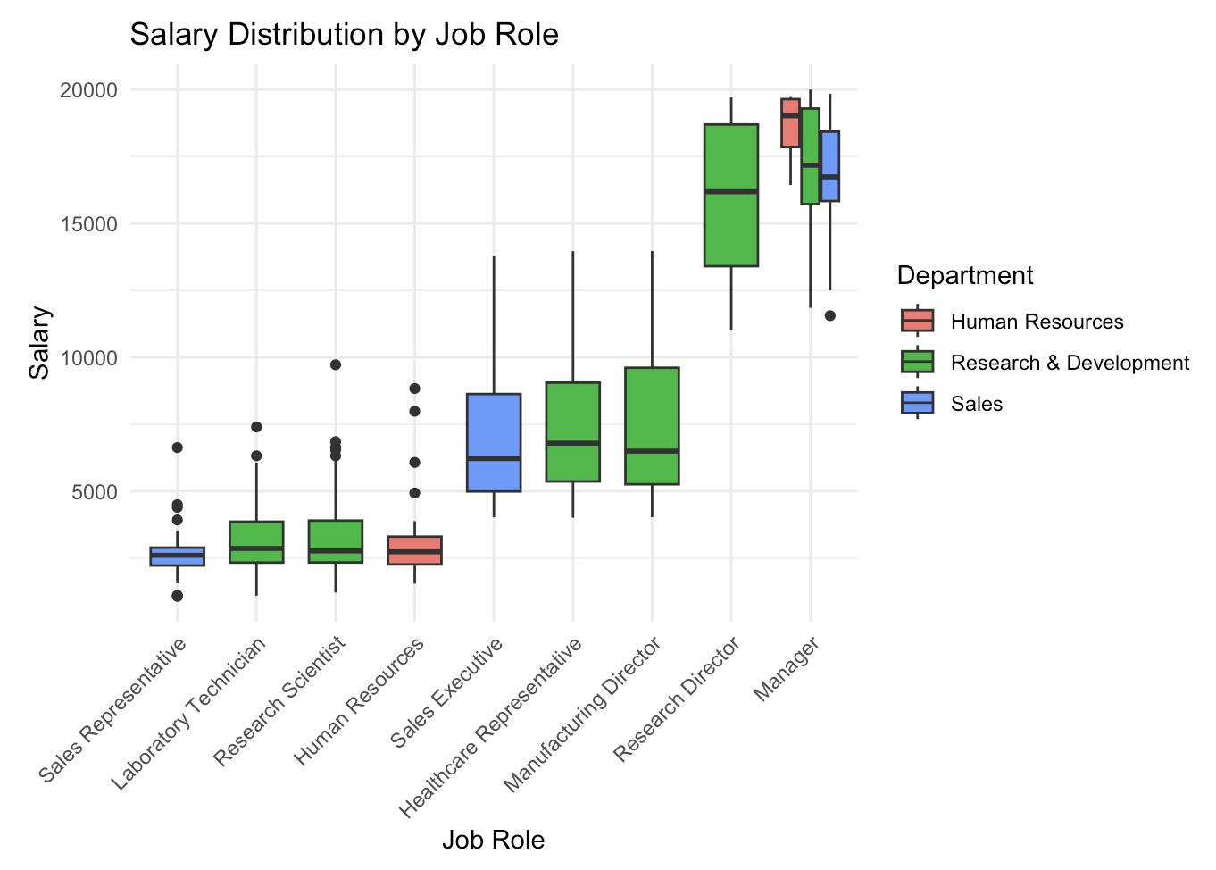
Employment Data Exploration
Salary
Significanly lower for employees who left
~$2,000 (p < 0.01)
Differs by Department
And Across roles

Slide 5
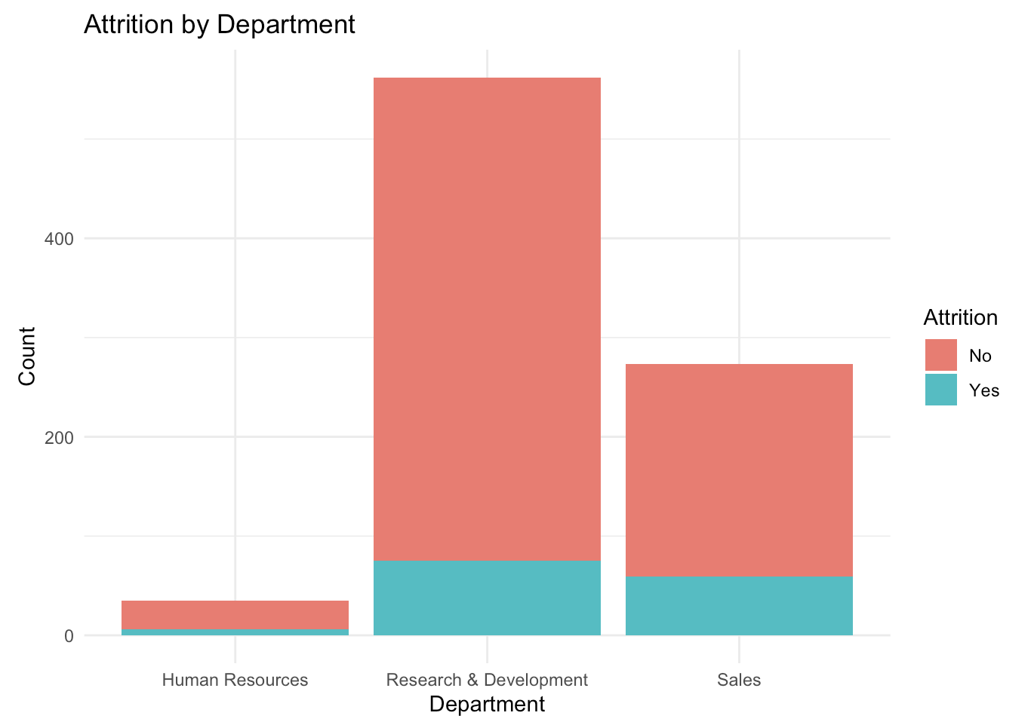
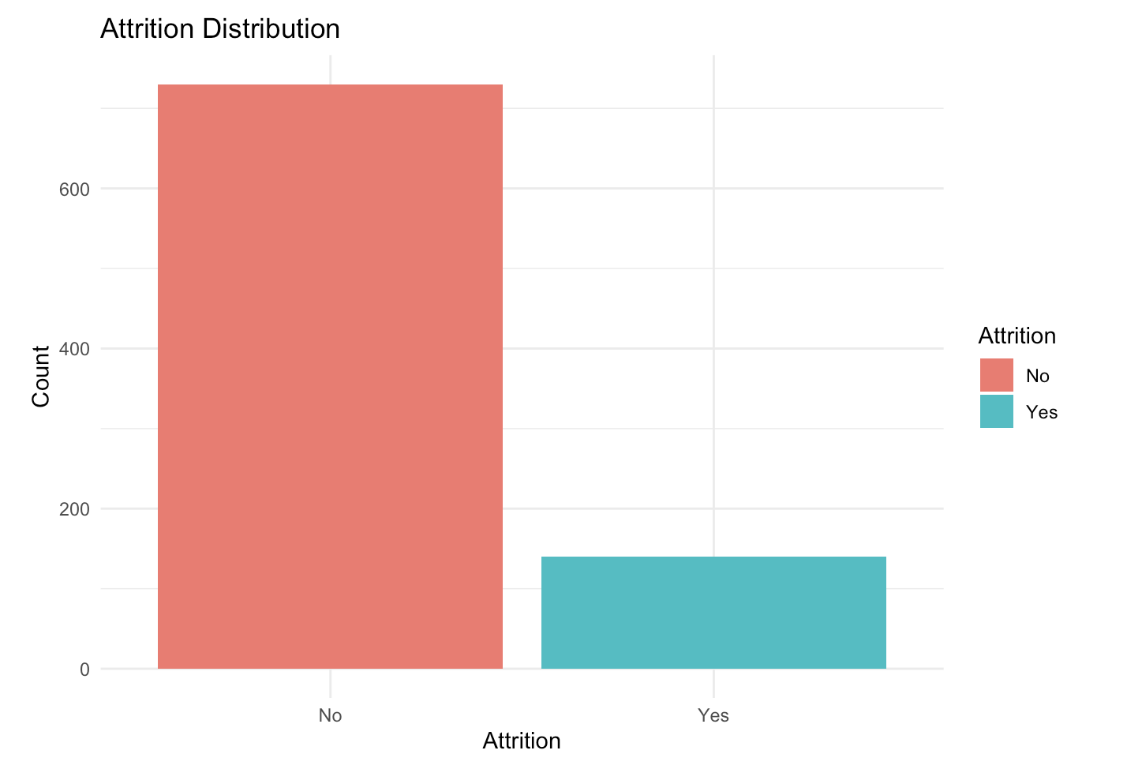
Employment Data Exploration
Attrition
Unbalanced Overall
Differs by Department

Slide 6
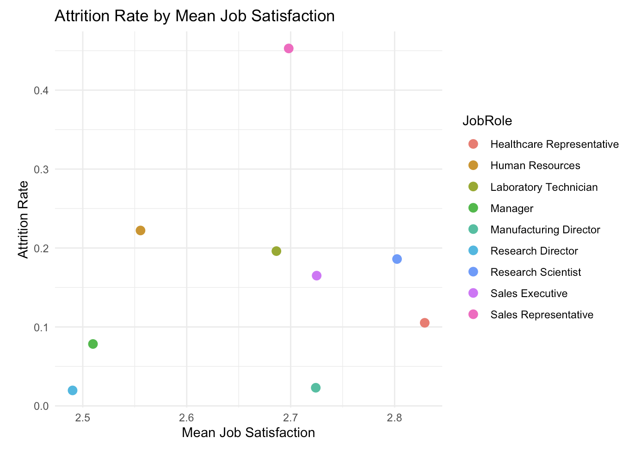
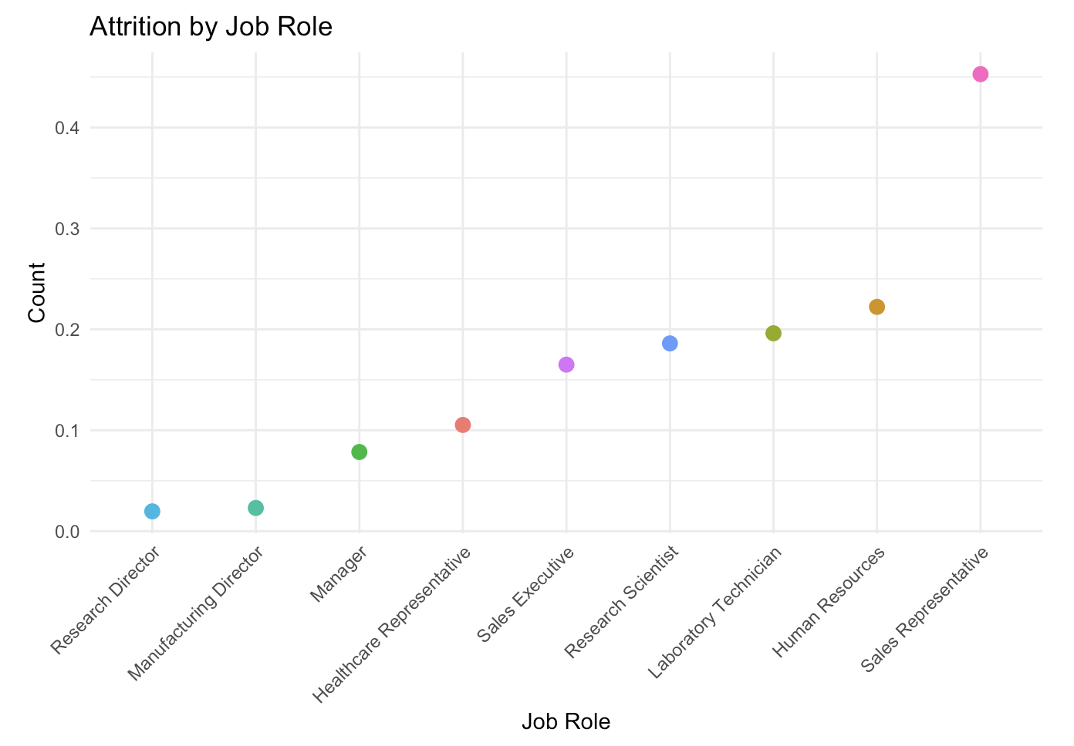
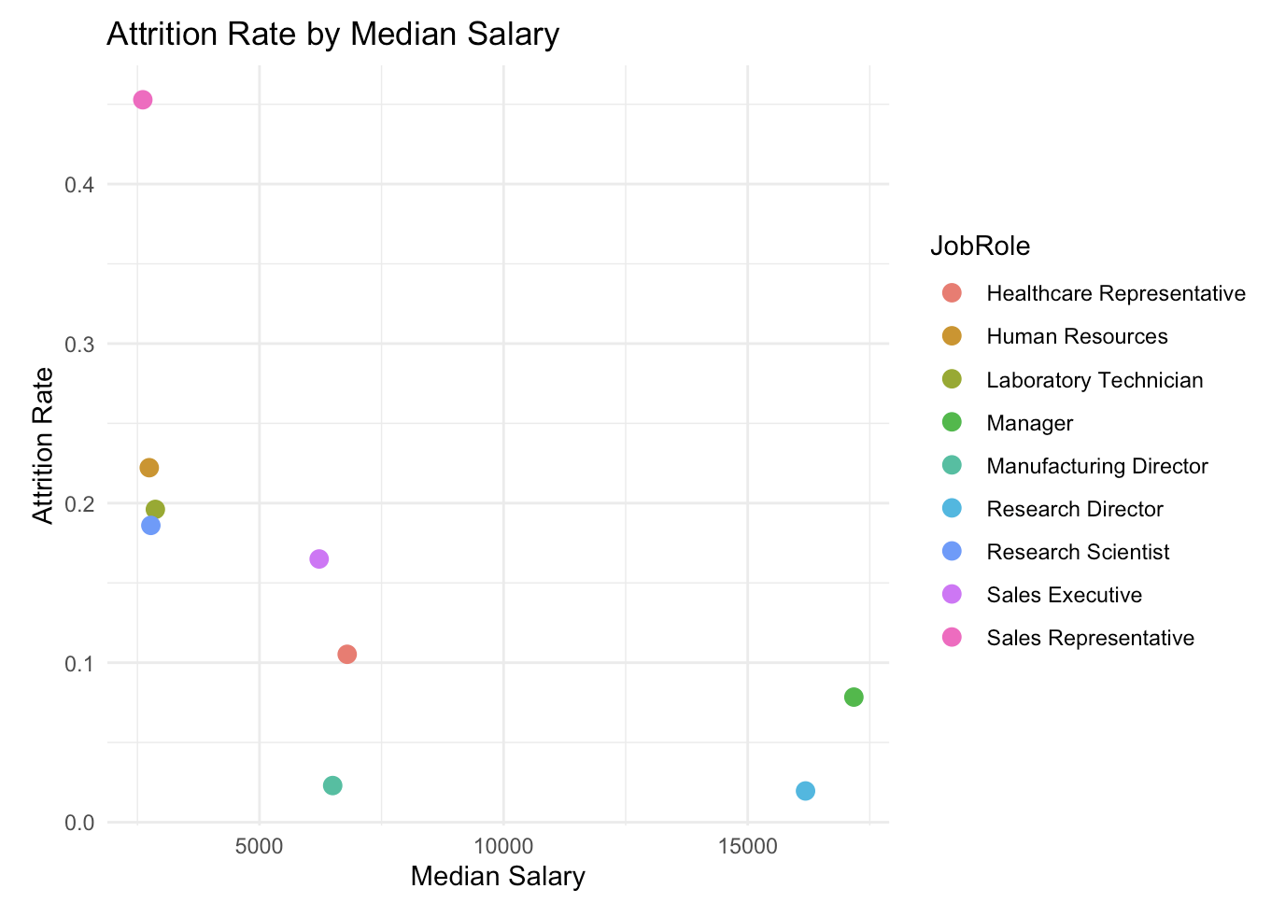
Employment Data Exploration
Attrition
Job Role
Median Salary
Job Satisfaction

Slide 7
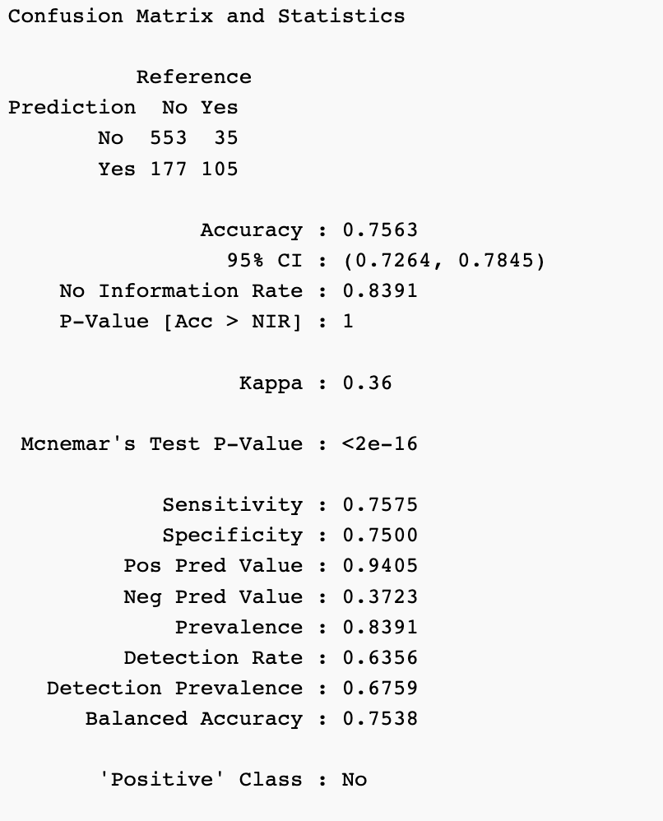
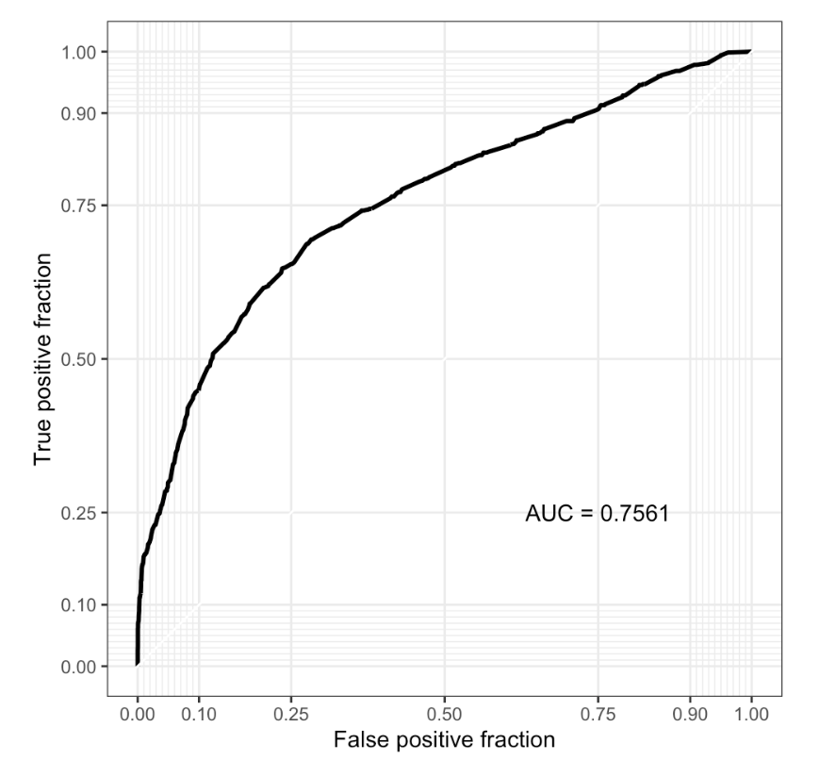
Modelling - Attrition
KNN
K = 39

Slide 8
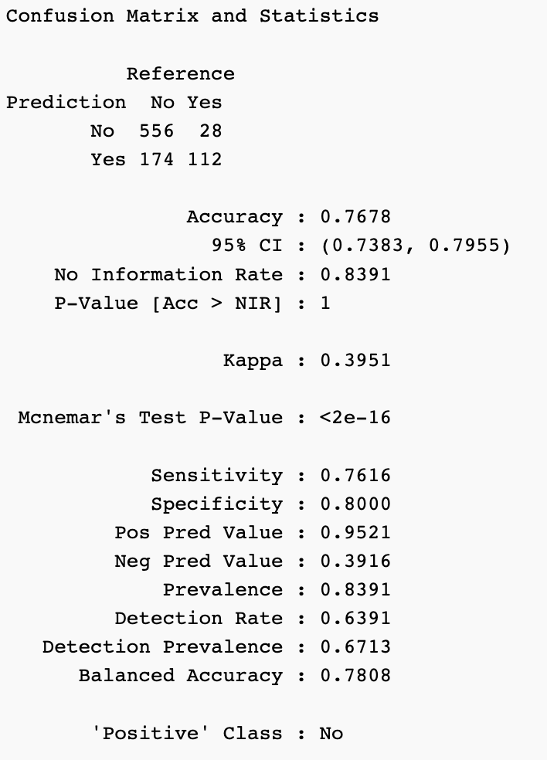
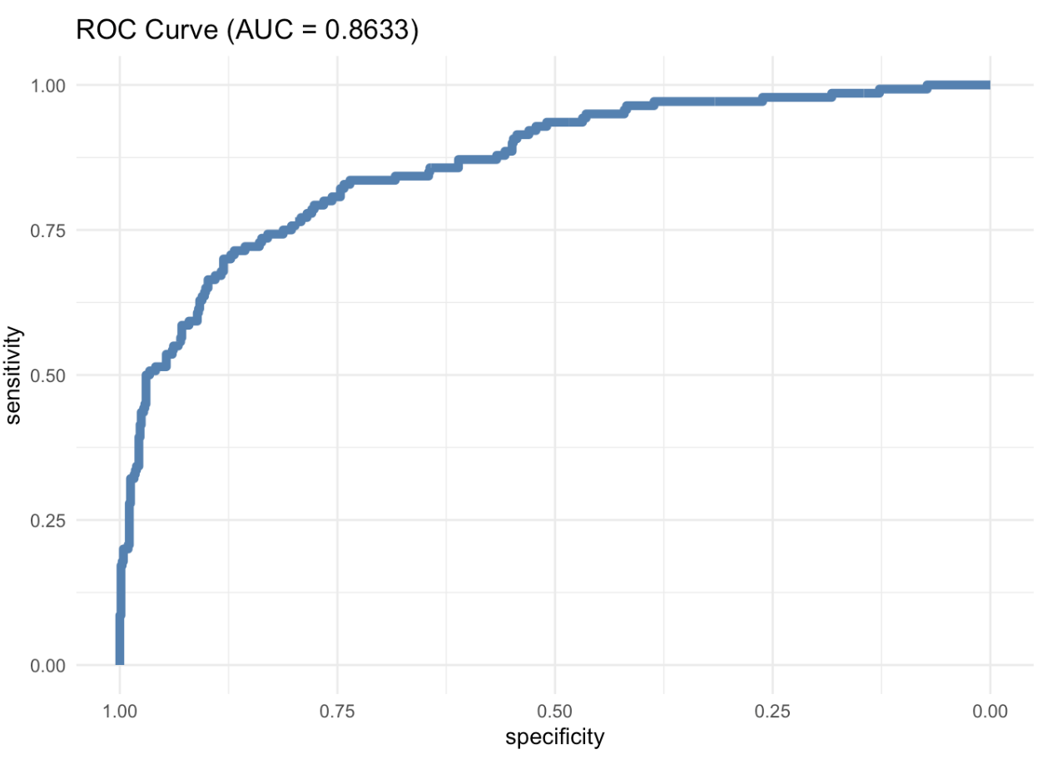
Modelling - Attrition
Naïve Bayes

Slide 9
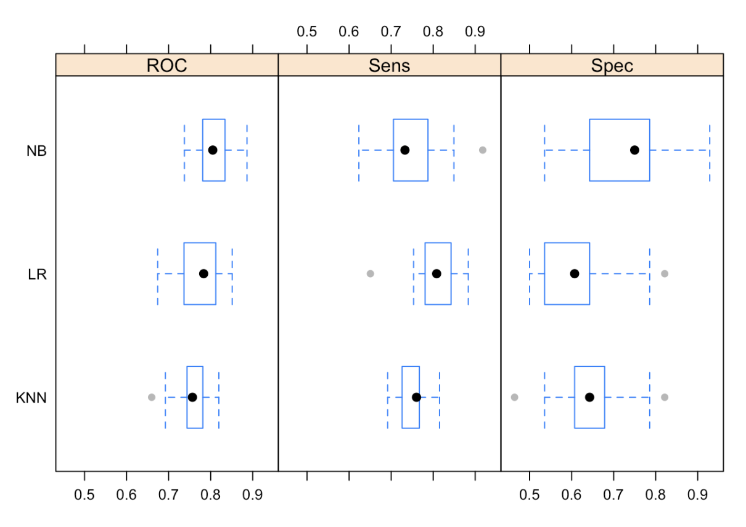
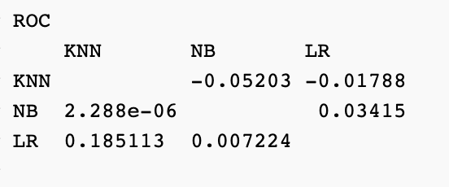
Modelling - Attrition
Which model performs better?
We will use the Naïve Bayes model.

Slide 10
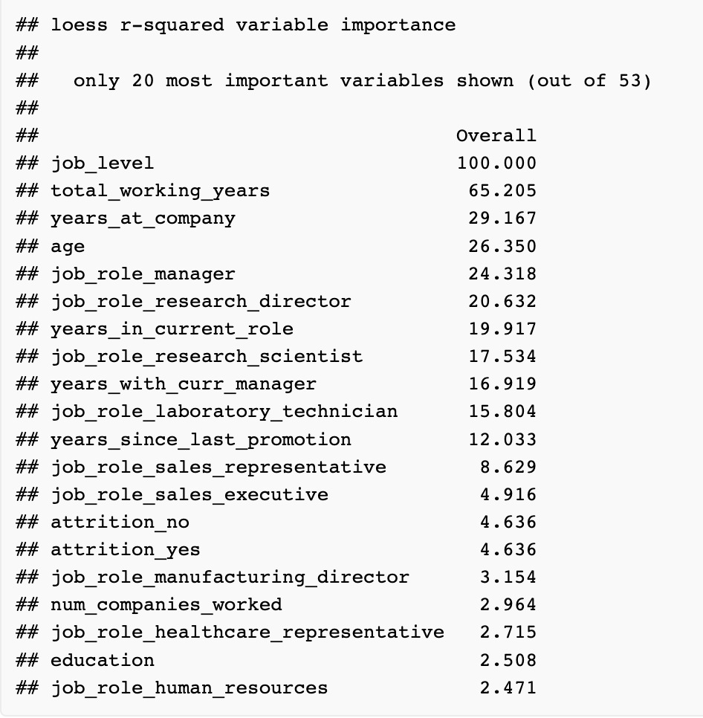
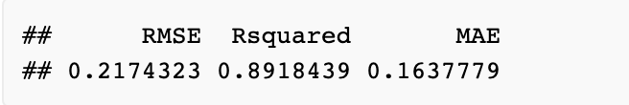
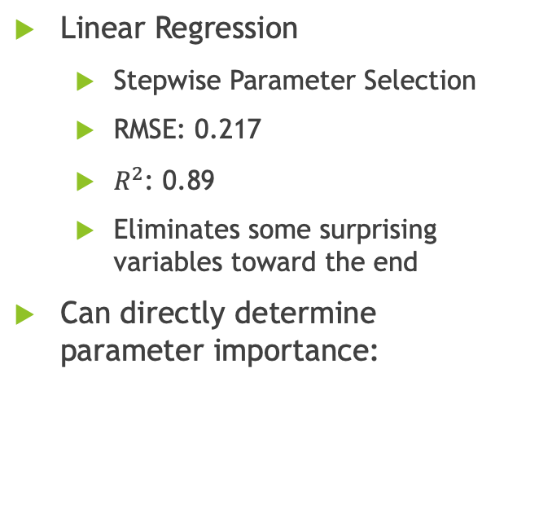
Modelling - Salary
Linear Regression
Stepwise Parameter Selection
RMSE: 0.217
$R^{2}$: 0.89
Eliminates some surprising variables toward the end
Can directly determine parameter importance:

Slide 11
Salary Factors
Found by analyzing results of KNN model.
Important factors:
Job Level
Total Working Years
Age
Years at company
Specific Job Roles

Slide 12
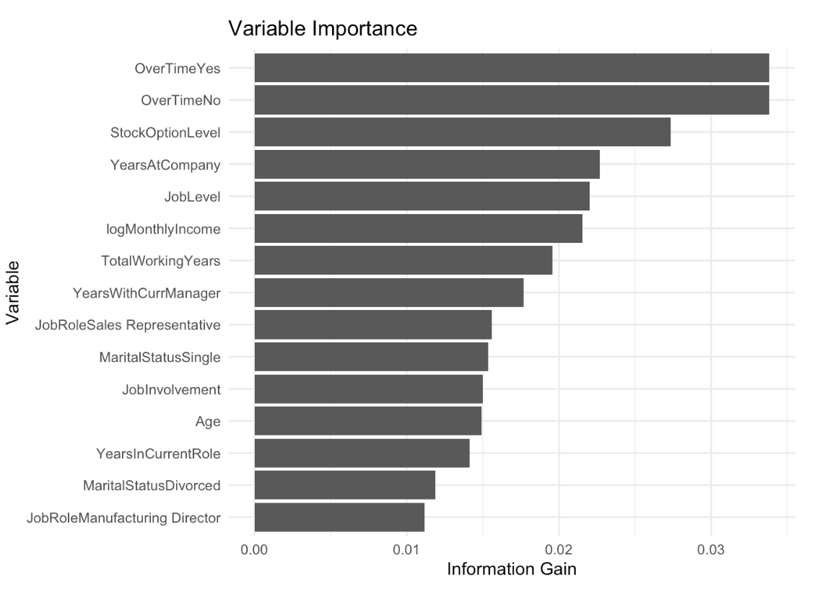
Attrition Factors
Found by analyzing results of Naïve Bayes model.
Important factors:
Part Time
Stock options (collinearity?)
Years at company
Job Level
Income

Slide 13

Conclusion

Slide 14

Thank You.
Nicholas Sager
nsager@smu.edu
Nicksager.github.io

