Slide 1

MSDS 6306 Case Study 1
US Craft Beer and Brewery Analysis
Presented By: Nicholas Sager and Steven Cox

Slide 2
Topics Covered in this Case Study
How many Breweries are there in the US?
Is there a relationship between ABV and Bitterness?
Wrangling the data – How we handled missing values and unknows
Modeling analysis of ABV and IBU focusing on Ales and IPAs
How does each State rank when comparing Alcohol Content and Bitterness?
How does each State rank when comparing Alcohol Content and Bitterness?
Deeper Dive into alcohol content by volume (ABV)
Additional modeling that we found exciting.

Slide 3



How many breweries are in the US and each State?
On initial investigation, it appeared that according to the data, there are approximately 558 breweries in the US.
However, when we went to break down the number of breweries per State, we found that there were 7 breweries that had duplicate IDs.
So…with the duplicates merged, we are confident that there are 551 breweries within the United States.

Slide 4
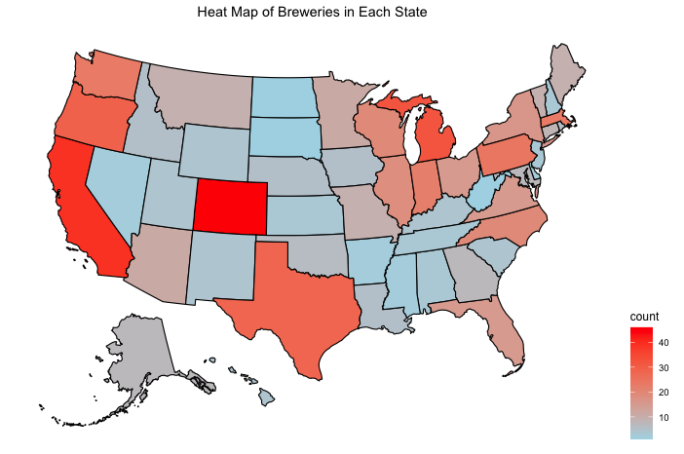
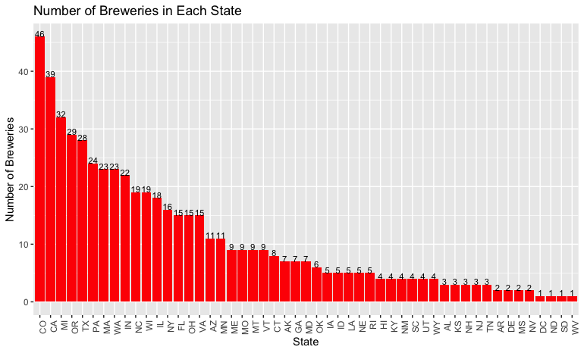
Number of Breweries In Each State
Top 5 States
Colorado (46)
California (39)
Michigan (32)
Oregon (29)
Texas (28)
Bottom 5 States
North and South Dakota (1 ea.)
West Virginia (1)
Mississippi (2)
Nevada (2)
Arkansas (2)
Notes:
In the United States, A-B owns 12 breweries: St Louis; Newark, New Jersey; Los Angeles; Houston; Columbus, Ohio; Jacksonville, Florida; Merrimack, New Hampshire; Williamsburg, Virginia; Fairfield, California; Baldwinsville, New York; Fort Collins, Colorado; and Cartersville, Georgia.

Slide 5
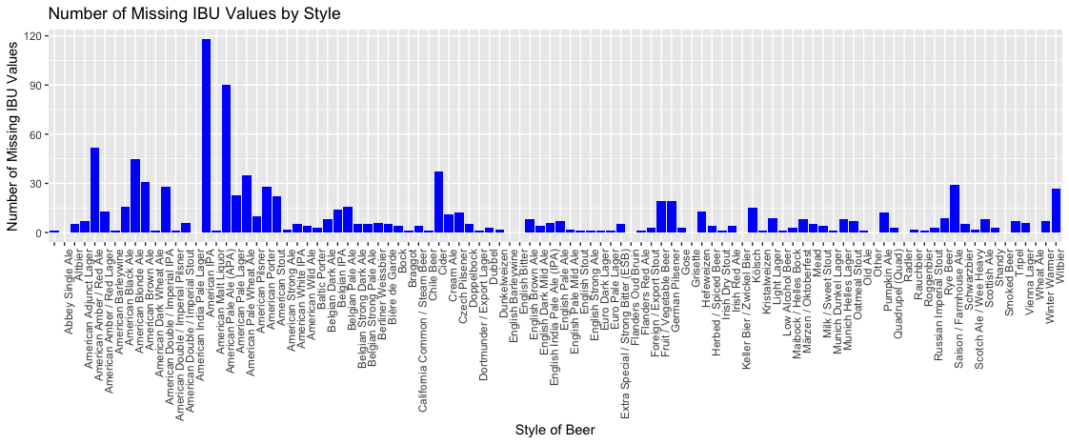
Wrangling the Missing Data
Out of the 2410 beers from our data:
Before: 62 have missing ABV values ~ 3%
With only a few missing ABV values, it was more efficient to simply search for the data online and replace those that were available. In doing so, we were able to find 47 values and an additional 2 that were misrepresented as beers.
After: 13 missing ABV values ~ 0.5%
Out of the 2410 beers from our data:
Before: 1005 have missing IBU values ~ 42%
This is much more significant and requires further investigation.
IBU values appear to be missing at random. The amount differs by style of beer, but we have no reason to believe it differs based on the actual value of IBU. American IPA’s have the highest number of missing IBU values but, as we will see later, they have a unique range of IBU values, so the imputation should be accurate.
After performing imputation with the mean value IBU by style, we reduced our missing IBUs to 2%
Notes:
1.) It is understandable that the IBU values had so many missing values. IBUs are often hard to measure and not required by law.
2.) Out of the remaining missing IBU values, only 1 beer was an Ale which is what we are predominately concerned with.

Slide 6
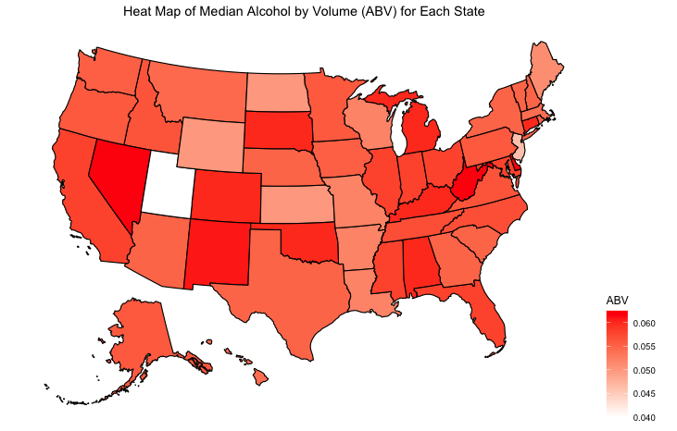
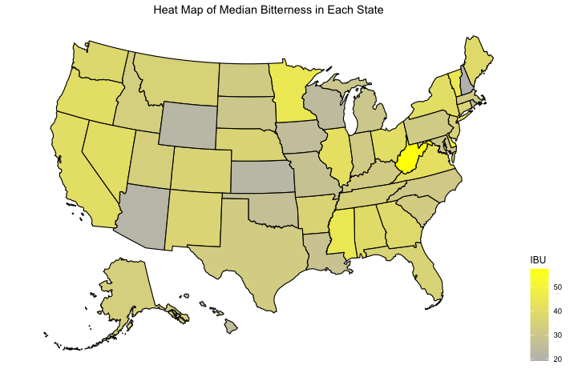
Median ABV and IBU Value by State
There is not an excessive variation in median ABV across the states.
The notable exception to this is the much lower median ABV for Utah.
This abnormality may be an artifact of the state laws. ABV of all beer sold in Utah was previously limited to 3.2%.
Though the heat maps provide a great visualization of ABV and IBU medians, we must recognize that some states like West Virginia and Delaware only had 2 observations.
The most alcoholic beer in the dataset is from Colorado. It is a Belgian Quadrupel with a 12.8% ABV
The most bitter beer is called “Bitter Bitch Imperial IPA”, which is from Oregon and has 138 IBU.

Slide 7
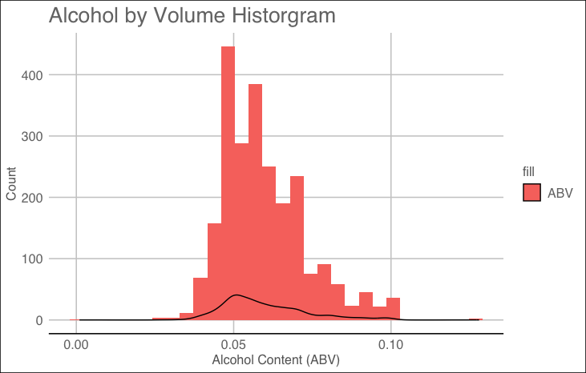
Alcohol by Volume (ABV) Statistics
Mean ~ 6.0%
Median ~ 5.6%
Std. Dev ~ 1.0%
Min ~ 0.1%
Max ~ 12.8%
For comparison, Bud Light has an ABV of 4.2% while Budweiser has around a 5.0%

Slide 8
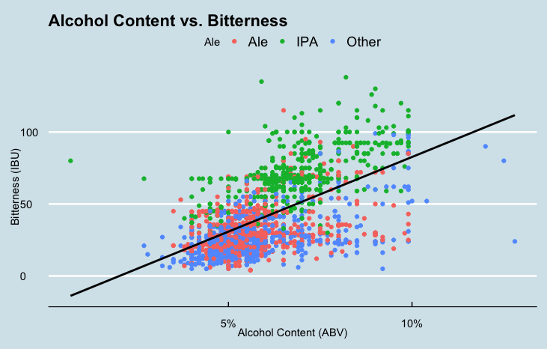
Relationship Between ABV and IBU
The positive slope depicts that there is a direct correlation between the bitterness of the beer vs. the alcohol content by volume.
It is also very apparent that IPAs are considerably more bitter than the other types of Ales when comparing with the alcohol content.

Slide 9
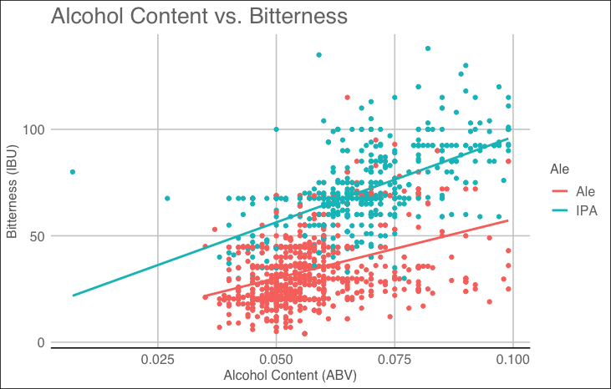
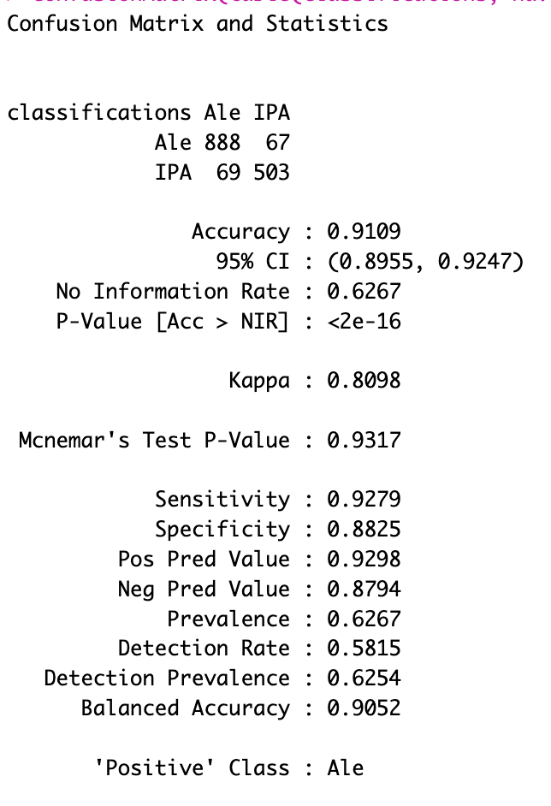
KNN Classification with Only Ales
Notes:
The KNN model using only Ales (IPAs and other Ales) has more than a 91% accuracy rate. 888 Ales were identified correctly giving us a sensitivity of 93% and 503 IPAs were also correctly identified, leading to a specificity of 88.3%.

Slide 10
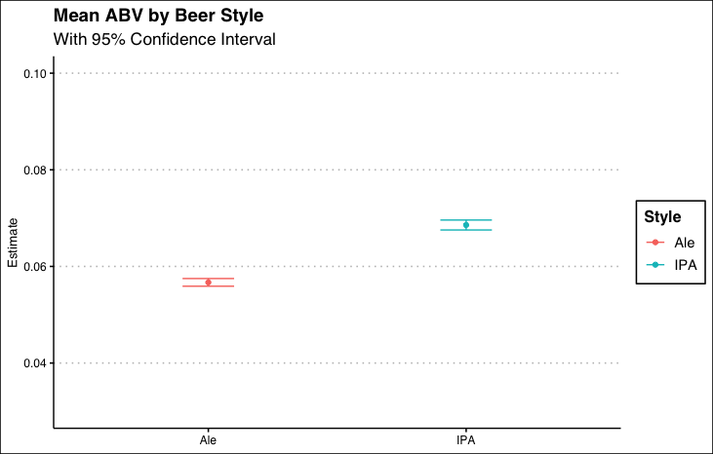
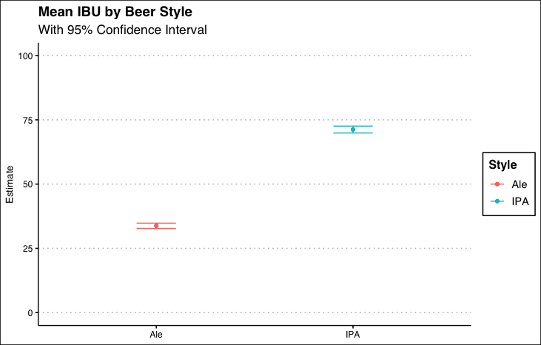
Comparing the ABV and Bitterness Between the Between Ales and IPAs
Here we can clearly see the difference in the ABV and IBU values between Ales and IPAs as we did previously.
Notes:
We can see that the mean ABV of IPA's is significantly higher than the mean ABV of Ales. The error bars indicate that we can be 95% confident that their ranges are not even close to overlapping.

Slide 11
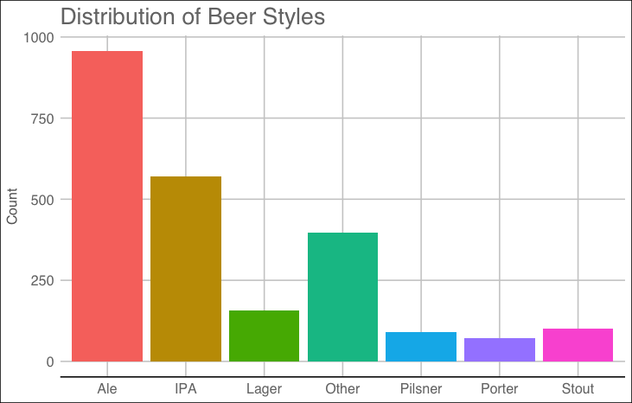
Expanding Beer Classifications
Since the analysis of Ales vs IPAs, was so effective, we decided to investigate the difference between other styles of beer. This may be useful for Budweiser to determine what specific profiles of ABV and IBU are associated with each style of beer. Such information could help with positioning their beers relative to the existing markets.

Slide 12
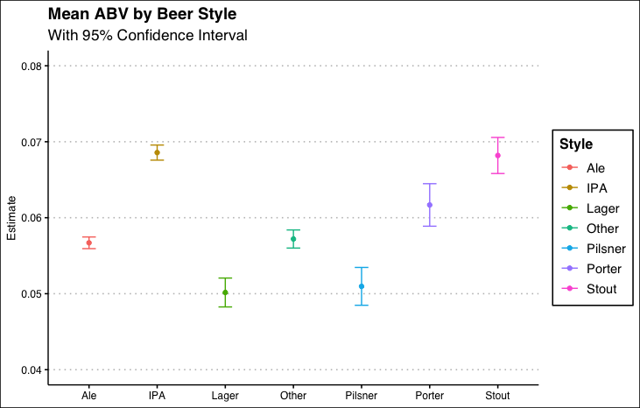
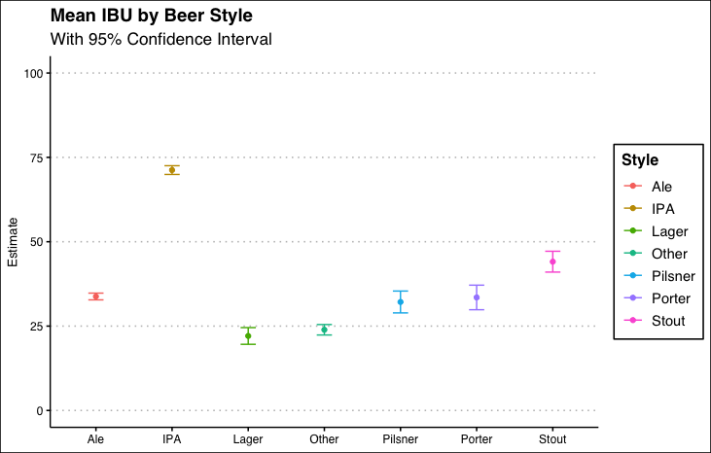
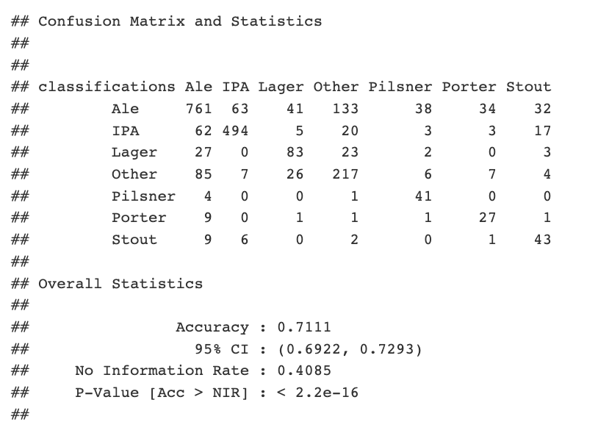
Comparing the ABV and Bitterness Between the Different Styles of Beer
After expanding the ABV’s over the different beer styles, we can better visualize how to group the alcohol content .
Expanding the beer styles, we can see that other styles of beer are more closely aligned with Ales than IPAs. With Ales, Pilsners, and Porters statistically the same.
This KNN model does very well, allowing us to classify the beers with a 71% accuracy.
Considering that there are 7 categories, this is a very usable result.
Notes:
We can see that, while some categories have overlapping confidence intervals, most are different. The only categories that do not have a significant difference in their mean ABV values (p > 0.05 including Bonferroni adjustment for post-hoc comparisons) are Ale and Other, IPA and Stout, Lager and Pilsner, and Other and Porter.

Slide 13
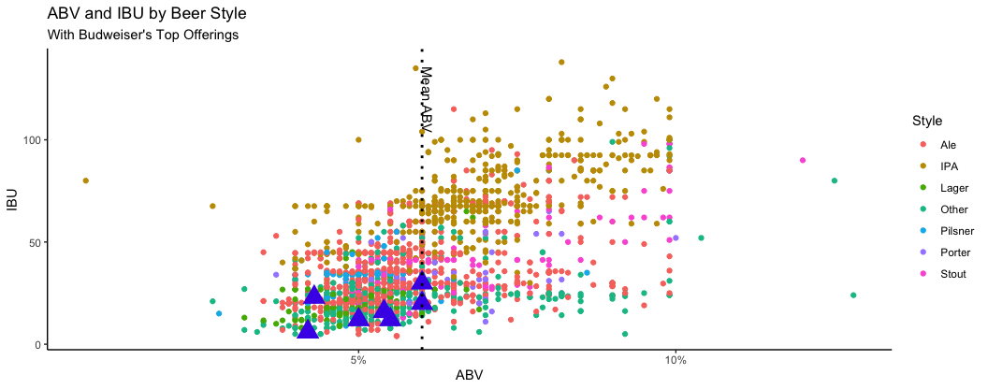
Additional Areas for Exploration
Budweiser
Visualizing the relationship between the ABV and IBU for the different styles of beer, we can see the industry norms and predict where new products should fall on the graph.
Interesting to note that Budweiser's top offerings are all in the lower range of ABV and IBU for the market

Slide 14


Team 4
Thank You
Nicholas Sager
nsager@mail.smu.edu
Steven Cox
sacox@mail.smu.edu
Notes:
Thank you for the opportunity to evaluate your beer data and we hope that we shed some insight into your questions

