Slide 1


Slide 2
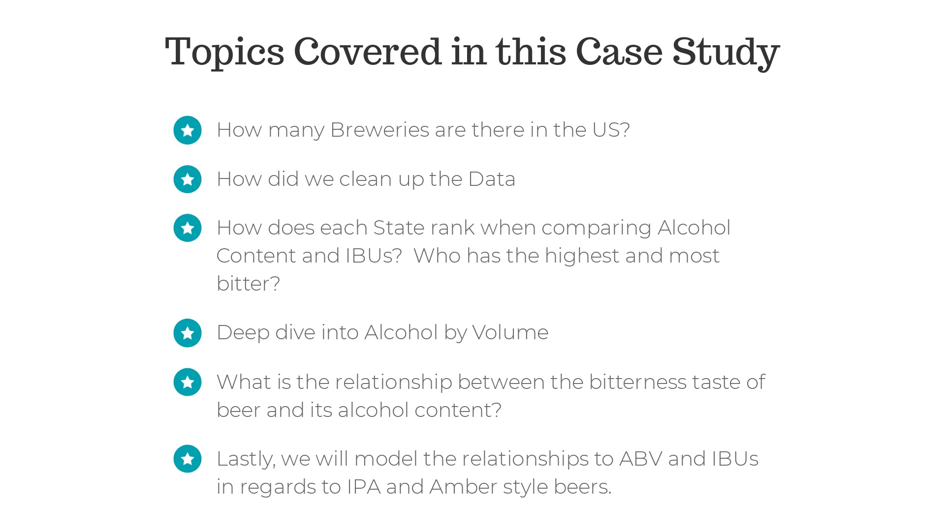

Slide 3
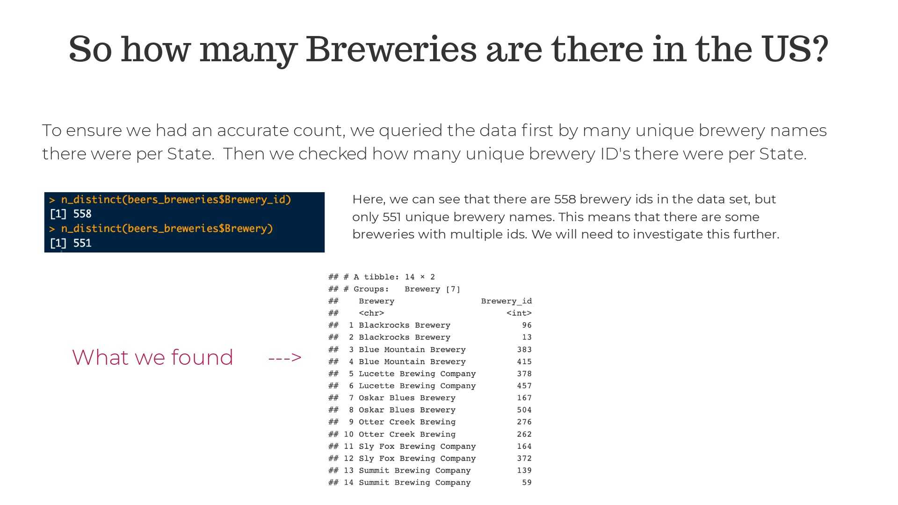
Notes:
Here, we can see that there are 558 brewery ids in the data set, but only 551 unique brewery names. This means that there are some breweries with multiple ids. We will need to investigate this further.

Slide 4
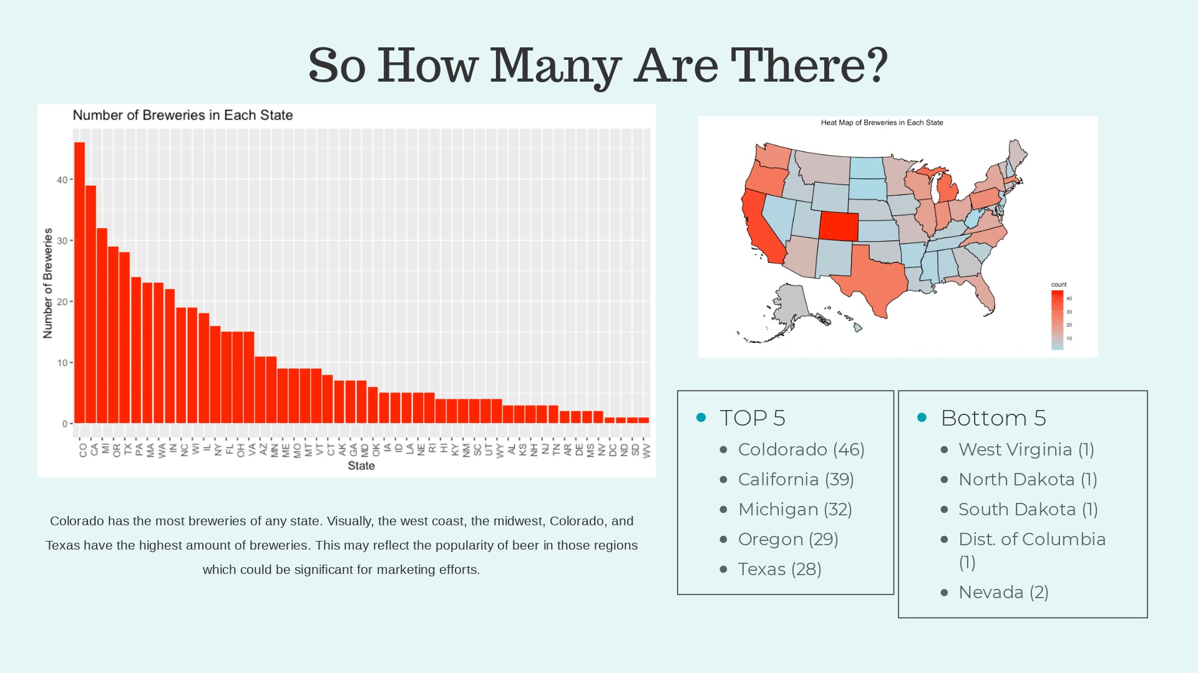

Slide 5
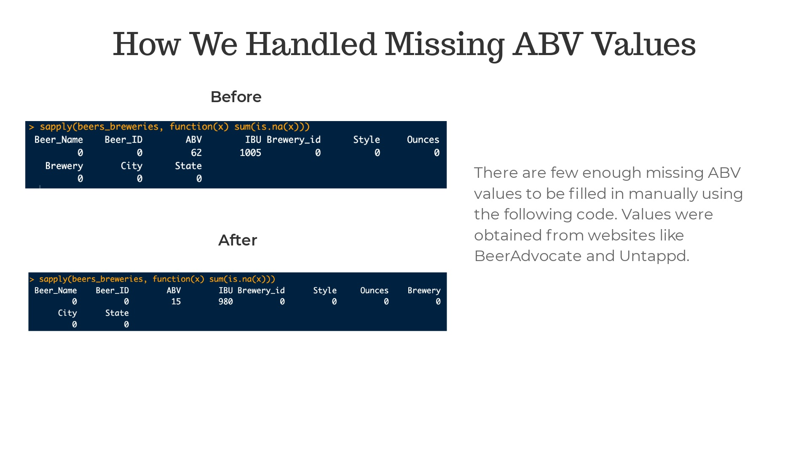
Notes:
There are 62 missing ABV values, 1005, missing IBU values, and 5 missing beer Style values, which are not reflected in the output above. Note: We have pending requests for APIs to handle missing data in the future.

Slide 6
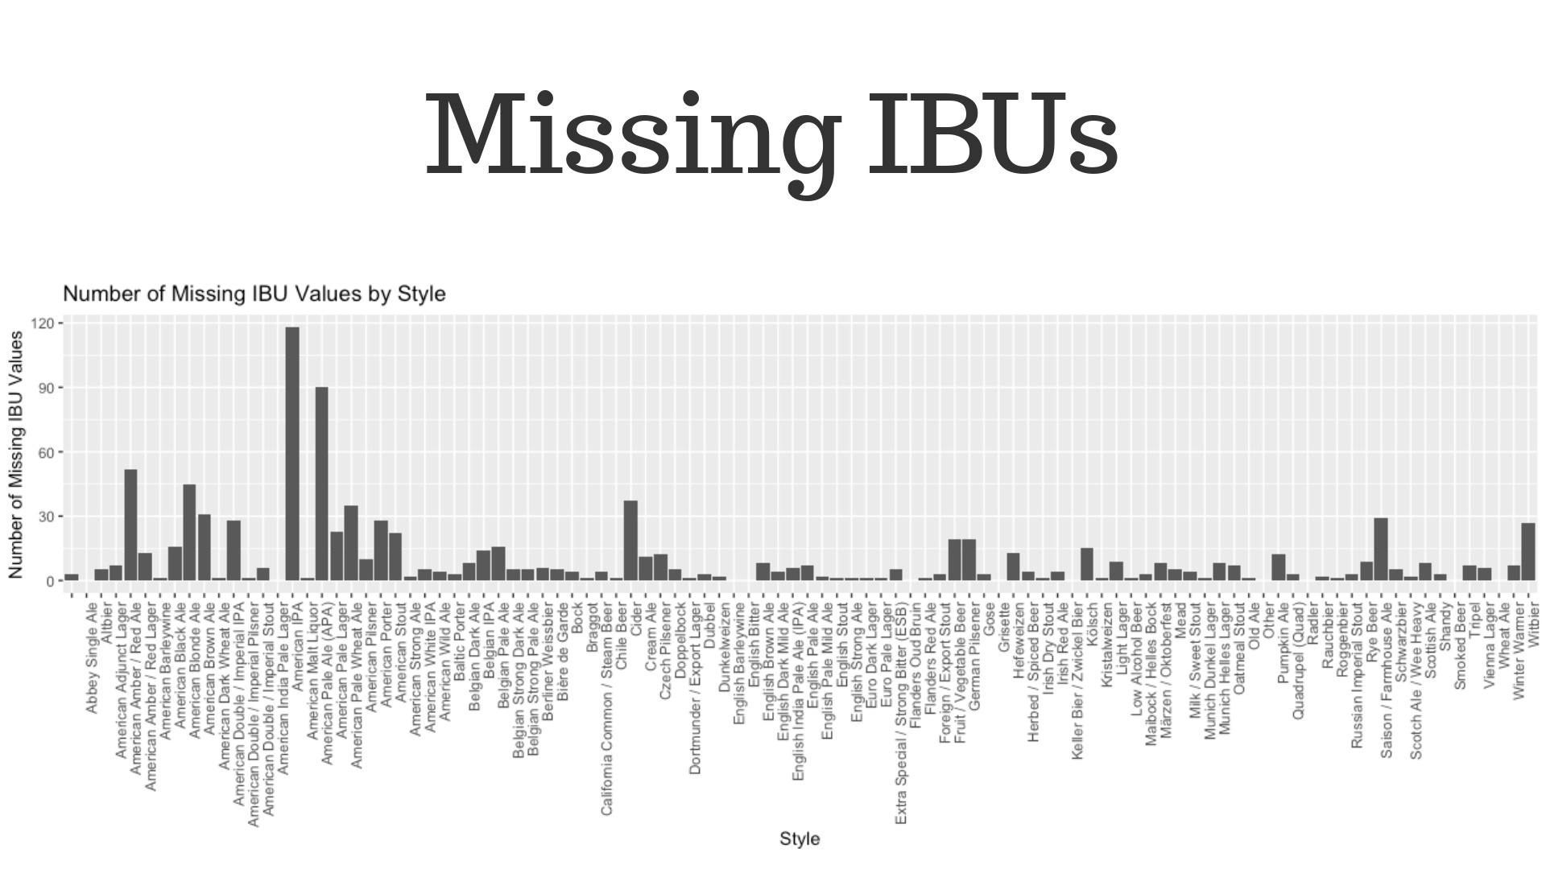
Notes:
IBU values appear to be missing at random. The amount differs by style of beer, but we have no reason to believe it differs base on the actual value of IBU. American IPA’s have the highest number of missing IBU values but, as we will see later, the have a unique range of IBU values, so the imputation should be accurate.

Slide 7
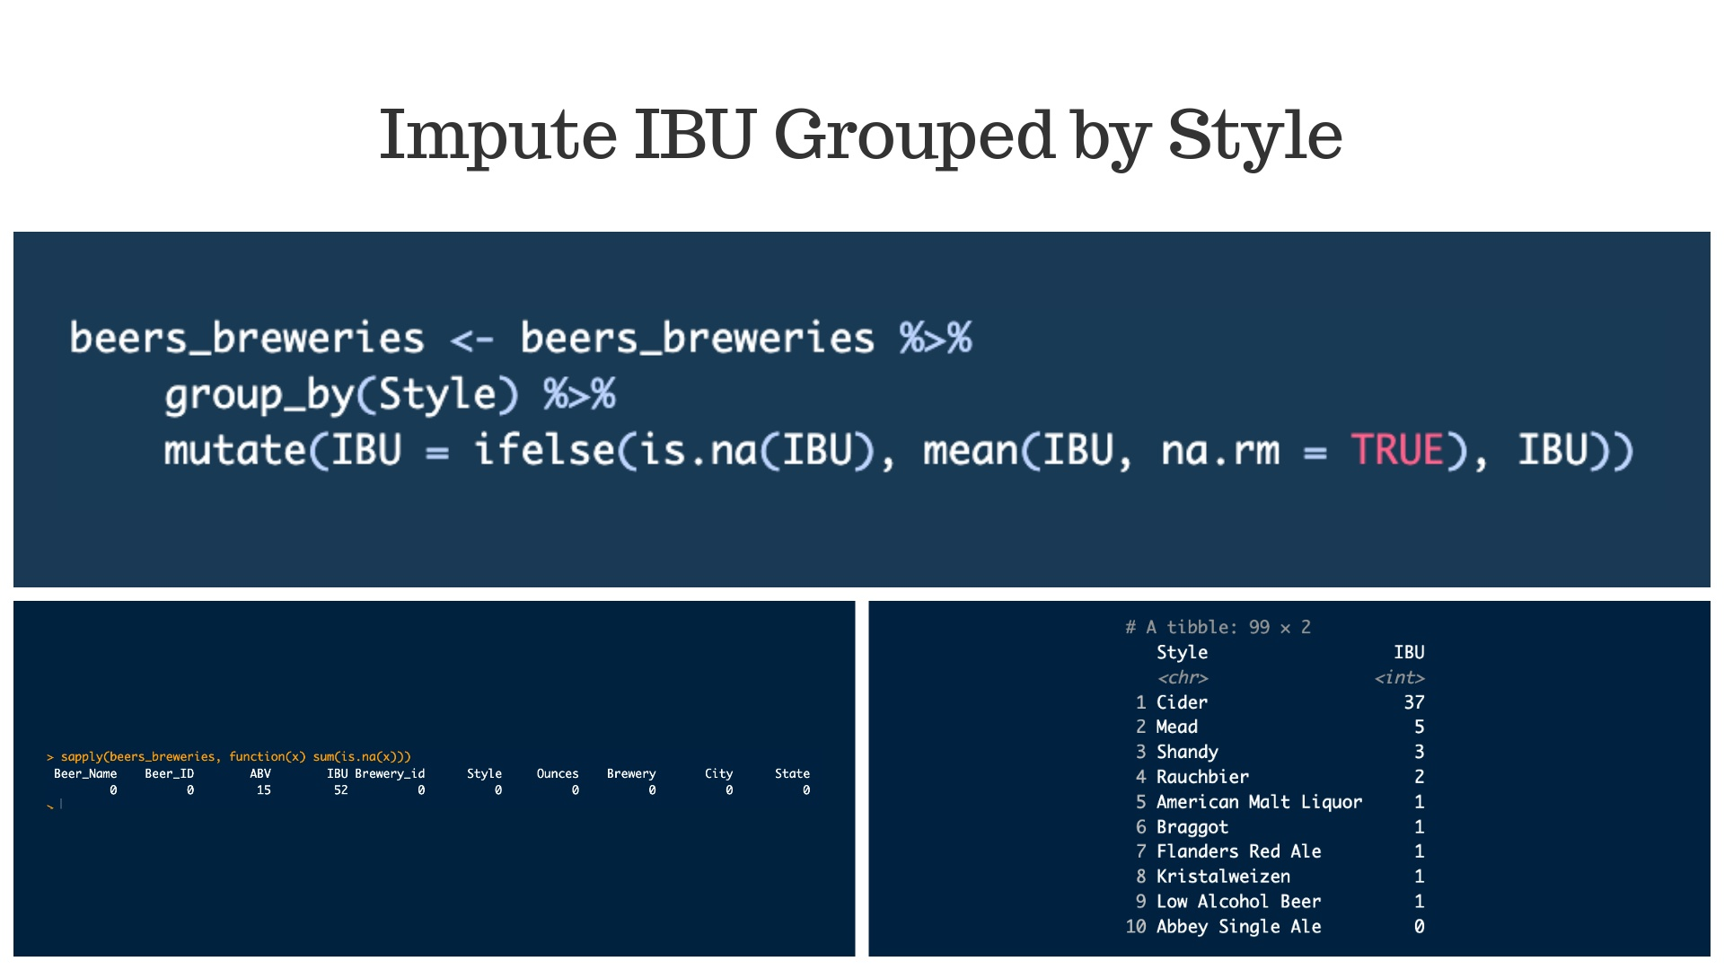
Notes:
Because our analysis is concerned with Ales, more effort could be put into finding these missing values if more time or money becomes available and a more accurate analysis is desired.

Slide 8
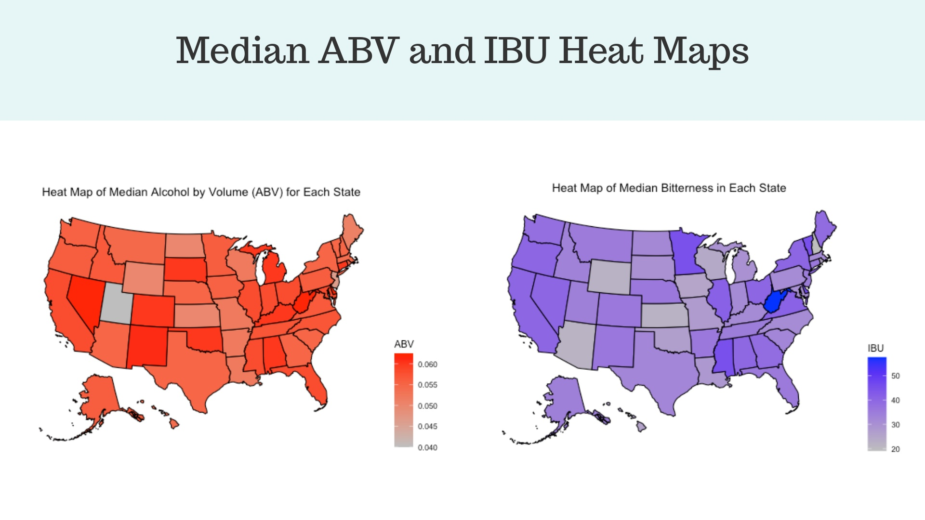
Notes:
There doesn’t seem to be excessive variation in median IBU or ABV across states. The notable exception to this is the much lower median ABV for Utah, which may be an artifact of the state laws. ABV of all beer sold in Utah was previously limited to 3.2%. That law has been repealed and one of the authors, who lives in Utah, can confirm that the beer situation is slowly improving.

Slide 9
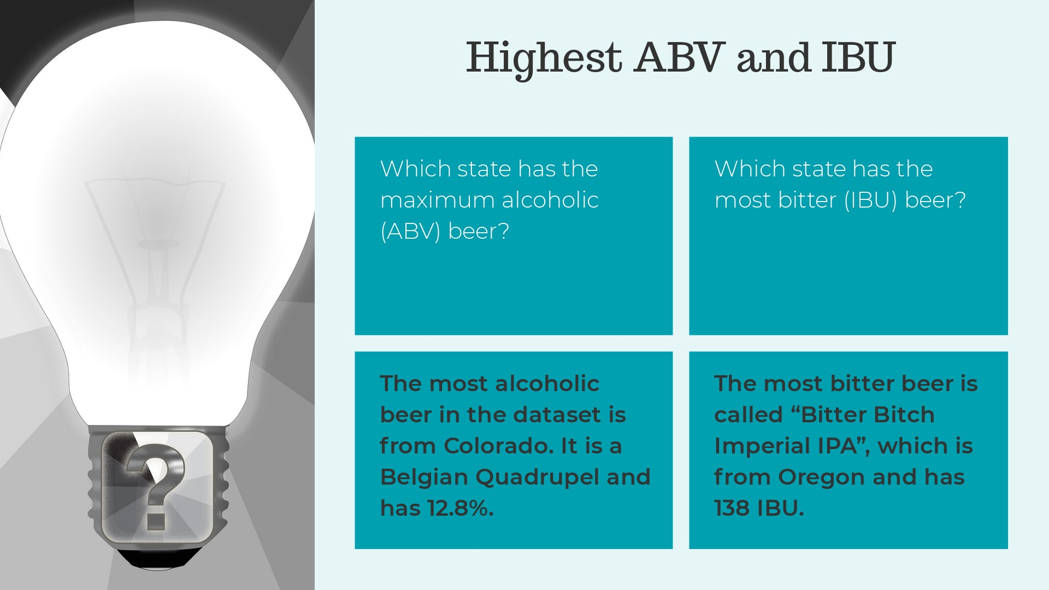

Slide 10
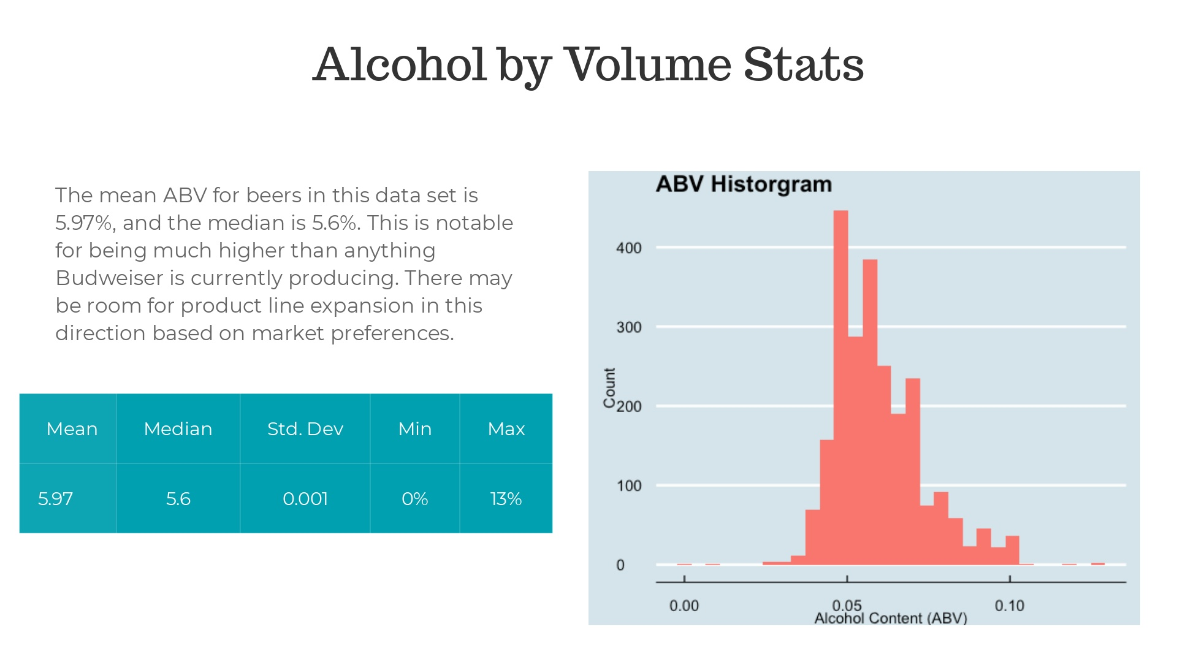
Notes:
The mean ABV for beers in this data set is 5.97%, and the median is 5.6%. This is notable for being much higher than anything Budweiser is currently producing. There may be room for product line expansion in this direction based on market preferences.

Slide 11
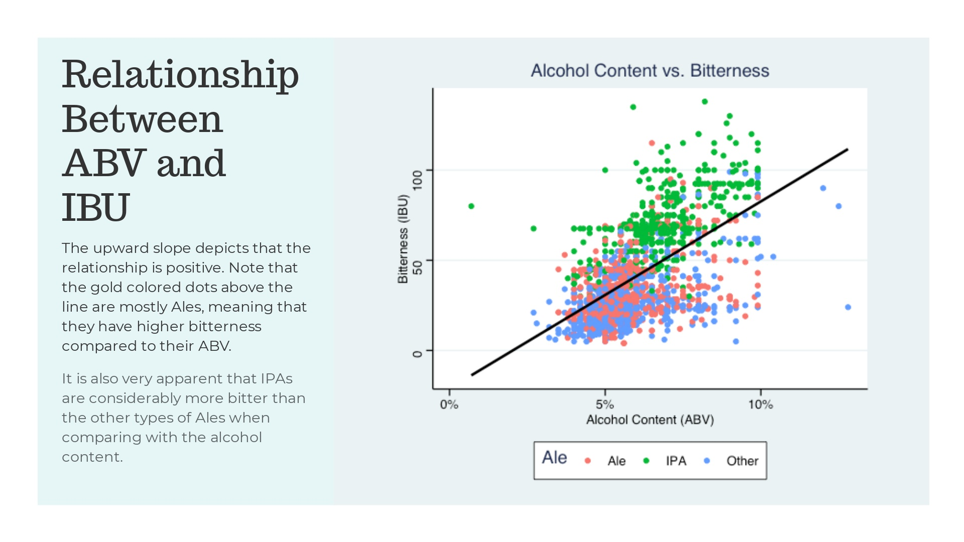

Slide 12
