Slide 1
Neural Metaphor Detection
Nick Saulnier
CS 6120, Fall 2021, NEU Seattle

Slide 2
Why Metaphor Detection?
“Humans use metaphors to conceptualize abstract and often difficult concepts by employing knowledge of more concrete domains. They are prevalent in speech and text, and allow us to communicate more effectively and more imaginatively. The fact that they are commonplace and easily understood by humans makes appropriate interpretation of them essential for high quality natural language processing applications.” ^{[1]}

Slide 3
Project Goals
Become familiar with current state-of-the-art deep learning architectures used for metaphor identification
Compare and contrast different model configurations, focusing mainly on embedding and attention layer setups
GloVe, custom embedding layers
How to process data for in the attention layer
Kept attention layer experiments simple – Luong-style attention layer provided by keras (https://keras.io/api/layers/attention_layers/attention/)
Get F1 scores as close to the baseline (VUAMC verb classification, Gao et al.) as possible!

Slide 4
Dataset – Vrije University Amsterdam Metaphor Corpus
“Largest available corpus hand-annotated for all metaphorical language use, regardless of lexical field or source domain”
Most widely used dataset for training metaphor detection models
Contains text from a variety of academic works, newspapers, conversation, and fiction
Annotations made with MIPVU metaphor identification protocol (Steen et al.) ^{[2]}
Each included sample has inter-annotator reliability score over 0.8
Limited in size (approximately 200,000 words)

Slide 5
Indirect Metaphor
Example:
Professional religious education teachers like Marjorie B Clark (Points of View, today) are doing valuable work in many secondary schools.
Contrast and comparison between basic meaning—concrete, specific or human-related sense—and contextualized meaning.
In this context, valuable refers not to its basic, literal meaning—a lot of money—but to the concept of value as it relates to quality in education.

Slide 6
Direct Metaphor
Example:
He’s like a ferret.
No contrast is made between a contextual and basic meaning. Metaphorical usage is determined by how the word is used, and is often signaled by a word such as ‘like’.
The contextual meaning of ‘a small thin furry animal with a long tail that people use for hunting rabbits and rats’ is also the basic meaning. A comparison is expressed directly and signaled by ‘like’.

Slide 7
Implicit Metaphor
Example:
Naturally, to embark on such as step is not necessarily to succeed in realizing it.
Indicated by semantic and/or grammatical linkage between non-literal usage and a referent that is not immediately identifiable as a direct or indirect metaphor.
By itself, ‘it’ does not call for a metaphorical indirect or direct comparison. But in this case, ‘it’ refers back to the metaphorically used ‘step’ and becomes implicitly metaphorical.

Slide 8
VUAMC Dataset – Shared Tasks
Sequence Labeling – sample sentence is accompanied by a sequence of binary labels indicating the metaphoricity of each word
Sample Sentence: “Most athletes first encountered him as a voice , bellowing in multi-lingual fury at officials who had broken rules or arrangements designed to make racing safer or more fair.”
Sample Labels: [ 0, 0, 0, 0, 0, 0, 0, 0, 1, 0, 0, 0, 0, 0, 0, 0, 0, 0, 0, 0, 0, 0, 0, 0, 0, 0, 0, 0 ]
Classification – sample sentence has a target verb and a binary label indicating if the verb is used literally or metaphorically.
Sample Sentence: “Most athletes first encountered him as a voice , bellowing in multi-lingual fury at officials who had broken rules or arrangements designed to make racing safer or more fair.”
Sample Verb: ‘bellow’
Label: 1

Slide 9
My Approach - Inspirations
Ideas/techniques from several research papers:
Gao et al. (2018) ^{[3]}
Model architecture: Simple Bidirectional LSTM model with attention layer
Data preprocessing: Concatenation of GloVe, ELMo, and locally trained embeddings
Model Evaluation: baseline precision, recall, and F1 scores
Brooks and Yussef (2020) ^{[4]}
Data Preprocessing: 11-gram window with target verb at the center index
F1 scores ~13 points higher than Gao et al.

Slide 10
My Approach – First Attempt Preprocessing Pipeline
Load 840B token, 300d GloVe embeddings into dictionary
Replace remaining words with concatenated GloVe, ELMo, and one-hot POS array
Load ELMo3 module via TensorFlow hub
Create 11-gram windows for each sample with target verb at center index
Basic Preprocessing: to lower case, <UNK> for words not in Glove dict
Generate POS tags for each sample with spaCy

Slide 11
My Approach – First Attempt Problems
Gao et al. code available online – they use this approach, but with PyTorch
Each input sample is 11 arrays, with each token represented by a 1341d concatenated embedding array
TensorFlow does not play nicely with ragged tensors
Various other input size errors, shape mismatches between input and LSTM layers
Memory errors when converting with tf.ragged.constant
Ragged tensors are allegedly not well supported

Slide 12
Approach – Second Attempt
It’s trivial to create a non-trainable GloVe embedding layer
Load GloVe embedding dict
Use keras.preprocessing.text Tokenizer to create a vocab and integer mapping
Create embedding matrix - 300d GloVe vector for each word in vocab
Left-right window padding – use <UNK>
Set the embedding layer weights to the GloVe embedding matrix
Reused window creation code
Downsides
ELMo embedding layer doesn’t work (or is difficult to get working) with TensorFlow 2.0+
TensorFlow Hub API changes

Slide 13
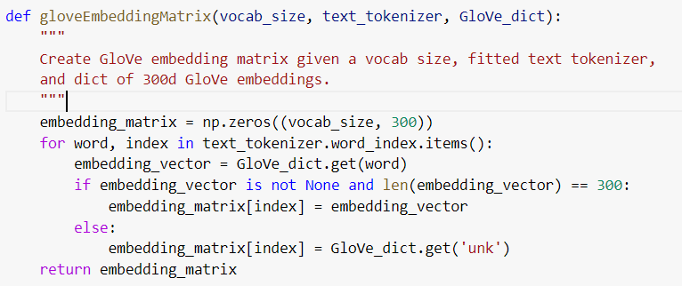
Creating a GloVe Embedding Matrix

Slide 14
Model Training Setup
Hyperparameters:
Epochs: 5
Cross-fold validation
Training seems to be done after 7 or 8 folds
LSTM layer dropout of 0.3, recurrent dropout of 0.2
Batch size: 128
Learning rate: 0.001

Slide 15
Experiments – Input Data
Basic Model
Single hidden LSTM Layer
300 Nodes per layer
Glove embedding layer
Two inputs:
‘Raw’ input – vectorized input containing full sample and label
Windowed input – 11-gram windows
Input | F1 | Precision | Recall | Accuracy
Windowed | 52.04 | 56.68 | 50.90 | 75.41
Raw | 38.55 | 44.41 | 37.11 | 69.50

Slide 16
Experiments – Model Architecture
Experiments with Embedding Layers
GloVe
Custom 300d
Experiments with different attention layer configurations
Hyperparameters – chosen from research articles
Slight deviations and tunings had little to no effect on the results
Output Layer: single node with sigmoid activation
Results too good to be true using softmax and 2 node configuration

Slide 17
Evaluation - Metrics
Standard Metrics
Precision
Recall
Accuracy
Binary Classification, so researchers mainly use F1 score to compare models

Slide 18
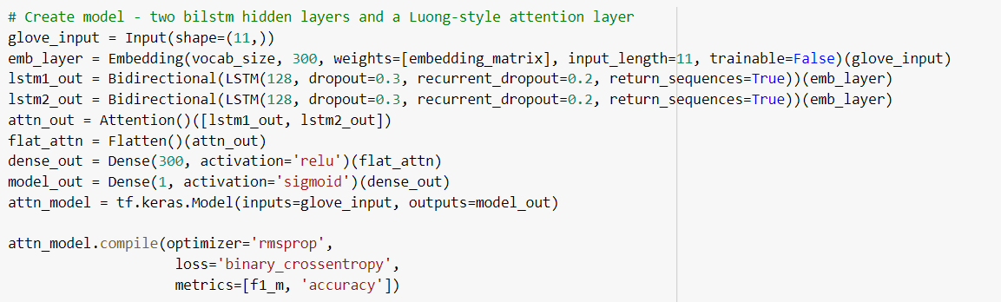
Two biLSTM model with GloVe embedding and attention layer
Purpose: examine the affects of multiple biLSTM layers and an attention layer on performance.

Slide 19
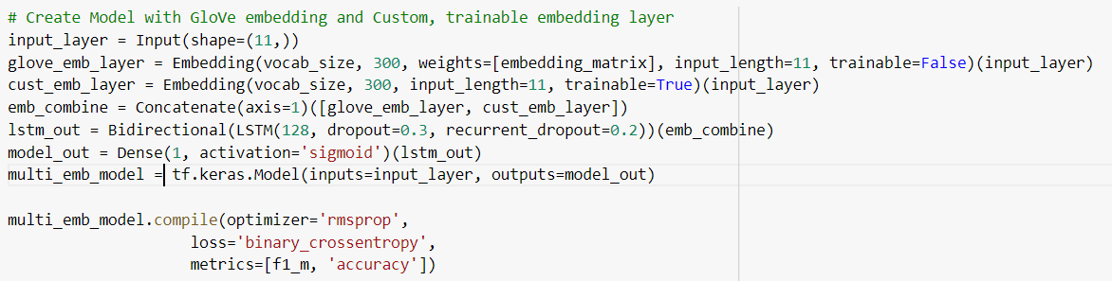
Single biLSTM hidden layer with GloVe and custom 300d embedding layers
Purpose: examine the affects of adding a custom 300d embedding layer and combining it with a GloVe embedding layer

Slide 20
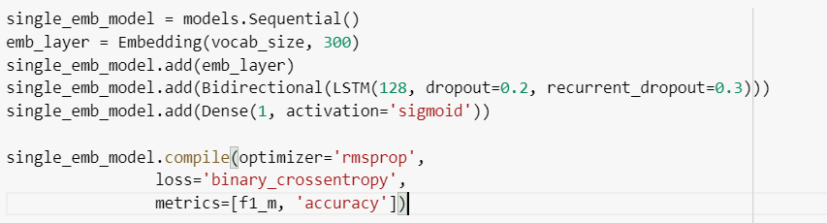
Single biLSTM layer model with a custom 300d embedding layer and no GloVe
Purpose: examine the difference in performance between custom 300d embedding layer and GloVe embedding layer

Slide 21
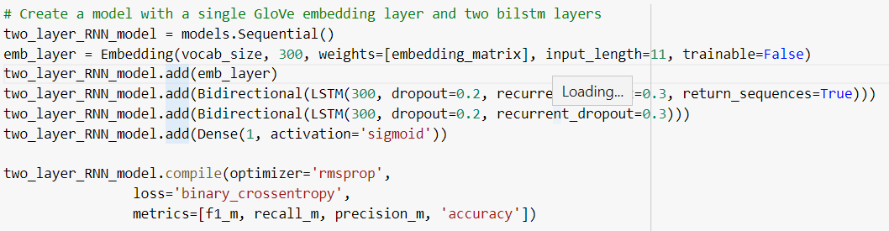
Two biLSTM layer model with single GloVe embedding layer
Purpose: Compare this model’s performance against the same model with an attention layer

Slide 22
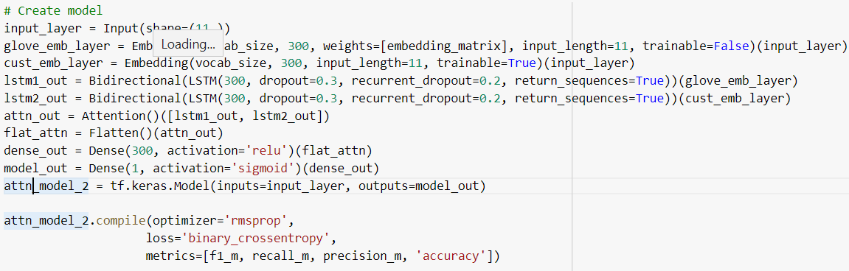
Two biLSTM layers with custom 300d and GloVe embeddings and attention layer
Purpose: combine all experimental variations to examine their combined affects on model performance.

Slide 23
Model Performance – Table Key
Model # | Description
Model 1 | Single biLSTM with GloVe embedding layer and windowed (11-gram) input
Model 2 | Single biLSTM with GloVe embedding layer and ‘raw’ non-windowed input
Model 3 | Two biLSTM layers with GloVe embedding and attention layer
Model 4 | Single biLSTM with GloVe and custom 300d embedding layer
Model 5 | Single biLSTM with custom 300d embedding layer
Model 6 | Two biLSTM with GloVe embedding layer
Model 7 | Two biLSTM with GloVe embeddings, custom 300d embeddings, and attention layer

Slide 24
Model Performance
 | Precision | Recall | F1 Score | Accuracy
Model 1 | 56.68 | 50.90 | 52.04 | 75.41
Model 2 | 44.41 | 37.11 | 38.55 | 69.50
Model 3 | 54.95 | 50.51 | 50.96 | 74.48
Model 4 | 54.06 | 53.43 | 52.42 | 74.56
Model 5 | 48.78 | 51.55 | 48.63 | 71.12
Model 6 | 58.42 | 48.56 | 51.51 | 76.08
Model 7 | 48.40 | 58.82 | 51.68 | 70.99

Slide 25
Brooks and Yussef Results – VUAMC Classification (All POS)
VUAMC – Test
Task | Precision | Recall | F1 Score | Accuracy
Classification | 68.3 | 71.5 | 0.689 | -

Slide 26
Gao et al. Results – VUAMC Classification and Sequence Labeling
VUAMC – Test
Task | Precision | Recall | F1 Score | Accuracy
Classification | 53.4 | 65.6 | 58.9 | 69.1
Sequence Labeling | 68.2 | 71.3 | 69.7 | 81.4

Slide 27
Takeaways
Adding an additional biLSTM layer had little affect on results (highest F1 score achieved with single biLSTM and both GloVe and custome embedding layers)
Apart from inputting the sample text as an 11-gram centered on the target verb, GloVe embeddings alone provided the greatest boost in performance
My models had much lower recall scores than Gao et al. – too many false negatives, and I’m not sure why
Other than that (and the resultant lower F1 scores), performance was comparable
By the end of the eighth fold, all models (besides the raw input model) had both validation and training metrics all above 0.99
Novel metaphors are very difficult to classify

Slide 28
Future Work
We need better training data to improve scores and correctly classify novel metaphors
VUAMC dataset is over 10 years old and unbalanced towards verbs (which is all I worked on)
Annotated data is expensive and difficult to generate
Alternative data generation experiments (like Steen et al.)
Exploiting syntax to identify additional data using VerbNet
VerbNet network of English verbs that links syntactic and semantic patterns
Using “syntactic properties of certain lexemes” to identify relevant samples using dependency parsers

Slide 29
Citations
[1] Stowe et al., “Linguistic Analysis Improves Neural Metaphor Detection,” Proceedings of the 23rd Conference on Computational Natural Language Learning (CoNLL), Nov. 2019. [Online] Available: https://aclanthology.org/K19-1034/ [Accessed Nov. 27, 2021].
[2] Steen et al., “A Method for linguistic metaphor identification. From MIP to MIPVU,” John Benjamins, Amsterdam, 2010.
[3] Gao et al., “Neural Metaphor Detection in Context,” Proceedings of the 2018 Conference on Empirical Methods in Natural Language Processing, Oct.-Nov. 2018. [Online] Available: https://aclanthology.org/D18-1060/ [Accessed Nov. 27, 2021].
[4] Jennifer Brooks and Abdou Youssef, “Metaphor Detection using Ensembles of Bidirectional Recurrent Neural Networks,” Proceedings of the Second Workshop on Figurative Language Processing, July 2020. [Online] Available: https://aclanthology.org/2020.figlang-1.33/ [Accessed Nov. 27, 2021].
[5] Netherland Organization for Scientific Research. [Online] Available: http://www.vismet.org/metcor/documentation/ home.html [Accessed Nov. 27, 2021].

