Slide 1
State Persistence/ Multi-container Patterns

Slide 2
Outline
Introducing K8S volumes
Persistence in a Pod
Persistent Volumes / Persistent Volume Claims
Multi-container patterns:
  Init Container Pattern
  Sidecar Container Pattern
Lab

Slide 3
K8S Volumes
A Volume is a Kubernetes capability that persists data beyond a Pod restart
Essentially, a Volume is a directory that’s shareable between multiple containers of a Pod
Persistent Volumes are a specific category of the wider concept of Volumes. The mechanics for Persistent Volumes are slightly more complex.
The Persistent Volume is the resource that actually persists the data to an underlying physical storage

Slide 4
K8S Volumes
The Persistent Volume Claim represents the connecting resource between a Pod and a Persistent Volume responsible for requesting the storage
The Pod needs to claim the Persistent Volume and mount it to a directory path available to the containers running inside of the Pod.

Slide 5
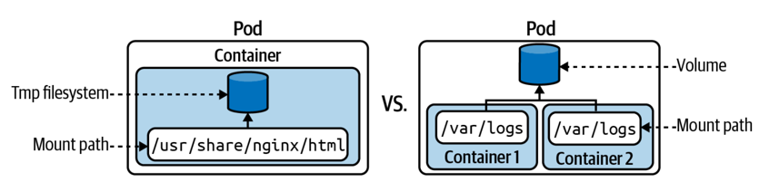
A container using a temp filesystem vs a Volume

Slide 6
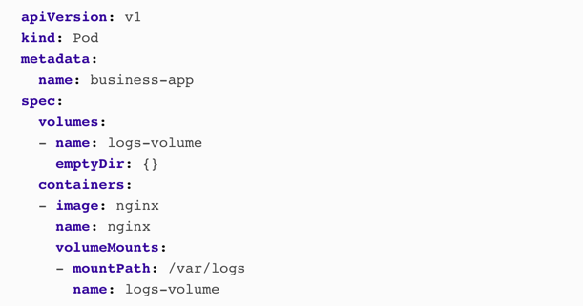
A pod with volume

Slide 7
Persistent Volumes
In many applications, the data lives far beyond the lifecycles of the applications, container, Pod, nodes, and even the clusters themselves
Data persistence ensures the lifecycles of the data are decoupled from the lifecycles of the cluster resources.
A typical example would be data persisted by a database. That’s the responsibility of a Persistent Volume. Kubernetes models persist data with the help of two primitives: the PersistentVolume and the PersistentVolumeClaim

Slide 8
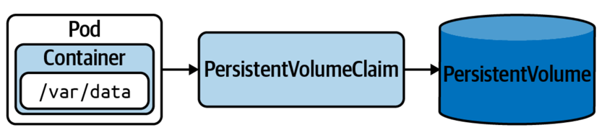
Claiming a Persistent Volume from a Pod

Slide 9
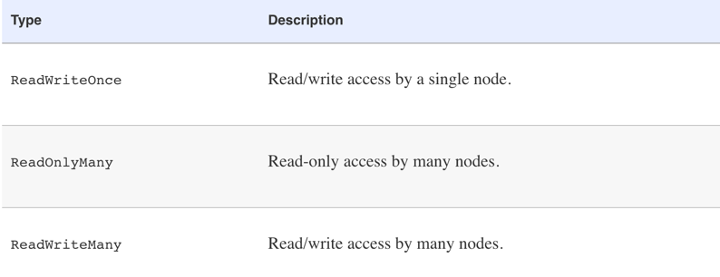
Persistent Volumes access modes

Slide 10
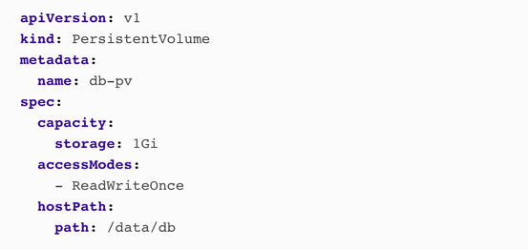
Creating a Persistent Volume

Slide 11
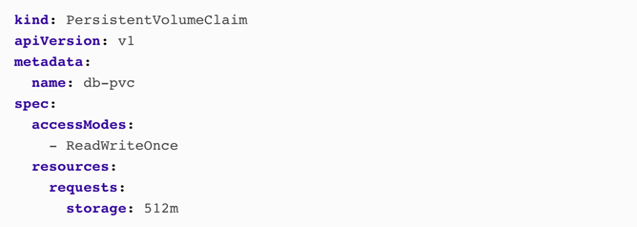
Creating a Persistent Volume Claim

Slide 12
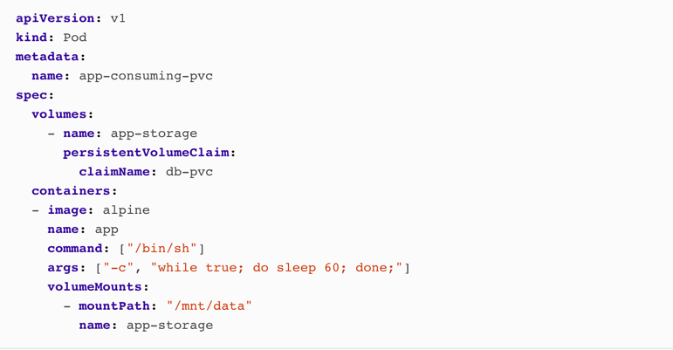
Mounting Persistent Volume Claims in a Pod

Slide 13
Multi-Container Kubernetes Patterns

Slide 14
Init Containers Pattern
Init Containers enable separation of concerns by providing a separate lifecycle for initialization-related tasks distinct from the main application containers.
Init Containers are similar to constructors in OOP, but at Pod level rather than class level
if you have one or more containers in a Pod that represent your main application, these containers may have prerequisites before starting up
These may include setting up special permissions on the filesystem, database schema setup, or application seed data installation.

Slide 15
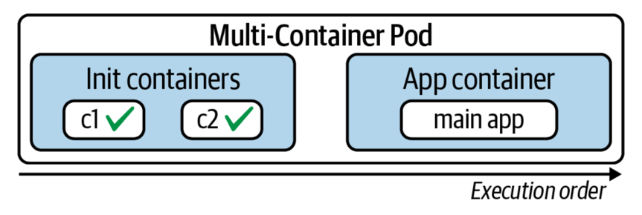
Init Containers

Slide 16
Sidecar Container Pattern
Typically, there are two different categories of containers:
  The container that runs the application
  Another container that provides helper functionality to the primary application
  In K8S, the container providing helper functionality is called a sidecar
  Among the most commonly used capabilities of a sidecar container are file synchronization, logging, and watcher capabilities
  Having single-purpose reusable containers requires ways of extending the functionality of a container and a means for collaboration among containers
  The Sidecar pattern describes this kind of collaboration where a container enhances the functionality of another preexisting container.

Slide 17
Sidecar Container Pattern
A typical example used to demonstrate this pattern is with an HTTP server and a Git synchronizer.
The HTTP server container is focused only on serving files over HTTP and does not know how and where the files are coming from.
Similarly, the Git synchronizer container’s only goal is to sync data from a Git server to the local filesystem. It does not care what happens to the files once synced, and its only concern is keeping the local folder in sync with the remote Git server

Slide 18
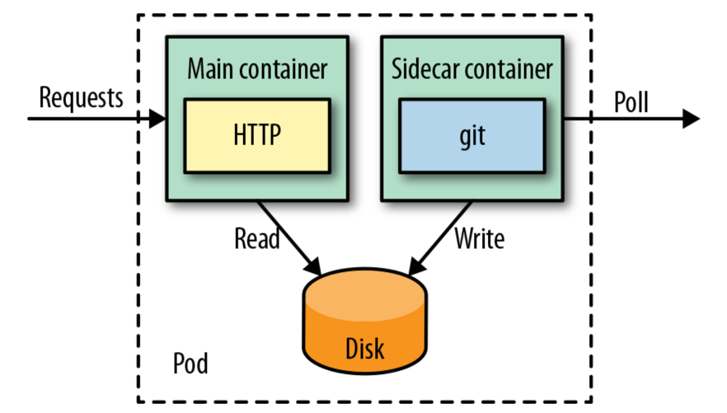
Sidecar Container Pattern

Slide 19
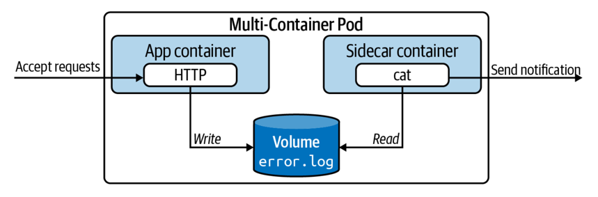
Sidecar Container Pattern

Slide 20
State Persistence/ Multi-container Patterns

