Slide 1
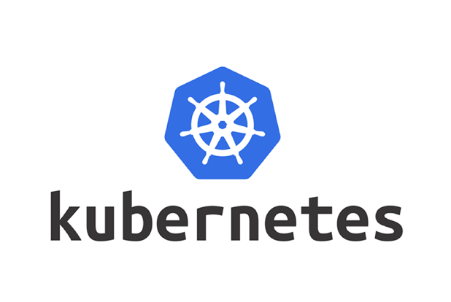

Slide 2
Containers
A container is a lightweight, stand-alone, executable package of software that includes everything needed to run it: code, runtime environment, system tools, system libraries and settings.
Containers isolate software from it’s surroundings
It reduces conflict between teams running different software on the same infrastructure

Slide 3
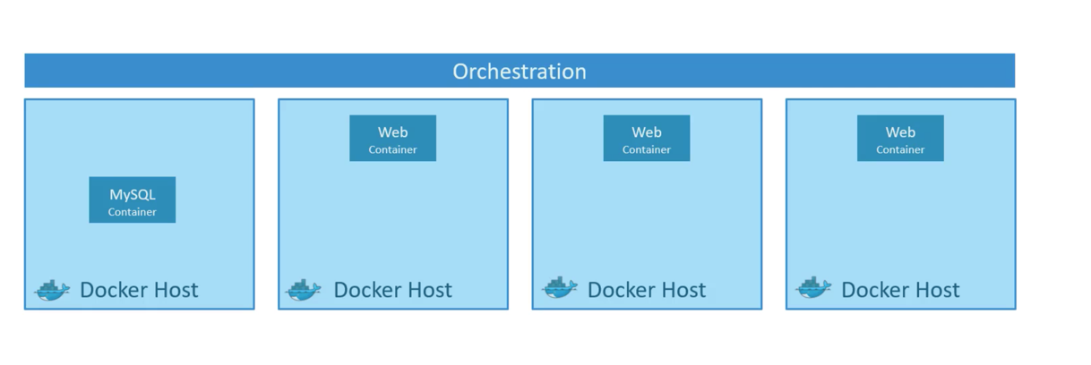
Why Container Orchestration
Container orchestration manages the availability, scaling and networking of containers.
It helps in monitoring the cluster i.e., group of hosts
It helps in managing the timing of container creations
It helps in container configuration in order to allow containers to communicate with one another

Slide 4
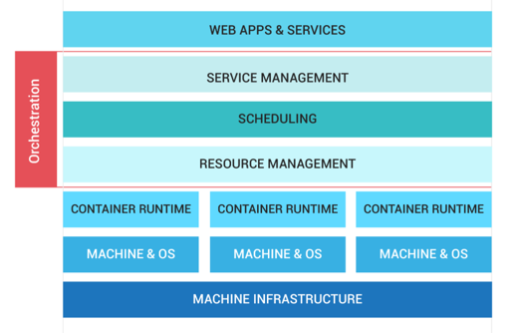
Container Orchestration

Slide 5
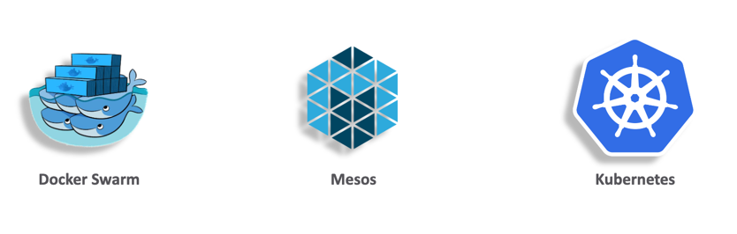
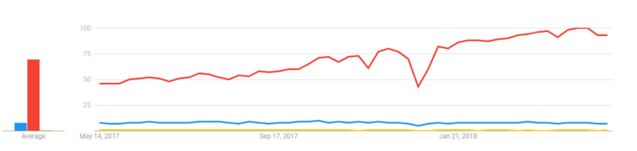
The top 3 Container Orchestrators

Slide 6
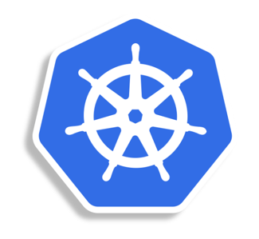
What is Kubernetes?
It’s an open source orchestration system which is used for:
  Deployment of containerized applications
  Scaling of containerized applications
  Management of containerized applications

Slide 7
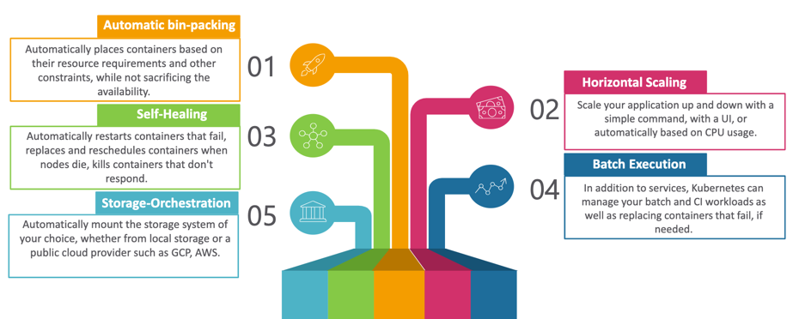
Features of Kubernetes

Slide 8
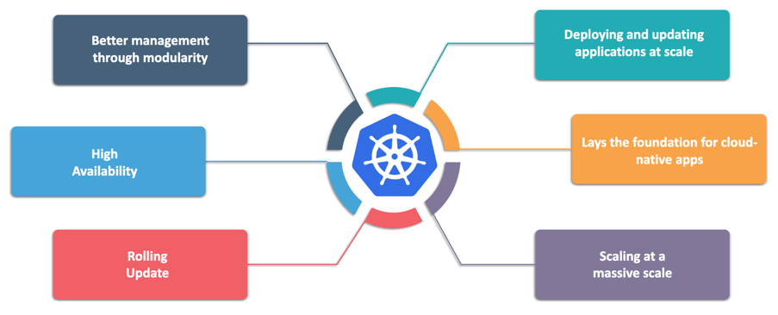
Advantages of Kubernetes

Slide 9
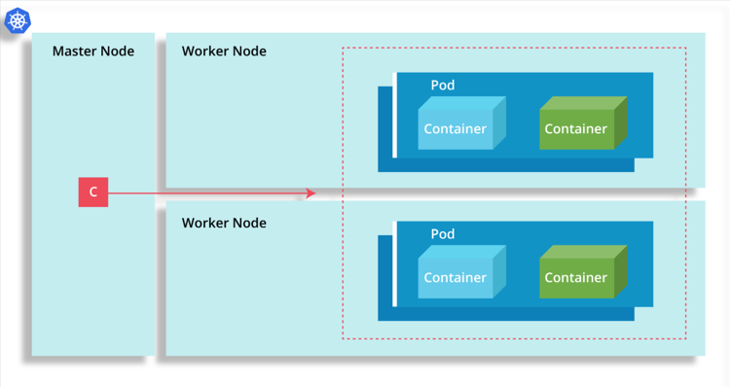
Kubernetes Cluster Architecture

Slide 10
Kubernetes Cluster Components
Master Node: Cluster master manages the Kubernetes API Server, resource controller and scheduler. It’s life cycle is managed by Kubernetes engine when starting
Worker Node: Worker node previously known as minions maybe a physical machine or a virtual machine based on the cluster
Pods: Pods are group of containers which are tightly coupled together. This is done, when the containers are dependent on each other.

Slide 11
Kubernetes Master
Kube-apiserver: It validates and configures all the data for the API objects which includes pods, services, replica controllers, and others
Kube-controller-manager: It’s a daemon that includes the non terminating loops (that regulates the state of the system) shipped with Kubernetes
Etcd: It’s a distributed key-value store designed to reliably and quickly preserve and provide access to critical data
Kube-scheduler: The Kubernetes scheduler is a work-load specific function that significantly impacts availability, performance, and capacity. Workload-specific requirements will be exposed through the API as required.

Slide 12
Kubernetes Worker Nodes
Kubelet: It’s a foremost node agent running on each node works under the terms of PodSec. A PodSec is a YAML or JSON object that describes a pod
Kube-Proxy: Kubernetes network proxy runs on each node
Container Runtime: The container runtime is the software that is responsible for running containers. Kubernetes supports several runtimes: Docker, rkt, runc and any OCI runtime-spec implementation

Slide 13
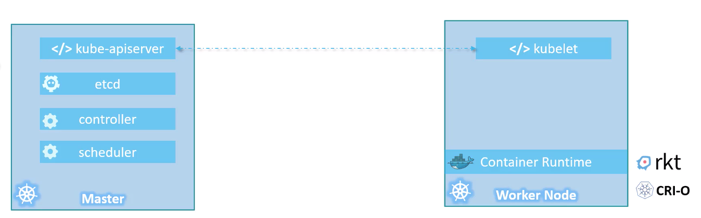
Master vs Worker Nodes

Slide 14
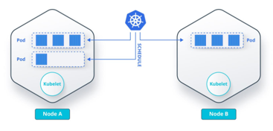
Kubernetes Pods
Containers are deployed and scheduled through Kubernetes in a group called Pods.
These are tightly coupled containers i.e. the applications running on them are dependent on each other
1 to 5 tightly coupled containers can be stored in a pod that collaborate to provide a service

Slide 15
Kubectl Introduction
It’s a Kubernetes command line tool which is used to deploy and manage applications on Kubernetes
It helps in inspecting the Kubernetes cluster resources
By using Kubectl, we can create, delete, and update components on Kubernetes cluster

Slide 16
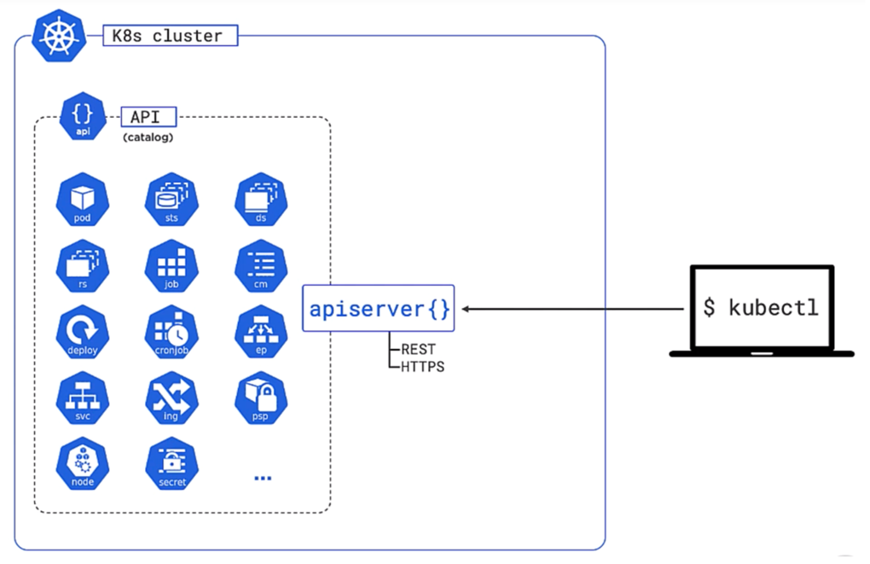
Kubectl

Slide 17
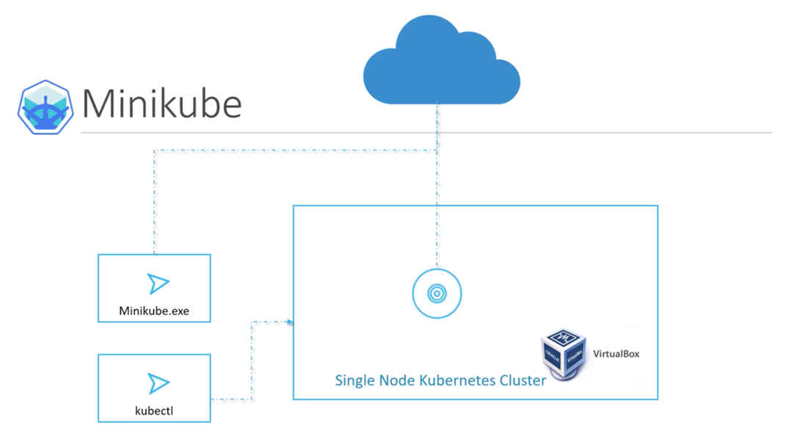
Minikube

Slide 18
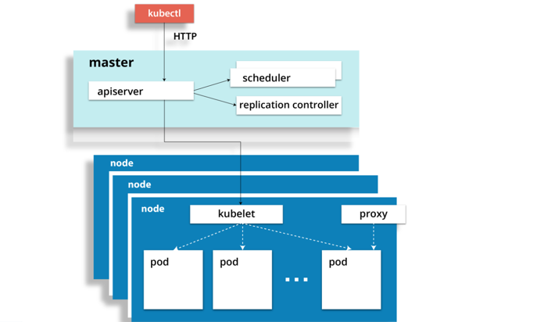
How Kubectl works

Slide 19
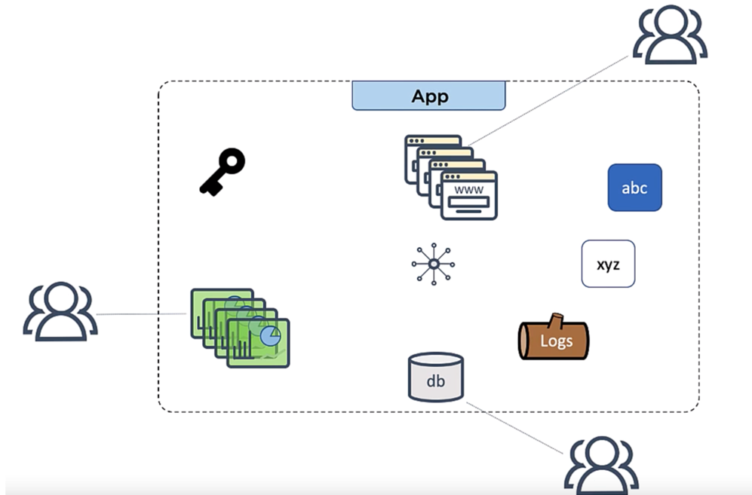
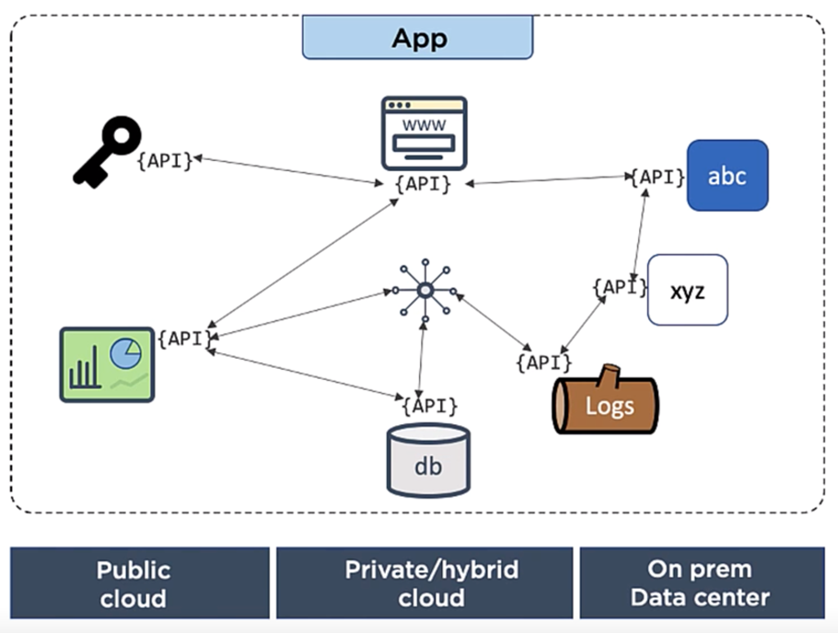
Monolith vs Microservices

Slide 20
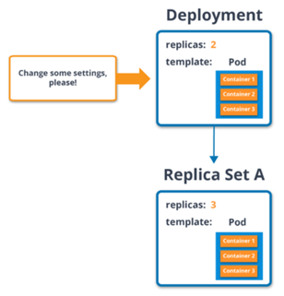
Deployment in Kubernetes
Deployment can be defined to create new replicasets
It can also be defined to remove the existing deployment and use all their resources with new Deployments
Selector field defines how the pods management sequence is determined by deployment

Slide 21
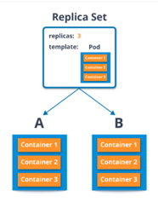
ReplicaSet
A replicaSet makes sure that stated number of pod replicas are running at any instant of time
It can be scaled up or down
ReplicaSet controller ensures that a desired number of pods with a matching label selector are available and operational

Slide 22
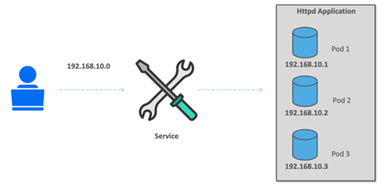
Services in Kubernetes
Services act like load balancers in Kubernetes,
they also have an IP address. This IP address automatically route to healthy pods. In case the pods becomes unhealthy the service automatically routes to next healthy pod. Hence, with this the user will interact with only one IP address.

Slide 23
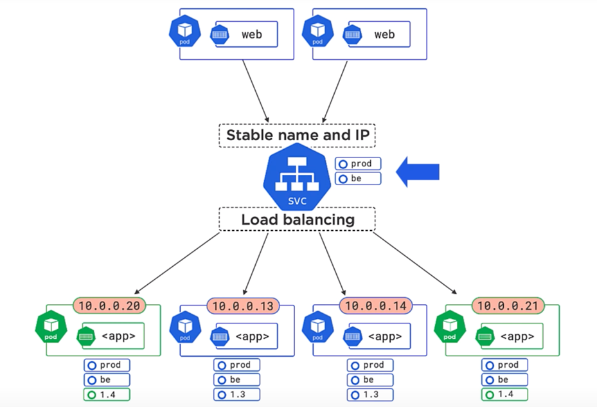
Services in Kubernetes
Services define the logical set of pods and the policy through which they will be accessed
They are the abstractions, and sometimes called as micro-services
Label selectors determines the set of pods to be targeted by services

Slide 24
Namespaces
Namespaces are intended for use in environments with many users spread across multiple teams, or projects.
Namespaces provide a scope for names. Names of resources need to be unique within a namespace, but not across namespaces.
Namespaces cannot be nested inside one another and each Kubernetes resource can only be in one namespace.
Namespaces are a way to divide cluster resources between multiple users.
It is not necessary to use multiple namespaces just to separate slightly different resources, such as different versions of the same software: use labels to distinguish resources within the same namespace.

Slide 25
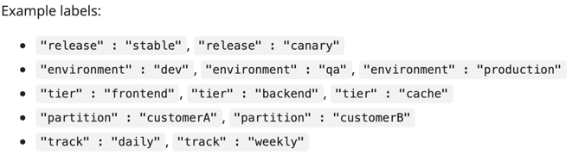
Labels
Labels are key/value pairs that are attached to objects, such as pods.
Labels can be used to organize and to select subsets of objects.
Labels can be attached to objects at creation time and subsequently added and modified at any time.
Each object can have a set of key/value labels defined. Each Key must be unique for a given object.
Labels enable users to map their own organizational structures onto system objects in a loosely coupled fashion.

Slide 26
Commands
kubectl cluster-info
kubectl get nodes
kubectl get pods
kubectl get pods -o wide
kubectl get pods --watch
kubectl get svc
kubectl get deployments
kubectl get replicaset
kubectl describe pods
kubectl run tomcat --image tomcat:8.0 --port=8080

Slide 27
Commands
kubectl delete pod tomcat
kubectl expose pod tomcat --name=tomcat-svc --target-port=8080 --type=NodePort
kubectl delete service tomcat-svc
kubectl create deployment app1 --image aldiab/webapp
kubectl scale deployment app1 --replicas 3
kubectl expose deployment app1 --type LoadBalancer --port 80 --target-port 8080
kubectl delete deployment app1

Slide 28
Commands
kubectl get namespace
kubectl get pods --namespace=ns1
kubectl create namespace ns1
kubectl get pods --show-labels
kubectl run nginx --image=nginx --namespace=ns1
kubectl create -f https://k8s.io/examples/admin/namespace-dev.json
kubectl get pods -l 'env in (production, development)'
kubectl get pods -l env=development
kubectl run nginx --image=nginx --namespace=ns1
kubectl label pods tomcat label3=healty
kubectl label --overwrite pods tomcat status=unhealthy

Slide 29


