Slide 1


CONFIGURATION MANAGEMENT I

Slide 3
Ansible > Why do we need it?
Easy way to configure / provision a machine
Human-readable, it uses YAML files to define the infrastructure.
Maintain our infrastructure definition in a version control system (GIT).
We can use it as a documentation of our infrastructure.
Have as similar as possible the development and production environments.

Slide 4
Ansible > Remote machine requirements
SSH
Python

Slide 5
Ansible > General overview
ssh
ubuntu
web
10.0.2.33
ssh
Ansible Controller Machine
ubuntu
web
ssh
10.0.2.34
ubuntu
web
10.0.2.35
Inventory 10.0.2.33
10.0.2.34
10.0.2.35
….
Playbook web
5

Slide 6
Ansible > Installation in the Controller Machine
We only need Ansible in the controller machine (Jenkins in our case)
Requirements: Python 2 (version 2.7) or Python 3 (versions 3.5 or higher)
Windows is not supported for a controller machine :)
Install on Ubuntu:
$ sudo apt-get update
$ sudo apt-get install software-properties-common
$ sudo apt-add-repository --yes --update ppa:ansible/ansible
$ sudo apt-get install ansible
Install on Mac:
$ brew install ansible

Slide 7
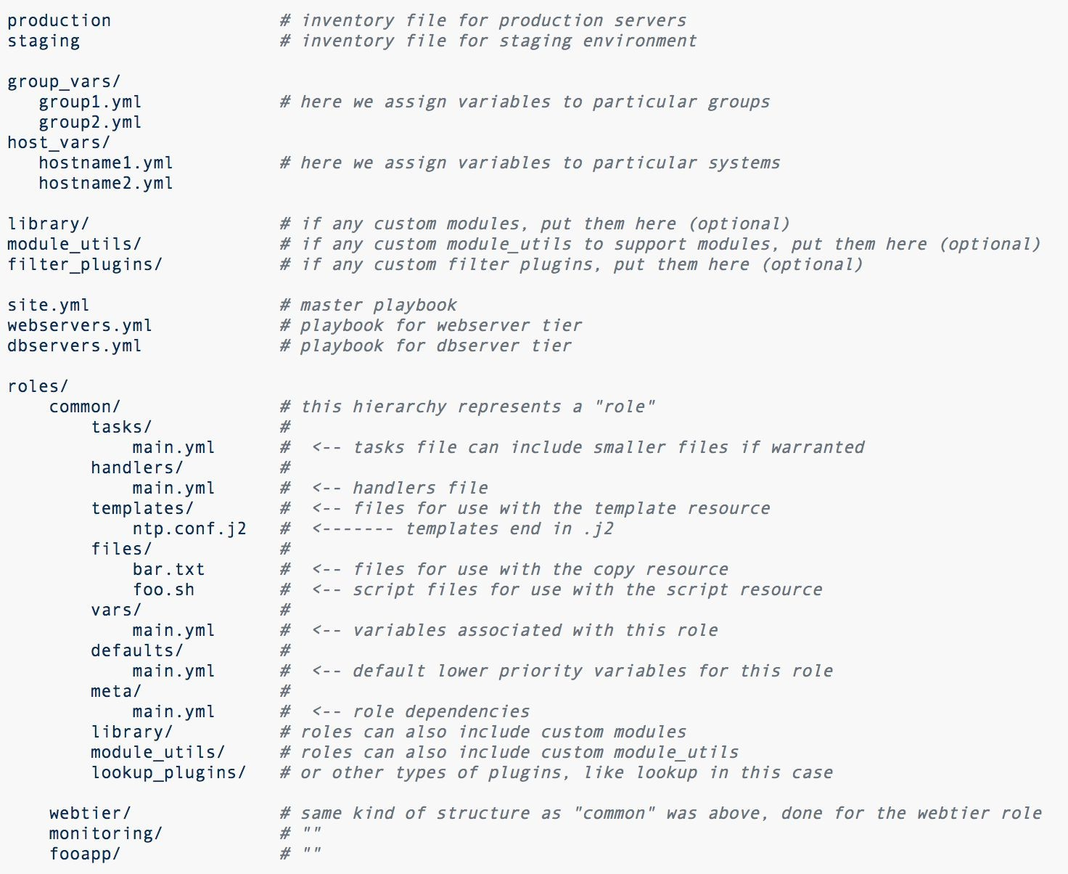
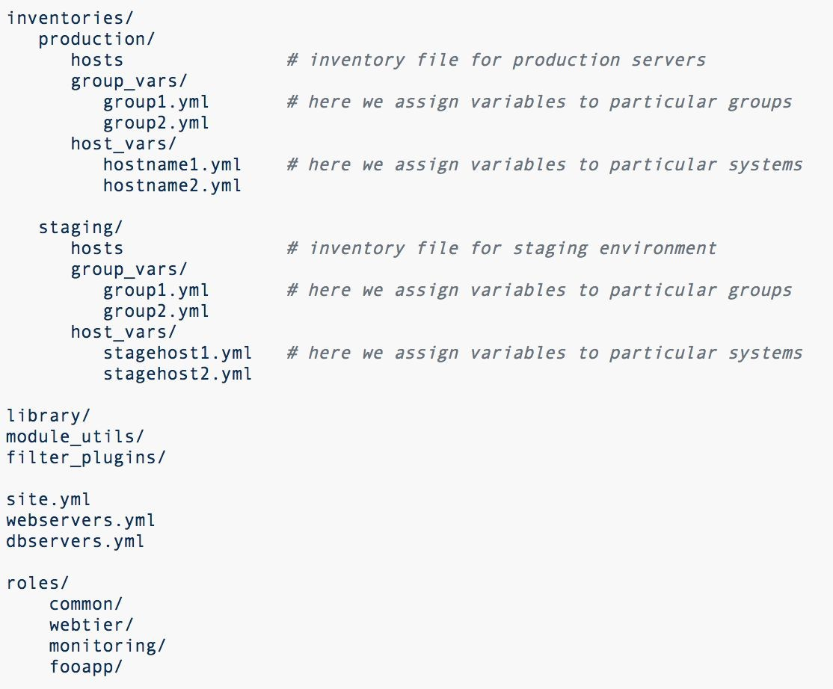
Ansible > Directory Layout

Slide 8
Ansible > Directory Layout
inventory
inventories
variables
variables
inventory
variables
playbooks
roles
playbooks
roles

Slide 9
Ansible > Playbook
It is the entry point when we want to execute ansible
It is like a script where you specify each task to configure a machine.
It is written using YAML syntax.
Each Playbook is composed of one or more “Plays”

Slide 10
Ansible > Playbook > Play
A Play maps a group of hosts to some defined roles. Hosts are defined in a
separate files called Inventories.
A Role is a group of “tasks”.
A Task is a call to an Ansible module

Slide 11
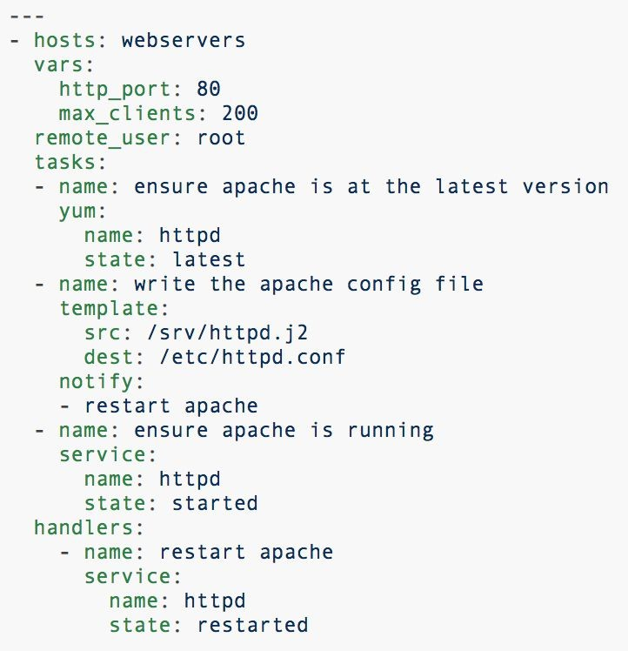
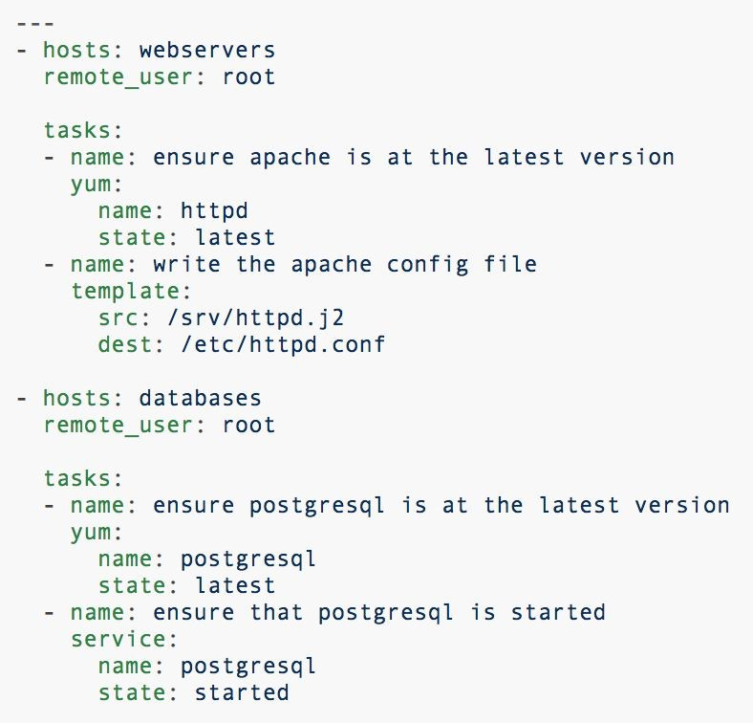
Ansible > Playbook > Example
playbook_1.yml
playbook_2.yml
P1
P2
Playbook with one Play
Playbook with two Plays

Slide 12
Ansible > Playbook > Execution
To execute a playbook you need to type:
$ ansible-playbook [options] playbook.yml [playbook2 ...]
Execute the playbook playbook_1.yml:
$ ansible-playbook -i inventories/production playbook_1.yml

Slide 13
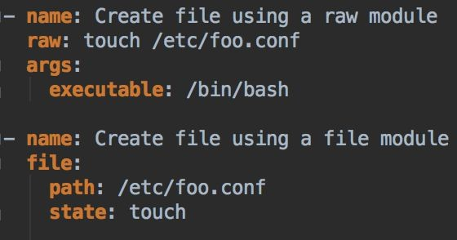
Ansible > Modules (Task or Library plugins)
Units of code we can use from the command line or in a playbook
Simplify the readability and the way to execute actions on each task.
Example:
List of all modules: https://docs.ansible.com/ansible/latest/modules/list_of_all_modules.html
List of modules by category: https://docs.ansible.com/ansible/latest/modules/modules_by_category.html

Slide 14
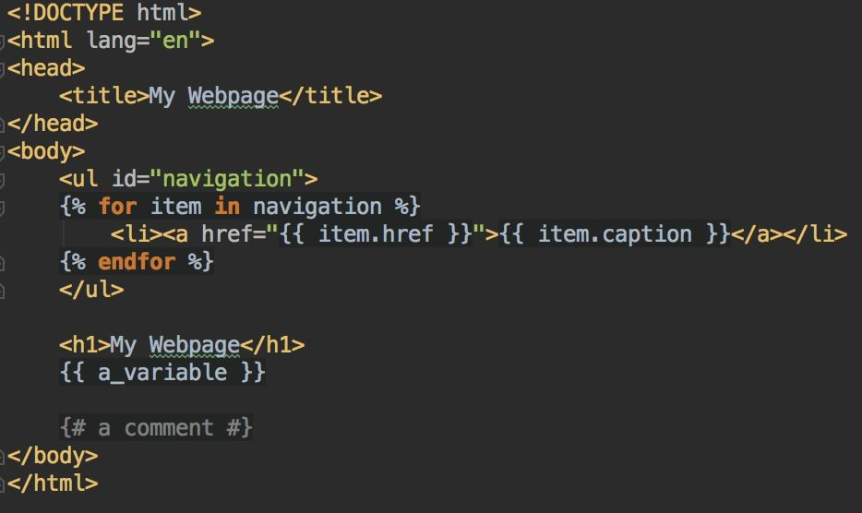
Ansible > Modules > template
Ansible module used to define configuration file templates where we can use variables inside them.
Templates are processed by the Jinja2 templating language (http://jinja.pocoo.org/docs/).
template_example.html.j 2
14

Slide 15
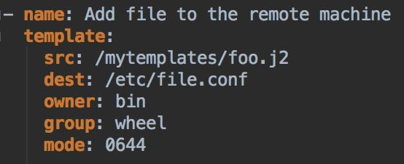
Ansible > Modules > template
Example of a task using this module:
https://docs.ansible.com/ansible/latest/modules/template_module.html#template-module

Slide 16
Ansible > Handlers
Run operations on change.
Playbooks have a basic event system to respond when they detect a change in the remote machine.
A change can be made by one or more modules.
When a module of a task makes a change in the remote machine, we can notify about this change to execute some actions.
“Notify” actions are triggered at the end of each block of tasks in a play.
“Notify” actions will only be triggered once even if notified by multiple tasks.

Slide 17
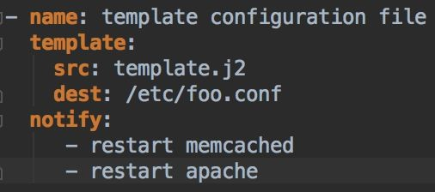
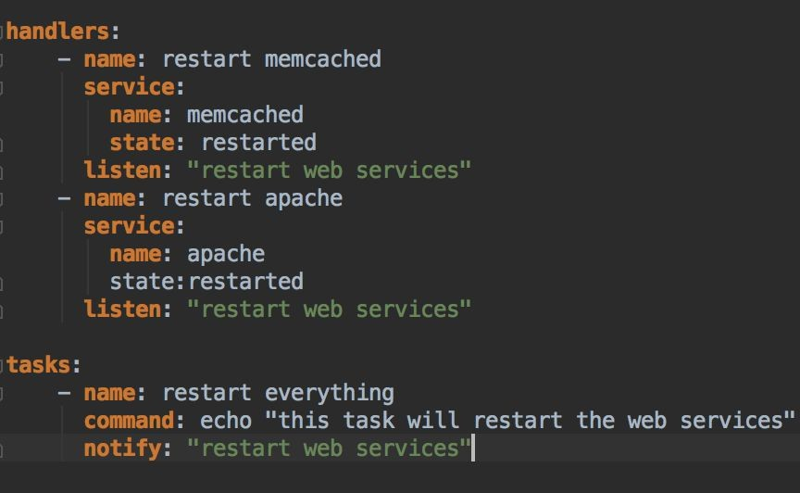
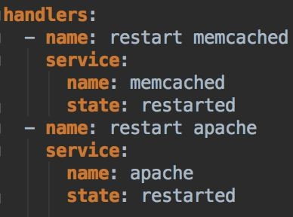
Ansible > Handlers > Example
New since Ansible 2.2

Slide 18
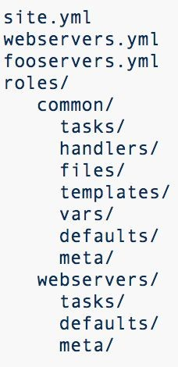
Ansible > Roles > Structure
A way to load some variables, tasks, handlers and files to easy reusing tasks in multiple playbooks using roles.
Possible directories in a role:
tasks: tasks to be executed in the role
handlers: handlers used in this role or outside this role
files: files can be deployed via this role
templates: templates can be deployed via this role
vars: variables of this role
defaults: default variables of this role (can be overridden by other variables).
meta: list of role dependencies for this role
If a directory is used, it must have at least the main.yml

Slide 19
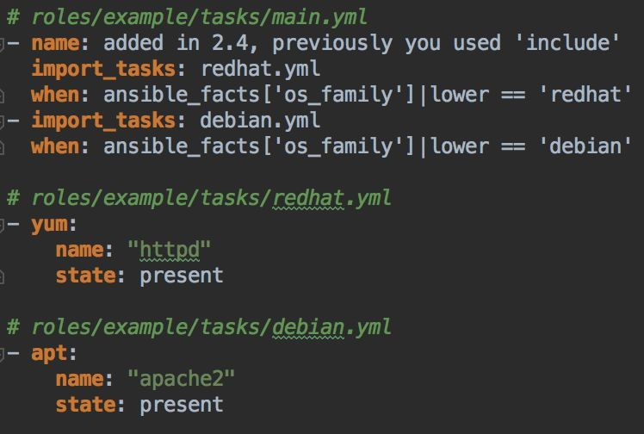
Ansible > Roles > Organizing tasks

Slide 20
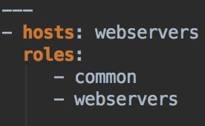
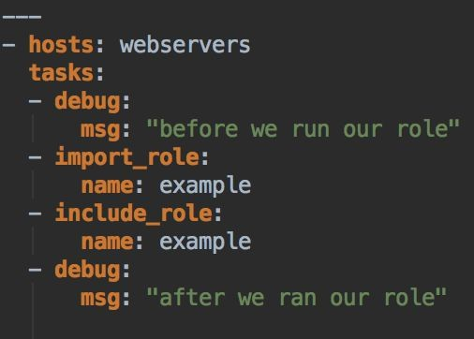
Ansible > Roles > Using roles in a Playbook
playbook.yml (original version)
playbook.yml (since Ansible 2.4)

Slide 21
Ansible > Roles > Dependencies
Defined in the meta/main.yml file.
List of dependencies a role needs.
Each role dependency will be executed before the main role.
We can specify some variables for this role.

Slide 22
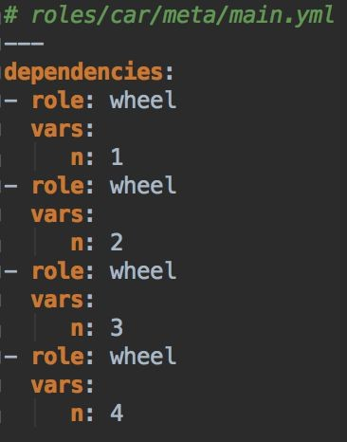
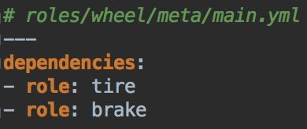
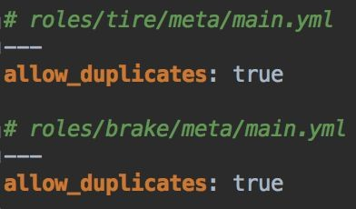
Ansible > Roles > Dependencies > Example
*Note that the role wheel does not need allow_duplicates: true because each wheel has a
different parameter (n).
22

Slide 23
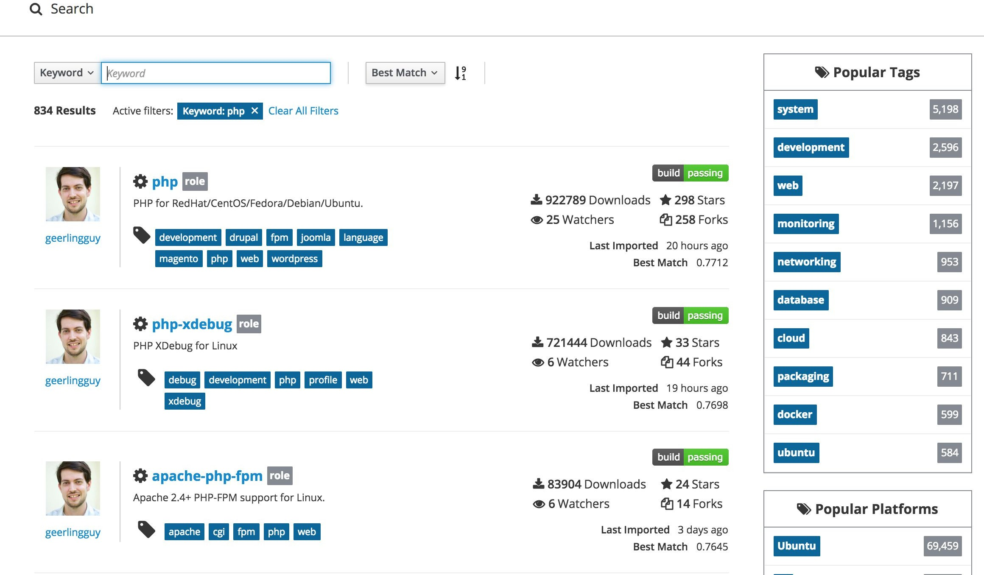
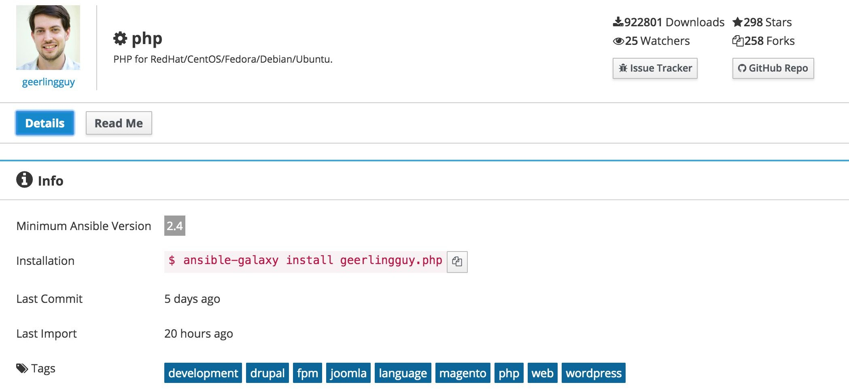
Ansible > Ansible Galaxy
Open source platform to find and use roles.
See more: https://galaxy.ansible.com/

Slide 24
Ansible > Ansible Galaxy > Install external roles
If our project needs roles from Ansible Galaxy or another source, we can install each one using:
$ ansible-galaxy install username.role_name
Or installing all together using a requirements.yml file:
$ ansible-galaxy install -r requirements.yml

Slide 25
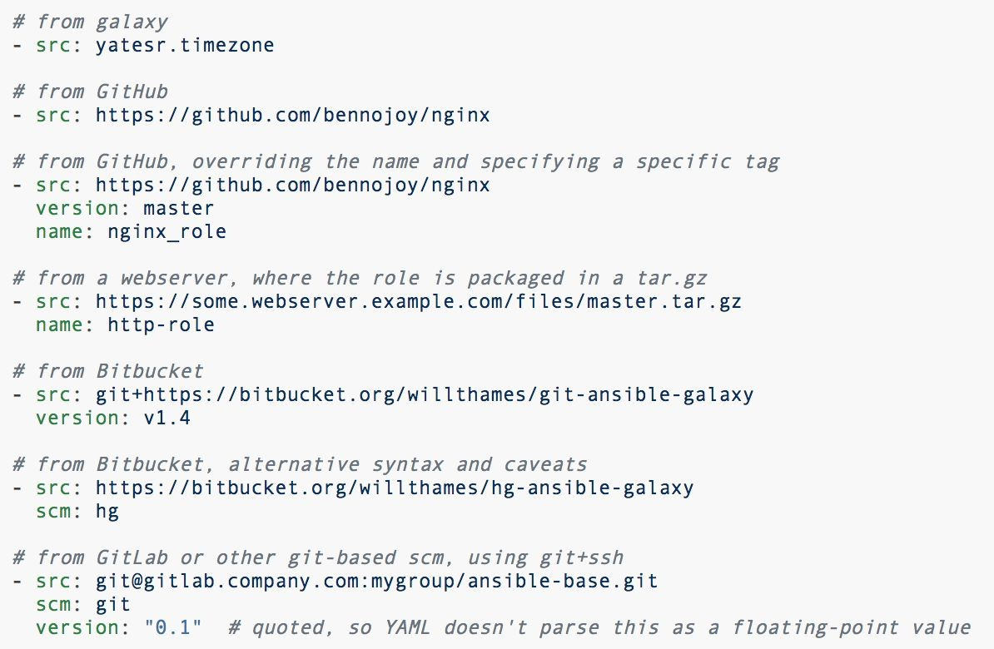
Ansible > Ansible Galaxy > Install external roles
The requirements.yml file has the following aspect:
requirements.yml

Slide 26
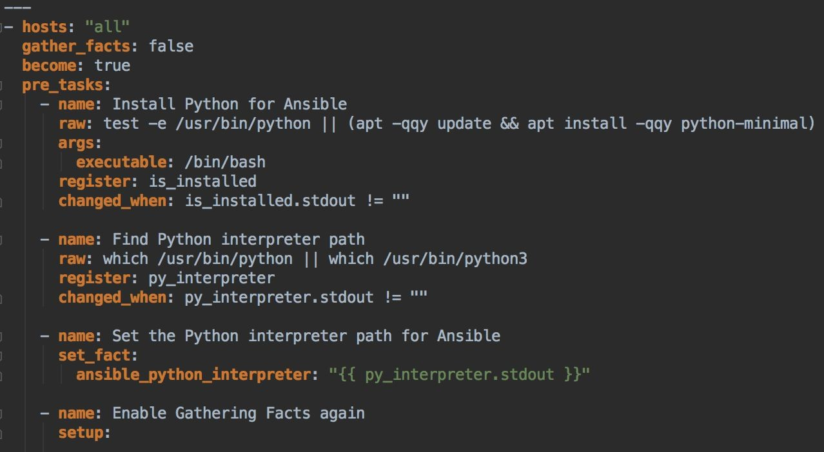
Ansible > Gather facts
Collect data from remote machines to be used in playbooks.
It is a call performed by Ansible at the very beginning.
Data we can collect: ansible 127.0.0.1 -m setup
_bootstrap_for_ansible.yml

Slide 27
Ansible > Inventories
An inventory is the place where our systems are listed.
Ansible can work with multiple systems at the same time.
There’s a dynamic inventory to retrieve our remote machines when we need to provision them*.
*More info about Dynamic inventories: https://docs.ansible.com/ansible/latest/user_guide/intro_dynamic_inventory.html

Slide 28
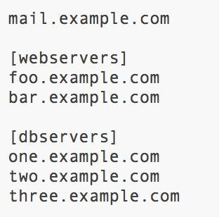
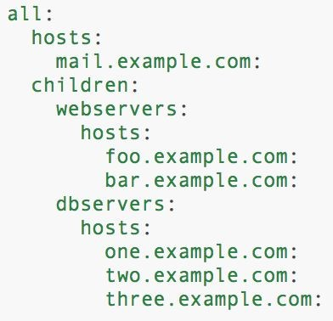
Ansible > Inventories > Hosts and Groups
We can define our hosts of the remote machines in inventory files.
We can classify each host in different groups.
INI format
YAML format

Slide 29
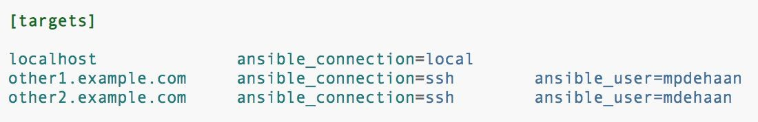
Ansible > Inventories > Hosts and Groups
By default, Ansible tries to connect via SSH using the standard port 22. If the remote machine uses another one, we need to specify it in the inventory file:
badwolf.example.com:5309
We can define the connection type for each host using host variables*:
*Variables defined in an inventory file using INI format will be always interpreted as STRING.

Slide 30
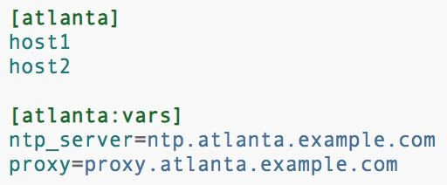
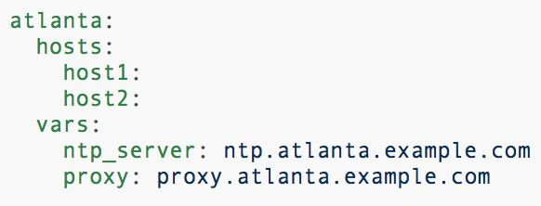
Ansible > Inventories > Hosts and Groups
We can define variables per group:
INI format
YAML format

Slide 31
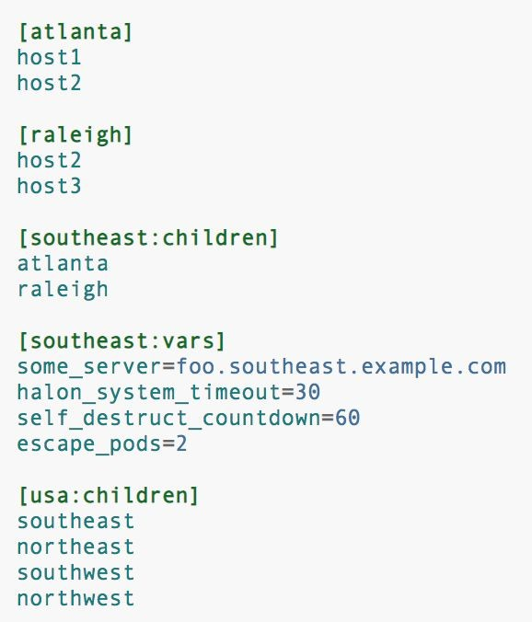
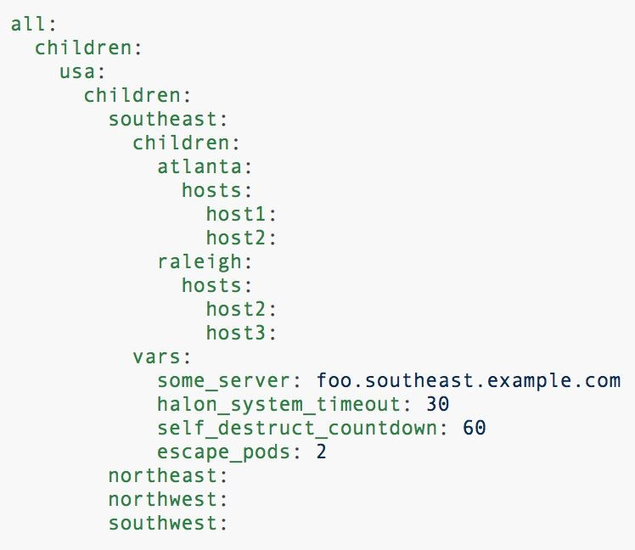
Ansible > Inventories > Hosts and Groups
INI format YAML format
Note: A child group variable will override a parent group variable.

Slide 32
Ansible > Inventories > Default Groups
Every host is grouped in the default group all.
A host without a specific group belongs to the group all and ungrouped.

Slide 33
Ansible > Variables
A variable should start with a letter. It can contain letters, numbers and underscores.
Definition and referencing of variables:
foo:
field1: one field2: two
foo['field1'] foo.field1
Can be defined in:
Inventories (per host or group) and splitted in group_vars or host_vars files.
Playbooks
Roles
https://docs.ansible.com/ansible/latest/user_guide/playbooks_variables.html

Slide 34
Ansible > Variables > Inventories
We can define variables directly in inventory files or in group_vars or host_vars files.
Directory layouts
34

Slide 35
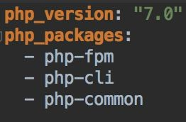
Ansible > Variables > Inventories
For a host named example.com we can define some variables related to the host in a specific file:
The file is located on host_vars/example.com or
host_vars/example.com.yml .
We can also organize variables in different files. Following the previous example: host_vars/example.com/php.yml
For a group of hosts or a group of groups we use the same logic as hosts but
using another main folder: group_vars/
35

Slide 36
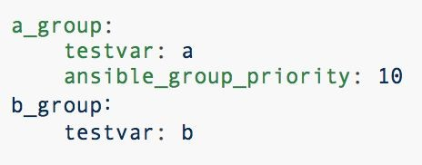
Ansible > Variables > How ansible use them
When a playbook is executed, Ansible maps at level of host.
Ansible merge all variables needed to provision each host.
The order to merge variables is:
all group (is the parent of all other groups)
Parent group
Child group
Host
When two groups are in the same level, the order is alphabetical, but we can define which is the priority of each group in order to be merged in a different order using the variable ansible_group_priority which is 1 the default value:
Example:
https://github.com/xserrat/company-infrastructure/tree/variables-merging-order
36

Slide 37
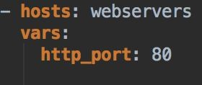
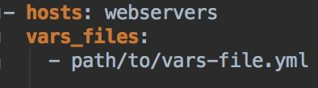
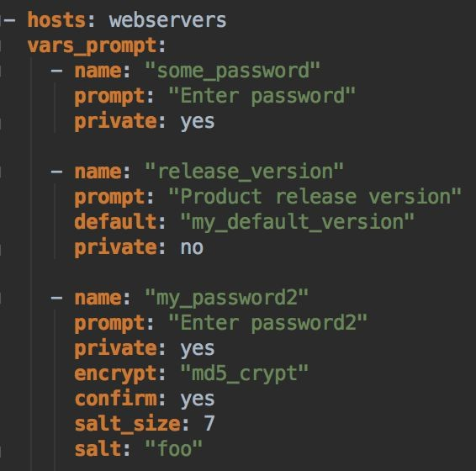
Ansible > Variables > Playbooks
We can define variables in a specific play in different ways:
Specifying the variable and the value:
Specifying a variables file where variables are defined and assigned to a value:
Specifying variables to be prompted when executing the playbook:

Slide 38
Ansible > Variables > Roles
Three ways to define variables in roles:
my_role/defaults/main.yml : default variables of our role
my_role/vars/main.yml : variables of our role
my_role/meta/main.yml : variables for role dependencies

Slide 39
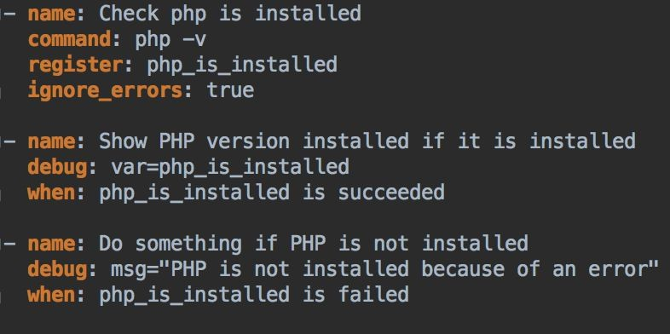
Ansible > Variables > Usage in a playbook
Conditionals
https://docs.ansible.com/ansible/latest/user_guide/playbooks_conditionals.html

Slide 40
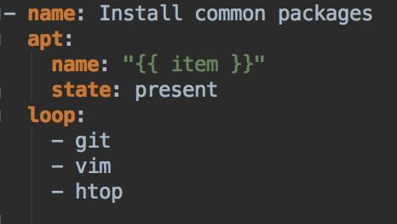
Ansible > Variables > Usage in a playbook
Loops
https://docs.ansible.com/ansible/latest/user_guide/playbooks_loops.html

Slide 41
Ansible > Variables > Main Prioritization
command line values (eg “-u user”)
role defaults
inventory file or script group vars
inventory group_vars/all
playbook group_vars/all
inventory group_vars/*
playbook group_vars/*
inventory file or script host vars
inventory host_vars/*
playbook host_vars/*
host facts / cached set_facts
play vars
play vars_prompt
play vars_files
role vars (defined in role/vars/main.yml)
block vars (only for tasks in block)
task vars (only for the task)
include_vars
set_facts / registered vars
role (and include_role) params
include params
extra vars (always win precedence)
PRIO
https://docs.ansible.com/ansible/latest/user_guide/playbooks_variables.html#variable-precedence-where-should-i-put-a-variable

Slide 42
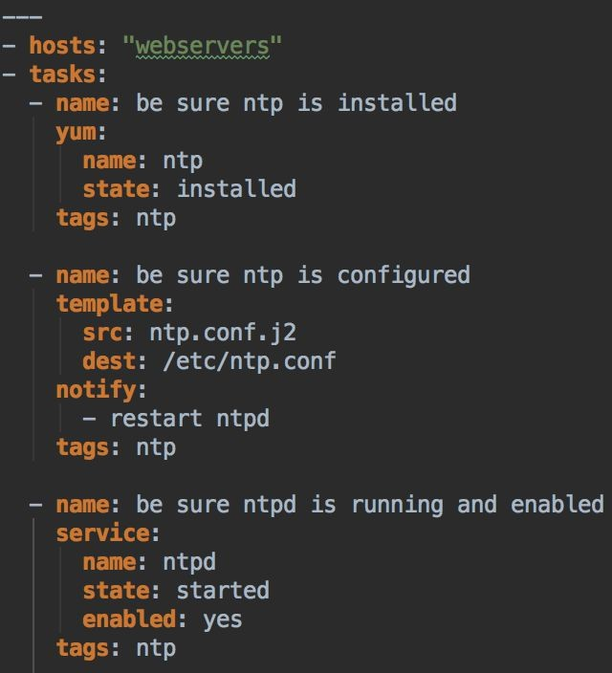
Ansible > Tags
We can tag tasks using tags. They allow us to execute only specific tasks who have those tags.
$ ansible-playbook -i production playbook.yml --tags ntp
*We only re-configure ntp service to the group webservers .
playbook.yml
42

Slide 43
Ansible > Extras > Dynamic Inventory
We can use external inventories that execute some calls to the host provider
to find out hosts and then use them in a playbook.
https://docs.ansible.com/ansible/latest/user_guide/intro_dynamic_inventory.html#inventory-script-example-aws-ec2

Slide 44
Ansible > Extras > Ad-Hoc Commands
We use when we need to do something really quickly and we don’t want to save for later.
Execute a command in a multiple remote machines.
Example: Copy a file to some hosts (webservers)
$ ansible webservers -m copy -a "src=/etc/hosts dest=/tmp/hosts"

Slide 45
Ansible > Extras > Ansible Container
Configure and run docker containers using playbooks rather than using a Dockerfile.
https://docs.ansible.com/ansible-container/

Slide 46
Ansible > Extras > IDE plugins
PhpStorm: Plugin called YAML/Ansible support that allows you to navigate through roles and variables using CMD/CTRL + CLICK!
https://github.com/vermut/intellij-ansible
Visual studio code: Plugin with autocompletion and other features.
https://marketplace.visualstudio.com/items?itemName=vscoss.vscode-ansible

Slide 47
Ansible > Extras > Best practices
Ansible provides a list of best practices when creating our playbooks:
https://docs.ansible.com/ansible/2.7/user_guide/playbooks_best_practices.html

Slide 48
Ansible > More examples
Ansible examples: https://github.com/ansible/ansible-examples
Building a LAMP:
https://github.com/ansible/ansible-examples/tree/master/lamp_simple

Slide 50
Packer > Why do we need it?
Easy way to automate the creation of any type of machine image.
Easy to share images for testing or deployment.
Keep development, staging and production as similar as possible.
Some advantages:
Super fast infrastructure deployment: Launch provisioned and configured machines in seconds.
Multi-provider portability: Create and use images in different environments and providers.
In production using AWS or/and Google Cloud.
In development using Docker
Greater testability: We can launch a machine using the image we have built to test if it works. Then we can ensure that the new machines launched from that image work properly.

Slide 51
Packer > General overview
Packer uses “Templates” which are JSON files where we define how our images have to be created.
A template has three basic components:
Provisioners: Responsible to configure the image (install packages, deploy app code...)
Builders: Responsible for creating machines and generating images from them.
Post-processors: Responsible for executing an action after the image is built (e.g. Upload image to a registry).

Slide 52
Packer > General overview > Workflow
BUILDER
PROVISIONER
BUILDER
POST-PROCESSOR (OPTIONAL)
Create machine
Provision machine
Stop machine
Generate image from stopped machine
Upload generated image

Slide 53
Packer > Builders
They are responsible for creating machines and generating images from them.
We can use existing builders or create a new one.
Available builders:
https://www.packer.io/docs/builders/index.html

Slide 54
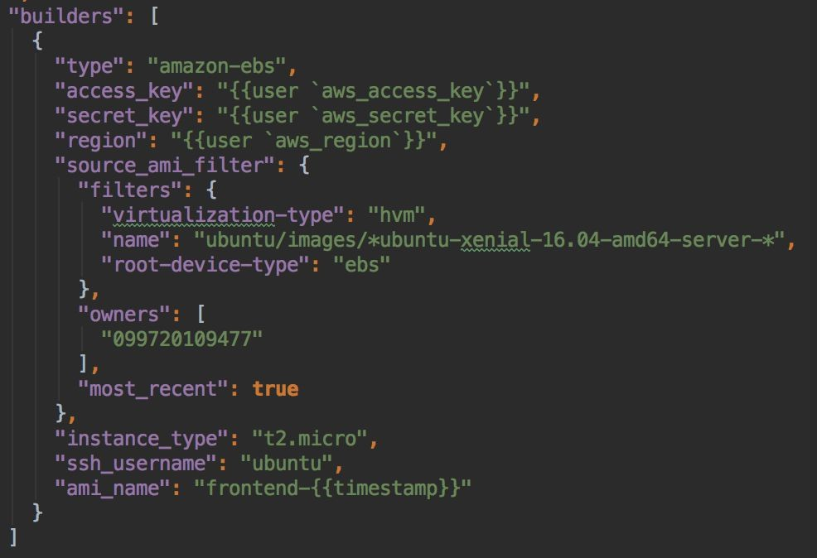
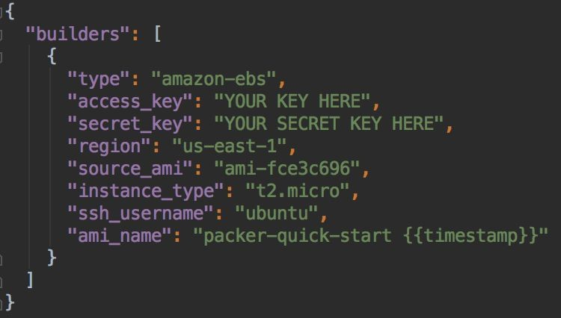
Packer > Builders > Amazon EC2 AMI Builder
It is the builder to be used if we want to create an AWS AMI.
Create an AMI using a custom AMI
Create an AMI using an AWS AMI

Slide 55
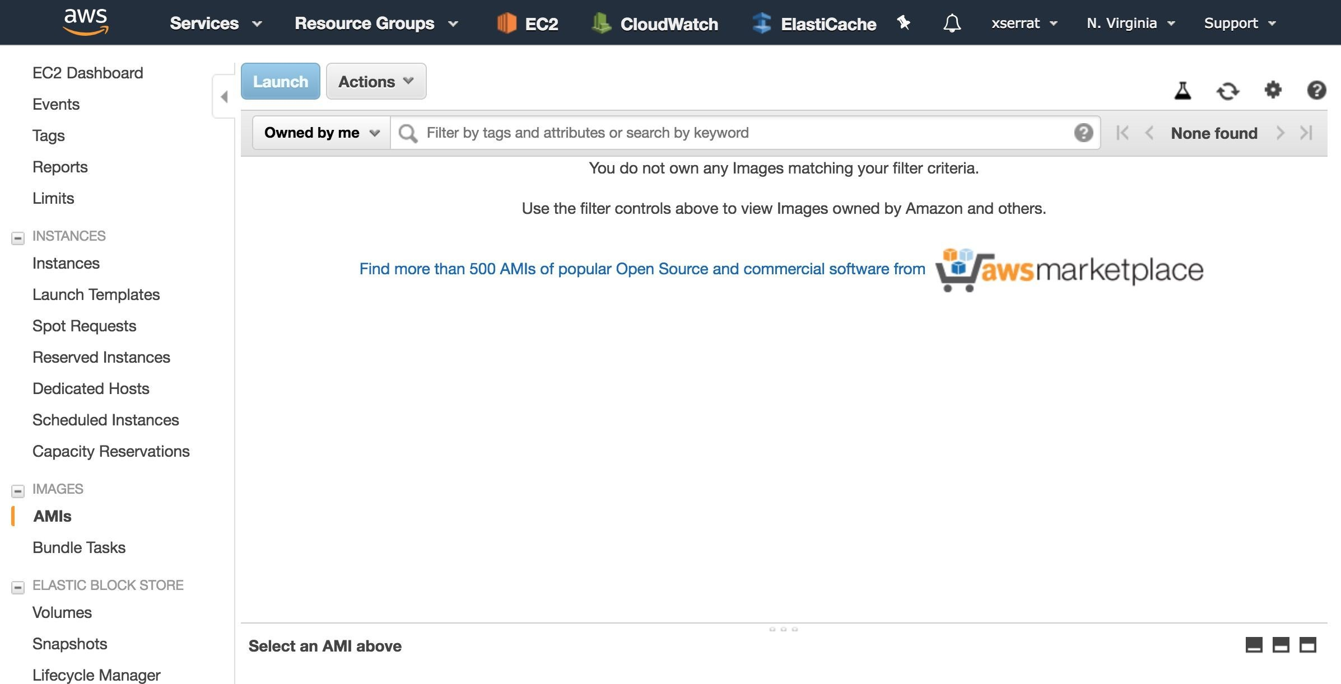
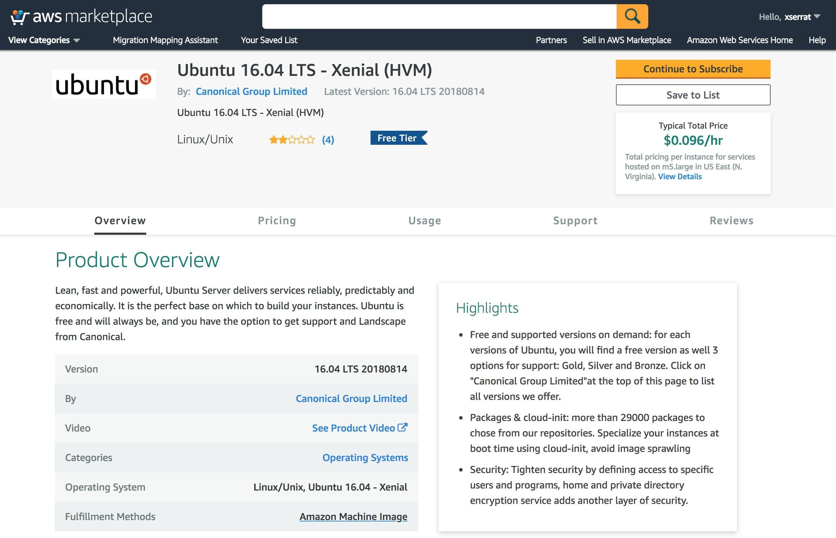
Packer > Builders > Amazon EC2 AMI Builder
Using an AWS AMI as a source_ami is the same as access to the aws marketplace and looking for the AMI we want to use:

Slide 56
Packer > Provisioners
They are responsible for configure the booted image using a third-party
tool.
Typical configurations:
Install packages
Create users
Deploy the application code

Slide 57
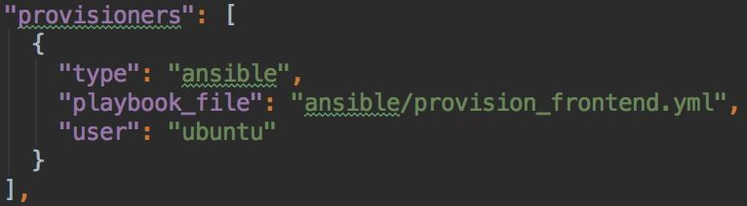
Packer > Provisioners > Ansible Remote
Ansible Remote is a provisioner that uses ansible playbooks to provision the booted machine.
Ansible Remote configures the booted machine using SSH, so no ansible packages needed in the booted machine. If you want to execute Ansible in the booted machine you can use the Ansible Local provisioner.

Slide 58
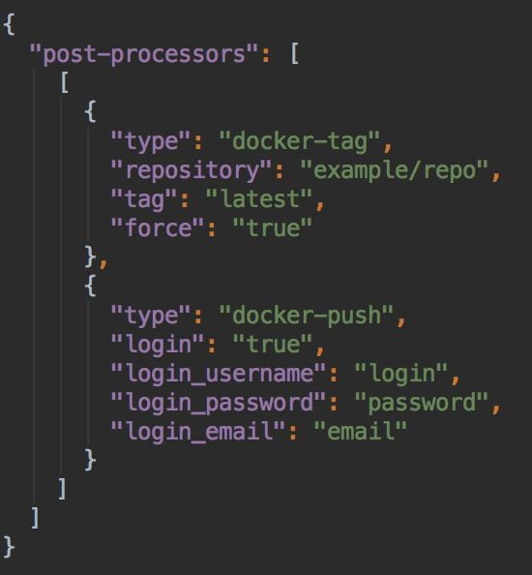
Packer > Post-Processors
They are responsible for execute some actions when the image is built.
Example of usage: Upload the image to a registry.

Slide 59
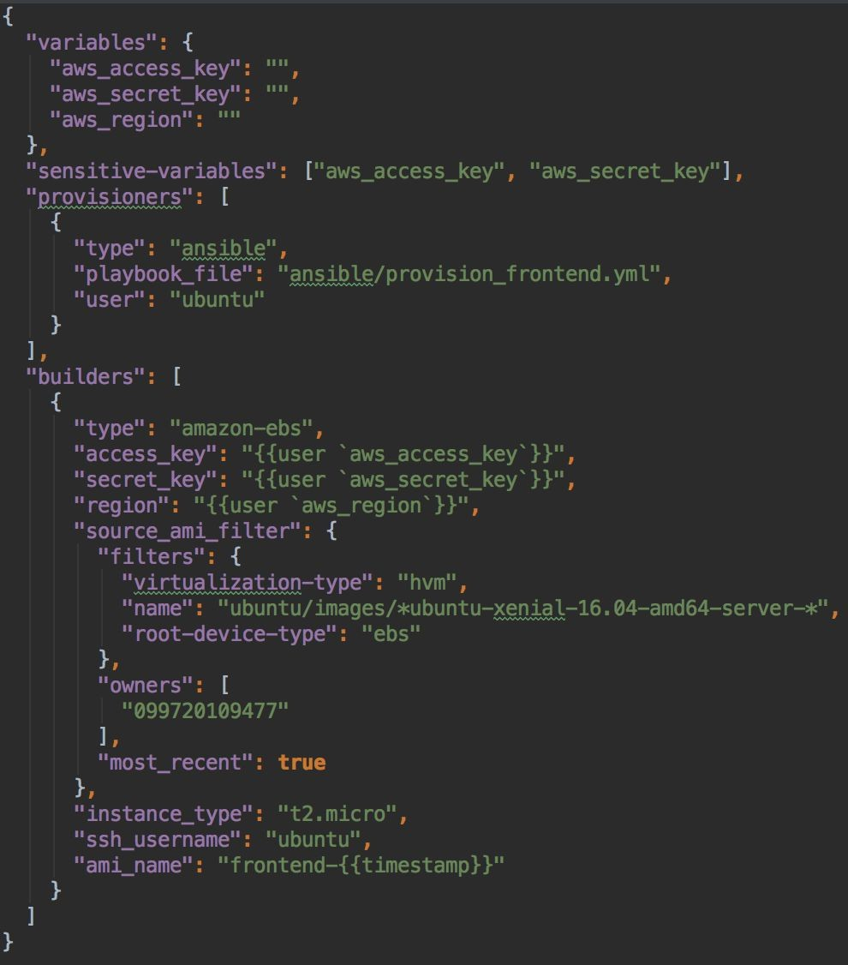
Packer > ami_template.json

Slide 60
Packer > Installation
Install on Ubuntu
https://www.packer.io/intro/getting-started/install.html#precompiled-binaries
Install on Mac
$ brew install packer

Slide 61
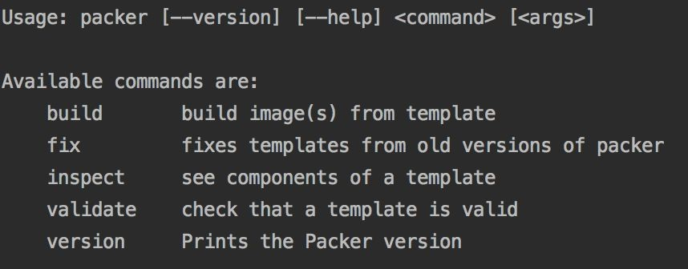
Packer > Template execution
$ packer build ami_template.json

Slide 62
Packer > Best practices
Hashicorp provides a Github repository to show a good way to define our
configuration management project:
https://github.com/hashicorp/best-practices

Slide 63
DEMO > Build Amazon AMI with PHP installed
$ packer build \
-var-file=packer/amazon/credentials.json \
-var-file=packer/amazon/variables.json \ packer/amazon/ubuntu/frontend/base_ami.json
https://github.com/xserrat/company-infrastructure

Slide 64
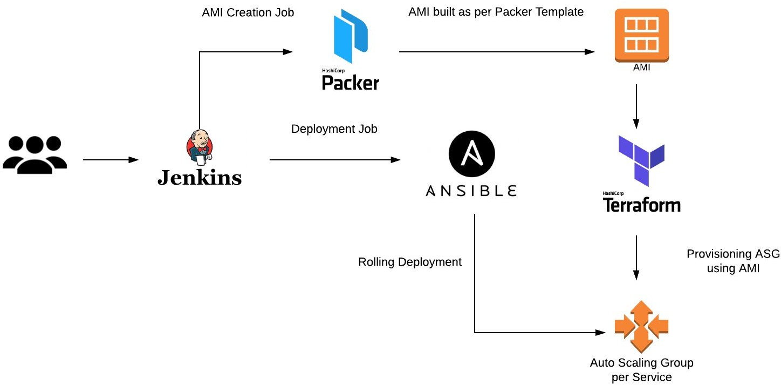
Next steps > Ansible + Packer + Terraform

