Slide 1
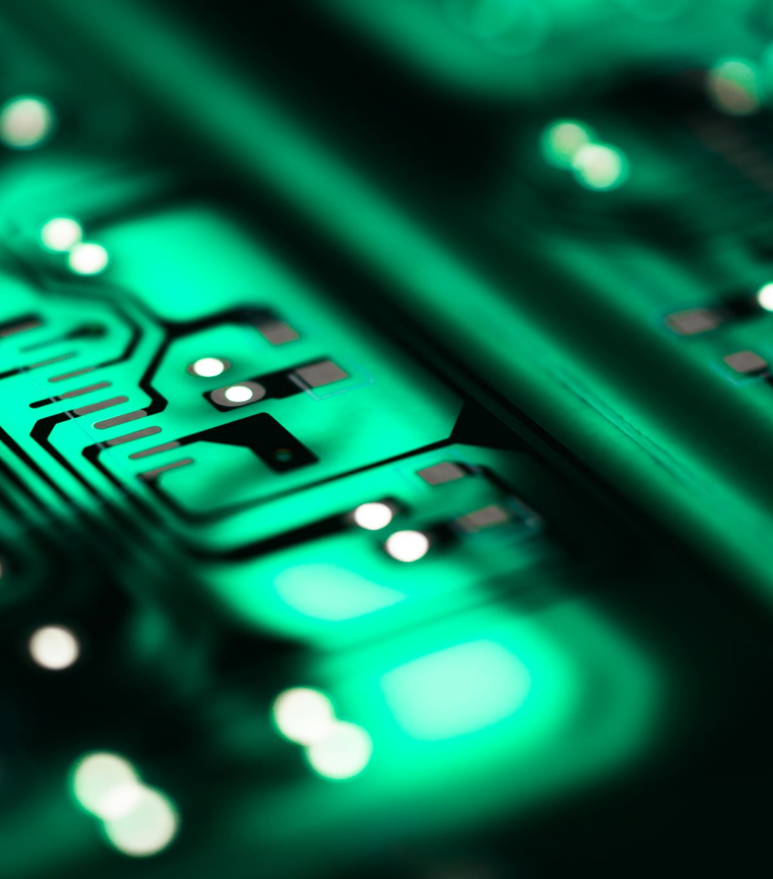
Spiking Neural Network Implemented on a FPGA
Senior Design
ECE Team 07

Slide 2
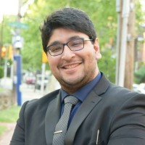
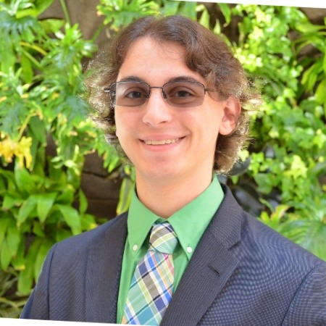
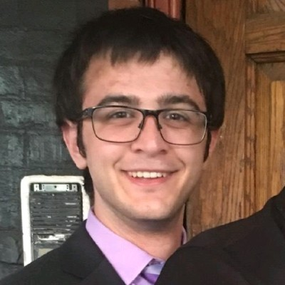
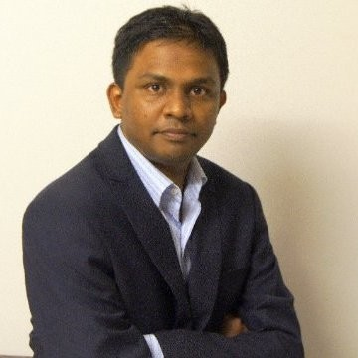
The Dream Team
Neel Jagad
Leads software design and provides extensive machine learning knowledge
Cameron Calv
Leads verification and assists in both hardware and software
Nick Sica
Leads hardware design and organizes project design flow
Capstone senior design advisor
Dr. Anup Das

Slide 3
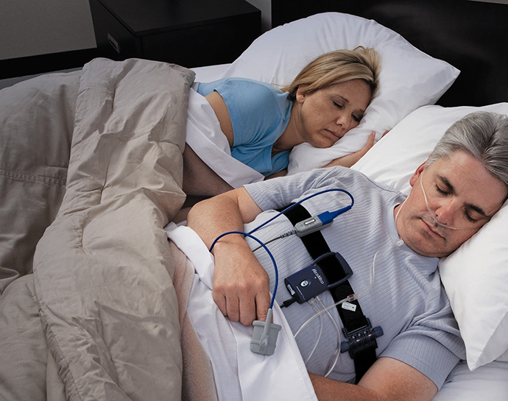
Background
Sleep Apnea
Detrimental health impacts
936 million global cases
Prevalent in all ages, genders, and ethnicities
Polysomnography (PSG)
Primary method
Expensive
Dissimilar to the usual sleeping environment
In-home test kits
Accurate only for moderate to severe cases
Cheaper and less invasive
Sensors can be shuffled or can become faulty

Slide 4
Problem Statement
Reduce the gap between lab (PSGs) and in-home sleep tests
Improve detectability
Reduce cost threshold
Machine Learning Model
Spiking neural network (SNN)
Low-Latency Architecture
Field Programmable Gate Arrays (FPGAs)

Slide 5

Technologies Leveraged
Why Spiking Neural Network?
Low power consumption
Fast inference
Event-driven information processing
Ability to Generalize based on smaller samples
Why FPGA?
Faster than a classical computer
Aren’t permanent like ASICs
Reconfigurable
Implement a different neural network if a better one comes out in the future
Allows for same results as a GPU in a smaller form factor

Slide 6
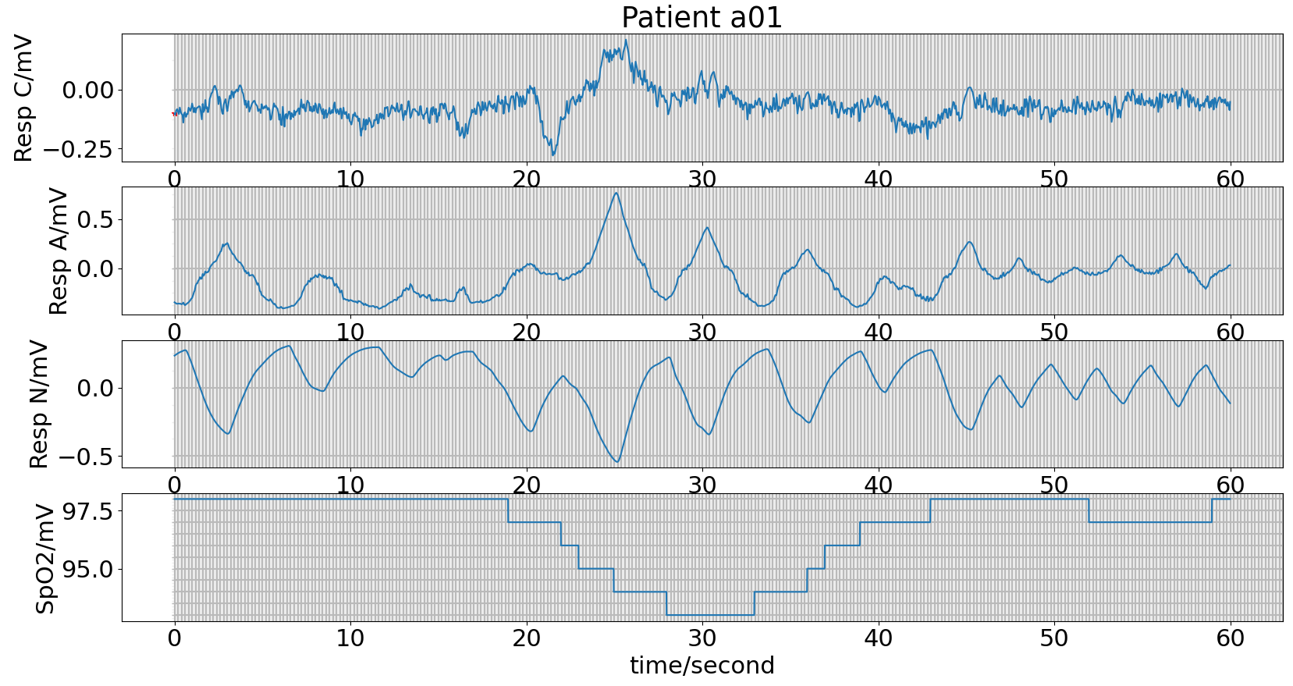
Design Constraints
Model
Architecture
Spiking Neural Network (SNN)
Training/Learning Rules
Internal Switching
FPGA
Power Requirements
Static Power
Transistor Leak
Dynamic Power
Validation
Feature Selection Analysis
Data

Slide 7
Economic Analysis
Material/Software | Cost | Sourcing
Xilinx FPGA | $3,500.00 | Drexel University
Python | $------0.00 | Open Source
SymbiYosys | $------0.00 | Open Source
Vivado License | $------0.00 | Xilinx

Slide 8



Broader Impact
Environmental Impact
Heavy metals in electronics to influence end-of-life plan
Low power requirements to influence total carbon footprint of device
Social Impact
Greater accessibility
Ethical Impact
False positives may be bothersome or disruptive
False negatives may be lethal or damaging
Potential to increase insurance coverage
Less disruption and discomfort from CPAP devices
Less expensive

Slide 9
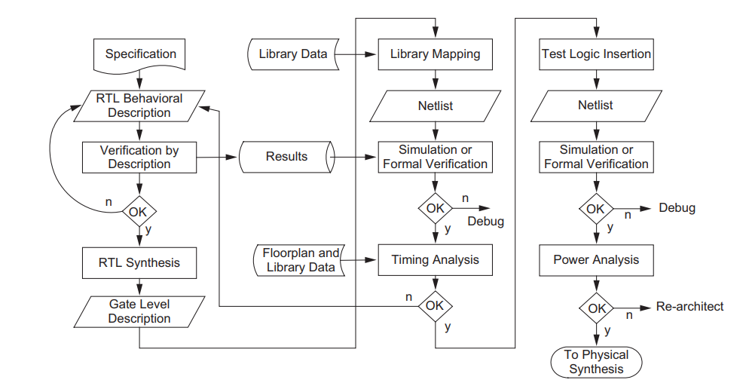
Approach
Develop a software “golden model” with Python
Feature Selection Analysis
Train with feature selected data
Validate
Build hardware with Verilog
Simulate hardware against golden model
Subsystems verified using formal verification
Use SymbiYosys
Synthesis after simulation passes
Fix and reiterate

Slide 10




Materials/Resources
Hardware
FPGA
Software
Vivado
Python
Make
SymbiYosys
Ninja/Meson

Slide 11
Organization and Milestones
Team Organization
Use GitHub
Hardware uses a make flow executing Tcl commands
Software will be built leveraging meson
Everything is rigidly structured which keeps us organized and focused on the project
Kanban board to keep track of individual tasks
Milestones
Software Completion
Hardware Completion
Testbench Passes
Successful if the system works efficiently

Slide 12




Project Management Analysis
Strengths
Collaboration while playing to individual specialties
Data specific to intended application focus (electroencephalograms, EEGs)
Past research to jumpstart from
Weaknesses
Remote correspondence and staggered availability
Numerous architectures and training models to choose from
Limited access to personal test boards
Internal
Opportunities
Emerging machine learning technologies
Wide array of open-source solutions available for use
Funding opportunities for impact of project beyond intended application
Threats
Hardware realizations that are unable to adapt to new rules
Lack of online and real-time algorithms with distinct implementations
Fitting within 6-month timeline
External

Slide 13
Timeline
 | Fall |  |  | Winter Term |  |  |  |  |  |  |  |  |  | Spring Term |  |  |  |  |  |  |  |  |  | Assignments
Tasks |  |  |  |  |  |  |  |  |  |  |  |  |  |  |  |  |  |  |  |  |  |  |  | Calv | Jagad | Sica
Hardware
FPGA Verilog
Hardware Synthesis
Software
Data EDA
Golden Model
Develop Testbench
Verification
SymbiYosys
Prediction Accuracy
Efficiency Analysis

Slide 14

Deliverables
Verilog source code
FPGA programmed with verified hardware design
Testbench source code
Python source code
Prediction accuracy and speed test results from hardware and software implementations

Slide 15
References
B. Xie and H. Minn, "Real-Time Sleep Apnea Detection by Classifier Combination," in IEEE Transactions on Information Technology in Biomedicine, vol. 16, no. 3, pp. 469-477, May 2012, doi: 10.1109/TITB.2012.2188299.
N. H. E. Weste, CMOS VLSI Design: A Circuits and Systems Perspective, 4th Edition. ed. Boston: Addison-Wesley Publishing Company, 2010.
Sweet Sleep Studio. “sleep-apnea-1.jpg” [Online]. Available: https://sweetsleepstudio.com/wp-content/uploads/2019/03/sleep-apnea-1.jpg. [November 8, 2020].
"The Dangers of Uncontrolled Sleep Apnea" HopkinsMedicine, n.d. [Online]. Available: https://www.hopkinsmedicine.org/health/wellness-and-prevention/the-dangers-of-uncontrolled-sleep-apnea [Accessed: November 8, 2020].
Wikipedia."393px-XilinxVivado_Logo.jpg" [Online]. Available: https://upload.wikimedia.org/wikipedia/en/thumb/0/00/XilinxVivado_Logo.jpg/393px-XilinxVivado_Logo.jpg. [November 8, 2020].
Wikimedia Commons."768px-Python-logo-notext.svg.png" [Online]. Available: https://upload.wikimedia.org/wikipedia/commons/thumb/c/c3/Python-logo-notext.svg/768px-Python-logo-notext.svg.png. [November 8, 2020].
Xilinx. “xilinx-logo.png” [Online]. Available: https://www.xilinx.com/content/dam/xilinx/imgs/press/media-kits/corporate/xilinx-logo.png. [November 8, 2020].
YosysHQ (2020) SymbiYosys [Source code]. https://github.com/YosysHQ/SymbiYosys.
Valentine, K., Ayas, N., Eastwood, P., Heinzer, R., Ip, M., Patel, S., Peppard, P., Sinha, S., Tufik, S., Nunez, C. and Malhotra, A., 2018. Global Prevalence Of Obstructive Sleep Apnea In Adults: Estimation Using Currently Available Data. [online] Atsjournals.org. Available at: https://www.atsjournals.org/action/showCitFormats?doi=10.1164%2Fajrccm-conference.2018.197.1_MeetingAbstracts.A3962 [Accessed 12 November 2020].

Slide 16

Thanks for Listening!
Any Questions?

