Slide 1
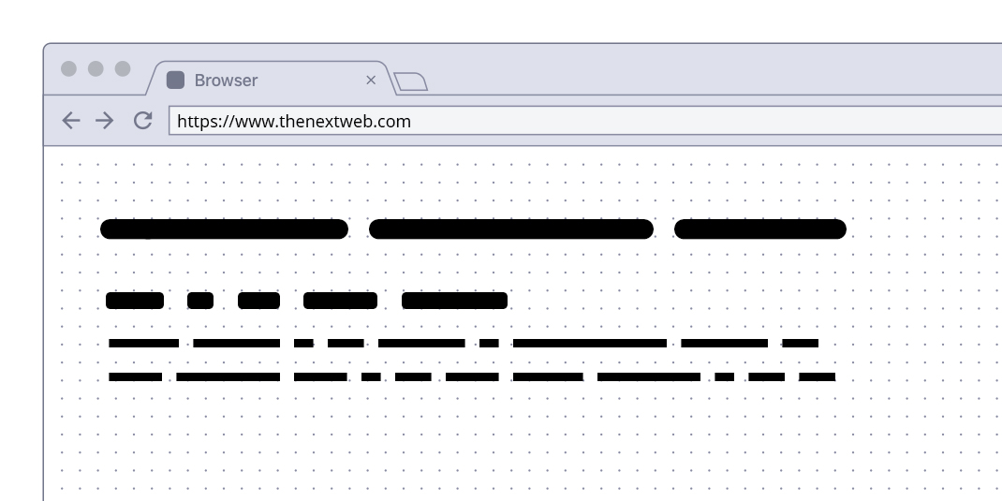
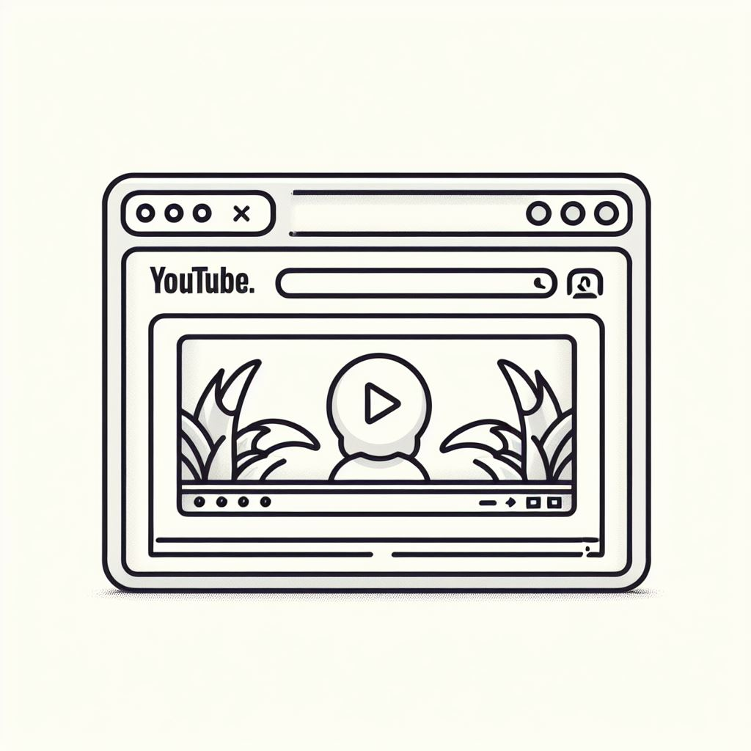





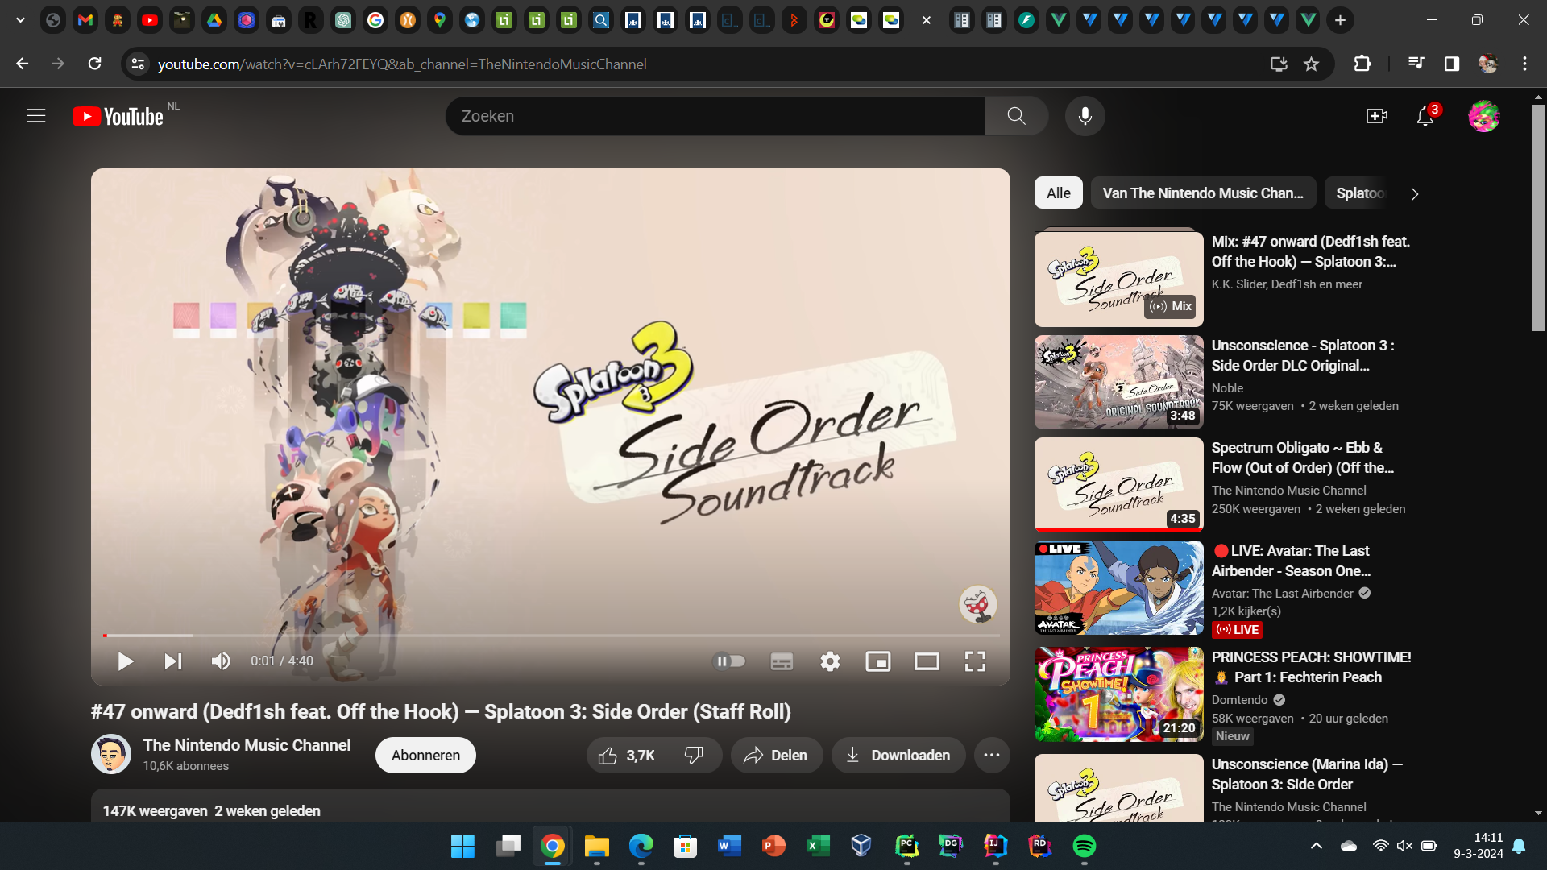


1
COPY URL
https://www.youtube.com/watch?v=1QF-dejfExg
2
PASTE URL
TODO: create mobile browser version and overlay it on the right side

Slide 2
You were close but the Y looks too much like a slingshot
YTDownloader
Y
DOWNLOADER
DOWNLOADER
DOWNLOADER
DOWNLOADER
Downloader
Downloader
Downloader
Downloader
DOWNLOADER
DOWNLOADER
These are all rough sketches, remake them properly if you want to use them
Downloader
Downloader

Slide 3
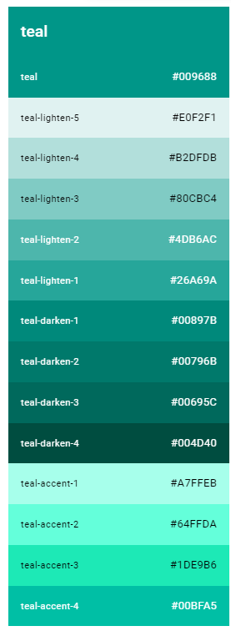
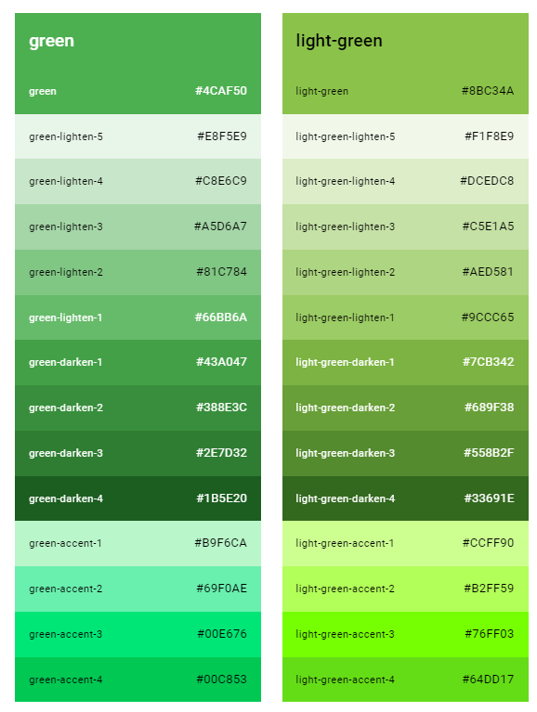

DOWNLOADER
DOWNLOADER
DOWNLOADER
DOWNLOADER
DOWNLOADER
DOWNLOADER
WE HAVE A WINNER!!
I think this green color really emphasises the “download” aspect of things

