Slide 1


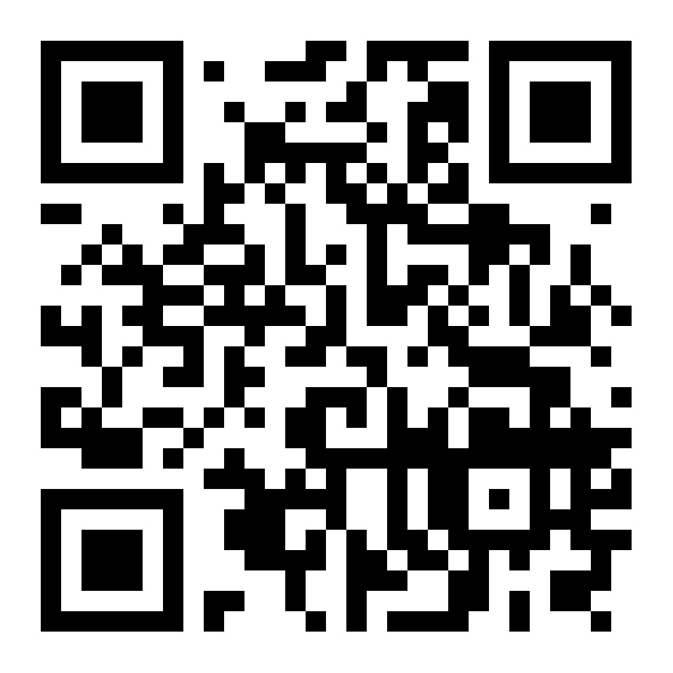
Coming Soon
SAVE THE DATE
The Cary Garden Tour
May 30th – May 31st 2026
Hosted by The Cary Woman’s Club & Mom Wishing Widows Well
A Bloom-Filled Celebration of Beauty and Community
Wander through stunning spring gardens, enjoy local charm, and connect with neighbors in bloom!

