Slide 1
Sudoku Solver In C# 7.1
Brought to you by Jenny & Nick of the DDSB(CSC)

Slide 2
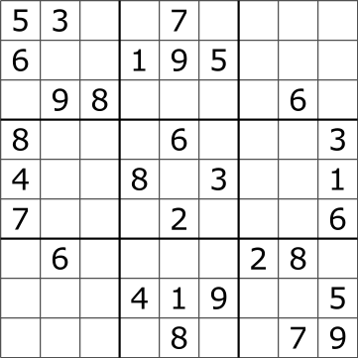
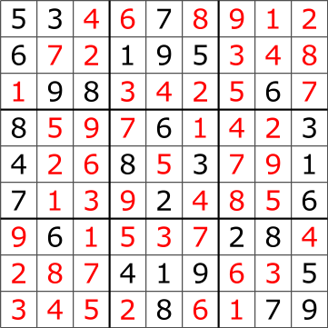
9x9 grid with 3x3 sub-grids solution: each row, column, and sub-grid contains numbers 1-9

Slide 3
C# concepts used
Variables, loops, reading from a file, writing to console, etc.
E V E R Y T H I N G
2-dimensional array (not a “jagged array”)
The grid (9x9 2-D array)
LINQ
Finding cells and comparing sets

Slide 4
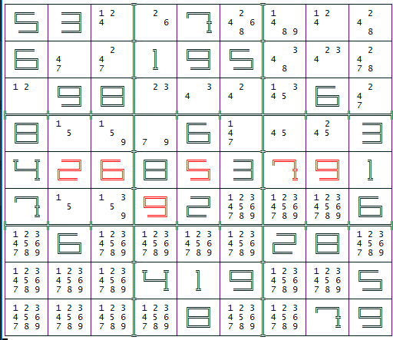
Solving the puzzle
Load grid into program
Print unsolved grid to screen
Loop over each cell
If it’s solved, skip it
Get all the other cells in the row, column, and sub-grid (collectively called the ‘givens’)
Will further expand on this important step later
Get the difference between the set 1-9 and the givens
Those are the ‘notes’, which are all the possible answers for the current cell
If only one possibility, that is the answer
Print solved board to screen

Slide 5
Our board
Big black numbers
Clues
Small numbers
Notes (possible answers)
Big red numbers
Solved answers (that we found)

Slide 6
1. Load grid into program
var board = new Board();
var boardLines = File.ReadAllLines("board.txt").ToList();
foreach (var row in ValidCellIndexes)
foreach (var column in ValidCellIndexes)
if (Char.IsNumber(boardLines[row][column]))
board.Cells[row, column] = new Cell((Byte) (boardLines[row][column] - '0'), isOriginal:true);

Slide 7
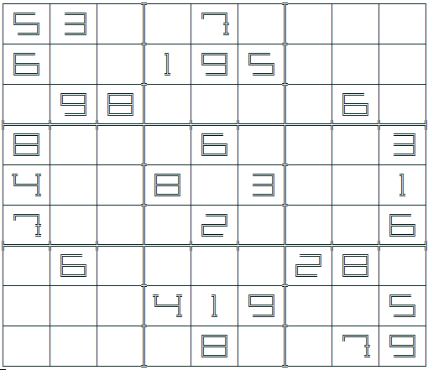
2. Print unsolved grid to screen
Print the grid
Loop over each cell
if the cell contains a clue, print a big black number to the current location in the grid

Slide 8
3. Loop over each cell
foreach (var row in ValidCellIndexes)
{
foreach (var column in ValidCellIndexes)
{
var cell = board.Cells[row, column];
…
}
}

Slide 9
3. a) If it’s solved, skip it
foreach (var row in ValidCellIndexes)
{
foreach (var column in ValidCellIndexes)
{
var cell = board.Cells[row, column];
if (cell.HasAnswer)
continue;
}
}

Slide 10
3. b) Get all the other cells in the row, column, and sub-grid (collectively called the ‘givens’)
var rowCells = ValidCellIndexes.Select(x => board.Cells[row, x]);
var columnCells = ValidCellIndexes.Select(x => board.Cells[x, column]);
var subGridCells = GetOtherSubGridCells(board, row, column);
var allRelatedCells = rowCells.Concat(columnCells).Concat(subGridCells);
…
private static Cell[] GetOtherSubGridCells(Board board, Int32 row, Int32 column)
{
var otherSubGridCells = new Cell[BoardSize];
var i = 0;
var rowIndex = row / SubgridSize * SubgridSize;
var columnIndex = column / SubgridSize * SubgridSize;
for (var subGridRow = rowIndex; subGridRow != rowIndex + 3; subGridRow++)
for (var subGridColumn = columnIndex; subGridColumn != columnIndex + 3; subGridColumn++)
otherSubGridCells[i++] = board.Cells[subGridRow, subGridColumn];
return otherSubGridCells;
}

Slide 11

3. c) Get the possibilities
var obviousImpossibilities = allRelatedCells.Where(x => x != cell)
.Where(x => x.HasAnswer)
.Select(x => x.Answer)
.Distinct();
var obviousPossiblilities = ValidCellValues.Except(obviousImpossibilities)
.ToArray();
1 2 3 4 5 6 7 8 9
5 3 7 6 9 8
1
2
4

Slide 12
3. d) Those are the ‘notes’, which are all the possible answers for the current cell
var obviousImpossibilities = allRelatedCells.Where(x => x != cell)
.Where(x => x.HasAnswer)
.Select(x => x.Answer)
.Distinct();
var obviousPossiblilities = ValidCellValues.Except(obviousImpossibilities)
.ToArray();
cell.Possibilities = obviousPossiblilities;
1 2 3 4 5 6 7 8 9
5 3 7 6 9 8
1
2
4

Slide 13
Our board (again)
Big black numbers
Clues
Small numbers
Notes (possible answers)
Big red numbers
Solved answers (that we found)

Slide 14
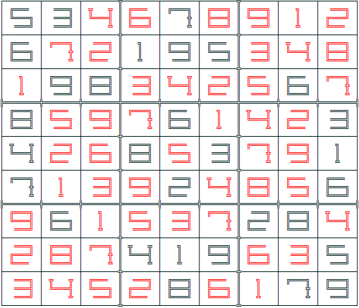
4. Print solved board to screen
Print the grid
Loop over each cell
If the cell contains an answer, print a big number to the current location in the grid (black if clue, red if the answer was found by us)
If the cell has multiple possibilities, print those numbers to the cell as “notes”

