Slide 1
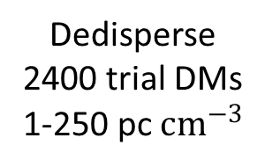
Tile beamforming
& channelisation
MWA
128 x MWA tile
(4 x4 dipoles)
VCS storage
(on-site)
Pulsar processing pipeline
Recombine &
Calibrate
Pawsey
MWA
archives
Beamform & fold on all known pulsars
Upload detections to database
Candidate
Follow up
MWA pulsar search pipeline
Multi-pixel
beamformer
Dedisperse
2400 trial DMs
1-250 pc ${cm}^{−3}$
FFT search
Fold candidates
LOTTAS ML classifier
OzSTAR
Single pulse search

