Slide 1
Asymmetric horizontal distribution for time series
Made by
Kotlyarov Nikolay Aleksandrovich
Nurmash Nurlan Mukhtarovich
Sabyr Samatuly

Slide 2
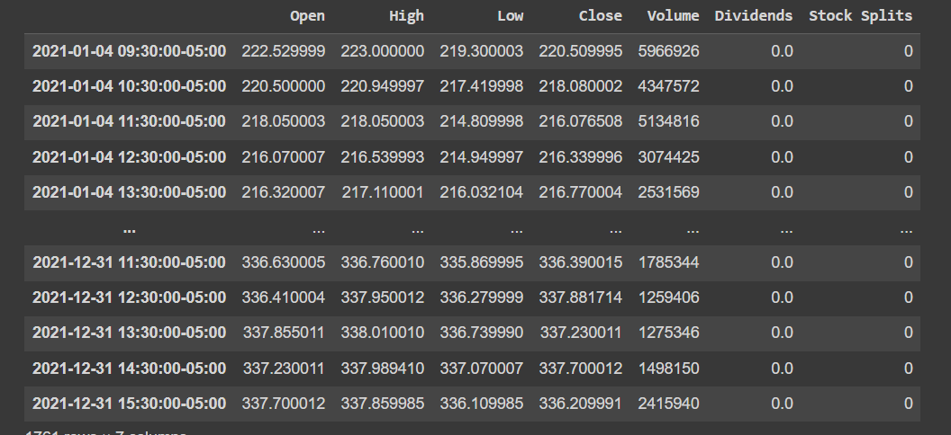
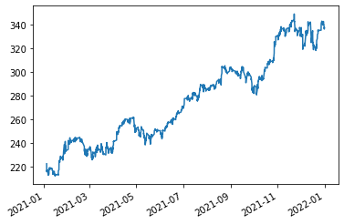
Data to be gathered
In project financial time series will be used
Example: Stock data gathered for 1 year

Slide 3
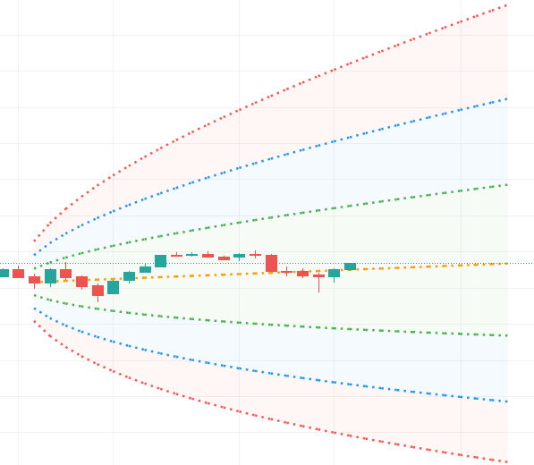
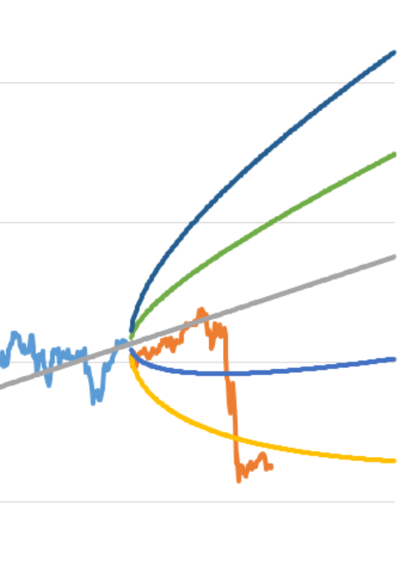
Question to be solved
The goal is to create novel graphical tool that will outperform probability cone, yet solve the same problem (forecasts a statistical distribution from a set point in time into the future).

Slide 4
Encountered problems
Graphical tool is rare; thus, we must implement tool from scratch in D3.js
Models are expected to produce 2 points (lower and upper bound) for 1 time period in future.
Optimization issue: calculation for creating point to graph distribution shouldn’t be too heavy.
In spite of the fact that data is relatively easy to collect, there is no ready data for y part (answer in supervised learning terms)

Slide 5
Methods
Classical time series methods: ARIMA, GRACH, stochastic processes
ML methods:
Non-sequential: NN, regression etc
Sequential: RNN, LSTM etc

Slide 6




Formulization for supervised learning
Given
Predictions
Algorithm to create upper bound
Algorithm is iterative
For lower bounds is the same

Slide 7
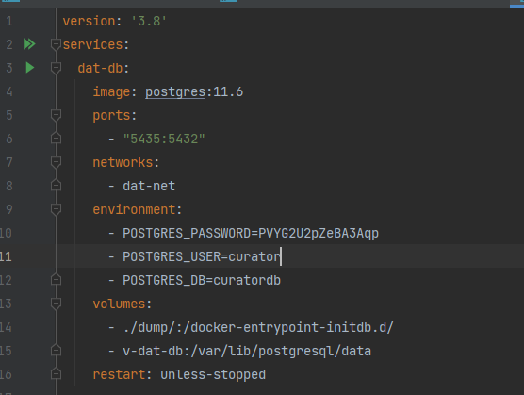
What have been done
Added postgresql and docker

Slide 8
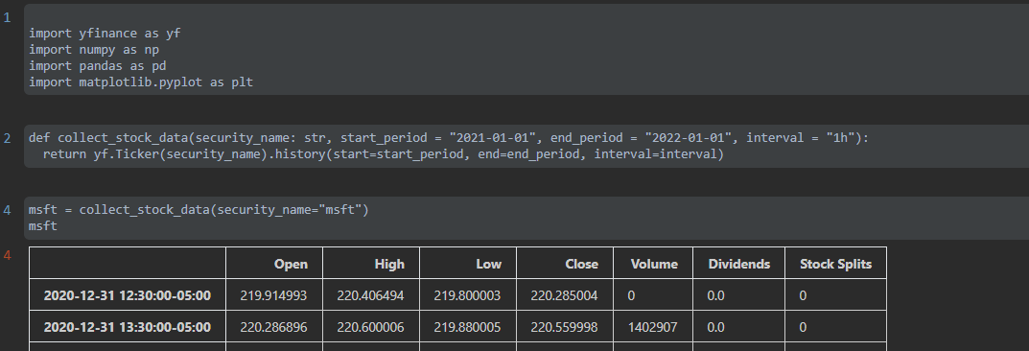
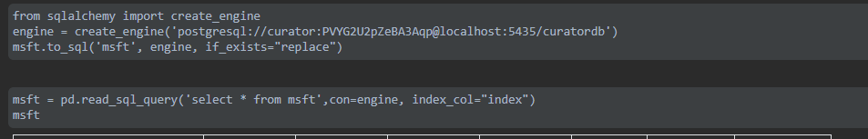
Implemented methods for loading data and saving to db

Slide 9
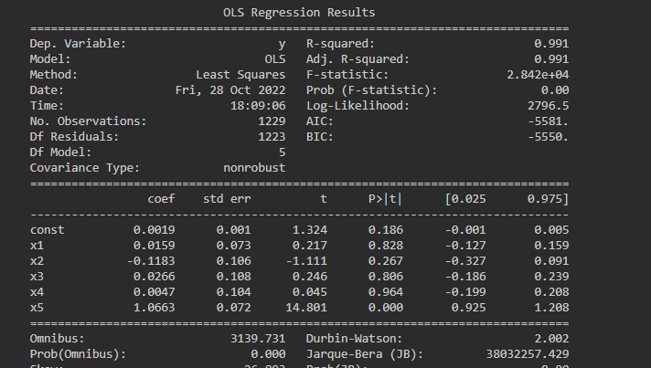
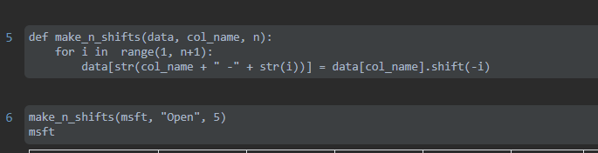
Added backend (Flask) and OLS model with data transformation

Slide 10
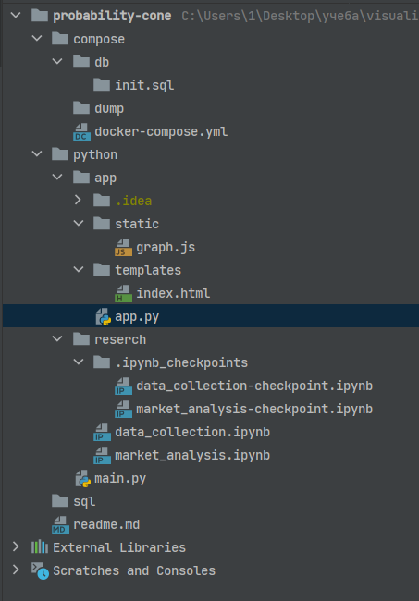
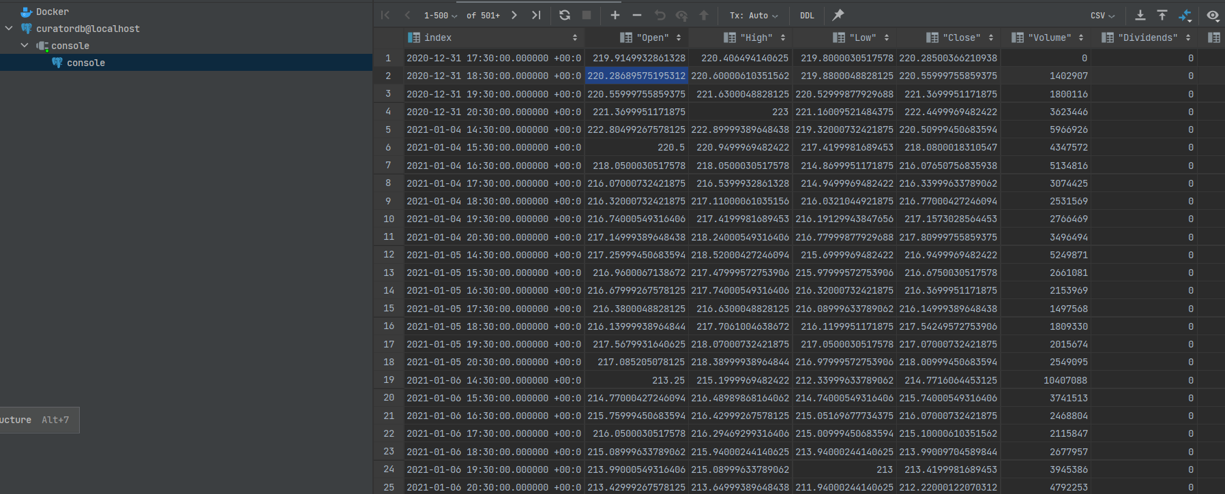
Structure and data from db in docker

Slide 11
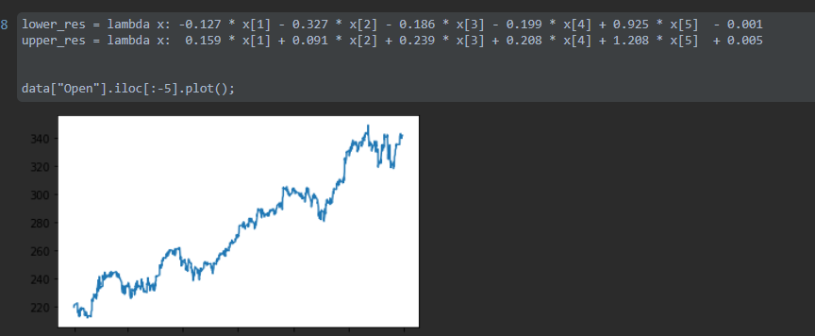
Functions to generate cone
https://github.com/NickThe1/kbtu-data-visualization/tree/main/probability-cone

