Slide 1
Asymmetric horizontal distribution for time series
Made by
Kotlyarov Nikolay Aleksandrovich
Nurmash Nurlan Mukhtarovich

Slide 2
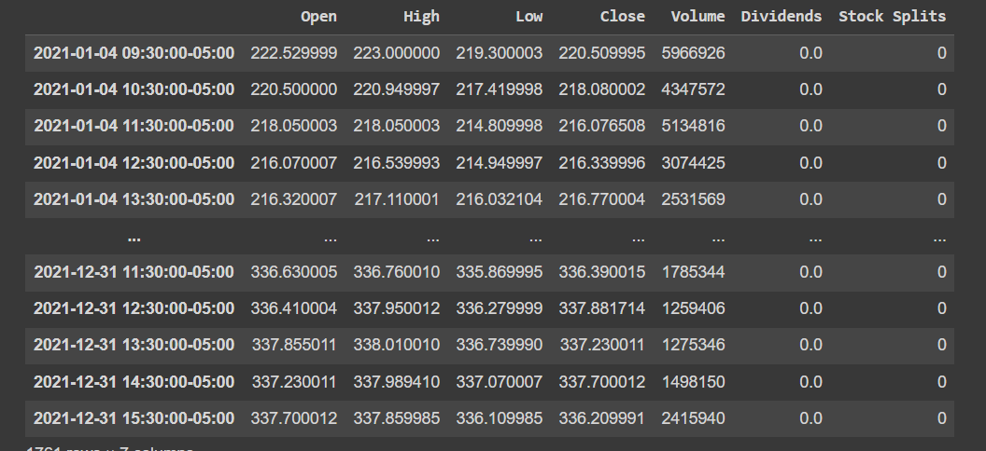
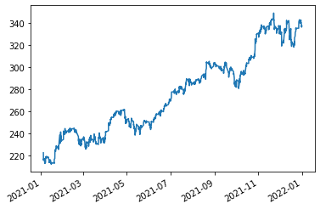
Gathered data
In project financial time series will be used
Example: Over 50 stock time series were gathered for 1 year

Slide 3
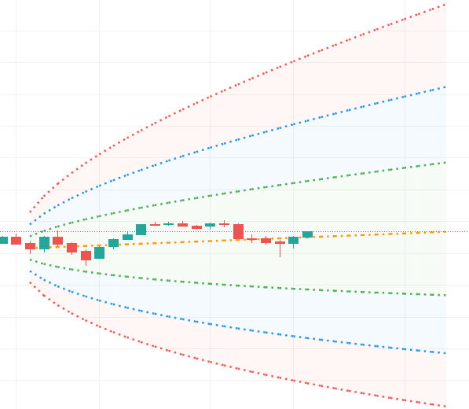
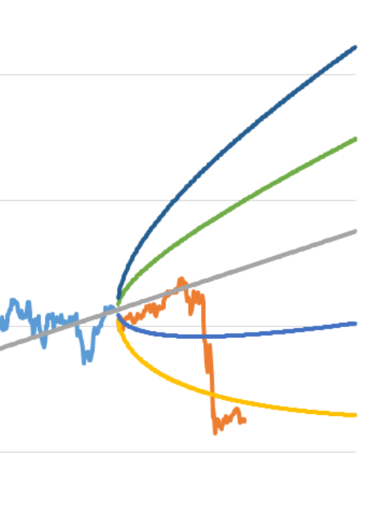
Question to be solved
The goal is to create novel graphical tool that will outperform probability cone, yet solve the same problem (forecasts a statistical distribution from a set point in time into the future).

Slide 4
Encountered problems
Graphical tool is rare; thus, we must implement tool from scratch in D3.js
Models are expected to produce 2 points (lower and upper bound) for 1 time period in future.
Optimization issue: calculation for creating point to graph distribution shouldn’t be too heavy.
In spite of the fact that data is relatively easy to collect, there is no ready data for y part (answer in supervised learning terms)

Slide 5
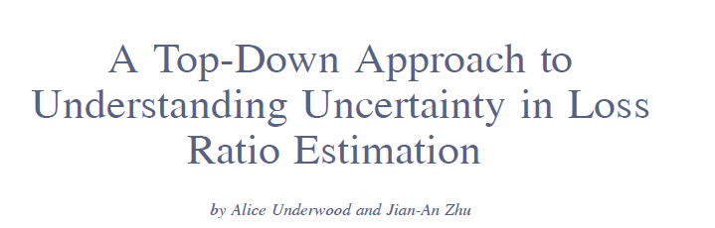
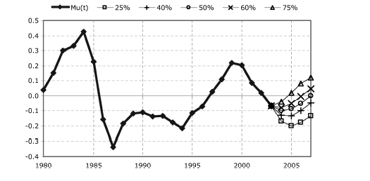
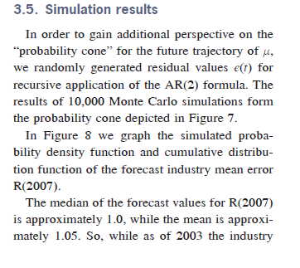
Background

Slide 6
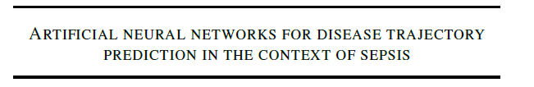
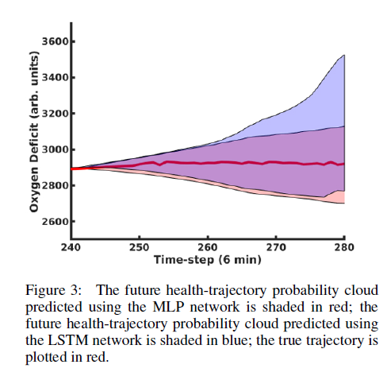
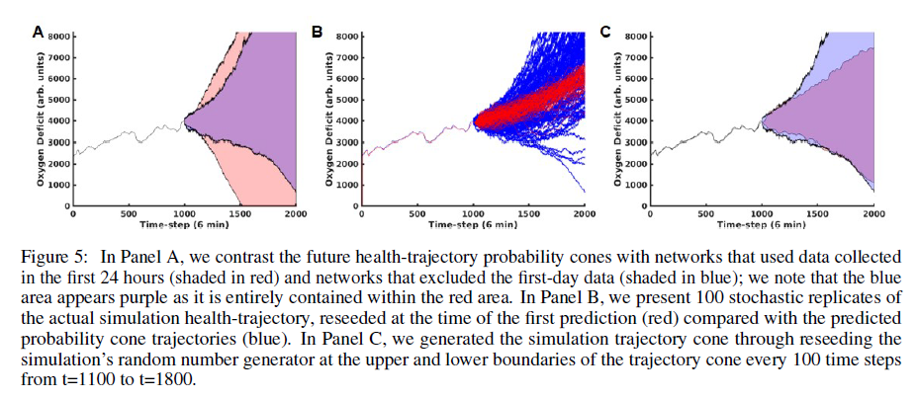

Slide 7

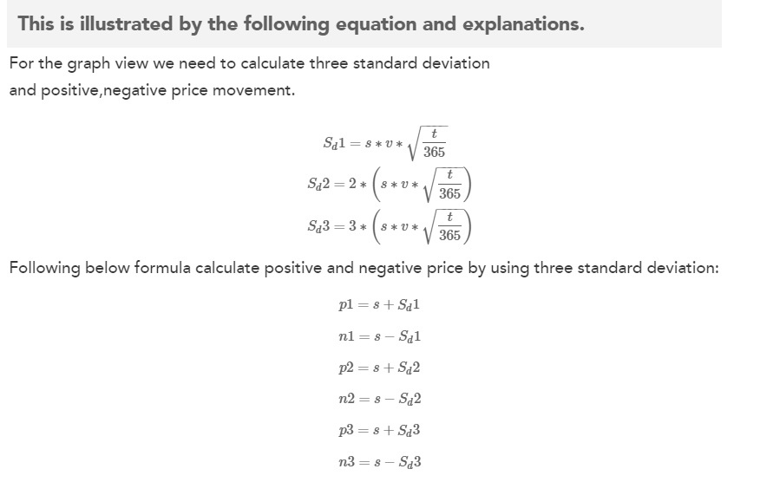
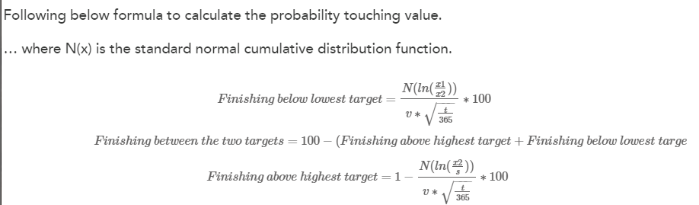

Slide 8
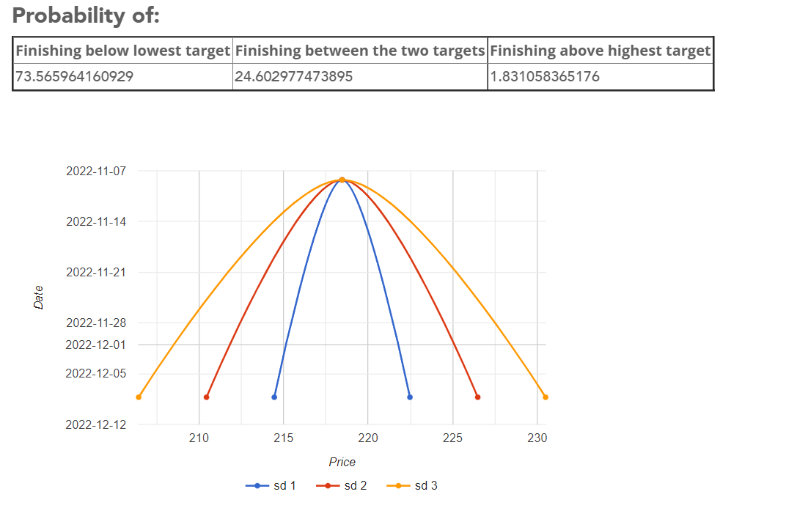
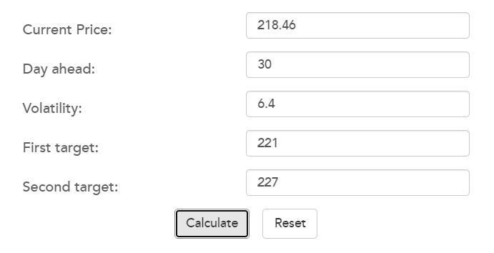

Slide 9
Methods
Classical time series methods: ARIMA, GRACH, stochastic processes
ML methods:
Non-sequential: NN, regression etc
Sequential: RNN, LSTM etc

Slide 10




Formulization for supervised learning
Given
Predictions
Algorithm to create upper bound
Algorithm is iterative
For lower bounds is the same

Slide 11
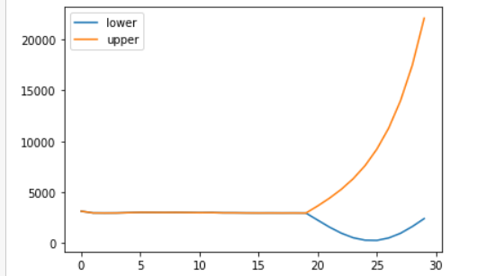
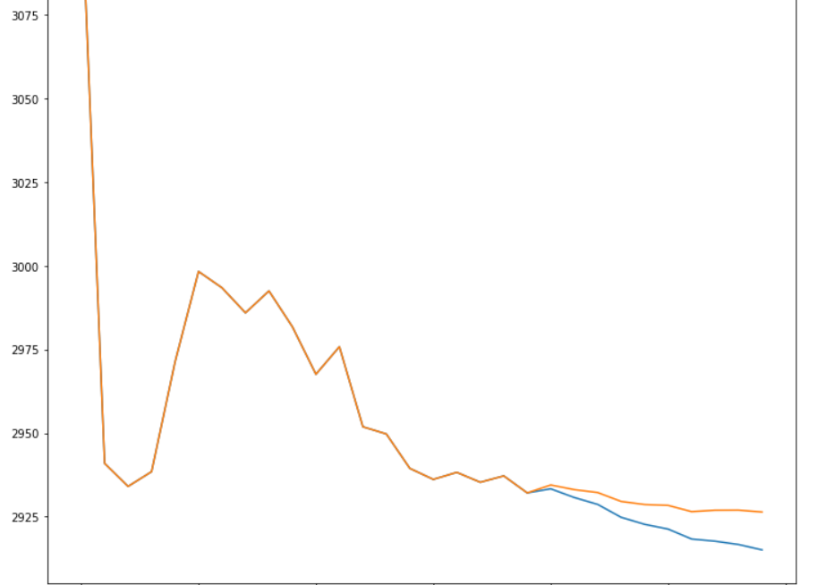
Results for regression models
Linear regression doesn’t work good due to its assumptions about data
Kernel regression is non-parametric model and works much better

Slide 12
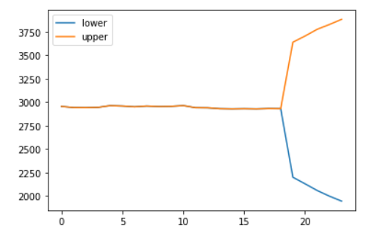
Time series specific models result
Good for short term prediction
Low standard deviation
But parametric models

Slide 13
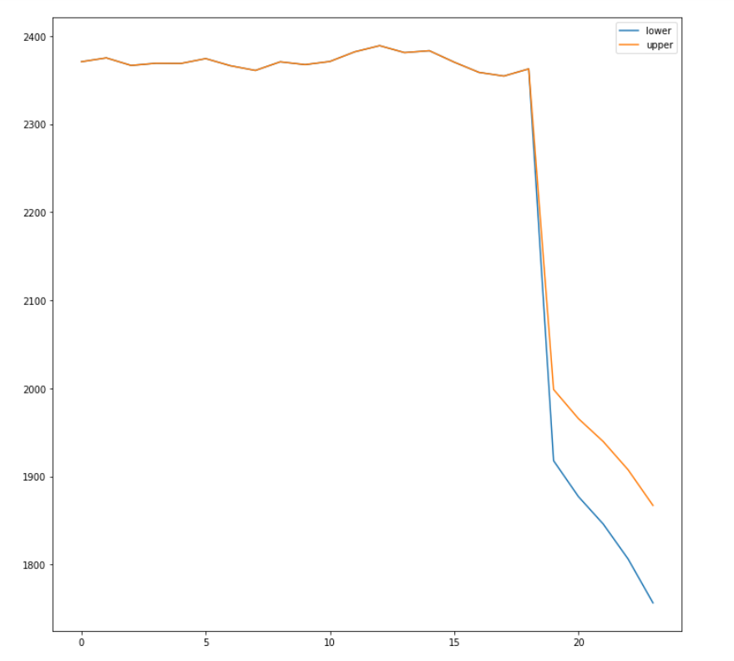
Machine learning result
Non-parametric and robust models perform well if they aren’t overtrained

Slide 14
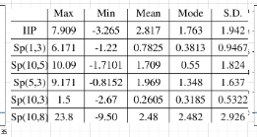
Statistics for series
Max and min of an asset
Mean and mode
Std dev or error

Slide 15
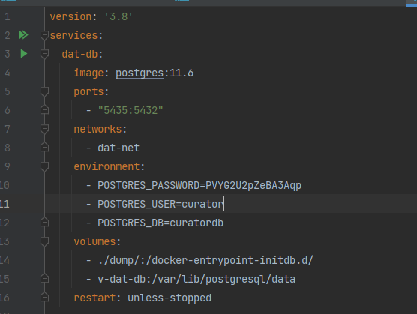
Infrastructure
Added postgresql and docker

