Slide 1
Asymmetric horizontal distribution for time series
Made by
Kotlyarov Nikolay Aleksandrovich
Nurmash Nurlan Mukhtarovich

Slide 2
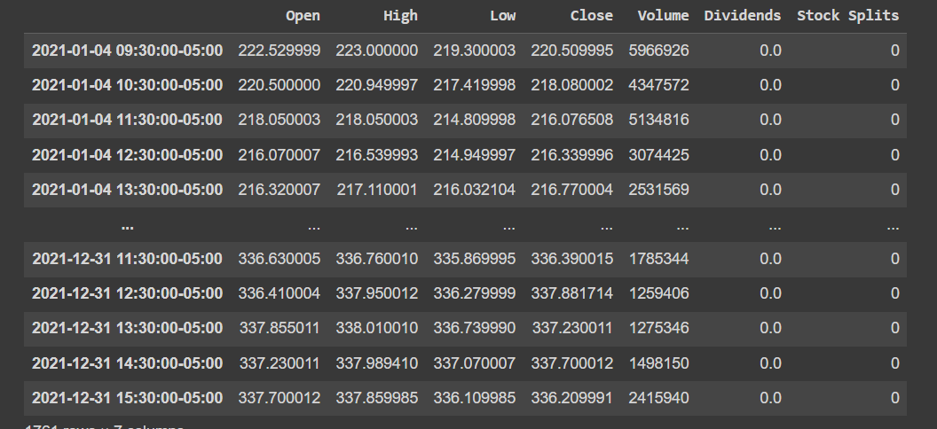
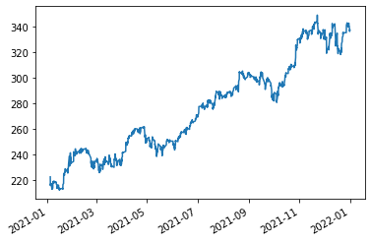
Gathered data
In project financial time series will be used
Example: Over 50 stock time series were gathered for 1 year

Slide 3
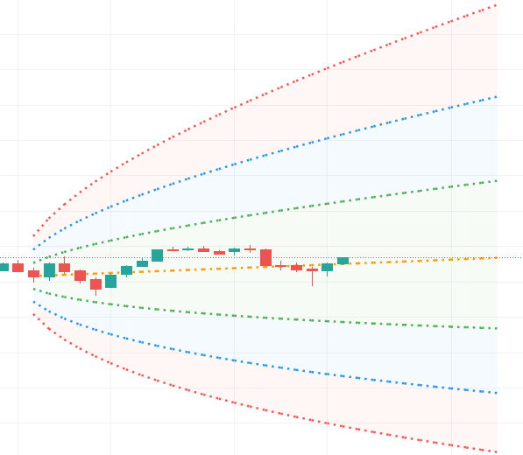
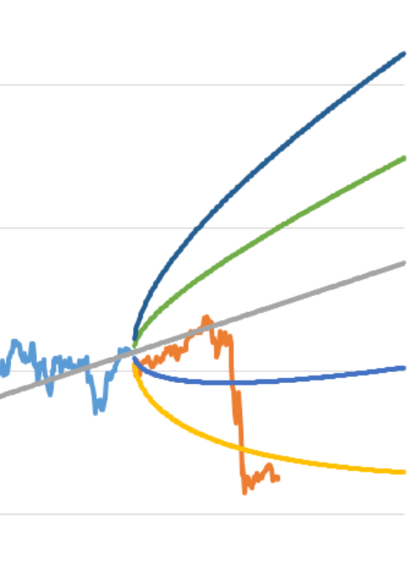
Question to be solved
The goal is to create novel graphical tool that will outperform probability cone, yet solve the same problem (forecasts a statistical distribution from a set point in time into the future).

Slide 4
Encountered problems
Graphical tool is rare; thus, we must implement tool from scratch in D3.js
Models are expected to produce 2 points (lower and upper bound) for 1 time period in future.
Optimization issue: calculation for creating point to graph distribution shouldn’t be too heavy.
In spite of the fact that data is relatively easy to collect, there is no ready data for y part (answer in supervised learning terms)

Slide 5




Formulization for supervised learning
Given
Predictions
Algorithm to create upper bound
Algorithm is iterative
For lower bounds is the same

Slide 6
Methods
Classical time series methods: ARIMA
ML methods:
Non-sequential: NN, regression
Sequential: RNN, LSTM

Slide 7
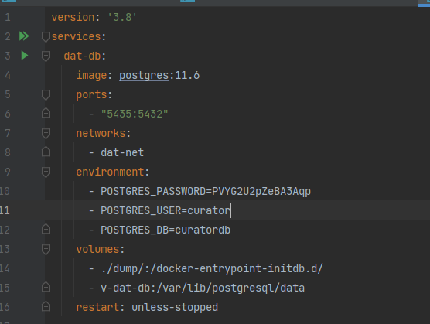
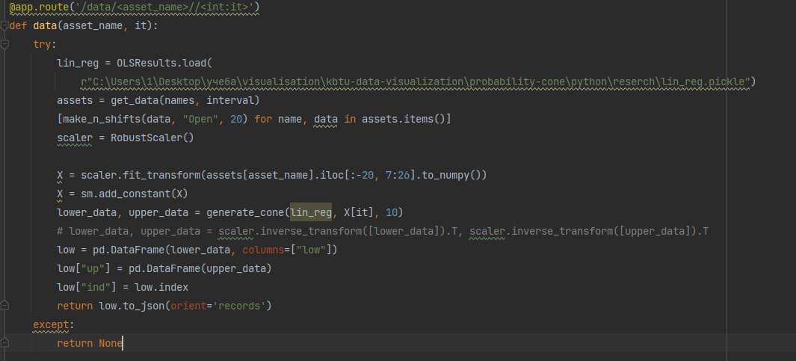
Infrastructure
Added postgresql and docker

Slide 8
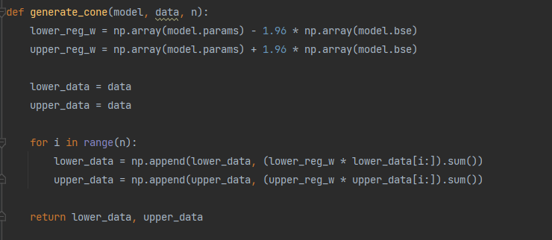
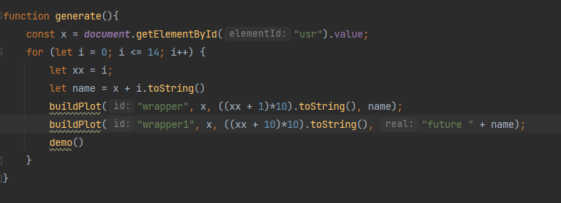
Code

Slide 9
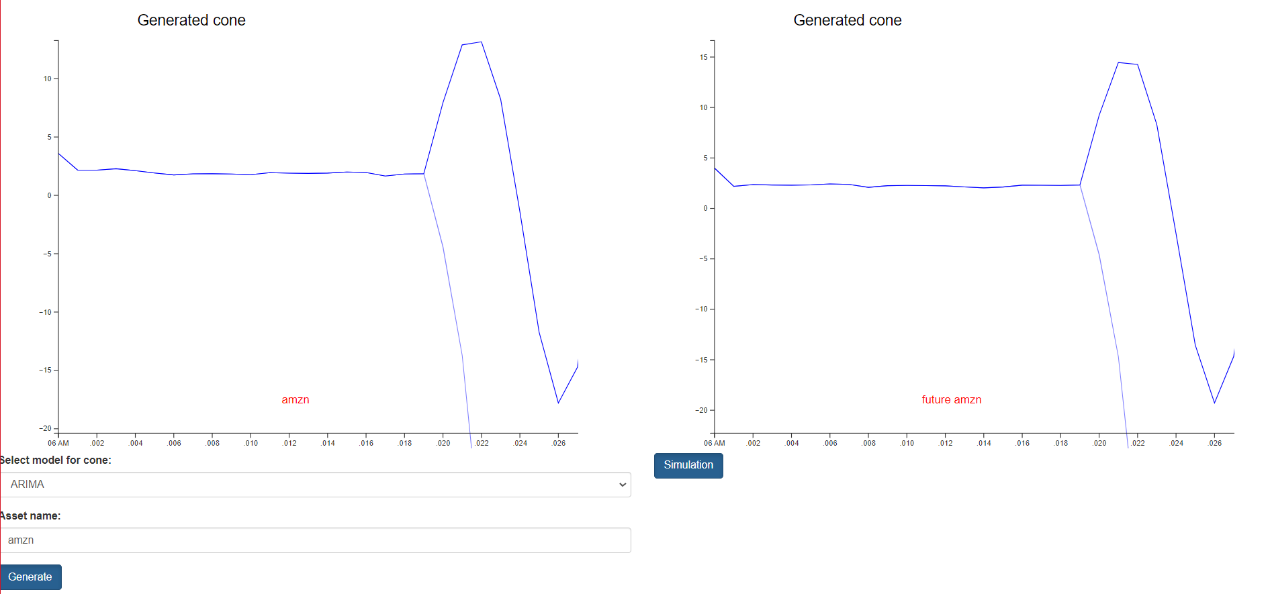
Results

Slide 10
Work
Kotlyarov Nikolay
Model creating and stats justification
Backend implementation
Nurmash Nurlan
Frontend implementation
Model creating help

