Slide 1
INFS3605: Information Systems Innovation & Transformation
Week 07 · PoC Demo
QuickLift.ai
W14A-10 · Wednesday 2PM seminar · [Challenge stream]
Nicholas Griffith · Aidan Smith · Isaac Ho · Owen Burgher · Dyashothan Kumar
Notes:
Say the team and the product name: QuickLift, an AI agent that fixes what stops Australian shoppers buying on small Shopify stores. Then go straight to the problem.

Slide 2
The problem
≈ 40 SEC
Problem statement
1
Unexpected extra costs at checkout, like shipping, are among the top reasons shoppers abandon a cart.
Small Australian Shopify stores lose sales to gaps a shopper notices in seconds: no Afterpay next to the price, delivery costs hidden until checkout, nothing saying the business is local. Owners can’t tell which gaps matter most, and most can’t edit their theme without paying a developer. So the gaps stay.
Source: Baymard Institute, cart abandonment research
2
Even big brands miss basics: our check of frankbody.com found no Afterpay by the price and no local-business signal.
Source: Our own QuickLift check, 27 Oct 2026
3
[Quote from our participating owner: what is hard about changing their store]
Who has this problem:
Founders of small Australian Shopify stores, with no developer and little time
Source: [Owner interview, date]
Notes:
About 40 seconds. One sentence: small Australian Shopify stores lose sales to small gaps, and the owner can't tell which matter or fix them without a developer. Strongest evidence first: our owner's own words. Then Baymard on surprise costs, and that even a big brand like Frank Body misses basics.

Slide 3
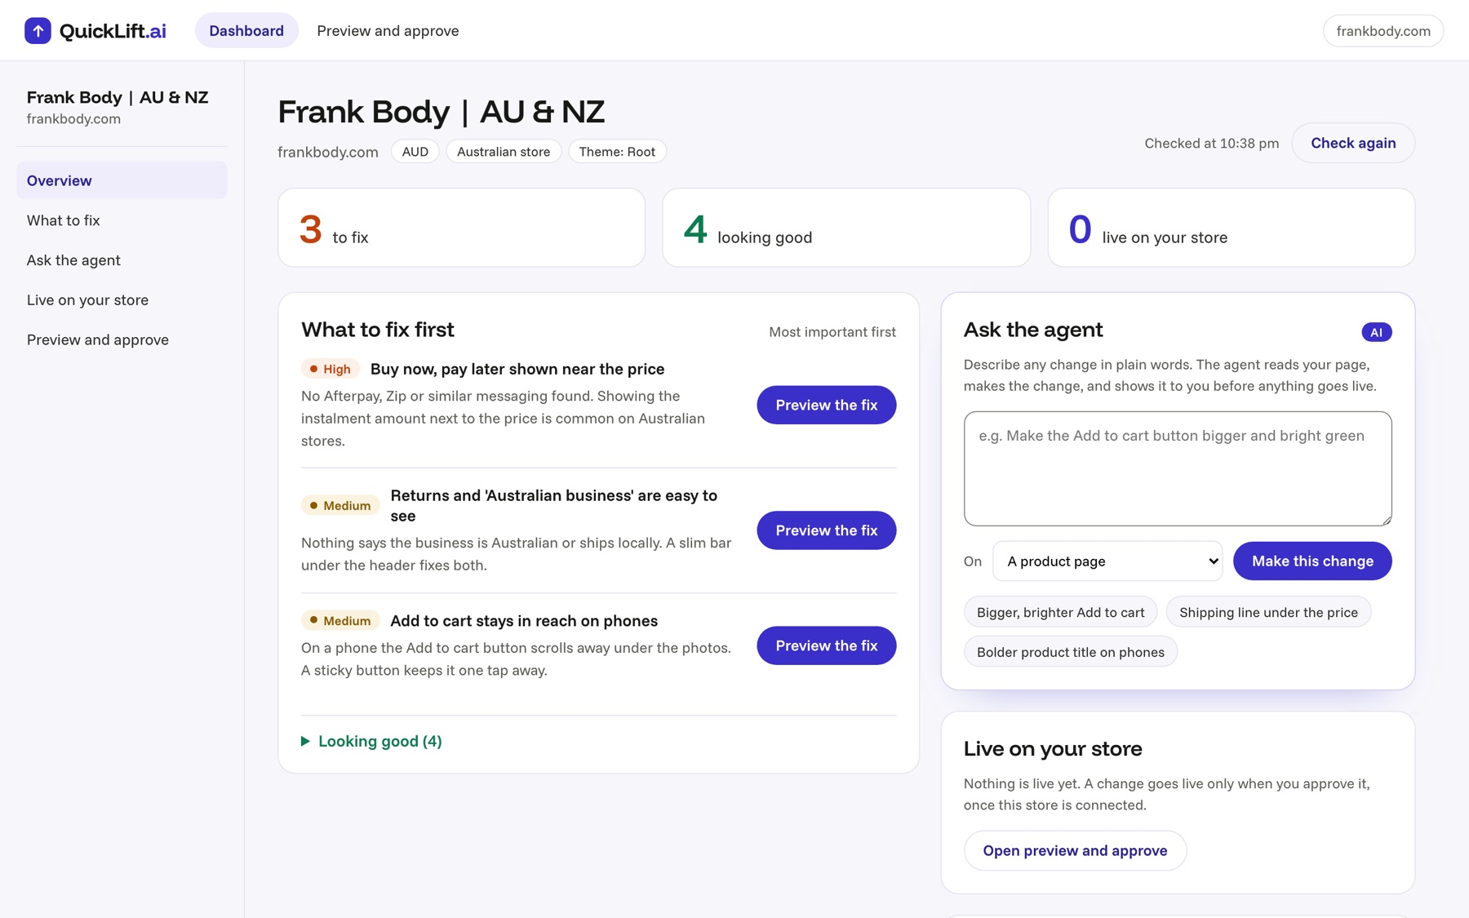
Our solution design
≈ 50 SEC
In one sentence
Design decisions and the evidence behind them
Paste in a Shopify store: QuickLift ranks what shoppers would miss, shows each fix on the real page, and its AI agent makes any change the owner asks for.
Decision 1
Because
Shopify stores only, across all of ecommerce
Every Shopify store publishes its pages and product data, so we can check any store with no login
Decision 2
Because
Show every change on a copy of the real page before it goes live
Week 2: trust, not cost, is SMEs’ main barrier to AI. Owners trust what they see on their own page
Decision 3
Because
Never invent facts. We chose not to auto-add reviews
Fake reviews or timers mislead shoppers. The agent flags any fact only the owner can confirm
Notes:
About 50 seconds. This is the owner's dashboard: what to fix first, and the agent. Decision 1: Shopify only, because every Shopify store publishes its pages and products, so we can check any store with no install; conversion works the same across ecommerce, so we didn't narrow to one category. Decision 2: the owner always sees the change on their own page first; our Week 2 research said trust is the barrier. Decision 3: it never invents facts, so we deliberately don't add reviews automatically.

Slide 4
Our agentic feature
≈ 60 SEC
The friction it removes: changing anything on a Shopify page means editing theme code, or paying a developer
Today, without it
With the agent
Work out which theme file controls it
Trigger
The agent
Human check
Outcome
The owner types a change in plain words, or switches on a suggested fix
Reads the live page, picks the elements, writes the code for that theme
Sees it on the real page, reads any warning, then presses Approve
A store change in minutes, no code or developer, one-click undo
Write and test the code by hand
Or brief and pay a developer, then wait
Why it’s agentic, not just a chatbot
It acts, not only answers. It reads an outline of the store’s live page, decides which elements to change and writes the CSS and JavaScript with Claude (Anthropic API, fixed reply format). It applies the change to a sealed preview, flags anything it had to assume, like a shipping time, and on approval publishes it into the theme through Shopify’s Admin API.
Notes:
About 60 seconds, the heart of it. Today: to change anything on a Shopify page the owner has to find the right theme file and write code, or pay a developer. With QuickLift: they type the change in plain words. The agent reads that exact page, writes the code against the store's own theme, and shows it on the real page. The owner checks it, including any fact the agent flags, like a shipping time it can't know, and presses Approve. That's the work it takes off their plate.

Slide 5
How we built it
≈ 30 SEC
Interface
Web app: home page, owner’s dashboard, and a preview of the store’s real page with Approve and publish
Working today
Check any Shopify store: 7 checks, ranked dashboard, 4 ready-made fixes, agent changes in a live preview, 16 automated tests
Data
No database. Reads each store’s public pages and product feed live, cached for 5 minutes. Stores nothing about shoppers.
Mocked or still to build
No log-in yet: the dashboard opens for any store address. Publishing works only on a store we hold a key for [not yet run on our dev store]. Weeks 8–9: connect stores through Shopify, test with our owner.
AI and agent
Claude via the Anthropic API, called from our Node and Express server, so the key never reaches the browser
Connections
Shopify storefront pages and product feed (public, read-only); Shopify Admin API to publish
PROMPTS.md
github.com/NickWG113/shopfix-au (private, access on request) [PROMPTS.md to add]
Notes:
About 30 seconds. A web app on Node and Express with Claude as the agent. No database: each check reads the store's public pages live. Be honest: there's no log-in yet, and publishing is set up for one store we hold a key for. PROMPTS.md is in the repo.

Slide 6
Live demo
≈ 4 MIN
Demo script
Switch to the live demo
1
Home page: enter frankbody.com. The dashboard ranks three things to fix, each with its reason
User: Owner of a small Australian skincare brand on Shopify
Scenario: They want more shoppers to buy, but can’t tell what to change and can’t edit code. We use frankbody.com, a real Australian store.
Watch for: Step 3: the agent changes the live page from one plain sentence
2
Preview the Afterpay fix: it appears under the real price. Flip Before / After
3
Ask the agent: “Make Add to cart bigger and bright green, and add ‘Ships from Sydney in 1–2 days’”
4
It changes the page and flags the shipping claim for the owner to check. Press Approve and publish
Notes:
About 4 minutes. Use the demo bar at the top (keys 1, 2, 3) to move between home, dashboard and preview. Check frankbody.com once before presenting so it loads instantly. If something fails, say so and go to the backup slide or the recording.

Slide 7
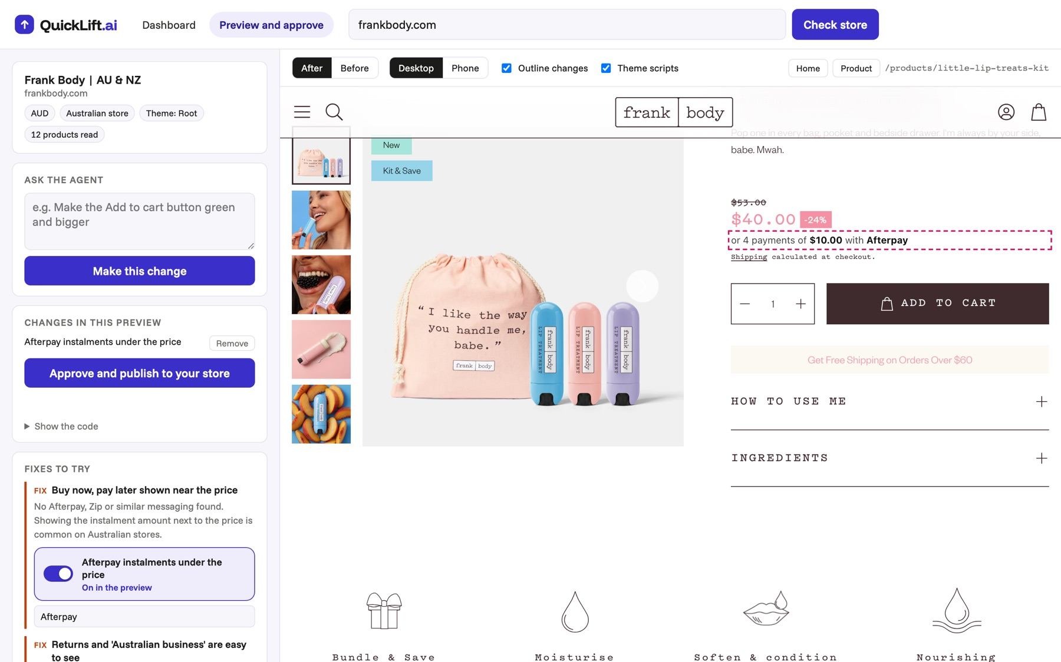
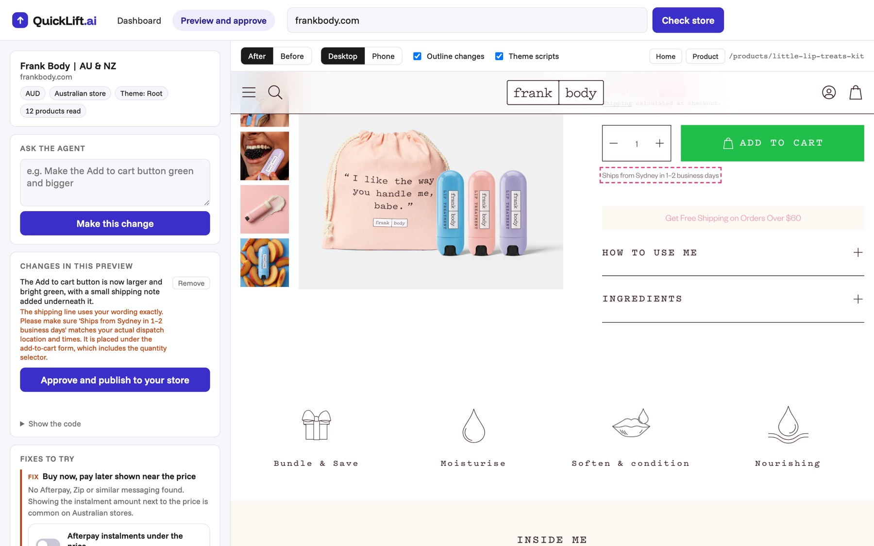
Backup: if the demo fails
ONLY IF NEEDED
The owner’s dashboard: three things to fix on frankbody.com, most important first
A ready-made fix on the real page: Afterpay instalments under the price
The agent’s change: a bigger green button and a shipping line, flagged for the owner to confirm
Notes:
Only if the live demo fails. There's also a screen recording of the full demo.

Slide 8
Questions
5 MIN Q&A
Thank you
Next: testing with users in Weeks 8–9
Our participating Shopify owner, on their own store
Check their store, switch on the fixes they agree with, and ask the agent for one change of their own
They’d approve a change they would otherwise have paid a developer for, and come back for the next one
QuickLift.ai · W14A-10
Notes:
Leave this up for questions.

