Slide 1
Final Project - Titanic Survival Studies
Kaiping Liu, Nick Zhu
DS 100

Slide 2
Table of Content
Dataset Overview
Variable Relationship
Statistical Test
Causal Interpretation
Logistic Regression Model
Notes:
While there was some element of luck involved in surviving, it seems some groups of people were more likely to survive than others. In our project, we aim to build a predictive model that answers the question: “what sorts of people were more likely to survive?” using passenger data (ie name, age, gender, socio-economic class, etc).

Slide 3
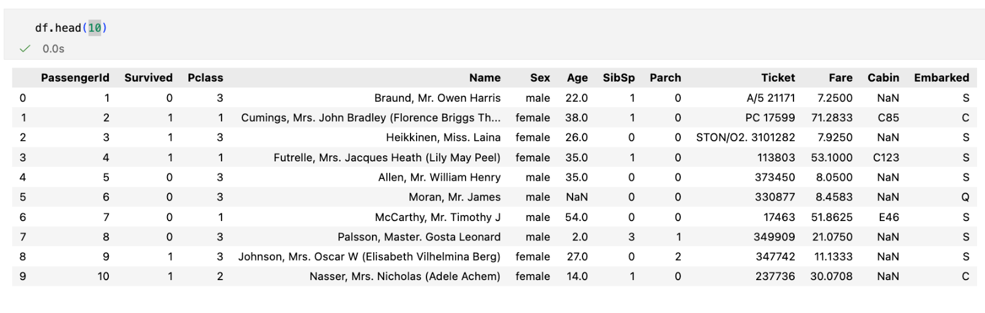
Dataset Overview
Notes:
Datasets provided include passenger information like name, age, gender, socio-economic class, etc. Here is the outlook.

Slide 4
Variable | Definition | Key
survival | Survival | 0 = No, 1 = Yes
pclass | Ticket class | 1 = 1st, 2 = 2nd, 3 = 3rd
sex | Sex
Age | Age in years
sibsp | # of siblings / spouses aboard the Titanic
parch | # of parents / children aboard the Titanic
ticket | Ticket number
fare | Passenger fare
cabin | Cabin number
embarked | Port of Embarkation | C = Cherbourg, Q = Queenstown, S = Southampton
Notes:
Table of explanation of the variables
Survival being 0 or 1

Slide 5
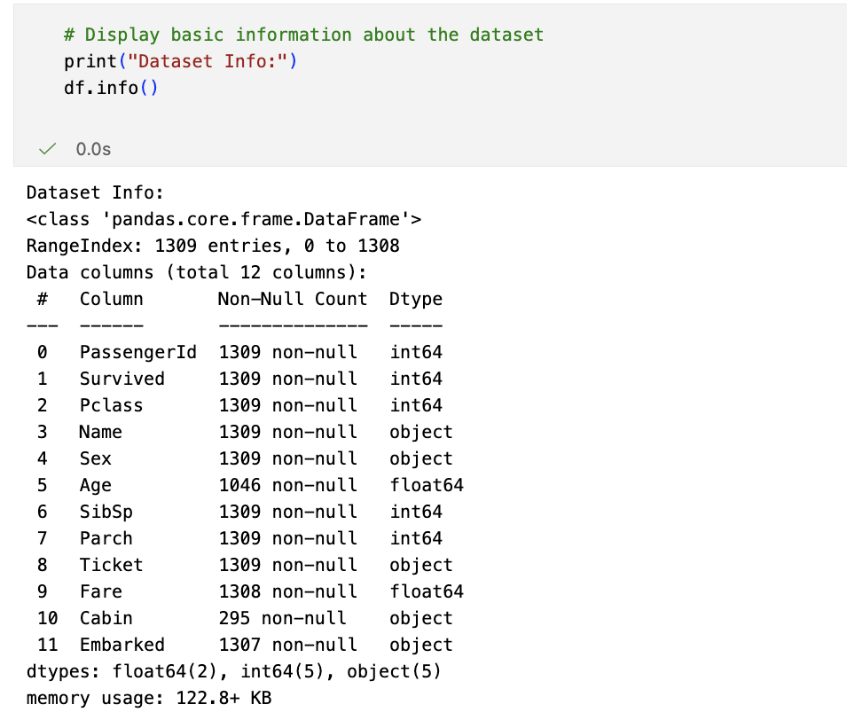
Dataset - Missing Data and Cleaning
Age: 177 missing values (19.9% of data)
Impute missing Age values using median age grouped by Pclass and Sex
Fare: 1 missing value (~0.00% of data)
Impute missing Fare value using median fare grouped by Pclass
Cabin: 687 missing values (77.1% of data)
Drop the Cabin column due to excessive missing data
Embarked: 2 missing values (0.2% of data)
Replaced with the mode value

Slide 6
Dataset - Missing Data and Cleaning
For categorical data:
Sex: object → int
Male = 1, Female = 0
Embarked: object “C”, “Q”, “S”→ boolean → int
Embarked is converted into three dummy variables (C, Q, S), each encoded as 0/1
Notes:
Embarked is converted into three dummy variables (C, Q, S), each encoded as 0/1 so the model can use these categories numerically without implying any order.

Slide 7
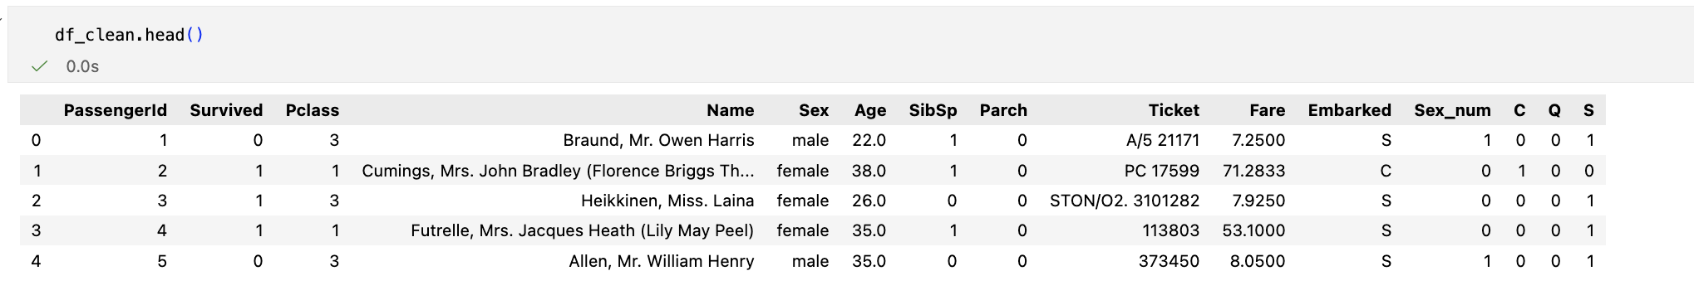
Dataset Overview
Notes:
In later analysis, we will remove the Name, Ticket column. Given so many variables, it would be wise if we could eliminate some not so relevant variables before jumping to the logistic regression model

Slide 8
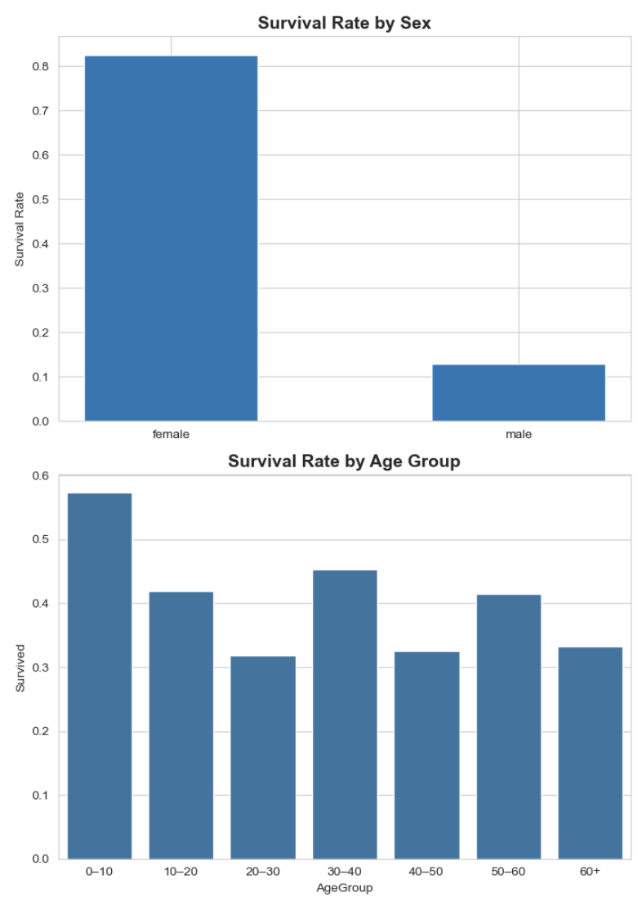
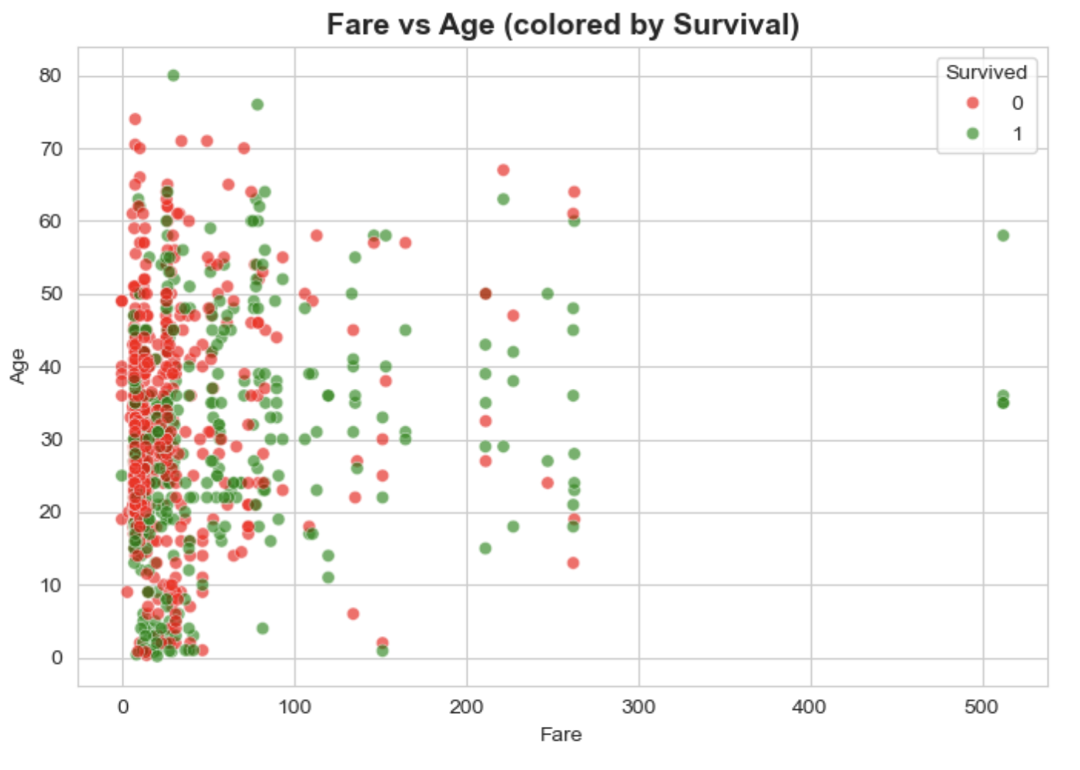
Notes:
These plots help us understand which passenger characteristics are associated with survival. First, the survival rate by sex shows a clear pattern: over 80% of females survived, compared to only about 12% of males. This suggests that gender could be one of the strongest determinants of survival on the Titanic. Next, when we group passengers by age, we see a more ambiguous pattern. Young children have the highest survival rates, but for adults the differences are much smaller and not strictly monotonic. This suggests that age alone may not be a strong linear predictor. On the right, we plot fare against age and color by survival outcome. We can see that survivors tend to cluster toward higher fares, reflecting the advantage of passengers from higher socioeconomic classes. However, within any given age group, survival appears mixed, again reinforcing that age may not a dominant driver.

Slide 9
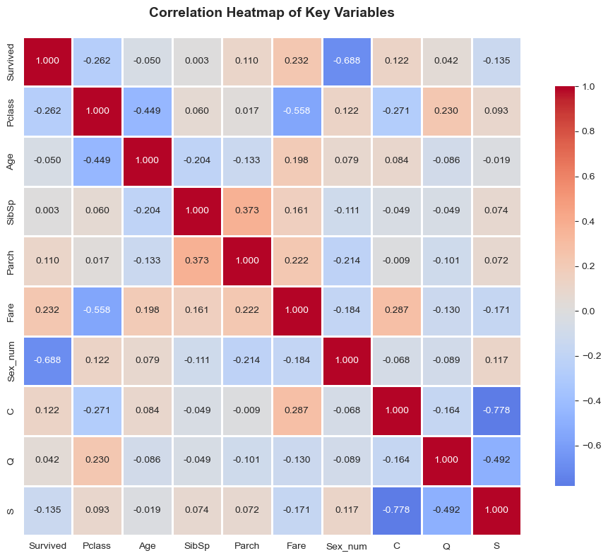
Variable Relationship
The heatmap highlights several meaningful relationships among key variables in the dataset:
Strong, clear predictors:
Sex_num shows the strongest association with survival (corr ≈ –0.688)
Fare (corr ≈ 0.232) and Pclass (corr ≈ –0.262)
Ambiguous or weaker relationships:
Age
Parch and Sibsp
Embarked (C,Q,S)
Strong correlations among the dummy variables (C,Q,S) reflect that a passenger can only belong to one port category.
SibSp and Parch show mixed signals: they correlate with each other but weakly with survival, suggesting family size influences survival in complex ways.
Notes:
A heatmap is simply a visual representation of the correlation coefficient matrix, where each color-shaded cell corresponds to the numerical correlation value between a pair of variables. Here, stronger correlations appear as colors closer to the extremes (deep red for strong positive, deep blue for strong negative), indicating a tighter relationship between the two variables compared.
Strong, clear predictors: Sex shows the strongest relationship with survival (corr ≈ –0.69). Pclass (–0.27) and Fare (0.23) also show consistent, interpretable effects.
Ambiguous or weak linear relationships: Age has a very small correlation (–0.05), likely masking nonlinear patterns (e.g., children vs adults). SibSp and Parch show mixed signals: they correlate with each other but only weakly with survival, suggesting family size influences survival in complex ways.
Strong correlations among the dummy variables (C,Q,S) reflect that a passenger can only belong to one port category. → remove ‘Q’
SibSp and Parch show mixed signals: they correlate with each other but weakly with survival, suggesting family size influences survival in complex ways. → statistical test to better decide whether we should keep or discard which variable
//
The heatmap highlights several meaningful relationships among key variables in the Titanic dataset:
Sex shows the strongest association with survival (corr ≈ –0.69), confirming that females had a much higher chance of surviving than males.
Fare is positively correlated with survival (corr ≈ 0.23), suggesting that passengers who paid more—typically those in higher classes—were more likely to survive.
Pclass is negatively correlated with survival (corr ≈ –0.26): lower-class passengers faced lower survival rates, reflecting structural inequalities in access to lifeboats.
Age shows almost no linear correlation with survival (corr ≈ –0.05), indicating that age alone is not a strong predictor without further interaction effects.
Mild correlations among family-size indicators (SibSp, Parch) suggest they contribute information but are not dominant drivers of survival.

Slide 10
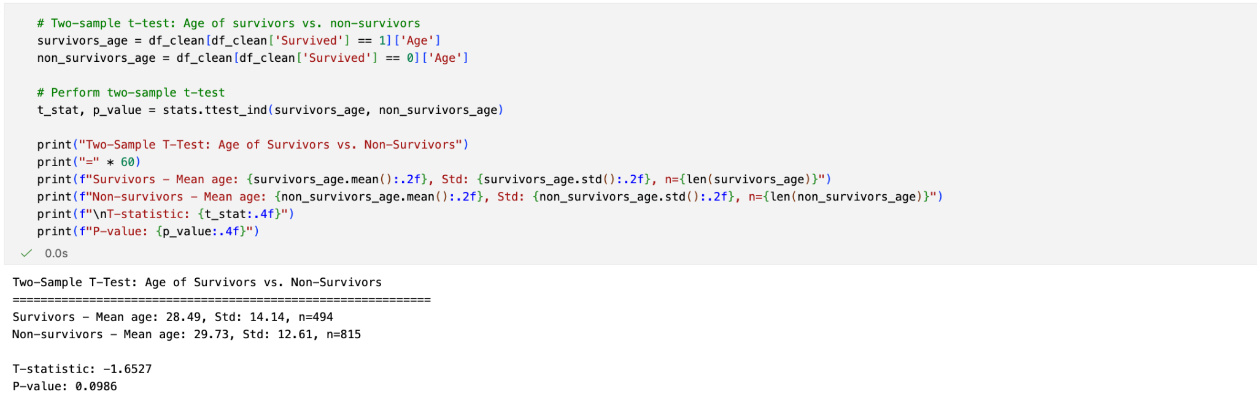
Statistical Test
‘Age’
H₀: The mean age of survivors equals the mean SibSp of non-survivors. H₁: The mean age of survivors differs from the mean SibSp of non-survivors.
At a significance level of α=0.05, we fail to reject H₀. There is no statistically significant difference in mean age between survivors and non-survivors in this dataset.

Slide 11
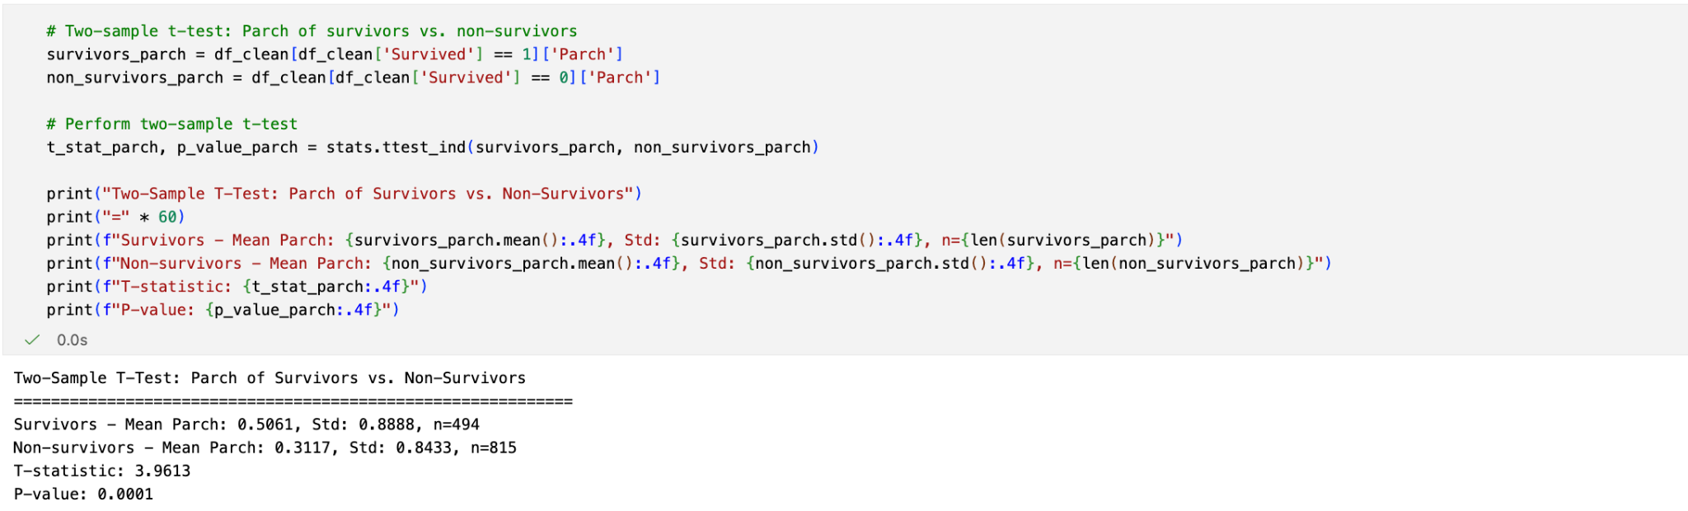
Statistical Test
‘Parch’
H₀: The mean Parch of survivors equals the mean Parch of non-survivors. H₁: The mean Parch of survivors differs from the mean Parch of non-survivors.
At a significance level of α=0.05, we reject H₀ and conclude that traveling with parents/children is associated with higher survival odds.

Slide 12
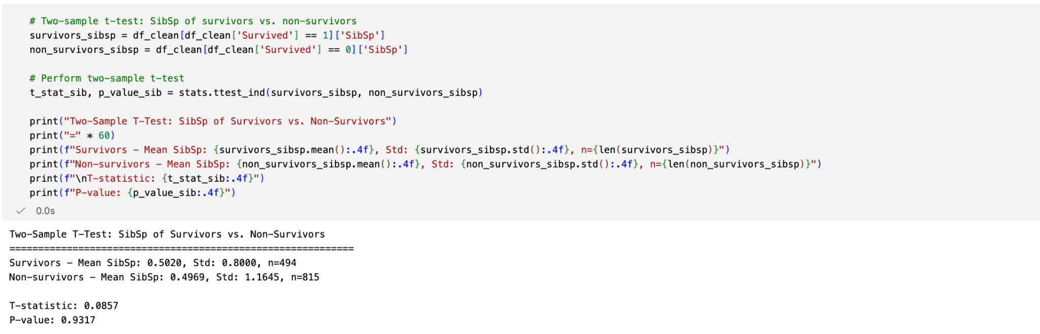
Statistical Test
‘Sibsp’
H₀: The mean SibSp of survivors equals the mean SibSp of non-survivors. H₁: The mean SibSp of survivors differs from the mean SibSp of non-survivors.
The p-value is approximately 0.93, which is far greater than 0.05. We fail to reject H₀. This suggests that there is no statistically significant difference in the average number of siblings/spouses between those who survived and those who did not.

Slide 13
Causal Interpretation
Selection Bias
Confounding Variables
Correlation ≠ Causation
Passengers differed systematically in wealth, cabin location, and travel companions. Therefore, differences in survival across Pclass and Fare reflect pre-existing differences, not the causal effect of class.
Sex, Age, Pclass, and Fare are intertwined with social norms (eg. “Women and children first" policy), group travel behavior, and ship layout. These confounders affect both the “treatment” variables and survival, making correlations non-causal.
Strong associations (Sex, Pclass) cannot be interpreted causally, and weak correlations (Age) do not imply no causal effect. The data is observational, so correlation only describes patterns, not mechanisms.

Slide 14
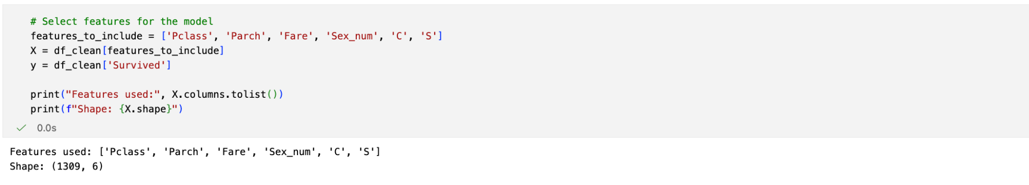
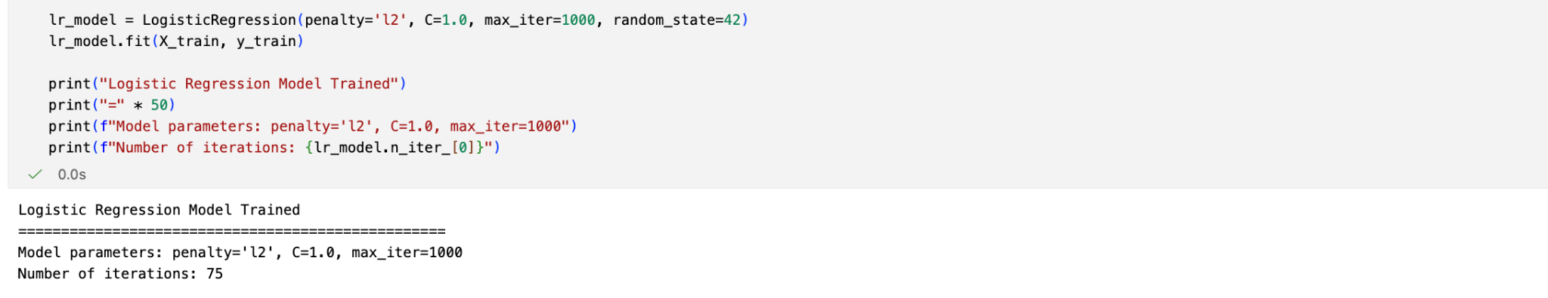
Predictive Model - Logistic Regression
Prepare Features:
Train-Test Split: 80% - 20%
Train Logistic Regression Model:
Notes:
We choose logistic regression as we are just predicting a binary outcome - the passenger did or did not survive. With the earlier analysis of correlation and statistical tests, we decide to only include … these variables in the final model.The train-test split is at 80%-20%. Then fit the logistic regression model to the training set of data

Slide 15
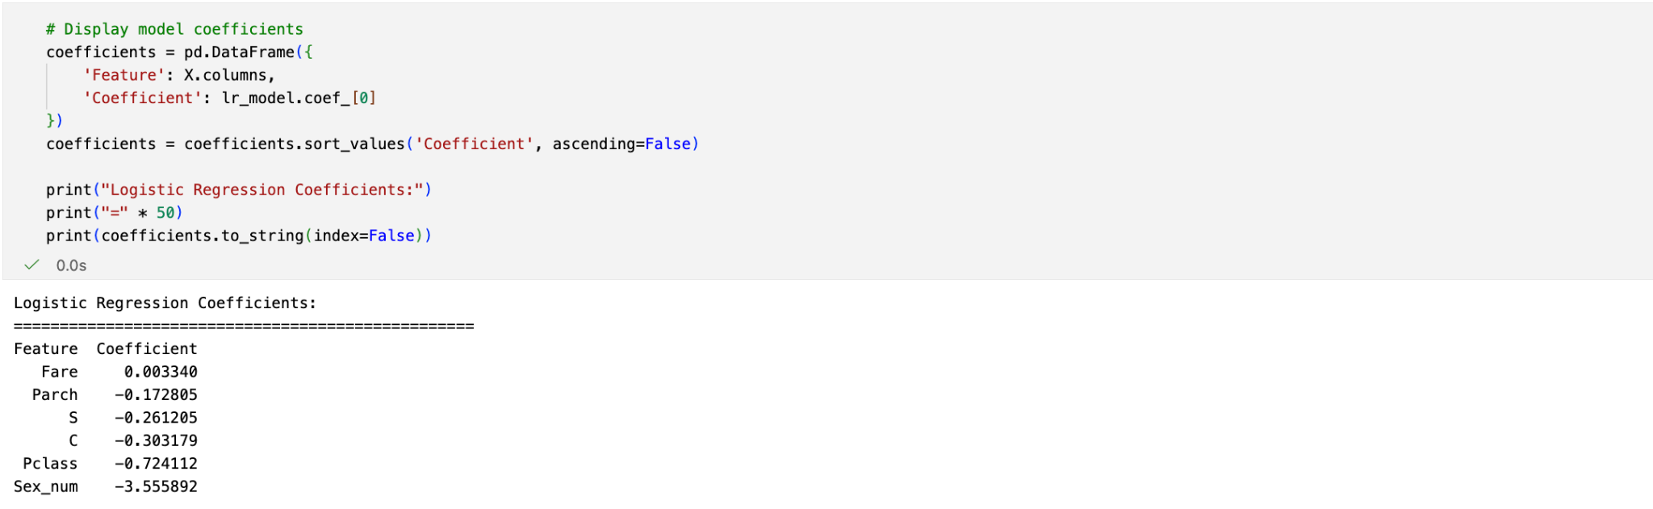
Predictive Model - Logistic Regression
Sex_num has the largest negative coefficient, meaning the trained model learns that being male drastically reduces the predicted odds of survival.
Pclass has a strong negative effect, indicating the model identifies lower-class passengers as significantly less likely to survive.
Parch, Embarked indicators (C,S) and Fare contribute weakly

Slide 16
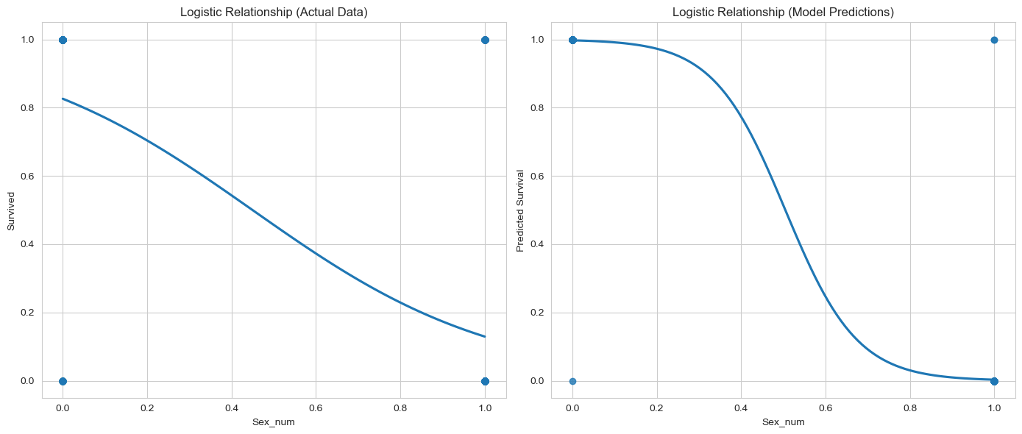
Predictive Model
Notes:
These 2 graphs can help us visualize how the logistic regression model learns those patterns and compares them to what we observe empirically.
On the left, we fit a logistic curve directly to the actual data. The curve doesn’t perfectly follow an S-shape. We can see females have a much higher survival probability than males.
On the right, we plot the model’s predicted relationship. Here, the logistic curve is much cleaner because it comes from the trained coefficients. It highlights how strongly the model separates the two groups: the predicted survival for females is close to 1, while for males it drops close to 0.
Comparing both plots, we see that the model captures the underlying pattern in the data and amplifies it into a clear decision boundary.

Slide 17
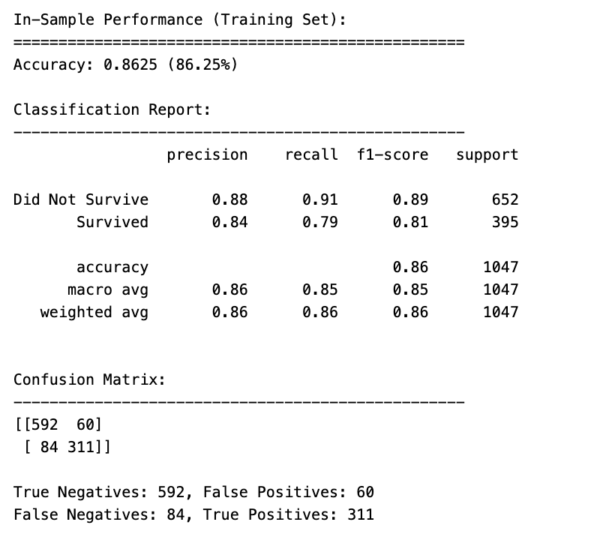
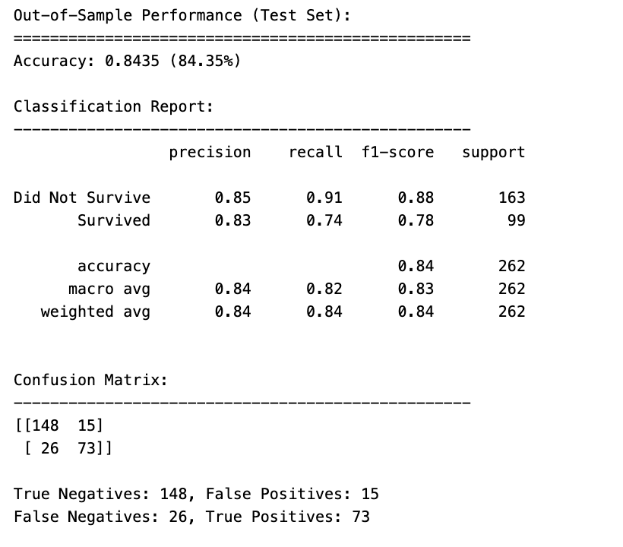
Predictive Model - Performance
Notes:
Here we evaluate how well our logistic regression model performs on both the training set and the test set. On the training data, the model achieves about 86% accuracy, and the precision–recall balance is quite strong for both classes. Importantly, the confusion matrix shows the model correctly identifies most non-survivors, with relatively few false positives or false negatives. On the test set, the accuracy remains high at 84%, which is very close to the training performance. This tells us the model generalizes well and is not overfitting. The recall for survivors is slightly lower on the test set, meaning the model misses some actual survivors, but overall performance across both classes remains stable. The model performs consistently across training and testing, showing good predictive power and strong ability to generalize to new data.

Slide 18
Thank you
Notes:
To conclude, our investigation brings together exploratory analysis, statistical testing, and predictive modeling to understand survival patterns on the Titanic. The strongest signals emerge from gender and socioeconomic class. Our logistic model successfully learns these patterns and performs reliably out-of-sample. While we cannot draw causal conclusions from observational data, our findings offer a data-driven view of what shaped survival. Thank you.

