Slide 1
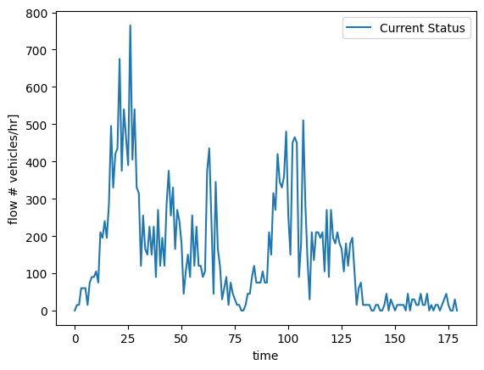
Current State - No control
Region 4 reaches ≈ 110 veh/km → flow collapses → “Gridlock”
Average journey time > 1 h.
Long waiting time: 45 min
No anticipation of future traffic
Traffic flow with no control leads to gridlock, marked in red.

Slide 2
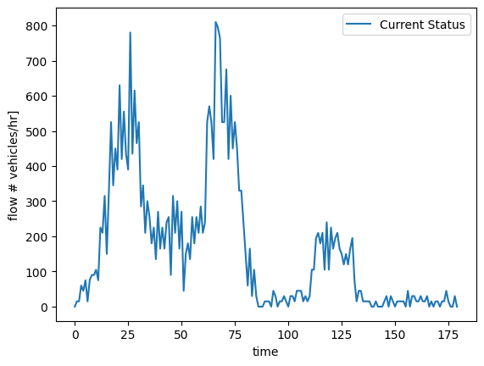
Failure mode - P controller
P-controller reduces journey time by 20% yet can’t handle late‑rush surge.
Single‑region feedback ignores upstream queues.
Same speed factor broadcast to all five roads → sub‑optimal.
A drastic reduction in CO2 emissions and travel time can be achieved with a new controller
Traffic flow with P-control still leads to gridlock, marked in red.

Slide 3
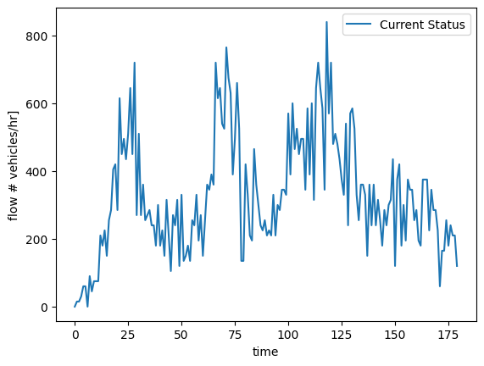
MPC Model Predictive Control
Predictable behaviour
Easy to follow DSL changes
Can anticipate future traffic
Traffic flows freely without gridlock using the MPC controller
Avg travel time −72.5 % • 100 % trips completed

Slide 4
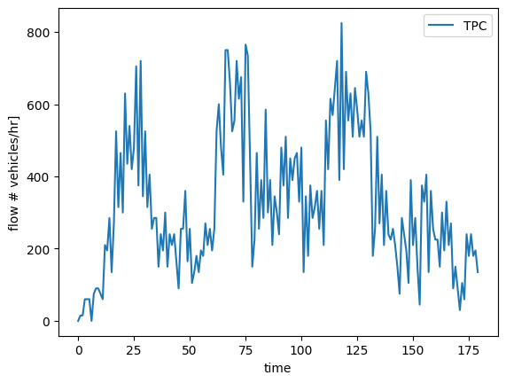
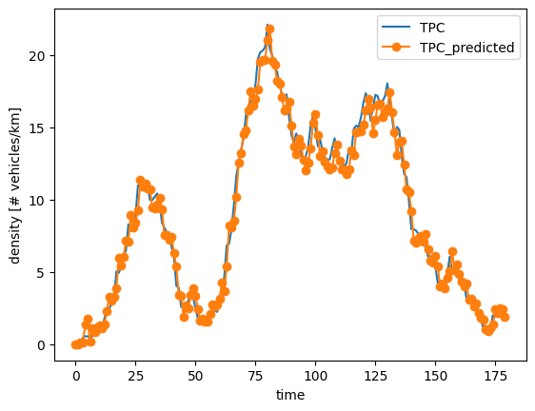
TPC Transient Predictive Control
Can deal with closed loop training data
Fast compilation time
Fastest average travel time
Density [# vehicles/km]
TPC makes accurate density predictions
Traffic flows freely without gridlock using the TPC controller
Avg travel time −80 % • Solves ≈ 3× faster than MPC

Slide 5
Deployment
Implementation
Trade-offs
Phase | Model-based MPC | Data-driven TPC
1. Offline preparation | Identify real world model and linearize around operating point | Collect 1-2 weeks of DSL commands, densities and flows from the real network (excite each road a bit to cover the dynamics).
2. Implementation | Implement hardware to run the controller Include a Kalman or moving-average state estimator to filter sensor noise. | Implement hardware to run the controller No explicit state estimator—uses raw measured inputs/outputs.
3. Monitoring & updates | Re-identify model yearly or after major roadworks Retune parameters if traffic patterns shift. | Retrain predictors monthly with the newest data. No manual gain retuning needed in most cases.
Aspect | Model-based MPC | Data-driven TPC
Up-front effort | Needs a trustworthy physics-based model and calibration → more engineering hours. | Minimal modelling; biggest cost is gathering representative data.
Transparency & verification | High: linear model + quadratic cost allow formal proofs of stability and constraint satisfaction. | Medium‑high: predictors are linear and inspectable but still data‑driven.
Adaptability to network changes | Requires revisiting the model and gains after structural changes. | Simply collect new data and retrain; quick to port to other corridors.
Robustness to unseen scenarios | Good if the model covers the operating envelope; brittle outside it. | Same risk as any data‑driven method: edge-case behaviour may be unknown

Slide 6
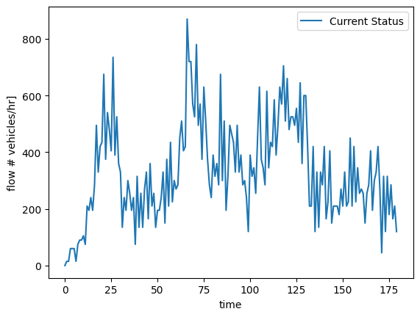
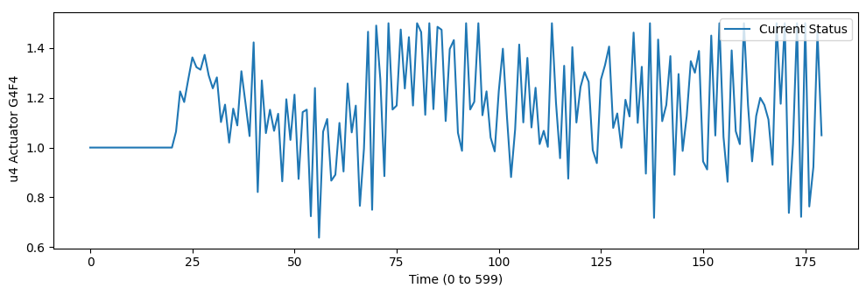
Bonus: DeePC Data-enabled Predictive Control
Better at capturing complex behaviour
Uses real SUMO data—no model mismatch.
More complex DSL changes
More parameters to tune, requiring extra expertise
DSL changes may be more challenging for human drivers.
Traffic flows freely without gridlock using the DeePC controller
Avg travel time −74 % • Solves ≈ 2× faster than MPC

