Slide 1


INFORMATION INTEGRATION 2023/2024
NICOLA DE SIENA 1926056

Slide 2
DOMAIN OF INTEREST:MOVIES AND TV SHOWS
The domain of interest i chose for this project is about the best 1000 movies from imdb(since 2020) and the best 2000 tv shows(since 2020) from imdb. To obtain these data, I picked two datasets from kaggle in a csv file format: top 1000 imdb movies and top 2000 best tv shows imdb. They both contain informations about votes,rating,genre,description,ecc.

Slide 3
SOURCE SCHEMA
Now let’s analyze the source schema of these two datasets: In IMDB-movie-data-top1000 we have a relation movie with these attributes: title, genre, description, director, actors, year, runtime, rating, votes, revenue and metascore. Runtime, year, votes and metascore are type integer; Title, genre, description, director and actors are type string; Rating and revenue are type double. In IMDB_top_2000_tvshow we have a relation tvshow with these attributes: show_name, airdate, show_rating, show_genre, show_votes and show_runtime. Show_name, airdate(type date) and show_genre are type string while show_rating and show_votes are type double.

Slide 4
GLOBAL SCHEMA
ID: id of all elements (integer); Title_finale: The title of the movie or TV show(string); Type_finale: A new attribute to distinguish between movies and TV shows(string); Genre_finale: The genre(s) of the movie or TV show(string); Description: A brief description (for movies only)(string); Director: The director(s) of the movie (for movies only)(string); Actors: The main actors in the movie (only for tv movies)(string); Rating_finale: The IMDb rating of the movie or TV show(double); Votes_finale: The number of votes the movie or TV show has received(integer); Revenue: The box office revenue (for movies only)(double); Metascore: The Metascore rating (for movies only)(integer).

Slide 5
MAPPING
Now let’s see the mapping rules for our project and let’s start with IMDB top 1000 movies :
∀title, genre, description, director, actors, rating, votes,type, revenue, metascore. Movie(id,title,genre,description,director,actors,rating,votes,type,revenue,metascore) → global_schema(id,Title_finale, Genre_finale, Description,Director, Actors, Rating_finale, Votes_finale,Type_finale,Revenue, Metascore).

Slide 6
MAPPING
Let’s set now the mapping rules IMDB top 2000 tvshows:
∀Show_Name,Show_Rating,Show_Genre,Show_Votes,Type.Tvshow(id,Show_name,Show_rating,Show_Genre,Show_Votes,Type) → global_schema(id,Title_finale, Genre_finale, Rating_finale, Votes_finale, Type_finale).

Slide 7
TASKS
List titles of movies and their genre with a rating greater than 8.0
FOL:
∃id,title_finale,genre_finale,rating_finale,type_finale. global_schema(id,title_finale,genre_finale,rating_finale,votes_finale,type_finale) ∧ type_finale=′movie′ ∧ rating_finale > 8.0
SQL:
SELECT id, title_finale,genre_finale,rating_finale
FROM global_schema
WHERE rating_finale > 8.0 AND type_finale = ‘Movie’

Slide 8
TASKS
Retrieve the titles of all movies with a rating above 7.0 or TV shows with a rating above 8.0.
FOL:
∃id,title_finale,rating_finale,type_finale. global_schema(id,title_finale,genre_finale,rating_finale,votes_finale,type_finale) ∧ type_finale = ′movie′ ∧ rating_finale > 7.0 ∨ ∃id,title_finale,rating_finale,type_finale. global_schema(id,title_finale,genre_finale,rating_finale,votes_finale,type_finale) ∧ type_finale = ′tvshow′ ∧ rating_finale > 8.0
SQL:
SELECT title_finale FROM global_schema
WHERE (type_finale = 'Movie' AND rating_finale > 7.0) OR (type_finale = ‘TvShow' AND rating_finale > 8.0)

Slide 9
TASKS
Retrieve all movies directed by Christopher Nolan with a rating greater than 7.5
FOL:
∃id,title_finale,director,type_finale. global_schema(id,title_finale,director,type_finale) ∧ director=′ChristopherNolan′ ∧
type_finale=′movie′ ∧ rating_finale > 7.5
SQL:
SELECT id, title_finale,rating_finale
FROM global_schema
WHERE director = 'Christopher Nolan' AND rating_finale > 7.5

Slide 10
TASKS
Find movies with revenue over $100 million and an IMDb rating below 7.0.
FOL:
∃id,title_finale,rating_finale,revenue,type_finale. global_schema(id,title_finale,genre_finale,rating_finale,votes_finale,revenue,type_finale) ∧ type_finale=′movie′ ∧ revenue >100.000.000 ∧ rating_finale < 7.0
SQL:
SELECT title_finale
FROM global_schema
WHERE type_finale = ‘Movie’ AND revenue > 100000000 AND rating_finale < 7.0

Slide 11
TASKS
Find all TV shows that do not have more than 500,000 votes.
FOL:
∃id,title_finale,votes_finale,type_finale. global_schema(id,title_finale,genre_finale,rating_finale,votes_finale,type_finale) ∧ type_finale = ′tvshow′ ∧ votes_finale ≤ 500000
SQL:
SELECT id, title_finale, votes_finale
FROM global_schema
WHERE type_finale = ‘TvShow'
AND votes_finale <= 500000

Slide 12
TASKS
Select the title and rating of all movies or TV shows with "Drama" or "Comedy" genre, and rating above 7.5
FOL:
∃id,title_finale,rating_finale,genre_finale,type_finale. global_schema(id,title_finale,genre_finale,rating_finale,votes_finale,type_finale) ∧ genre_finale = ′Drama′ ∧ rating_finale >7.5 ∨ ∃id,title_finale,rating_finale,genre_finale,type_finale. global_schema(id,title_finale,genre_finale,rating_finale,votes_finale,type_finale) ∧ genre_finale = ′Comedy′ ∧ rating_finale > 7.5
SQL:
SELECT title_finale, rating_finale
FROM global_schema
WHERE (genre_finale = 'Drama' OR genre_finale = 'Comedy’) AND rating_finale > 7.5

Slide 13
IMPLEMENTATION WITH PENTAHO
For this project, we chose Pentaho as Data Integration Tool. Pentaho is an open-source ETL (Extract, Transform, Load) tool that provides a comprehensive platform for data integration, processing and analytics. We used two pipelines with the same blocks, one for IMDB movies CSV file and another one to make the mapping, until the merge with a Join Block and using a Table Output to create the final dataset with our global schema. About the dataset, since we are using a materialized approach, we choose PostgreSql to show Dataset and also to ask query related to our tasks.

Slide 14
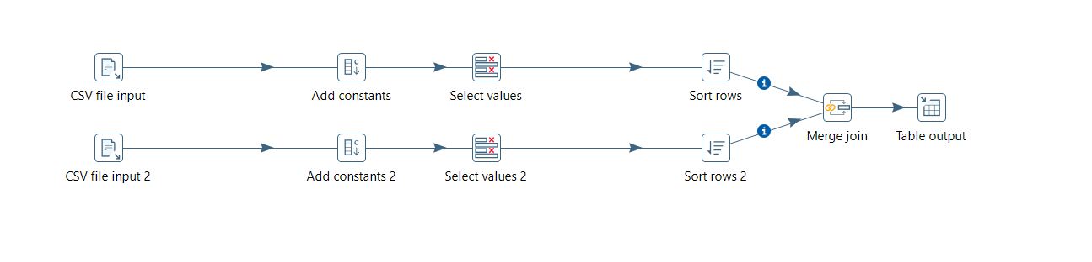
IMPLEMENTATION WITH PENTAHO

Slide 15
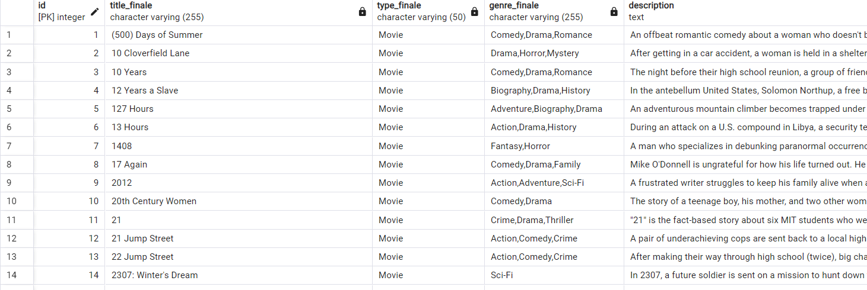
IMPLEMENTATION WITH PENTAHO

Slide 16
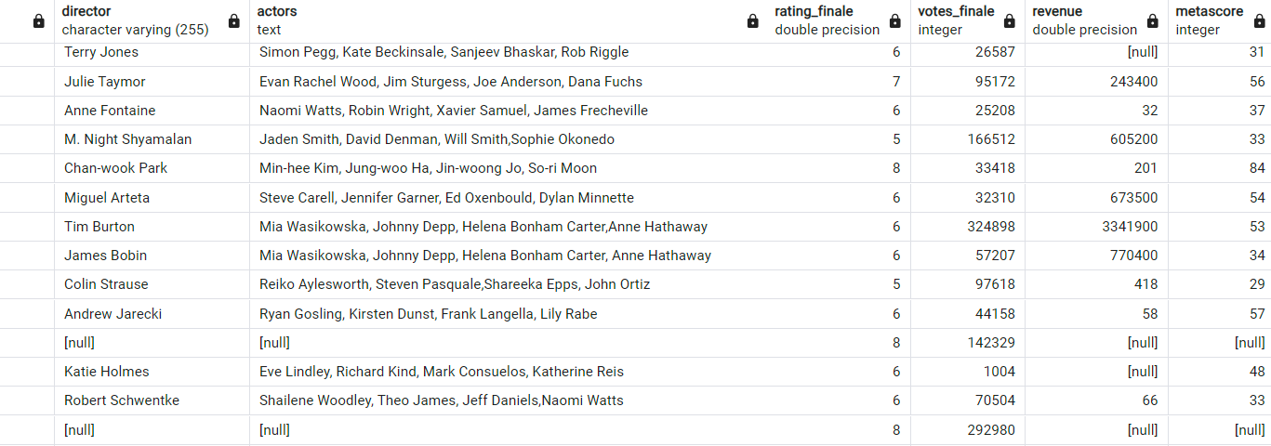
IMPLEMENTATION WITH PENTAHO

Slide 17
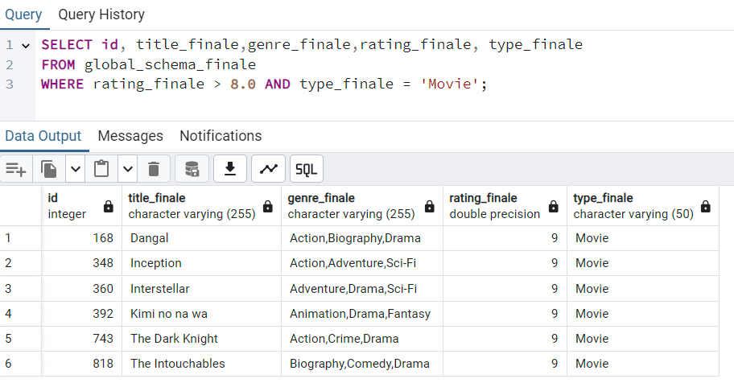
TASKS IN POSGRESQL

Slide 18
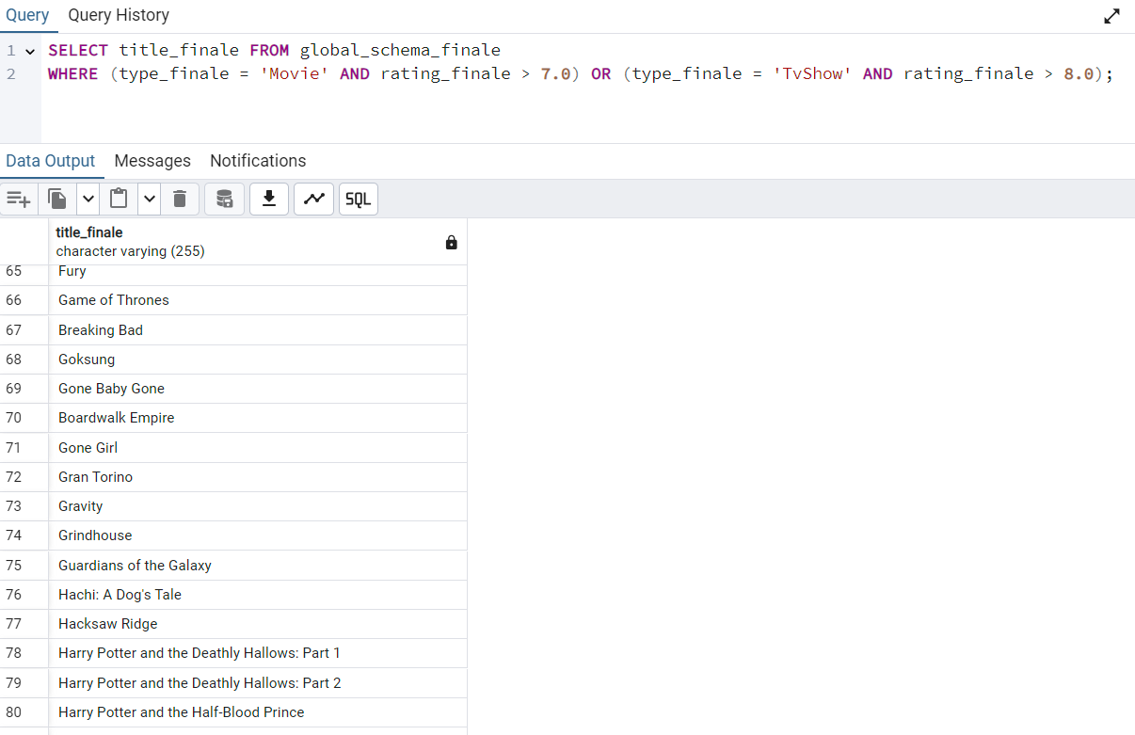
TASKS IN POSTGRESQL

Slide 19
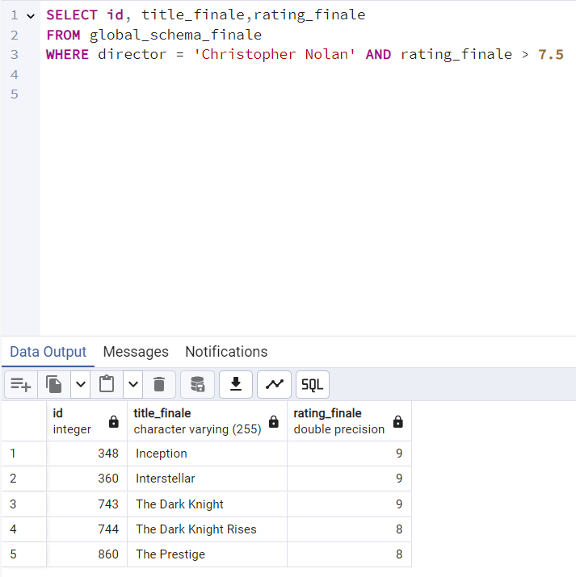
TASKS IN POSTGRESQL

Slide 20
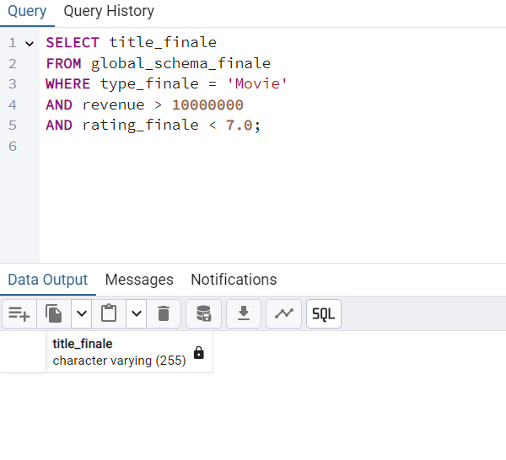
TASKS IN POSTGRESQL

Slide 21
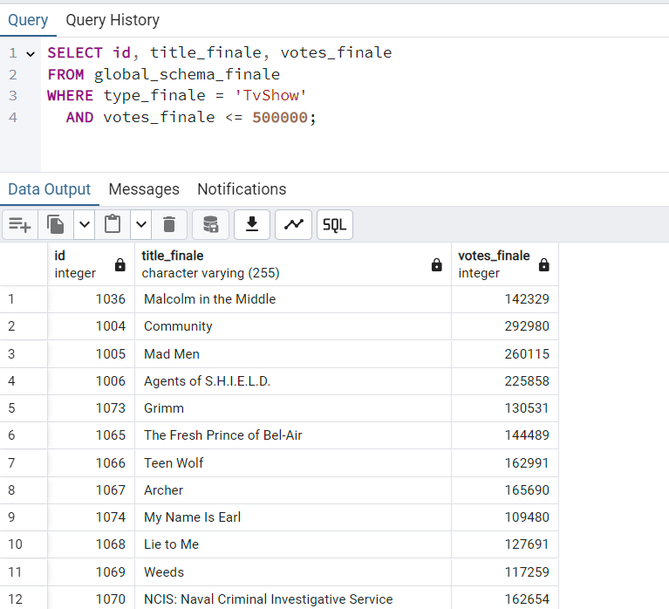
TASKS IN POSTGRESQL

Slide 22
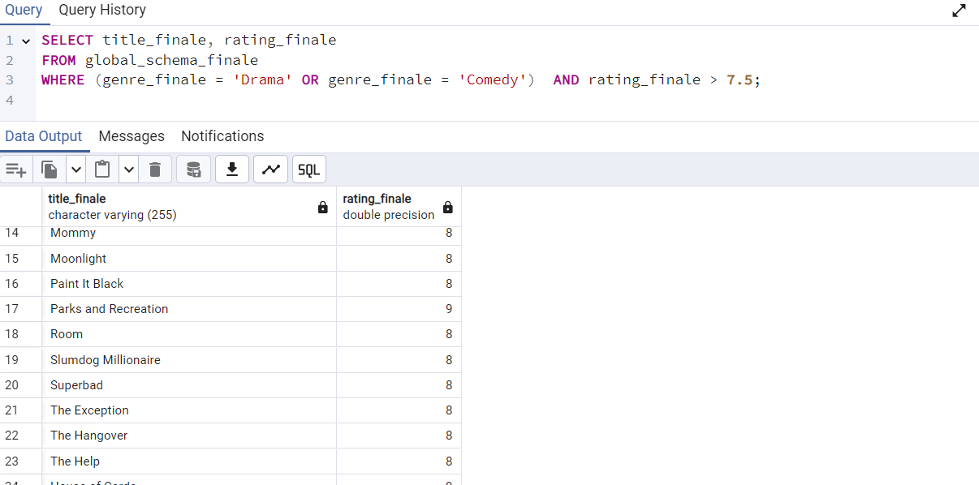
TASKS IN POSTGRESQL

Slide 23
Thanks for your attention

