Slide 1



Knowledge Representation and
Semantic Technologies
NICOLA DE SIENA
1926056
Project realized on Protègè

Slide 2
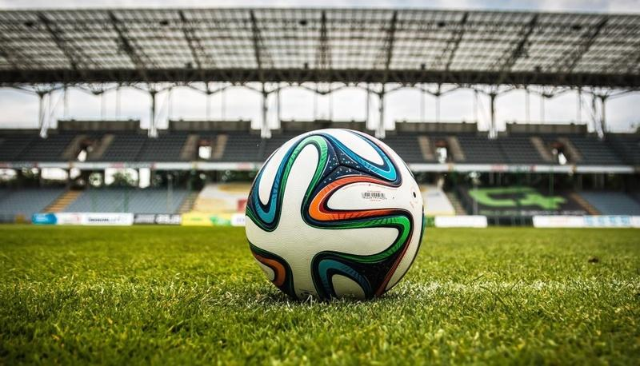
My Ontology: The world of European Football
The ontology that I realized from scratch on Protégé it’s called «the world of european football».
In this ontology we focus on the aspects of the main football championships in Europe, national and international.
Pagina <number>

Slide 3
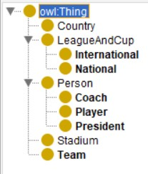
Class Hierarchy
On the left we can see a picture representing the class hierarchy of our ontology.
Basically, we have some objects reguarding the people that are an important part of a football team and reguarding the competitions.
Titolo Presentazione
Pagina <number>

Slide 4
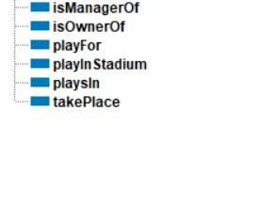
Object property hierarchy
On the left, there is a picture with the Object properties of this ontology:
isManagerOf: Domain is Coach and Range is Team
isOwnerOf: Domain is President and Range is Team
playFor: Domain is Player and Range is Team
playInStadium: Domain is Team and Range is Stadium
playsIn: Domain is Team and Range is LeagueandCup
takePlace: Domain is LeagueandCup and Range is Country
As an example, we can say that:
Jurgen Klopp isManagerOf Liverpool -> Liverpool playsIn FACup -> FACup takePlace England
Titolo Presentazione
Pagina <number>

Slide 5
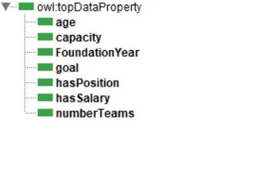
Dataproperty Hierarchy
On the left there is a picture representing all the Data Properties of this ontology:
age: Domain is Person
capacity: Domain is Stadium
FoundationYear: Domain is Team
goal: Domain is Person
hasPosition: Domain is Person
hasSalary: Domain is Person
numberTeams: Domain is LeagueandCup
We can see that most of the data properties are related to the Superclass Person, that’s because the Coach,President and Player are the most important objects of a Football Team.
Notice that some dataproperties, like goal, are not very accurate because we are considering the current season 2023/24 in the ontology.
Titolo Presentazione
Pagina <number>

Slide 6
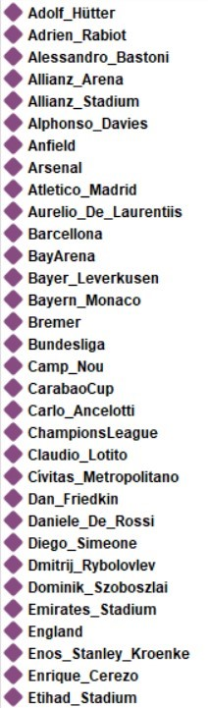
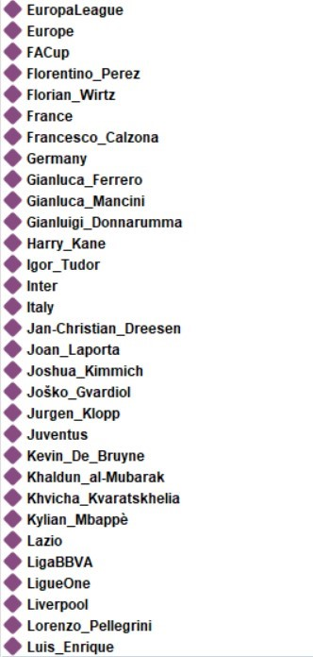
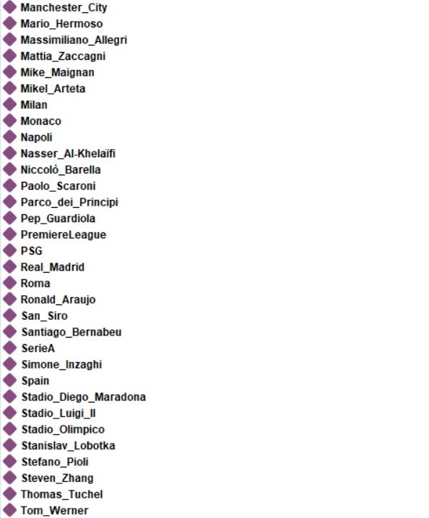

Individuals
This is the list of all 98 individuals of this ontology. Except for class Country, every other object has at least a data property or an object property.
Obviously, we didn’t put all the players in the individuals, just a few for every football Team.
Titolo Presentazione
Pagina <number>

Slide 7
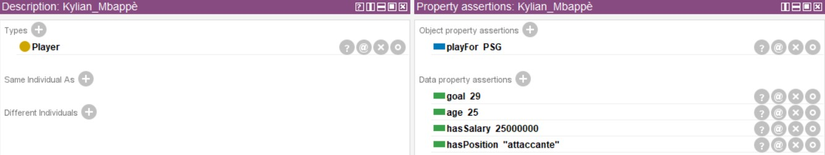
Individuals
For example, this is the individual Kylian Mpabbè from class Player and we can see his object properties and data propertiesf
Titolo Presentazione
Pagina <number>

Slide 8
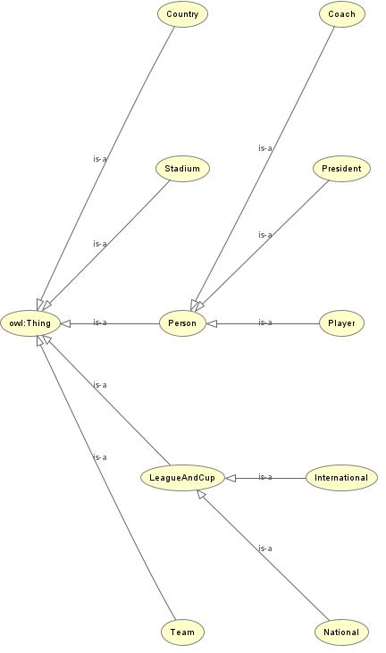
Owl Viz
In Protegè, there is tab called OWL Viz that allows the user to see the graphical representaion of an ontology.
This is the OWL Viz of this ontology.
Titolo Presentazione
Pagina <number>

Slide 9
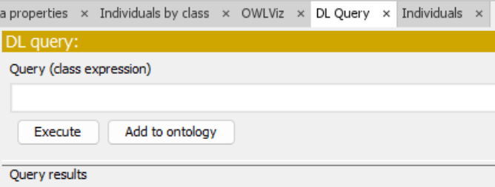
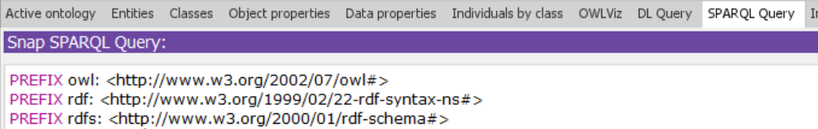
DL and Sparql Query
In Protegè there is the possibility to query the Dataset with DL query and Sparql Query, using the reasoner
In the next slides, we’ll show the results of some queries done in both ways and we also compare them.d
Titolo Presentazione
Pagina <number>

Slide 10
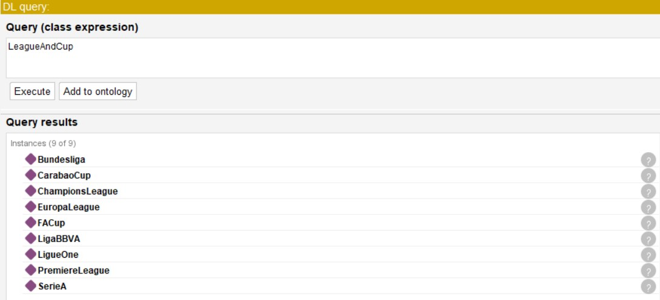
DL Query
The simplest query that we can do is just the name of a class. Executing the query <<LeagueAndCup>>, the results will provide all the instance of the class LeagueAndCup and af all its subclasses.
Titolo Presentazione
Pagina <number>

Slide 11
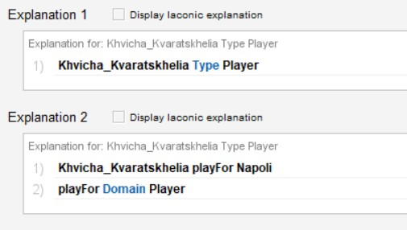
DL Query
After a query, if we click on the question mark in the grey circle <<?>>, we can obtain an explanation of why we got this result
Titolo Presentazione
Pagina <number>

Slide 12
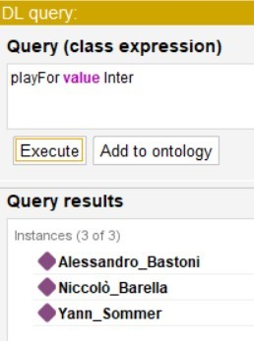
DL Query
Let’s now consider the query <<playFor value Inter >> :
With this query, we retrieve all the object that are playing for Inter: more specifically, in this case we obtain all the players that are playing for FC Inter in our ontology.
Like we said before, for convenience we didn’t put all the players for every football Team in the dataset, just a few for every team.
We can also combine this queries between them and with other conditions.
Titolo Presentazione
Pagina <number>

Slide 13
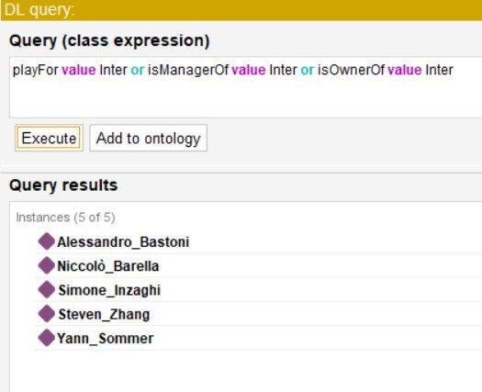
DL Query
Like we said in the previous slide, in this more complex query, we retrieve also the president and the coach related to the individual ‘’Inter’’.
We added two more object properties, like ‘’isManagerOf’’ and ‘’isOwnerOf’’.
Titolo Presentazione
Pagina <number>

Slide 14
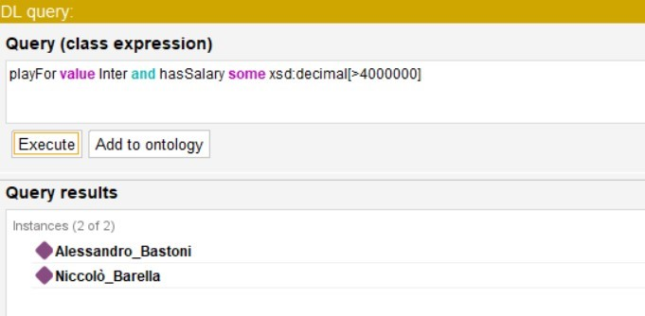
DL Query
Now we added a condition, in detail with <<some xsd:decimal[>4000000]>>, we asked the dataset to retrieve all the individuals that are playing for Inter and also they have a salary higher than that value.
Reguarding the salary, both players and coaches, for simplicity we rounded up the values we found on the german website TransferMarkt.
Titolo Presentazione
Pagina <number>

Slide 15
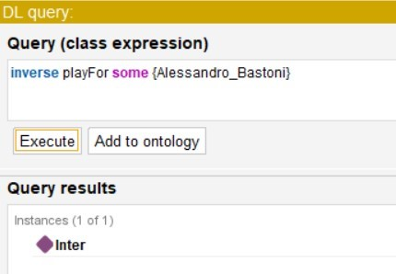
DL Query
Using <<inverse>> we can retrieve the range of an object property from an individual.
Indeed, the object property playFor has domain Player and range Team.
Titolo Presentazione
Pagina <number>

Slide 16
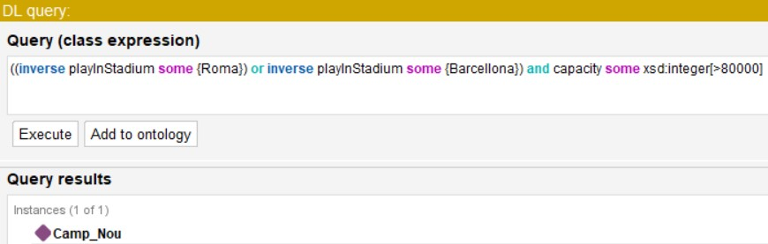
DL Query
Let’s see the use of <<inverse>> in a more complex query:
Let’s suppose we want retrieve which stadium owned by Roma or Barcellona has more capacity than 80.000
The result is correct since that Camp Nou has a capacity of 99354 seats
Titolo Presentazione
Pagina <number>

Slide 17
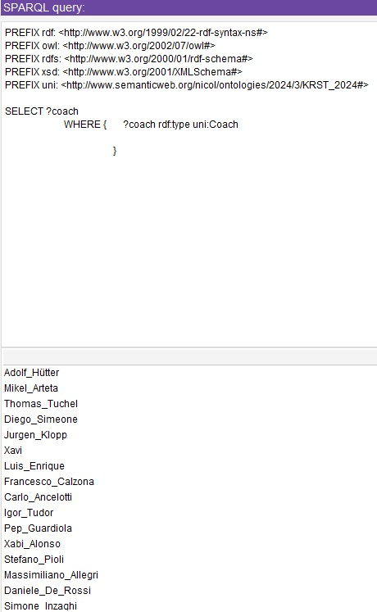
SPARQL Query
Let’s analyze the SPARQL Query Tab:
Firs of all, in SPARQL we have to set the prefix for our name space:
PREFIX uni:http://www.semanticweb.org/nicol/ontologies/2024/3/KRST_2024#>
In this first query we retrieve all the individuals that belong to class Coach.
Titolo Presentazione
Pagina <number>

Slide 18
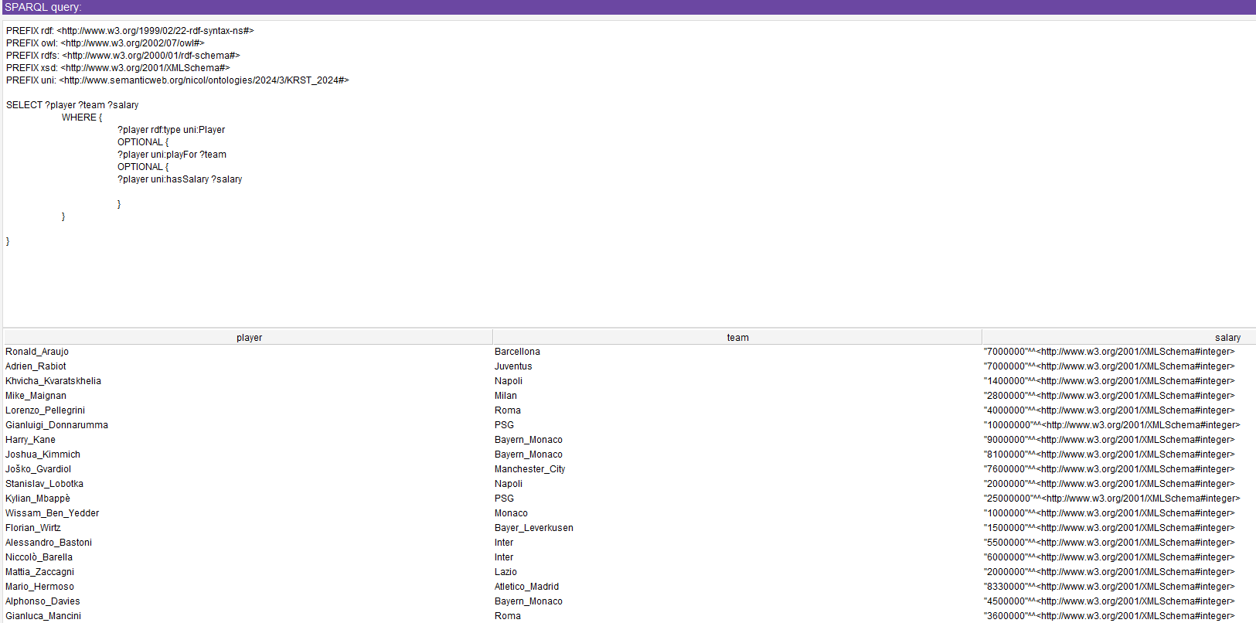
SPARQL Query
Now, let’s suppose we want to retrieve all the players in the dataset and also the team in which they’re playing and their salaries.
Thanks to <<OPTIONAL>> we can get these informations separately and here below the results.
Titolo Presentazione
Pagina <number>

Slide 19
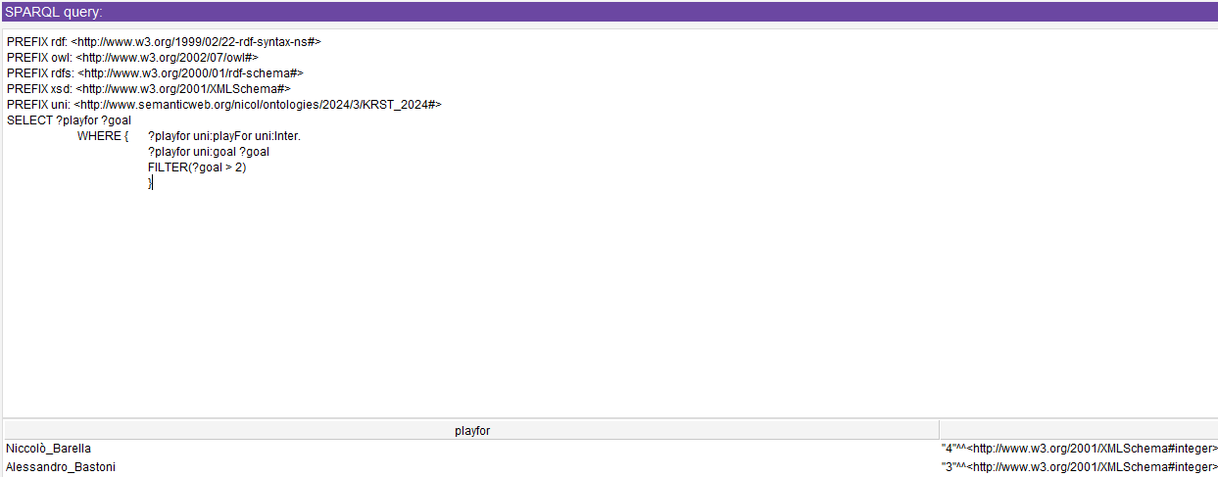
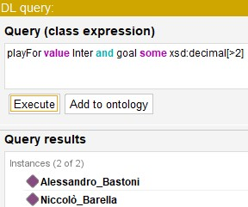
SPARQL Query
In these images we compare the two ways of doing the same query.
In SPARQL we can also see the exact number of goal for each individual in the results, while in DL we only get the individuals that have more than two goals playing for Inter. The SPARQL syntax at first glance may result more articulated, but it a standard RDF query language and it is more versatile.
Titolo Presentazione
Pagina <number>

Slide 20
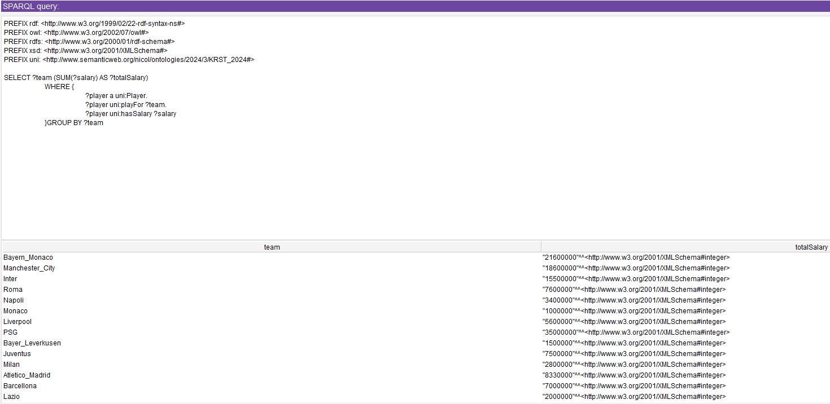
SPARQL Query
Consider now this simple query showing the use of keyword GROUP BY: <<The sum of the salaries of all players for every team>>
We can see the results below and that there aren’t Arsenal and Real Madrid, because we didn’t add players for both teams in the dataset, to see if the query was working as an experiment.
Titolo Presentazione
Pagina <number>

Slide 21
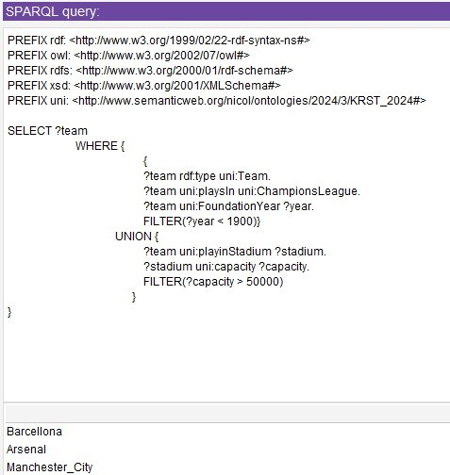
SPARQL Query
For testing our dataset with a more articulated request, let’s now suppose this query: <<return all objects that are playing in Champions League and they also have a stadium with capacity > 50000 and a FoundationYear < 1900>>
Results on the picture on the left are correct because, for example, Arsenal was created in 1886 and Emirates Stadium has a capacity of 60.432 seats.
Titolo Presentazione
Pagina <number>

Slide 22
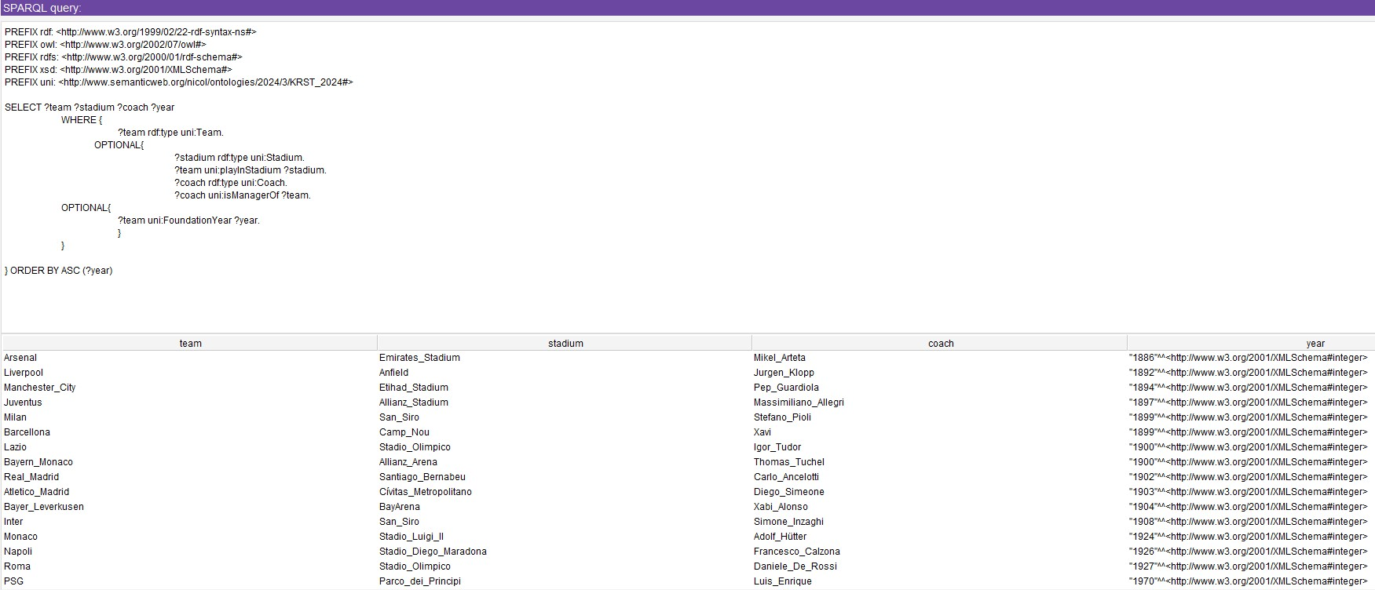
SPARQL Query
Finally, in this last query we test our dataset again with a complex query. In this case we request: <<return all the teams with their stadiums and their coaches, and in the end, order all of them by their foundation year>>.
Using the keyword ORDER BY ASC, we obtained this result.
Titolo Presentazione
Pagina <number>

Slide 23
THE END
Thanks for your attention
Titolo Presentazione
Pagina <number>

