Slide 1
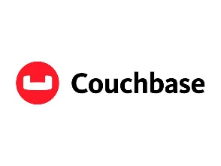
BIG DATA MANAGEMENT 2023/2024
Project realized with Couchbase
NICOLA DE SIENA 1926056

Slide 2
Introduction
What is Couchbase ?
Couchbase Server, originally known as Membase, is a source-available, distributed multi-model NoSQL document-oriented database software package optimized for interactive applications
These applications may serve many concurrent users by creating, storing, retrieving, aggregating, manipulating and presenting data
It is designed to be clustered from a single machine to very large-scale deployments spanning many machines

Slide 3
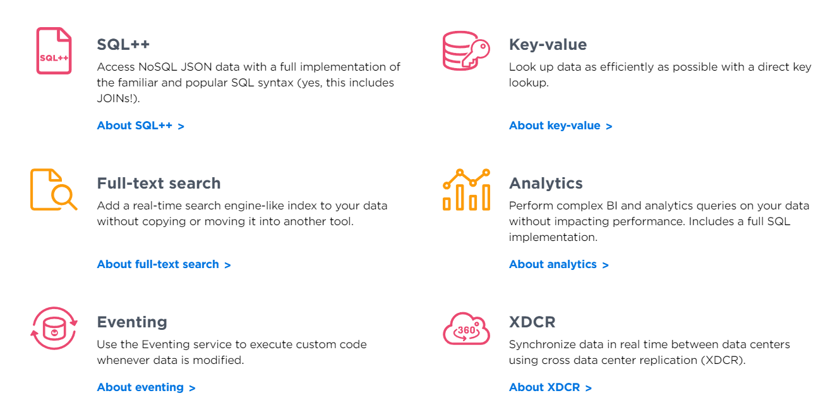
Main features

Slide 4
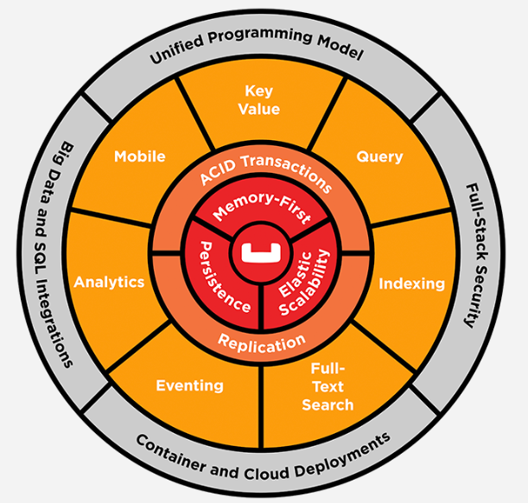
Main features
A flexible database to store JSON data without a rigid schema
A familiar SQL standard for queries on your JSON data
The speed of a built-in managed cache, providing microsecond latency
Scale that can accommodate a startup and grow to support a massive enterprise

Slide 5
Replication in Couchbase
The replication mechanism is crucial for ensuring data redundancy, availability, and consistency across the cluster.
There are two types of replication in Couchbase:
Intra-cluster replication
Cross Data Center Replication (XDCR)

Slide 6
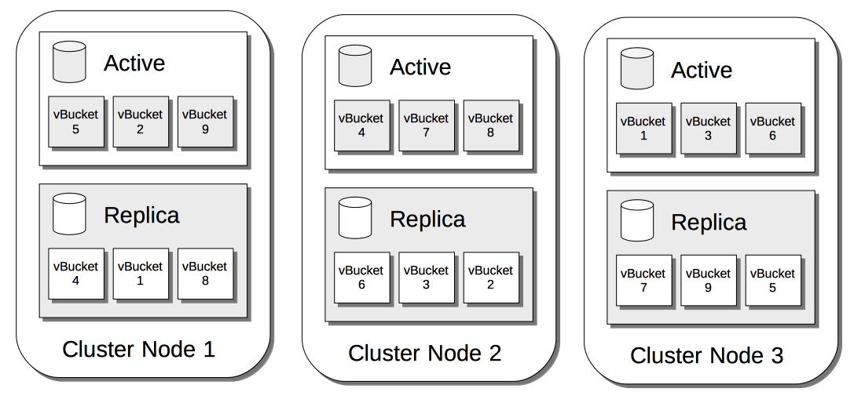
Intra-cluster replication
intra-cluster replication is a mechanism that ensures data redundancy, high availability, and fault tolerance within a single Couchbase cluster. This process involves replicating data across multiple nodes within the same cluster.

Slide 7
Intra-cluster replication
The key aspects of this replication method are:
Cluster: A group of Couchbase nodes working together to store and manage data.
Node: An individual server within a Couchbase cluster.
Bucket: A logical container for storing documents in Couchbase.
Vbucket: A partition of a bucket, which is the fundamental unit of data distribution and replication within a cluster.
Replica: A copy of a VBucket that resides on a different node to ensure data redundancy.

Slide 8
Intra-Cluster Replication Process
Data Partitioning: Each bucket is divided into multiple partitions called VBuckets. By default, there are 1024 VBuckets per bucket. VBuckets are distributed across all nodes in the cluster.
Primary and Replica Vbuckets:Each VBucket has a primary instance and one or more replica instances. The primary VBucket handles read and write operations, while replica VBuckets provide redundancy. The number of replica VBuckets is configurable, typically set to one or two replicas for redundancy.
Data Distribution: When a document is written to a bucket, it is assigned to a specific VBucket based on a hashing function. The primary VBucket responsible for that document is determined, and the document is stored there.

Slide 9
Intra-Cluster Replication Process
Replication Mechanism: After the document is written to the primary VBucket, the system asynchronously replicates it to the replica VBuckets located on different nodes. Replication is done asynchronously to minimize latency for the write operations. This means there might be a slight delay before the replica VBuckets have the latest data.
Failover and Recovery: If a node fails, Couchbase can automatically promote one of the replica VBuckets to become the new primary, ensuring that the data remains available. The system also rebalances the cluster by redistributing VBuckets across the available nodes to maintain even distribution and redundancy.

Slide 10
Configuration and Management
Replication factor: The number of replicas (default is 1, can be increased for higher redundancy).
Auto-Failover: Couchbase can be configured to automatically detect node failures and promote replicas to primary status
Rebalancing: When nodes are added or removed from the cluster, Couchbase redistributes VBuckets to ensure balanced data distribution and consistent replication.

Slide 11
XDCR
Cross Data Center Replication (XDCR) in Couchbase Database is a powerful feature that allows data to be replicated across multiple Couchbase clusters, which can be located in different data centers or cloud regions. This ensures data availability, disaster recovery, and geographic distribution of data for improved latency and fault tolerance.

Slide 12
Key concepts of XDCR
Cluster: same for Intra-cluster.
Bucket: same for Intra-cluster.
Replication Stream: A continuous flow of data changes from one cluster to another.
Source Cluster: The cluster from which data is replicated.
Target Cluster: The cluster to which data is replicated.

Slide 13
XDCR Components
Replication Definitions: Administrators define replication relationships between source and target clusters, specifying which buckets to replicate and the direction of replication.
XDCR Processes: Background processes that handle the actual data replication between clusters.

Slide 14
XDCR Setup
Cluster Pairing: Establish a connection between the source and target clusters using their IP addresses or hostnames and authentication credentials are configured to allow secure communication between clusters.
Replication Configuration: Define replication tasks specifying source and target buckets and configure settings such as filtering (e.g., only replicate documents that match certain criteria), conflict resolution, and network bandwidth limitations.

Slide 15
XDCR Operation
Data Changes Detection: XDCR continuously monitors the source bucket for changes, such as document inserts, updates, and deletions. leverages Couchbase's DCP (Database Change Protocol) to detect changes efficiently.
Data Transfer: Detected changes are transferred from the source cluster to the target cluster over the network. XDCR compresses and batches data to optimize network usage and reduce latency.
Conflict Resolution: Since data can be modified in both the source and target clusters, conflicts might occur. XDCR uses configurable conflict resolution strategies, such as timestamp-based or custom conflict resolution logic.

Slide 16
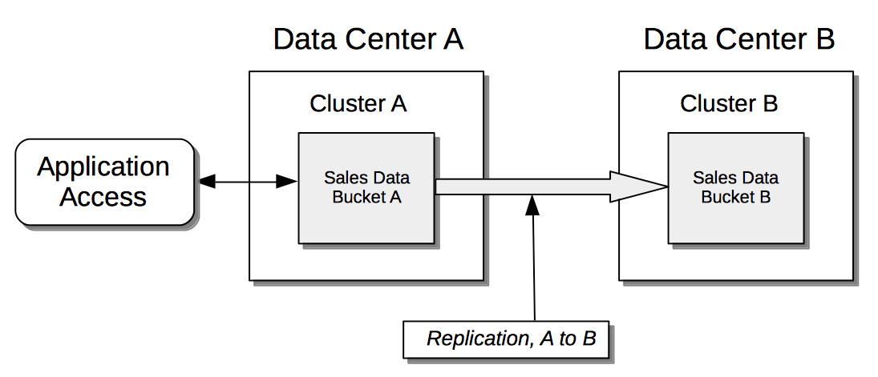
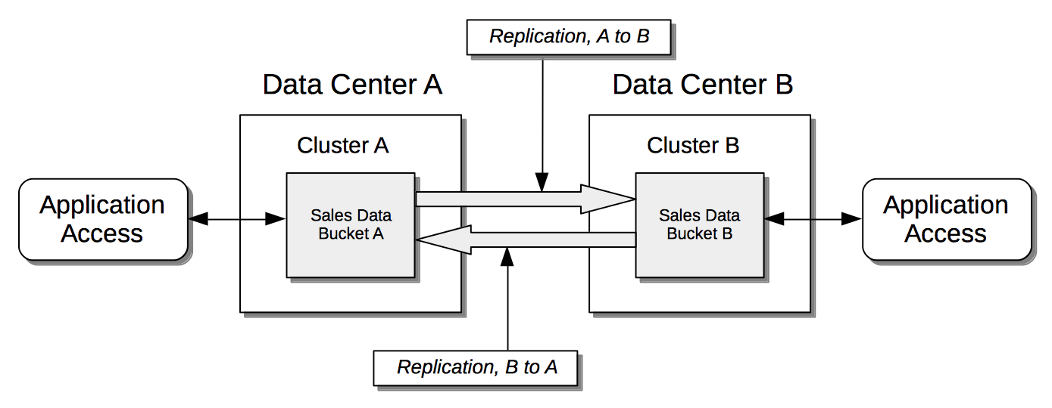
XDCR Replication Topologies
We have two topologies in XDCR: Unidirectional(picture on the left) and Bidirectional(picture on the right).
In the first one data is replicated from the source cluster to the target cluster in one direction. In the second one Data is replicated in both directions between two clusters, allowing for active-active data usage.

Slide 17
XDCR Use Cases
Disaster Recovery: By replicating data to a geographically distant data center, XDCR ensures that a backup is always available in case of a catastrophic failure in the primary data center.
Geographic Distribution: Data can be replicated to clusters closer to end-users, reducing latency and improving performance for global applications.
Cloud Migration: XDCR can be used to migrate data between on-premises clusters and cloud-based clusters seamlessly.
Data Aggregation: Data from multiple clusters can be replicated to a central cluster for aggregation and analysis.

Slide 18
Monitoring and Management
XDCR Dashboard: Couchbase provides a web-based interface to monitor and manage XDCR tasks, showing statistics such as data transfer rates, replication lag, and error rates.
Logging and Alerts: Administrators can configure logging and alerts to be notified of issues such as replication failures or network problems.

Slide 19
Queries in Couchbase
Couchbase Server uses a query language called SQL++. The Couchbase implementation of SQL++ was formerly known as N1QL (pronounced "nickel"). SQL++ is an expressive, powerful, and complete SQL dialect for querying, transforming, and manipulating JSON data. Based on SQL, it’s immediately familiar to developers who can quickly start developing rich applications.

Slide 20
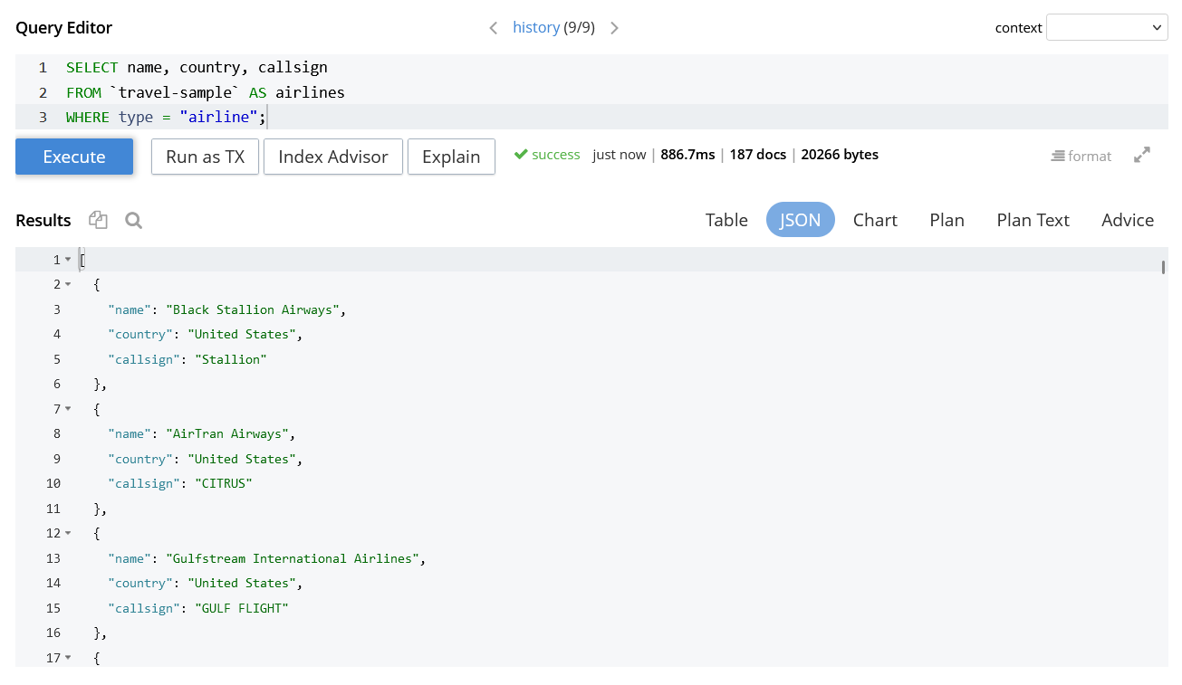
Query example 1
With this query, we retrieve all airlines with their country of origin and their callsign.

Slide 21
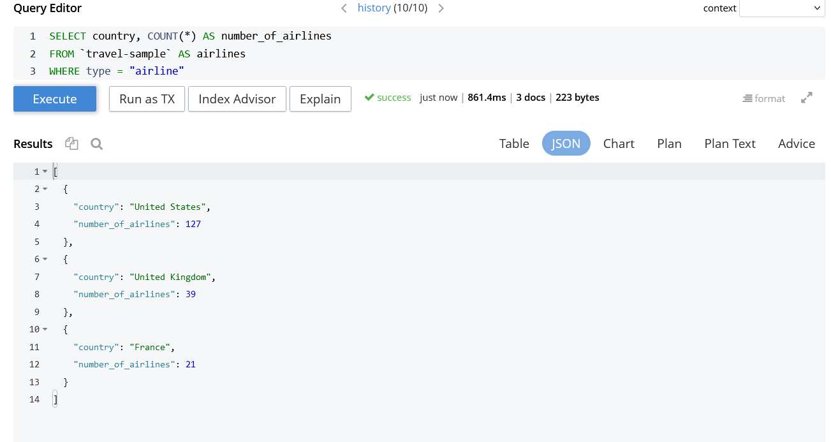
Query example 2
With this query, we count the number of airlines operating in each country

Slide 22
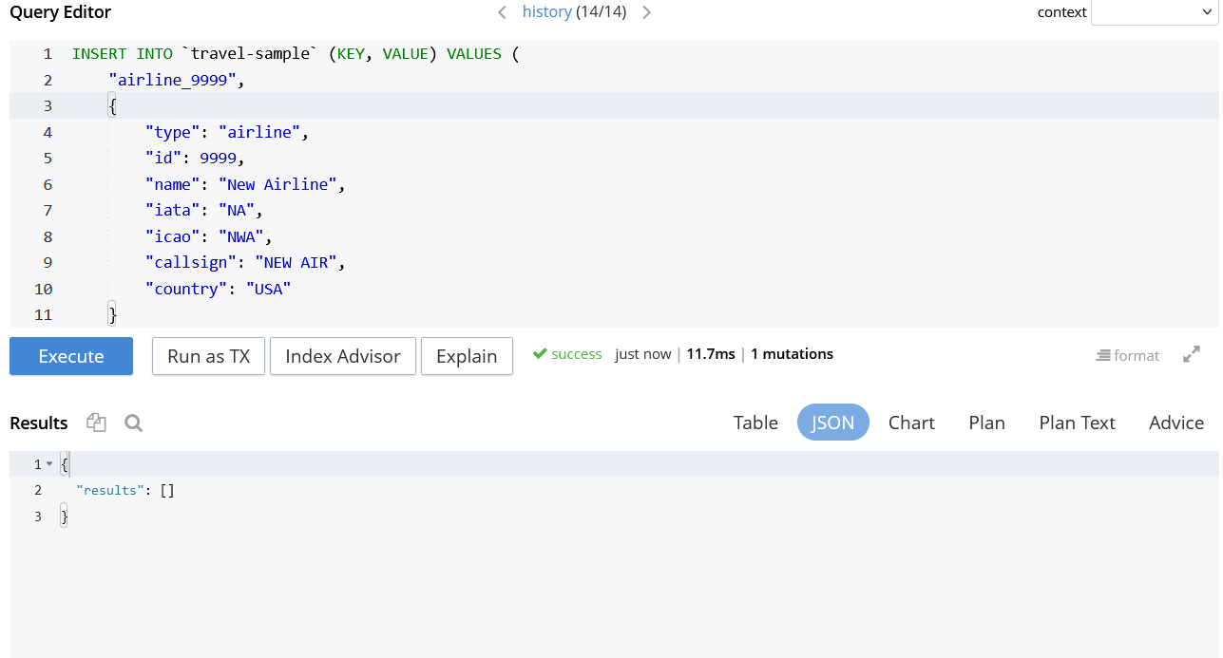
Query example 3
With this query, we add a new airline using JSON format.

Slide 23
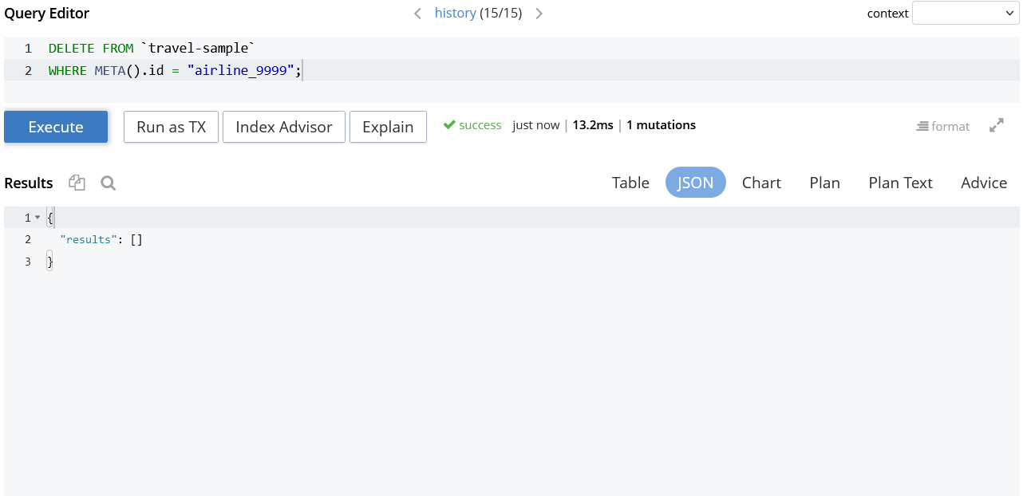
Query Example 4
With this query, we delete the data we created before.

