Slide 1

Nickey and Erik

Slide 2
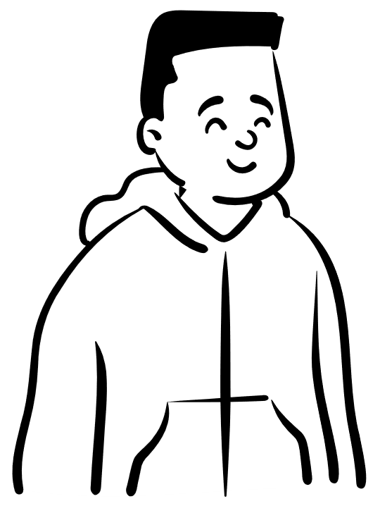

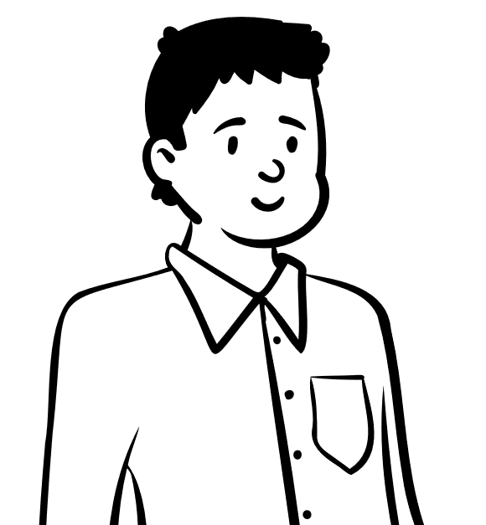
Research question
How can we make sure young people seek help faster when having mental health problems?
Lorum ipsum
Lorum ipsum
Lorum ipsum

Slide 3
Which factors in the data from lifelines influence the mental health of young people the most?
What is the connection between physical activities and mental health?
What application can we make to ellaborate sub-questions 1 and 2?

Slide 4


What did we make?
Application
Quiz / Survey
Information about mental health

Slide 5

Results
A working application
Learning about mental health

Slide 6


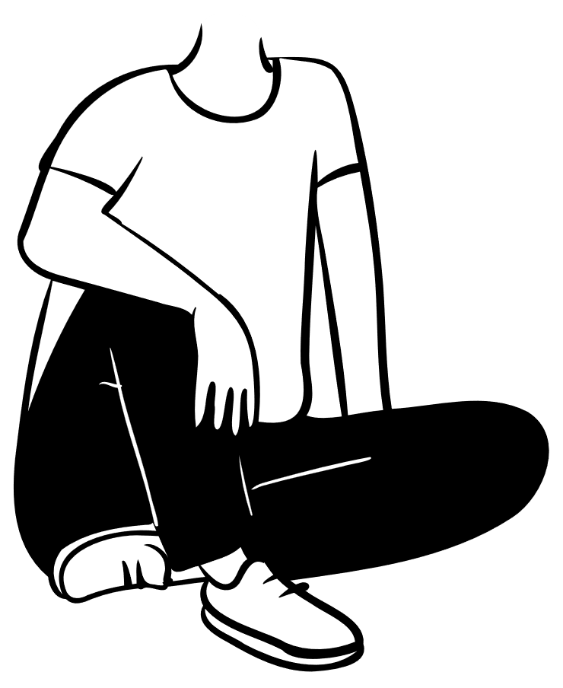
What have we learned from ARYC
How many people temper with mental health problems
Where people can seek help with mental health problems

Slide 7
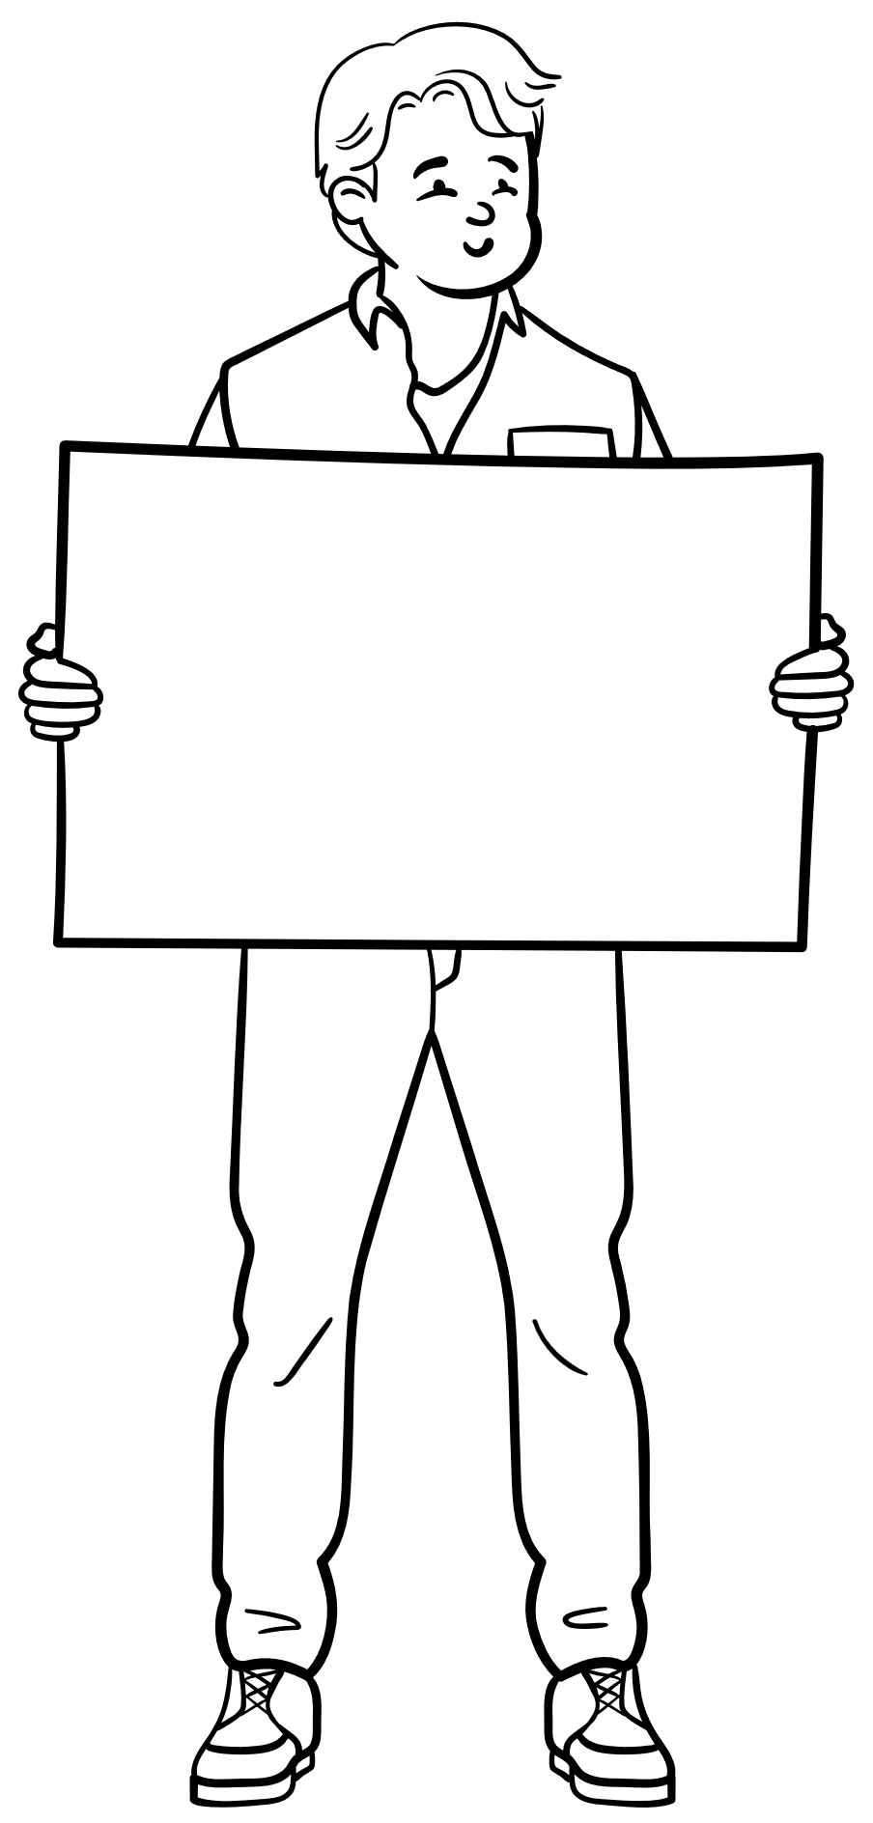
The end

