Slide 1
Sorting Visualizer

Slide 2
TOPIC TO BE COVERED
Objective
Sorting Visualiser
​Feature
Working
​Code Journey
Benefits
Conclusion

Slide 3
soRTING vISUALIZER
The “Sorting Visualizer” project is basically a web development project which is used to visualize the sorting algorithms and performs the operation of algorithms step by step as the algorithms works like Bubble Sort, Selection Sort , Merge Sort etc. We shuffle the bars in a random order that is in a unsorted order.
We perform sorting algorithms on these bars to sort these bars in a ascending order by applying the different algorithms by clicking on the buttons of these sorting algorithms.
The project is based on GUI application,It is a graphical user interface application which is an interface or a window based application or software which runs without the help of internet.
.

Slide 4
OBJECTIVE
The main objective of “Sorting Visualizer” project is to learn and visualise the sorting algorithms how these algorithms works We can see the steps of swapping or any divide and conquer part of these bars. Here 5 different types of sorting algorithms is used to visualise.
A visualization of data is implemented as a bar graph, after which a data sorting and algorithm may be applied .The resulting animation is then performed either automatically or by the user, who then sets their own pace.

Slide 5
SORTING VISUaLizER
A web application showcasing the inner workings of sorting algorithms.
Implemented algorithms:
Bubble sort
Selection sort
Insertion sort
Merge sort
Quick sort
Heap sort

Slide 6
Colored representation of step being executed.
1.1) Blue : default
1.2) Yellow: Being compared
1.3) Red: Identified as in incorrect position and to be moved
1.4) Green: In correct position
2) Controls for visualizations
2.1) Speed of visualization (5 speed levels)
2.2) Data size ()
2.3) Generation of new data (Randomly generate new data).
Time and Space complexity of algorithm being visualized.

Slide 7
Features
• Visualize sorting part: Users can see the steps followed by these
sorting visualiser as it contains five buttons of different algorithms
to sort the bars.
• Shuffle bars : Users can easily shuffle the bars in random order
i.e. with small height or large height of bars
• User Friendly: It’s easy for users and quite simple to operate.
• Ease of Use: Being user friendly environment it is very easy to
operate by just clicking the button for the desired result.

Slide 8
•Colours used: Colours should be used to show whether or not anything is being compared
•Observe the swapping of bars: when a users apply any sorting algorithms by clicking the button than these bars start sorting by swapping according to their height .

Slide 9
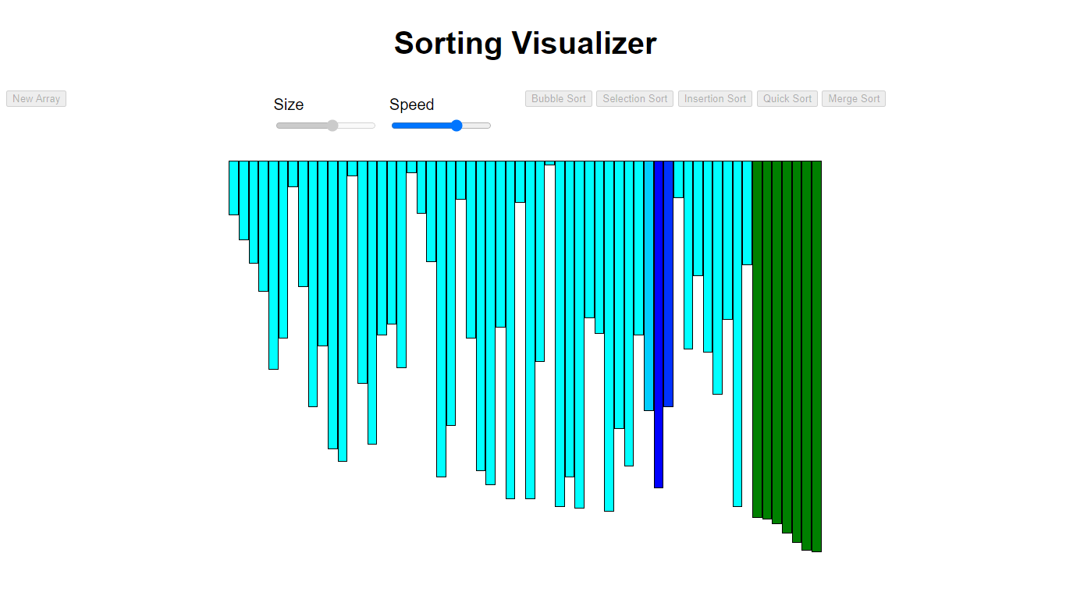
Bubble Sort Visualiser

Slide 10
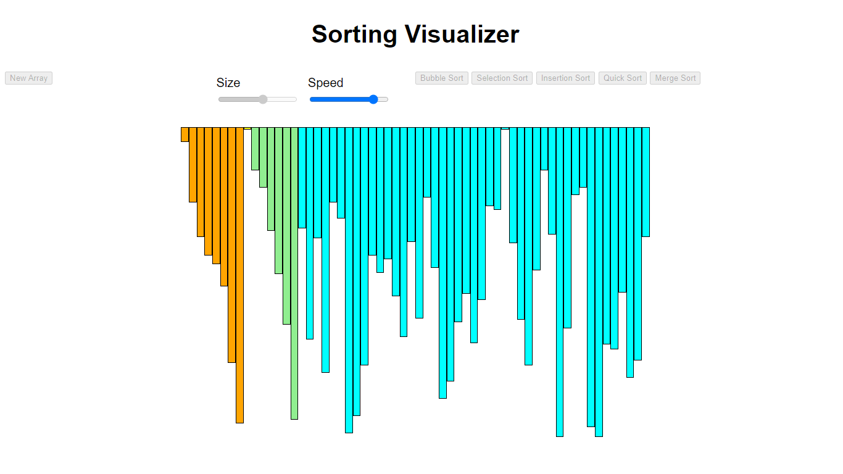
Merge Sort Visualiser

Slide 11
Benefits Of Project
Advantages:
• Efficient Way to visualize the working of sorting algorithms.
• This technique is quite simple to explain to someone in
conversation.
• Colours should be used to show whether or not anything is being compared.
• Shows expected time to finish up the working of the algorithm to sort the array.
• User friendly and easy to use.

Slide 12
THANK YOU very Much ☺

