Slide 1
Web Security
Saint Petersburg, 2019

Slide 2
Agenda
Правовая основа
OWASP Top 10
Основные подходы к обнаружению уязвимостей
Средства защиты на стороне браузера
Криптография
Java security frameworks
Практика

Slide 3
Правовая основа
Статья 272 УК РФ. Неправомерный доступ к компьютерной информации
Статья 273 УК РФ. Создание, использование и распространение вредоносных программ для ЭВМ
Статья 274 УК РФ. Нарушение правил эксплуатации средств хранения, обработки или передачи компьютерной информации и информационно-телекоммуникационных сетей
3

Slide 4

OWASP Top 10
Open Web Application Security Project (OWASP) — это открытый проект обеспечения безопасности веб-приложений. Сообщество OWASP включает в себя корпорации, образовательные организации и частных лиц со всего мира. Сообщество работает над созданием статей, учебных пособий, документации, инструментов и технологий, находящихся в свободном доступе.
OWASP Top 10 – список наиболее актуальных угроз составленный и поддерживаемый организацией.
4

Slide 5
OWASP top 10 2017

Slide 6
OWASP Top 10 2017
A1:2017-Injection
A2:2017-Broken Authentication
A3:2017-Sensitive Data Exposure
A4:2017-XML External Entities (XXE)
A5:2017-Broken Access Control
A6:2017-Security Misconfiguration
A7:2017-Cross-Site Scripting (XSS)
A8:2017-Insecure Deserialization
A9:2017-Using Components with Known Vulnerabilities
A10:2017-Insufficient Logging&Monitoring
6
Notes:
https://www.owasp.org/index.php/Category:OWASP_Top_Ten_2017_Project

Slide 7
OWASP Top 10 2017 A1: Injection
SQL injection:
String query = "SELECT * FROM accounts WHERE custID='" + request.getParameter("id") + "'";
HQL injection:
session.createQuery("from Book where title like '%" + userInput + "%' and published = true")
SpEL injection:
<spring:eval expression="${param.vulnerable}" />
page.jsp?vulnerable=T(java.lang.Runtime).getRuntime().exec(“cmd.exe”)
7
Notes:
Injection flaws are very prevalent, particularly in legacy code. Injection vulnerabilities are often found in SQL, LDAP, XPath, or NoSQL queries, OS commands, XML parsers, SMTP headers, expression languages, and ORM queries. Injection flaws are easy to discover when examining code. Scanners and fuzzers can help attackers find injection flaws.
Is the Application Vulnerable?
User-supplied data is not validated, filtered, or sanitized by the application.
Dynamic queries or non-parameterized calls without context-aware escaping are used directly in the interpreter.
Hostile data is used within object-relational mapping (ORM) search parameters to extract additional, sensitive records.
Hostile data is directly used or concatenated, such that the SQL or command contains both structure and hostile data in dynamic queries, commands, or stored procedures.
Some of the more common injections are SQL, NoSQL, OS command, Object Relational Mapping (ORM), LDAP, and Expression Language (EL) or Object Graph Navigation Library (OGNL) injection. The concept is identical among all interpreters. Source code review is the best method of detecting if applications are vulnerable to injections, closely followed by thorough automated testing of all parameters, headers, URL, cookies, JSON, SOAP, and XML data inputs. Organizations can include static source (SAST) and dynamic application test (DAST) tools into the CI/CD pipeline to identify newly introduced injection flaws prior to production deployment.
https://www.owasp.org/index.php/Top_10-2017_A1-Injection
https://www.owasp.org/index.php/Expression_Language_Injection
SpEL injection: https://habr.com/ru/company/dsec/blog/433034/ + https://2018.zeronights.ru/wp-content/uploads/materials/10%20ZN2018%20WV%20-%20Spel%20injection%20.pdf

Slide 8
OWASP Top 10 2017 A2: Broken Authentication
Credential stuffing (where the attacker has a list of valid usernames and passwords), brute force или другие автоматизированные атаки
Разрешены слабые пароли ("Password1«) или пароли по-умолчанию ("admin/admin")
Слабый механизм восстановления пароля
Недостатки при имплементации двухфакторной аутентификации
Неправильная работа с сессиями (отображение Session ID в URL, не происходит подмена Session ID после успешного логина (Session Fixation), неправильный механизм инвалидации Session ID в случае выхода из приложения или длительного периода бездействия)
8
Notes:
The prevalence of broken authentication is widespread due to the design and implementation of most identity and access controls. Session management is the bedrock of authentication and access controls, and is present in all stateful applications. Attackers can detect broken authentication using manual means and exploit them using automated tools with password lists and dictionary attacks.
Is the Application Vulnerable?
Permits automated attacks such as credential stuffing, where the attacker has a list of valid usernames and passwords.
Permits brute force or other automated attacks.
Permits default, weak, or well-known passwords, such as "Password1" or "admin/admin“.
Uses weak or ineffective credential recovery and forgot-password processes, such as "knowledge-based answers", which cannot be made safe.
Uses plain text, encrypted, or weakly hashed passwords (see A3:2017-Sensitive Data Exposure).
Has missing or ineffective multi-factor authentication.
Exposes Session IDs in the URL (e.g., URL rewriting).
Does not rotate Session IDs after successful login.
Does not properly invalidate Session IDs. User sessions or authentication tokens (particularly single sign-on (SSO) tokens) aren't properly invalidated during logout or a period of inactivity.
https://www.owasp.org/index.php/Top_10-2017_A2-Broken_Authentication

Slide 9
OWASP Top 10 2017 A3: Sensitive Data Exposure
Данные не шифруются в процессе передачи или хранения
Используются слабые/устаревшие алгоритмы шифрования
Используются слабые алгоритмы генерации ключей
Правильная конфигурация для актуальных данных и неправильная для резервных копий
Notes:
Over the last few years, this has been the most common impactful attack. The most common flaw is simply not encrypting sensitive data. When crypto is employed, weak key generation and management, and weak algorithm, protocol and cipher usage is common, particularly for weak password hashing storage techniques. For data in transit, server side weaknesses are mainly easy to detect, but hard for data at rest.
Is the Application Vulnerable?
Is any data transmitted in clear text? This concerns protocols such as HTTP, SMTP, and FTP. External internet traffic is especially dangerous. Verify all internal traffic e.g. between load balancers, web servers, or back-end systems.
Are any old or weak cryptographic algorithms used either by default or in older code?
Are default crypto keys in use, weak crypto keys generated or re-used, or is proper key management or rotation missing?
Is encryption not enforced, e.g. are any user agent (browser) security directives or headers missing?
Does the user agent (e.g. app, mail client) not verify if the received server certificate is valid?
https://www.owasp.org/index.php/Top_10-2017_A3-Sensitive_Data_Exposure

Slide 10
OWASP Top 10 2017 A4: XML External Entities (XXE)
XXE:
<?xml version="1.0" encoding="ISO-8859-1"?>
<!DOCTYPE foo [
<!ELEMENT foo ANY >
<!ENTITY xxe SYSTEM "file:///etc/passwd" >]>
<foo>&xxe;</foo>
…
<!ENTITY xxe SYSTEM "https://192.168.1.1/private" >]>
…
<!ENTITY xxe SYSTEM "file:///dev/random" >]>
Notes:
By default, many older XML processors allow specification of an external entity, a URI that is dereferenced and evaluated during XML processing.
Is the Application Vulnerable?
The application accepts XML directly or XML uploads, especially from untrusted sources, or inserts untrusted data into XML documents, which is then parsed by an XML processor.
Any of the XML processors in the application or SOAP based web services has document type definitions (DTDs) enabled. As the exact mechanism for disabling DTD processing varies by processor, it is good practice to consult a reference such as the OWASP Cheat Sheet 'XXE Prevention'.
If the application uses SAML for identity processing within federated security or single sign on (SSO) purposes. SAML uses XML for identity assertions, and may be vulnerable.
If the application uses SOAP prior to version 1.2, it is likely susceptible to XXE attacks if XML entities are being passed to the SOAP framework.
Being vulnerable to XXE attacks likely means that the application is vulnerable to denial of service attacks including the Billion Laughs attack
https://www.owasp.org/index.php/Top_10-2017_A4-XML_External_Entities_(XXE)

Slide 11
OWASP Top 10 2017 A5: Broken Access Control
Ошибки разграничения доступа к чувствительным ресурсам (обход контроля доступа путем изменения URL)
Неправильная организация ограничения доступа к данным (возможность повышения привилегий)
Недостаточно защищаются предоставляемые API по сравнению с GUI
Защита строится на стороне предоставляемого клиента (браузер, мобильное приложение)
Пример:
pstmt.setString(1, request.getParameter("acct"));
ResultSet results = pstmt.executeQuery( );
http://example.com/app/accountInfo?acct=notmyacct
11
Notes:
Restrictions on what authenticated users are allowed to do are not properly enforced. Attackers can exploit these flaws to access unauthorized functionality and/or data, such as access other users' accounts, view sensitive files, modify other users’ data, change access rights, etc.
Is the Application Vulnerable?
Bypassing access control checks by modifying the URL, internal application state, or the HTML page, or simply using a custom API attack tool.
Allowing the primary key to be changed to another's users record, permitting viewing or editing someone else's account.
Elevation of privilege. Acting as a user without being logged in, or acting as an admin when logged in as a user.
Metadata manipulation, such as replaying or tampering with a JSON Web Token (JWT) access control token or a cookie or hidden field manipulated to elevate privileges, or abusing JWT invalidation
CORS misconfiguration allows unauthorized API access.
Force browsing to authenticated pages as an unauthenticated user or to privileged pages as a standard user. Accessing API with missing access controls for POST, PUT and DELETE.
https://www.owasp.org/index.php/Top_10-2017_A5-Broken_Access_Control

Slide 12
OWASP Top 10 2017 A6: Security Misconfiguration
Неправильно настроенные параметры безопасности используемых средств защиты
Устаревшие средства защиты
Устаревшие конфигурации средств защиты
12
Notes:
Security misconfiguration can happen at any level of an application stack, including the network services, platform, web server, application server, database, frameworks, custom code, and pre-installed virtual machines, containers, or storage. Automated scanners are useful for detecting misconfigurations, use of default accounts or configurations, unnecessary services, legacy options, etc.
Is the Application Vulnerable?
Missing appropriate security hardening across any part of the application stack, or improperly configured permissions on cloud services.
Unnecessary features are enabled or installed (e.g. unnecessary ports, services, pages, accounts, or privileges).
Default accounts and their passwords still enabled and unchanged.
Error handling reveals stack traces or other overly informative error messages to users.
For upgraded systems, latest security features are disabled or not configured securely.
The security settings in the application servers, application frameworks (e.g. Struts, Spring, ASP.NET), libraries, databases, etc. not set to secure values.
The server does not send security headers or directives or they are not set to secure values.
The software is out of date or vulnerable (see A9:2017-Using Components with Known Vulnerabilities).
https://www.owasp.org/index.php/Top_10-2017_A6-Security_Misconfiguration

Slide 13
OWASP Top 10 2017 A7: Cross-Site Scripting (XSS)
Reflected XSS:
?eid=<script>alert(‘Hello world!’);</script>
<% String eid = request.getParameter("eid"); %>
Employee ID: <%= eid %>
Stored XSS
DOM based XSS:
page.html?default=<script>alert(‘Hello world!’);</script>
Select your language: <select><script>
document.write("<OPTION value=1>"+document.location.href.substring(document.location.href.indexOf("default=")+8)+"</OPTION>");</script></select>
page.html#default=<script>alert(‘Hello world!’);</script>
13
Notes:
XSS flaws occur whenever an application includes untrusted data in a new web page without proper validation or escaping, or updates an existing web page with user supplied data using a browser API that can create JavaScript. XSS allows attackers to execute scripts in the victim’s browser which can hijack user sessions, deface web sites, or redirect the user to malicious sites.
Reflected XSS: The application or API includes unvalidated and unescaped user input as part of HTML output. A successful attack can allow the attacker to execute arbitrary HTML and JavaScript in the victim’s browser. Typically the user will need to interact with some malicious link that points to an attacker-controlled page, such as malicious watering hole websites, advertisements, or similar.
Stored XSS: The application or API stores unsanitized user input that is viewed at a later time by another user or an administrator. Stored XSS is often considered a high or critical risk.
DOM XSS: JavaScript frameworks, single-page applications, and APIs that dynamically include attacker-controllable data to a page are vulnerable to DOM XSS. Ideally, the application would not send attacker-controllable data to unsafe JavaScript APIs.
https://www.owasp.org/index.php/Top_10-2017_A7-Cross-Site_Scripting_(XSS)

Slide 14
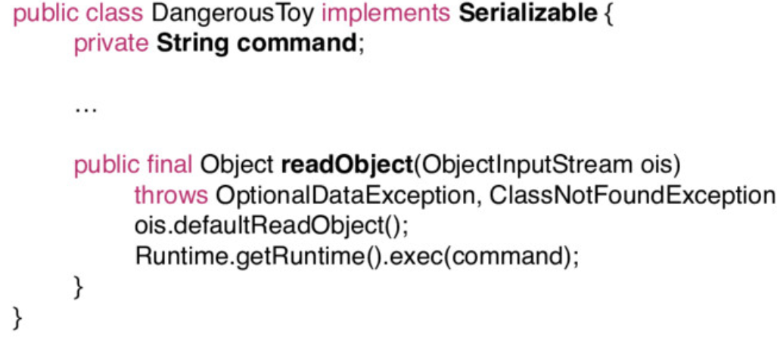
OWASP Top 10 2017 A8: Insecure Deserialization
Приложения позволяет десериализовывать объекты, предоставленные злоумышленником. Это может привести к двум основным типам атак:
Атаки, связанные с объектами и структурой данных, когда злоумышленник изменяет логику приложения или достигает произвольного удаленного выполнения кода, если для приложения доступны классы, которые могут изменить поведение во время или после десериализации.
Типичные атаки с фальсификацией данных, такие как атаки, связанные с контролем доступа, когда используются существующие структуры данных, но содержимое изменяется.
Notes:
Is the Application Vulnerable?
Applications and APIs will be vulnerable if they deserialize hostile or tampered objects supplied by an attacker. This can result in two primary types of attacks:
Object and data structure related attacks where the attacker modifies application logic or achieves arbitrary remote code execution if there are classes available to the application that can change behavior during or after deserialization.
Typical data tampering attacks such as access-control-related attacks where existing data structures are used but the content is changed.
Serialization may be used in applications for:
Remote- and inter-process communication (RPC/IPC)
Wire protocols, web services, message brokers
Caching/Persistence
Databases, cache servers, file systems
HTTP cookies, HTML form parameters, API authentication tokens
A React application calls a set of Spring Boot microservices. Being functional programmers, they tried to ensure that their code is immutable. The solution they came up with is serializing user state and passing it back and forth with each request. An attacker notices the "R00" Java object signature, and uses the Java Serial Killer tool to gain remote code execution on the application server.
https://www.owasp.org/index.php/Top_10-2017_A8-Insecure_Deserialization
http://gursevkalra.blogspot.com/2016/01/ysoserial-commonscollections1-exploit.html
https://speakerdeck.com/pwntester/surviving-the-java-deserialization-apocalypse

Slide 15
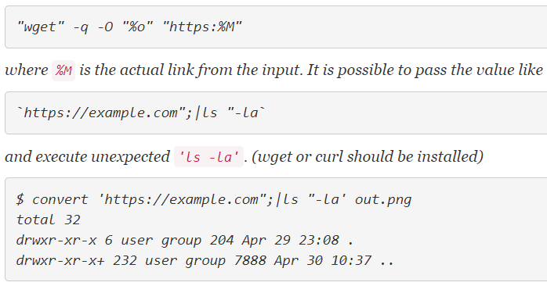
OWASP Top 10 2017 A9: Using Components with Known Vulnerabilities
ImageTragick (CVE-2016-3714 - Insufficient shell characters filtering leads to(potentially remote) code execution), изначально найдено Nikolay Ermishkin from the Mail.Ru Security Team, но на Facebook’е заработал Andrey Leonov ($40 000). См. https://imagetragick.com/,https://www.grahamcluley.com/facebook-remote-code-execution-vulnerability-earns-researcher-40000/
15
Notes:
Components, such as libraries, frameworks, and other software modules, run with the same privileges as the application. If a vulnerable component is exploited, such an attack can facilitate serious data loss or server takeover. Applications and APIs using components with known vulnerabilities may undermine application defenses and enable various attacks and impacts.
Is the Application Vulnerable?
If you do not know the versions of all components you use (both client-side and server-side). This includes components you directly use as well as nested dependencies.
If software is vulnerable, unsupported, or out of date. This includes the OS, web/application server, database management system (DBMS), applications, APIs and all components, runtime environments, and libraries.
If you do not scan for vulnerabilities regularly and subscribe to security bulletins related to the components you use.
If you do not fix or upgrade the underlying platform, frameworks, and dependencies in a risk-based, timely fashion. This commonly happens in environments when patching is a monthly or quarterly task under change control, which leaves organizations open to many days or months of unnecessary exposure to fixed vulnerabilities.
If software developers do not test the compatibility of updated, upgraded, or patched libraries.
If you do not secure the components' configurations (see A6:2017-Security Misconfiguration).
https://www.owasp.org/index.php/Top_10-2017_A9-Using_Components_with_Known_Vulnerabilities
https://imagetragick.com/
https://www.grahamcluley.com/facebook-remote-code-execution-vulnerability-earns-researcher-40000/

Slide 16
OWASP Top 10 2017 A10: Insufficient Logging&Monitoring
Отсутствие средств:
Обнаружения вторжений
Предотвращения вторжений
Логгирования
Невозможность быстрого закрытия обнаруженных уязвимостей
Notes:
This issue is included in the Top 10 based on an industry survey. One strategy for determining if you have sufficient monitoring is to examine the logs following penetration testing. The testers' actions should be recorded sufficiently to understand what damages they may have inflicted.
Is the Application Vulnerable?
Auditable events, such as logins, failed logins, and high-value transactions are not logged.
Warnings and errors generate no, inadequate, or unclear log messages.
Logs of applications and APIs are not monitored for suspicious activity.
Logs are only stored locally.
Appropriate alerting thresholds and response escalation processes are not in place or effective.
Penetration testing and scans by DAST tools (such as OWASP ZAP) do not trigger alerts.
The application is unable to detect, escalate, or alert for active attacks in real time or near real time.
https://www.owasp.org/index.php/Top_10-2017_A10-Insufficient_Logging%26Monitoring

Slide 17
OWASP Top 10 2013

Slide 18
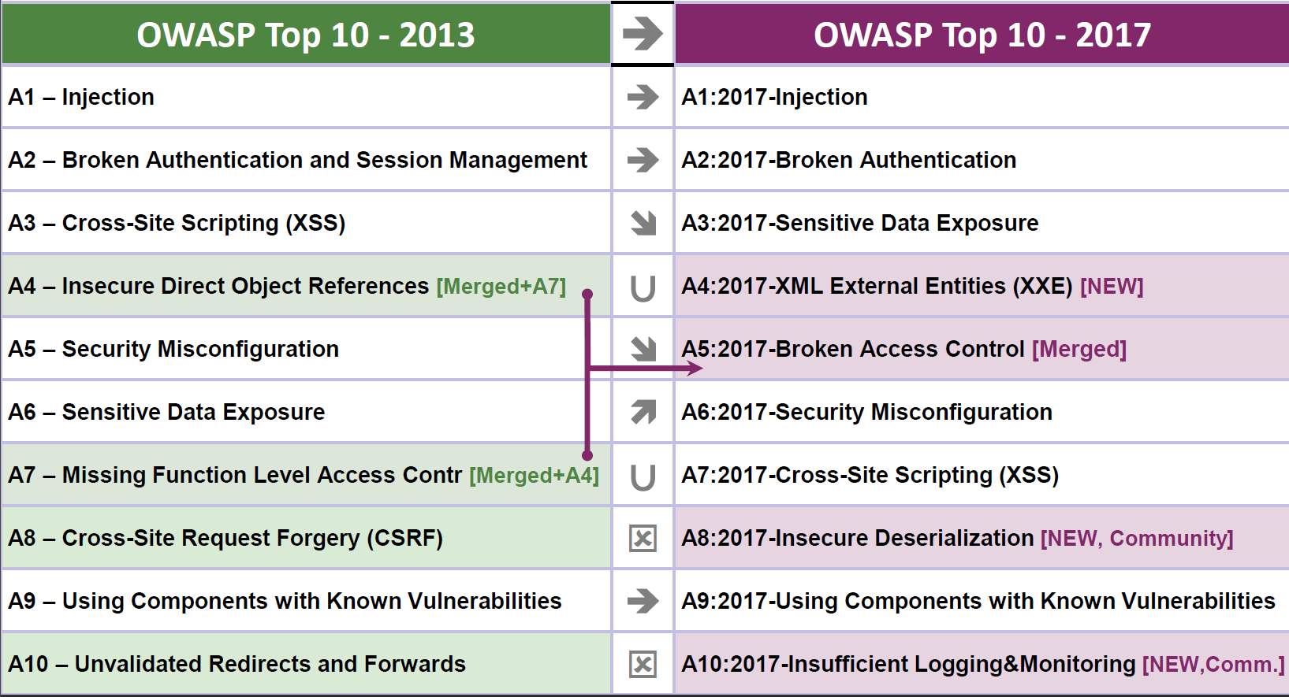
What changed from 2013 to 2017?
Notes:
https://www.owasp.org/index.php/Top_10-2017_Release_Notes

Slide 19
OWASP Top 10 2013 A8: Cross-Site Request Forgery (CSRF)
<img src="http://bank.com/transfer.do?acct=MARIA&amount=100000" width="0" height="0" border="0">
<script>
function put() {
var x = new XMLHttpRequest();
x.open("PUT","http://bank.com/transfer.do",true);
x.setRequestHeader("Content-Type", "application/json");
x.send(JSON.stringify({"acct":"BOB", "amount":100}));
}
</script>
<body onload="put()">
19
Notes:
A CSRF attack forces a logged-on victim’s browser to send a forged HTTP request, including the victim’s session cookie and any other automatically included authentication information, to a vulnerable web application. Such an attack allows the attacker to force a victim’s browser to generate requests the vulnerable application thinks are legitimate requests from the victim.
https://www.owasp.org/index.php/Top_10_2013-A8-Cross-Site_Request_Forgery_(CSRF)

Slide 20
OWASP Top 10 2013 A10: Unvalidated Redirects and Forwards
Отсутствие валидации целевой страницы при redirect’ах или forward’ах.
Примеры:
http://www.example.com/redirect.jsp?url=evil.com (redirect пользователя с доверенного сайта на фишинговую страницу на другом сайте)
http://www.example.com/boring.jsp?fwd=admin.jsp (forward пользователя на страницу admin.jsp на том же сайте)
Notes:
Applications frequently redirect users to other pages, or use internal forwards in a similar manner. Sometimes the target page is specified in an unvalidated parameter, allowing attackers to choose the destination page. Detecting unchecked redirects is easy. Look for redirects where you can set the full URL. Unchecked forwards are harder, because they target internal pages.
https://www.owasp.org/index.php/Top_10_2013-A10-Unvalidated_Redirects_and_Forwards

Slide 21
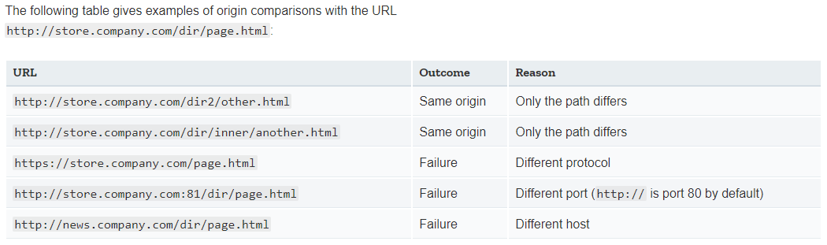
Средства защиты на стороне браузера
SOP (same origin policy)
XMLHttpRequest
21
Notes:
SOP in IE:
Trust Zones: if both domains are in highly trusted zone e.g, corporate domains, then the same origin limitations are not applied
Port: IE doesn't include port into Same Origin components, therefore http://company.com:81/index.html and http://company.com/index.html are considered from same origin and no restrictions are applied.
https://developer.mozilla.org/en-US/docs/Web/Security/Same-origin_policy

Slide 22
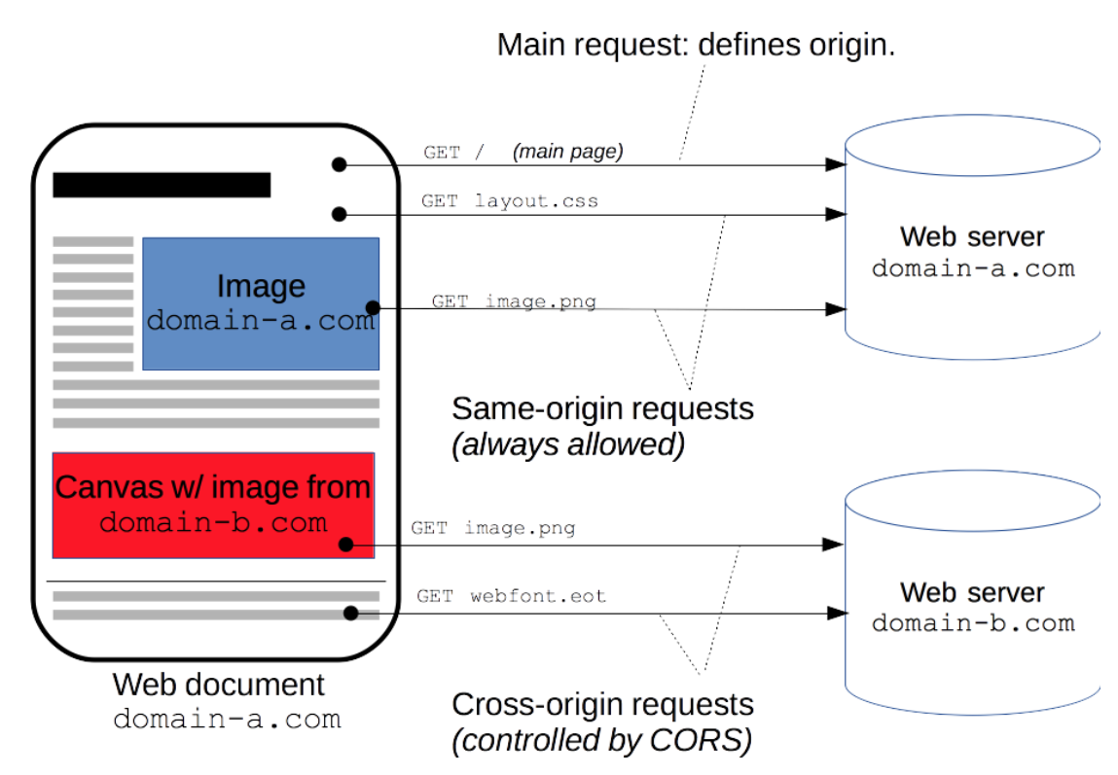
Средства защиты на стороне браузера
CORS (Cross-origin resource sharing)
Access-Control-Allow-Origin: http://example.com
Notes:
CORS is supported:
Gecko 1.9.1 (Firefox 3.5^{[2]}, SeaMonkey 2.0) и выше.
WebKit (Safari 4 и выше^{[3]}, Google Chrome 3 и выше^{[4]}, возможно более ранние).
MSHTML/Trident 6.0 (Internet Explorer 10) имеет встроенную поддержку^{[5]}, MSHTML/Trident 4.0 и 5.0 (Internet Explorer 8 и 9) предоставляет частичную поддержку через XDomainRequest объект. Браузеры Internet Explorer 10 и 11, согласно имеющимся баг-репортам ^{[6]}, не поддерживают CORS для интернациональных доменных имен (IDN), содержащих нелатинские символы.
Presto браузеры (Opera) CORS реализован в Opera 12.00^{[7]} и Opera Mobile 12, но не в Opera Mini
Chrome:
--disable-web-security --user-data-dir="[some directory here]“
Cross-Origin Resource Sharing (CORS) is a mechanism that uses additional HTTP headers to tell a browser to let a web application running at one origin (domain) have permission to access selected resources from a server at a different origin.
https://developer.mozilla.org/en-US/docs/Web/HTTP/CORS

Slide 23
Средства защиты на стороне браузера
JSONP или «JSON with padding» (JSON с набивкой) — это дополнение к базовому формату JSON. Он предоставляет способ запросить данные с сервера, находящегося в другом домене — операцию, запрещённую в типичных веб-браузерах из-за политики ограничения домена.
URL http://server2.example.com/Users/1234, передав Id равный 1234, получит ответ следующего формата: { "Name": "Foo", "Id": 1234, "Rank": 7 }
<script src=“…/Users/1234?jsonp=parseResponse"/>
parseResponse({"Name": "Foo", "Id": 1234, "Rank": 7});
Notes:
JSON-данные в ответе стороннего сервера обычно создаются динамически, в зависимости от параметров запроса, переданных в URL. В основу технологии JSONP положен тот факт, что политика безопасности браузера не запрещает использовать HTML-элемент <script type="text/javascript" src="…"/> для обращения к серверам, отличным от сервера, с которого произошла загрузка страницы.
Предположим, UserId объекта Foo равен 1234. Браузер, запрашивающий URL http://server2.example.com/Users/1234, передав Id равный 1234, получит ответ следующего формата:
{ "Name": "Foo", "Id": 1234, "Rank": 7 }
JSON-данные в ответе стороннего сервера обычно создаются динамически, в зависимости от параметров запроса, переданных в URL.
Ниже HTML-элемент <script> указывает в качестве атрибута src ссылку, возвращающую JSON:
<script type="application/javascript" src="http://server2.example.com/Users/1234"> </script>
В свою очередь, браузер скачает файл script, разберёт его содержимое, интерпретирует сырые JSON-данные как блок и выкинет ошибку синтаксиса. Даже если данные были интерпретированы как литеральный объект JavaScript, к нему невозможно получить доступ из JavaScript, выполняемого в браузере, поскольку без присвоения переменной объектные литералы недоступны.
В паттерне JSONP URL, на который указывает атрибут src тега <script>, возвращает данные JSON, обёрнутые в вызов функции. В подобном случае функция, уже определённая в среде JavaScript, может манипулировать JSON-данными. Начинка JSONP может выглядеть так:
functionCall({"Name": "Foo", "Id": 1234, "Rank": 7});
Вызов функции — это и есть «P» в слове JSONP — «padding» (набивка, «отступ») вокруг чистого JSON, или, согласно некоторым источникам^{[5]}, — «префикс». По соглашению, браузер передаёт имя функции обратного вызова как именованный параметр запроса, обычно используя имя jsonp или callback в запросе к серверу, то есть,
<script type="text/javascript" src="http://server2.example.com/Users/1234?jsonp=parseResponse"> </script>
В данном примере начинка будет такова:
parseResponse({"Name": "Foo", "Id": 1234, "Rank": 7});
https://ru.wikipedia.org/wiki/JSONP

Slide 24
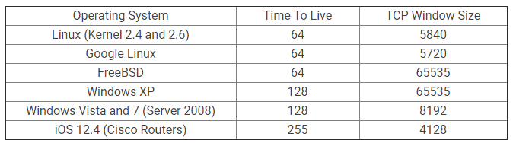
Основные подходы к обнаружению уязвимостей
Статический анализ кода
Динамический анализ кода
Анализ развернутого приложения
Сканирование безопасности
Fuzzing
Анализ при помощи “Attack Proxy” (Burp Suite, OWASP ZAP)
Sniffing
Finger printing
Social engineering
etc…
24
Notes:
С помощью динамического тестирования могут быть получены следующие метрики:
используемые ресурсы - время выполнения программы в целом или ее отдельных модулей, количество внешних запросов (например, к базе данных), количество используемой оперативной памяти и других ресурсов;
цикломатическая сложность, степень покрытия кода тестами и другие метрики программы;
программные ошибки - деление на ноль, разыменование нулевого указателя, утечки памяти, "состояние гонки";
наличие в программе уязвимостей.
Динамическое тестирование наиболее важно в тех областях, где главным критерием является надежность программы, время отклика или потребляемые ресурсы. Это может быть, например, система реального времени, управляющая ответственным участком производства, или сервер базы данных. В таких областях любая допущенная ошибка может оказаться критической.
When doing passive analysis of current traffic or even looking at old packet captures, one of the easiest, effective, ways of doing OS Fingerprinting is by simply looking at the TCP window size and Time To Live (TTL) in the IP header of the first packet in a TCP session.
https://www.howtogeek.com/104337/hacker-geek-os-fingerprinting-with-ttl-and-tcp-window-sizes/

Slide 25
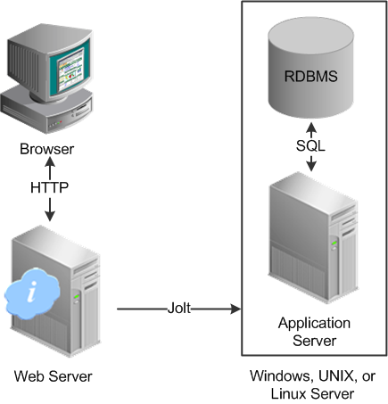
Окружение
25
Notes:
Поверхность атаки — термин, применяемый при решении задач информационной безопасности компьютерных систем, и обозначающий общее количество возможных уязвимых мест.
Чем больше компонентов установлено на сервере, тем больше число потенциально уязвимых мест и, соответственно, поверхность атаки. Сетевые приложения могут использоваться для осуществления атаки на серверы, поэтому для уменьшения потенциальных возможностей атаки можно сократить количество используемых приложений в сети, просто отключив ненужные службы и приложения и установив брандмауэр с определённым списком управления доступом.
Открытый порт — это возможность для взлома сервера, поэтому чем меньше приложений прослушивает сеть, тем меньше вероятность атаки. Для обеспечения максимальной безопасности следует отключить неиспользуемые сетевые приложения.

Slide 26

Криптография. Введение
Криптосистема должна оставаться безопасной даже в том случае, когда злоумышленнику известно всё, кроме применяемых ключей.
Огюст Керкгоффс, «Военная криптография» (1883).
26
Notes:
Криптография — наука о методах обеспечения конфиденциальности (невозможности прочтения информации посторонним), целостности данных (невозможности незаметного изменения информации), аутентификации (проверки подлинности авторства или иных свойств объекта), а также невозможности отказа от авторства.
Нарисовать Alice - <Eva> - Bob, перейти от постановки задачи про конфиденциальную передачу данных к принципу Керкгоффса.
Принцип Керкгоффса — правило разработки криптографических систем, согласно которому криптосистема должна оставаться безопасной даже в том случае, когда злоумышленнику известно всё, кроме применяемых ключей.
Керкгоффса «Военная криптография» (издана в 1883 году).
Разобрать задачу про страну замков, сундуков и ключей:
Вы хотите послать своей любимой посылку с брильянтовым колье по почте.
Вы можете повесить любое количество замков.
Все замки в стране открыть без ключа никто не в состоянии.
Почта - единственное средство общения.

Slide 27
Криптография. Шифрование. Виды алгоритмов.
Асимметричные алгоритмы – для шифрования и расшифрования используются разные ключи (закрытый и открытый соответственно). При этом из закрытого ключа можно получить открытый но не наоборот.
RSA (Rivest-Shamir-Adleman)
Diffie-Hellman (Обмен ключами Диффи - Хелмана)
ECDSA (Elliptic Curve Digital Signature Algorithm) - алгоритм с открытым ключом для создания цифровой подписи.
ГОСТ Р 34.10-2012
Симметричные алгоритмы – для шифрования и расшифрования используется один и тот же ключ.
AES (Advanced Encryption Standard) - американский стандарт шифрования
ГОСТ 28147-89 - советский и российский стандарт шифрования
DES (англ. Data Encryption Standard) - стандарт шифрования данных в Европе и США (3DES (Triple-DES))
27
Notes:
В отечественной практической криптографии для данного преобразования используется термин «расшифрование» , а дешифрование означает взлом.
Лавинный эффект - понятие в криптографии, обычно применяемое к блочным шифрам и криптографическим хэш-функциям. Важное криптографическое свойство для шифрования, которое означает, что изменение значения малого количества битов во входном тексте или в ключе ведет к «лавинному» изменению значений выходных битов шифротекста. Другими словами, это зависимость всех выходных битов от каждого входного бита.

Slide 28
Криптография. Хэширование
Требования:
Необратимость или стойкость к восстановлению прообраза
Стойкость к коллизиям первого рода или восстановлению вторых прообразов: для заданного сообщения M должно быть вычислительно невозможно подобрать другое сообщение N, для которого H(N)=H(M)
Стойкость к коллизиям второго рода: должно быть вычислительно невозможно подобрать пару сообщений (M,M') имеющих одинаковый хеш
Виды:
Ключевая
Бесключевая
28
Notes:
Идеальной криптографической хеш-функцияей является такая криптографическая хеш-функция, к которой можно отнести пять основных свойств:
Детерминированность. При одинаковых входных данных результат выполнения хеш-функции будет одинаковым (одно и то же сообщение всегда приводит к одному и тому же хешу);
Высокая скорость вычисления значения хеш-функции для любого заданного сообщения;
Невозможность сгенерировать сообщение из его хеш-значения, за исключением попыток создания всех возможных сообщений;
Наличие лавинного эффекта. Небольшое изменение в сообщениях должно изменить хэш-значения, так широко, что новые хэш-значения не совпадают со старыми хэш-значениями;
Невозможность найти два разных сообщения с одинаковыми хеш-значениями.
bcrypt — адаптивная криптографическая функция формирования ключа, используемая для защищенного хранения паролей.
MAC — стандарт, описывающий способ обмена данными и способ проверки целостности передаваемых данных с использованием секретного ключа.
HMAC (сокращение от англ. hash-based message authentication code, код аутентификации (проверки подлинности) сообщений, использующий хеш-функции)
В чем разница между коллизиями хеш функции 1-го и 2-го рода:
- Первого рода: находим другое сообщение с такой же хеш-функцией. - Второго рода: находим два (любых) сообщения с одинаковой хеш-функцией.
В коллизии первого рода надо подобрать текст, хэш которого совпадает с имеющимся хэшем. То есть при лобовой атаке перебираем тексты, пока однажды хэш не совпадёт с заданным. В коллизии второго рода надо подобрать 2 разных текста с одинаковыми хэшами. То есть перебираем тексты, пока хэш не совпадёт с одним из ранее полученных хэшей. Вероятность этого существенно выше.

Slide 29
Криптография. Генерирование случайных чисел
Требования к криптографически стойкому генератору псевдослучайных чисел:
они должны проходить статистические тесты на случайность (генерируемая последовательность бит должна быть близкой к случайной)
они должны сохранять непредсказуемость, даже если часть их исходного или текущего состояния становится известна криптоаналитику
java.security.SecureRandom – имплементация в Java криптографически стойкого генератора псевдослучайных чисел
java.util.Random - не является криптографически стойкой имплементацией
29

Slide 30
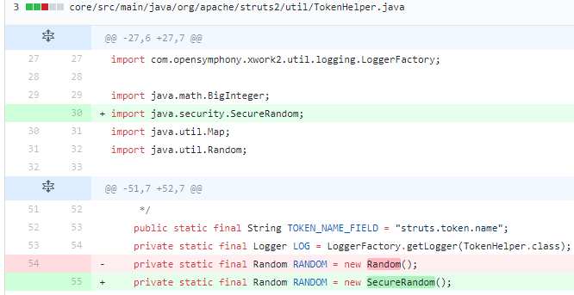
Криптография. Генерирование случайных чисел
CVE-2014-7809
Description
Apache Struts 2.0.0 through 2.3.x before 2.3.20 uses predictable <s:token/> values, which allows remote attackers to bypass the CSRF protection mechanism.

Slide 31
Java security frameworks
Basic functionality:
Authentication
Authorization
Data integrity
Confidentiality
Non-repudiation
Quality of Service
Auditing
Main frameworks:
J2EE based
EJB
Java servlet API
Java Authentication and Authorization Service (JAAS)
Spring Security
31
Notes:
Authentication: The means by which communicating entities, such as client and server, prove to each other that they are acting on behalf of specific identities that are authorized for access. This ensures that users are who they say they are.
Authorization, or access control: The means by which interactions with resources are limited to collections of users or programs for the purpose of enforcing integrity, confidentiality, or availability constraints. This ensures that users have permission to perform operations or access data.
Data integrity: The means used to prove that information has not been modified by a third party, an entity other than the source of the information. For example, a recipient of data sent over an open network must be able to detect and discard messages that were modified after they were sent. This ensures that only authorized users can modify data.
Confidentiality, or data privacy: The means used to ensure that information is made available only to users who are authorized to access it. This ensures that only authorized users can view sensitive data.
Non-repudiation: The means used to prove that a user who performed some action cannot reasonably deny having done so. This ensures that transactions can be proved to have happened.
Quality of Service: The means used to provide better service to selected network traffic over various technologies.
Auditing: The means used to capture a tamper-resistant record of security-related events for the purpose of being able to evaluate the effectiveness of security policies and mechanisms. To enable this, the system maintains a record of transactions and security information.

Slide 32
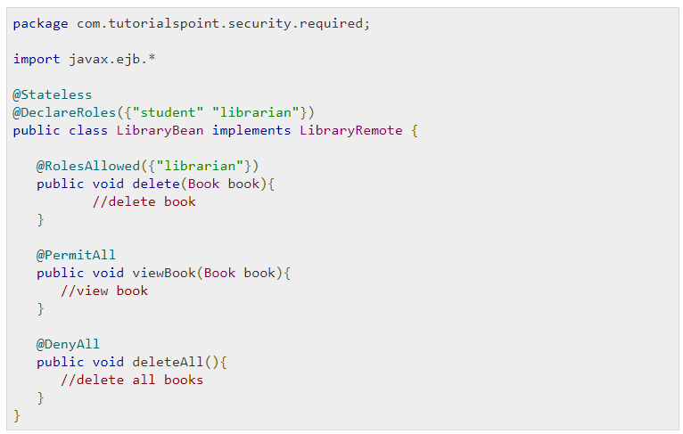
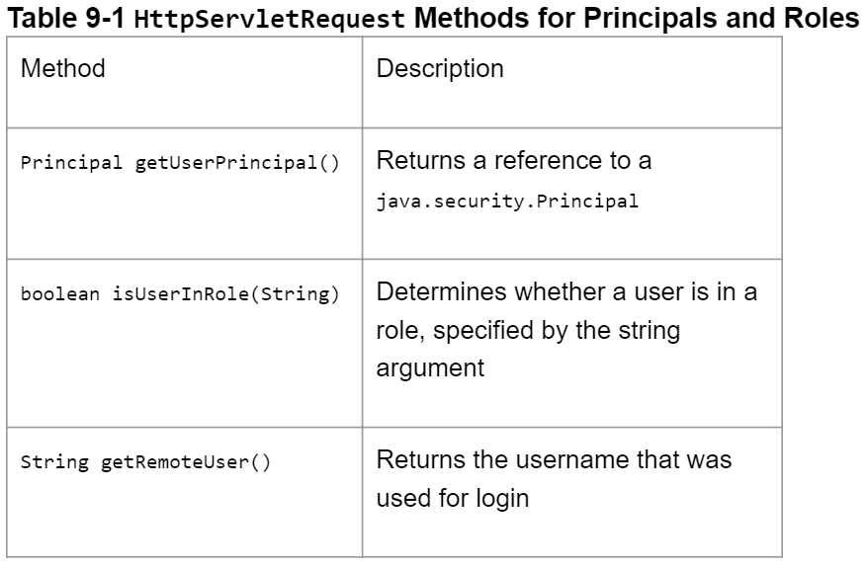
Java security frameworks
32
Notes:
Authentication: The means by which communicating entities, such as client and server, prove to each other that they are acting on behalf of specific identities that are authorized for access. This ensures that users are who they say they are.
Authorization, or access control: The means by which interactions with resources are limited to collections of users or programs for the purpose of enforcing integrity, confidentiality, or availability constraints. This ensures that users have permission to perform operations or access data.
Data integrity: The means used to prove that information has not been modified by a third party, an entity other than the source of the information. For example, a recipient of data sent over an open network must be able to detect and discard messages that were modified after they were sent. This ensures that only authorized users can modify data.
Confidentiality, or data privacy: The means used to ensure that information is made available only to users who are authorized to access it. This ensures that only authorized users can view sensitive data.
Non-repudiation: The means used to prove that a user who performed some action cannot reasonably deny having done so. This ensures that transactions can be proved to have happened.
Quality of Service: The means used to provide better service to selected network traffic over various technologies.
Auditing: The means used to capture a tamper-resistant record of security-related events for the purpose of being able to evaluate the effectiveness of security policies and mechanisms. To enable this, the system maintains a record of transactions and security information.

Slide 33
Практика

Slide 34
Демо #1: SQL-Injection
Notes:
Демонстрация SQL-Injection
http://192.168.99.100:8080/JavaVulnerableLab/login.jsp
admin' or '1'='1
Опционально:
http://192.168.99.100:8080/JavaVulnerableLab/vulnerability/Injection/xpath_login.jsp
neo' or 1=1 or ''='
/users/user[username='neo' or 1=1 or ''='' and password='"+pass+"']/name

Slide 35
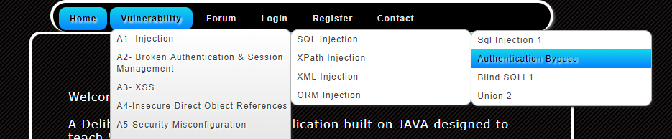
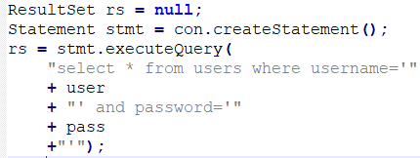
Упражнение #1: SQL-Injection
Цель: зайти в приложение с именем пользователя “admin” не зная пароля
Подсказка 1:
Notes:
Практика SQL-Injection
http://192.168.99.100:8080/JavaVulnerableLab/vulnerability/forumposts.jsp?postid=1
-1 union select 1,2,3,4 from users
http://192.168.99.100:8080/JavaVulnerableLab/vulnerability/forumposts.jsp?postid=-1%20union%20select%201,password,3,4%20from%20users
http://192.168.99.100:8080/JavaVulnerableLab/vulnerability/forumposts.jsp?postid=-1%20union%20select%201,password,username,4%20from%20users
http://localhost:8080/JavaVulnerableLab/robots.txt
Disallow: /admin/admin.jsp
Файл дает поисковым роботам рекомендации: какие страницы/файлы стоит сканировать.
http://localhost:8080/JavaVulnerableLab/admin/adminlogin.jsp

Slide 36
Демо #2: Broken Authentication and Session Management
Notes:
http://192.168.99.100:8080/JavaVulnerableLab/ForgotPassword.jsp
http://192.168.99.100:8080/JavaVulnerableLab/vulnerability/baasm/URLRewriting.jsp;jsessionid=99432A123FB105EA52099E85B53BE139

Slide 37
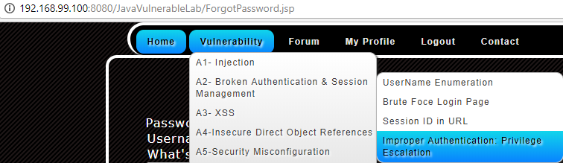
Упражнение #2: Broken Authentication and Session Management
Цель: получить доступ к странице только для администраторов обычным пользователем. Переименовать сайт в “Hacked by %hackername%”.
Подсказка 1: зарегистрировать пользователя с любыми данными, зайти под ним на сайт и посмотреть, что в куках
Подсказка 2: параметр privilege может содержать и другие значения.
Notes:
http://192.168.99.100:8080/JavaVulnerableLab/vulnerability/idor/download.jsp
http://192.168.99.100:8080/JavaVulnerableLab/vulnerability/idor/download.jsp?file=doc1.pdf
http://192.168.99.100:8080/JavaVulnerableLab/vulnerability/idor/download.jsp?file=../../../../../../etc/passwd
http://192.168.99.100:8080/JavaVulnerableLab/vulnerability/idor/download.jsp?file=../../../../../../etc/shadow

Slide 38
Демо #3: XSS
Notes:
Демонстрация XSS (отключить XSS аудитор у хром: chrome.exe --disable-xss-auditor)
test<script>console.log(document.cookie);</script>
http://192.168.99.100:8080/JavaVulnerableLab/vulnerability/xss/search.jsp?keyword=%3Cscript%3Ealert%28document.cookie%29%3B%3C%2Fscript%3E&action=Search

Slide 39
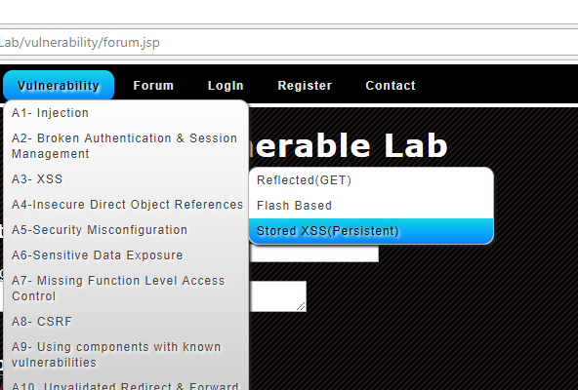
Упражнение #3: Stored XSS
chrome.exe
--disable-xss-auditor
Цель: создать пост на форуме, который будет логгировать куки пользователя (либо выводить во всплывающем окне).
Подсказка: (document.cookie).
Notes:
Создать пост с сообщением: <script>console.log(document.cookie);</script>

Slide 40
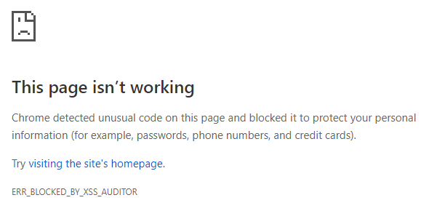
Упражнение #3: Stored XSS
chrome.exe --disable-xss-auditor
IE 10:
Follow these steps to disable XSS filter.
a. Open Internet Explorer and click on Tools.
b. Click on Internet Options and then select Security tab.
c. Click on Custom level.
d. Under Scripting select disable XSS filter and click Ok.
e. Close the window and restart Internet Explorer.
Notes:
Создать пост с сообщением: <script>console.log(document.cookie);</script>

Slide 41
Демо #4: Broken Access Control
Notes:
http://192.168.99.100:8080/JavaVulnerableLab/myprofile.jsp?id=7 – можно смотреть чужие данные
http://192.168.99.100:8080/JavaVulnerableLab/vulnerability/idor/change-email.jsp
- network log
Можно отредактировать чужие данные

Slide 42
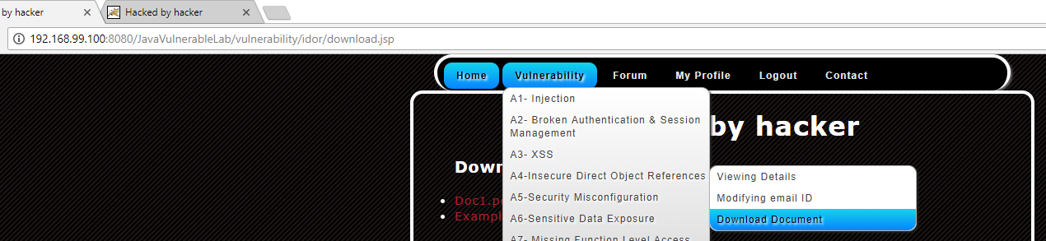
Упражнение #4: Broken Access Control: Directory traversal
Цель: скачать файлы /etc/passwd и /etc/shadow
Подсказка 1: скопировать ссылку и попробовать указать другой файл
Подсказка 2: посмотреть на FileNotFoundException, NB: “..” – подняться на одну директорию вверх
Notes:
passwd is the file where the user information (like username, user ID, group ID, location of home directory, login shell, ...) is stored when a new user is created.
shadow is the file where important information (like an encrypted form of the password of a user, the day the password expires, whether or not the passwd has to be changed, the minimum and maximum time between password changes, ...) is stored when a new user is created.
Демонстрация XSS (C:\Program Files (x86)\Google\Chrome\Application\chrome.exe --disable-xss-auditor)
test<script>console.log(document.cookie);</script>
http://192.168.99.100:8080/JavaVulnerableLab/vulnerability/xss/search.jsp?keyword=%3Cscript%3Ealert%28document.cookie%29%3B%3C%2Fscript%3E&action=Search

Slide 43
Демо #4: CSRF
Notes:
\web_security\csrf
python -m http.server

