Slide 1
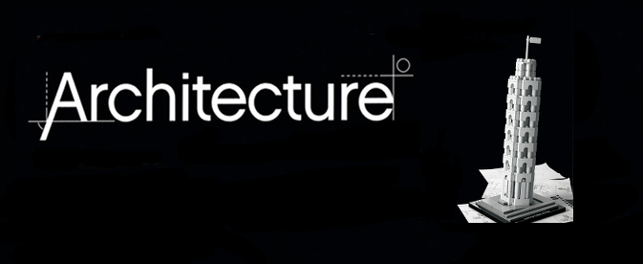
Software Architecture and Software Architect
T-Systems RUS. JavaSchool
Voronezh, 2019
Sysoeva Darya, Mironchenko Alexander

Slide 2
Intro
0
Introduction
1
Questions
2
Terms
3
Simplification

Slide 3
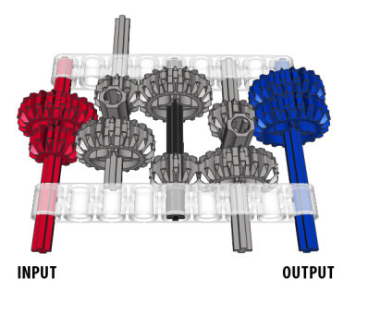
Agenda
Content
0
Intro
1
Basic design principles
2
Design example
3
Multilayered architecture

Slide 4

Why we need Architects?
I know Java and SQL, why I need Architect for our product?

Slide 5
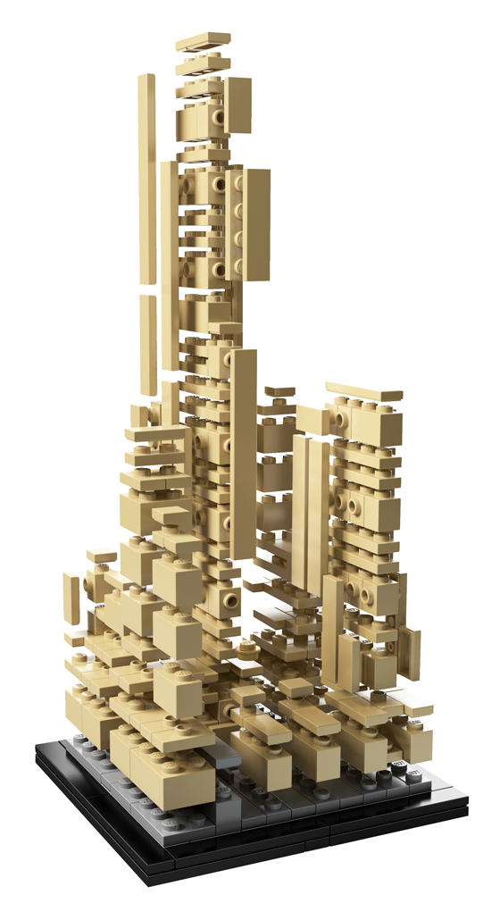

Why we need Architects? Short Answer.
I know Java and SQL, why I need Architect for our product?
Because your product has Architecture.

Slide 6

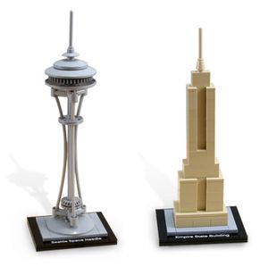
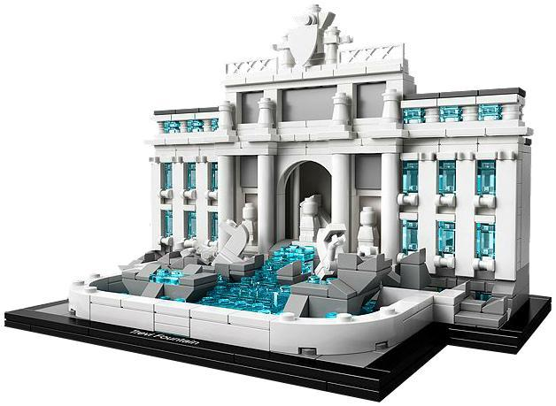
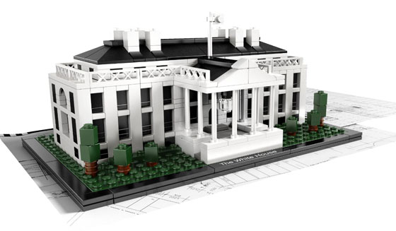
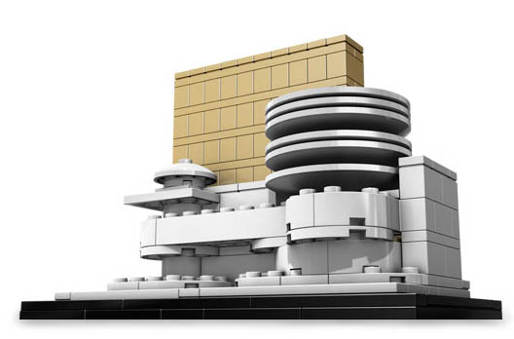
Different architectures

Slide 7
Outer Function requirements

Slide 8
Outer quality attributes
Notes:
Performance
Volume

Slide 9
Our internal functional requirements
Notes:
Monitoring
Logging
Internal admin tools

Slide 10
Our internal quality requirements
Notes:
Расширяемость
Тестопригодность
переносимость (Portability) приложения или системы на другие платформы.

Slide 11
Design Guidlines
Notes:
Guidelines – кровью пишутся.
CDDM / CSDG
Patterns: factory / singleton
Príncipes

Slide 12
Resources
Notes:
time, people, money, partners, trust, risks

Slide 13
Personal pain experience
Notes:
Personality in design

Slide 14
Development team

Slide 15
Company restriction
Notes:
Technologies stack
Open source software
Слияние, поглощение

Slide 16
Architecture depends on
Notes:
Conway law
Организации, которые проектируют системы ... вынуждены производить проекты, которые являются копиями коммуникационных структур этих организаций

Slide 17
Architecture depends on
Notes:
integration landscape, locked-in vendors

Slide 18
But outer requirement is more important

Slide 19
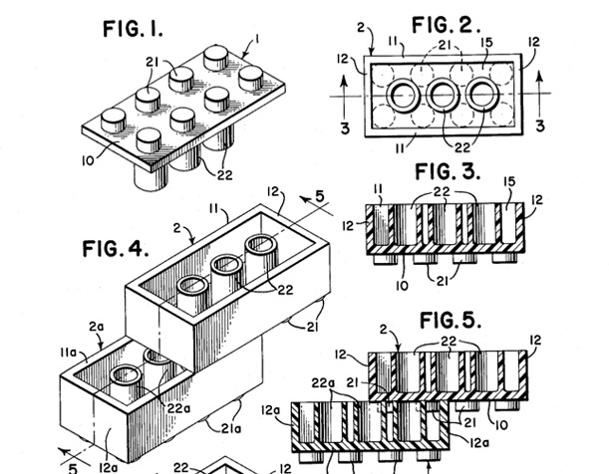
What means good architecture?
Quality attributes
Meet requirements
Ready for change
Ready for scaling and distribution
Minimize cost
Other NFR

Slide 20
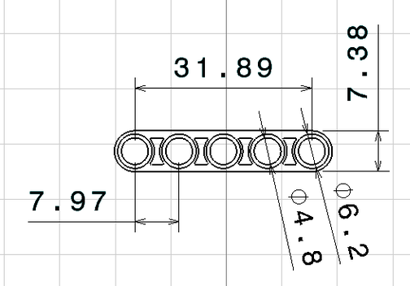
ISO 9126 Software quality
Quality attributes
Functionality
Reliability
Usability
Efficiency
Maintainability
Portability

Slide 21
Key architecture principles and practice
Principles
Separation of concerns.
Single Responsibility principle.
Principle of Least Knowledge.
Don’t repeat yourself (DRY).
Notes:
Separation of concerns - Divide your application into distinct features with as little overlap in functionality as possible. The important factor is minimization of interaction points to achieve high cohesion and low coupling. However, separating functionality at the wrong boundaries can result in high coupling and complexity between features even though the contained functionality within a feature does not significantly overlap.
Example OSI model. Patterns: Information Expert, Creator, Mediator
Single Responsibility principle. Each component or module should be responsible for only a specific feature or functionality, or aggregation of cohesive functionality.
It is bad to have component which include two responsibility, because it is two reason to change it. Good example SOA – term Service.
Principle of Least Knowledge (also known as the Law of Demeter or LoD). A component or object should not know about internal details of other components or objects.
Example: Interface
Don’t repeat yourself (DRY). You should only need to specify intent in one place. For example, in terms of application design, specific functionality should be implemented in only one component; the functionality should not be duplicated in any other component.
Microsoft Application Architecture Guide, 2nd Edition

Slide 22
Key architecture principles and practices
SOLID
Prefer composition to inheritance
Prefer interfaces to abstract clases
Separate the areas of concern between layers
A component /object should not rely on internal details of other components/objects.
Do not overload the functionality of a component.
Dependency Inversion Principle
Establish a coding style and naming convention for development.
Maintain system quality using automated QA techniques during development.
Encapsulate what varies

Slide 23
Key architecture principles and practices
SOLID
Single Responsibility
Open-Closed
Liskov substitution
Interface segregation
Dependency inversion
Notes:
Принцип единственной ответственности (The Single Responsibility Principle)Каждый класс должен иметь одну и только одну причину для изменений.
Принцип открытости/закрытости (The Open Closed Principle)«программные сущности … должны быть открыты для расширения, но закрыты для модификации.»
Принцип подстановки Барбары Лисков (The Liskov Substitution Principle)«объекты в программе должны быть заменяемыми на экземпляры их подтипов без изменения правильности выполнения программы.» См. также контрактное программирование.Наследующий класс должен дополнять, а не изменять базовый.
Принцип разделения интерфейса (The Interface Segregation Principle)«много интерфейсов, специально предназначенных для клиентов, лучше, чем один интерфейс общего назначения.»^{[9]}
Принцип инверсии зависимостей (The Dependency Inversion Principle)«Зависимость на Абстракциях. Нет зависимости на что-то конкретное.»^{[9]}

Slide 24
Design example

Slide 25
Design Example: Simple Enterprise Search (SES)
Description:
SES is software of search information within an enterprise data.
Requirements (plain style):
Users from our company should be able to search across office document. Initially documents can be stored on external storages (ftp, corporative web server, windows shared folder). Also it should be possible to upload document directly to system. Only managers and dedicated persons should be able to search across finance documentation. All our user have browser Chrome on their PCs.

Slide 26
Trying to rewrite requirements
UR01. Users should be able to search accross documents.
UR02. Users can have different access right.
UR03. Document types: Word, XLS.
UR04. Web inteface should work in Chrome.
UR05. System should be able to get document via:
1. FTP
2. SAMBA
3. HTTP
UR 06. Special users can upload document directly to System
Notes:
Please communicate with stakeholder as soon as you have any question about requirements.
For example it can help avoid strange application with “maximum drivers per wagon” or “change tariff to Standard in case deleting tariff”

Slide 27
Trying to rewrite requirements

Slide 28
Looking for Actors
Notes:
Who will use your application?

Slide 29
Actors generalization

Slide 30
UseCase analyzes
Notes:
How they will use it?

Slide 31
UseCase analyzes. Traceability
Notes:
As we see some user requirements not covered by use cases.

Slide 32
UseCase analyzes. Traceability
Notes:
For example, requirements about access right, not directly related to user behavior.
From experience we know that any requirements with right, access, user related to set of User Management cases:
* Create, delete, update, list user
* Assign roles
* Assign groups
* Authorization / authentication / audit
All this case in most cases clear and very similar in different applications. We will hide details heir.
But our roles also use these scenarios, so we should assign them to actors.

Slide 33
UseCase analyzes. Finally

Slide 34
Activity
Notes:
In parallel very useful to start detail all use cases from user point of view.
Which actions user should perfrom to complete use case.

Slide 35
System analyses
Notes:
After analyses user scenarios we should start define how our application will support these scenarios.
In our case I use external information source to understand how usually works any search and index engines.
As you can see on slide – the process very similar with traditional pattern ETL – extract, transform, load.
Our application should extract document, transform it to clean form (ready for indexing) and update index with it.

Slide 36
System UseCases
Notes:
As result we have set of use cases which performed inside our system. And just in directly called by users.
These cases have name System use cases.
UI – hided set of user interfaces which needed for provide functionality like:
Search page
Search result page
Login page
Upload document
Define place of document
User management pages
Etc

Slide 37
System Functional decomposition
Notes:
Our next step is performing decomposition to different functional packages.
It can help us in understanding internal structure of application and also support separation of concern principle

Slide 38
System Components: A-architecture
Notes:
As we have functional packages we can define components for covering functionalities.
In simplest way – one component responcible for one package.
But if component overloaded it should be splitted.
Also spliting can be useful if you want to user standart or external components, on your own components should be glue for them.

Slide 39
System Components
Notes:
After consultation with development team we can understand how and if it possible to implement our abstract components.
In this point we can decide about technologies stack and make some prototypes

Slide 40
Application Components + Technical components
Notes:
Of course we will have some technical components, which should help us to implement NFR
(also reduce development cost)

Slide 41
Detailed Activity Diagram
Notes:
This activity diagram show same both cases as before, but added more details
Activity separated by system components.
Some important object flow shown

Slide 42
Entity Classes
Notes:
Blue – binary format, not interesting for us.
Green – persistent entity
Rest classes just DTO
In case if we will explain activity for all use cases, probably additional objects/classes will be discovered. For example for UserManagement (Users, Roles, Groups, Rights)

Slide 43
Interfaces
Notes:
It is important to understand
Each layers communicate via specified interfaces
No communication cross layer

Slide 44
Behavior classes
Notes:
Strategy pattern
(instead abstract class can be interface used)
Important:
Parser know nothing about document types
WordParser known nothing about XLS specific
Easy to extend

Slide 45
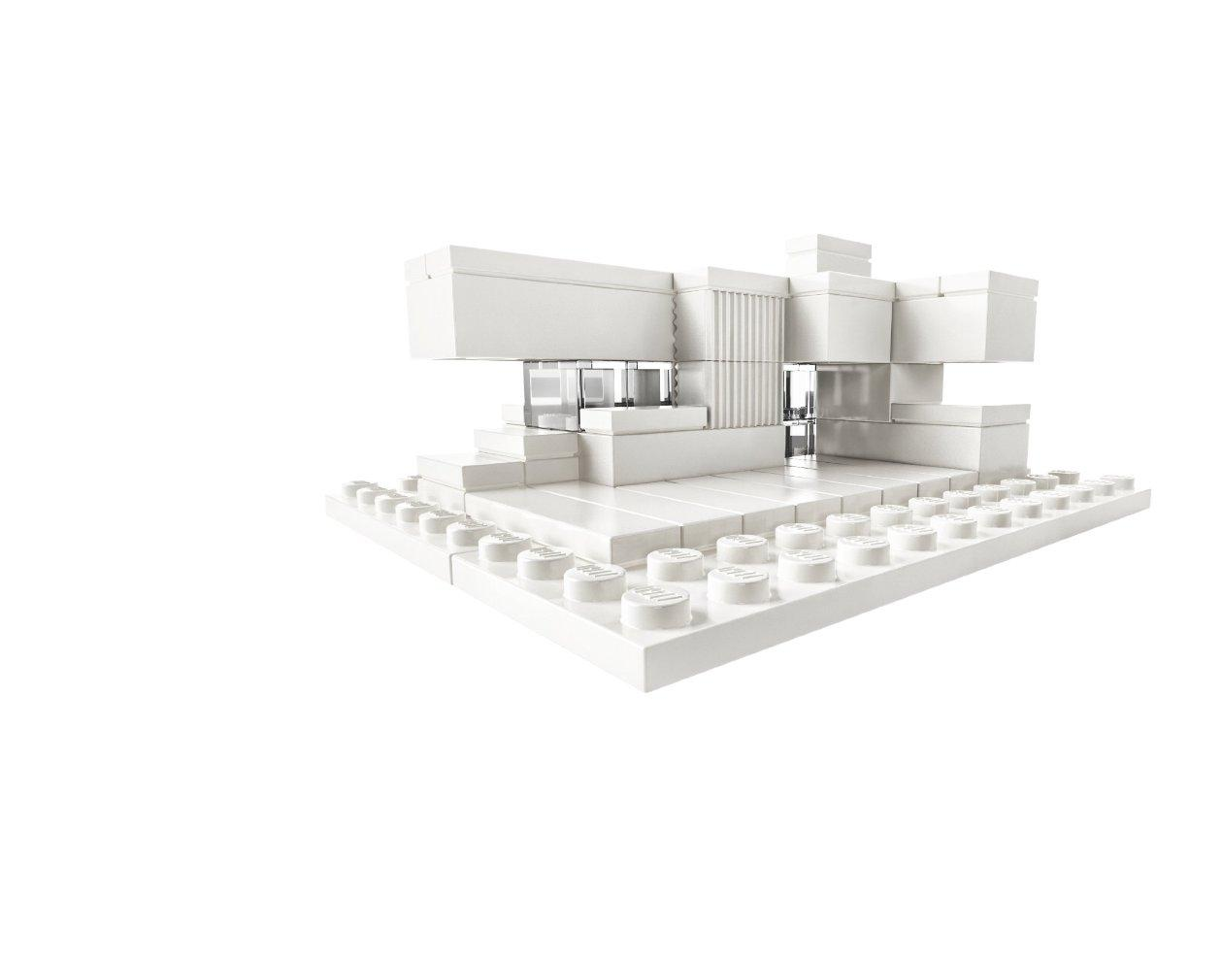
Questions?
Design example
?
Notes:
Short resume

Slide 46
Multilayer application pattern

Slide 47
Multilayered architecture: Why?
Benefits from the box
Abstraction
Isolation
Manageability
Performance
Reusability
Testability
Notes:
Abstraction. Layers allow changes to be made at the abstract level. You can increase or decrease the level of abstraction you use in each layer of the hierarchical stack.
Isolation. Allows you to isolate technology upgrades to individual layers in order to reduce risk and minimize impact on the overall system.
Manageability. Separation of core concerns helps to identify dependencies, and organizes the code into more manageable sections.
Performance. Distributing the layers over multiple physical tiers can improve scalability, fault tolerance, and performance.
Reusability. Roles promote reusability. For example, in MVC, the Controller can often be reused with other compatible Views in order to provide a role specific or a user-customized view on to the same data and functionality.
Testability. Increased testability arises from having well-defined layer interfaces, as well as the ability to switch between different implementations of the layer interfaces. Separated Presentation patterns allow you to build mock objects that mimic the behavior of concrete objects such as the Model, Controller, or View during testing.

Slide 48
3-tier Architecture
Notes:
Presentation Layer, handle user behavior, adapt data for visualization. Can include logic for UI (for example, validation rules, screen flow rules)
Business logic - All Application functional algorithms. + Mediator between Presentation layer and Data access Layer
Data access layer – data storage and unified access methods. (at least CRUD). + Integration between Data sources

Slide 49
3-tier Architecture: our application
Notes:
Remind our application
In order to simplify, we will use abstract component model.
Question to auditory – which component will be in which layer?

Slide 50
3-tier Architecture: our application
Notes:
Remind our application

Slide 51
n-tier Architecture
Notes:
"All problems in computer science can be solved by another abstraction layer ...except for the problem of too many layers of indirection.“
Service layer – interfaces between Business and presentation, data transformation, data aggregation from different BL.
Infrastructure layer – logging, monitoring, audit.
DAL – ORM
persistence

Slide 52
n-tier Architecture: JEE
Rich application or JS/Html application
JSP / JSF / Struts / Spring MVC …
EJB
JPA + Database
Notes:
Client tier or client computer (web application or rich client)
Web tier (optional) Jee server (web container)
Business tier Jee server (ejb container)
Information Tier = Enterprise Information System Tier

Slide 53
n-tier Architecture: JEE
Notes:
Not included security aspect
It can be JAAS
Or in case Spring MVC – Spring Security.

Slide 54
Alternatives
Domain Driven Design
Specific
No strict layers
Entity and their behavior combined
Pro
Easy to extend domain model
Easy to test
Easy to map requirements
Cons
Hi- efforts/costs
Notes:
If we user DDD aspects in design our application we will another entity classes. And probably Business layer will be excluded.

Slide 55
Alternatives
Event Based
Notes:
In case Event base architecture, our Business layer can have another structure.
The root of new structure is Queues.

Slide 56
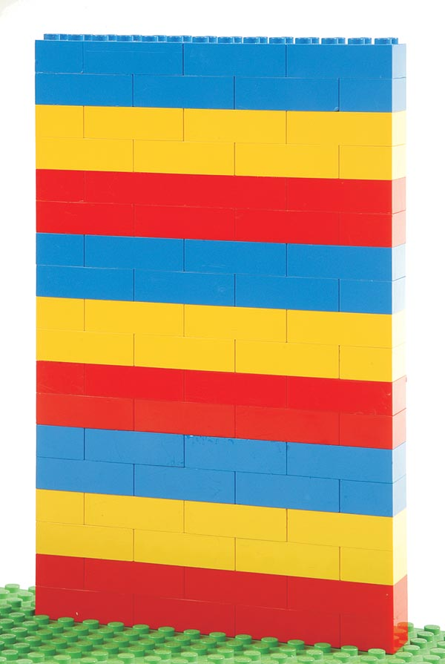
Important
Please start your enterprise application from n-tiers architecture
It is clear and easy to understand
It is proven by time
Most current EA using layered architecture
JEE designed for layered architecture
You don’t have any strong NFR
Notes:
EA == enterprise application
NFR – Non functional requirements

Slide 57

Questions?
Multilayered architecture
Notes:
Short resume

Slide 58
Thank you!

Slide 59
References

Slide 60
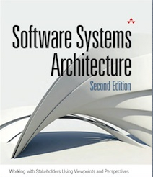
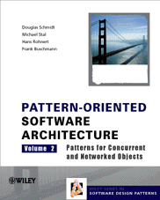


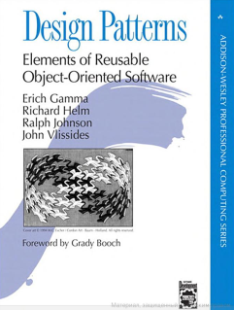
Sources
Architecture itself
Rozanski&Woods
POSA
Fowler
EIP
GOF
Notes:
Rozanski&Woods – for beginners. Many details, terms.
POSA 5 volumes many authors. At least first two volumes can be interesting (System level, concurrent problems)
Martin Fowler
Enterprise Integration Patterns: Designing, Building, and Deploying Messaging Solutions (Gregor Hohpe, Bobby Woolf)
GOF – gang of four. Erich Gamma, Richard Helm, Ralph Johnson, John Vlissides

Slide 61
Sources
Architecture practice / PLC aspects
CMMI® for Development, Version 1.3
Carr, Marvin et al, Taxonomy-Based Risk Identification, CMU/SEI-93-TR-006. Pittsburgh, Pa.: Software Engineering Institute, Carnegie Mellon University, June 1993.
Microsoft Application Architecture Guide, 2nd Edition

Slide 62
Sources
SOA / EDA
The Growing Role of Events in Enterprise Applications. Five forces. July 2003, Roy W. Schulte, Gartner
“Event-Driven Architecture Complements SOA”, by Roy W. Schulte, Yefim V. Natis, July 2003, by Gartner
“2.0 The Mission and Future of Integration” 2004, Gartner “Enterprise Integration Patterns: Designing, Building, and Deploying Messaging Solutions” by Hohpe G., Woolf B., 2004
“Applied SOA: Conquering IT Complexity through Software Architecture”, by Yefim V. Natis, May 2005, by Gartner, Inc. “Event-driven architecture” by Hohpe G., 2006
Notes:
Max Smirnov / Advanced SOA / EDA

Slide 63
Sources
Requirements
IEEE Recommended Practice for Software Requirements Specifications IEEE Std 830-1998
Requirements management using IBM Rational RequisitePro / Peter Zielczynski
WRITING EFFECTIVE USE CASES. Alistair Cockburn

