Slide 1

GHOST JOB
DETECTION
A Labor Market Mispricing Signal
COMM 486I · UBC Sauder School of Business
Nilabh Agrawal · Carter Jaquette · Zixi Lian
Group 6

Slide 2
AGENDA
01
Theoretical Framework & Motivation
Ghost jobs: literature, theory, financial relevance
02
Model Design & Implementation
XGBoost + SHAP + GMM pipeline; feature engineering
03
Empirical Results
Walk-forward backtest; strategy performance; concentration
04
Robustness, Stability & Limitations
Failure modes, data constraints, out-of-sample caveats
05
Implications for Financial Decision-Making
Trading signals, investor relevance, next steps
UBC SAUDER · COMM 486I · GROUP 6

Slide 3
01
Theoretical Framework
& Motivation
Ghost jobs in context: what the research says and why it matters for finance
UBC SAUDER · COMM 486I · GROUP 6

Slide 4
WHAT ARE GHOST JOBS?
Job listings posted by real companies with no present intention to hire
21%
40%
50%
of postings may be ghost jobs
(Ng 2024)
of companies admit
posting ghost jobs
of postings now lead
to no hire (vs 20% in 2018)
Why Ghost Jobs Matter for Finance
Investors read job postings as growth signals (Gutiérrez et al. 2020, Management Science)
Ghost postings inflate vacancy counts → distort the Beveridge Curve and aggregate labor statistics
If ghost-heavy firms appear stronger than they are, a ghost-adjusted measure could predict underperformance
UBC SAUDER · COMM 486I · GROUP 6

Slide 5
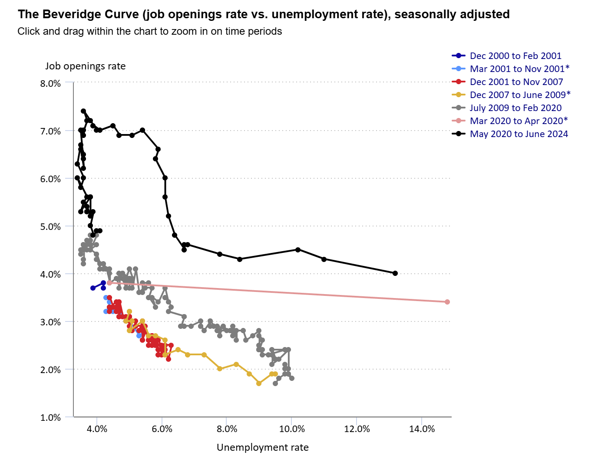

Slide 6
THE POSTING vs HIRING GAP
Investors see postings. Revelio lets us see what actually happened. The gap is the signal.
95
3.9%
jobs posted per quarter
AutoZone (AZO)
actually lead to a hire
96 of 100 postings = noise
Why This Gap Exists and Why It Matters for Finance
Investors treat posting volume as a growth signal -- Gutierrez et al. (2020) show hiring announcements move stock prices
If 96 of 100 postings are never filled, the signal investors are reading is largely noise -- creating a systematic mispricing opportunity
Our model quantifies that gap for 204 public firms across 15 years -- turning a qualitative observation into a tradeable signal
UBC SAUDER · COMM 486I · GROUP 6

Slide 7
KEY LITERATURE
Three papers that frame our work — findings, gaps, and our contribution
2024
Ng — Ghost Job Detection via BERT on Glassdoor Reviews
KEY NUMBER
Finding: ~21% of postings are ghost jobs; mid-sized tech firms peak at 25%. BERT classifier trained on Glassdoor reviews.
21%
Gap: Labels confounded by sentiment — negative reviews ≠ ghost intent.
ghost rate → our percentile cutoff
↳ Outcome-anchored labels from actual hire data; XGBoost on behavioral features
2022
Amaar et al. — Fake Job Detection with TF-IDF + ML Classifiers
ACCURACY
Finding: 99.9% accuracy with Extra Trees on Kaggle scam job dataset.
99.9%
Gap: Detects fraudulent scam postings — not ghost jobs posted by real firms.
on scams — not
ghost jobs
↳ Ghost jobs are a distinct phenomenon: real firms, real postings, zero hiring intent.
2025
Singer & Oktay — Framework for Ghost Posting ID from Behavioral Data
KEY INSIGHT
Finding: Behavioral features (duration, still-active rate, salary) can identify ghost postings from CoreSignal data.
Behavioral
features
Gap: Framework only — no model, no validated measure, no link to financial outcomes.
right signal — not text
↳ Implement end-to-end: XGBoost + SHAP; extend to portfolio construction and walk-forward backtesting.
None of these papers produces a validated, outcome-linked ghost measure with financial return implications — this is our contribution.
UBC SAUDER · COMM 486I · GROUP 6

Slide 8
HYPOTHESES & THEORETICAL FRAMEWORK
Bridging the literature to our empirical design
H1 — Fundamental Mispricing
H2 — Attention & Behavioural Premium
Ghost postings inflate perceived growth. Investors over-extrapolate hiring signals into future earnings. Once the fundamental gap is revealed — through missed earnings or hiring stalls — prices correct downward.
High posting volume attracts investor attention and signals growth ambition. Sentiment-driven demand can persist even without fundamental support, and limits to arbitrage prevent rapid correction of the resulting mispricing.
vs
→ Prediction: Ghost firms earn negative long-run abnormal returns
→ Prediction: Ghost firms earn a near-to-medium-term attention premium
Ghost Posting
Inflated Growth
Signal
Investor
Perception
Near-term
Demand ↑
Fundamental
Gap Widens
Ghost Score Formula
GhostScore(i, t) = 1 − Rankt [ PredFillRate(i, t) ] / Nt
PredFillRate(i, t) = XGBoost[X(i, t)] / Postings(i, t) predicting inflows at t + 1 [no lookahead]
Score → 0: genuine hirer | Score → 1: ghost firm (low predicted fill relative to all firms in same quarter)
UBC SAUDER · COMM 486I · GROUP 6

Slide 9
02
Model Design &
Implementation
XGBoost prediction · SHAP attribution · GMM cluster validation
UBC SAUDER · COMM 486I · GROUP 6

Slide 10
PIPELINE OVERVIEW
Three-output framework: predicted fill rate · actual fill rate · posting volume
Revelio Labs
Data
Feature
Engineering
XGBoost
Regression
SHAP
Analysis
Ghost
Intensity Score
GMM
Validation
310k postings
2,919 firms
2009–2024
14 features: 10 posting
behavioural + 4 company
Predicts Q+1
inflows (no leakage)
Test R²=0.49
Feature attribution
per firm-quarter
Pred fill rate
→ percentile rank
→ 0–1 score
k=7 clusters
validates ghost
behaviour
Trading Strategy: Walk-Forward Backtest
Long High Ghost: Long top-decile ghost firms (anomaly persistence)
Ghost Barbell: Long both extremes (High + Low Ghost)
Long Low Ghost: Long genuine-hirer firms (quality signal)
Ghost Momentum: Sort on changes in ghost intensity
Long / Short: Long Low Ghost vs Short High Ghost
Threshold (is_ghost): Binary flag based on 21st-pct threshold
UBC SAUDER · COMM 486I · GROUP 6

Slide 11
DATA
310,821
2,919
1,017
2009–24
job postings
(unified, deduplicated)
US public firms
with tickers
firms with ≥3 postings/qtr
entering the model
temporal coverage
15 years of data
Key Feature Sets
Track | Features | Source
Posting Behavioural | num_postings, avg/median duration, still_active_rate, salary_disclosure_rate, avg_salary, total/avg_expected_hires, role_diversity, remote_rate (10 features) | Unified postings (COSMOS)
Company | headcount, headcount_growth_4q (YoY %), log_headcount, naics_int (4 features) | Individual positions
Outcome | actual_inflows Q+1 (regression target); actual_fill_rate for validation | Individual positions
UBC SAUDER · COMM 486I · GROUP 6

Slide 12
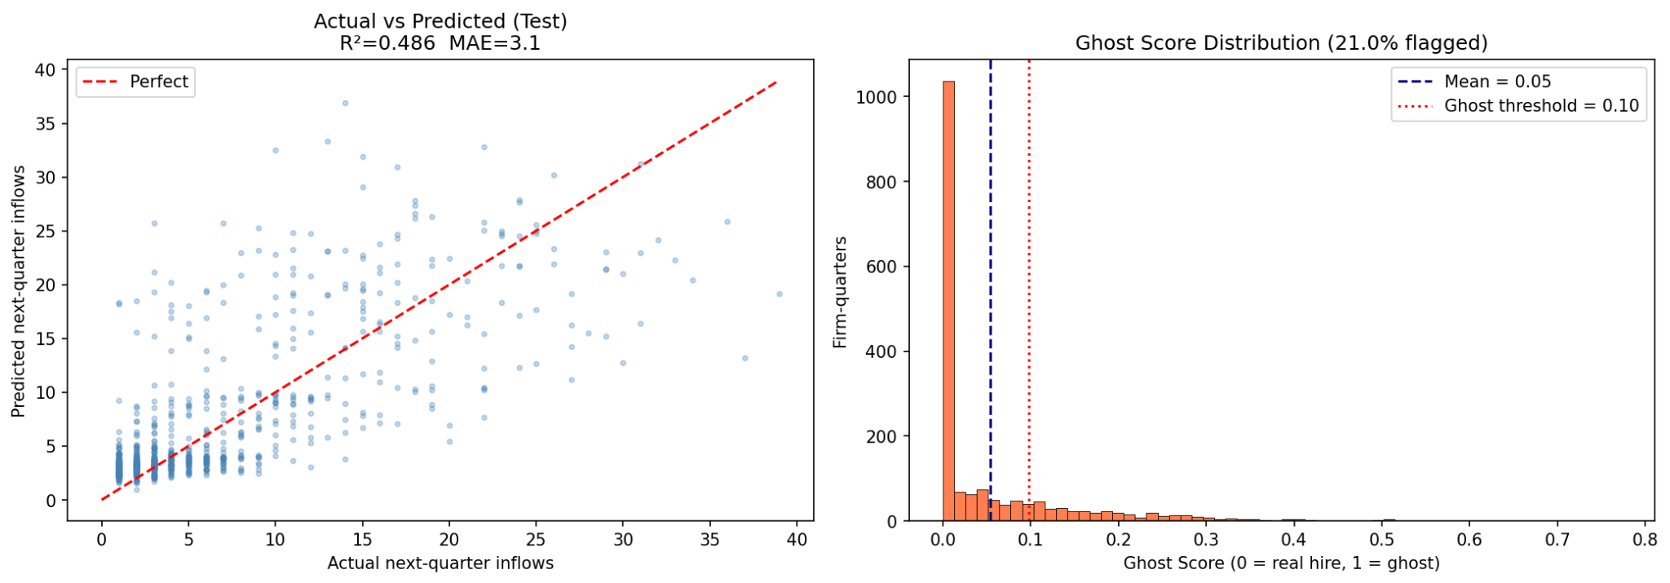
FEATURE ENGINEERING & XGBOOST MODEL
Target: actual inflows Q+1 | Train: 7,167 rows (813 firms) | Val: 884 | Test: 886 |
Feature Matrix — 14 features, firm-quarter level
Model Output — Test Set & Ghost Score Distribution
num_postings
Volume without hires = suspicious
avg/median_duration
Longer duration = lower fill intent
still_active_rate
Behavioural ghost signal
salary_disc_rate
Low disclosure → low commitment
avg_salary
Higher salary → more genuine roles
total/avg_exp_hires
Expected fill, per posting
role_diversity
Low diversity = repeated ghost posting
remote_rate
Context control
headcount
#1 SHAP driver — size predicts hires
Test R²:
0.486 MAE = 3.1 (XGBoost)
log_headcount
#2 SHAP driver — log firm size
vs Ridge:
Test R² = 0.279 (baseline)
Ghost flag:
43 / 204 firms (21.0%, score > 0.10)
headcount_growth_4q
#3 SHAP — growing firms hire more
naics_int
Industry controls hiring rates
UBC SAUDER · COMM 486I · GROUP 6

Slide 13
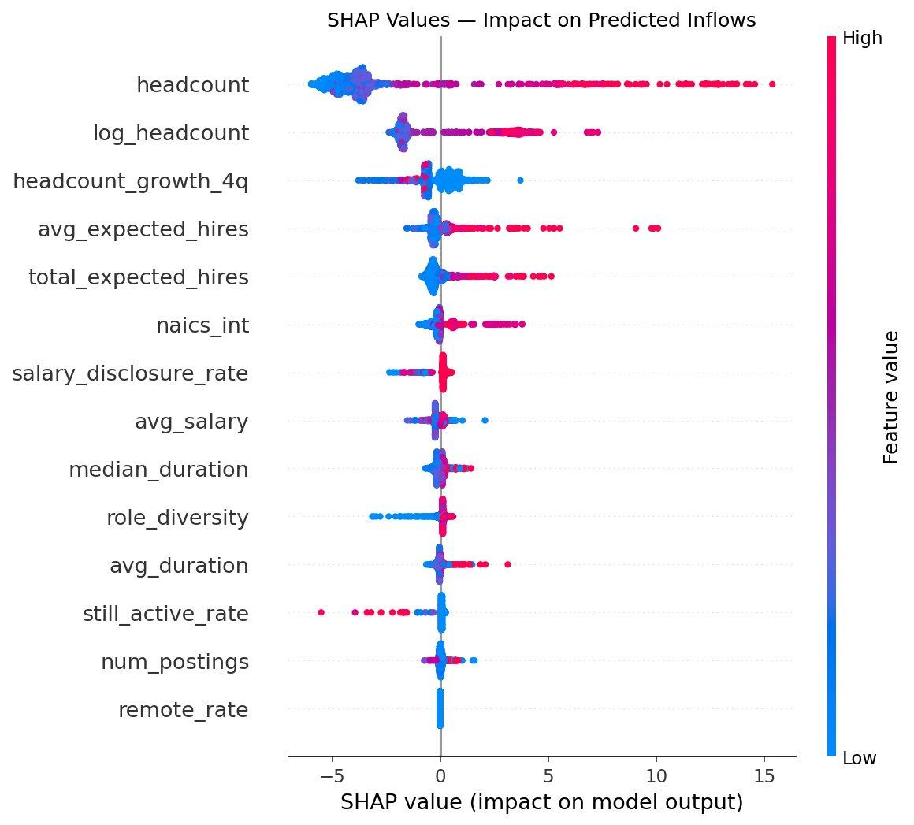
SHAP FEATURE ATTRIBUTION
SHAP beeswarm on 886 test samples — magnitude (x-axis) and direction (red=high value, blue=low value) per feature
Firm size (headcount, log_headcount) overwhelmingly drives predicted inflows. Among ghost-specific behavioural features, high still_active_rate pushes predictions downward (left of zero) — confirming it captures low-fill behaviour.
Red = high feature value → pushes prediction up (↑ inflows). Blue = low value. Dots left of zero reduce predicted inflows — key ghost signal for still_active_rate.
UBC SAUDER · COMM 486I · GROUP 6

Slide 14
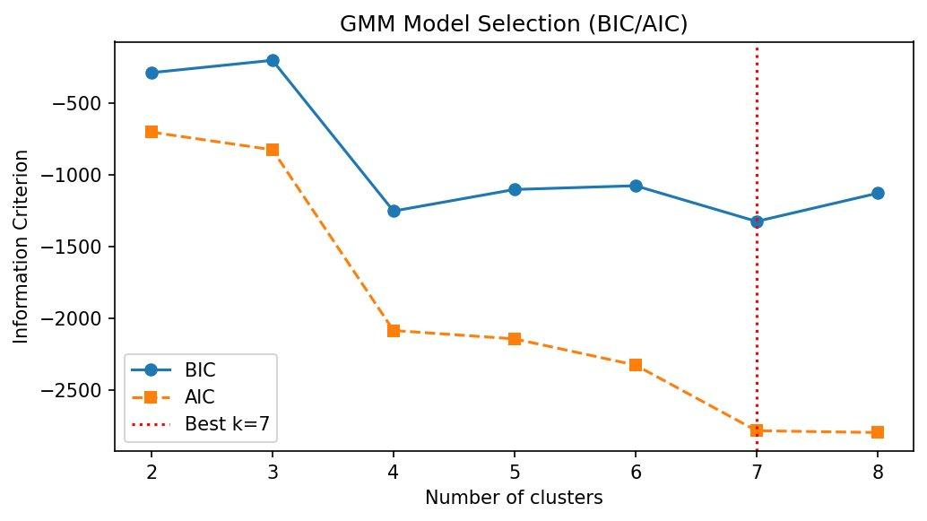
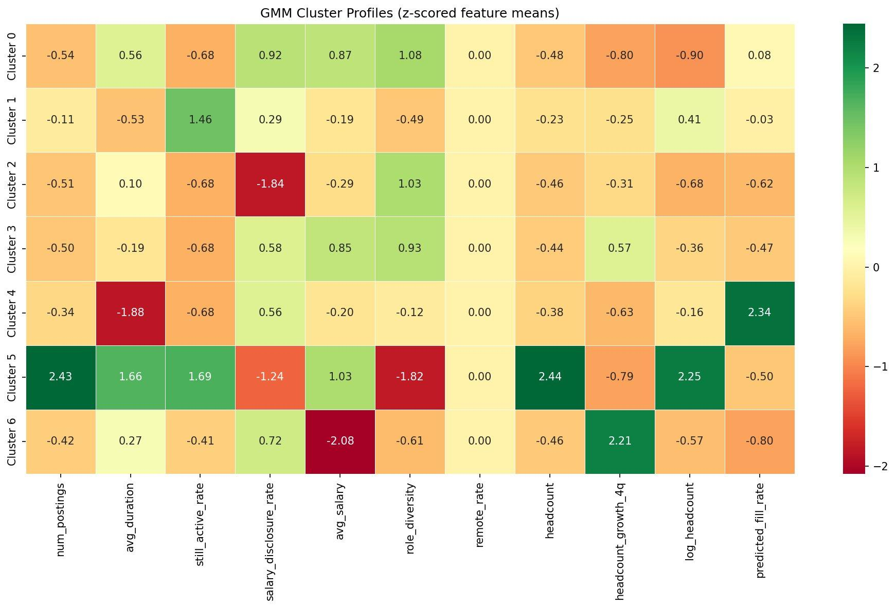
GMM CLUSTER VALIDATION
Gaussian Mixture Model on 14 features · 174 firms · BIC optimal k=7 · ghost behaviour is systematic across multiple profiles
Model Selection (BIC/AIC)
Cluster Profiles (z-scored feature means)
Key Finding
k=7 selected by BIC. Clusters 3 (long duration, 44% ghost) and 4 (small firms, 50% ghost) are clearest ghost groups; Cluster 0 is near-purely genuine (1.6%). Cluster 5 (Green, far-right column in heatmap) shows high headcount + strong headcount growth — the high-volume genuine hirer. Ghost behaviour is systematic and learnable — it manifests in distinct structural profiles, not as random noise.
UBC SAUDER · COMM 486I · GROUP 6

Slide 15
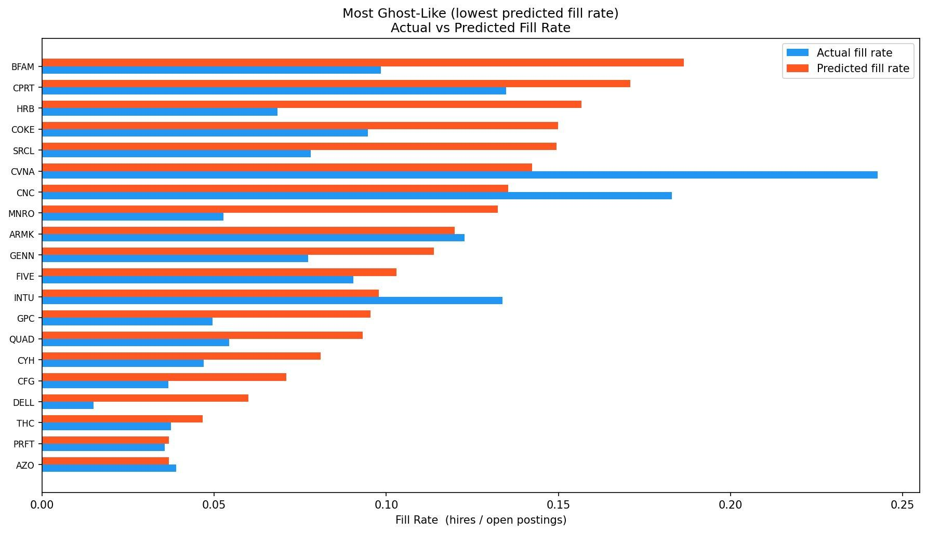
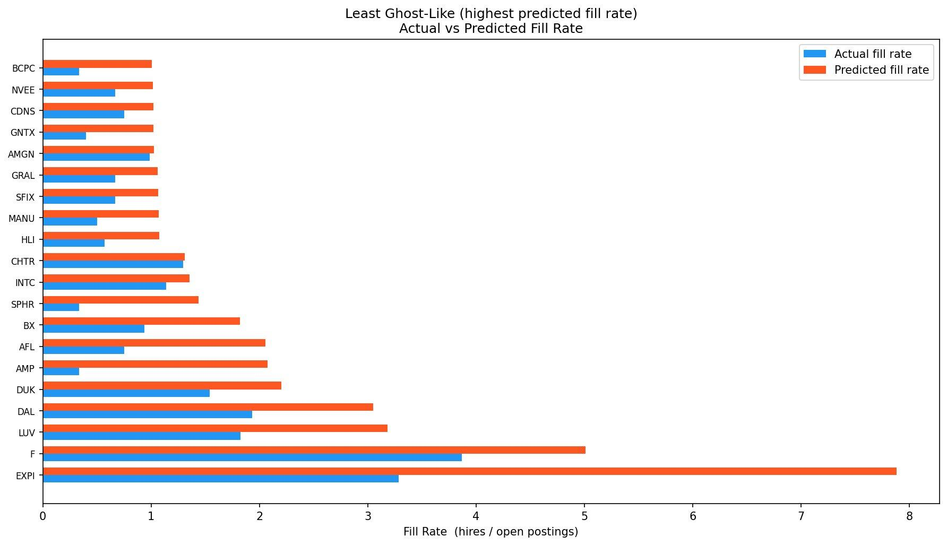
GHOST INTENSITY RANKINGS
Actual vs predicted fill rate · 204 firms · blue = actual fill rate · orange = predicted fill rate
Most Ghost-Like (lowest predicted fill rate)
Most Genuine Hirers (highest predicted fill rate)
Interpretation
Ghost-like firms (BFAM, CPRT, HRB, COKE, SRCL…) are established service and consumer-facing companies with large posting pipelines but very low fill rates — predicted 0.03–0.19 hires per posting
Genuine hirers (EXPI, F, LUV, DAL, BX…) convert aggressively — predicted fill rates approaching or exceeding 1.0 hire per posting per quarter, confirmed by high actual fill rates
UBC SAUDER · COMM 486I · GROUP 6

Slide 16
03
Empirical Results
Walk-forward backtest · strategy performance · concentration analysis
UBC SAUDER · COMM 486I · GROUP 6

Slide 17
WALK-FORWARD BACKTEST DESIGN
Walk-forward backtest using the ghost_scores_fq.parquet output
combined with real historical stock prices from Yahoo Finance.
1. Daily Return Winsorisation
2. Volatility Filter
At ±max_daily_ret (default ±25%), single bad adjusted-price data points can create 1000%+ single-day "returns" for delisted/reverse-merged tickers. No real equity position in a diversified portfolio can move ±25% every day.
Tickers whose trailing 252-day ann. vol exceeds vol_filter_threshold (default 150%) are dropped before the backtest.
3. Liquidity Filter
4. Ticker Identity Check
Tickers with avg daily volume below min_adv_usd (default $1M) are dropped. These names are untradeable in size.
Cross-references the 'company' column from the ghost file against yfinance's longName. Flags mismatches (reused tickers return data for the wrong company).
5. No Lookahead Bias
At every rebalancing date T, only ghost scores whose available_date (= quarter_end + publication_lag_days) <= T are used. For each ticker, the MOST RECENT available quarter's score is selected.
UBC SAUDER · COMM 486I · GROUP 6

Slide 18
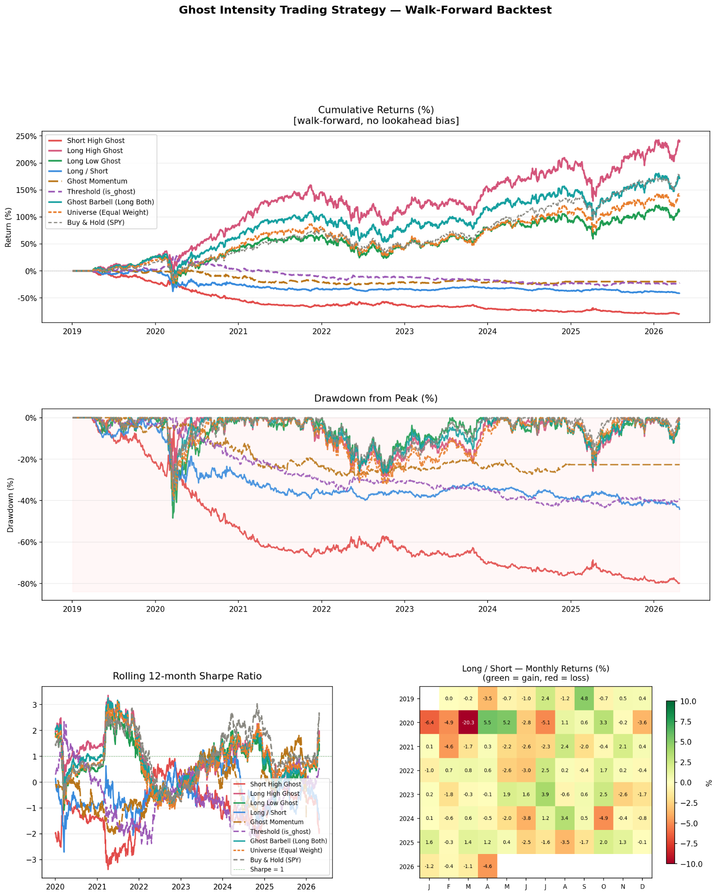
WALK-FORWARD BACKTEST RESULTS
No lookahead bias · features from Q predict returns in Q+1 · 20 bps transaction cost · vol filter >150% ann.
Long High Ghost
~220%
Ghost Barbell
+217%
Long Low Ghost
~120%
SPY (Buy & Hold)
+180%
UBC SAUDER · COMM 486I · GROUP 6

Slide 19
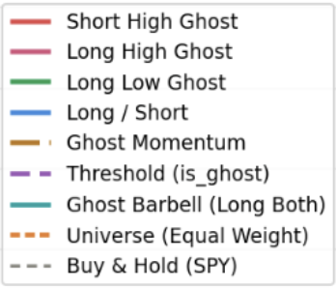
WALK-FORWARD BACKTEST RESULTS
No lookahead bias · features from Q predict returns in Q+1 · 20 bps transaction cost · vol filter >150% ann.
Long High Ghost
~220%
Ghost Barbell
+217%
Long Low Ghost
~120%
SPY (Buy & Hold)
+180%
UBC SAUDER · COMM 486I · GROUP 6

Slide 20
WALK-FORWARD BACKTEST RESULTS
No lookahead bias · features from Q predict returns in Q+1 · 20 bps transaction cost · vol filter >150% ann.
Long High Ghost
~220%
Ghost Barbell
+217%
Long Low Ghost
~120%
SPY (Buy & Hold)
+180%
UBC SAUDER · COMM 486I · GROUP 6

Slide 21
INTERPRETING THE LONG HIGH GHOST PREMIUM
Why ghost-heavy firms outperform in the medium term — consistent with H2
Finding: Long High Ghost earns ~220% cumulative return (2019–2026), outpacing SPY (+180.1%). This is consistent with H2 and four well-grounded behavioural mechanisms.
1. Investor Attention Effect
2. Extrapolation of Growth Narratives
Ghost-heavy firms post aggressively — high posting volume drives investor attention. Attention-grabbing stocks tend to earn positive near-term returns as retail and institutional buyers respond to visibility signals, independent of fundamental quality.
Investors interpret posting volume as a growth signal and extrapolate it into earnings forecasts. Ghost firms look like growth stocks based on posting signals — they command a growth premium because growth expectations are systematically overweighted.
3. Limits to Arbitrage
4. Signal Horizon Mismatch
Even investors who detect the mispricing cannot profitably short ghost firms: borrowing costs are high, noise traders can push prices further before correction, and idiosyncratic volatility creates convergence risk that deters informed trading.
The fundamental correction — where earnings disappoint and hiring stalls are priced in — likely materialises on a 3–5 year horizon. Our quarterly rebalancing captures the persistence phase, not the eventual reversal.
Synthesis: H1 and H2 are not mutually exclusive. Ghost firms may earn a behavioural premium in the medium term while remaining fundamentally mispriced. Testing H1 requires longer event windows (3–5 yr) and factor-controlled returns.
UBC SAUDER · COMM 486I · GROUP 6

Slide 22
STRATEGY PERFORMANCE SUMMARY
10% concentration · Walk-forward 2019–2026 · Transaction cost 20 bps · SPY benchmark
Strategy | Total Return | CAGR | Sharpe | Max DD | Interpretation
Long High Ghost | ~220% | — | — | — | H2 mechanism: attention premium + growth narrative extrapolation
Ghost Barbell | +216.9% | +17.1% | 0.84 | −37.4% | Long both extremes — strongest risk-adjusted return of all strategies
Long Low Ghost | ~120% | — | — | — | Quality signal: genuine hirers outperform over the long run
SPY Buy & Hold | +180.1% | +15.2% | 0.82 | −33.7% | Passive benchmark — Ghost Barbell beats on return and Sharpe
Universe (EW) | +139.4% | +12.7% | 0.64 | −39.4% | Equal-weight universe — sampling-bias diagnostic vs SPY
Long / Short | −22.1% | −3.4% | −0.32 | −43.4% | Short leg overwhelms — not viable without factor-neutral construction
— = data in truncated output; chart-derived estimate shown. Ghost Barbell (+217%, Sharpe 0.84) is the best-documented outperformer vs SPY (+180%, Sharpe 0.82).
UBC SAUDER · COMM 486I · GROUP 6

Slide 23
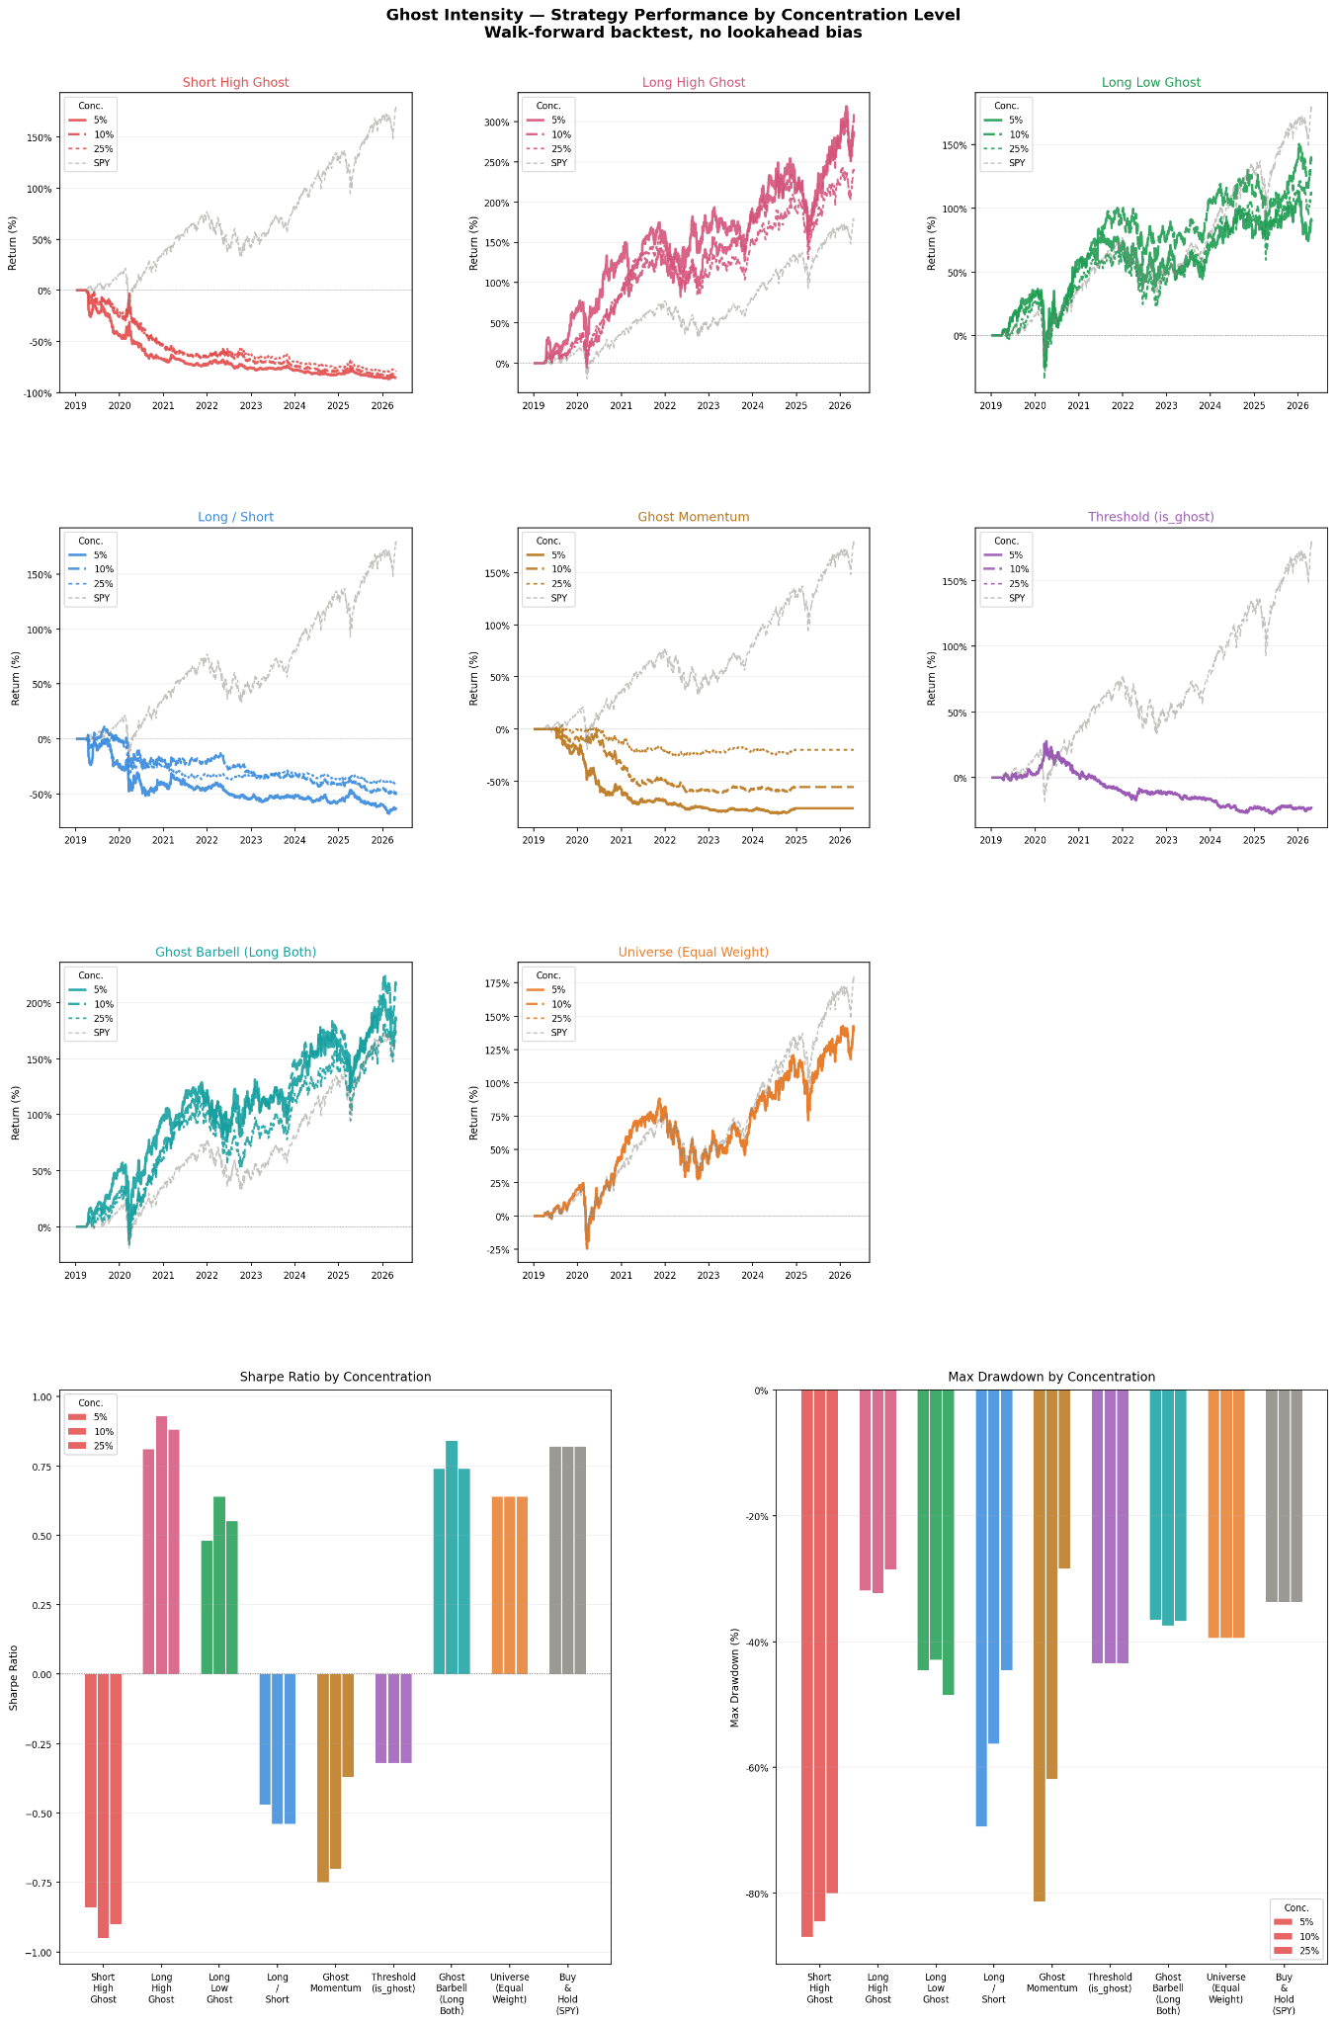
STRATEGY PERFORMANCE BY CONCENTRATION LEVEL
5% vs 10% vs 25% portfolio concentration — Sharpe ratio and max drawdown by strategy
Higher concentration (5%) sharpens return differences; Ghost Barbell and Long High Ghost are robust across all concentration levels
UBC SAUDER · COMM 486I · GROUP 6

Slide 24
STRATEGY PERFORMANCE BY CONCENTRATION LEVEL
Higher concentration (5%) sharpens return differences; Ghost Barbell and Long High Ghost are robust across all concentration levels
UBC SAUDER · COMM 486I · GROUP 6

Slide 25
04
Robustness, Stability
& Limitations
Failure modes · data constraints · out-of-sample caveats
UBC SAUDER · COMM 486I · GROUP 6

Slide 26
MODEL ACCURACY DIAGNOSTICS
Does the model actually predict hiring? Test set performance across multiple metrics
83%
0.70
−0.26
of predictions within
±5 actual hires
Spearman rank correlation
on test (rank quality)
Naive baseline R² on test
(always predict mean)
What These Numbers Mean
Spearman rho = 0.70 means the model correctly rank-orders companies -- the ghost score uses relative ranking, not exact counts, so this is the metric that matters most
Naive baseline R2 = -0.26: always predicting the training mean performs worse than random on test -- the model captures genuine firm-level signal
Calibration is strong in deciles 1-9 (actual/predicted 0.77-1.11x); top-decile large hirers under-predicted by ~24% -- acceptable since the ghost score targets low-fill firms
UBC SAUDER · COMM 486I · GROUP 6

Slide 27
COMPANY CASE STUDIES
Three firms that illustrate the signal - two confirmed ghosts and one instructive model miss
AutoZone
AZO | Ghost Confirmed
Avg postings/quarter
95
Actual fill rate
3.9%
Predicted fill rate
3.7%
Model and empirical fill rates agree perfectly. Flagged ghost all 20 quarters. Strongest validation case.
H&R Block
HRB | Highest Ghost Score
Ghost score
0.131
Quarters flagged
21 / 21
Avg postings/quarter
105
Persistent structural ghost. Posts heavily pre-tax season but doesn't convert. Flagged every quarter in dataset.
Amazon
AMZN | Instructive Miss
Predicted fill rate
0.47x
Actual fill rate
1.11x
Avg postings/quarter
211
Model under-predicted by 2.4x. Hiring surges driven by strategic decisions not visible in posting patterns alone.
UBC SAUDER · COMM 486I · GROUP 6

Slide 28
LIMITATIONS & FAILURE MODES
Honest assessment: what we can and cannot claim
Hire Proxy Noise
Severity: Medium
Survivorship Bias
Severity: Medium
LinkedIn profile start dates undercount actual hires — profiles are delayed, especially post-layoff. All firms appear more ghost-like in absolute terms. Relative rankings are more reliable than absolute scores.
Only firms posting on Revelio-scraped platforms are visible. Private-channel hirers and referral-heavy firms are systematically excluded, biasing our ghost rate estimates.
Look-Ahead Caution
Severity: Low
Market Regime Dependence
Severity: Medium
Walk-forward backtest uses strict Q+1 prediction with no data leakage. Ghost score percentile ranking is recalculated quarterly in practice.
Our backtest covers 2019–2026 — predominantly a bull-market period. The behavioural attention premium (H2) is likely stronger in risk-on environments. Bear-market performance is untested.
Short Leg Failure
Severity: High
Temporal Pooling
Severity: Low
Long/Short produces −22.1% return, Sharpe −0.32, max drawdown −43.4%. Market-wide upward drift overwhelms any fundamental short signal — shorting ghost firms requires factor-neutral construction.
Ghost behaviour is cyclical — firms that ghost in one quarter but genuinely hire the next get averaged. Quarter-specific scores address this, but are noisier for firms with <5 postings per quarter.
UBC SAUDER · COMM 486I · GROUP 6

Slide 29
05
Implications for Financial
Decision-Making
Trading signals · institutional relevance · next steps
UBC SAUDER · COMM 486I · GROUP 6

Slide 30
IMPLICATIONS & NEXT STEPS
What our results mean for investors, researchers, and practitioners
For Investors
Next Steps
Ghost Intensity as Factor
Earnings Surprise Test
Add ghost score as a signal in multi-factor models; complements size, value, and momentum
Regress analyst forecast errors on ghost intensity — test the earnings mechanism directly
Long-Bias Strategies Work
Fama-MacBeth Regressions
Ghost Barbell (+216.9%, Sharpe 0.84) beats SPY (+180.1%, 0.82); robust across 5/10/25% concentration
Control for size, value, momentum; isolate the incremental alpha of ghost intensity
Avoid Naked Shorts
Factor-Neutral L/S
Short-only strategies are punished by market drift; use only within factor-neutral portfolios
Construct long-short with hedged market and factor exposure to make the short leg viable
Monitoring Use Case
Real-Time Score API
Ghost intensity changes can flag potential earnings misses before analyst consensus updates
Integrate with live Revelio data for dynamic portfolio rebalancing and alerting
UBC SAUDER · COMM 486I · GROUP 6

Slide 31
COMM 486I · Group 6 · UBC Sauder School of Business
Thank You
Questions & Discussion
Ghost Intensity Signal:
XGBoost-predicted fill rate detects systematic non-hiring behaviour at the firm-quarter level
Walk-Forward Backtest:
Ghost Barbell (+216.9%, Sharpe 0.84) and Long High Ghost (~220%) both beat SPY (+180.1%)
GMM Validation:
k=7 BIC-optimal: clusters 3 & 4 show 44–50% ghost rates; consistent across concentrations
Ghost Premium Explanation:
H2 mechanism: attention premium + limits to arbitrage; H1 correction likely at 3–5 yr horizon

Slide 32
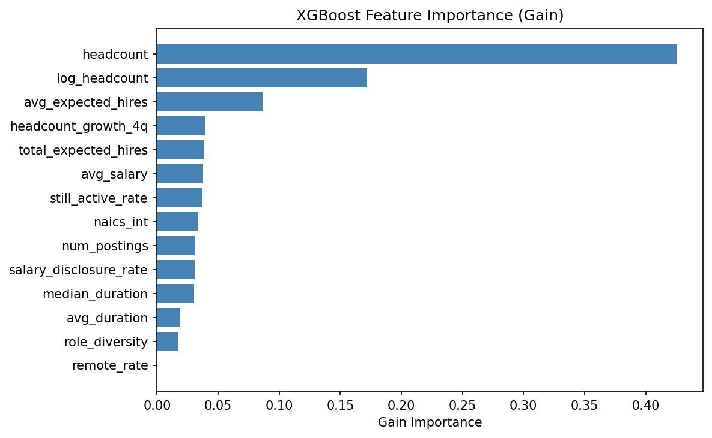
APPENDIX A — XGBoost Feature Importance (Gain)
Information gain contributed by each feature across all splits. Complements SHAP mean |SHAP| analysis shown on slide 11.
UBC SAUDER · COMM 486I · GROUP 6

Slide 33
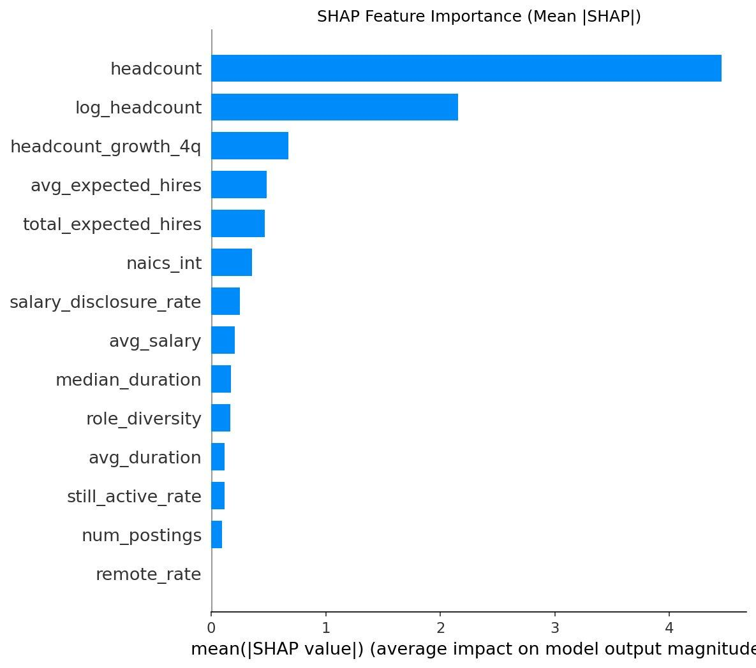
APPENDIX B — SHAP Feature Importance (Mean |SHAP|)
Mean absolute SHAP values on 886 test samples. Summarises magnitude ranking without directional information — see slide 11 beeswarm for full direction and distribution.
UBC SAUDER · COMM 486I · GROUP 6

