Slide 1
Quiz – Gissa talet
Scrum arbete av – Nicklas, Jonas, Lisa, Yohan, Marie, Olof

Slide 2
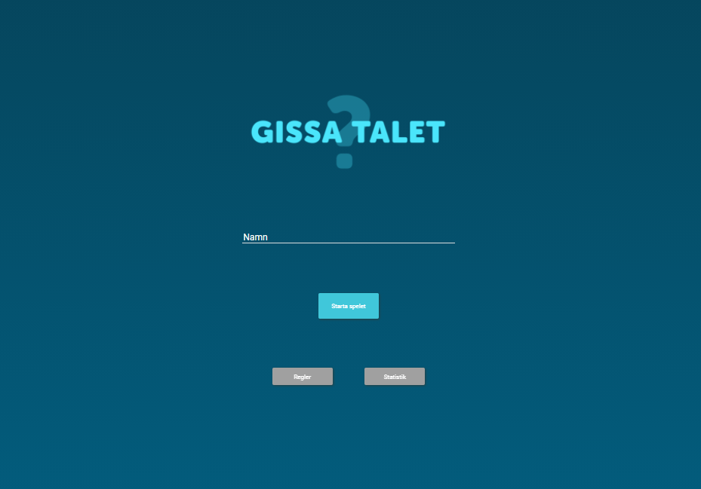
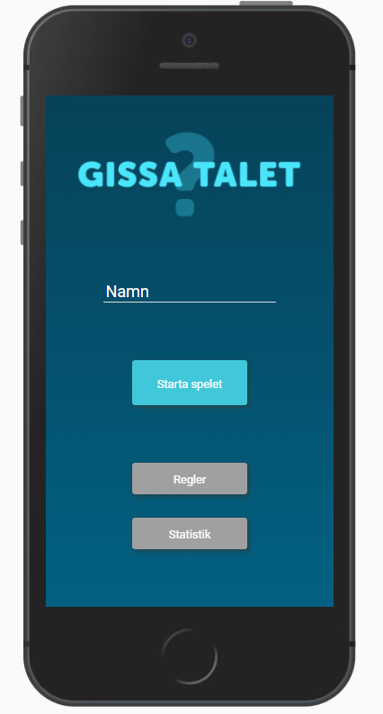
Gissa talet https://nicklas-holmqvist.github.io/scrum-quiz/index.html

Slide 3
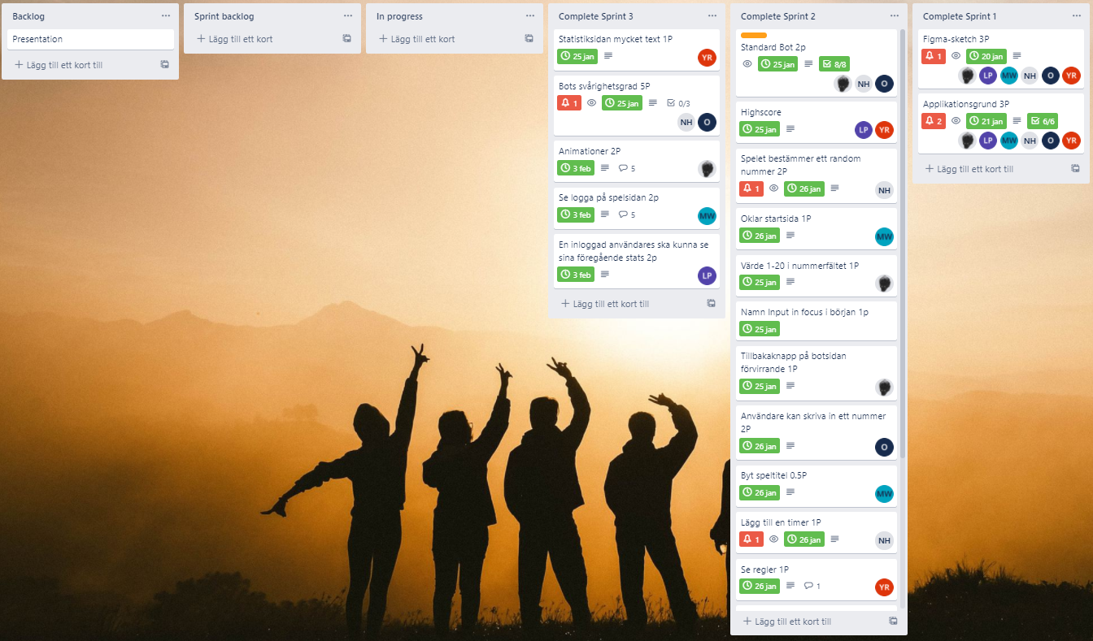
Trelloboard https://trello.com/b/J0bT5ZYt/quiz

Slide 4

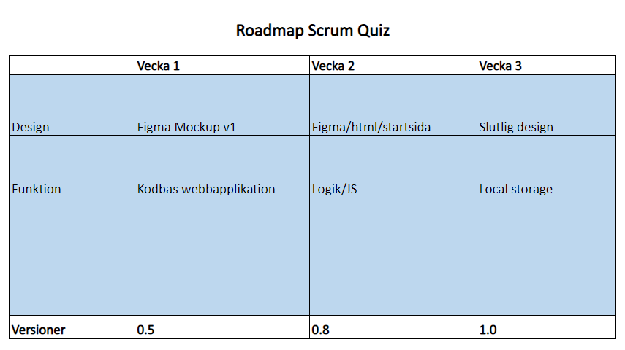
Färdplan

Slide 5
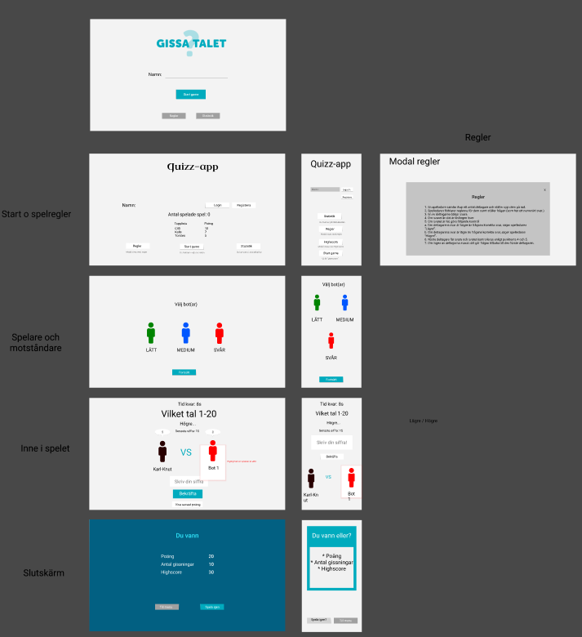
Figma design

Slide 6
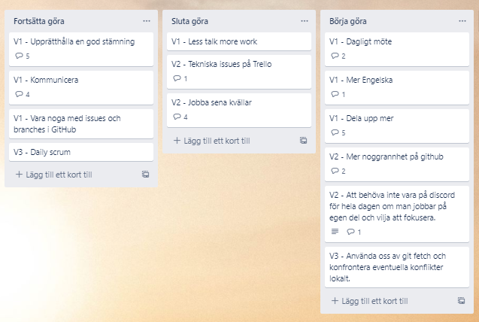
Insiktslogg

Slide 7
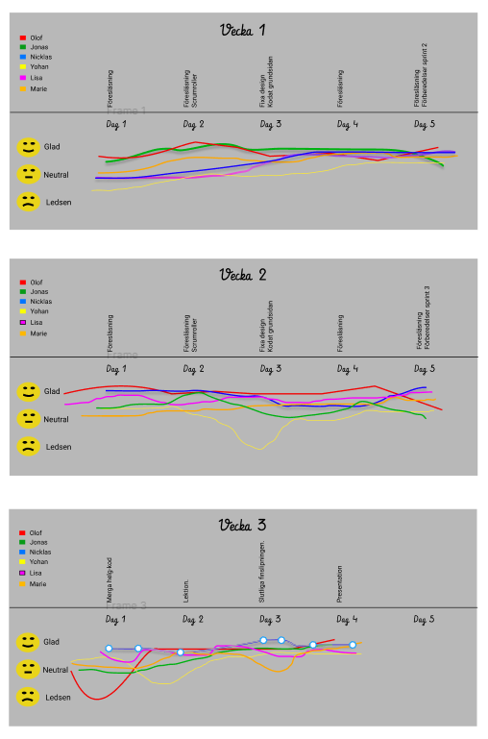
Moodboard

Slide 8
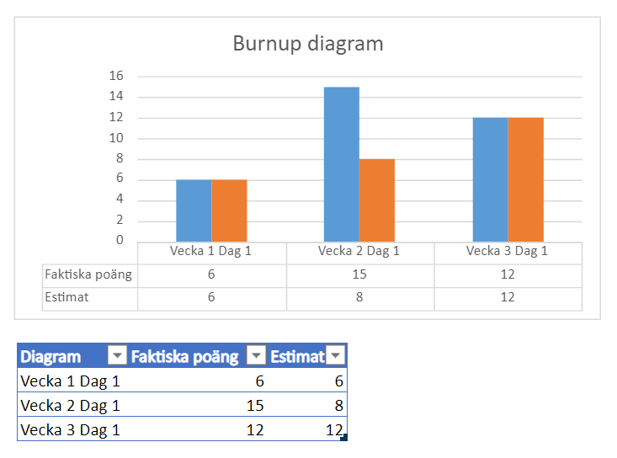
Burnup Diagram

Slide 9
Demo
https://nicklas-holmqvist.github.io/scrum-quiz/index.html

