Slide 1
Finite Element modeling in Solidworks: Introduction
OPTI 421/521 DL
Lecturer : James Burge (jburge@optics.arizona.edu)
TA : Won Hyun Park
(whpark@optics.arizona.edu)

Slide 2
FEA Theory Review
Finite element method – approximates the physics
Subdivide a large problem into small elements connected by nodes
Assume a simple polynomial behavior in each element
Write equilibrium at nodes → matrix equations →solve
for nodal values (displacements)
In general odd geometries are easily handled
Simple models have many advantages
  Easy to develop and easy to change
  Fast solution time
  Easy to optimize or perform “What If” studies
Complex models are time consuming to develop
  Require precise modeling and care
  Difficult to change
  May require long run times
From Prof. Robert Stone’s note

Slide 3
FEA Theory Review
Capability
  Linear Static (small displacement, linear materials)
  Nonlinear (large displacement, nonlinear material properties)
  Linear or nonlinear Dynamics
  Frequency analysis
  Random vibration analysis
  Buckling
  Thermal and heat transfer
  Fluid mechanics
  Electromagnetics
  Optimization
Limitation
  Accurately modeling of load and boundary conditions is very difficult
  Complex joints are difficult
  Any form of member pre-tensioning requires a work around
  Symmetric problem with a mesh that lacks symmetry will produce asymmetric results
From Prof. Robert Stone’s note

Slide 4
Fundamental steps in FEA
General steps in FEA software
  Preprocessing of the FEA model
  Solution for computing wanted results
  Post-processing for results
Specific steps in Solidworks Simulation
  Generate 3D solid model or building the mathematical model
  Building the finite element model
    Apply material properties (E, G, density, Poisson’s ratio, ….)
    Apply boundary conditions (Load, pressure, fixtures ….)
    Meshing (Tetra10 or Tetra4)
  Solving the finite element model
  Analyze the results
From Prof. Robert Stone’s note

Slide 5
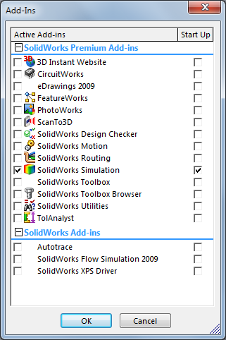
Solidworks Simulation
Share Solidworks platform and interface.
Check Solidworks simulation Add-in out.

Slide 6
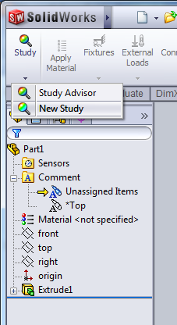
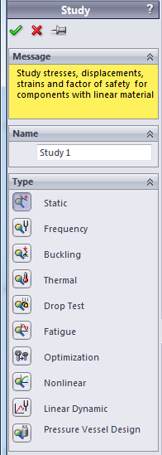
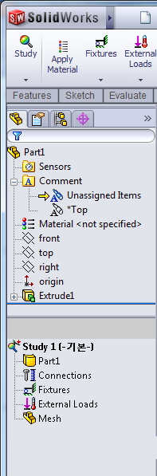
Solidworks Simulation
Open new study
Simulation options

Slide 7
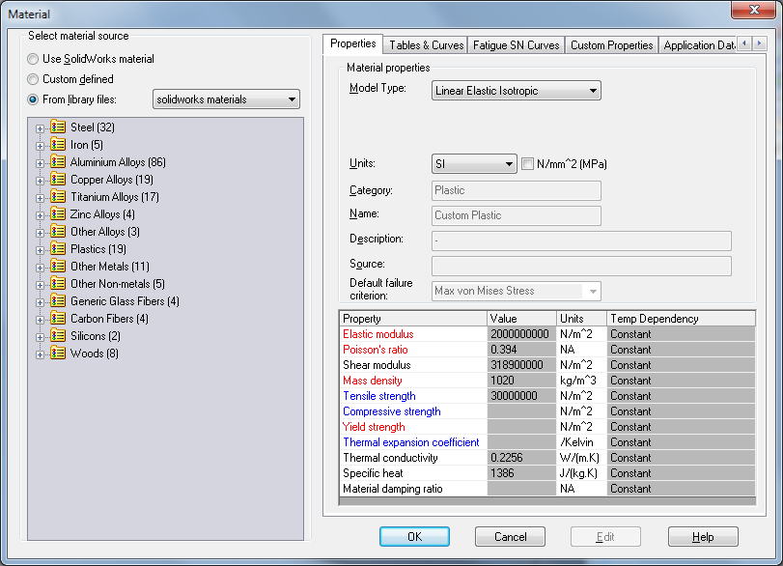
Solidworks Simulation
Apply material properties

Slide 8
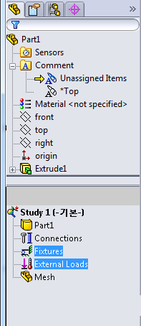
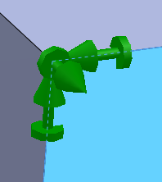
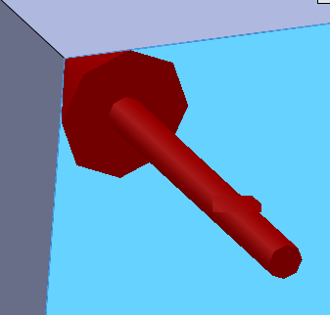
Solidworks Simulation
Apply boundary conditions
Fixtures:
Arrows and disks represent
6 Degree of freedom
External loads:
Pressures and Forces,
Arrows represent direction

Slide 9
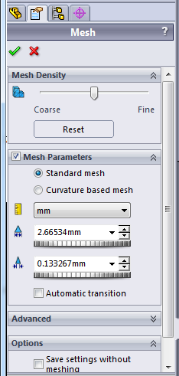
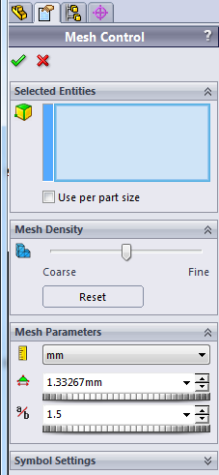
Solidworks Simulation
Meshing
Mesh control

Slide 10
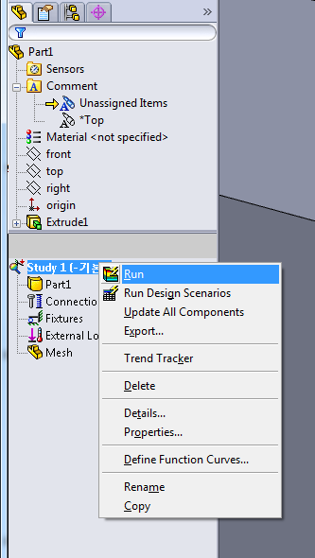
Solidworks Simulation
Run analysis

Slide 11
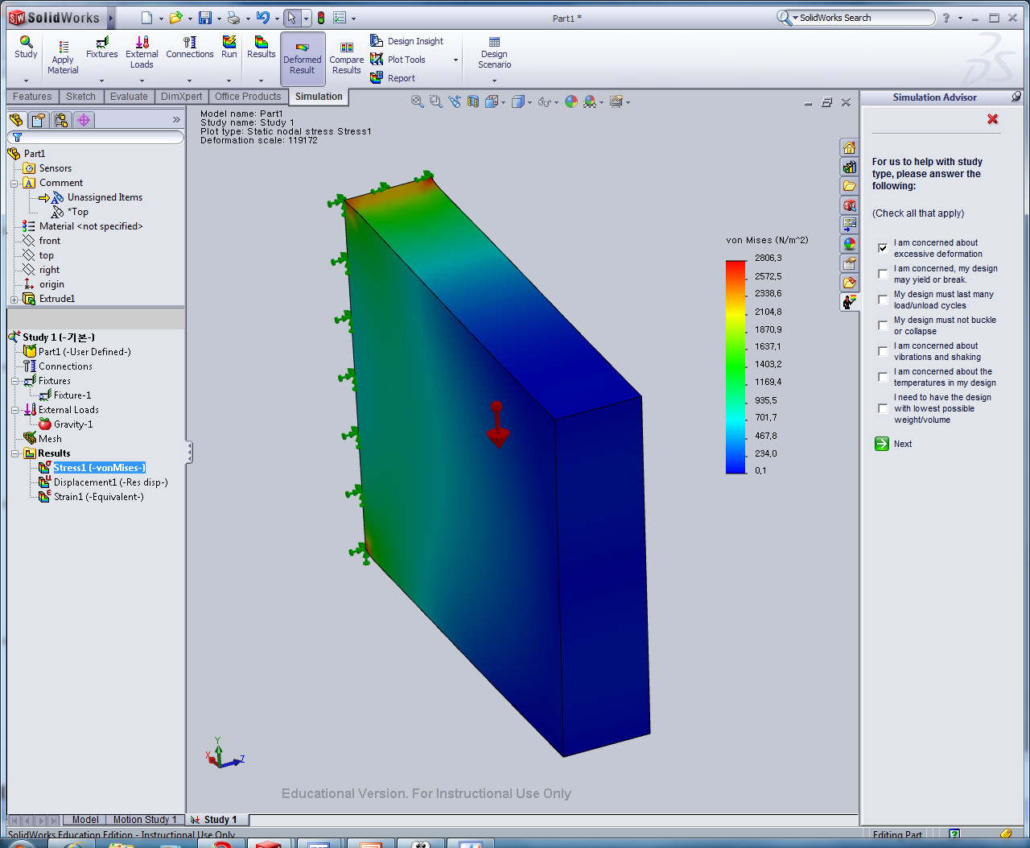
Solidworks Simulation
Analyze the results

Slide 12
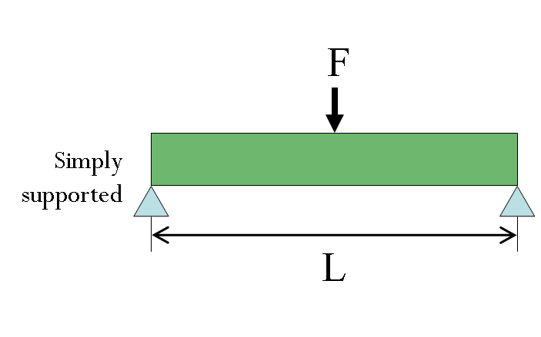
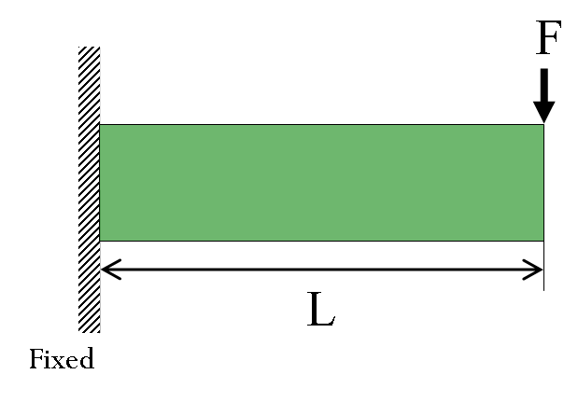
Examples I
An aluminum cantilever beam, 10 cm long
1 cm x 1 cm cross section
an applied force of 10 N

Slide 13
Examples II
Homework 8- 2c
30”
A
(1)
B
D
y
(2)
15”
F
x
C

