Slide 1
Opto-Mechanics of Lasercom
Windows
OPTI521
Tim Williams
Dec. 12, 2006

Slide 2
Outline
Motivation
Introduction
Strawman Window
Loss Analysis
Summary

Slide 3
Why Windows?
Protection – from Dust, Rain, Bugs, etc.
Isolation – from Temp & Press change, Air Turbulence
Filter (base) – pass signal, block background

Slide 4
Window Environments
Thermal gradients
Pressure differentials
Acceleration
Vibration
Structure induced stress
Radiation

Slide 5
Window Environments (cont.)
Impact
Improper cleaning procedures
Chemical attack
Abrasive attack

Slide 6
Good Practises
Cover window except during use
Insure coating is as durable as window
Employ proper cleaning procedures
Replaceable windows for hostile environments

Slide 7
LaserCom Windows
LaserCom is usually power limited.
Any loss of power makes link less robust or decreases data rate.
Low loss is the goal for LaserCom windows.

Slide 8
LaserCom Windows
Smaller is better.
Less deflection, less stress, less cost.

Slide 9
Strawman Window
Assume Standard BK7 glass & λ=1550nm
Minimum size = Aperture + FOR
  Assume 10” (.25 m) diameter is required
Minimum thickness = just strong enough
  For simply supported, with safety factor of 4,
  thk = 1.06*Dia* Pressure/σ_{ys} ^{½ (Vuk. Pg 173)}
  For Strawman @ 1 atm, thk ~ 1.00”

Slide 10
Loss Analysis
Intrinsic Losses
Polishing Losses
Environmental Losses

Slide 11
Absorption Loss
Strawman (BK7, 1.0” thick)
  Transmittance @1529 nm = 0.985 (-0.07 dB) (Schott)
For other thicknesses: T2 = T1^^{(d2/d1)} (Schott)

Slide 12
Reflection Loss
R = ((n₂-n₁)/(n₂+n₁))^2 (Schott)
Strawman, 2 surfaces
  R ~ 0.08 (-0.36 dB)
Anti-reflection coating required…
  R ~ 0.005 (-.02 dB)

Slide 13
Index inhomogeneity
∆W_{PV} = 2* ∆n* t/λ (Schott)
Strawman, H1 Grade, ∆W_{rms}~0.16 (-4.4 dB)
Higher grade BK7 required…
Strawman, H4 Grade, ∆W_{rms}~0.008 (-.01 dB)

Slide 14
Birefringence (Polarization dependent systems only)
Retardance = Birefringence* thk/λ (Class notes)
Strawman,
  ∆Deg ~ 5.8º (-.02 dB)

Slide 15
Stress Birefringence (P.D. systems only)
∆W_{PV} = k* t* σ (Schott)
BK7, k = 1.94 e-8/psi,
  Strawman,
    retardance~0.11º/psi (-.00008 dB/psi)
  BK7 tensile strength ~ 1000 psi > retardance is negligible.

Slide 16
Surface Flatness
∆W_{PV} = (n-1)* ∆S/λ (class notes)
For 0.1 wave PV surface,
  ∆W_{rms} ~0.0125
  2 surfaces, ∆W_{rms} ~0.0177

Slide 17
Surface Finish
Loss = [(n-1)* ∆S*2π/λ]^^{2 (class notes)}
For 20 angstrom rms surface finish,
  Loss = .0016%

Slide 18
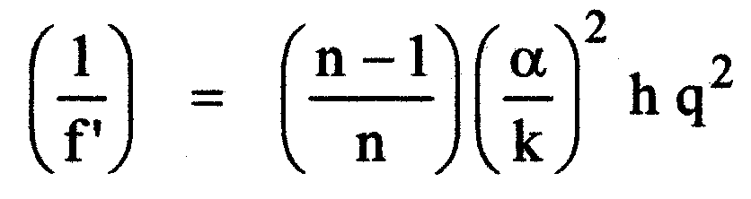
Axial Temperature
Lens power due to axial heat flux
        Vukabratovich, pg 165
For Strawman, ∆1ºC
  WFE (rms wv) ~ 0.000075

Slide 19
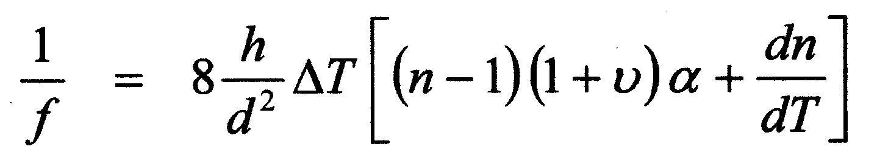
Radial Temperature
Lens power due to radial heat flux
        Vukabratovich, pg 167
For Strawman, ∆1ºC
  WFE (rms wv) ~ 0.030

Slide 20
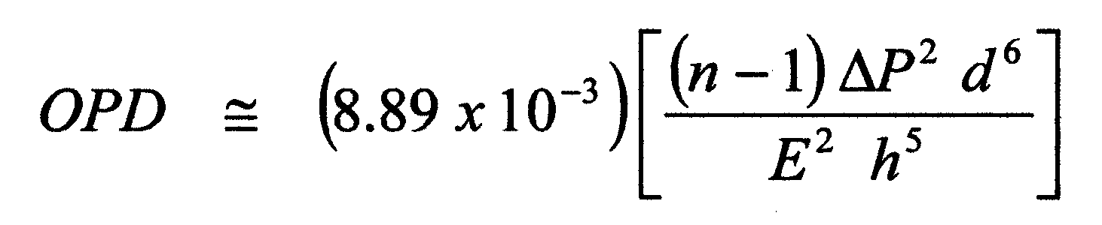
Pressure Differential
OPD due to pressure differential
        Vukabratovich, pg 168
For Strawman, 1 atm
  OPD rms wv = 0.0000087

Slide 21
Aerodynamic Pressure
OPD due to ∆P~0.7P_{fs}Mach²
Vukabratovich, pg 169
For Strawman, P_{fs}1 atm, M=0.75
  OPD rms wv = 0.00000054

Slide 22
Acceleration
OPD due to ∆P~G’s*thick*density
        Vukabratovich, pg 169
For Strawman, 1G
  OPD rms wv = 1.3e-10

Slide 23
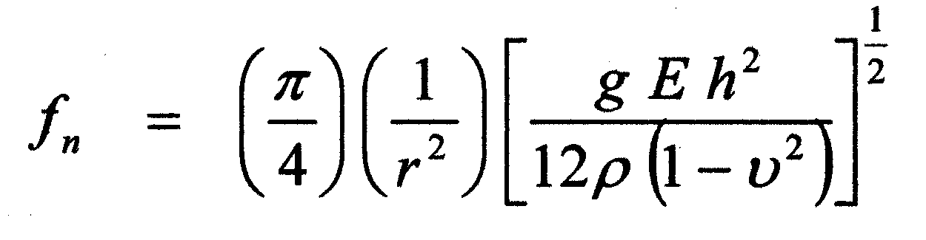
Vibration
For simply supported circular window
        Vukabratovich, pg 177
Strawman f_{n} ~ 227 Hz

Slide 24
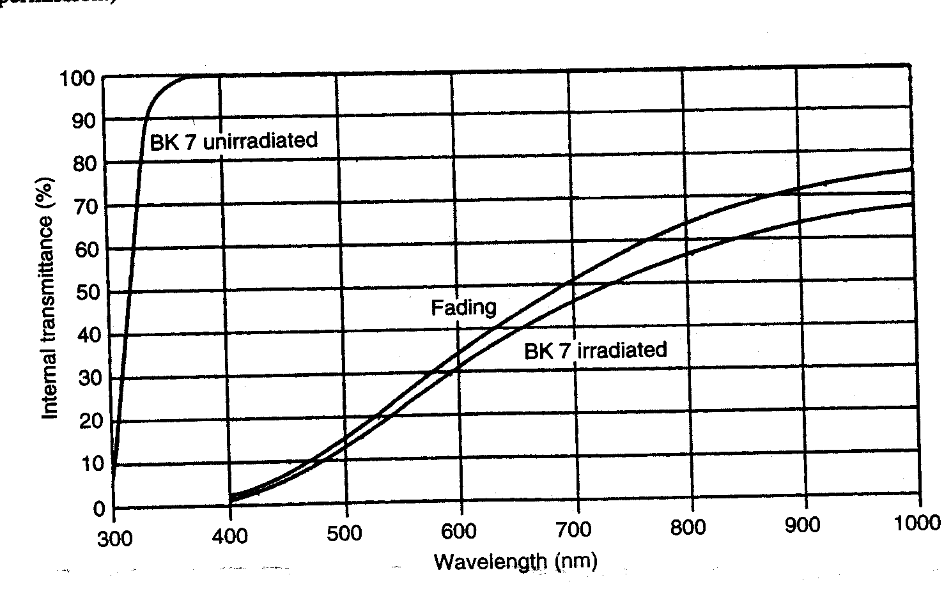
Radiation
Radiation can cause significant darkening of glass…
        Yoder pg 90
Radiation grade BK7 available
  For Example, BK7G18, BK7G25 (Cerium Oxide added)
  Mechanical properties virtually unchanged

Slide 25
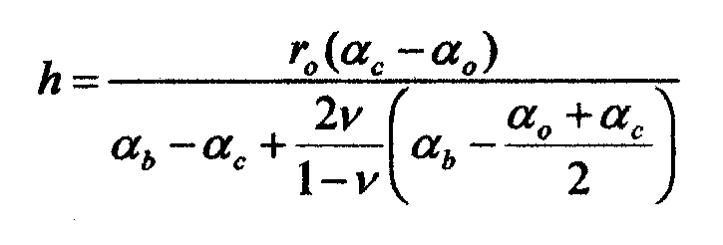
Athermal Mount Design
Thermally induced stresses can be minimized by athermal design of mount.
Bond thickness given by Van Bezooijen:
        Monti, Eq. 11 & 13
Strawman bond (RTV566, Alum.) h~0.180”

Slide 26
Summary
 |  | 0.25" thk | Strawman
*Loss | Basis | Loss (dB) | Loss (dB)
Absorption | BK7 | 0.017 | 0.070
Reflection (coated) | 0.005 | 0.020 | 0.020
Index inhomogeneity | H4 grade | 0.001 | 0.011
Birefringence | 10 nm/cm | 0.001 | 0.022
Stress Birefringence | 1.94e-8/psi | 0 | 0
Flatness (0.1 wv) | 0.1 wv | 0.050 | 0.050
Finish | 10 ang | 0 | 0
Axial Thermal gradient | 1C | 0 | 0
Radial Thermal gradient | 1C | 0.008 | 0.154
Pressure differential | **1 atm | 0 | 0
Dynamic Press. Diff. | **1 atm | 0 | 0
Acceleration | 1 G | 0 | 0
Net Loss (dB) |  | 0.09 | 0.27
Vibration | Fn (Hz) | 57 | 227
Athermal bond thickness | RTV566/Alum | 0.180" | 0.180"
*Assumes Diffraction limited system at 0.072 wv rms | ** 1.00" thk only

Slide 27
Summary
Low loss windows for LaserCom are achievable given a proper application of opto-mechanical principles.
Understanding of Thermal and Pressure environments is essential for correct window design.

Slide 28
References
Vukabratovich, D., Introduction to Opto-Mechanical Design, 2006.
Yoder, P., Opto-Mechanical Systems Design, CRC, 2006.
Class Notes, OPTI521, Introductory Opto-Mechanical Engineering, UA, Prof. Jim Burge, 2006.
Schott Glass Catalog, http://www.us.schott.com/optics_devices/english/download/.
Athermal Bonded Mounts, Monti, C., Tutorial for OPTI521, 2006.

