Slide 1

Angular School
Lesson 2. Components.

Slide 2


Agenda:
Components overview.
Components configuration.
Templates and bindings.
Components interaction.
Components lifecycle.
Advanced interaction.

Slide 3

COMPONENT
Declare reusable UI building blocks for an application
The @component annotation specifies when a component is instantiated and which properties and listeners it binds to

Slide 4
COMPONENT’S DEFINITION
An Angular application is a tree of components
A component controls a patch of screen real estate that we call a view
We define a component’s application logic inside class. The class interacts with the view through an API of properties and methods

Slide 5
COMPONENT === DIRECTIVE
There are three kinds of directives in Angular:
Components
Structural directives
Attribute directives

Slide 6
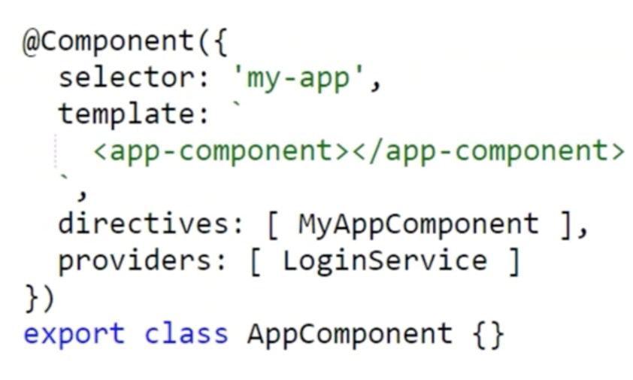
COMPONENT CONFIGURATION
selector
templateUrl
directives
providers

Slide 7
TEMPLATE
Template is a form of HTML that tells Angular how to render the component
Interpolation {{ }}
Property binding [ ]
Event binding ( )
Two-way data binding [( )]

Slide 8
TEMPLATE EXPRESSIONS
JavaScript expressions that have or promote side effects are prohibited,
including Assignments (=, +=, -=, …)
new
chaining expressions with ; or ,
Increment and decrement operators (++ and --)
No support for bitwise operators | and &

Slide 9
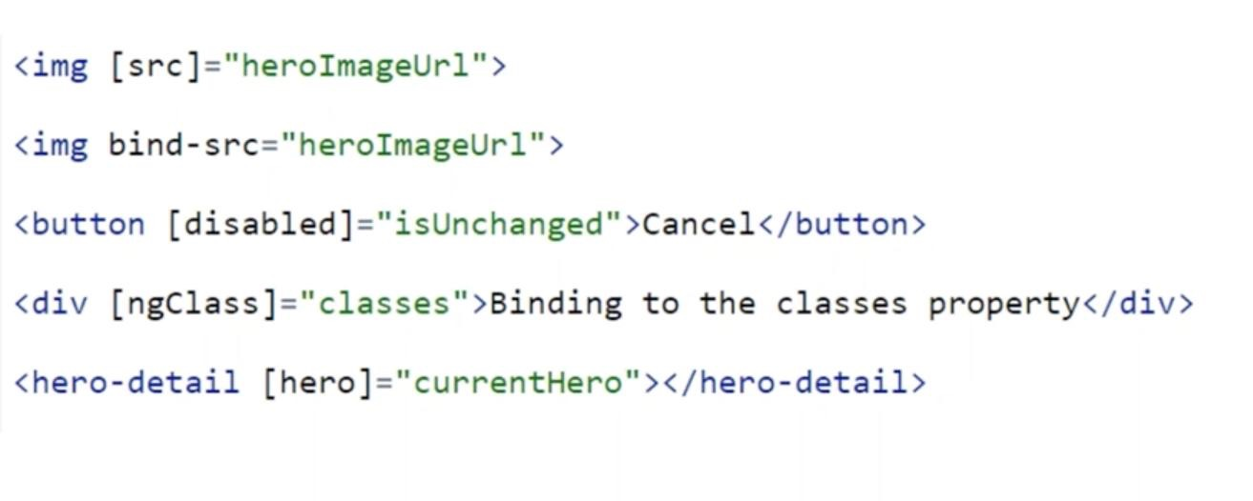
PROPERTY BINDING

Slide 10
ONE-TIME STRING INITIALISATION
We should omit brackets when all of the following are true:
The target property accepts a string value.
The string is a fixed value that we can bake into the template
This initial value never changes.

Slide 11
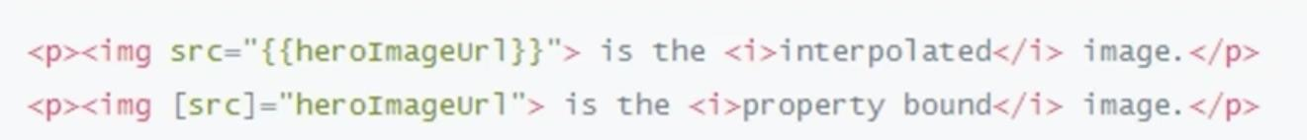
PROPERTY BINDING OR INTERPOLATION
There is no technical reason to prefer one form to the other.

Slide 12
ATTRIBUTE BINDING
We can set the value of an attribute directly with an attribute binding
We must use attribute binding when there is no element property to bind

Slide 13
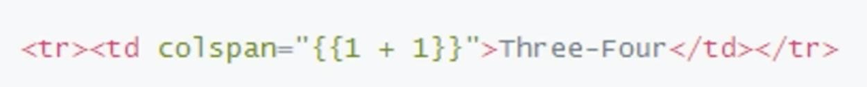
ATTRIBUTE BINDING
Raise an error
Correct

Slide 14
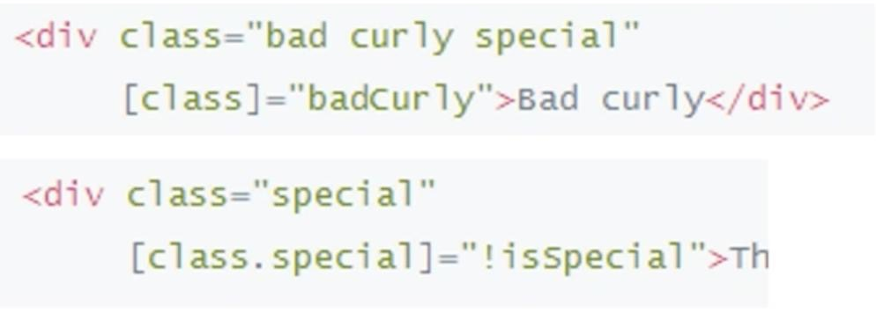
CLASS BINDING
We can add and remove CSS class names from an element’s class attribute with class binding

Slide 15
STYLE BINDING
We can set inline styles with a style binding.

Slide 16
COMPONENT STYLES
We may define not only an HTML template, but also the CSS styles that go with that template:
Inline in template HTML
By setting styles or styleUrls metadata
With CSS imports

Slide 17
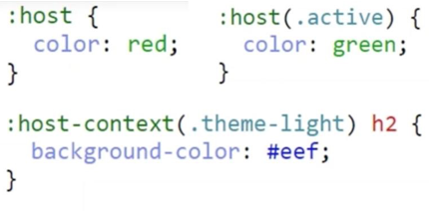
SPECIAL SELECTORS
:host
:host-context

Slide 18
TEMPLATE REFERENCE VARIABLES
A template reference variable is a reference to a DOM element or directive within a template
It can be used with native DOM elements but also with Angular 2 components – in fact, it will work with any custom web component

Slide 19
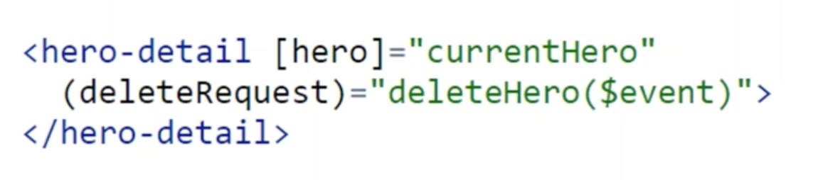
@INPUT AND @OUTPUT
Input properties usually receive data values. Output properties expose event producers, such as EventEmitter objects.

Slide 20
COMPONENT LIFECYCLE
Component has a lifecycle managed by Angular itself.
Angular offers component lifecycle hooks that give us visibility into component’s key moments and the ability to act when they occur.
Developers can tap into key moments in that lifecycle by implementing Lifecycle Hook interfaces.

Slide 21
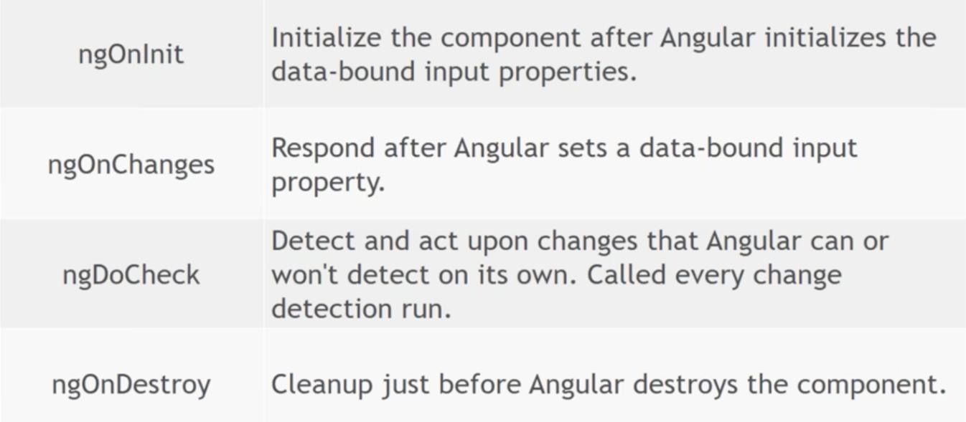
LIFECYCLE: DIRECTIVES AND COMPONENTS

Slide 22
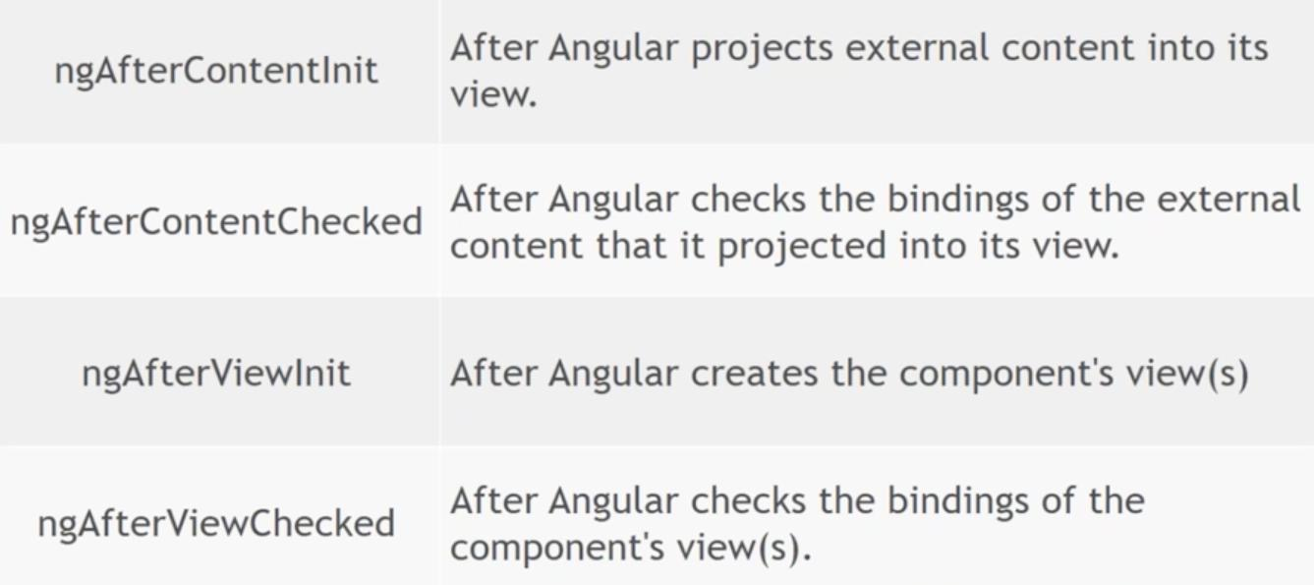
LIFECYCLE: COMPONENTS ONLY

Slide 23
NGONINIT
To perform complex initialisations shortly after construction
To set up the component after Angular sets the input properties.

Slide 24
ONDESTROY
This is replace to free resources that won’t be garbage collected automatically
Unsubscribe from observables and DOM events
Stop interval timers
Unregister all callbacks that this directive registered with global application service

Slide 25
ONCHANGES
Detects changes to input properties of the component (or derictive)
Angular only calls the hook when the value of the input property changes

Slide 26
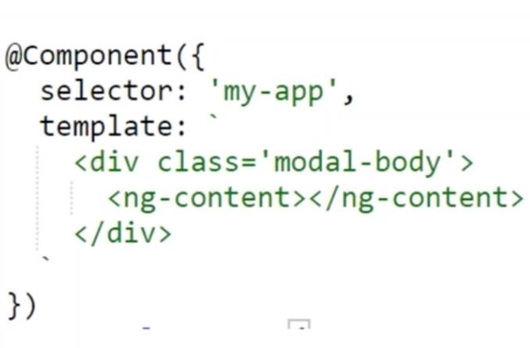
PROJECTION
<ng-component>
Supports single-slot and
multi slot content projection

Slide 27
VIEW CHILDREN AND CONTENT CHILDREN
View children – The children element which are located inside of its template of a component
Content children – elements which are used between the opening and closing tags of the host element of a given component

Slide 28
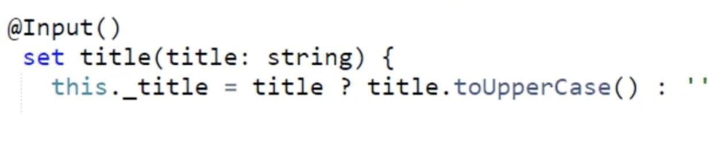
COMPONENT INTERACTION: FROM PARENT TO CHILD
Pass data from parent to child with input binding
Intercept input property changes with setter
Intercept input property changes with ngOnChanges

Slide 29
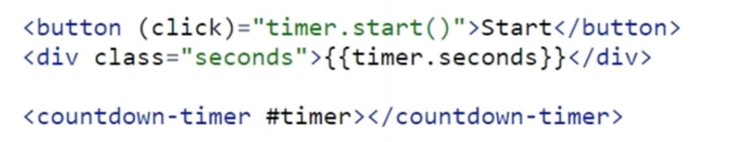
COMPONENT INTERACTION: FROM CHILD TO PARENT
Parent listens for child event
Parent calls a ViewChild
Parent interacts with child via local variable
Parent and children communicate via a service

Slide 30

Destructing
TypeScript Supports following type of destructing:
Object destructing
Array destructing
Module destructing

Slide 31
Thanks for watching

