Slide 1

Angular School
Lesson 3. Pipes & Directives

Slide 2


Agenda:
What are pipes on Angular 4.
Use of Pipes.
Build-in Pipes
Custom pipes
Pure and Impure pipes.
Directives.
Bult-in directives.
Custom directives

Slide 3
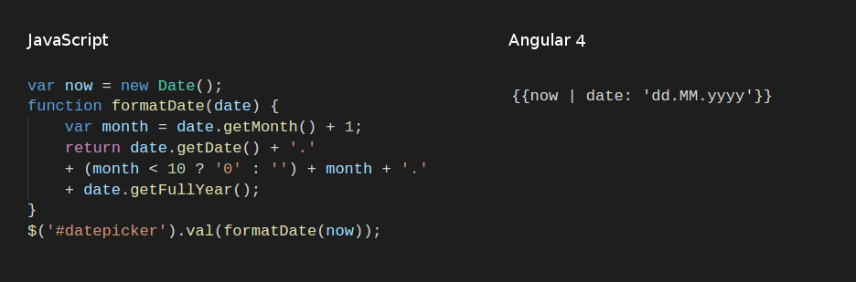
WHAT ARE PIPES ON ANGULAR
Pipes allow us to change data inside of a template

Slide 4
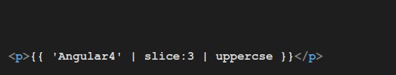
USING PIPES
General syntax(template)
Chaining Pipes
Angular4
ular4
ULAR4

Slide 5
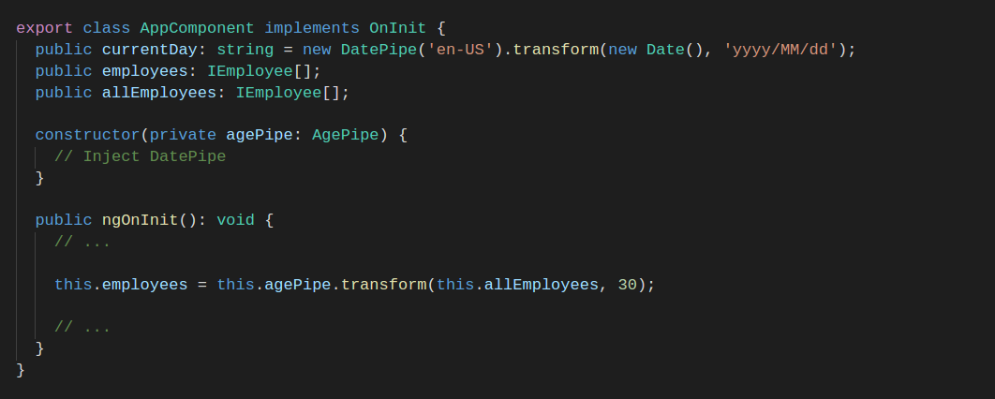
USING PIPES
Using in code

Slide 6
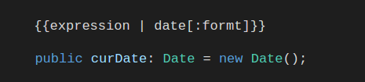
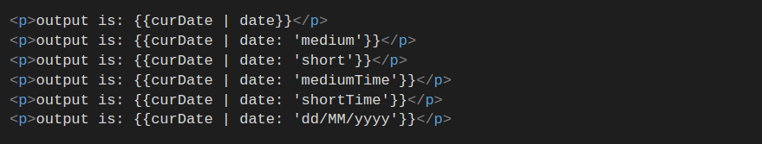
BUILT-IN PIPES
Date Pipe:
Sep 14, 2017
Sep 14, 2017, 4:43:54
9/14/2017, 4:43 PM
4:43:54 PM
4:43 PM
14/09/2017

Slide 7
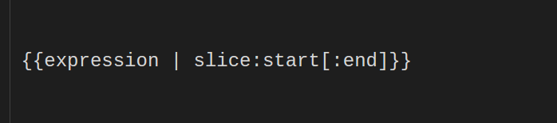
BUILT-IN PIPES
Slice Pipe:

Slide 8
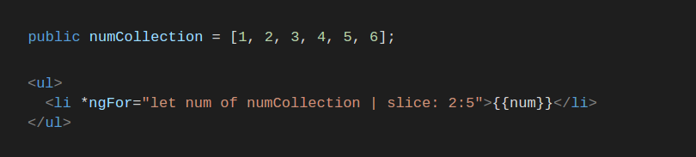
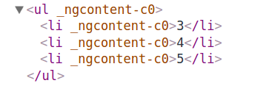
BUILT-IN PIPES

Slide 9


BUILT-IN PIPES
Uppercase Pipe:
Lowercase Pipe:

Slide 10
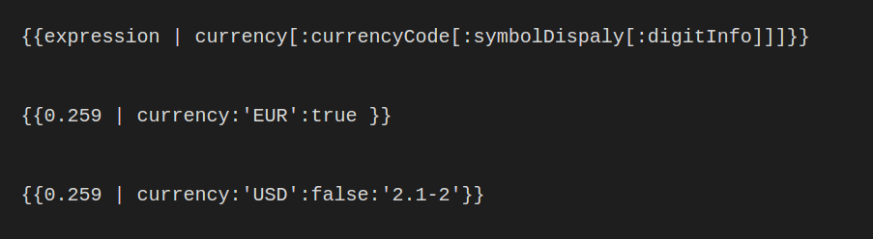


BUILT-IN PIPES
Currency Pipe:

Slide 11
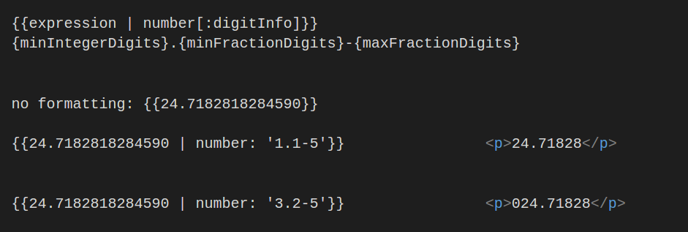
BUILT-IN PIPES
Decimal Pipe :

Slide 12
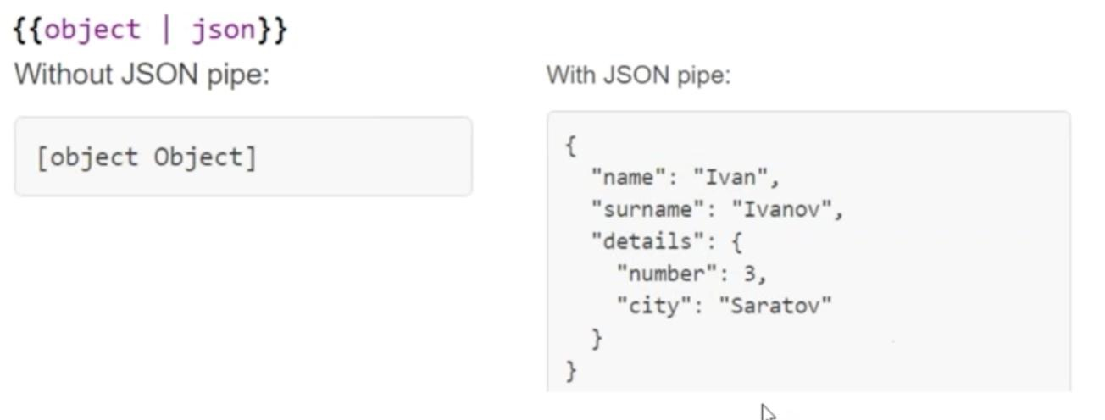
BUILT-IN PIPES
JSON Pipe:

Slide 13
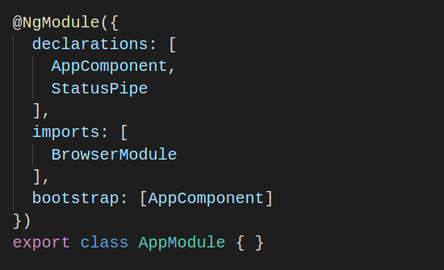
CUSTOM PIPES
How to make the custom pipe available everywhere

Slide 14
PURE AND IMPURE PIPE
Pure Pipes:
Angular executes a pure pipe only when it detects a pure change to the input value. A pure change is either a change to a primitive input value
(String, Number, Boolean, Symbol) or a changed object reference
(Date, Array, Function, Object).
Pipes are pure by default.

Slide 15
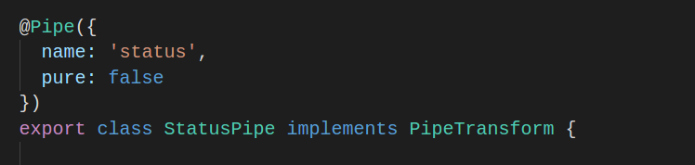
PURE AND IMPURE PIPE
Impure Pipes:
Angular executes an impure pipe during every component change detection cycle. An impure pipe will be called a lot, as often as every keystroke or mouse-move.

Slide 16


WHY DIRECTIVES
Directives attach behavior to elements.

Slide 17


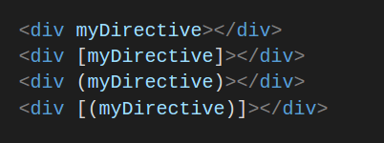
DIRECTIVES
Components
Structural directives
Attribute directives

Slide 18
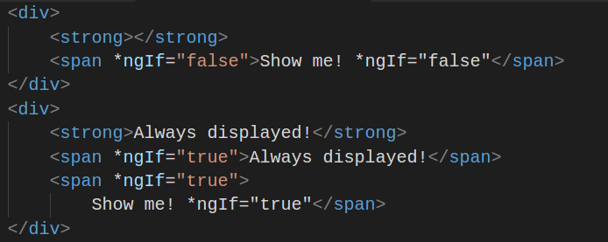
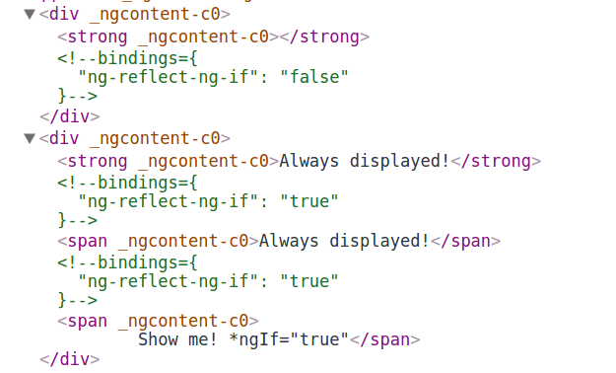
STRUCTURAL DIRECTIVES *NGIF BASIC

Slide 19
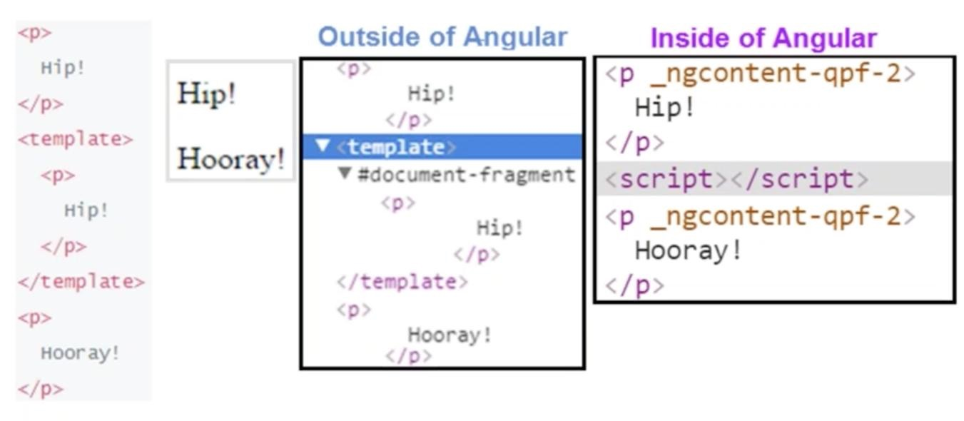
TEMPLATE AND ANGULAR 4

Slide 20
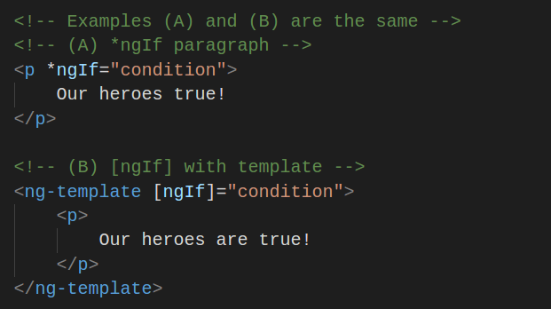
ASTERISK (*)

Slide 21
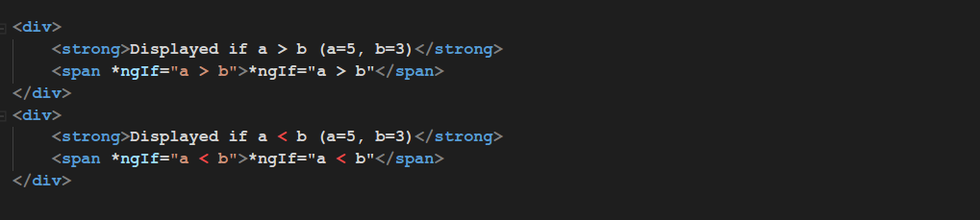
STRUCTURAL DIRECTIVES *NGIF COMPARISON
1
2
Displayed if a > b (a=5, b=3) *ngIf=”a > b”
Displayed if a > b (a=5, b=3)

Slide 22
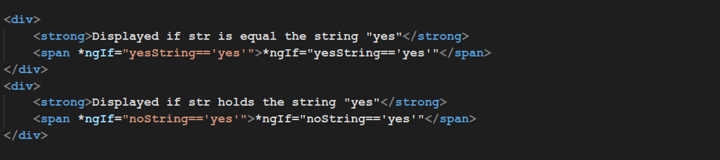
STRUCTURAL DIRECTIVES *NGIF COMPARISON
1
2
Displayed if str is equal the string “yes” *ngIf=”yesString==’yes’”
Displayed if str holds the string “yes”

Slide 23
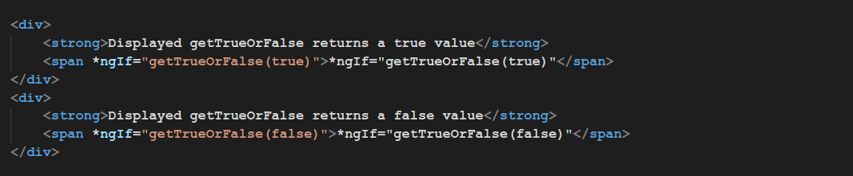
STRUCTURAL DIRECTIVES *NGIF FUNCTION
1
2
Displayed getTrueOrFalse returns a true value
Displayed getTrueOrFalse returns a false value

Slide 24
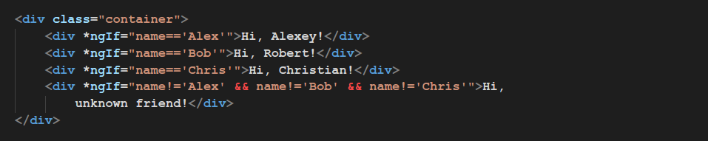
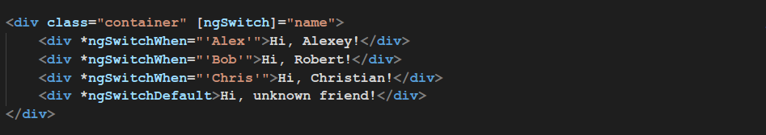
STRUCTURAL DIRECTIVES NGSWITCH
1
2

Slide 25
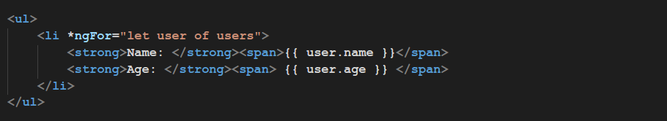
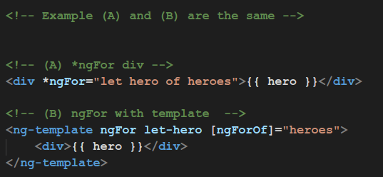
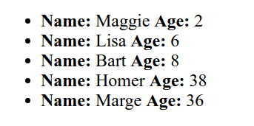
STRUCTURAL DIRECTIVES *NGFOR

Slide 26
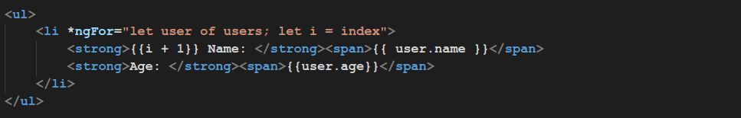
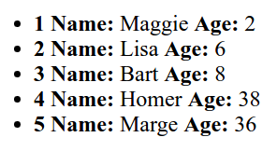
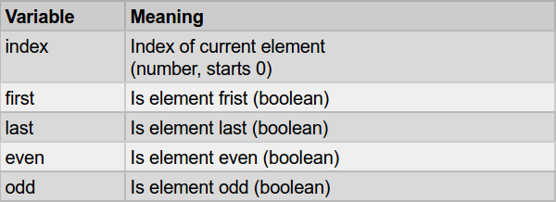
STRUCTURAL DIRECTIVES *NGFOR GETTING AN INDEX

Slide 27


ATTRIBUTE DIRECTIVES NGSTYLE
1
2

Slide 28
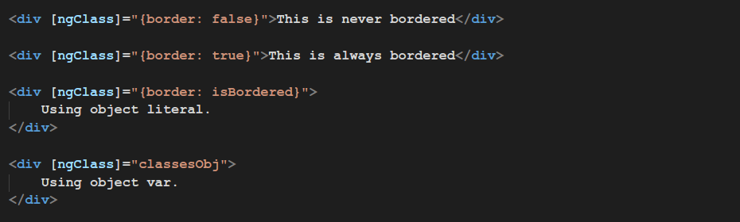
ATTRIBUTE DIRECTIVES NGCLASS

Slide 29
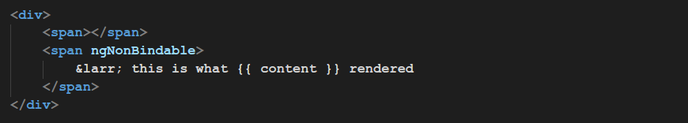
ATTRIBUTE DIRECTIVES NGNONBINDABLE

Slide 30

CUSTOM DIRECTIVES

Slide 31

Destructing
TypeScript Supports following type of destructing:
Object destructing
Array destructing
Module destructing

Slide 32
Thank you for your attention

