Slide 1

Angular School
Lesson 1. TypeScript.

Slide 2


Agenda:
Data Types
Functions
Generics
OOP basic concepts.
OOP TypeScript.
Classes. Interfaces. Mixins.
Namespaces and Modules.
Decorators.
Promises
Declarations

Slide 3
Data Types
TypeScript | JavaScript
number | Number
string | String
boolean | Boolean
object | Object
undefined | undefined
null | null
enum | -
Array | -
Tupple | -
any | -
never | -
void | -

Slide 4
Functions
In TypeScript used keyword function but you need specify input parameter types and after colon specify output parameter type.
Types in the declaration and in call should be the same

Slide 5
Optional parameters
Function may retrieve parameters as marked as optional
Optional parameters declare after compulsory
If optional parameter did not set it equal undefined

Slide 6
Default settings
As special type of optional parameters is default settings. If you do not pass any parameter program use default value

Slide 7
The count of input parameters
In TypeScript a call to the function must as much value as it is defined into the parameters

Slide 8
Overloading
Overloading is create few signatures of one function
Typescript allows create few declarations of one function

Slide 9
Callback functions
Type script use the lambda expression for passing callback function as argument

Slide 10
Union
Union helps you define several types for the one parameter

Slide 11
Generics
For better type re-using we have Generics
Generics has constraints that allows creates restriction for types

Slide 12
OOP. Classes
TypeScript support Object Oriented Approach.
Full class support
For define new class use class keyword.

Slide 13
OOP. Constructors.
Apart from the usual functions of classes have special features designers
Constructor defined with keyword constructor
Designers perform initial define of instance properties

Slide 14
OOP. Constructors.
Constructor as well as ordinary functions, TypeScript supported overload

Slide 15
OOP. Static.
Besides usual properties and functions you can define static members
Static members is not available via this

Slide 16
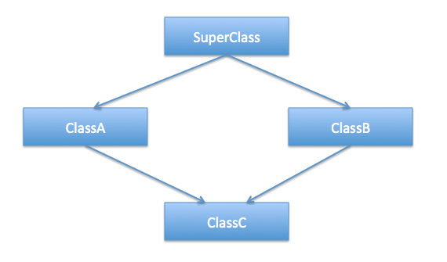
Inheritance

Slide 17
Inheritance example

Slide 18
OOP: Access modifiers.
Accessable On | public | protected | private
Class instances | yes | no | no
Class | yes | yes | yes
Class child | yes | yes | no

Slide 19
OOP: Abstract
Abstract can be thought as access modifier
Abstract class can’t be directly instantiated
Abstract members can’t be directly accessed it can be implemented in child class only

Slide 20
OOP: Properties

Slide 21
OOP: Interfaces
The interface defines property and methods that object has to implement
The interface is definition of custom data type.

Slide 22
Mixins
Along with traditional OO hierarchy, another popular way building classes from the reusable components is to build them by combining simplier partial classes
To satisfy this requirements we create stand-in properties and their types for the members that will com from mixins
That satisfy compiler that members will available in runtime.

Slide 23
Generic interfaces and classes

Slide 24
Modules
Modules are designed for organisation of large programs.
Modules help group interfaces and classes in logical structures
Modules is obsolete construction in TypeScript

Slide 25
Namespaces
The same as modules.
Modules removed by Namespace.

Slide 26
Decorators
Used to add new functionality to an existing object, without being obtrusive

Slide 27
Decorators
Decorators - basic

Slide 28
Decorators - Classes

Slide 29
Decorators - Methods

Slide 30
Promises

Slide 31
Declare and types

Slide 32
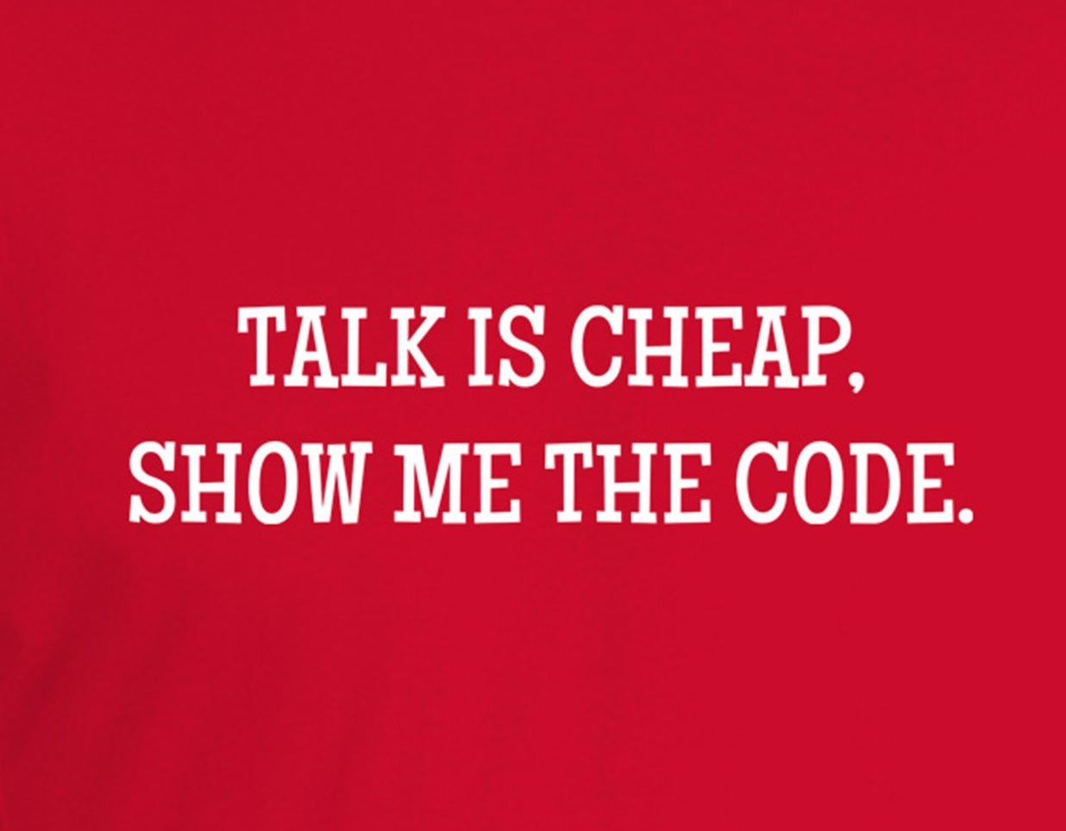
Destructing
TypeScript Supports following type of destructing:
Object destructing
Array destructing
Module destructing

Slide 33
Thank you for your attention

