Slide 1

Angular School
Lesson 5. TypeScript. Unit testing.

Slide 2


Agenda:
Testing Types.
TDD.
BDD.
Refactoring.
Code quality metrics. Code coverage
Jest.
Async code testing patterns

Slide 3




Testing types
What difference between Testing kinds

Slide 4
Unit testing
What is Unit testing?
What difference between Testing kinds

Slide 5

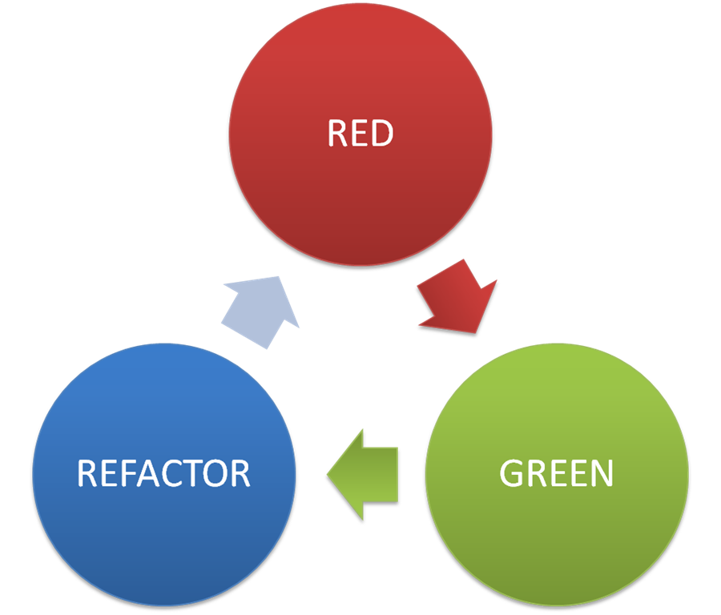
TDD
RED – Green – Refactor Pattern

Slide 6
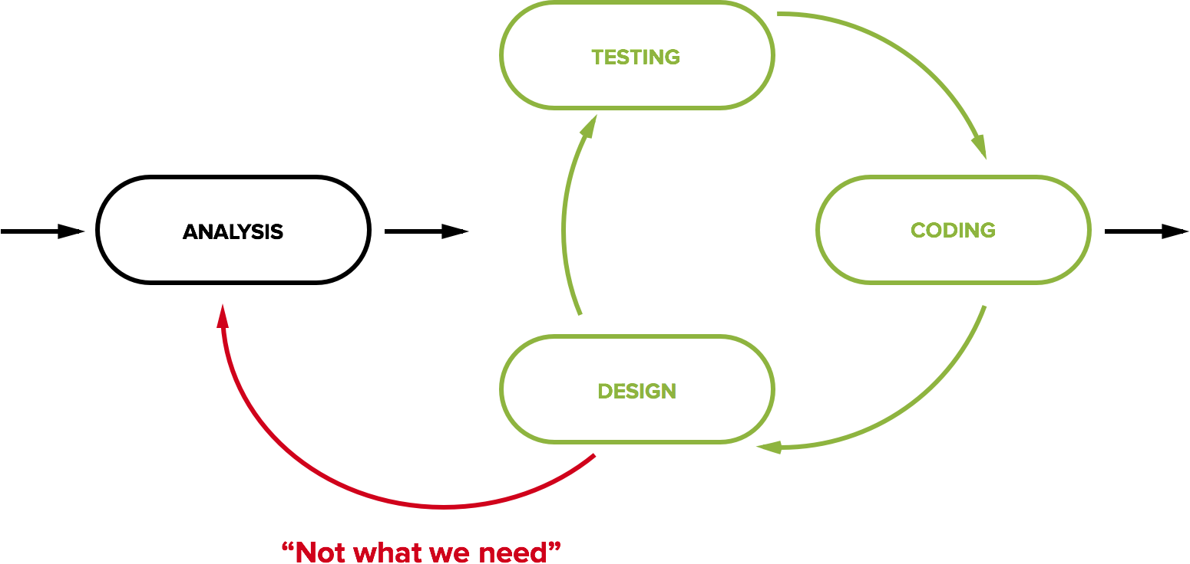
BDD
Behaviour Driven development

Slide 7

Refactoring
Refactoring without unit tests calls ‘refucking’

Slide 8
Code quality metrics
Code complexity
Comments
Testing coverage
By lines
By functions/classes
By branches
By expressions

Slide 9



Unit test frameworks
Javascript testing frameworks

Slide 10



What we have to test?
What we have to test?

Slide 11
Jest: Where test run?
Real browsers
Headless browser (PhantomJS)
JSDOM
Node Environment

Slide 12

Jest
Jest is a bit different from most test runners. Facebook designed it to work well in the context of it's infrastructure:
Monorepo
Sandboxing
providesModule
Error messages are helpful and color coded. Stack traces point to the source of problems quickly
Integrated support for testing with promises and async/await
Jest runs previously failed tests first. Together with --bail it provides useful signal quickly
Integrated manual mocking library
Automatically find tests related to changed files to execute in your project with -o
Run tests in parallel processes to minimize test runtime

Slide 13
Jest: Test

Slide 14
Jest: Describe, It

Slide 15
Chai: Exceptions

Slide 16
Jest: Async

Slide 17
Jest: Promise

Slide 18
Jest: Code coverage

Slide 19

Destructing
TypeScript Supports following type of destructing:
Object destructing
Array destructing
Module destructing

Slide 20
Thank you for your attention

