Slide 1

TypeScript Flow
Lesson 2. OOP.

Slide 2


Agenda:
OOP basic concepts.
OOP TypeScript.
Classes. Interfaces. Mixins.
Namespaces and Modules.
Decorators.
Promises
Declarations

Slide 3
OOP. Classes
TypeScript support Object Oriented Approach.
Full class support
For define new class use class keyword.

Slide 4
OOP. Constructors.
Apart from the usual functions of classes have special features designers
Constructor defined with keyword constructor
Designers perform initial define of instance properties

Slide 5
OOP. Constructors.
Constructor as well as ordinary functions, TypeScript supported overload

Slide 6
OOP. Static.
Besides usual properties and functions you can define static members
Static members is not available via this

Slide 7
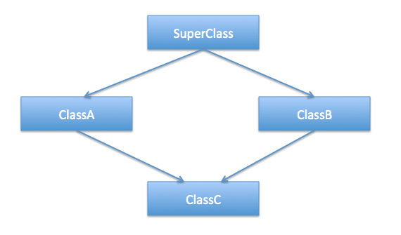
Inheritance

Slide 8
Inheritance example

Slide 9
OOP: Access modifiers.
Accessable On | public | protected | private
Class instances | yes | no | no
Class | yes | yes | yes
Class child | yes | yes | no

Slide 10
OOP: Abstract
Abstract can be thought as access modifier
Abstract class can’t be directly instantiated
Abstract members can’t be directly accessed it can be implemented in child class only

Slide 11
OOP: Properties

Slide 12
OOP: Interfaces
The interface defines property and methods that object has to implement
The interface is definition of custom data type.

Slide 13
Mixins
Along with traditional OO hierarchy, another popular way building classes from the reusable components is to build them by combining simplier partial classes
To satisfy this requirements we create stand-in properties and their types for the members that will com from mixins
That satisfy compiler that members will available in runtime.

Slide 14
Generic interfaces and classes

Slide 15
Modules
Modules are designed for organisation of large programs.
Modules help group interfaces and classes in logical structures
Modules is obsolete construction in TypeScript

Slide 16
Namespaces
The same as modules.
Modules removed by Namespace.

Slide 17
Decorators
Used to add new functionality to an existing object, without being obtrusive

Slide 18
Decorators
Decorators - basic

Slide 19
Decorators - Classes

Slide 20
Decorators - Methods

Slide 21
Promises

Slide 22
Declare and types

Slide 23
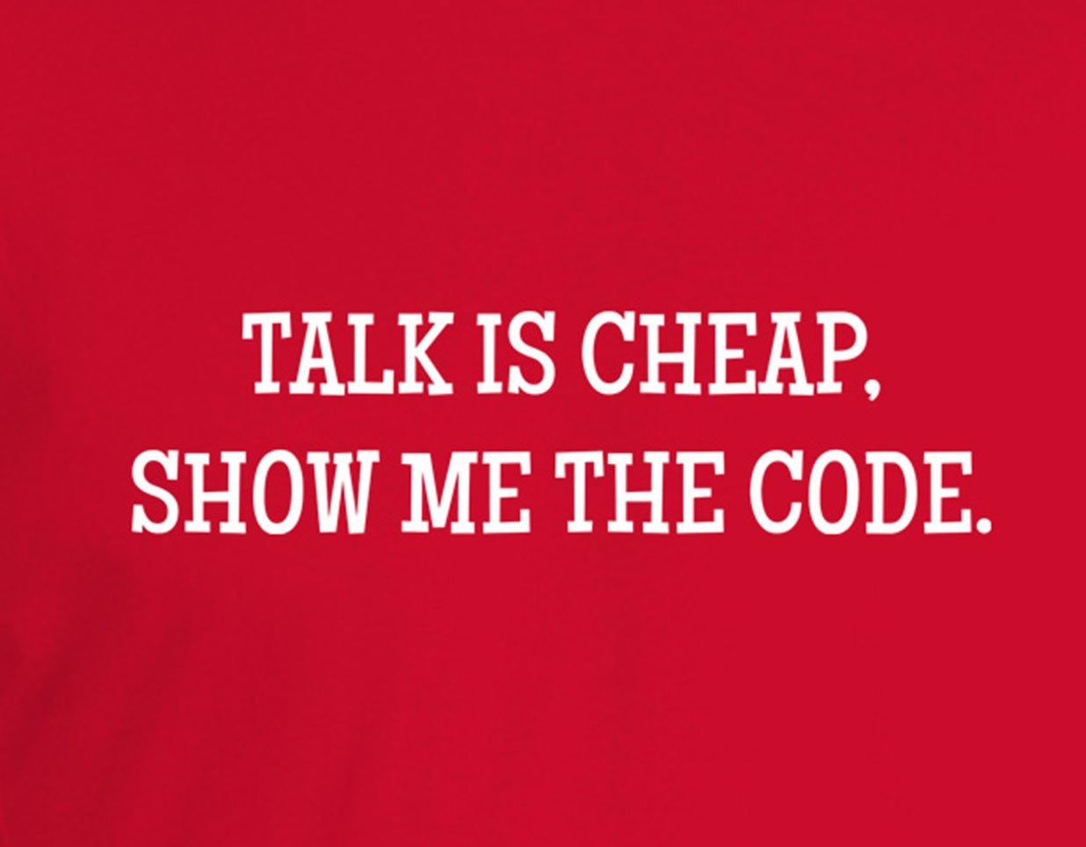
Destructing
TypeScript Supports following type of destructing:
Object destructing
Array destructing
Module destructing

Slide 24
Thank you for your attention

