Slide 1

TypeScript Flow
Lesson 1. TypeScript. Basics.

Slide 2


Agenda:
History.
TypeScript Basic Concepts.
Data Types.
Enum. Array. Tuples.
Functions.
Generics.

Slide 3

History
TypeScript development began in late 2012. Its creator is Anders Hejlsberg. He also developed such languages as Delphi, C#. Project develop as open source.
And from the very beginning of new language began to spread rapidly because of their flexibility and performance.

Slide 4
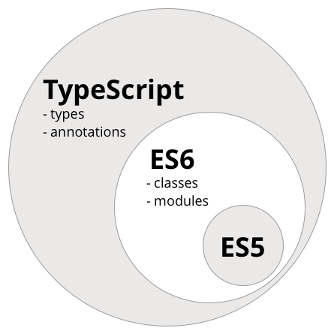
TypeScript Specifications
Static typization.
OOP Support.
Interfaces and abstract classes support.
Namespaces and modules.
Full - ES6 feature support.
Search errors at compilation time.

Slide 5
Transpiling
Typescript language with static typization and transpilation to JavaScript
In TypeScript configuration you can set JavaScript version as result of transpilation.
TypeScript support transpilation to next JavaScript versions:
ECMAScript 6
ECMAScript 5
ECMAScript 3

Slide 6
Data Types
TypeScript and JavaScript
TypeScript | JavaScript
number | number
string | string
boolean | boolean
object | object
undefined | undefined
null | null
symbol | symbol

Slide 7
Data Types
TypeScript only
TypeScript | JavaScript
enum | -
Array | -
Tuple | -
any | -
never | -
void | -

Slide 8
Variables and constants
To declare variable you use var and let.
For type definition use colon.
For constant definition use const.
Const like let declaration but, as their implies, their value cannot be changed once they are bound. In other worlds, they has the same scoping ruler as let, but you can’t re-assign to them. This should not be confused with the idea that the values they refer to are immutable.

Slide 9
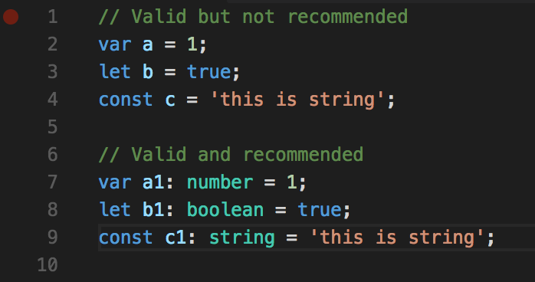
Variables and constants

Slide 10
Types tips and tricks
All valid JavaScript is valid for TypeScript
If you define value and not set it type TypeScript set its type as first value of these variable.
When you define value type you can’t change this type.
You can’t assign variables of one type to another.
Only type for type any you can assign another types.
When you use type any you have no idea that’s type would be used.

Slide 11
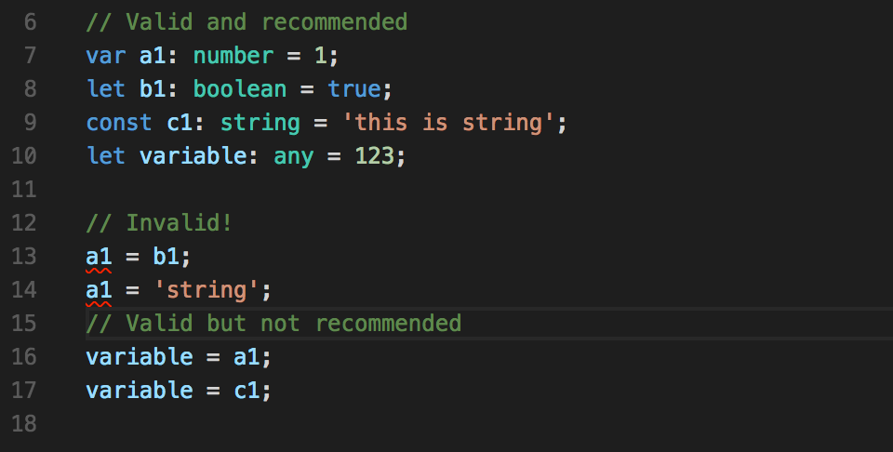
Types tips and tricks

Slide 12
Types tips and tricks
You can’t re-assign constant variable.
BUT if constant variable is object do not forget that constant save only reference to this object and you can change object properties.
Also you can add new and delete existing properties of the constant object.

Slide 13
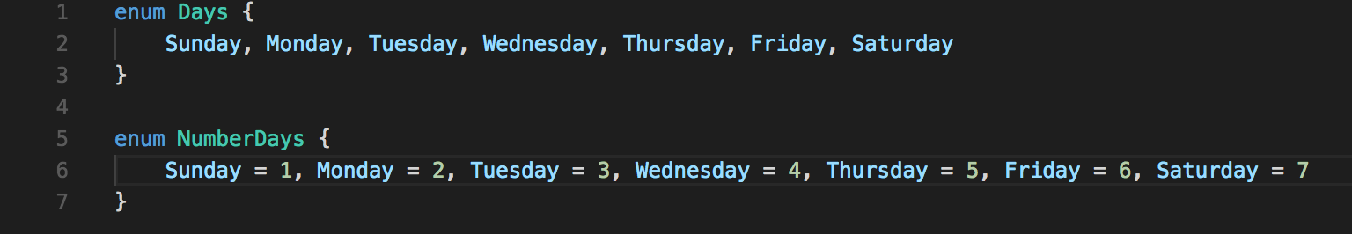
Enum
Type enum is borrowed from C# and is intended to describe set of numeric data using string constants.
When creating enum all items are numeric values ranging from zero
You can override these values

Slide 14
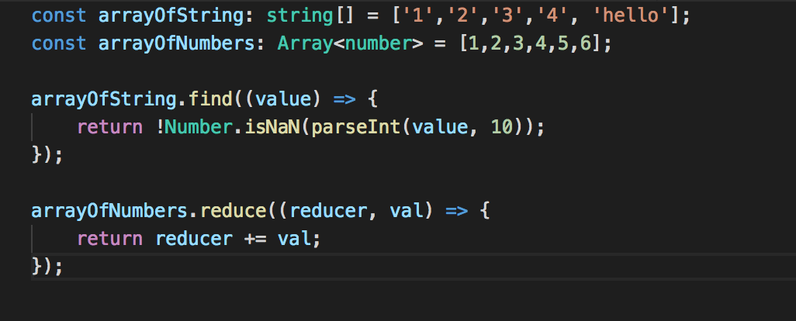
Arrays
Type array is collection of elements with the same type

Slide 15
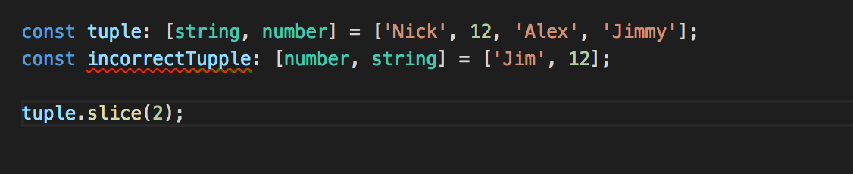
Tuples
Type array is collection of elements with the different type

Slide 16
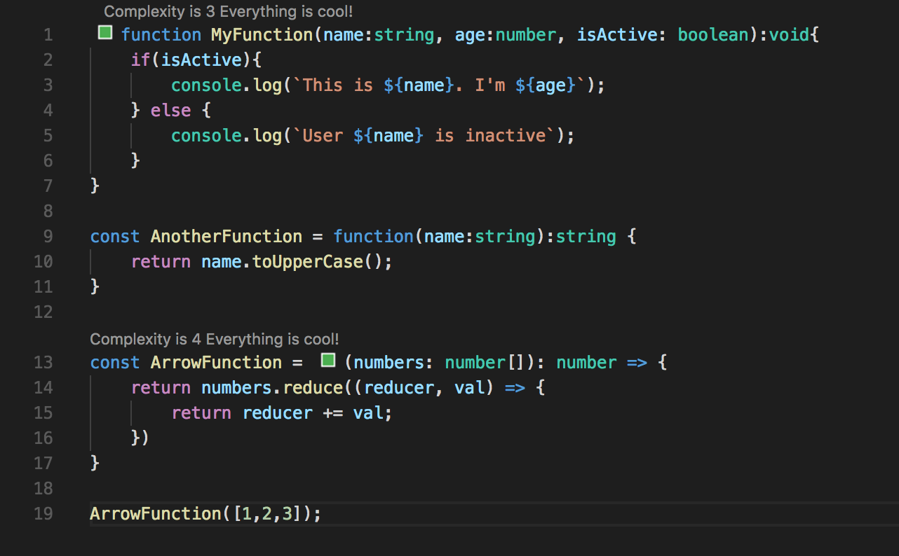
Functions
In TypeScript used keyword function but you need specify input parameter types and after colon specify output parameter type.
Types in the declaration and in call should be the same

Slide 17
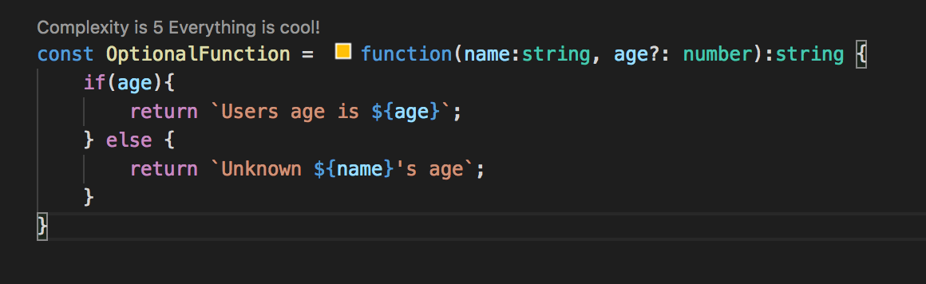
Optional parameters
Function may retrieve parameters marked as optional
Optional parameters declare after compulsory
If optional parameter did not set it equal undefined

Slide 18
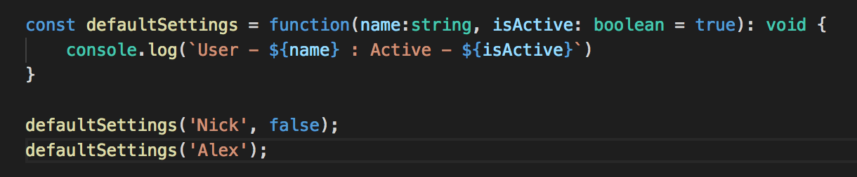
Default parameters
As special type of optional parameters is default settings. If you do not pass any parameter program use default value.

Slide 19
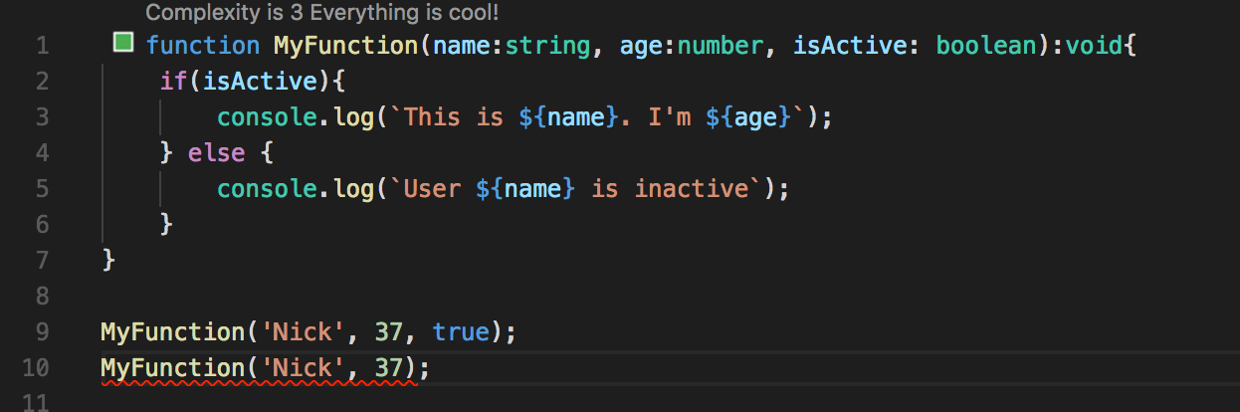
The count of input parameters
In TypeScript call of the function must has as much value as it is defined into the parameters list.

Slide 20
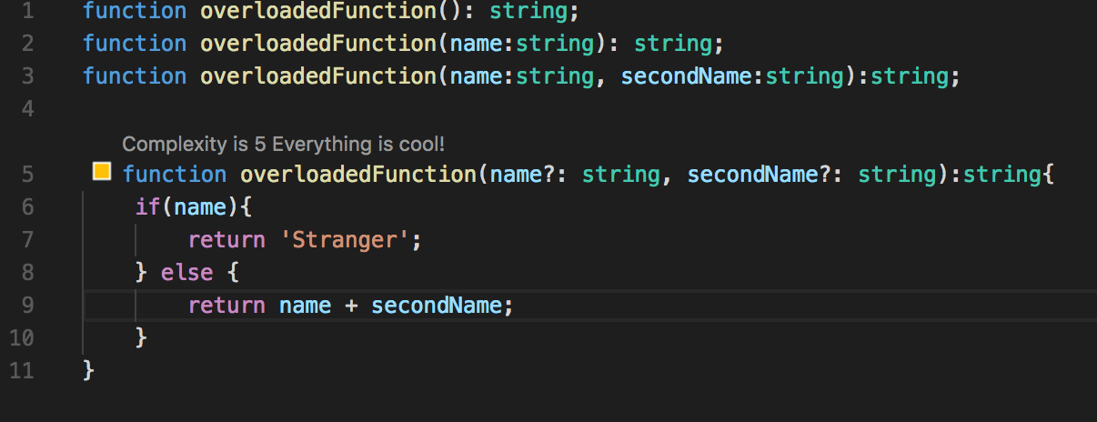
Overloading
Overloading is create few signatures of one function
Typescript allows create few declarations of one function

Slide 21
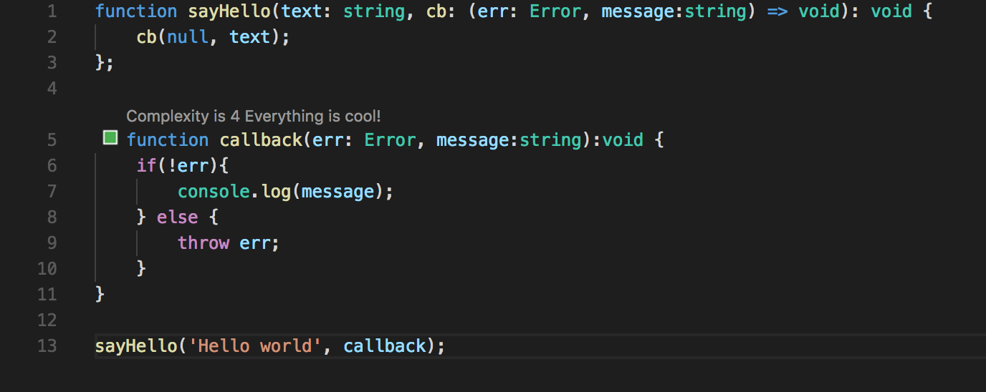
Callback functions
TypeScript use the lambda expression for passing callback function as argument

Slide 22
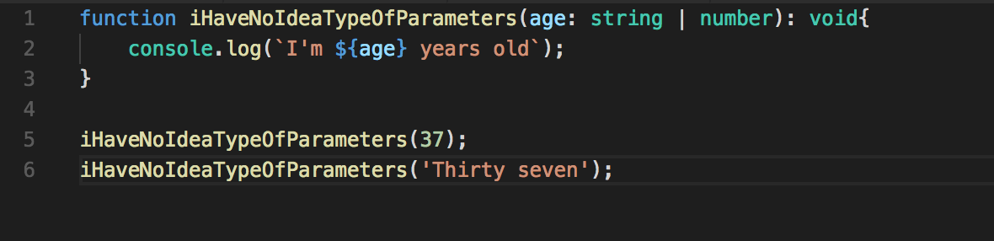
Union
Union helps you define several types for the one parameter

Slide 23
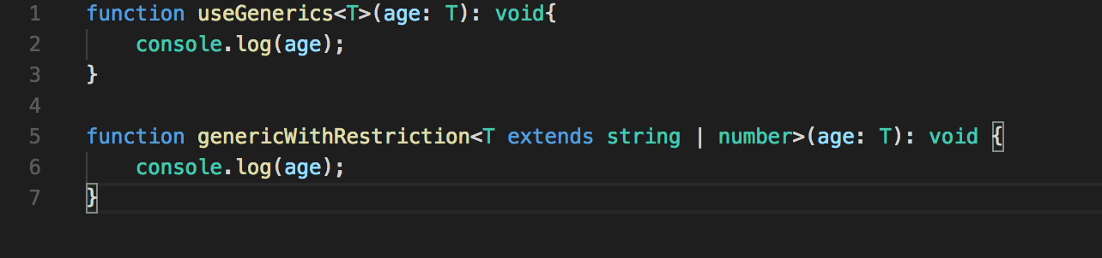
Generics
For better type reusing we have Generics
Generics has constraints that allows creates restriction for types

Slide 24

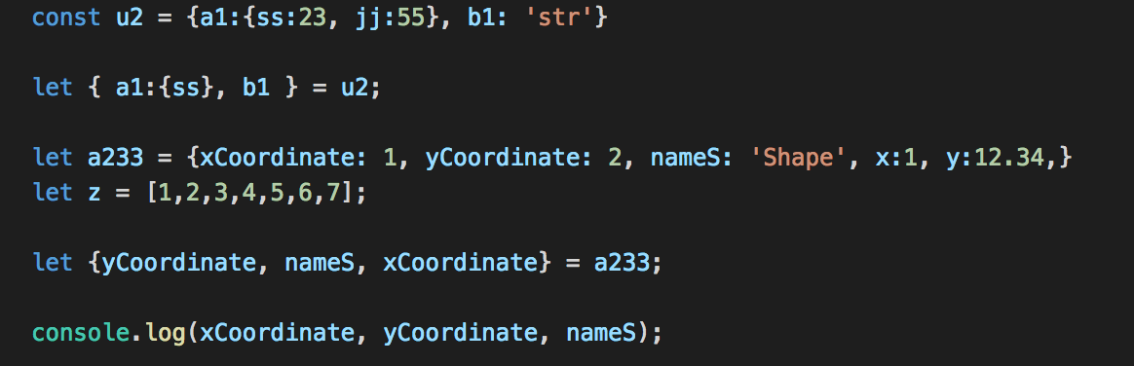
Destructing
TypeScript Supports following type of destructing:
Object destructing
Array destructing
Module destructing

Slide 25
Thank you for your attention

