Slide 1

Angular Школа
Урок 1. TypeScript. Базовый.

Slide 2


План урока:
Немного истории.
TypeScript базовые принципы.
Первый проект.
Настройки транспайлера.
Типы данных.
Enum.
Массивы.
Кортежи.
Функции.

Slide 3

Немного истории
Тайпскрипт начало разработки в 2012.
Автор языка Anders Hejlsberg. Причастен к созданию Delphi, C#.
Проект разрабатывался как проект с открытым исходным кодом.
Язык начал развиваться очень быстро из-за простоты и гибкости. Многие из фишек тайпскрипта думаю в скорости перекочуют в JavaScript

Slide 4
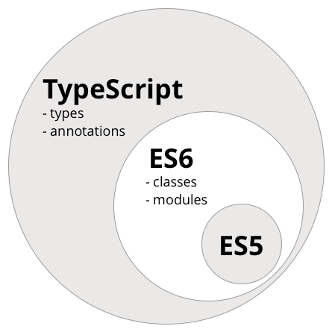
Спецификация
Статическая типизация.
Поддержка ООП.
Поддержка интерфейсов и абстрактных классов.
Пространства имен.
Полная поддержка стандарта ES6.
Поиск ошибок во время транспиляции.

Slide 5
Транспиляция
Typescript язык со статической типизацией транспилирующийся в JavaScript
В конфигурации TypeScript вы можете задать версию JavaScript, как результат транспиляции.
TypeScript поддерживает транспиляцию в следующие версии JavaScript:
ECMAScript 7
ECMAScript 6
ECMAScript 5
ECMAScript 3

Slide 6
Типы
TypeScript | JavaScript
number | Number
string | String
boolean | Boolean
object | Object
undefined | undefined
null | null
Symbol | Symbol
Array, Tupple | -
any | -
never | -
void | -

Slide 7
Variables and constants
To declare variable you use var and let.
For type definition use colon.
For constant definition use const.
Const like let declaration but , as their implies, their value cannot be changed once they are bound. In other worlds, they has the same scoping ruler as let, but you can’t re-assign to them.
This should not be confused with the idea that the values they refer to are immutable.

Slide 8
Variables and constants

Slide 9
Types tips and tricks
All valid JavaScript is valid for TypeScript
If you define value and not set it type TypeScript set its type as first value of these variable.
When you define value type you can’t change this type.
You can’t assign variables of one type to another.
Only type for type any you can assign another types.
When you use type any you have no idea that’s type would be used.

Slide 10
Types tips and tricks

Slide 11
Types tips and tricks
You can’t re-assign constant variable.
BUT if constant variable is object do not forget that constant save only reference to this object and you can change object properties.
Also you can add new and delete existing properties of the constant object.

Slide 12
Enum
Type enum is borrowed from C# and is intended to describe set of numeric data using string constants.
When creating enum all items are numeric values ranging from zero
You can override these values

Slide 13
Arrays
Type array is collection of elements with the same type

Slide 14
Tuples
Type array is collection of elements with the different type

Slide 15
Functions
In TypeScript used keyword function but you need specify input parameter types and after colon specify output parameter type.
Types in the declaration and in call should be the same

Slide 16
Optional parameters
Function may retrieve parameters as marked as optional
Optional parameters declare after compulsory
If optional parameter did not set it equal undefined

Slide 17
Default settings
As special type of optional parameters is default settings. If you do not pass any parameter program use default value

Slide 18
The count of input parameters
In TypeScript a call to the function must as much value as it is defined into the parameters

Slide 19
Overloading
Overloading is create few signatures of one function
Typescript allows create few declarations of one function

Slide 20
Callback functions
Type script use the lambda expression for passing callback function as argument

Slide 21
Union
Union helps you define several types for the one parameter

Slide 22
Generics
For better type re-using we have Generics
Generics has constraints that allows creates restriction for types

Slide 23
Destructing
TypeScript Supports following type of destructing:
Object destructing
Array destructing
Module destructing

Slide 24
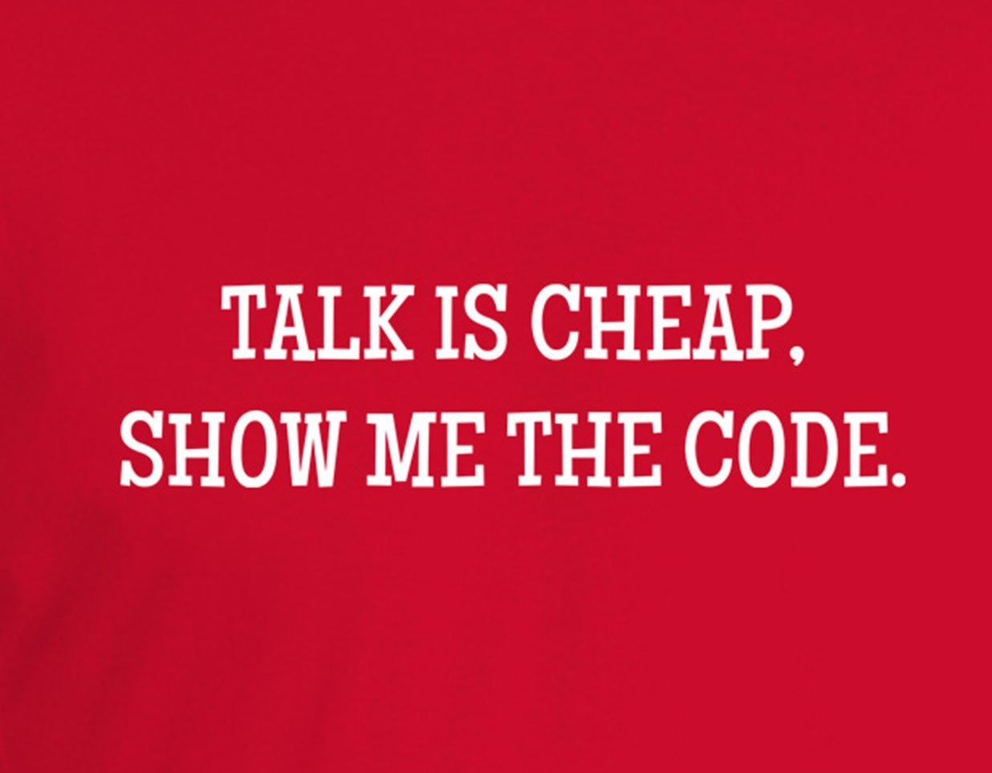
Destructing
TypeScript Supports following type of destructing:
Object destructing
Array destructing
Module destructing

Slide 25
Thank you for your attention

