Slide 1

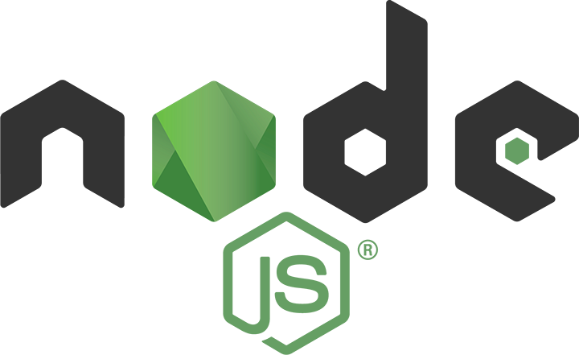
Dev-Pro Node.js
Advanced Flow
Lesson 7. Monitoring. Prometheus

Slide 2

Agenda:
Micro services architecture approach
Monitoring problems
Prometheus architecture
Data model
Installing
Configuration

Slide 3

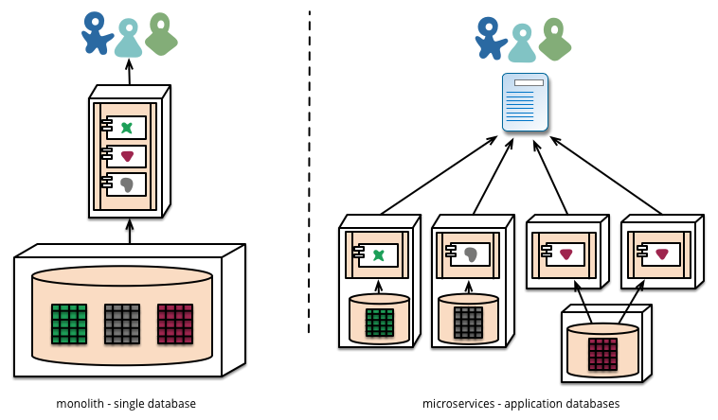
Micro services vs Monolith architecture approach

Slide 4
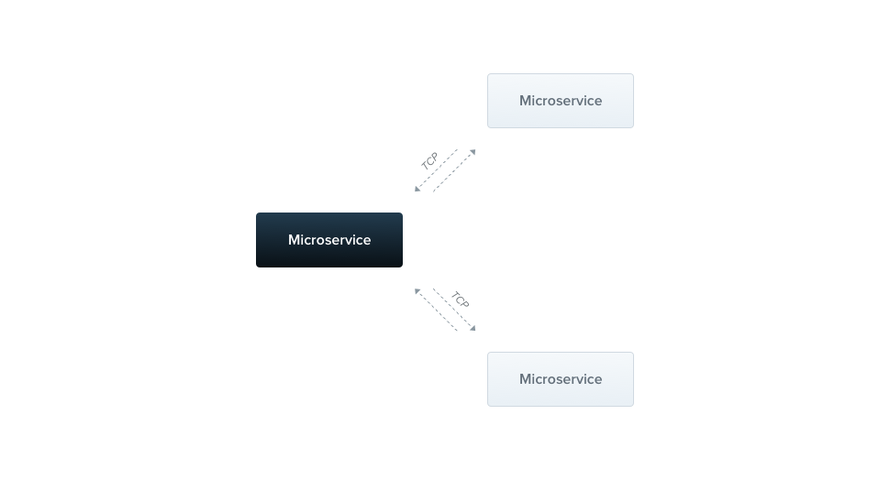
Micro services vs Monolith architecture approach

Slide 5
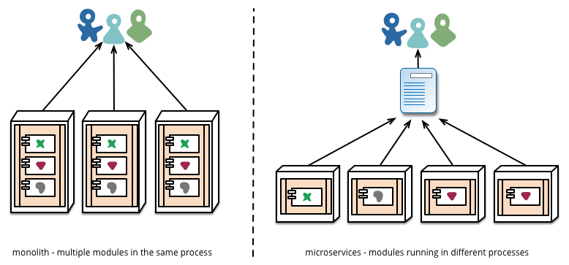
Micro services vs Monolith architecture approach

Slide 6
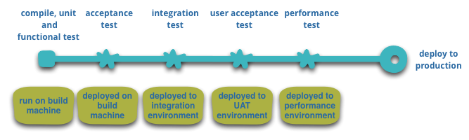
Infrastructure authomatization

Slide 7
Micro services Pros
Microservice architecture gives developers the freedom to independently develop and deploy services
A microservice can be developed by a fairly small team
Code for different services can be written in different languages (though many practitioners discourage it)
Easy integration and automatic deployment (using open-source continuous integration tools such as Jenkins, Hudson, etc.)
Easy to understand and modify for developers, thus can help a new team member become productive quickly
The developers can make use of the latest technologies
The code is organized around business capabilities
Starts the web container more quickly, so the deployment is also faster
When change is required in a certain part of the application, only the related service can be modified and redeployed—no need to modify and redeploy the entire application
Better fault isolation: if one micro service fails, the other will continue to work (although one problematic area of a monolith application can jeopardize the entire system)
Easy to scale and integrate with third-party services
No long-term commitment to technology stack

Slide 8
Micro services Cons
Due to distributed deployment, testing can become complicated and tedious
Increasing number of services can result in information barriers
The architecture brings additional complexity as the developers have to mitigate fault tolerance, network latency, and deal with a variety of message formats as well as load balancing
Being a distributed system, it can result in duplication of effort
When number of services increases, integration and managing whole products can become complicated
In addition to several complexities of monolithic architecture, the developers have to deal with the additional complexity of a distributed system
Developers have to put additional effort into implementing the mechanism of communication between the services
Handling use cases that span more than one service without using distributed transactions is not only tough but also requires communication and cooperation between different teams
The architecture usually results in increased memory consumption
Partitioning the application into micro services is very much an art

Slide 9
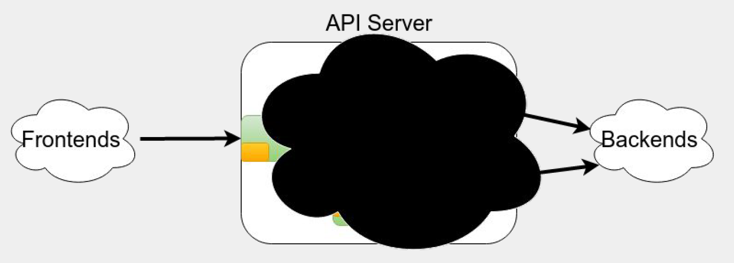
Many Approaches have Limited Visibility

Slide 10
Black-box monitoring
Monitoring from the outside
No knowledge of how the application works internally
Examples: ping, HTTP request, inserting data and waiting for it to appear on dashboard

Slide 11
Where to use Black-box
Black-box monitoring should be treated similarly to smoke tests.
It’s good for finding when things have badly broken in an obvious way, and testing from outside your network.
Not so good for knowing what’s going on inside a system.
Nor should it be treated like regression testing and try to test every single feature.
Tend to be flaky, as they either pass or fail.

Slide 12
White-box Monitoring
Complementary to black-box monitoring.
Works with information from inside your systems.
Can be simple things like CPU usage, down to the number of requests triggering a
particular obscure code path.

Slide 13
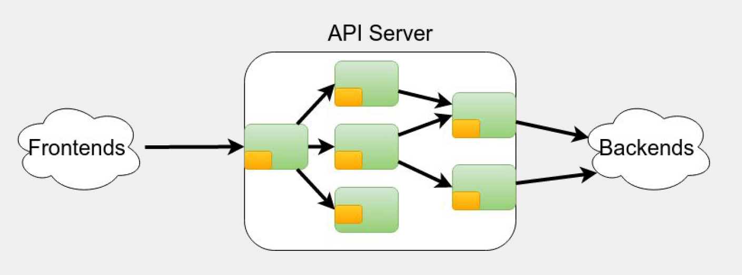
Services have Internals

Slide 14
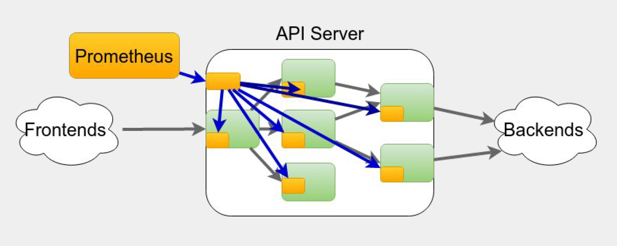
Monitor the Internals

Slide 15
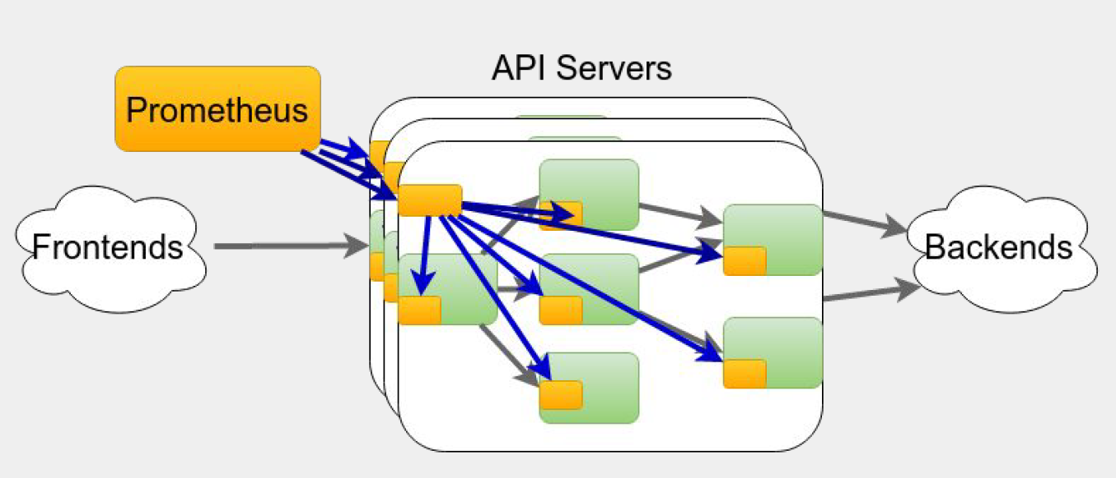
Monitor as a Service, not as Machines

Slide 16
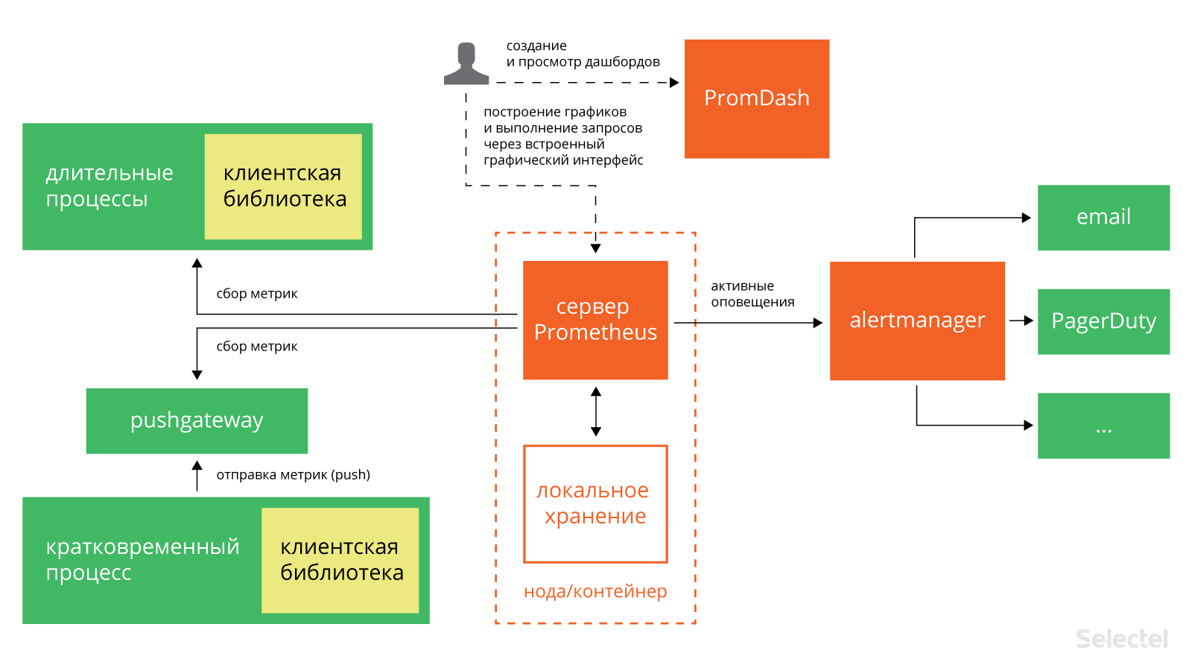
Prometheus architecture

Slide 17
What does Prometheus offer?
Inclusive Monitoring
Powerful data model
Powerful query language
Manageable and Reliable
Efficient
Scalable
Easy to integrate with
Dashboards

Slide 18
Inclusive Monitoring
Don’t monitor just at the edges:
● Instrument client libraries
● Instrument server libraries (e.g. HTTP/RPC)
● Instrument business logic
Library authors get information about usage.
Application developers get monitoring of common components for free.
Dashboards and alerting can be provided out of the box, customised for your
organisation!

Slide 19
How to instrument your code?
Several common approaches:
● Custom endpoint/interface to dump stats (usually JSON or CSV)
● Use one mildly standard instrumentation system (e.g. JMX in Java)
● For libraries, have some type of hooks
● Don’t

Slide 20
This isn’t great
Users run more than just your software project, with a variety of monitoring tools.
As a user you’re left with a choice: Have N monitoring systems, or run extra
services to act as shims to translate.
As a monitoring project, we have to write code and/or configuration for every
individual library/application.
This is a sub-optimal for everyone.

Slide 21
Open ecosystem
Prometheus client libraries don’t tie you into Prometheus.
For example the Python and Java clients can output to Graphite, with no need to
run any Prometheus components.
This means that you as a library author can instrument with Prometheus, and your users with just a few lines of code can output to whatever monitoring system they want. No need for users to worry about a new standard.
This can be done incrementally.

Slide 22
It goes the other way too
It’s unlikely that everyone is going to switch to Prometheus all at once, so we’ve integrations that can take in data from other monitoring systems and make it useful.
Graphite, Collectd, Statsd, SNMP, JMX, Dropwizard, AWS Cloudwatch, New Relic, Rsyslog and Scollector (Bosun) are some examples.
Prometheus and its client libraries can act a clearinghouse to convert between monitoring systems.
For example Zalando’s Zmon uses the Python client to parse Prometheus metrics from directly instrumented binaries.

Slide 23
Instrumentation made easy
Prometheus clients don’t just marshall data.
They take care of the nitty gritty details like concurrency and state tracking. We take advantage of the strengths of each language.
In Python for example that means context managers and decorators.

Slide 24
Data model
счётчик (counter) — хранит значения, которые увеличиваются с течением времени (например, количество запросов к серверу);
шкала (gauge) — хранит значения, которые с течением времени могут как увеличиваться, так и уменьшаться (например, объём используемой оперативной памяти или количество операций ввода-вывода);
гистограмма (histogram) — хранит информацию об изменении некоторого параметра в течение определённого промежутка (например, общее количество запросов к серверу в период с 11 до 12 часов и количество запросов к этому же серверов в период с 11.30 до 11.40);
сводка результатов (summary) — как и гистограмма, хранит информацию об изменении значения некоторого параметра за временной интервал, но также позволяет рассчитывать квантили для скользящих временных интервалов.

Slide 25
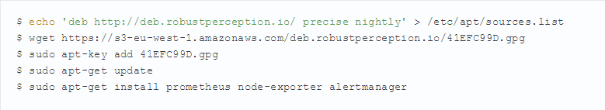
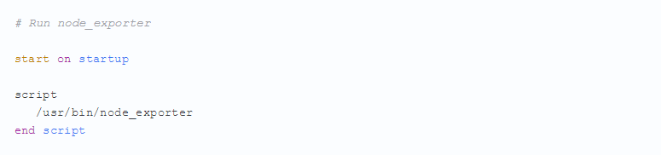
Installation

Slide 26
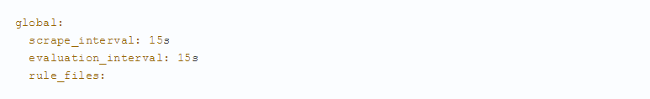
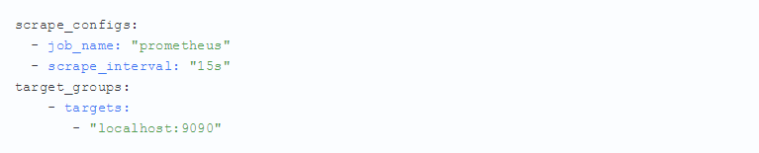
Configuration

Slide 27
Thank you for attention

